Slide 1
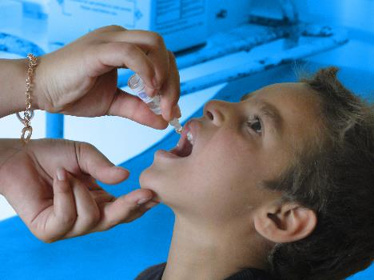
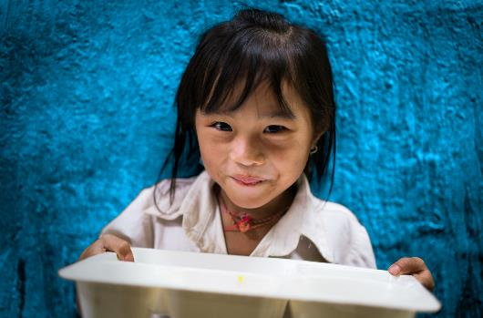
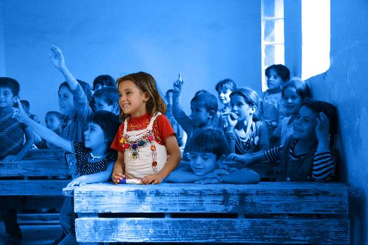
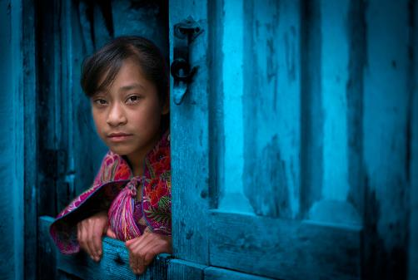
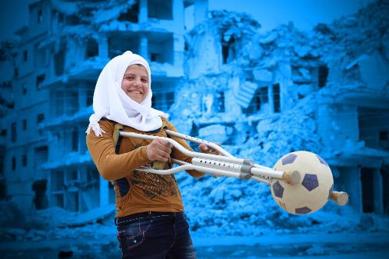
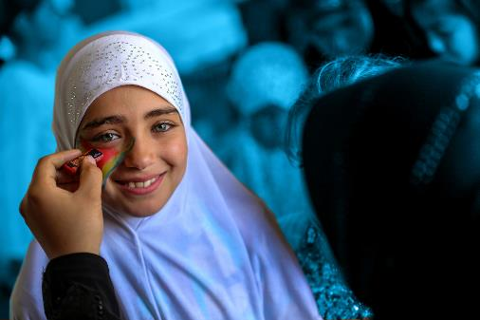
Notes:
Healthcare
Education
Nutrition
Protection
Advocacy

Slide 2
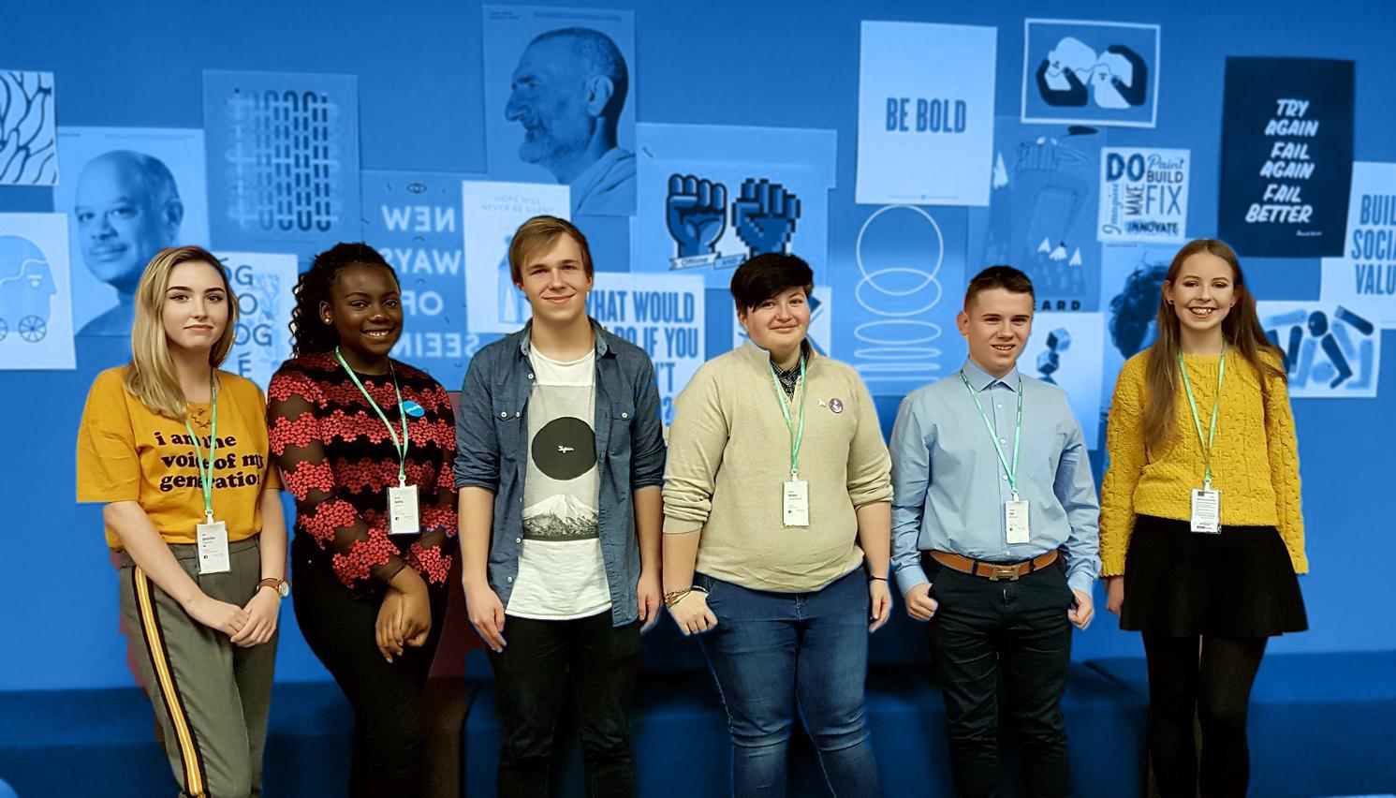
CLIMATE & ENVIRONMENT
ECONOMY
& JOBS
EDUCATION & SKILLS
POVERTY & HOMELESSNESS
WHAT ISSUES
MATTER
TO YOU?
HEALTH & WELLBEING
EQUALITY & INCLUSION
Notes:
Unicef Ireland conducted a poll of young people between the ages of 13-18 using U-Report. The results of the poll indicate most young people are concerned with these seven topics and others you feel passionate about. We’d like you to address these topics with the political parties running in the general election. We have prepared a quick starting point to the current status of these issues in Ireland and the positions of the main political parties to tackling these issues. Feel free to discuss, challenge and debate the issues and devise a set of questions that you would like to put to the candidates running in the election.

Slide 3
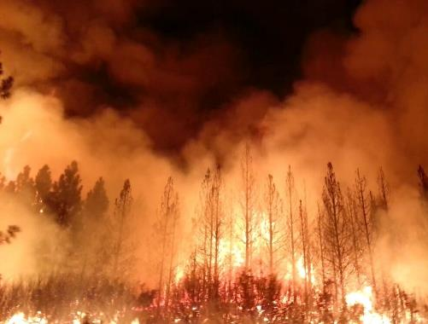
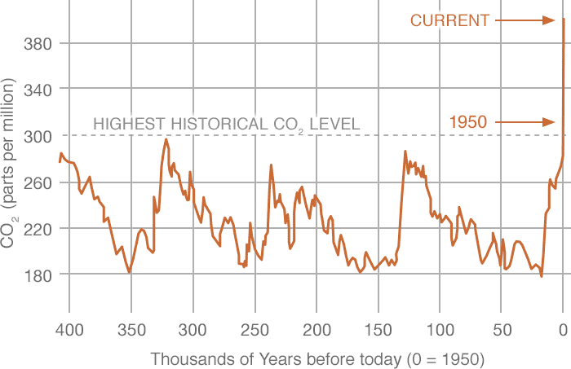
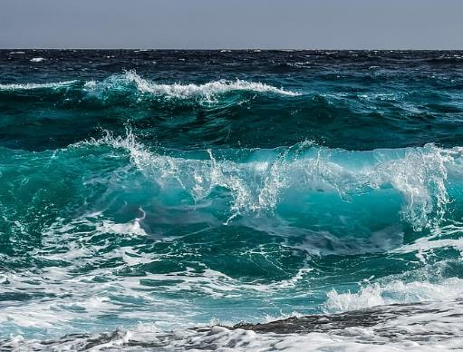
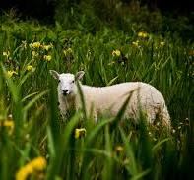
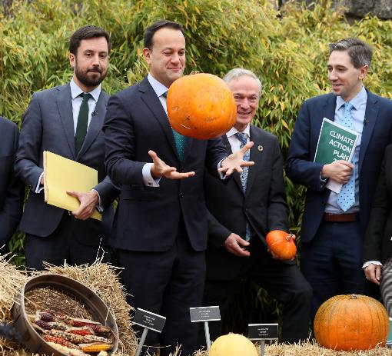
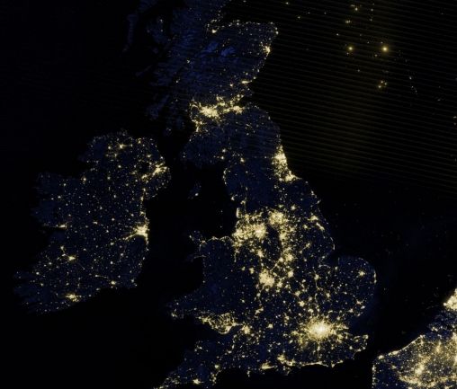
Climate & Environment
EXTREME EVENTS
Recent forest fires and other extreme events, will be the new normal as a result of climate change. (BBC)
CO2 RISE
The planet's temperature has risen about 0.9°C since the late 19th century, due to increased carbon dioxide and other human-made emissions. Most of the warming occurred in the past 35 years. (NASA)
OCEAN TEMPERATURE RISE
The heat in the world’s oceans reached a new record level in 2019, showing “irrefutable and accelerating” heating of the planet. (The Guardian) 2019 was the second hottest year on record.
BIODIVERSITY LOSS
Research has shown that potentially-catastrophic species losses are accelerating. The Dáil passes a motion declaring “a climate and biodiversity emergency” in Ireland. (Irish Times)
IRELAND’S PERFORMANCE
Ireland's performance on tackling climate change is rated as poor by many observers. Experts acknowledge that many parts of the new Government's new Climate Action Plan are positive, however they stress the plan must be enacted without delay.
IRELAND’S RECORD
Ireland has 3rd highest emissions in the EU.
10.7% of Ireland’s land area is covered by forestry; the 2nd lowest proportion in the EU.
Ireland performs poorly on key air pollutants.
Renewable energy accounted for 30.1% of electricity generation in 2017 – the EU28 average was 30.7 per cent. (Irish Times)
Notes:
For more on Ireland’s Climate performance go to: Climate Change Performance Index (CCPI)
EXTREME EVENTS
Recent forest fires and other extreme events, will be the new normal as a result of climate change. (BBC)
CO2 RISE
The planet's temperature has risen about 0.9°C since the late 19th century, due to increased carbon dioxide and other human-made emissions. Most of the warming occurred in the past 35 years. (NASA)
OCEAN TEMPERATURE RISE
The heat in the world’s oceans reached a new record level in 2019, showing “irrefutable and accelerating” heating of the planet. (The Guardian) 2019 was the second hottest year on record.
BIODIVERSITY LOSS
Research has shown that potentially-catastrophic species losses are accelerating. The Dáil passes a motion declaring “a climate and biodiversity emergency” in Ireland. (Irish Times)
IRELAND’S PERFORMANCE
Ireland's performance on tackling climate change is rated as poor by many observers. Experts acknowledge that many parts of the new Government's new Climate Action Plan are positive, however they stress the plan must be enacted without delay.
IRELAND’S RECORD
Ireland has 3rd highest emissions in the EU.
10.7% of Ireland’s land area is covered by forestry; the 2nd lowest proportion in the EU.
Ireland performs poorly on key air pollutants.
Renewable energy accounted for 30.1% of electricity generation in 2017 – the EU28 average was 30.7 per cent. (Irish Times)

Slide 4
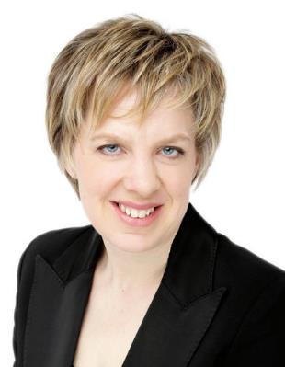
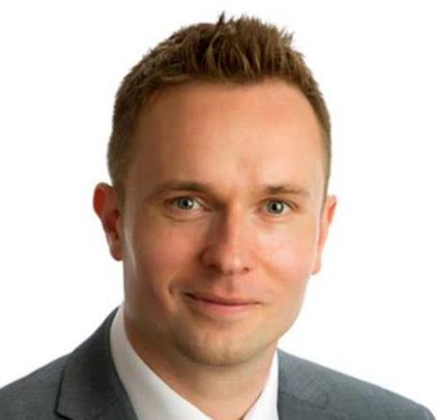
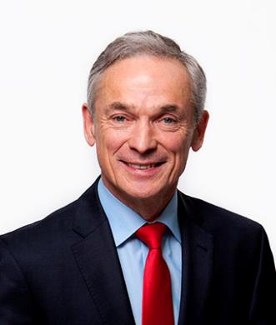
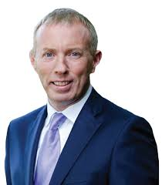
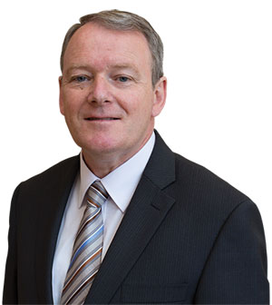
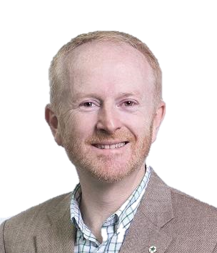
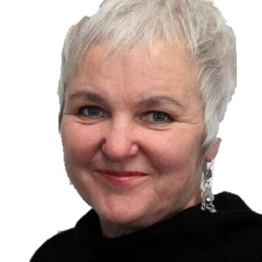
Labour Ivana Bacik
The Labour Party hopes to make Ireland’s cities carbon neutral over the course of the next 20 years. They also want to pay farmers a yearly fee to convert certain sections of their land to growing trees.
Fine Gael Minister Richard Bruton
Fine Gael wants to take steps to achieve carbon neutrality by 2050. Part of this will be accomplished by moving to 70% renewable electricity by 2030. They want to cut waste, especially single use plastics, improve air quality, and protect marine life.
Fianna Fáil Timmy Dooley T.D. Fianna Fáil have criticised Fine Gael and other parties for refusing to ban coal across the country. They believe that real change must take place to address serious issues of flooding that impact much of the nation.
Social Democrat Cllr. Cian O’Callaghan
SD wants to create “Green Communities” with a special emphasis on enhancing biodiversity. They also want to introduce a completely new waste system so that unrecyclable packaging is phased out and plastic pollution is reduced.
Climate & Environment
Sinn Féin Brian Stanley T.D.
Sinn Fein wants to stop offering licenses for offshore fossil fuel drilling and ensure that no new fossil fuel infrastructure is created. They also want to ban fracking and the importation of fracked gas.
Green Party David Healy Cllr
The Green Party wants to promote climate justice in Ireland by adopting new building standards that ensure new buildings and developments are more energy efficient. They also believe in refocusing national policy so that Ireland reaches the EU’s 2020 and 2030 emissions targets.
People Before Profit Brid Smith T. D.
People Before Profit plans to make public transport free and offer more buses for regular citizens to use. They also want to tax big corporations and polluters instead of taxing ordinary people.
Notes:
These are the Party spokespeople for these issues. Below is just a short summary of what they say on the issue. Find out more on their websites or leaflets.

Slide 5
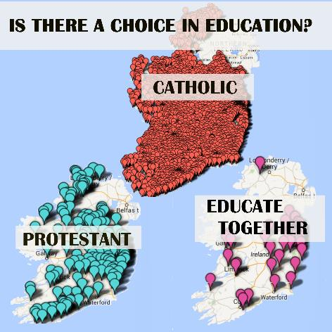
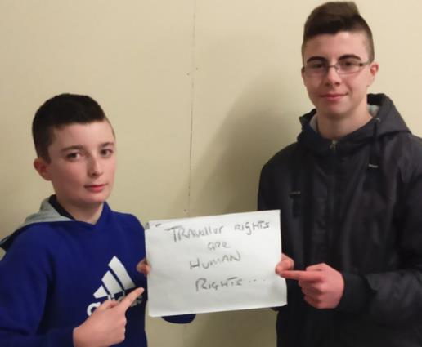
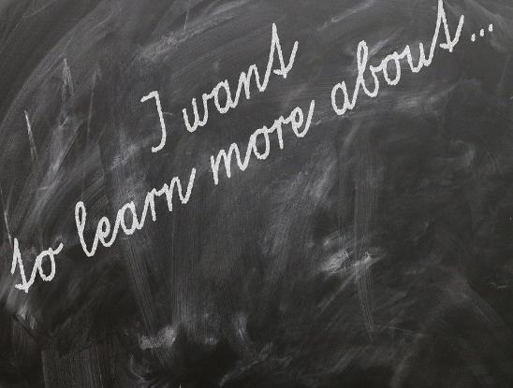
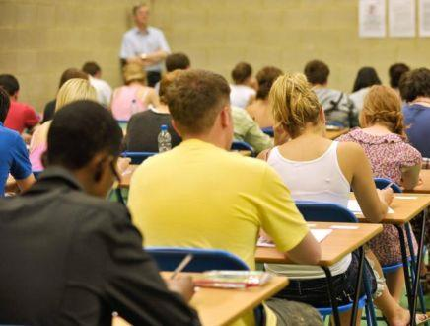
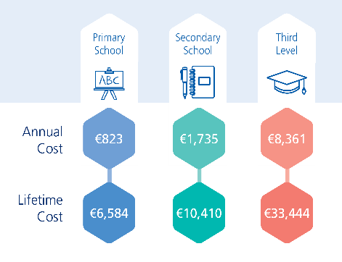
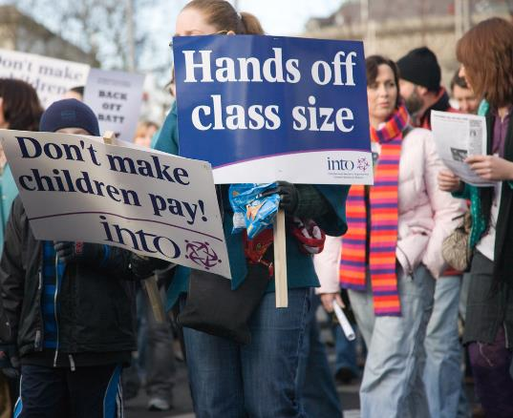
Education & Skills
RELIGION IN SCHOOL
90.3% of all primary pupils go to a Catholic school. Multi-denominational schools account for 5.7% of the total. Church of Ireland schools represent 3% of pupil enrolment. Other faiths accounted for 1%. Only ONE Irish school in 50 is multi-denominational.
EDUCATION INEQUALITY
Ireland ranks 2nd out of 41 nations in reducing education inequality. (UNICEF) Yet some groups like travellers, children experiencing homelessness and children in need of learning support are being left behind due to insufficient educational supports. The majority of disadvantaged children do not go to DEIS schools that access extra support.
CURRICULUM
Is the wider education system fit for purpose to meet the needs of school-leavers in the 21st century? Are too many school-leavers emerging from an exam-obsessed second-level where they are “taught to the test” and not learning to think for themselves?
COST OF EDUCATION
The cost of schoolbooks, uniforms, afterschool activities, school trips, and voluntary contributions can be a challenge for many parents. Average cost of school is €800 primary to €1700 secondary a year per pupil.
EXAMS/LEAVING CERT
The high-stakes nature of the exam, heavy workloads, and focus on rote learning are just some of the reasons why students, parents and teachers believe it is time to reform the current Leaving Cert cycle, according to a new study. (ERSI)
INVESTMENT IN EDUCATION
Spending on education has not kept up with rising number of students. (Independent) Ireland spends 10.7 billion in 2019 on education. We spend 2.5% of GDP on education. The OECD indicates this is the third lowest spending in the EU.
Notes:
RELIGION IN SCHOOL
90.3% of all primary pupils go to a Catholic school. Multi-denominational schools account for 5.7% of the total. Church of Ireland schools represent 3% of pupil enrolment. Other faiths accounted for 1%. Only ONE Irish school in 50 is multi-denominational.
Schools in Ireland are struggling to handle students who do not practice religion or believe in God. A report said that non-believers are often treated like "second-class citizens," and that schools regularly ignore guidelines put in place to accommodate non-religious students. (Irish Times)
-In 2019, Ireland's 15-year-olds outperformed other teenagers in reading, science, and mathematics. When compared to the same students, though, Irish students said they were generally more unhappy with their lives than students in other nations. (The Journal)
-Ireland has a highly educated population. However, in recent years, there has been little investment in the field of education. Of 35 nations surveyed, Ireland invested the least in secondary school education, just 1.2% of its GDP on second-level education. Overall, only 3.5% of the GDP was invested in education. (Irish Examiner)
EDUCATION INEQUALITY
Ireland ranks 2nd out of 41 nations in reducing education inequality. (UNICEF) Yet some groups like travellers, children experiencing homelessness and children in need of learning support are being left behind due to insufficient educational supports. The majority of disadvantaged children do not go to DEIS schools that access extra support.
CURRICULUM
Is the wider education system fit for purpose to meet the needs of school-leavers in the 21st century? Are too many school-leavers emerging from an exam-obsessed second-level where they are “taught to the test” and not learning to think for themselves?
COST OF EDUCATION
The cost of schoolbooks, uniforms, afterschool activities, school trips, and voluntary contributions can be a challenge for many parents. Average cost of school is €800 primary to €1700 secondary a year per pupil.
EXAMS/LEAVING CERT
The high-stakes nature of the exam, heavy workloads, and focus on rote learning are just some of the reasons why students, parents and teachers believe it is time to reform the current Leaving Cert cycle, according to a new study. (ERSI)
INVESTMENT IN EDUCATION
Spending on education has not kept up with rising number of students. (Independent) Ireland spends 10.7 billion in 2019 on education. We spend 2.5% of GDP on education. The OECD indicates this is the third lowest spending in the EU.

Slide 6
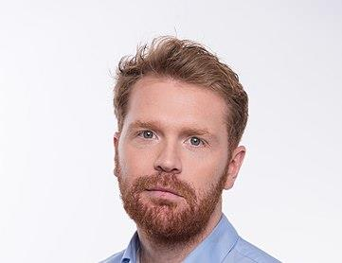
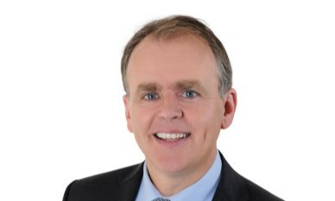
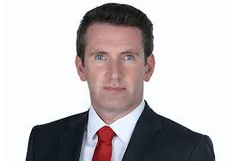
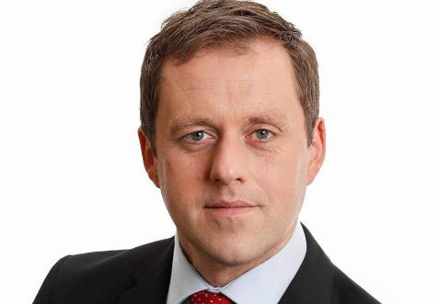
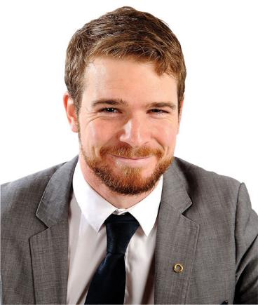
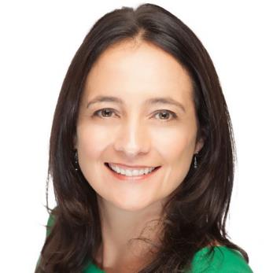
Social Democrat Garry Gannon
The Social Democrats believe in genuinely free primary education and investing to make sure families don’t have to cover basic costs for textbooks, school transport and voluntary contributions.
Fine Gael Minister Joe Mc Hugh
Fine Gael wants to make sure that the school admittance process is fair and unbiased so that people from all backgrounds have equal access to education. Fine Gael also wants to provide assistance to single-parent homes so that these individuals can provide their children with good opportunities.
Fianna Fáil Thomas Byrne TD
Fianna Fáil say that there is an education crisis in Ireland with costs skyrocketing. They also claim that there are not enough places in schools for the growing number of children in the country.
Labour Senator Aodhán Ó Ríordáin
Labour will ensure that people from all backgrounds have access to quality education, the Labour Party plans to provide 100 more multi-denominational schools by the year 2021.
Sinn Féin Donnchadh Ó Laoghaire TD
Sinn Féin want to make schoolbooks free for all children. They also have plans to ensure schools make uniforms affordable for all students.
EDUCATION & SKILLS
People Before Profit Brid Smith
People Before Profit want to provide 33 hours of free childcare per week. They also want to do a better job of helping those with disabilities or learning difficulties receive access to a good education by providing them with better support services.
Greens - Catherine Martin TD
Greens want to ensure that all people, despite their cultural or ethnic background, are provided with an exceptional education. They believe it is important to include all sexual identities and genders when discussing aspects of education so that no LGBTQI+ people are not excluded from conversations around education.
Notes:
These are the Party spokespeople for these issues. Below is just a short summary of what they say on the issue. Find out more on their websites or leaflets.

Slide 7
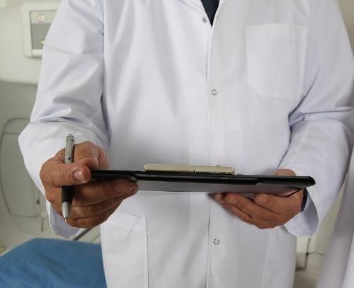
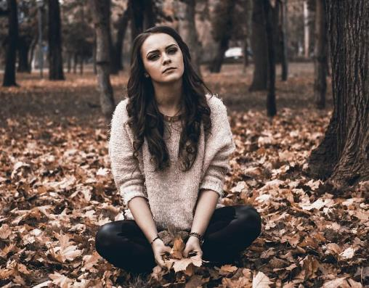
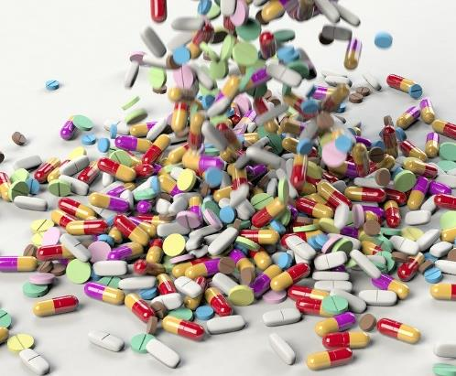
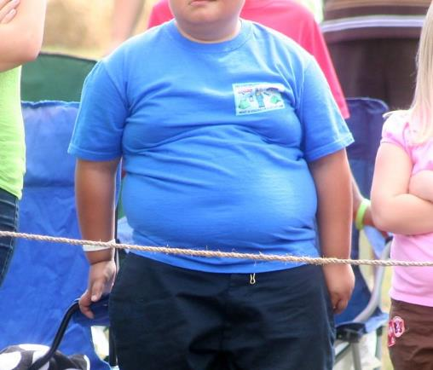
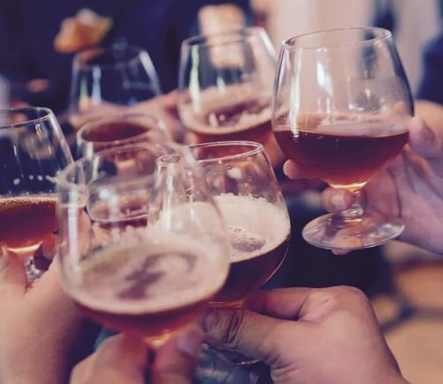
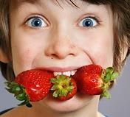
Health and Well Being
HOSPITAL WAIT TIMES
Hospital waiting lists reached record highs this year. In July, a total of 564,829 people were waiting for an outpatient appointment. There were reportedly 46,949 children waiting to see a paediatrician for an outpatient visit. (Irish Times)
MENTAL HEALTH IN YOUTH
Amongst children 11-13, the RCSI said that 15.4% of them were experiencing a mental disorder like anxiety. It also reported that 31.2% of 11-13-year-olds had experienced a mental disorder at some point. (Royal College of Surgeons-Ireland)
PRESCRIPTION DRUG COST
In Ireland, the average person pays six times the global average for generic drugs. That being said, Ireland also reportedly pays 14% less for branded drugs than the other 50 nations surveyed. (Irish Times)
OBESITY EPIDEMIC
Currently, one in five Irish school children is classified as obese or overweight. The World Health Organization predicted that by 2025 in Ireland, 2,000 children will have Type 2 Diabetes, 19,000 will have high blood pressure, and 27,000 will have first stage fatty liver disease. (Irish Heart Foundation)
ALCOHOL ABUSE
Although the rate of alcohol intake has fallen in many Western nations, it continues to rise in Ireland. Reports show that 54% of Irish men were classified as heavy episodic drinkers while 26% of women fell in the same category. And, compared with other nations, Irish citizens consume approximately twice the global average of alcohol. (Irish Times)
FOOD POVERTY
10% of Irish people live in food poverty, study shows. Lower-income families have to spend up to a third of their income to afford enough food. That is according to a new Safefood study which also found that 10% of the population lives in 'food poverty'.
Notes:
HOSPITAL WAIT TIMES
Hospital waiting lists reached record highs this year. In July, a total of 564,829 people were waiting for an outpatient appointment. There were reportedly 46,949 children waiting to see a paediatrician for an outpatient visit. (Irish Times)
MENTAL HEALTH IN YOUTH
Amongst children 11-13, the RCSI said that 15.4% of them were experiencing a mental disorder like anxiety. It also reported that 31.2% of 11-13-year-olds had experienced a mental disorder at some point. (Royal College of Surgeons-Ireland)
PRESCRIPTION DRUG COST
In Ireland, the average person pays six times the global average for generic drugs. That being said, Ireland also reportedly pays 14% less for branded drugs than the other 50 nations surveyed. (Irish Times)
OBESITY EPIDEMIC
Currently, one in five Irish school children is classified as obese or overweight. The World Health Organization predicted that by 2025 in Ireland, 2,000 children will have Type 2 Diabetes, 19,000 will have high blood pressure, and 27,000 will have first stage fatty liver disease. (Irish Heart Foundation)
ALCOHOL ABUSE
Although the rate of alcohol intake has fallen in many Western nations, it continues to rise in Ireland. Reports show that 54% of Irish men were classified as heavy episodic drinkers while 26% of women fell in the same category. And, compared with other nations, Irish citizens consume approximately twice the global average of alcohol. (Irish Times)
FOOD POVERTY
10% of Irish people live in food poverty, study shows. Lower-income families have to spend up to a third of their income to afford enough food. That is according to a new Safefood study which also found that 10% of the population lives in 'food poverty'.

Slide 8
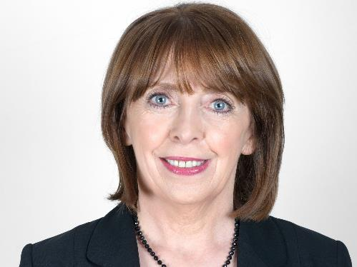
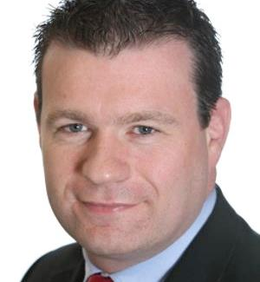
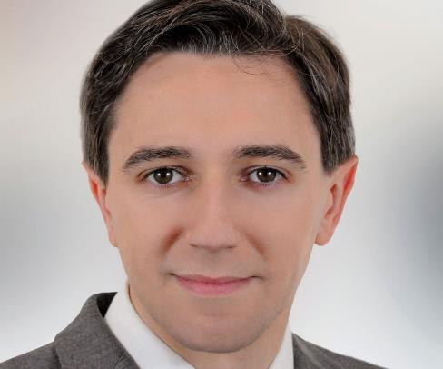
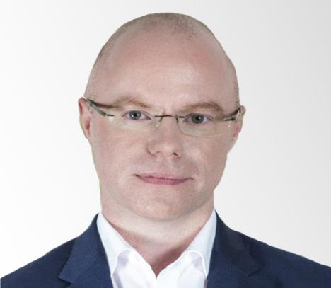
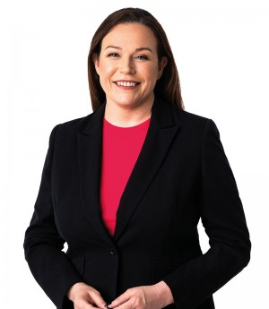
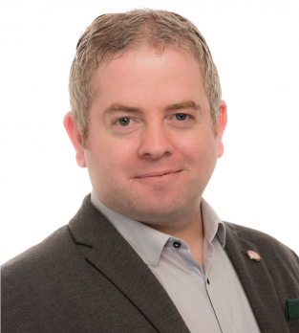
Health and Well Being
Labour Party Alan Kelly TD
Labour wants to provide free counselling services to individuals between 16 and 25 years of age. They also want more GPs to be trained in ways to help those suffering from mental health challenges.
Fine Gael Simon Harris Minister for Health
Fine Gael wants to help elderly individuals stay in their homes for as long as they so choose. They want to work on cutting down wait times so that those in need are treated in a timely manner.
Fianna Fáil
Stephen Donnelly TD
Fianna Fáil’s healthcare plan, commits to providing additional GPs through more GP training places and increasing the rural GP allowance to €30,000. They will provide an additional five million hours of home care support over the next five years as well as implementing a statutory homecare scheme.
Social Democrat Roisin Shorthall TD
Social Democrats believe in a properly funded universal single-tier health service will join up health and social care so people are able to access treatments in their communities.
People Before Profit
PBP is fighting to make health care more efficient for patients. They want people to be treated within 4 hours of arriving at the Emergency Department instead of endless wait times existing. They also want to provide extra support to groups that are often overlooked.
Sinn Féin Louise O'Reilly TD
Sinn Féin want to start making prescriptions free for all. They also want to place a greater emphasis on mental health services and helping individuals with disabilities receive adequate health care.
Green Party Dr Séamus McMenamin
Greens want to focus on helping people be proactive about their health by encouraging healthier lifestyle choices, provide better care to those with disabilities, and increase regulations on companies that promote alcohol and tobacco products. They also want to empower patients to be their own advocates.
Notes:
These are the Party spokespeople for these issues. Below is a just short summary of what they say on the issue. Find out more on their websites or leaflets.

Slide 9
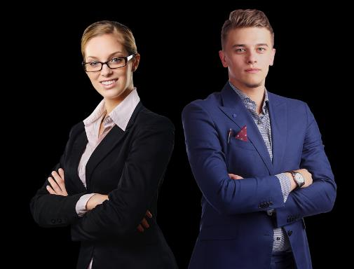
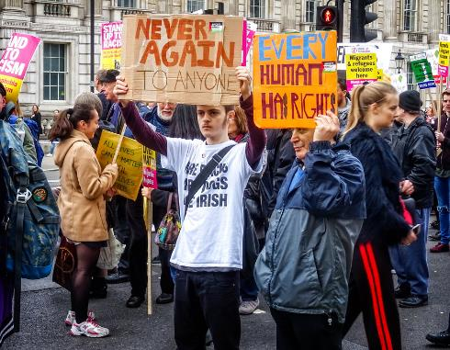
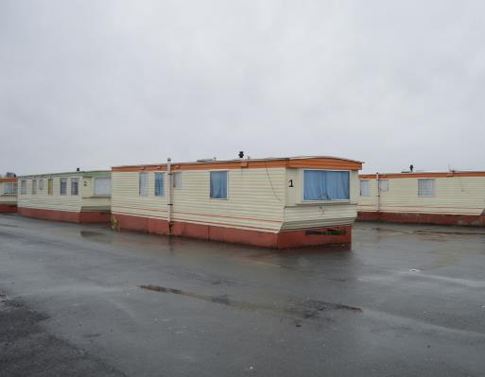
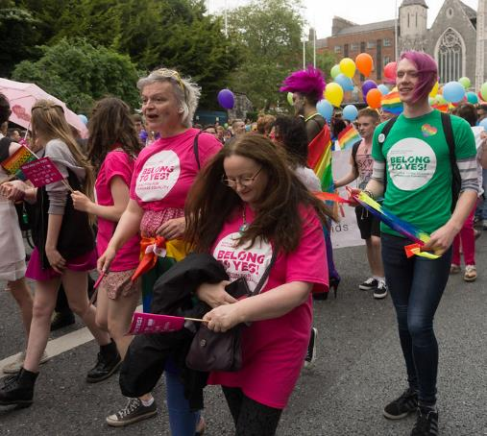
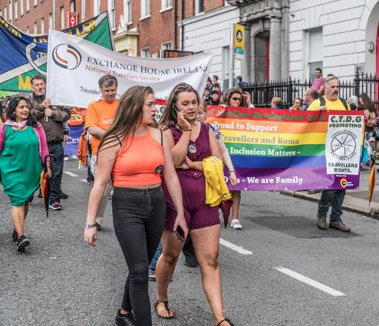
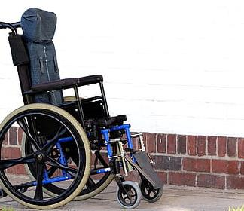
Inclusion and Equality
GENDER PAY GAP
Although women tend to pursue more advanced degrees than their male counterparts, they still tend to earn 28% less than men in the workforce. (Irish Independent)
RACISM
A third of individuals in Ireland said they felt discriminated against due to their skin colour. The head of the EU Fundamental Rights Agency said that Ireland has a "worrying pattern" of racism. Irish Times
DIRECT PROVISION
Individuals seeking international protection has risen by 50%. To provide these individuals with accommodation, new centres are needed. The government is planning to spend 320 million Euros to build such housing for them. (The Journal)
DISABILITY DISCRIMINATION
People with disabilities in Ireland are more discriminated against than those who do not have disabilities. One out of five reports of discrimination among the disabled concerns health services in Ireland. (Breaking News Ireland)
LGBTQI+ RIGHTS
Approximately three-quarters of gay and transgender teens feel unsafe in the Irish education system. (Irish Times)
TRAVELLER DISCRIMINATION
There is still significant and broad discrimination against Travellers in Ireland. According to the Council of Europe, Travellers are 38 times more likely to experience discrimination in pubs and 22 times more likely to be discriminated against when trying to access housing services. (Irish Examiner)
Notes:
GENDER PAY GAP
Although women tend to pursue more advanced degrees than their male counterparts, they still tend to earn 28% less than men in the workforce. (Irish Independent)
RACISM
A third of individuals in Ireland said they felt discriminated against due to their skin colour. The head of the EU Fundamental Rights Agency said that Ireland has a "worrying pattern" of racism. Irish Times
DIRECT PROVISION
Individuals seeking international protection has risen by 50%. To provide these individuals with accommodation, new centres are needed. The government is planning to spend 320 million Euros to build such housing for them. (The Journal)
DISABILITY DISCRIMINATION
People with disabilities in Ireland are more discriminated against than those who do not have disabilities. One out of five reports of discrimination among the disabled concerns health services in Ireland. (Breaking News Ireland)
TRAVELLER DISCRIMINATION
There is still significant and broad discrimination against Travellers in Ireland. According to the Council of Europe, Travellers are 38 times more likely to experience discrimination in pubs and 22 times more likely to be discriminated against when trying to access housing services. (Irish Examiner)
LGBTQI+ RIGHTS
Approximately three-quarters of gay and transgender teens feel unsafe in the Irish education system. (Irish Times)

Slide 10
Inclusion and Equality
Labour Party Kathleen Lynch
Labour want corporations to publish information about gender pay gaps that exist in their companies. Labour is striving to have all state boards be 50% female. They believe Travellers should be employed at local councils to receive fair job opportunities.
Fine Gael Minister Charlie Flanagan
FG want to ensure that individuals with disabilities have early access to treatments and diagnostic services. They also want to focus on eliminating discrimination from the workforce so that all people have equal opportunities.
Fianna Fáil Jim O’Callaghan TD
Fianna Fáil believes that Ireland has done a lot to advance the right of LGBTQI+ individuals. However, they still believe that there is a lot to be done to protect the rights of these individuals.
Social Democrat Sarah Durcan
The Social Democrats want to improve regulations and funding conditions so that access to buses, trains, taxis and housing is vastly improved for people with disabilities. They also want to improve financial supports for disabled transport users and eliminate notice time for travelling for mobility-impaired customers who require assistance.
Sinn Féin Martin Kenny TD
SF want to increase the Disability Allowance. They also want to put trainings in place to help individuals with disabilities (who wish to work) learn the necessary skills to do so.
Green Party Una Power Cllr.
The Green Party wants to require gender-neutral toilet facilities in public places. They also want to introduce new legislation to protect intersex and transgender individuals from hate crimes. Green Party feels that all contraception should be available, free of charge, from pharmacies.
People Before Profit
PBP want to guarantee access to early intervention services for those with Autism/other disabilities. People Before Profit believes in giving people Medical Cards based on need. They want to ensure that pregnant, transgender individuals receive good care. All reproductive/contraceptive services should be free.
Notes:
These are the Party spokespeople for these issues. Below is just a short summary of what they say on the issue. Find out more on their websites or leaflets.

Slide 11
Economy & Jobs
CHILDREN IN POVERTY
Right now, more than 300,000 children are living below the poverty line on the island of Ireland. (Irish Times)
HOMELESSNESS
More than 10,500 people are currently homeless in Ireland. (The Journal). Approximately 4,000 of those individuals are children (Children's Rights Report Card).
UNEMPLOYMENT
The unemployment rate in Ireland is currently at 4.8%. The last time it was below 5% was in July 2007 prior to the economic crash. (Irish Times )
WEALTH INEQUALITY
Ireland has a growing problem right now with wealth inequality. The World Economic Forum recently issued a report saying: "Ireland is faced with high income inequality and soaring wealth inequality." (The Journal)
INFRASTRUCTURE
Project Ireland 2040, an initiative focused on Ireland's infrastructure, has two elements: National Planning Framework (NPF) and National Development Plan (NDP). NPF is focused on balancing regional development across cities while NDP is to upgrade infrastructure because of the growing population. (Irish Times)
COST OF LIVING
The cost of living has gone up drastically in Ireland. Right now, it costs the average family over €50,000 a year to sustain themselves and run a family. (Irish Times)
Notes:
CHILDREN IN POVERTY
Right now, more than 300,000 children are living below the poverty line on the island of Ireland. (Irish Times)
HOMELESSNESS
More than 10,500 people are currently homeless in Ireland. (The Journal). Approximately 4,000 of those individuals are children (Children's Rights Report Card).
UNEMPLOYMENT
The unemployment rate in Ireland is currently at 4.8%. The last time it was below 5% was in July 2007 prior to the economic crash. (Irish Times )
WEALTH INEQUALITY
Ireland has a growing problem right now with wealth inequality. The World Economic Forum recently issued a report saying: "Ireland is faced with high income inequality and soaring wealth inequality." (The Journal)
INFRASTRUCTURE
Project Ireland 2040, an initiative focused on Ireland's infrastructure, has two elements: National Planning Framework (NPF) and National Development Plan (NDP). NPF is focused on balancing regional development across cities while NDP is to upgrade infrastructure because of the growing population. (Irish Times)
COST OF LIVING
The cost of living has gone up drastically in Ireland. Right now, it costs the average family over €50,000 a year to sustain themselves and run a family. (Irish Times)

Slide 12
Economy & Jobs
Labour Party Joan Burton TD
Labour plans to close the gender pay gap in the workplace. They also plan to prioritize eliminating workplace bullying and widening access to work for people with disabilities.
Fine Gael Paschal Donohoe TD
Fine Gael want to think about the future of the economy. This means that they want to focus on incorporating artificial intelligence and robotics into the work world. They also want to train/retrain workers so they can remain employable throughout their lives.
Fianna Fáil Michael McGrath TD
Fianna Fáil want to make efforts to support large and small enterprises to help the economy grow & advance.
Social Democrat Catherine Murphy TD
SD will equip the Workforce through investment in lifelong education, skills-based training, apprenticeships and access programmes to help workers maintain value in a fast changing world.
Sinn Féin Conor Murphy
They plan to increase the minimum wage by 1 Euro an hour so it is closer to a living wage. They also want to focus on supporting individuals with disabilities who wish to enter the workplace.
Green Party Neasa Hourigan Cllr
The Green Party is primarily interested in focusing on sustainability in the economy. They want to alter things to focus more on regeneration and recycling. They also want to put tax incentives in place to encourage tech start-ups to set-up in Ireland.
People Before Profit
People Before Profit believes in raising the minimum wage to 15 Euros an hour. They also want large corporations to stop viewing Ireland as a "Tax Haven" and have companies (like Apple) pay all their back taxes.
Notes:
These are the Party spokespeople for these issues. Below is a just short summary of what they say on the issues.

Slide 13
“A politician thinks of the next election a statesman thinks of the next generation.” James Freeman Clarke
“We are the first generation to feel the impact of climate change, and the last generation that can do something about it.” Barack Obama
Make this election count!

