Slide 1
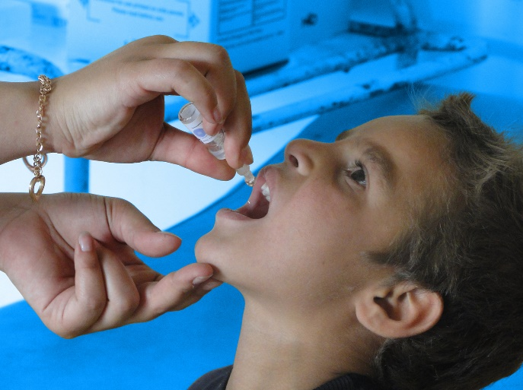
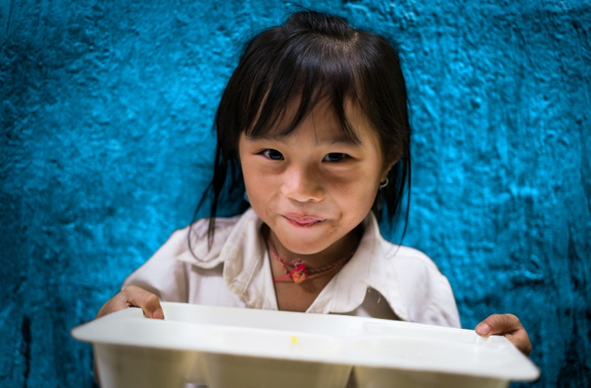
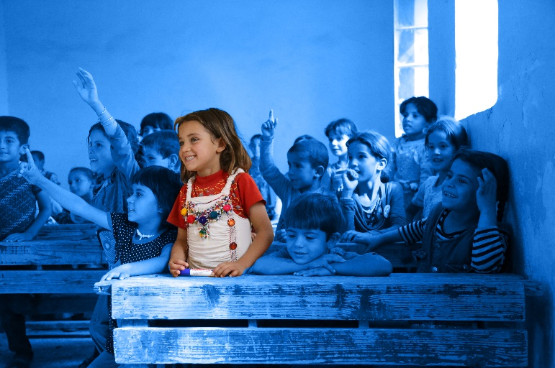
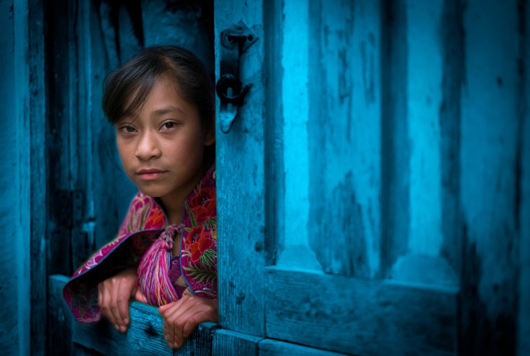
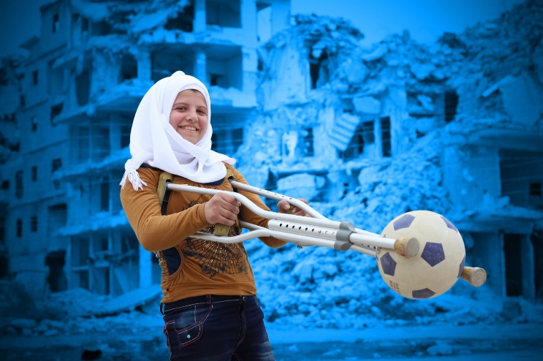
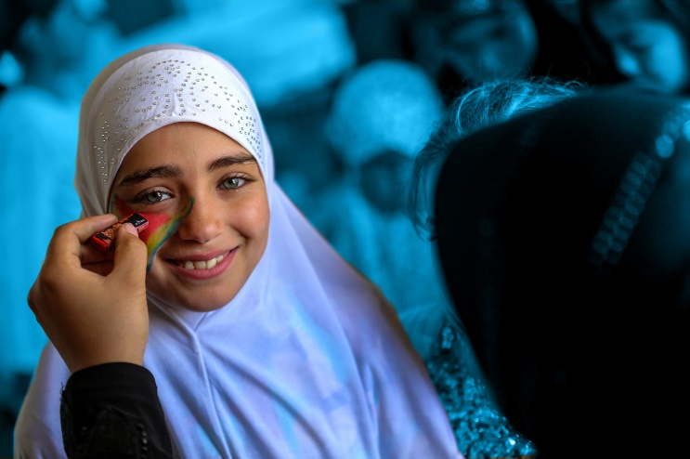
CHILDREN UPROOTED
Notes:
Delivering this Activity:
*Please Note: UNICEF encourages peer-led learning. If you are a young person delivering this workshop to your peers, follow the steps below for a successful workshop!
Get support from a teacher or adult to run through the workshop with you first.
If it is a challenging issue, that might cause upset to people, only deliver it with the support of an adult in the room. And give prior warning to the participants of topic you are covering as they may or may not wish to participate.
Make sure all the technical things (internet, computer connections, etc) are working before the workshop
Follow the notes and use them to talk through each of the slides and show the different videos. Most slides have notes with more info, but don’t worry if you don't share everything in the notes.
Always encourage discussion during the presentation – being sensitive to everyone’s personal experiences and perspectives.

Slide 2
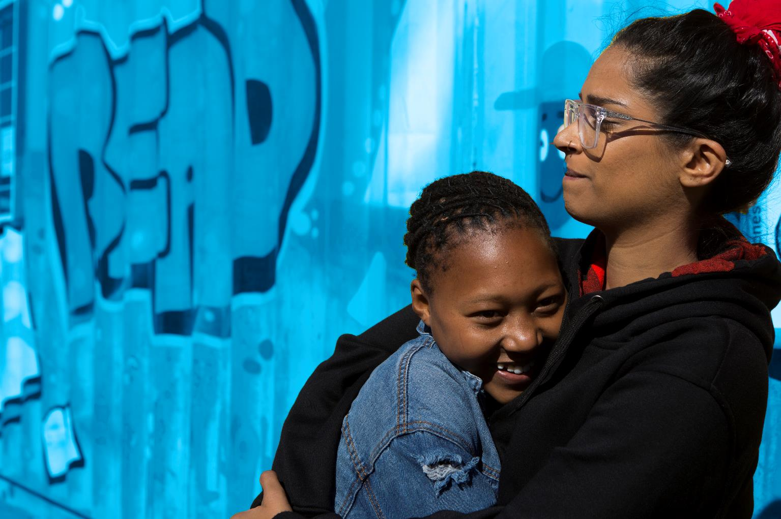
RESPECT
CONFIDENTIALITY
PRIVACY
INCLUSION
AWARENESS
Notes:
PRIVACY - We only share what we want to share
CONFIDENTIALITY – What is said here stays here
RESPECT- Listen when people are speaking, respect difference, and don't laugh, deride or make fun of others
INCLUSION – We make sure everybody has an opportunity to contribute and no one is left out of a group or discussion.
Sometimes the topics and discussions can be upsetting or you have been personally
affected by them.
If you have been upset or want to just talk please come to
Vivienne for
support.

Slide 3
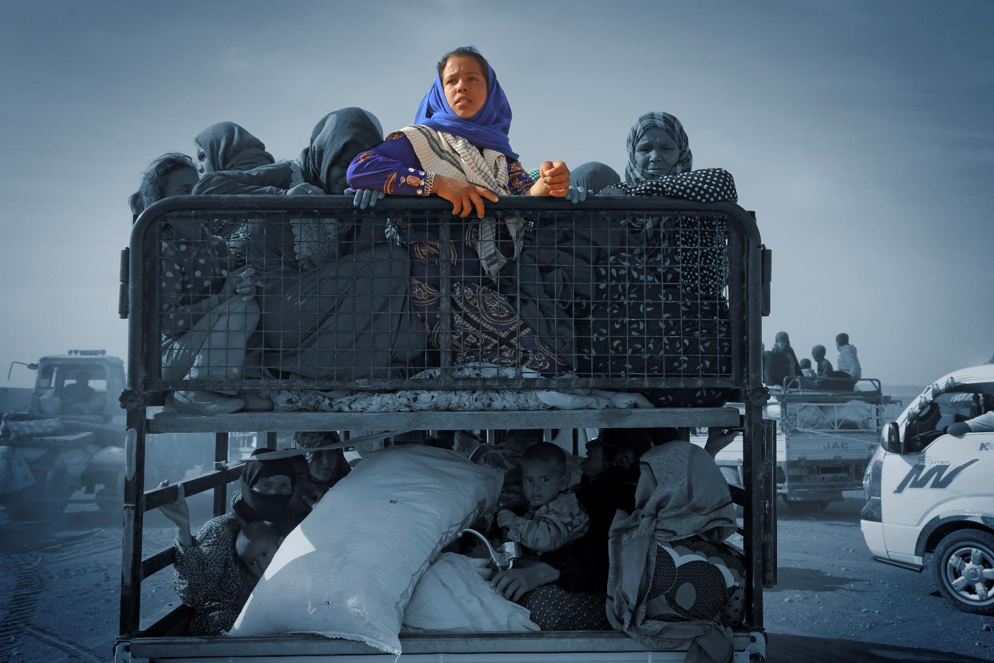
​70.8 MILLION PEOPLE
​HAVE BEEN FORCIBLY DISPLACED WORLDWIDE
Notes:
The aim of this activity is to help participants better understand the causes behind displacement and migration.
​Discussion:
Today 1.5 billion people are living in a state of near-permanent conflict or in zones of economic and social breakdown ​
In total, around 70.8 million people in the world are refugees or internally displaced persons (IDPs).​
refugees flee the brutalities of civil war and gang-related violence, assault, rape, recruitment to be child soldiers, disappearance and murder, climate-related issues like drought and the lack of food and water. ​
Refugees and IDPs are largely living in the country that they are from or a country that borders them​
Every day, more than 44,000 people are forced to flee their homes due to conflict or persecution. That’s 1 man, woman, or child every 2 seconds!​
85% of refugees are hosted by developing countries. The world’s richest countries only host around 5%.​
Watch one of the two videos above to introduce the class to some of the reasons why children are uprooted and forced to leave home.
What would cause you to leave Ireland, knowing you might not ever return? War, conflict, oppression, persecution because of ethnicity, sexuality, gender, poverty, climate change / natural disasters, a better quality of life, famine, crop failure, high crime
​What emotions or impact would you be feeling when making this decision? Fear, hunger, desperation, sadness, hope, loss, dread, apprehension, shame, determination, anxiety.
What forced Irish people to migrate? Famine (the late 1840s) Poverty (1900s) Employment (2000s)
What would you be seeking? Safety, peace, security, job, employment, education, opportunity.
Which of these is a human or child right? Refer to the Convention on the Rights of the Child Poster.
Activity: Watch one of the videos online, Based on the video, ask the participants to make up a scenario of a young refugee or migrant on the move.
The description should include:
​What country do they live in?
What the situation is like in that country and why they are leaving?
What their living conditions are like?
What incident happened that led them to make their decision?
Where they are trying to go to?

Slide 4
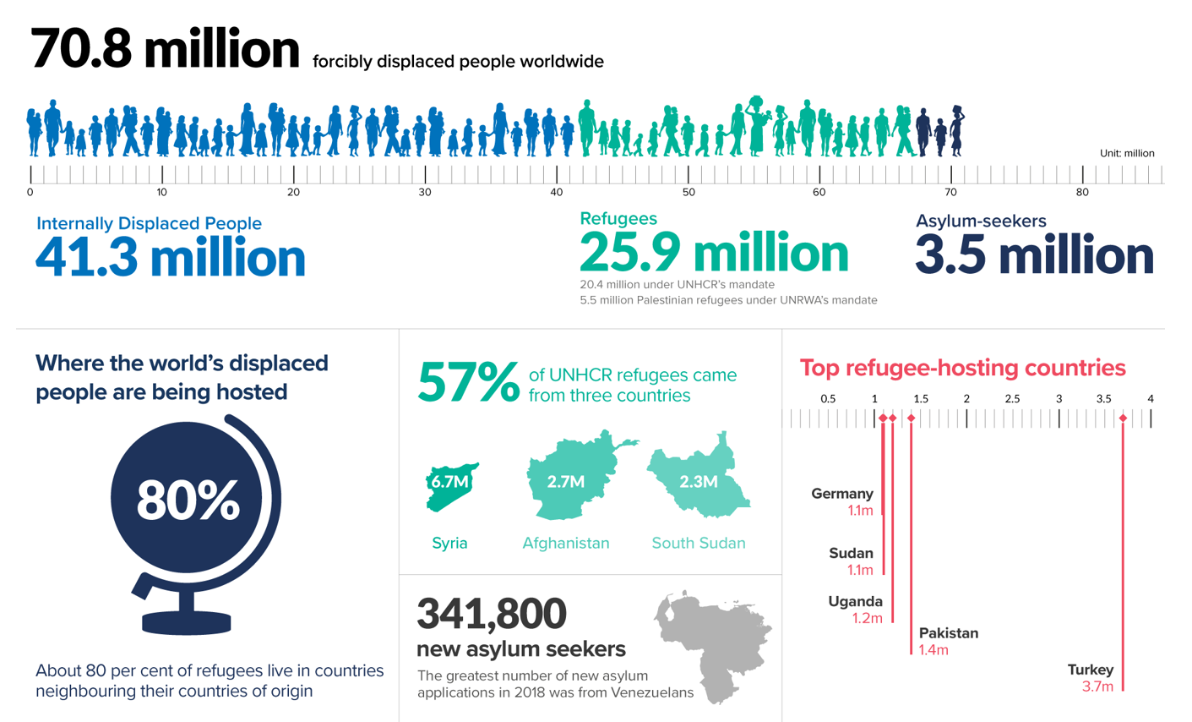
Notes:
Today 1.5 billion people are living in a state of near permanent conflict or in zones of economic and social breakdown
In total, around 68.5 million people in the world are refugees or internally displaced persons (IDPs).
refugees pouring into Europe from the Middle East is but one manifestation of this crisis. They flee the brutalities of civil war and gang-related violence, assault, rape, recruitment to be child soldiers, disappearance and murder, climate related issues like drought and the lack of food and water.
A recorded 63 million children were not enrolled in any form of education. Of these children, half of them live in conflict affected areas. The impact of conflict has shown to take away the rights of children.
90% of girls living in conflict will not attend secondary school.
Refugees and IDPs are largely living in the country that they are from or a country that borders them
Every day, more than 44,000 people are forced to flee their homes due to conflict or persecution. That’s 1 man, woman, or child every 2 seconds!
85% of refugees are hosted by developing countries. The world’s richest countries only host around 5%.
The refugee and migrant crises track the stress lines of today’s world. Societies and countries face fractures caused by conflict and violence, poverty, climate change and demographic change, not to mention technology which downloads images of affluence into just about every home.

Slide 5
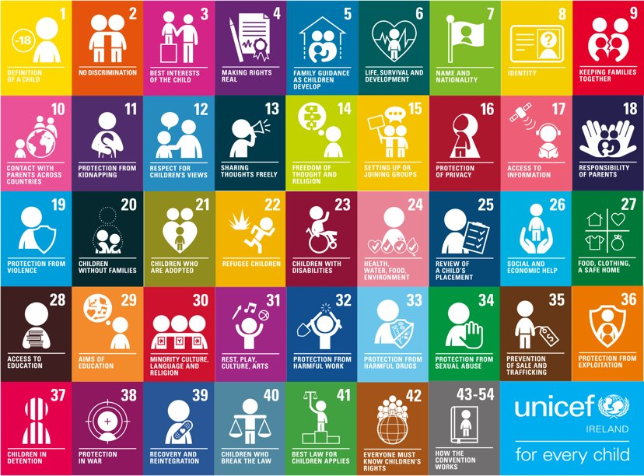
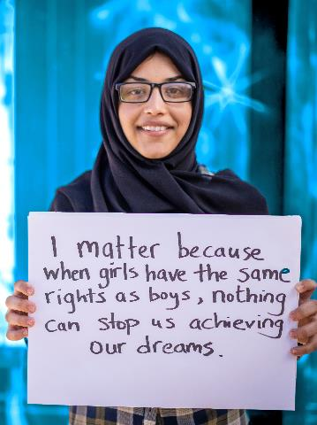
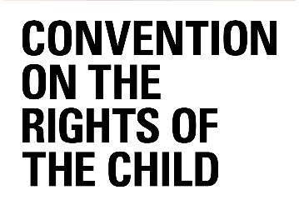
Notes:
How does this impact on children
Children in conflicts:
Fifteen new conflicts have broken out or reignited in the past five years, and the numbers of protracted emergencies –conflicts that have lasted for over five years –are also growing.
Children in poverty:
Nearly half of the 700 million people living in extreme poverty are children and most live in rural areas. Sub-Saharan Africa accounts for half of the global poor. Poverty is declining in all regions but it is becoming deeper and more entrenched in countries that are either conflict ridden or overly dependent on commodity exports. The number of young children from poor households is particularly pronounced in the lowest-income countries, where more than half of children under age 12 live in extreme poverty.
The demographic bulge in the developing world is another major driver of migration, both legal and illegal. A billion children will be living in Africa by 2050. UNICEF research from West and Central Africa and the Horn of Africa identifies poverty and a lack of employment opportunities as the main reason that young people move. More than 75 percent of the migration is within Africa. Less than 20% of migrants journey outside the regions.
Children in a climate crisis:
The current El Niño demonstrates how climate change will create new migration dynamics. To date, it has put at risk 11 million children in East and Southern Africa, 3.5 million in Central and South America and 2.4 million in the Pacific. Added to this is a body of evidence which forecasts that climate change will increase the intensity and frequency of natural disasters and create even move imperatives to move. In the coming decade, climate-change related events are projected to impact on 200 million children ― a tripling of current numbers. More children will be denied their most basic rights and made even more vulnerable. Most are concentrated in those countries that can least handle these challenges —and faced by those citizens and communities least able to survive them: the poorest, the most marginalized, and, everywhere, the children. Potentially each and every one of them could then be forced to move.
Last year alone, more than 5,000 men, women, and even unaccompanied children lost their lives during their search for safety and a better life.
Two refugee crises that have made headlines this year are the crisis in Venezuela and ongoing unrest in the Democratic Republic of Congo (DRC.)
REFUGEES AND HUMAN RIGHTS
Seeking asylum in other countries is a human right recognized by Article 14 of the Universal Declaration of Human Rights. Countries that have ratified the 1951 Refugee Convention are obligated to protect refugees in their territory.
Refugees and asylum seekers have numerous rights, including the right to: not get sent back to their home country; not be punished for illegally entering countries that are party to the Convention and Protocol; housing; work; access to education; access to public assistance; access to courts; get identification and travel documents. (CNN)
What articles in the Convention are threatened by displacement? ​

Slide 6
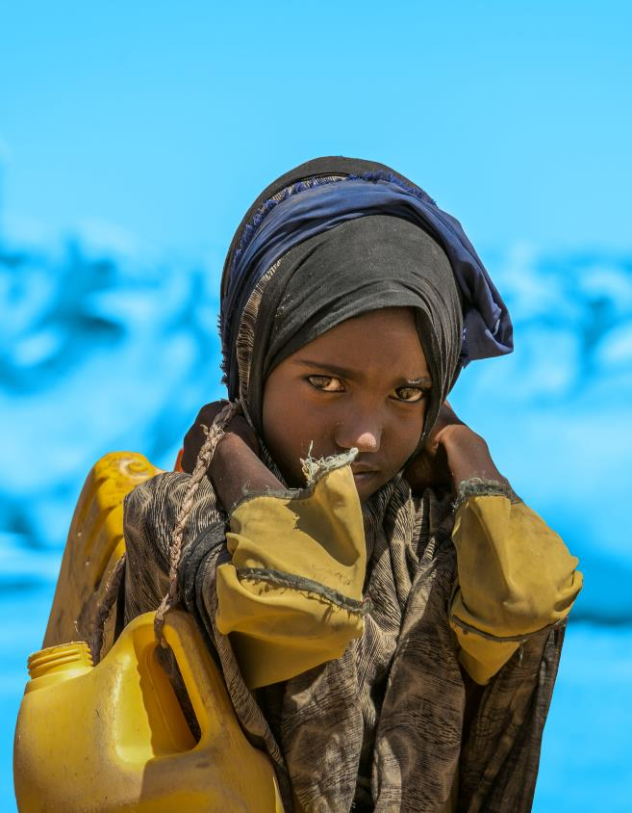
Notes:
Children represent a disproportionate and growing proportion of those who have sought refuge outside their countries of birth: they make up about a third of the global population but about half of all refugees. In 2015 around 45 per cent of all child refugees under UNHCR’s protection came from Syria and Afghanistan. • 28 million children have been driven from their homes by violence and conflict within and across borders, including 10 million child refugees; 1 million asylum-seekers whose refugee status has not yet been determined; and an estimated 17 million children displaced within their own countries – children in dire need of humanitarian assistance and access to critical services. • More and more children are crossing borders on their own. In 2015, over 100,000 unaccompanied minors applied for asylum in 78 countries – triple the number in 2014. Unaccompanied children are among those at the highest risk of exploitation and abuse, including by smugglers and traffickers.
• About 20 million other international child migrants have left their homes for a variety of reasons including extreme poverty or gang violence. Many are at particular risk of abuse and detention because they have no documentation, have uncertain legal status, and there is no systematic tracking and monitoring of their well-being – children falling through the cracks.
​A recorded 63 million children were not enrolled in any form of education. Of these children, half of them live in conflict affected areas. The impact of conflict has shown to take away the rights of children. ​
90% of girls living in conflict will not attend secondary school.​

Slide 7
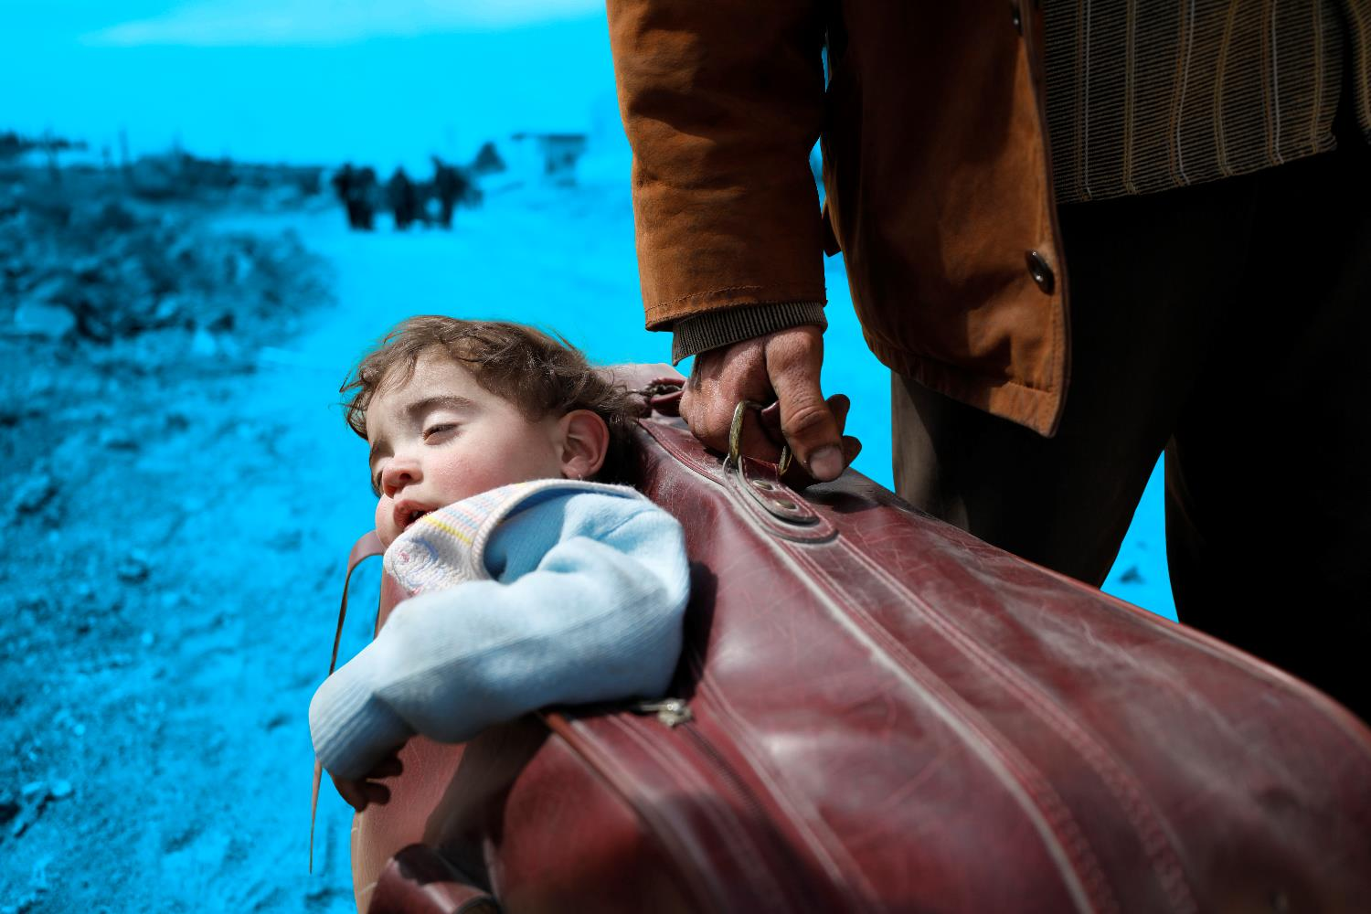
THE JOURNEY
PACK YOUR BAG
Notes:
Today we are going to bring your through the experiences of refugees as the journey to find safety and their stories of arrival and settling in to a new home here in Ireland. The stories you hear are all real stories of people like you and me and how they survived, BUT FIRST I WANT YOU TO PACK YOUR BAG.

Slide 8
Notes:
The first story is that of Rania

Slide 9
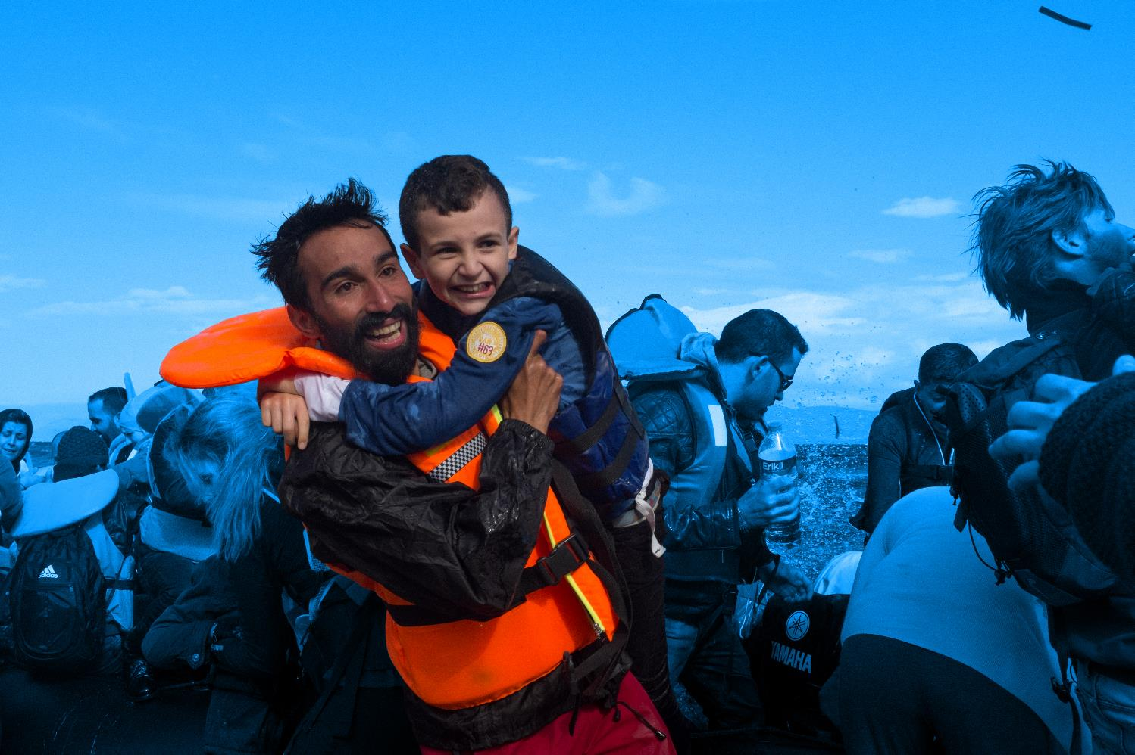
THE ARRIVAL
FELLING WELCOME
Notes:
Walking Debate: Should Ireland take in more refugees given that we have so many problems, like our housing crisis and healthcare crisis?
We can't afford to?- Ireland is one of the wealthiest nations in the world. In 2018, Ireland ranks 8th wealthiest amoung all nations on the global ranking scale: Inclusive Development Index (IDI) If Ireland can't afford to, how come other countries can?
​
Turkey hosted almost 3 million refugees in 2016, the largest population of any country. Refugee numbers climbed by nearly half a million - from 2.5 million to 2.9 million - in the space of a year. (UNHCR) In terms of percentage of their population, that would be the equivalent of Ireland receiving 250,000.
​
We are taking our fair share- The Government has failed to meet its original pledge of bringing 4,000 asylum seekers into the country by the end of 2017. A total of 1,337 men, women and children have arrived in Ireland under the State’s refugee protection programme since 2015, less than half the original pledge made by the Government.
As a percentage of our population, Ireland ranks 29th out of 45 European countries in receiving asylum seekers and refugees. Asylum seekers comprise 0.01% of the Irish population (that is 1 out of every 10,000 people is an asylum seeker).
In Lebanon, one in six people was a refugee in 2016 meaning that the country had the largest number of displaced people relative to its own population.
Globally, the number of refugees and internally displaced people reached 65 million for the first time, with 86% in developing countries without adequate resources to help them. (World Economic Forum)
Ireland is too small of a country to take in more refugees
Ireland used to have a population of over 8 million, Current population of the Republic is 4.5 million. Ireland has a population density of 65 people per square km (compared to the UK’s population density of 260 people per square km).
Ireland's economy will be hurt by taking in more refugees
The OECD, a club of mostly rich countries, assessed the effect of immigrants on its members’ finances in 2007-09. It found they made a net fiscal contribution of around 0.35% of GDP on average, with relatively little variation from country to country. (The Economist)

Slide 10
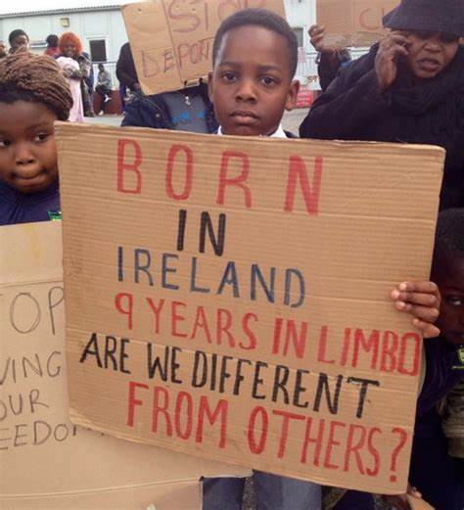

Slide 11
In the inner circle write down what is at the core of who you are. Three words that describe you.
In the middle circle write down what you have chosen to be things about your identity that are your choice. This is who you have decided to be.
In the outer circle write down all the things about you that just are. You were given this part of your identity. You were born that way. You can’t change it.
Notes:
Discussion: Refugees and Asylum-seekers in Ireland often face prejudice, xenophobia and discrimination. What are the barriers they face to being Irish and feeling like they belong? Introduce the activity by showing participants one or two of the introductory videos above. This activity will explore the concept of identity. This is an important component of the learning for establishing a sense of understanding of the assumptions, stereotyping and "othering" that goes on when talking about refugees and migrants.
Activity: ‘Circles of Me’ ​The following activity provides students with an opportunity to define their own identity. In so doing they will determine what components of that identity are given vs. chosen and what commonalities they share or don't share with others in the group. What assumptions or stereotypes are made about them based on labels that are given to them.
Step 1: Ask to draw three large circles (one inside the other) and fill them in as follows:
Inner circle: Record three adjectives that describe themselves. This is our core identity.
Middle circle: Record things about themselves that they have chosen, e.g. friends, hobbies, interests. This is the part of our identity that we choose for ourselves.
Outer circle: Record external characteristics e.g. their hair colour, eye colour, birthplace, nationality, culture, religion and race. This is the part of our identity that is given to us – we do not choose these traits.
Feedback: Ask participants to share some of the traits that have been given to them and chosen by them. Discuss the commonalities and differences that have arisen in the classroom. Ask them to share what it feels like when they are part of a large group, versus when they are part of a small group. Ask for adjectives that describe a larger group versus adjectives that describe a smaller group.
powerful (large group) or powerless (small group)
safe (large group) vulnerable (small group)
insider (large group) outsider (small group)
majority (large group) minority (small group)
​​Ask participants to think about the size of the group they find themselves in mostly and how does this affect them.
Ask them to reflect on their identity and to identify any labels, assumptions or stereotypes that are made about them based on their identity. Ask students to think about what it means to "be Irish".
Video: Individual World Poetry Slam Finals 2015 – Emi Mahmoud Final Roun

Slide 12
Kahoot

Slide 13
Text SPUNTOUT to 0861800280 or go online to spunout.ie
Call 1800666666 or chat online at childline.ie or text to 50101 10-4pm
Call 1800544729 or text “call me” to 0861802880
Call 116123 or 24/7 or email jo@samaritans.org
Call 1800247247 or text HELP to 51444 if feeling Suicidal/Self Harm
Call 016706223 or go to website belongto.org support for LGBTI+
SUPPORT
Notes:
Leave this up at the end of the workshop

