Slide 1
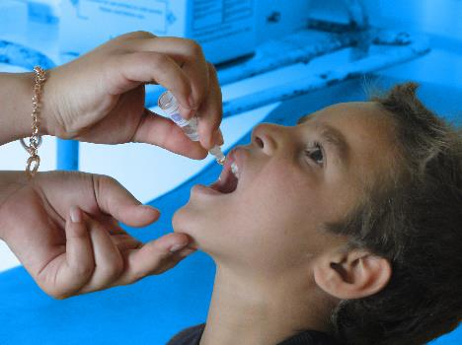
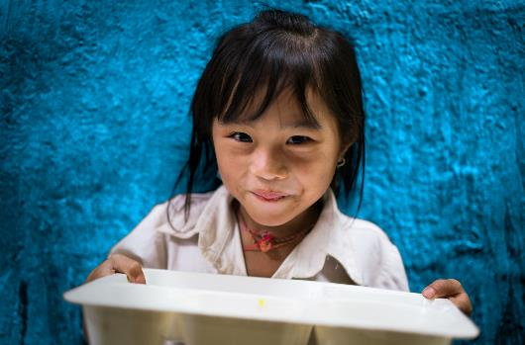
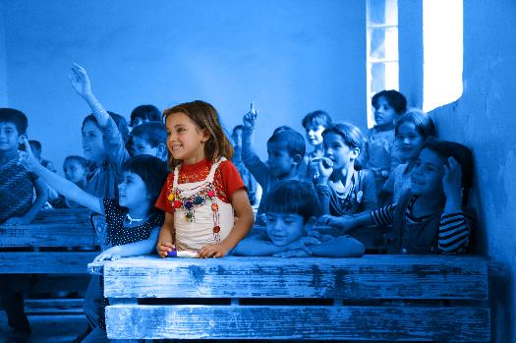
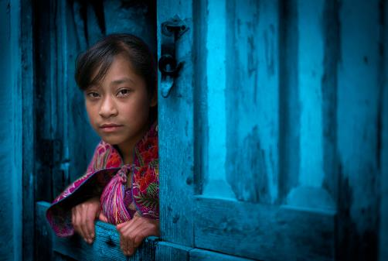
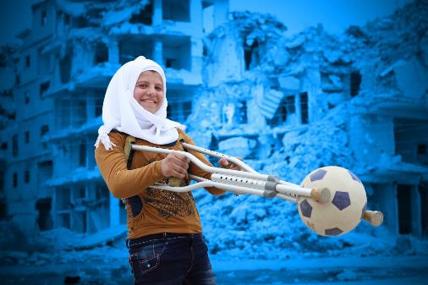
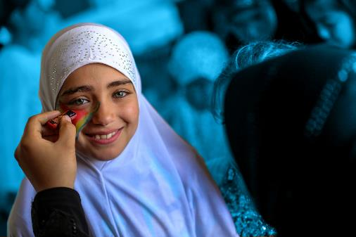
CLIMATE ACTION
Notes:
Introduce participants to the topic
Duration: 20 mins
Think, Pair, Share: How concerned are you about the climate crisis? How does it impact your life or your future? How knowledgeable are you on climate change and biodiversity loss or the actions the Irish government is taking on it? How vocal are you about it? Do you take any action on the climate or environment?
Activity: Walking debate “Given the critical nature of the climate crisis and the impact it has on children’s rights, should we lower the voting age to 16 to enable young people to participate in elections?”

Slide 2
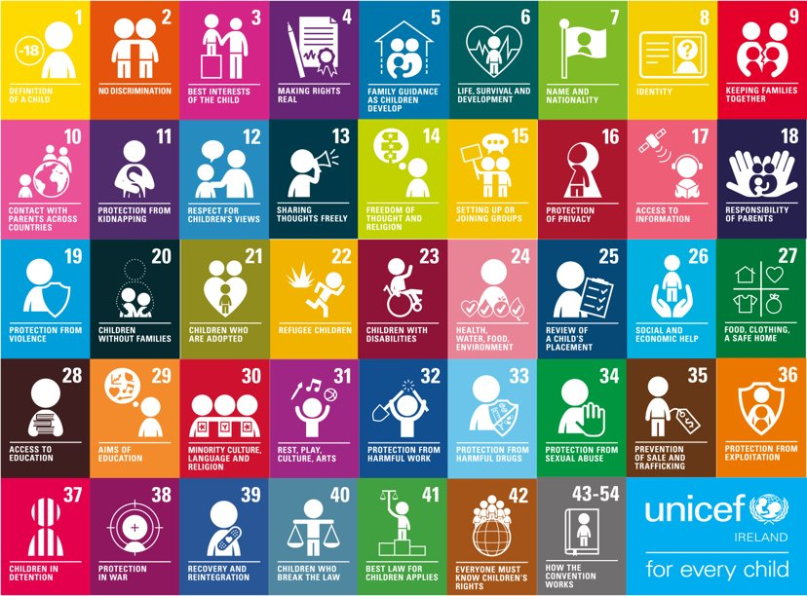
Notes:
The UNCRC is UNICEF’s mandate, there are 54 articles in total with 42 rights in total. Who here today has heard about Children’s Rights? Look at your posters to see your rights. Why do we single out child rights in a separate human rights Convention? Because… Children are more vulnerable than adults they start life as totally dependent beings. Children rely on adults to nurture and guide they need to grow towards independence. Children’s views are rarely heard and considered in the political process. Children cannot vote or take part in political processes. We all only get one childhood and that needs to be protected.
Activity: Walking debate “Given the critical nature of the climate crisis and the impact it has on children’s rights, should we lower the voting age to 16 to enable young people to participate in elections?”

Slide 3
What in life is important to me?
What do I want in my future?
What kind of world do I want?
Would most people in the world agree with this?
Would most people in the world agree with this?
Would most people in the world agree with this?
Can most people in the world have this?
Can most people in the world have this?
Can most people in the world have this?
What do I need to get this future/world for me ?
What can I give or do to get this future/world for others
Can the planet sustain this for all?
Notes:
Activity: Personal reflection Start the discussions on Climate Action with a reflection on needs and wants. Refer participants back to this throughout the discussions and activities.
Ask participants to divide an A4 sheet of paper into 12 boxes (3 columns and 4 rows)
In the first row answer the following questions: What in life is important to me? What do I want in my future? What kind of world do I want?
In the next row, answer the following questions: Would most people find those things important in life? Would most people want something similar in their future? Would most people want a similar world?
In the next row, answer the following questions: Can most people in the world have the things that are important to them in life? Can most people in the world have the kind of future they want? Can most people in the world have the kind of world they want?
In the next row, answer the following questions: What do I need to get this future/world for me? Do I and others have a right this kind of world? Can the planet sustain this for all?
Discussion: Ask participants to consider the difference between needs and wants. A need is an essential for most people to live, survive, develop and thrive and are usually protected as a right. Whereas wants are something people desire but are not necessary to survive and thrive. Should all people have their needs met before people’s wants are met? Discuss further this concept.

Slide 4
Notes:
VIDEO To kick things of let's take some inspiration from Jane Goodall - Play video to 5.12
The undeniable truth is that we continue to do great damage to the planet, and we haven’t learnt how to grow our economy without harming nature. In the past 50 years, truly a blink of an eye compared to the more than 2 million years of our species’ history, we have seen an exponential acceleration of the unsustainable and wasteful use of natural resources. If we continue to produce, consume and power our lives the way we do right now, forests, oceans and weather systems could be overwhelmed and irreversibly damaged. The only way to change this is for the world to work together on an agreed plan. “Do you believe the world has a plan?”

Slide 5
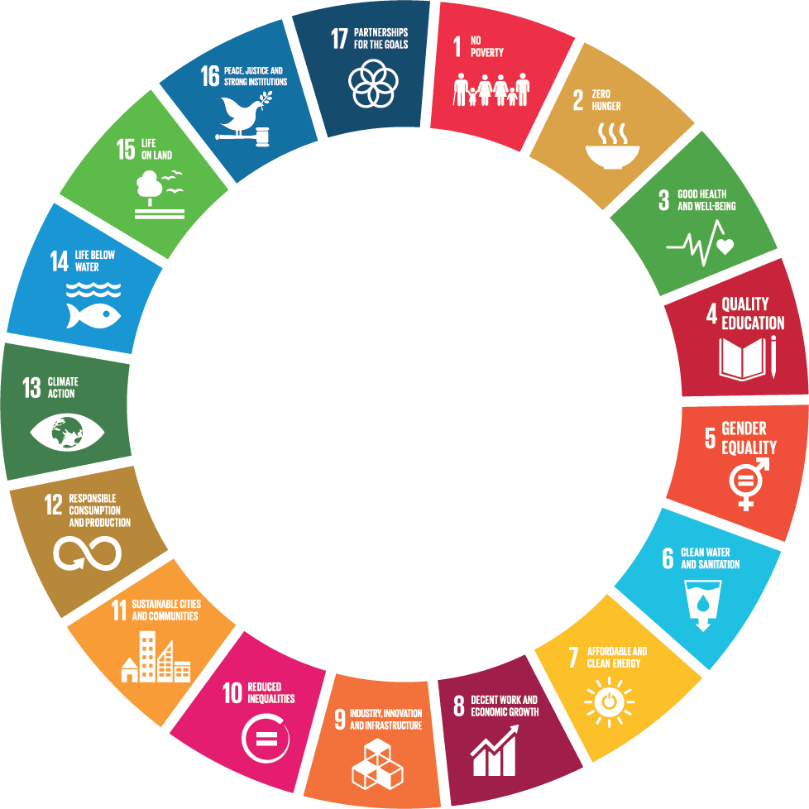
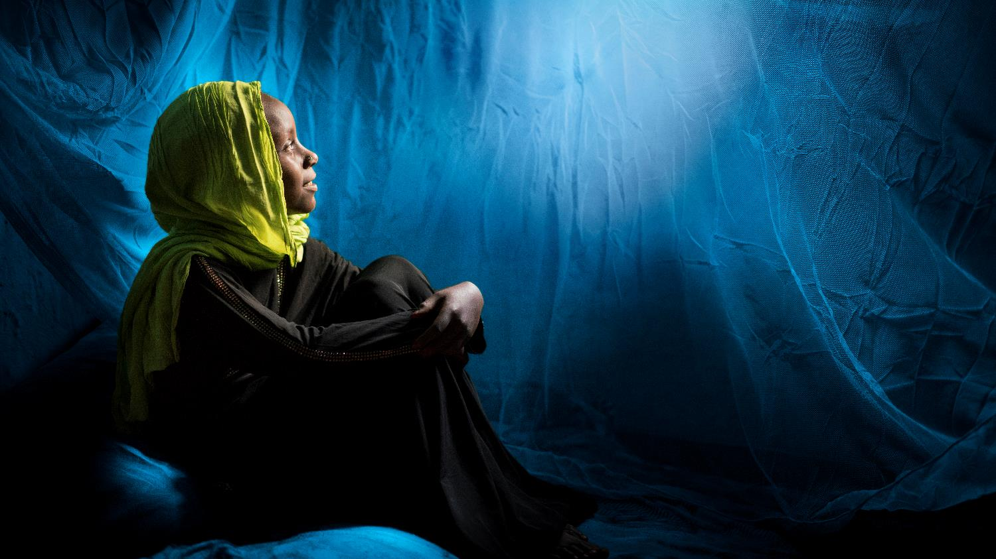
GLOBAL
GOALS
Notes:
The world does have a plan and it is called the Global Goals or the SDGs
This plan aims to make the world more sustainable, fairer and safer for every global citizen by 2030. to achieve this, 17 goals with 169 targets have been agreed and all countries are responsible to achieve them nationally and globally.
What is unique about this agreement is that it went through a long process of consultation with people from around the world representing many different groups including children and young people.
It is Universal so every nation, city, business, school, organisation, are challenged to achieve the goals.
The Goals are interconnected, we can’t achieve one without the other if there is poverty in the world you can’t end hunger. You can’t end hunger and poverty with out a healthy planet and without addressing the rapid rise of inequality.
What goals are mostly related to the issue we are discussing today? 7-12-13-14-15

Slide 6
Notes:
VIDEO Do people know what is happening, if yes skip this slide or would you like to see the easy to interpret slide on the build up of CO2 in our atmosphere?
Something to point out here, that we always need to keep in mind, is who has added most of those blocks to the atmosphere? America, but wealthy nations in general. We have all generated our wealth and luxury at the expense of others and putting the world in jeopardy. We have the heavier burden to drastically reduce emissions and to help others develop and adapt without causing the same problem we did.

Slide 7
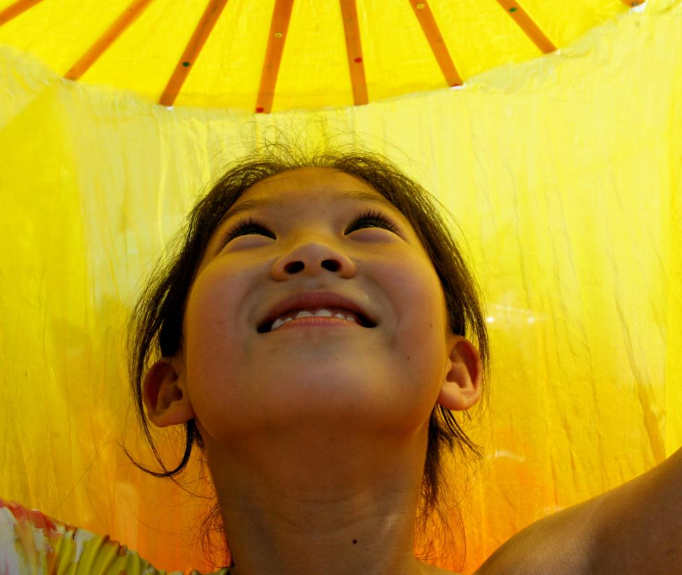
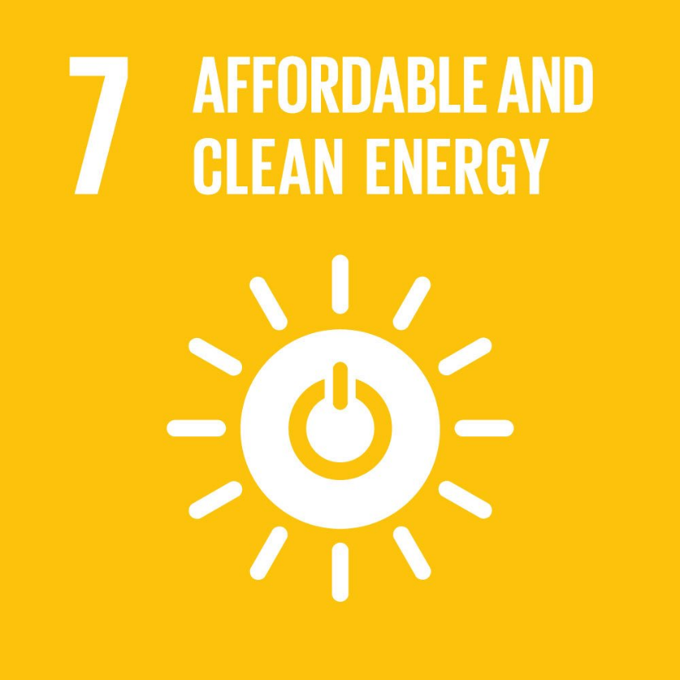
Notes:
Starting with clean and affordable energy, Goal 7
If we are to tackle greenhouse gas emissions it is clear this goal is going to need to be achieved globally.
We need to change the way we produce energy by investing in renewable sources of energy so that we can end our reliance on fossil fuels.
We also need think about how we consume energy and if can reduce that consumption.

Slide 8
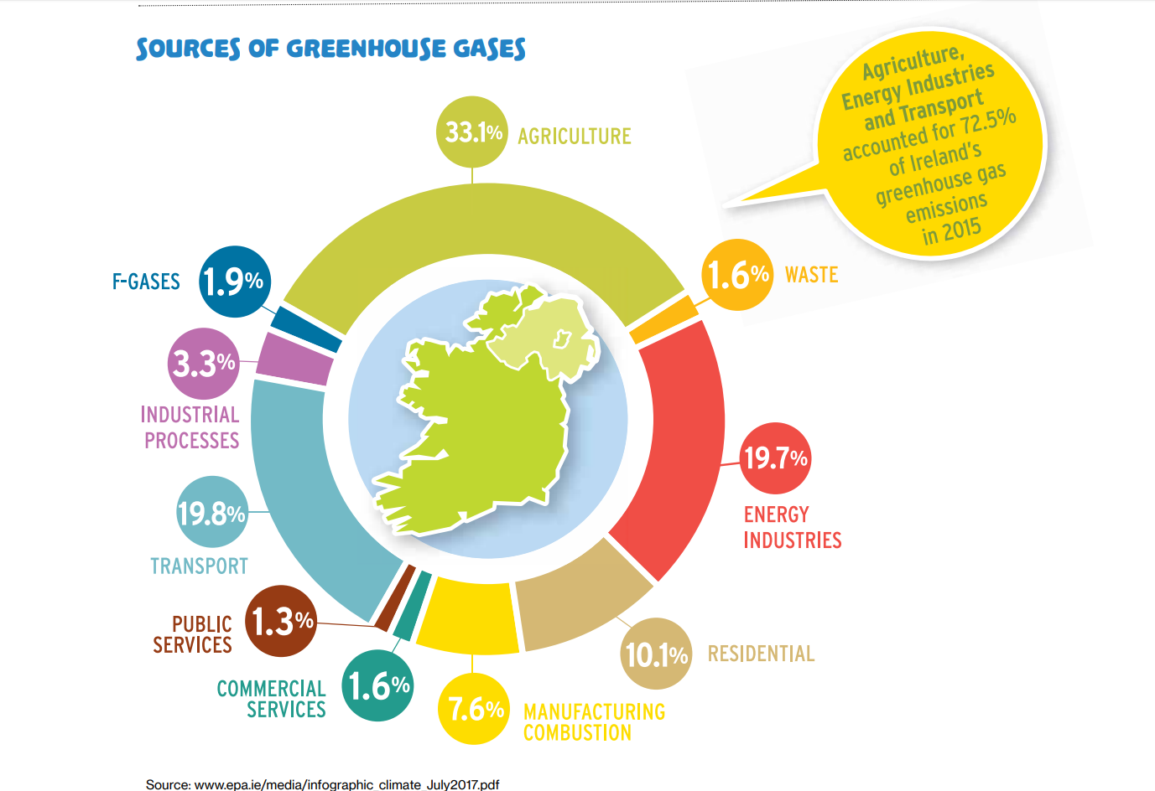
Notes:
In Ireland this posing a difficulty. We have a booming economy, poor public transport infrastructure, a rapidly expanding dairy sector and housing stock that largely is not energy-efficient This adds up to an Irish emissions problem.
Ireland agreed that it would reduce emissions in 2020 by 20% over 10 years. It failed by 4% and probably would have failed by even more had we not had the economic downturn.
Our new targets set for 2030 are to reduce by 40% over the next ten years our emissions, we are already in catch up
Our target will be to reduce greenhouse gas emissions by 80% to 95% by 2050. So in 30 years our gas emissions will be close to zero. How do we do this?

Slide 9
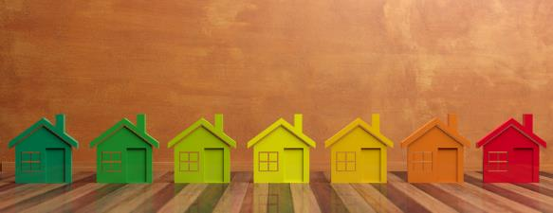
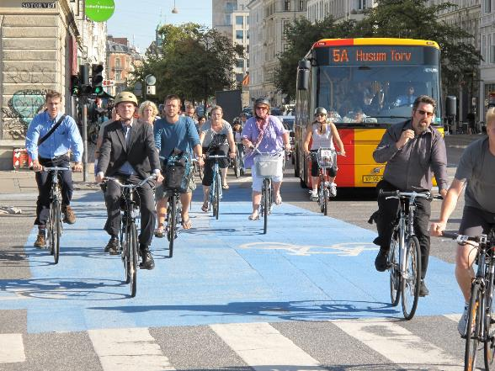
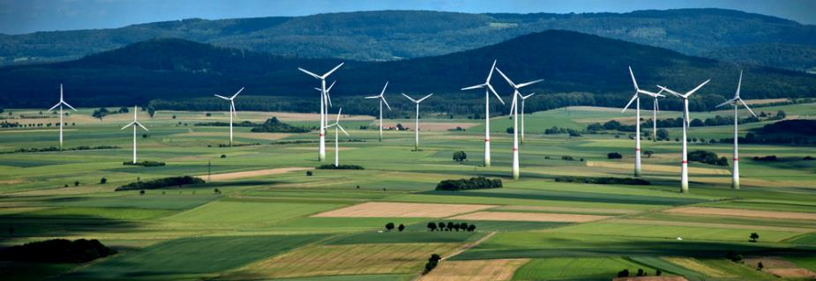
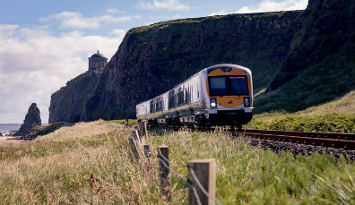
Notes:
We need to reduce our consumption and at the same time invest in alternatives.
SOLAR Today solar power is cheaper than coal at about 3 ¢ per kilowatt. For most of its history, solar power hasn't been seen as real competition by the fossil fuel industry. It was always too expensive to get a real foothold. But now prices for solar have fallen so far, it's become one of the cheapest kinds of energy on the market.
NUCLEAR Is on a cost par with solar, some would argue this is the best way to go and technology has made nuclear much safer than it was, and it takes up less ground space than solar and is easier to manage flow.
WIND Is a little pricier at 10¢ a kilowatt but it is something Ireland has in abundance. Wind generated 25% of all electricity in 2017, second only to natural gas. We have one of the highest wind power penetration in the world. Some are concerned however that birds are being killed by wind farms.
WAVE is another good source of power for Ireland, but the technology is still not good enough and costs about 50¢ a kilowatt
REDUCTION is something we could all contribute to by walking and cycling more and no doubt the government could do more to invest in public transport and ensure our buildings are energy efficient.

Slide 10
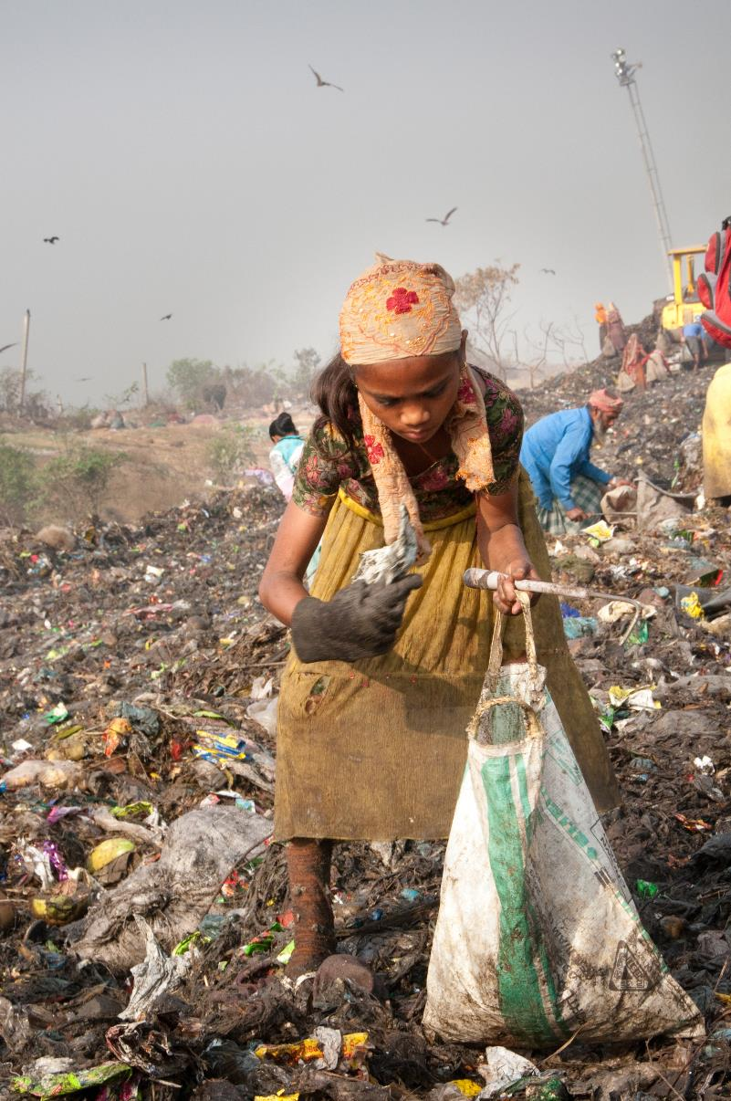
Notes:
Next is Goal 12 Responsible Consumption
We need to stop consuming at the rate we are consuming
We also need to think about the true cost of our consumption and whether it is sustainable for the planet
If you were to guess how much of the earth's resources are extracted to meet your needs each year what would you guess?
ANSWER 12 tons of resources were extracted per person.
There is a full Sustainable Living workshop on this goal on UNICEF website.

Slide 11
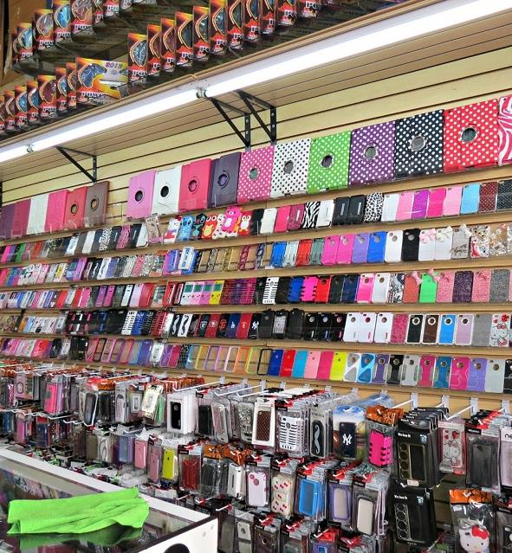
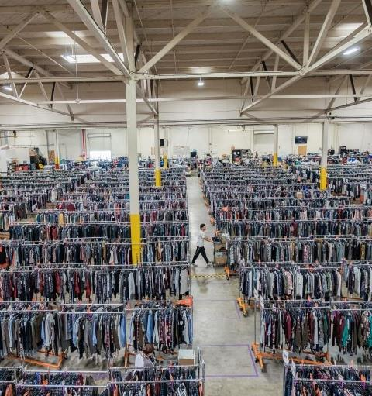
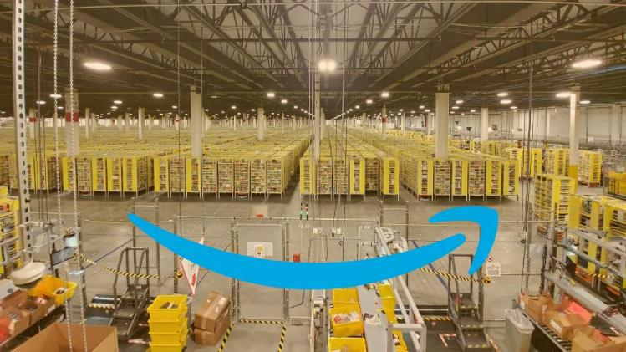
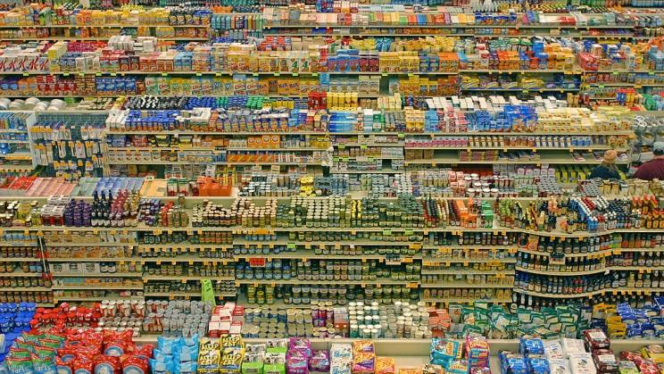
Notes:
150 billion garments per year are produced in the global fashion industry, which means about 20 items per person.
The UN Food and Agriculture Organisation (FAO) calculates that 1.3 billion tonnes of food is wasted each year, that is a third of all food produced. This is directly contributing to food shortages, water stress, unnecessary biodiversity loss, and increased greenhouse gas emissions. It’s also enough food to feed every undernourished person on the planet several times over.
In 2018, around 1.56 billion smartphones were sold worldwide.
Amazon Lists more than 3billon products
How do we manage this consumer culture and at what price to our planet?

Slide 12
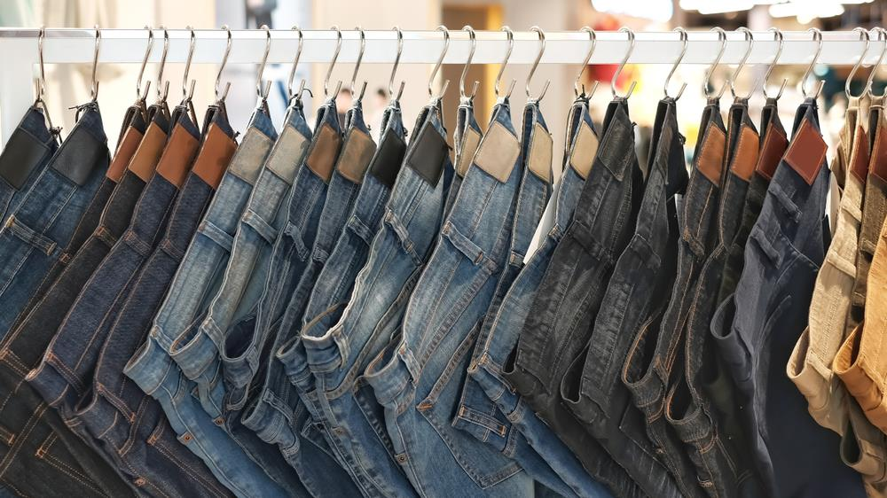
'true pricing'
Notes:
Price to our planet is key. We pay for those goods but to we pay the true cost?
What did you pay for your last pair of jeans?
Researchers from the Impact Institute have investigated a typical production chain for jeans: from cotton plantations and denim weaving mills in India to jeans factories in Bangladesh and transport to European markets. The Impact Institute calculated the 'true price gap': the difference between the purchase price that retailers pay and the actual total production costs, including environmental costs and the impact on (local) society. These costs, such as water pollution and water consumption, unauthorized (and therefore cheaper) labor (forced labor and child labor), are now not being paid.
If this were factored in researchers estimate you would be paying an extra €33.00 for your jeans. Would you buy as many pairs if that were the case, would retailers make the same profits if you were buying less or they had to take less profit so that you would buy more?
What if all products sold had the true price marked on the product?

Slide 13
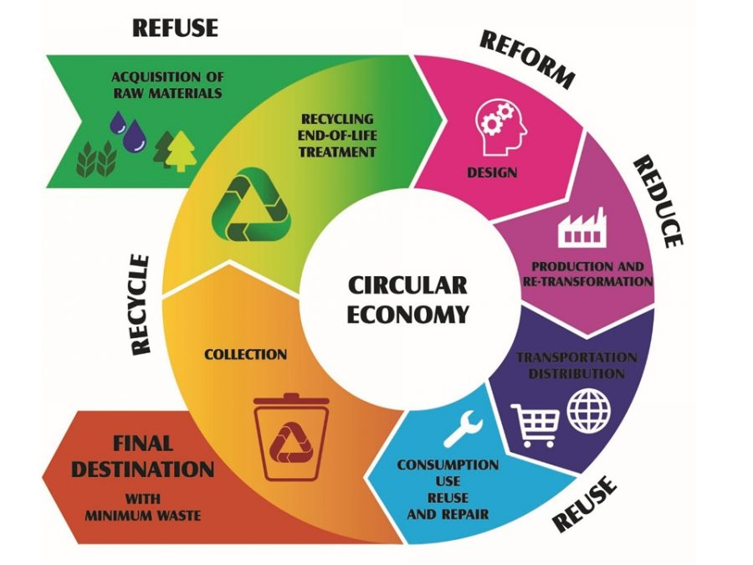
Notes:
One way toward responsible consumption is to create a circular economy, where we take material from the earth and design it uses as little raw material a possible, it is used over and over again and is repaired when broken or warn, we collect it and use as much of the product as we can to produce something else, only getting rid of a minimal amount each time.
Can anyone think of a product that can be used again and again and then recycled back to life again, without a huge cost to the environment

Slide 14
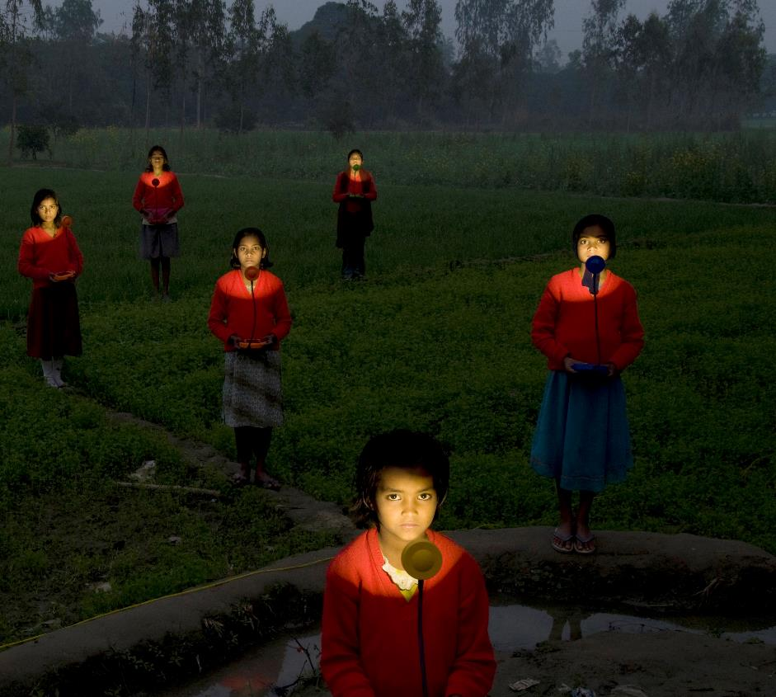
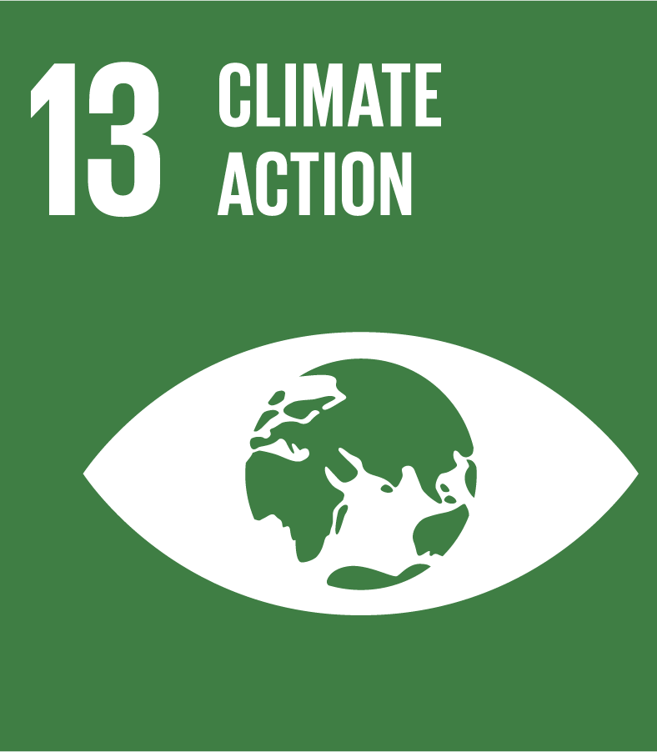
Notes:
Climate change is the defining issue of our time and the greatest challenge to sustainable development. Its compounding effects are speeding up its advance, leaving very little time to act if we want to prevent runaway climate change. You are the first generation to really be impacted by climate change and the last generation who can do something about it.
As greenhouse gas levels continue to climb, climate change is occurring much faster than anticipated, and its effects are evident worldwide.

Slide 15
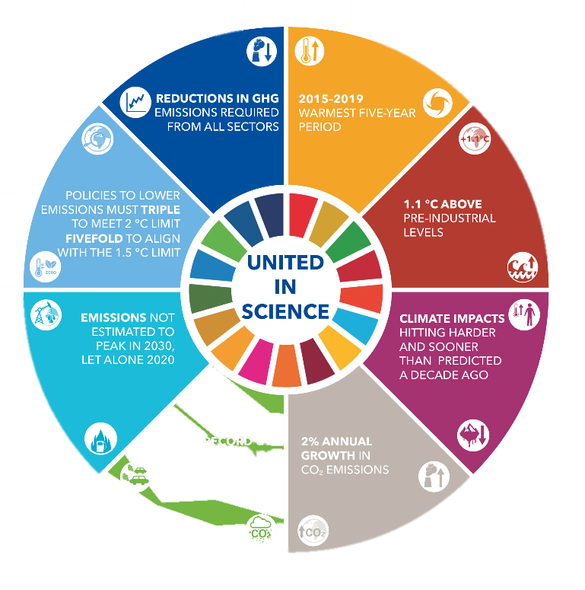
PROBLEM:
Notes:
This circle represents what is currently happening that is pushing us toward a tipping point. What is the tipping point? HANDOUT- The difference between 1.5 and 2
Greta talks about the science of climate crisis, understanding the basics is important.
2015 to 2019 have been the warmest years on record
We have reached 1.1 C above preindustrial levels; scientists believe 1.5 C is the tipping point at which we can never return
People are already dying, it is hitting harder and faster than predicted a decade ago
CO2 emissions continue to rise despite our pledge to reduce. It grows 2% annually.
There is a record 37 billion tonnes of co2 produced in 2018, do you know how much you personally added to that? We will find out in a minute
Emissions are not estimated to peak in 2030 let alone the promised peak this year.
Policies to lower emissions must triple to meet 2° and increase 5-fold for 1.5°

Slide 16
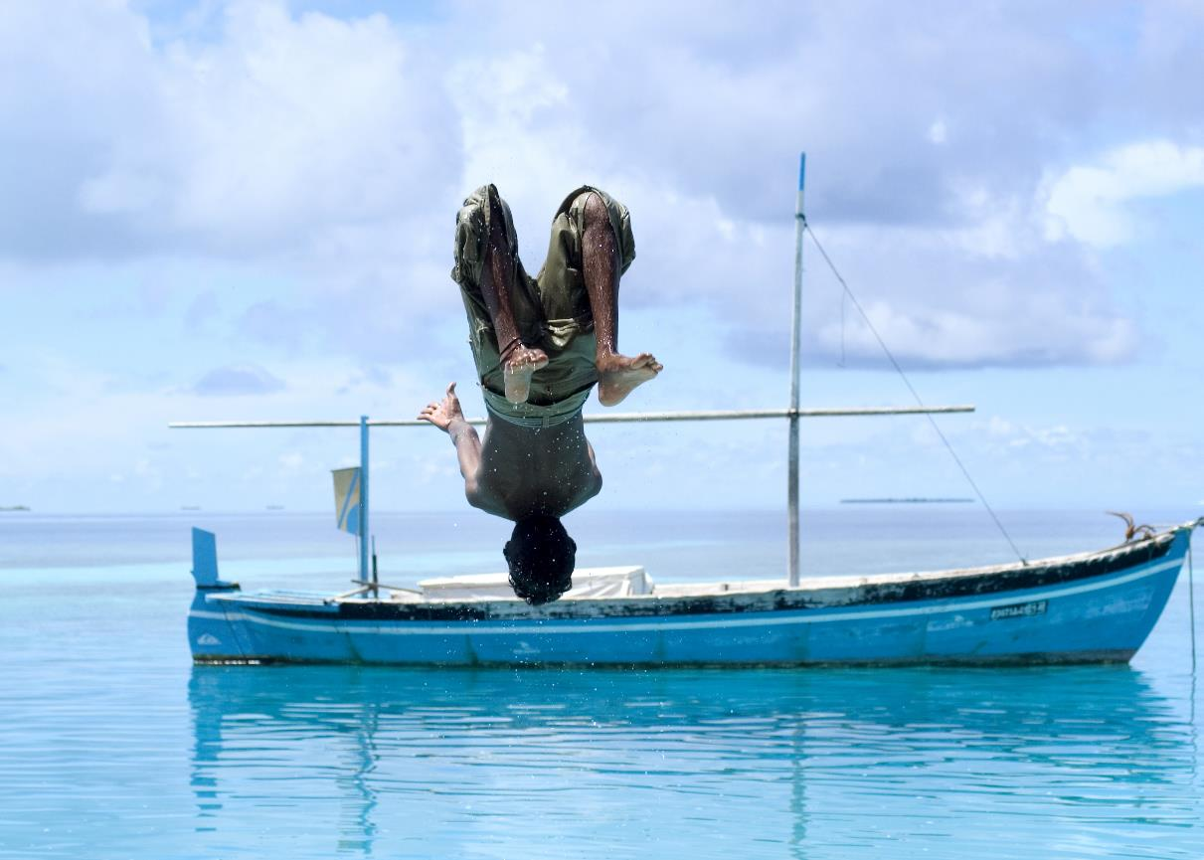
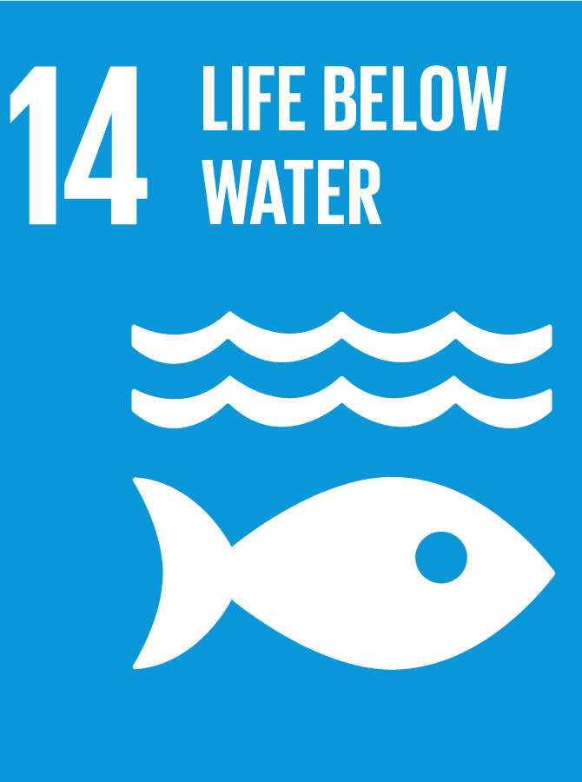
Notes:
Healthy oceans and seas are essential to our existence. They cover 70 percent of our planet and we rely on them for food, energy and water. The ocean puts food on the table for more than 2.5 billion people. The oceans regulate our weather and ultimately the climate. The ocean absorbs ¼ of our CO2 emissions. Unfortunately, our overproduction and consumption cycle is causing our oceans and seas to warm up, become polluted, overfished and acidified is. We are drastically altering life under the sea and putting the entire ecosystem under threat.

Slide 17
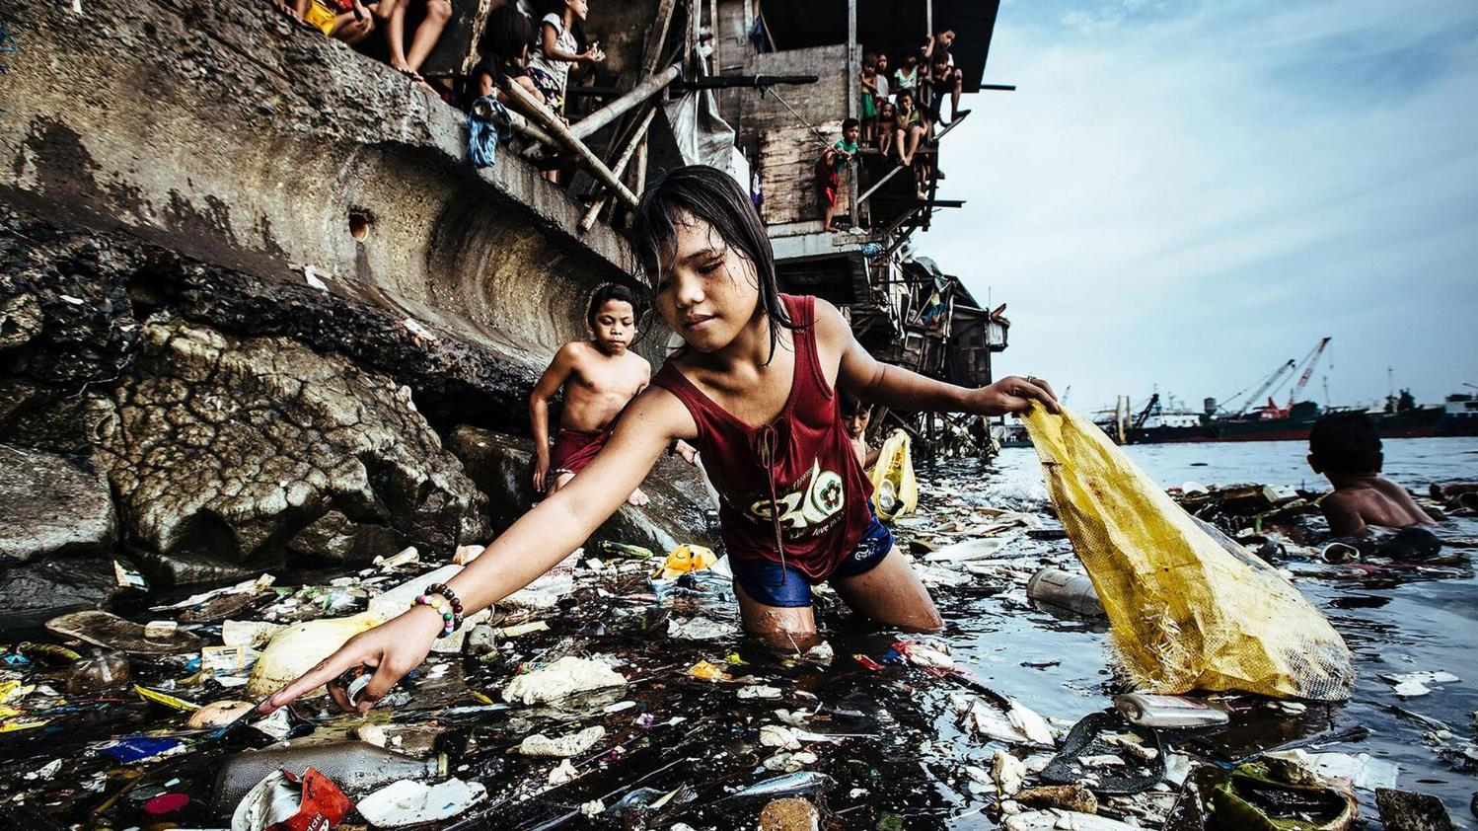
Notes:
One of the biggest problems is the pollution especially plastic pollution. Ten million tonnes of plastic are entering our oceans every year, and environmental experts believe that by 2050, plastic will actually outweigh fish in the sea. This isn’t just a problem for the marine life, it also poses a problem for humans because plastic is getting in to the food chain and we are also consuming it.
80% of the plastic pollution comes from land-based activities including barbecues, picnics and people flushing things down the toilet. Researchers have identified a “dirty dozen” list of items which get flushed down the loo. And three out of 10 Irish people are throwing these objects – which include cotton buds, baby wipes, tampons, cleansing pads, medicines, nappies and cigarette butts – into their toilets.
More than 90% of seabirds worldwide have plastic pieces in their stomachs.

Slide 18
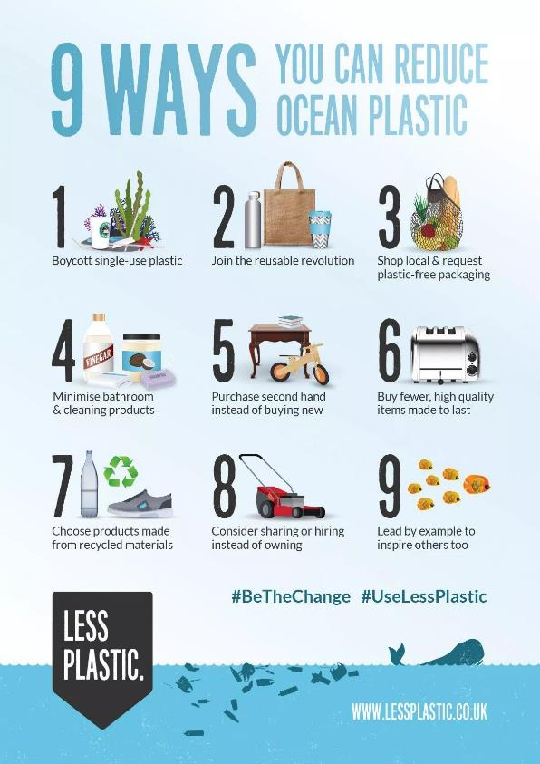
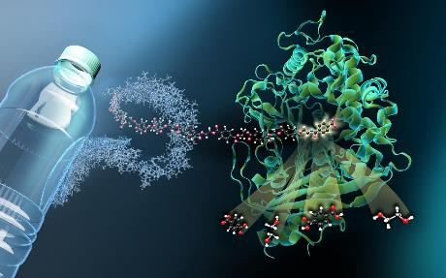
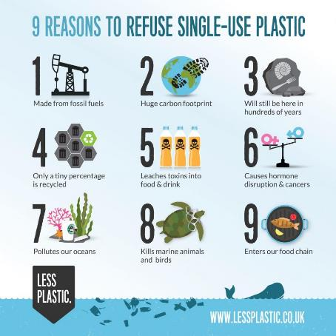
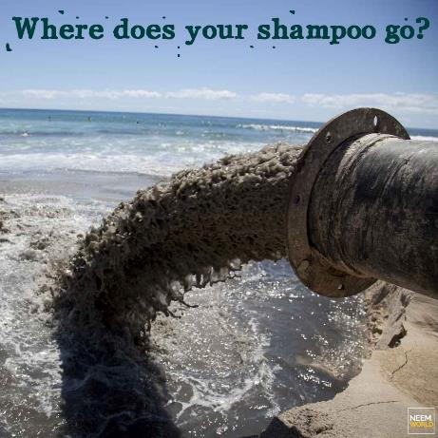
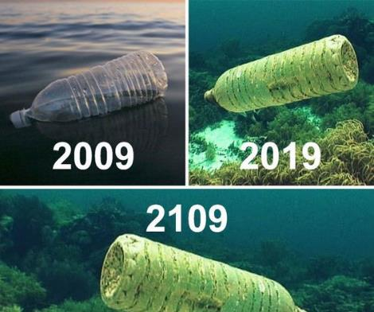
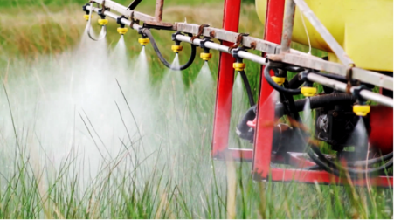
SOLUTIONS:
Notes:
Reduce - Think what you are putting down sinks, in toilets and bins. Cosmetics are a huge pollutant, do we need these chemicals in our water sources? Plastics take 100s to 1000s of years to biodegrade is it worth it for convenience. Buy glass or aluminium instead of plastic, it is fully recyclable.
Buy organic, pesticides to grow crops pollute our waterways. There has been new research carried out on plastic eating bacteria. This could offer us some hope.

Slide 19
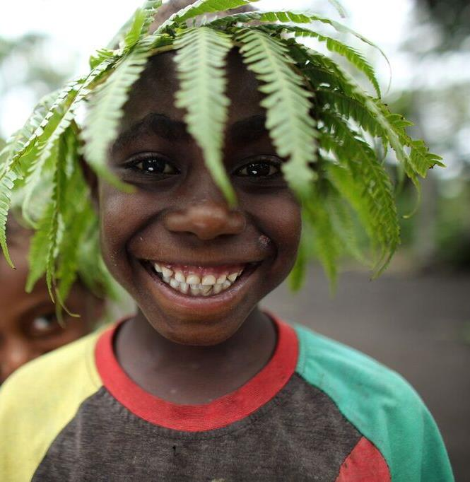
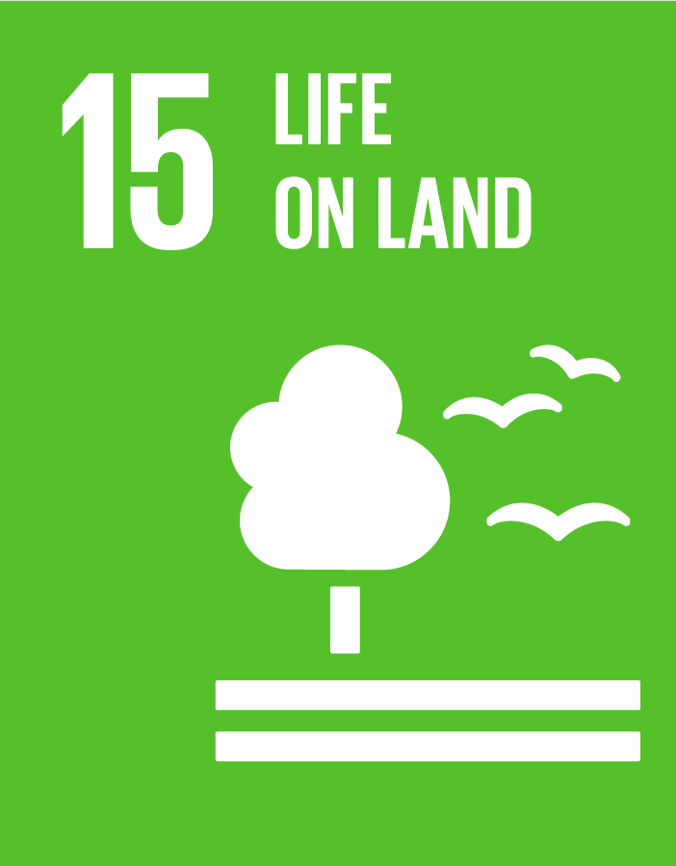
Notes:
A flourishing life on land is the foundation for our life on this planet. We are all part of the planet’s ecosystem and we have caused severe damage to it through deforestation, loss of natural habitats and land degradation. Promoting a sustainable use of our ecosystems and preserving biodiversity is not a cause. It is the key to our own survival. Sustainable Development Goal 15 aims to “protect, restore and promote sustainable use of terrestrial ecosystems, sustainably manage forests, combat desertification, and halt and reverse land degradation and halt biodiversity loss”.

Slide 20
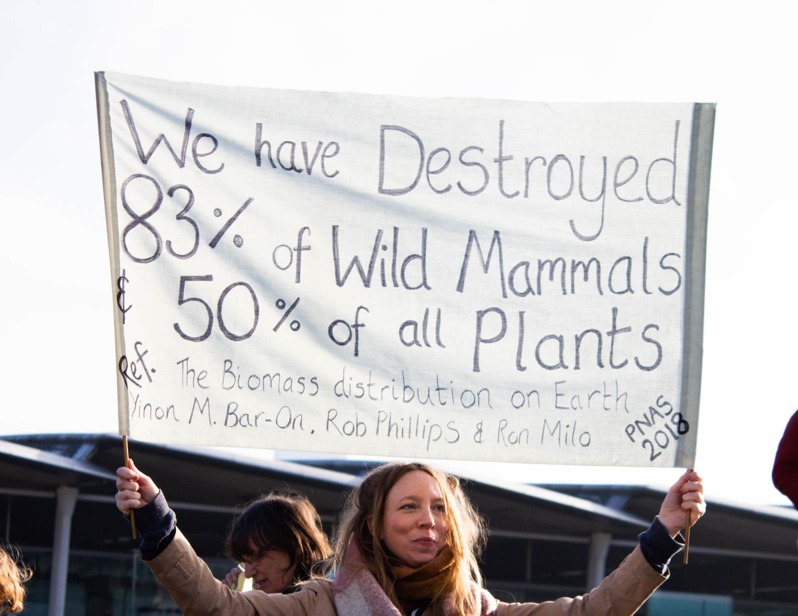
PROBLEM:
Notes:
THE EXTINCTION CRISIS Scientists say our planet is now in the midst of its sixth mass extinction of plants and animals, the worst spate of species die-offs since the loss of the dinosaurs 65 million years ago. Although extinction is a natural phenomenon, it occurs at a natural “background” rate of about one to five species per year. Scientists estimate we're now losing species at 1,000 to 10,000 times the background rate, with literally dozens going extinct every day. It could be a scary future indeed, with as many as 30 to 50 percent of all species possibly heading toward extinction by 2050.
Much of this is caused by the way we manage our land from deforestation, extraction practices and overproduction of land all contribute to loss of habitat and soil erosion.

Slide 21
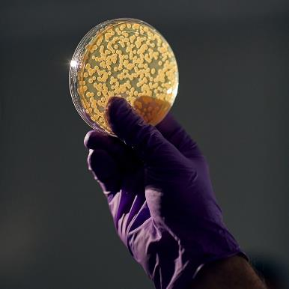
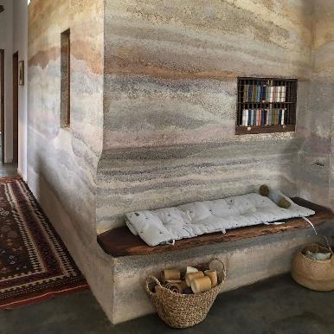
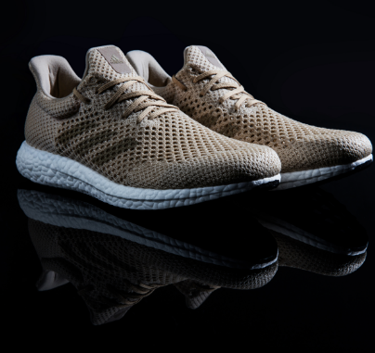
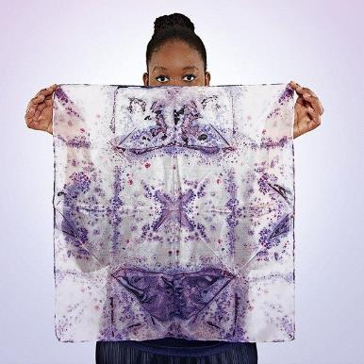
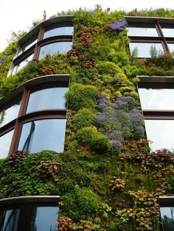
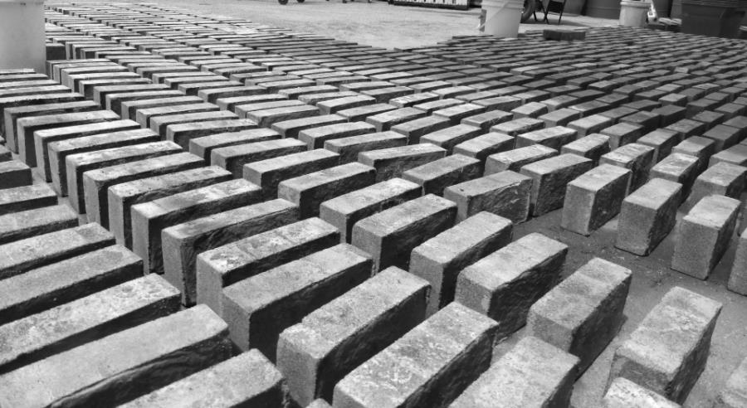
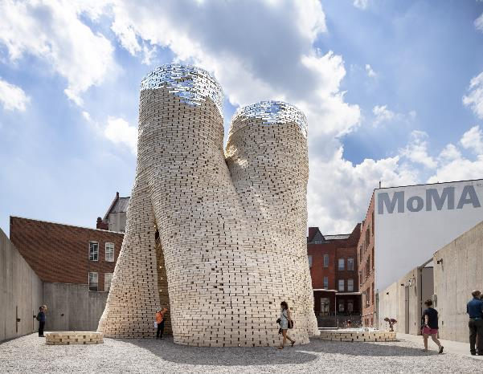
SOLUTION:
Notes:
There are some exciting possibilities and it starts with growing more and killing less. Biofabrication is being considered the next industrial revolution. It is viewed by some as a game changer. It uses bacteria, fungi and algae, all of which are plentiful and easy to grow to produce products from clothes to shoes to bricks and other such building products.
All of these pictures show you products that were grown in a matter of days or weeks from cells.
Mix hemp fibers with natural glue and some water and you get hemp concrete.
Mycelium” as “the vegetative part of a fungus mixed with waste and compressed for 10 minutes molds in to any shape to make all kinds of furniture or even bricks to build homes.
Bacteria put into a mold of sand and a solution of urea and calcium chloride produces these bricks in a matter of days, the bacteria will form a chain of chemical reactions that will cause it to solidify and bind the brick together. Its based on the way coral grows and is CO2 negative meaning it absorbs more Co2 then it emits
The material top right is made from bacteria but equally fungus and algae can be good to use. It takes a few days to make at home and can biodegrade outside within a week.
Other important things are simply to rewild our planet, allowing as much land as possible to turn back to nature.

Slide 22
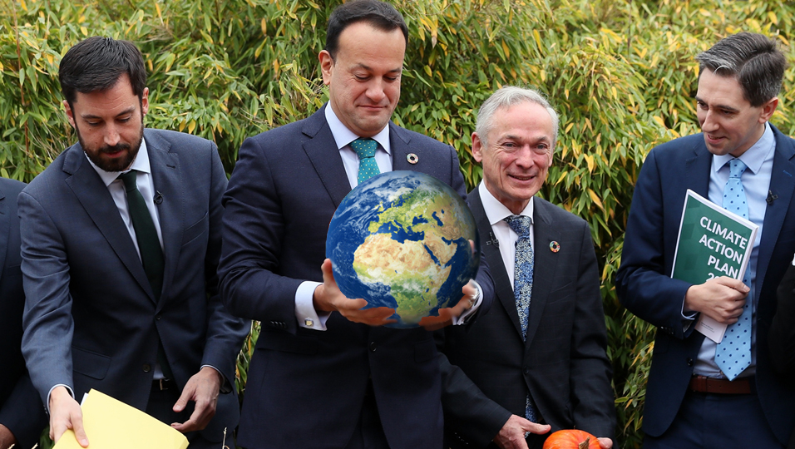
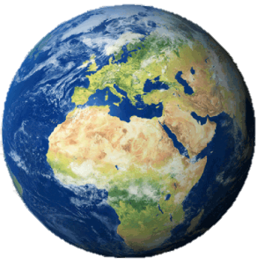
IRELAND’S RECORD:
Notes:
So how is Ireland doing when it comes to tackling these issues?
You will need: Sustainable Progress Index 2020 Report.
Group Work: The Global Goals are a framework for the world to take action on this crisis. These six goals are the most directly related to this topic and each has targets nations have agreed to meet by 2030. Determine based on a show of hands from participants, how well Ireland is doing in achieving each goal. Are we above target, on target or below target?
Divide participants into six groups, and assign each group a goal. Provide them with Social Justice Ireland’s recent report, The Sustainable Progress Index 2020. Ask participants to research and assess Ireland’s progress on their specific goal and determine Ireland’s grade A-F.
Extension: Ask participants to research possible solutions to achieving their assigned Goal and return to the group and present back their findings. Click on the goals above to link to Ted Talks that address each goal.
Well the Good news is that we know it is a problem and we have even declared a climate and biodiversity crisis, we were the second country in the world to do this.
We have agreed the Irish state will divest from the fossil fuel industry.
However, we get an F on our current progress to tackle the emergency because…
We get a D when it comes to our plan “The Climate Action Plan” that we have recently published to tackle the crisis, as it does not go far enough and that is, if we reach the very high targets we have set ourselves in the plan.

Slide 23
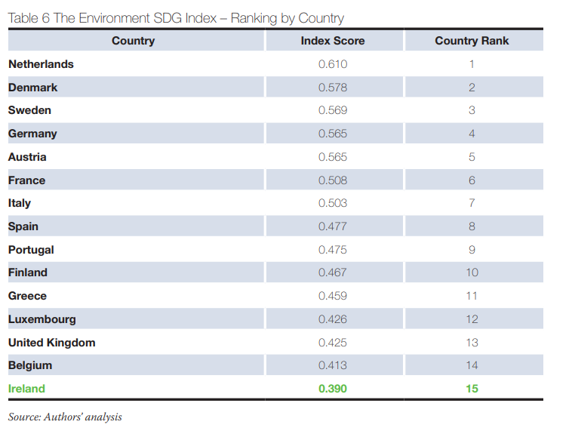

Slide 24
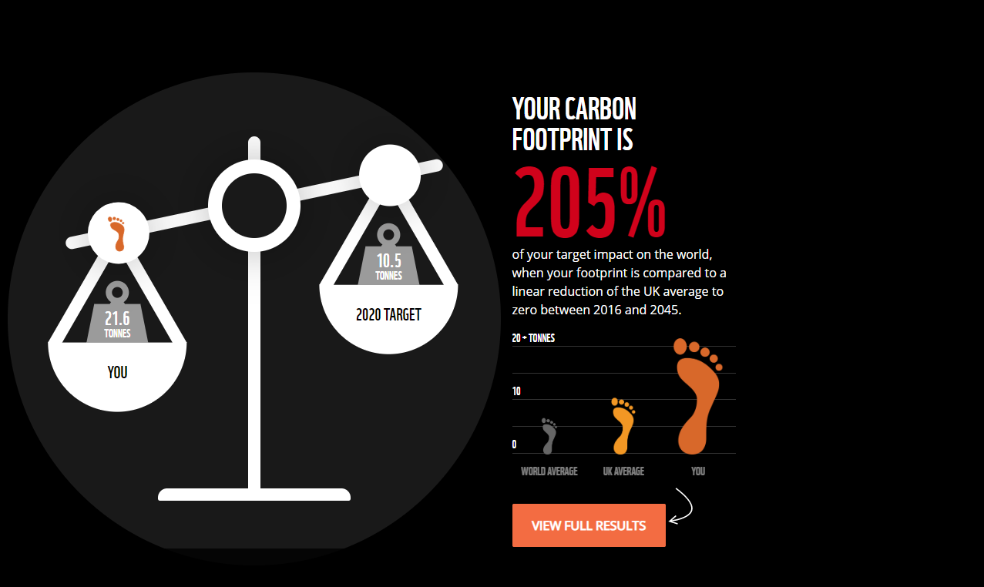
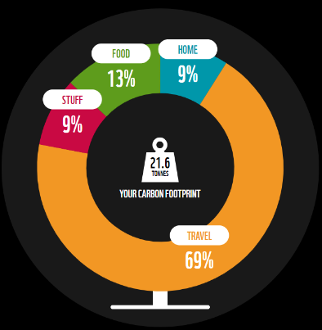
Notes:
So now to find out as individuals what we are contributing?
https://footprint.wwf.org.uk/#/
Activity 4 – Individual Action - Footprint Pledge
Duration: 40 mins
You will need: phones, pens and post-it notes
Activity: Have participants take this quiz from the World Wildlife Fund to find out their carbon footprint. It should take 10 minutes for them to complete.
Then ask each participant to reflect on the following questions:
How do you feel about your score?
Were you surprised?
What was your biggest footprint area? Food, Stuff, Home or Travel?
How much of your carbon footprint was a necessity and how much was a want?
What would you be willing to change?
Group Work: Ask the participants to divide into Food, Stuff, Home or Travel groups depending on their biggest footprint area. Give the groups 5 minutes to talk about what actions they could take to reduce their carbon footprint. Ask each group to feedback, then ask participants to write one action that they pledge to do.

Slide 25
Youth Voices on Climate
1992
2018
Notes:
Activity 5 – Political Action - Youth-led Movements
Duration: 40 mins
Discussion: It’s unfair to put the burden of climate change solely on individuals. Individual action is no doubt necessary if we are to reverse the climate crisis, but it is important to also think beyond voluntary behaviour change and think about collective political action. Systemic change needs a mass movement of people, holding to account the actions and policies of companies and governments. The special report — published by the United Nations’ Intergovernmental Panel on Climate Change — assessed what it will take to limit global temperature increase to no more than 2.7º F (1.5º C) above preindustrial levels, in accordance with the 2015 Paris Agreement.
Changing energy systems – identify 100% renewable energy solutions for the global energy system.
Changing food systems – making diet changes away from land-intensive animal products.
Changing infrastructure – making our urban areas green and energy-efficient.
Changing land usage – Plant new forests equal to the size of Canada 3.9 million square miles.
Changing transport systems – Switching from fossil fuels to electricity
For this kind of global systemic change to happen, people need to mobilise and put pressure on governments to invest and legislate for these changes and corporations to be held accountable for implementing and adhering to the changes. Ask participants to name people that are taking on this kind of political action on the climate crisis.
One of those people is undoubtedly Greta Thunberg, a 16-year-old climate activist. She has gained the attention of the world through her actions to address the climate crisis. She is not the first young person to lead a social movement, in fact, she was inspired by the #MarchForOurLives students from Marjory Stoneman Douglas High School and their actions on gun violence.
It is true to say that young people are often at the heart of social movements and have had an enormous impact in creating political change. Malala was another 16-year-old in 2013 that got the world’s attention.
In 1992, twenty-eight years ago, Severn Cullis-Suzuki attended the Rio Earth Summit, where, at the age of twelve, she delivered a powerful speech that garnered worldwide attention. Listen to her speech below and compare it to Greta’s speech in 2019.

Slide 26
2010 Arab Spring starting in Tunisa | 2011 #OccupyWallSteet Global Day of Rage and 7 months of protest
 |  | March for Our Lives 2018
2011
2013
2010
2011
2014
2016-2017
2018
2019
2019
2019
Notes:
Like this. These are all mass movements of people all led by “young people” powerful, knowledgeable and networked speaking out and creating change today.
Does anyone recognise these movements? Arab Spring, Occupy Wallstreet, Black Lives Matter, Bring back or Girls, Me Too, March for our lives, Pro Democracy marches in Hong Kong and of course Greta and Fridays for Future. Did you know by the way that Greta was inspired by the School walkouts carried out by March for our lives students.

Slide 27
TAKE ACTION
SHOW
ACT
TEACH
ASK
CREATE
Notes:
Deciding on the most effective action is always an important first step. Deciding to have the biggest impact on people or change is a good start in deciding what to do. In groups take the various actions and include your own if you want and place them in order of what you think could have the most impact in your school or community.

Slide 28
Kahoot

