Slide 1
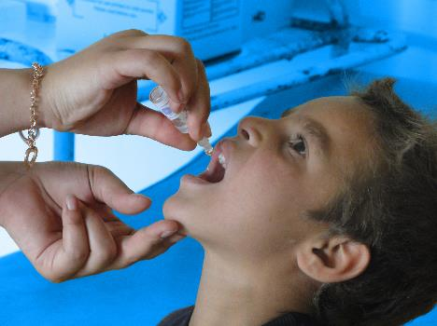
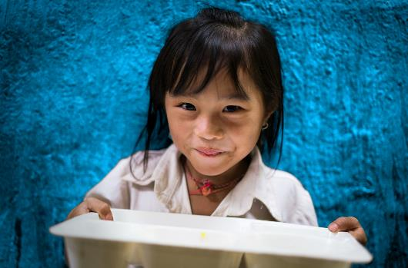
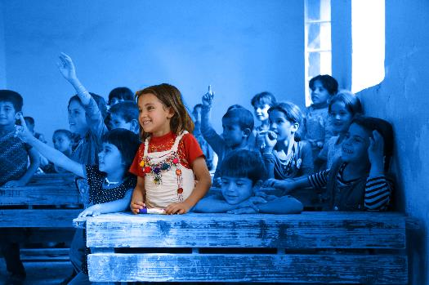
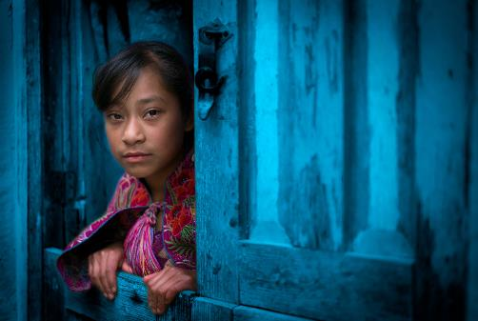
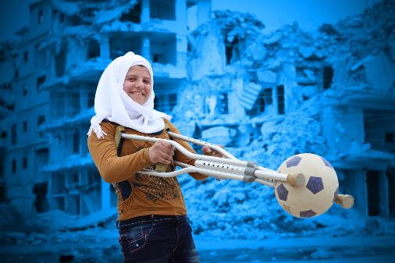
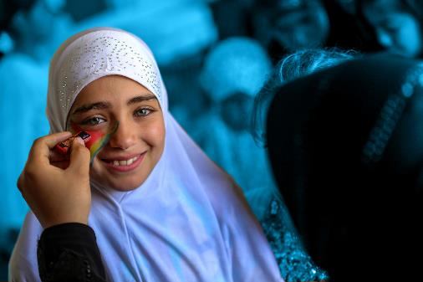
Digital Citizenship and Activism
Notes:
Delivering this Activity:
You will need:
The United Nations Convention on the Rights of the Child - a few double-sided printed copies
A projector, a screen and a reliable internet connection to show the presentation.
This presentation addresses children and young people’s use of the online world and explores digital citizenship and activism.
Online Rights
Online Influences
Digital Divides between Peers
Online Activism
*Please Note: UNICEF encourages peer-led learning. If you are a young person delivering this workshop to your peers, follow the steps below for a successful workshop!
Get support from a teacher or adult to run through the workshop with you first.
If it is a challenging issue, that might cause upset to people, only deliver it with the support of an adult in the room. And also give prior warning to the participants of topic you are covering as they may or may not wish to participate.
Make sure all the technical things (internet, computer connections, etc) are working before the workshop
Follow the notes and use them to talk through each of the slides and show the different videos. Most slides have notes with more info, but don’t worry if you don't share everything in the notes.
Always encourage discussion during the presentation – being sensitive to everyone’s personal experiences and perspectives.

Slide 2
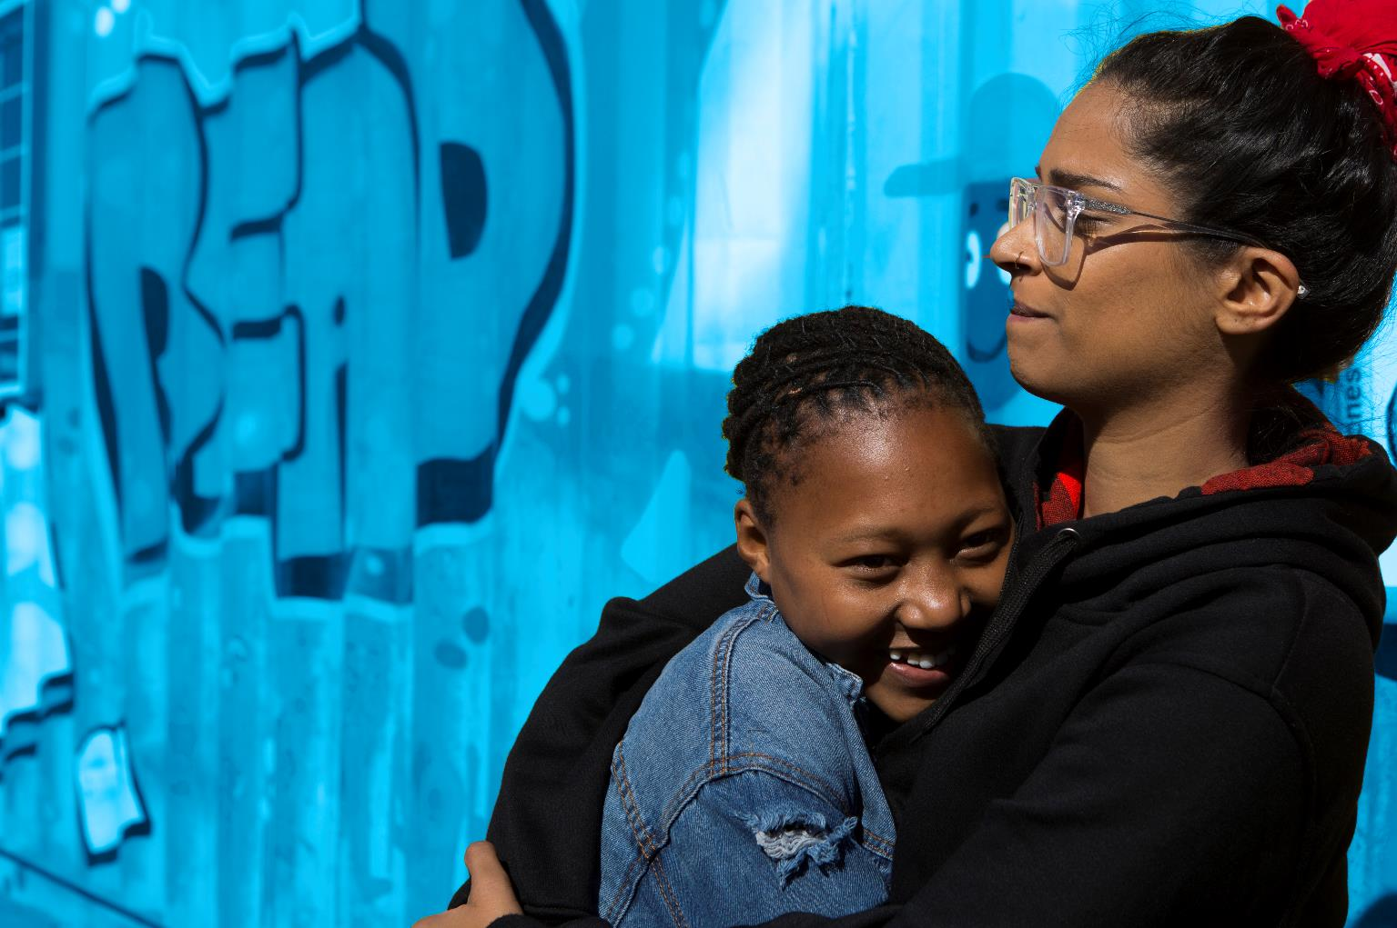

RESPECT
CONFIDENTIALITY
PRIVACY
INCLUSION
Notes:
Working Well Together
​
RESPECT- Listen when people are speaking, be non-judgmental and respect difference, and don't laugh, deride or make fun of others
CONFIDENTIALITY – Try to ensure that what is said in the room stays in the room
PRIVACY - Only share what we want to share with the group, though we ask for confidentiality, we cannot guarantee it.
INCLUSION – Include everyone, let’s all make sure everybody has an opportunity to contribute if they want to and no one is left out

Slide 3
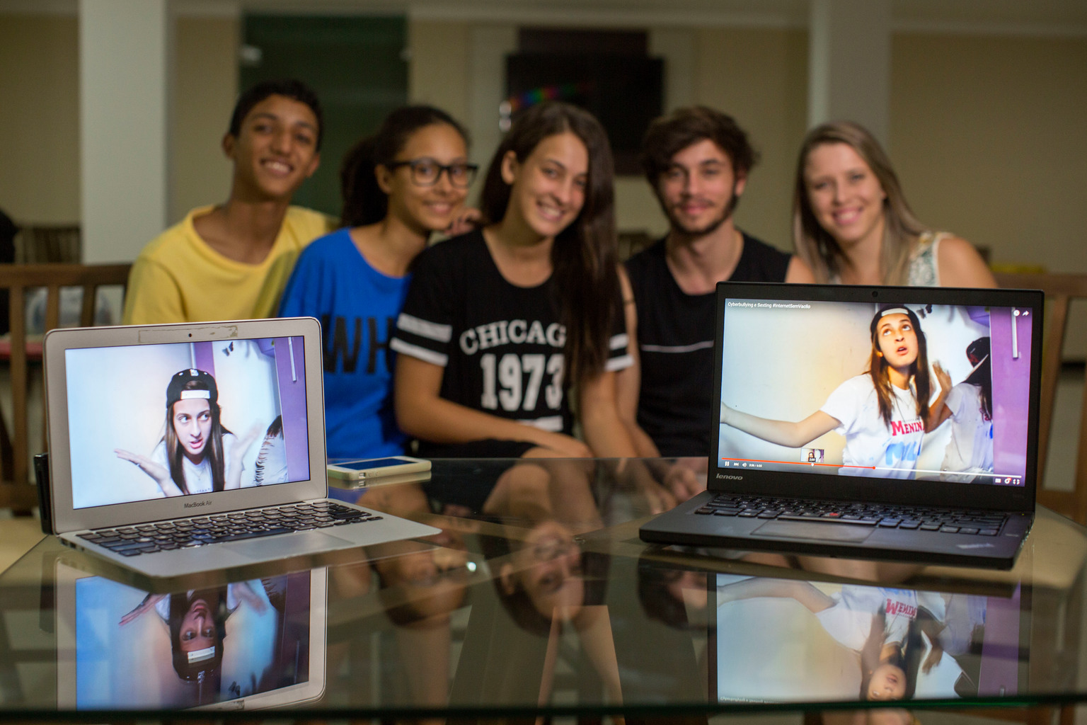
​1 IN 3 INTERNET USERS
IS UNDER THE AGE OF 18
​ARE YOUR RIGHTS PROTECTED ONLINE?
Notes:
1 in 3 internet users in under 18
Quickly brainstorm:
How does the internet benefit children and young people
How might the internet harm children and young people

Slide 4

​97% Students use the internet daily
​HOW ARE YOUR RIGHTS PROTECTED ONLINE?
Notes:
The rights of children online is a constant debate for adults and legislators.
Your right to participate vs your right to safety
Your right to information vs your right to privacy
Your right to association and assembly vs your right to protection from harm
Digital Age of consent who knows what age you have to be before you can sign up to social media or online service providers. It is a constant balancing act. Out of curiosity how many feel 16 is the right age, how many feel 13 is. Walking Debate
All children should be able to safely access ICTs and digital media, and be empowered to fully participate, express themselves, seek information and enjoy all the rights enshrined in the Convention on the Rights of the Child and its Optional Protocols without discrimination of any kind. States should address the risks posed by digital media and ICTs to the safety of children, including online harassment, sexual exploitation of children, access to violent and sexual content, grooming and self-generated sexual content, through holistic strategies that ensure the full enjoyment of their rights laid down under the Convention and its Optional Protocols.
States should thereby always ensure a balance promoting the opportunities provided by digital media and ICTs, and protecting children from harm.
In particular, States should:
(a) Develop and strengthen programmes aimed at preventing harm and tackling risks posed by digital media and ICTs, including by involving children, former victims, relevant NGOs and ICT and other relevant industries;
(b) Provide children with age-appropriate information regarding safety when using digital media and ICTs, so they can manage the risks and know where to go for help;
(c) Coordinate with the ICT industry so that it develops and puts in place adequate measures to protect children from violent and inappropriate material and other risks posed by digital media and ICTs to children;
(d) Further strengthen awareness-raising and education programmes for children on preventing and responding to risks when they use digital media and ICTs, with the involvement of children, including through the development of child-friendly information material;
(e) Provide adequate and continuous training for law enforcement personnel, members of the judiciary and professionals working with and for children with the aim to enhance their technical skills;
(f) Ensure accessible, safe, confidential, age-appropriate, child-friendly and effective reporting channels, such as child hotlines, for reporting violations of children’s rights in relation to digital media and ICTs; (g) Provide safe, child-friendly and confidential points of contact for children to report self-generated sexual content to a relevant authority;
(h) Provide fast and effective procedures for removal of prejudicial or harmful material involving children;
(i) Strengthen identification of victims as well as detection, investigation, prosecution and punishment of those responsible for any of the offences covered under the Convention and its Optional Protocols;
(j) Strengthen coordination between all actors and sectors in the protection system ensuring referral of cases and effective support to children victims; and
(k) Promote and facilitate international and regional coordination and collaboration to ensure effective enforcement of the applicable legal framework.

Slide 5
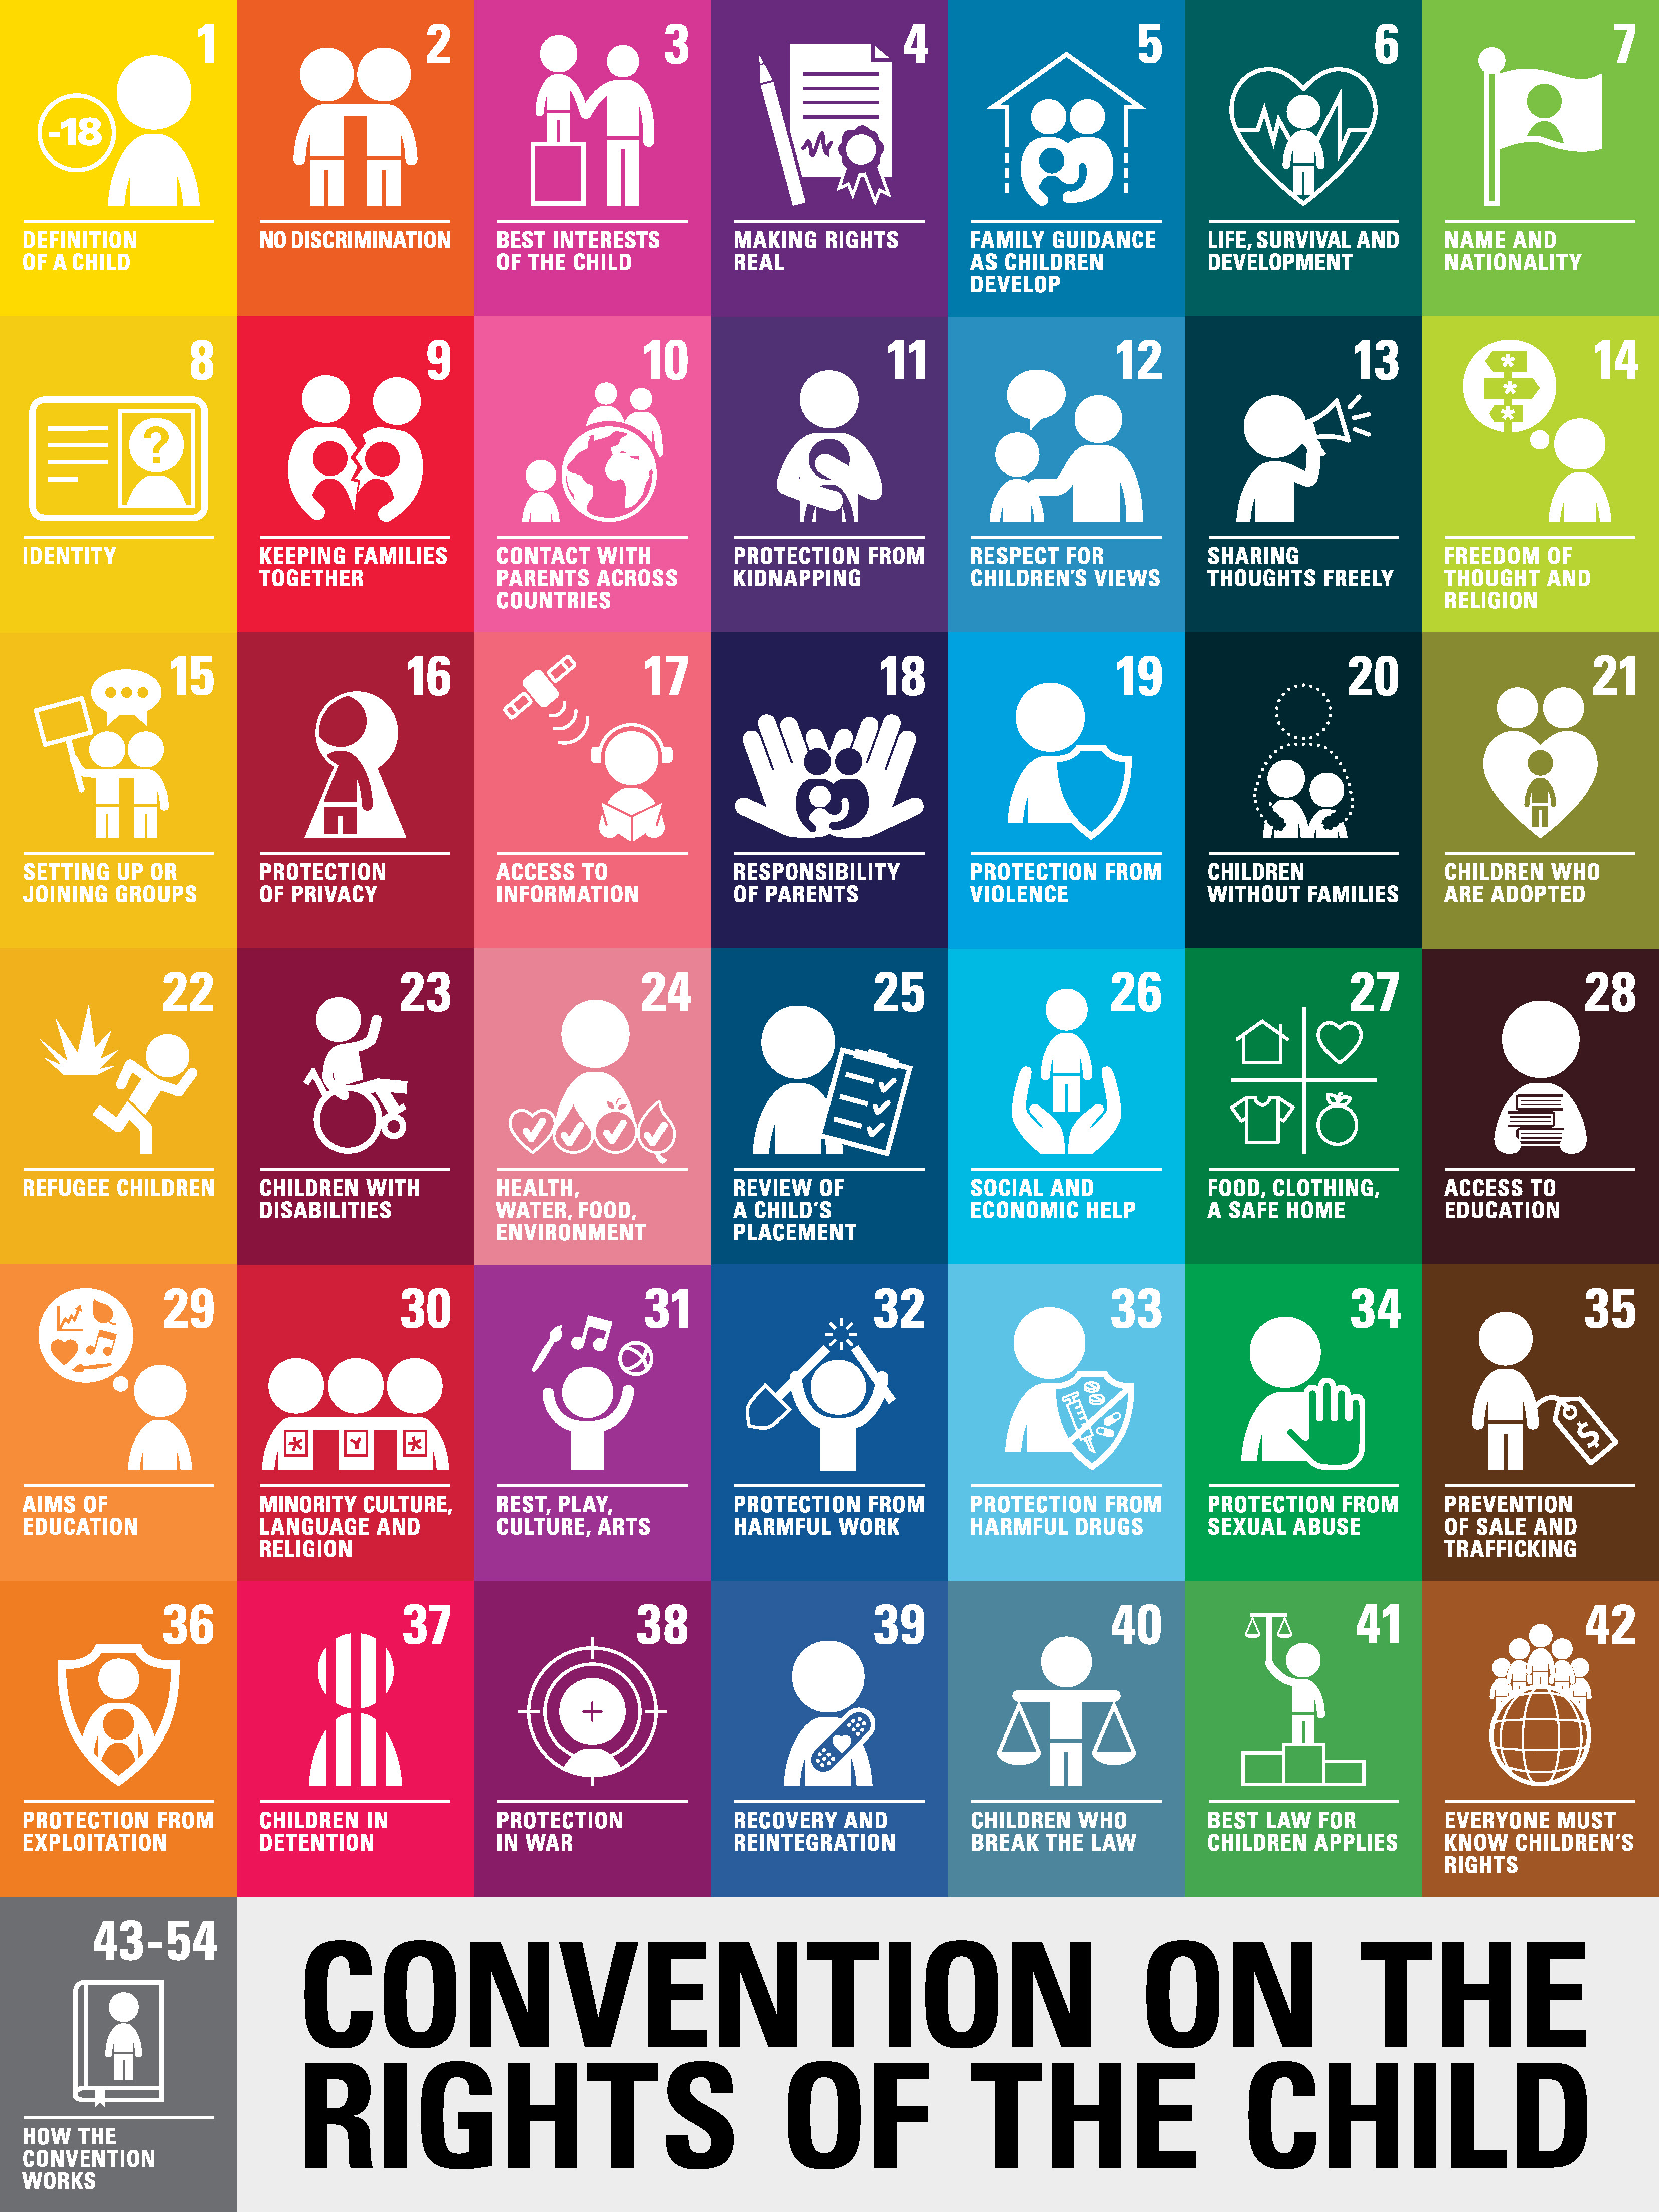
Online Rights & Online Safety
The Convention on the Rights of the Child was written before the online world existed.
How does the Convention provide for your, privacy, participation, and safety online?
Notes:
Even though the Convention on the Rights of the Child was written before children were online, it still provides you with rights that protect your safety, privacy and participation rights online. The Convention on the Rights of the Child, this was a document written in 1989, providing all people under the age of 18 with a specific set of rights. These rights apply in all situations including online and it is the duty of governments and adults to ensure your rights are upheld.
In regard to the rights online, there are several key rights: the right to access the information (Article 13 and 17), to participate (Article 12), join groups online (Article 15), the right to privacy (article 16) and the right to be protected from online violence or abuse (Article 19). It is the responsibility of governments, parents, schools and other institutions to protect your rights.
Activity: Create an imaginary line in the room. On that line place A4 sheets of paper with the following ages 10 –12 - 13 – 14- 15- 16 -17- 18. Ask participants to line up behind the age they feel is the right age for the following statements. Once they have made their decision ask them if they would like to change having reflected on new information.
Article 16 Privacy Rights: What age do your parents have a right to monitor your communications?
Ask participants to consider would they change their mind if they felt their child was being bullied online or was communicating with strangers?
Article 15 Joining Groups: What age should you be allowed to determine what groups you can join online?
Ask participants to consider would they change their mind if they were a member of the LGBTQ+ community and they needed support but could not get it from their parents?
Article 17 Safety: What age should caregivers be allowed to restrict access to certain sites?
Ask participants to consider would they change their mind if they felt their child was watching porn?
Article 12 Participation: What age should your caregivers be able to ban your access to online communications?
Ask participants to consider would they change their mind if they felt their child had bullied someone online?
Sometimes finding this balance can be challenging
Article 12 ensures that you have the right to involvement in decisions and actions that affect you and those views must be taken into account and given due weight in accordance with the age and maturity of the child. Governments and caregivers must balance decisions and make them based on ensuring Article 3 Your Best Interests are put first.
This is an ongoing debate across the world. The Irish government recently increased the digital age of consent to 16. The Committee on the Rights of the Child is currently producing a General Comment (this is a clarifying statement on how to interpret or implement certain rights within a human rights treaty) on Digital Rights. Ireland made this submission to it.
Rights related to this issue include:
Children’s right to be treated equally and fairly (Article 2),
Children’s right to have their ‘best interests’ taken into consideration (Article 3),
Children’s right to reach their full potential and to develop their talents and abilities, including through education (Articles 6, 28 and 29),
Children’s right to be involved in decisions that are made about them and to express themselves freely (Article 12),
Children’s right to share information and ideas unless it harms or offends other people (Article 13),
Children’s right to choose their own religion and beliefs, and to join or set up groups, as long as it isn’t harmful to others (Article 15),
Children’s right to privacy (Article 16),
Children’s right to get information that is important for their well-being, and to be protected from harmful information (Article 17),
Children’s right to feel safe and cared for, and to be protected from violence (Articles 19, 34 and 36)
Children’s right to access health services (Article 24), and
Children’s right to play and to take part in cultural life and the arts (Article 31).

Slide 6
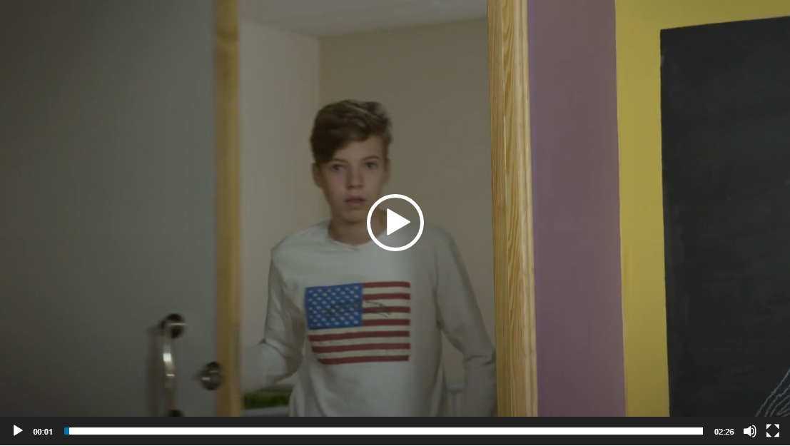
Notes:
Watch the following video and conclude the activity with any final thoughts.
Video: Growing Up Online 2:30

Slide 7
DIGITAL AGENCY
The autonomy you have over what you learn, spend time on and put online.
​Digital Footprint understanding what information you leave behind.
Online identity reflecting on how you present yourself online and taking steps to ‘curate’ it with care.
Digital Bubbles or Echo chambers The diversity of who you choose to follow and be influenced by.
Notes:
4 minutes
Digital agency is the autonomy you have over what you learn, spend time on and put online
Understanding our digital agency is key to unlocking the potential of our online world. To be influential in the issues you want to see change, you have to understand how you use the internet.
Digital Footprint - Understanding what information is left behind, knowing your online identity.
Online Identity - Social media gives us a chance to choose how we present ourselves to the world. We can snap and share a pic in the moment or carefully stage photos and select only the ones we think are best. When students reflect on these choices, they can better understand the self they are presenting and the self they aim to be.
Digital Bubbles - Who influences your thinking and is it broad or informative enough to understand an issue fully.

Slide 8
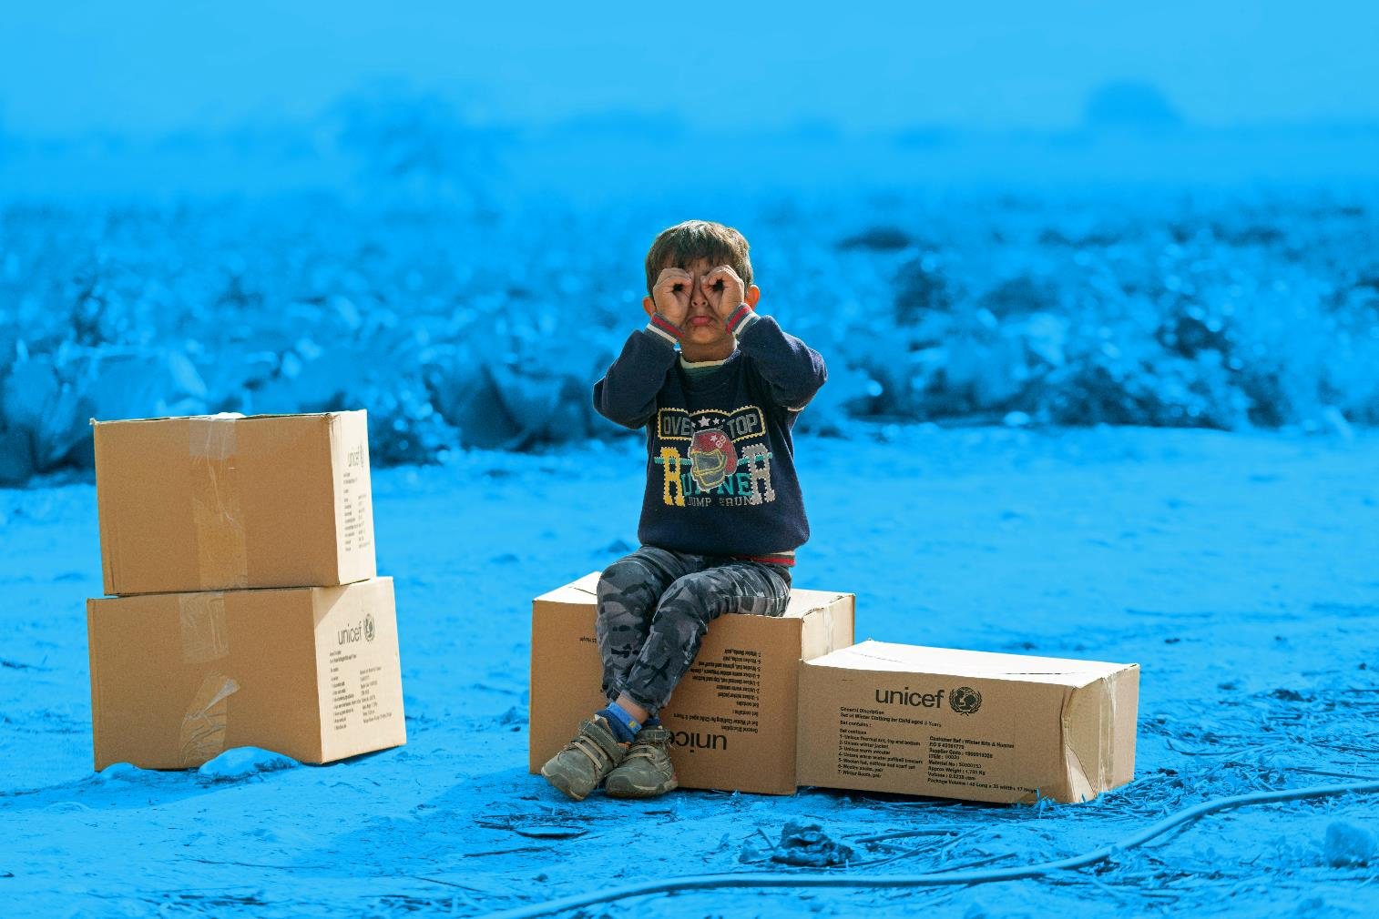

HEADS UP
GUESS WHO THE INFLUENCER
Notes:
The aim of this activity is to evaluate your online skills
Activity: Heads Up Download the following list of the top people on social media, Twitter, Instagram
Step 1: Download the worksheets for this activity. Print the names, number of followers and description of the most influential social media accounts (those with the most followers) on labels or write them Postits.
Step 2: Hand out a label to each participant, ask them to partner with someone and each person is to place a sticker on the other person's forehead. The aim is to then take turns guessing who you are.
Step 3: When the game is over, explain to participants that these are the most followed online accounts on social media. Ask the group to get out a sheet of paper and answer the following questions:
Where is your person from? Is this country particularly influential/dominant on the internet?
What is their field of work? Does this line of work give them authority or the right to be so influential online?
Who are their followers, who are they influencing/representing? In your mind describe the likely person who follows them and why?
Do they write their own tweets or do they hire someone to do it for them? Who then is doing the influencing and why?
Who do they not represent? Describe in your mind who does not follow them. Would they be decision-makers or powerful people in the world?
What is their purpose on twitter? What do they Tweet about
What do they stand for or represent? Do people pay attention to their opinions, does this give them power. Are their opinions well informed?
Do they talk about global issues? Are their opinions well informed? Are they experts in these issues?
Do they influence you?
Who else do you think is on the top list and do they follow any of them?
Feedback: Ask for and feedback or thoughts to be shared with the wider group.
Discussion: Most people in Ireland go online every day. It is an ordinary part of our everyday lives and yet the internet gives us all extraordinary powers to engage with the world. It allows us to connect, communicate, share and access information with millions of people all around the world, all within a matter of seconds. Understanding how we use that power is crucial to developing our digital skills. This starts with learning to apply life skills, like empathy, critical thinking, cooperation, curiosity to our online interactions. These skills can help you spot fake news, avoid trolls, act responsibly, manage your online persona and determine who or what influences you online and why. Ask the participants to rate and record their digital skills on a scale from 1-100?

Slide 9
DIGITAL SKILLS
Help you use the internet effectively and safely.
Digital Literacy
Knowing how to find and to evaluate credible information
Identifying and understanding “fake news”, clickbait, propaganda, bias and misleading stories
Digital Safety
Knowing how to ensure your privacy and safety online
Dealing with hate speech – racism, sexism, threatening, bullying.
Maintaining a healthy relationship with the online world and the physical world.
Notes:
As discussed under the UNCRC you provided with rights to enjoy and participate online and in the digital world. You also know that you have your own digital agency and can make choice about how you engage online.
Digital skills provide you with the tools to use the internet effectively and safely.

Slide 10
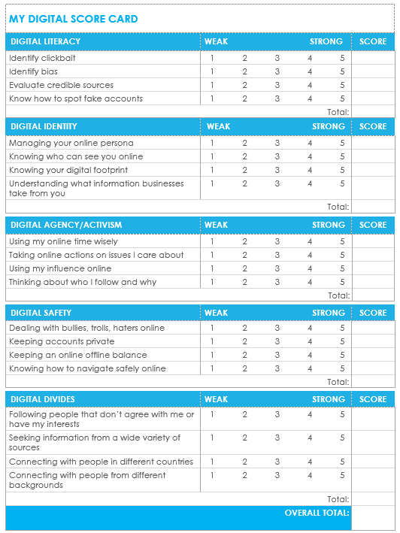
DIGITAL SCORECARD
Which sections did you score lowest on?
Why do you think that is?
What do you think are useful strategies to improve your score?
Notes:
Which sections did you score lowest on?
Why do you think that is?
What do you think are useful strategies to improve your score?
Helpful Tips:
Always look at multiple sources when reading news online.
Try to set a timer when browsing online to make sure that you spend time wisely.
Make sure you don't follow public personalities or celebrities who promote negative self-image, encourage violence, or engage in bullying.
If you want to engage in an issue on social media, use your voice in a way that is respectful and honest. Be open to hearing feedback, but no need to engage with people who are looking to fight.
It's okay to follow people who might not agree with you to learn their perspective and hear their viewpoint on issues. Remember to make up your own mind on important issues, though, based on facts and what matters most to you.
When connecting with people in other countries, be sure to keep safety at the front of your mind. Don't disclose personal information, contact information, or other information that could jeopardize your safety.

Slide 11
GLOBAL DIVIDES
​
Who do you follow and are influenced by? Are they like you? What is their profile background, interest, life experience?
What kind of information do you receive? Is it a different perspective? Do you follow news sites from other countries?
Who do you communicate with? Do you try and connect with others?
Who can’t reach you? Who do you not follow? And how might that affect your view of the world?
Who is seldom heard online? How does this effect on them?
How does poverty impact on the digital divide?
Does a digital divide exist in Ireland, if so, between which groups?
Notes:
15 minutes
How we spend our time online matters. It influences who we are and what we do.
Group discussion: Our digital bubbles (5-minutes)
Discuss and take notes for the following questions:
Who do you choose to follow and be influenced by ?
What kind of information do you receive?
Are you informed, inspired or distracted?
Who do you communicate with? Is it just friends or do you try and connect with others?
Who do you try to influence? Do you try and use your voice to make a change on issues that matter to you?
Digital Bubbles or Echo chambers ​
- Who do you choose to follow and be influenced by?
- What kind of information do you receive?
- Are you informed, inspired or distracted?
- Who do you communicate with?
- Who do you try to influence?
Digital Divides ​
Are we connected or divided by the internet?
- Understanding the divides you have from other voices in the world​
- What is the profile of those you follow? (background, interest, life experience)
- What voices or communities aren't able to reach you?
Digital divides:
Explain:
The internet was designed to connect people with one another and to provide opportunity to share ideas. Yet in reality what we call “digital divides” have created an online inequality between those with full access and those with partial or no access at all. If we are to create a more equal society we are going to need to understand how to redress these divides and ensure we are all fully connected.
Group discussion: Are we connected or divided by the internet? (5-minutes)
Understanding the divides you have from other voices in the world
What is the profile of those you follow? (background, interest, life experience)
What voices or communities aren't able to reach you? Who do you not follow? And how might that affect your view of the world and on issues that affect you?
Feedback to bigger group (5-minutes)
Give each group approximately 1-minute to feedback
IMAGE SOURCE: https://www.betterinternetforkids.eu/web/portal/practice/awareness/detail?articleId=3325256

Slide 12
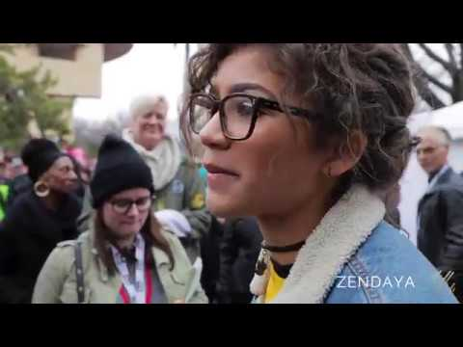
Notes:
5 minutes
1. Respectful and tolerant behaviour towards others
2. Online civic engagement (activism)
Digital Activism
Child and young people have a right to have their voices heard on issues that affect their lives.
Young people can use digital tools to:
Exercise their full rights in the digital world.
Advocate for their interests or those of their communities.
Watch video 4-minutes

Slide 13
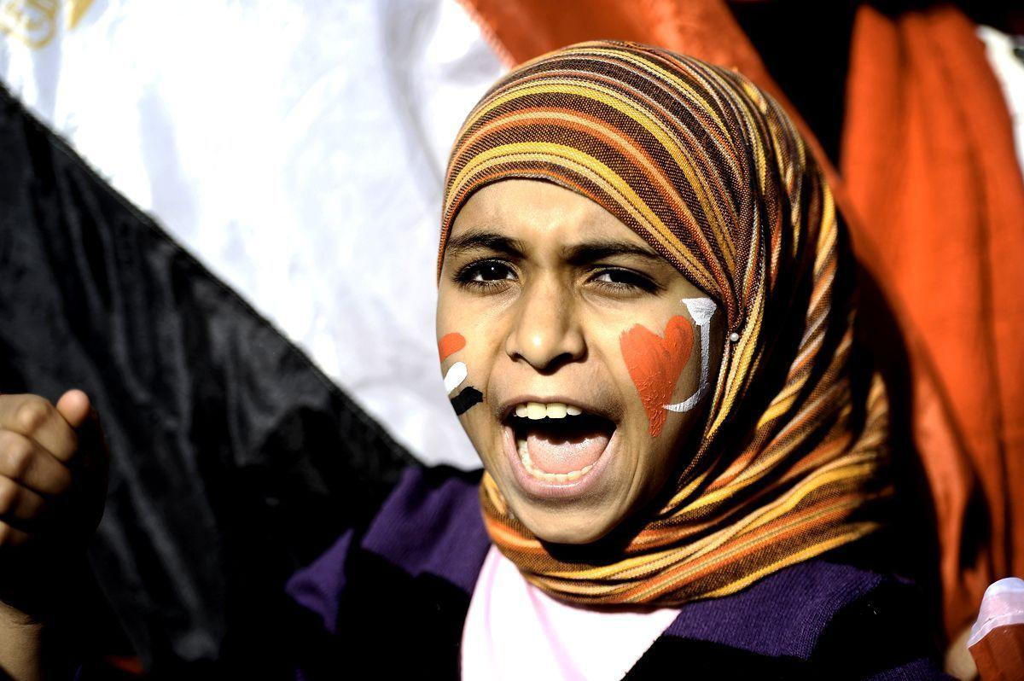
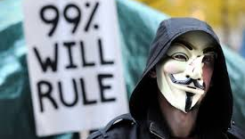
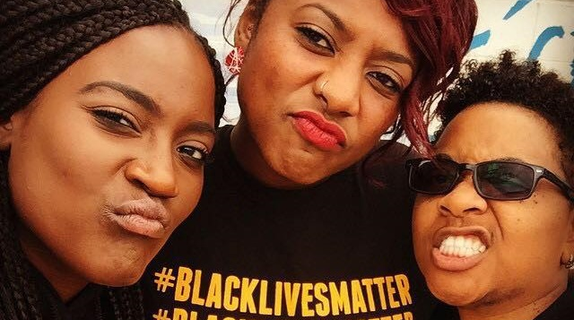
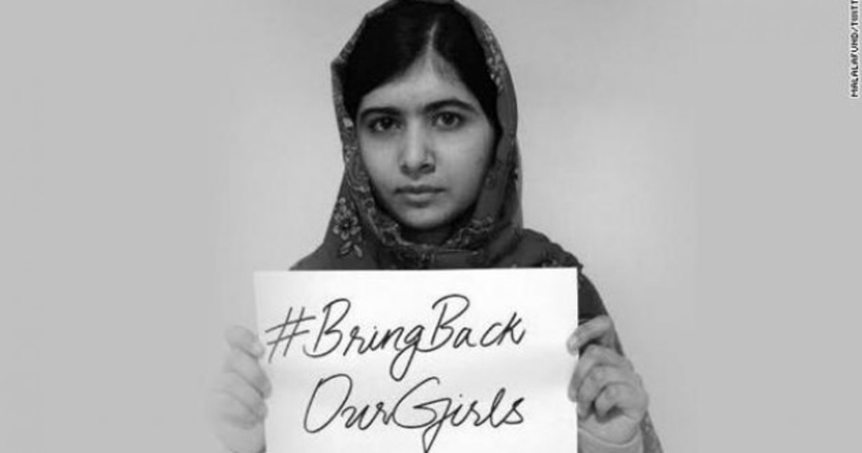
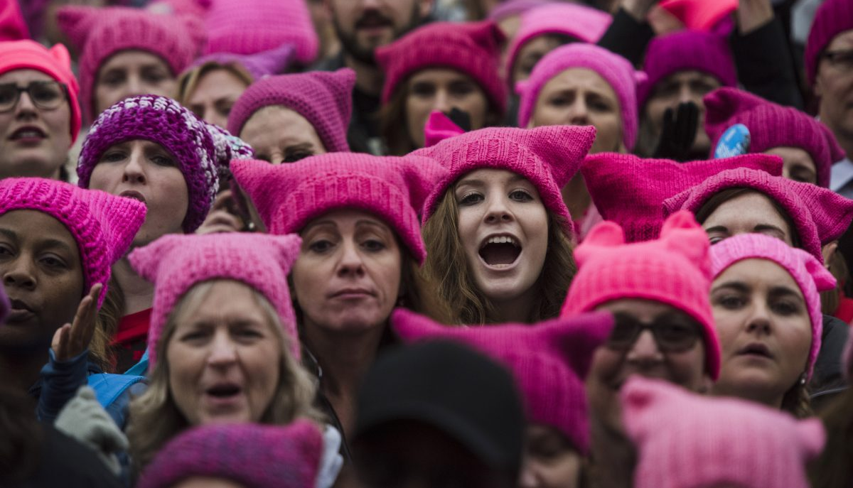

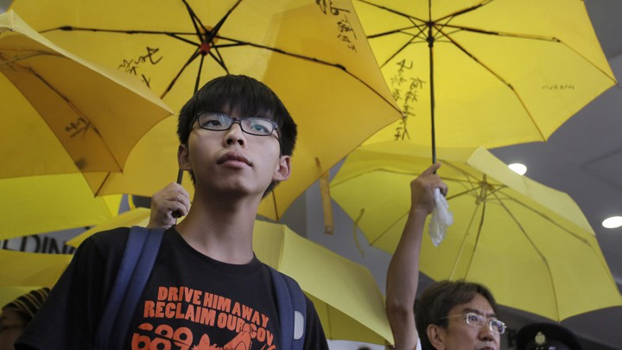
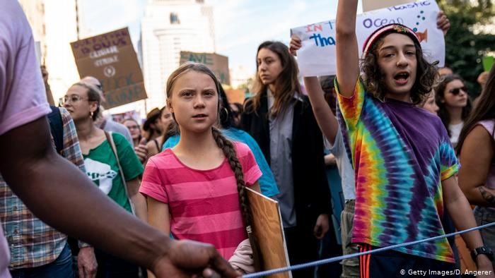
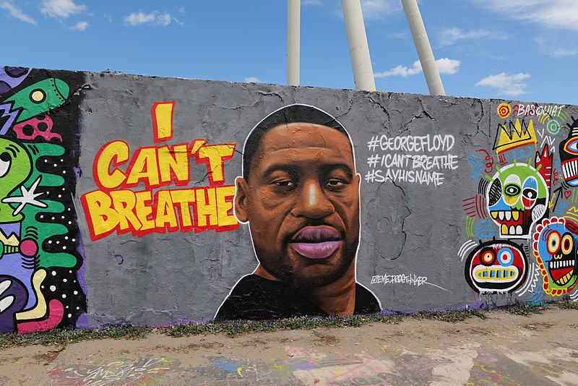
2010 Arab Spring starting in Tunisa | 2011 #OccupyWallSteet Global Day of Rage and 7 months of protest
 |  | March for Our Lives 2018
2011
2013
2010
2011
2014
2016-2017
2018
2019
2019
2020
Notes:
3 minutes
The last decade has been a combustible one.
Across the globe, millions of protesters have combined offline and online activism. These campaigns and protests have toppled despots and overthrown governments, transformed geopolitics, led to the death or transformation of old political parties, and the birth and ascendancy of new ones.
Worldwide, young people (in this case, those aged ten to 24) number almost 2 billion and make up about 25 percent of the population, the highest ratio ever recorded. A group that large carries a strong voice, one that can set significant social and political change into motion.
Discussion - ASK groups if they can identify the different protests (2-minutes)
NOTES
2010 Youth Unemployment The Arab Spring was characterized by the ability of social media to be used as a method for organization. Protesters were able to use the internet to coordinate gatherings and work against the government. This led to authoritarian leaders attempting to shut down internet access and suppress the protesters with force. In countries where the military assisted the protesters there was greater chance that the movement was successful. In countries like Saudi Arabia, the military worked to suppress the protesters and stopped the movement. gypt, Libya, Yemen, Syria, Bahrain, and other Middle Eastern countries. he event that sparked the Arab Spring. Rallies have marked the first anniversary of the event that triggered the Arab Spring uprisings. Young Tunisian Mohamed Bouazizi set himself on fire after he was banned from selling fruit to earn a living.Dec 17, 2011
2011 Global Inequality #OccupyWallstreet “Global Day of Rage” In September 2011, anti-corporate activists descended on a small park in lower Manhattan and Occupy Wall Street was born. More than six months of Occupy, a movement that spread from Zuccotti Park to over 100 cities around the world we are the 99% protesting inequality.
2013 Racism #BlackLivesMatter This movement and the new tools that we're using allows for new generations to get involved and see themselves as part of the change that's possible in our country. Garza: This moment has really been catalyzed by young people who stood up and decided that enough was enough in Ferguson, Missouri. And I think when we look around the country and we see what's happening, we see young people taking risks, being courageous, and inspiring us to do better and to do more. What that means is that we have hope not just for our future but also for our present.
2014, Terrorism #BringBackOurGirls Boko Haram terrorists kidnapped more than 300 girls from a school in northern Nigeria. Some 50 girls managed to escape but 276 remained captured prompting an international outcry that was largely funnelled into a social media campaign to lobby governments to intervene. The topic #BringBackOurGirls went viral within a week, with people like activist Malala Yousafzai and US First Lady, Michelle Obama, tweeting their support. The rapid fire rate that the hashtag #BringBack OurGirls shot across the internet helped galvanise public support for the families of the girls while the case drew attention from the international media and heads of state offered to help Nigeria find and bring back the missing girls.
2016 Sexual Assault The project instigated a social justice craftivist movement by organising women all around the world to knit and wear the now iconic pink pussyhat for the Women's March on January 21, 2016From the outrage that followed President Donald Trump’s toxic and aggressively sexist admission of ‘grabbing ’em by the pussy’ came the most visually effective and internationally recognised symbol of protest this century – the pink pussyhat. 2017 #metoo movement Sexual Assault and Harassment "#MeToo Survivors March" The #MeToo march was inspired by a social media campaign where victims of sexual assault and harassment came forward with their stories in solidarity following the series of allegations against powerful men in Hollywood, politics and beyond.
2018 Gun Violence gun-violence activism by teenagers at Marjory Stoneman Douglas High School started school walkouts. Which later inspired Greta’s School strike.
2019 Pro Democracy Protest Hong Kong
2019 Climate Protests
2020 Black Lives Matter – protests to tackle racism across the world following the murder of George Lloyd.

Slide 14
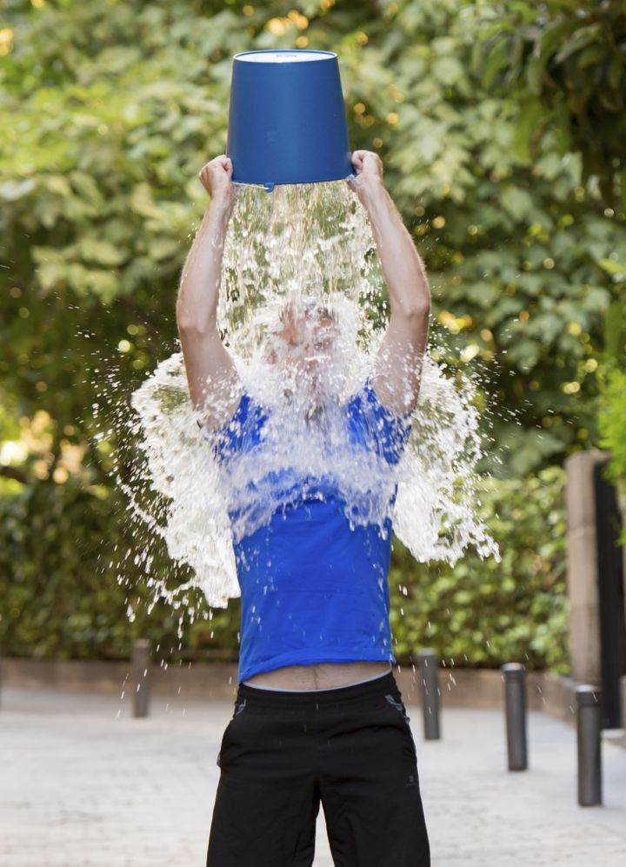
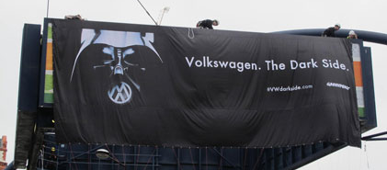

OTHER FORMS OF ACTIVISM
Notes:
2 minutes
There's other forms of activism for social and political change.
Leaks - The Panama Papers follow similar revelations by Wikileaks and Edward Snowden as examples of “leaktivism”. Here, the internet is used to obtain, leak and spread confidential documents with political ramifications. The Panama leaks have led to protests forcing Iceland’s prime minister to step aside and calls for similar action in the UK.
Stunts - (combining offline & online) - many successful modern campaigns involve physical stunts combined with online campaigns incorporating popular culture, like Greenpeace's Darth Vader campaign against Volkswagen.
Online fundraising campaigns - include the Ice Bucket challenge

Slide 15
WHAT HAS IMPACTED YOU?
Think about activism campaigns that you've been aware of
(local, national or international)
Write down the campaigns and their issues from your group
Discuss the types of digital activities or content you've seen or been part of (videos, blogs, gifs, petitions etc)
Discuss why they've influenced you (emotional, funny, powerful etc)
Notes:
10 minutes
Group discussion Part One: Campaigns that work.
Break into groups of 4 or 5
Think about activism campaigns (local, national or international) that you've been aware of (3-minutes)
Write down the campaigns and their issues from your group (1-minute)
Discuss the types of digital activities or content you've seen or been part of (videos, blogs, gifs, petitions etc) (2-minutes)
Discuss why they've influenced you (emotional, funny, powerful etc) (1-minute)

Slide 16
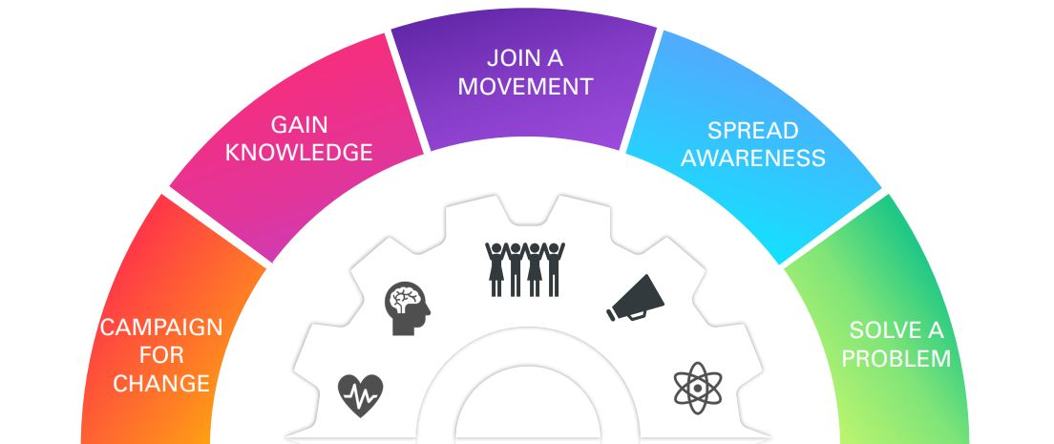
​You are more powerful than any generation before you.
MAKING A DIFFERENCE
Use your digital skills to change the world!
Notes:
Minutes
Group discussion Part Two Make a Pledge to...
You are more powerful than any generation before you.
How can you use your digital skills to change the world?
Acquire knowledge
Share information and raise awareness
Join and build movements
Organise and take part in actions:
Petitions, online campaigning, telling stories
Think of an issue you are interested in and make a pledge to take action on it
Feedback to the wider group.

Slide 17
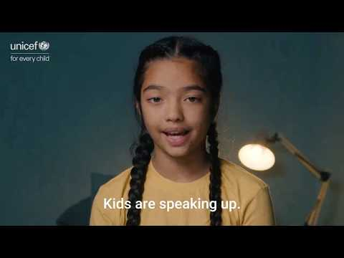
Notes:
2 minutes
Finish with this nice video - EVERYONE HAS A RIGHT TO A VOICE

Slide 18

Kahoot

Slide 19
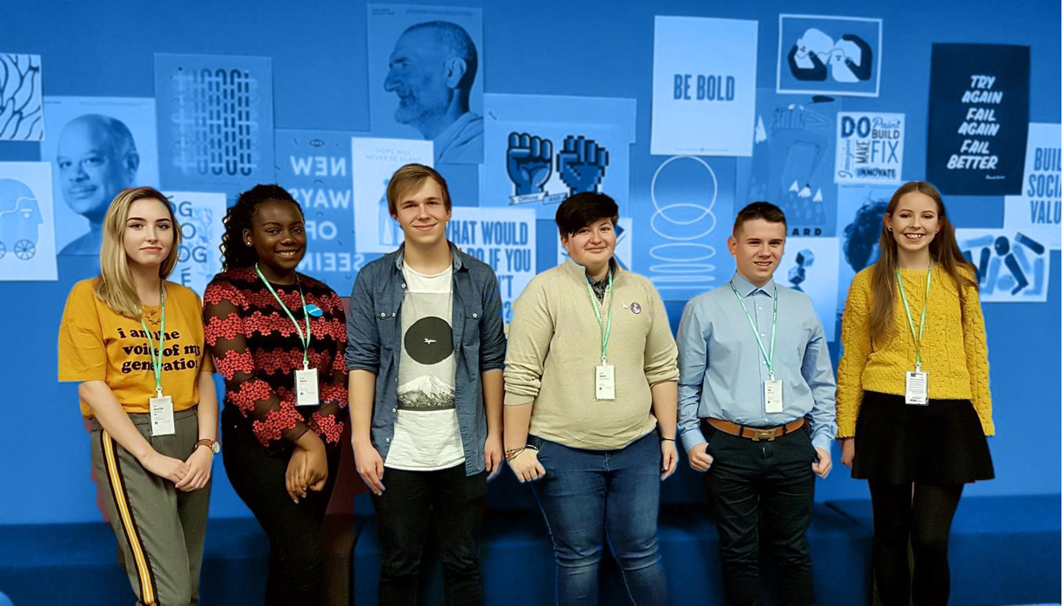
DESIGN A DIGITAL CAMPAIGN
Group activity:​
Decide on an issue that matters to you as a group​
Identify who has power to change that issue​
Think about who you need to influence​
Consider what online tools you could use and what your tactics will be​
Feedback your plan to the group through a short presentation
Notes:
Extension
Group activity: (Note: decide on the timings for the presentations when you know how many groups you have)
Decide on an issue that matters to you as a group
Identify who has power to change that issue
Think about who you need to influence
Consider what online tools you could use and what your tactics will be
Feedback your plan to the group through a short presentation (1-2 minutes per group - with final time decided by how many groups you have)
IMAGE Source: https://weshare.unicef.org/archive/-2AMZIFISWFPH.html

