Slide 1
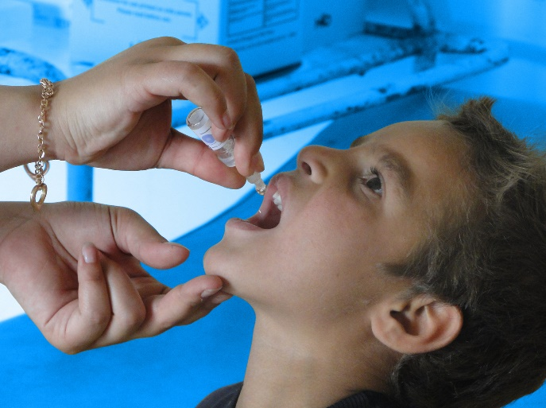
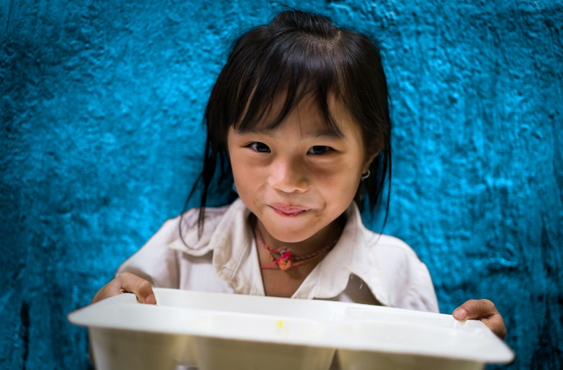
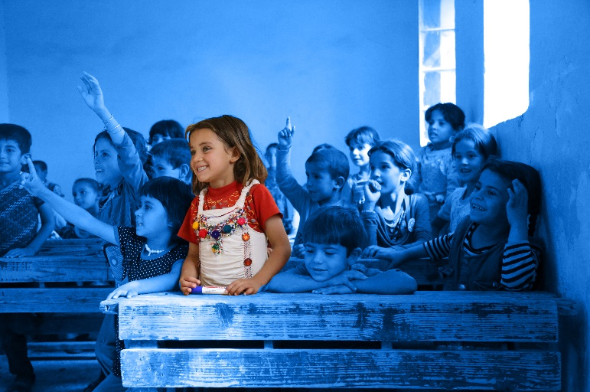
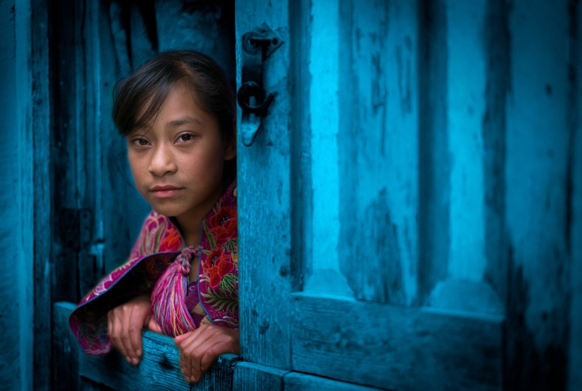
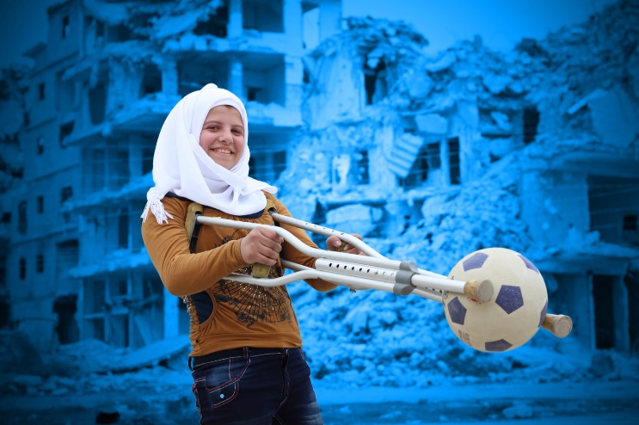
END HOMELESSNESS
Notes:
Delivering this Activity:
*Please Note: UNICEF encourages peer-led learning. If you are a young person delivering this workshop to your peers, follow the steps below for a successful workshop!
Get support from a teacher or adult to run through the workshop with you first.
If it is a challenging issue, that might cause upset to people, only deliver it with the support of an adult in the room. And give prior warning to the participants of topic you are covering as they may or may not wish to participate.
Make sure all the technical things (internet, computer connections, etc) are working before the workshop
Follow the notes and use them to talk through each of the slides and show the different videos. Most slides have notes with more info, but don’t worry if you don't share everything in the notes.
Always encourage discussion during the presentation – being sensitive to everyone’s personal experiences and perspectives.

Slide 2
WORKING TOGETHER
RESPECT
CONFIDENTIALITY
PRIVACY
INCLUSION & PARTNERSHIP
AWARENESS
Notes:
Working Well Together - This workshop might touch on some personal experiences you, a family member, or friend has dealt with. ​Because this is an open forum and the discussion might be challenging, please keep in mind the following.
​
RESPECT- Listen when people are speaking, be non-judgmental and respect difference, and don't laugh, deride or make fun of others
CONFIDENTIALITY – Try to ensure that what is said in the room stays in the room
PRIVACY - Only share what we want to share with the group, though we ask for confidentiality, we cannot guarantee it.
INCLUSION – Include everyone, let’s all make sure everybody has an opportunity to contribute if they want to and no one is left out of a group or discussion.
AWARENESS- Be aware this topic might be upsetting If you find the discussion is upsetting you and or you need support please feel free to excuse yourself and find an adult who can support you, be that a teacher, guidance counsellor or a support organisation. X is in the room to support you as well.

Slide 3
This workshop might touch on some personal experiences you, a family member or friend has dealt with. Because this is an open forum we encourage you not to share personal stories today with the group. If you are in need of professional help we can share with you contact details for organisations that can provide support. If you get upset during the workshop please feel free to leave at anytime and or seek out support from the guidance counsellor or another care provider.
Working Well Together
Privacy - We only share what we want to share
Confidentiality – What is said here stays here
Respect - Listen when people are speaking, respect difference, and don't laugh, deride or make fun of others
Inclusion – We make sure everybody has an opportunity to contribute and no one is left out of a group or discussion

Slide 4
Notes:
The UNCRC is UNICEF’s mandate, there are 54 articles in total with 42 rights in total. Who here today has heard about Children’s Rights? Look at your posters to see your rights. Why do we single out child rights in a separate human rights Convention? Because… Children are more vulnerable than adults they start life as totally dependent beings. Children rely on adults to nurture and guide they need to grow towards independence. Children’s views are rarely heard and considered in the political process. Children cannot vote or take part in political processes. We all only get one childhood and that needs to be protected.
Ask the group:
How might homelessness affect these rights for children?
Article 2, states that children should be protected from all forms of discrimination. There should not be inequalities in basic living standards. This includes discrimination on the basis of their (or their parents’) status or property.
Article 4, Public bodies should use the maximum available resources to ensure that all children have an adequate standard of living.
Article 26, Children have a right to receive assistance through social benefits, depending on the circumstances of their families.
Article 27 The State should ensure that every child has a standard of living which is adequate to allow them to develop fully - physically, mentally, spiritually, morally and socially. Whilst recognising the responsibilities that parents have, governments must ensure that they provide assistance to families to ensure that children’s essential needs are met - in particular, nutrition, clothing and housing.

Slide 5
RIGHTS VS CHARITY
Notes:
Rights vs Charity game
Activity: This activity helps participants understand the need for rights as opposed to relying on charity and handouts. Take a bag of supplies that can be divided among the group (individually wrapped Fair Trade sweets like Maltesers or jellies work well). Make sure you only put out enough for half the class.
Ask participants when they come in to the room to grab a packet of sweets/crisps etc., sit down but don’t open them
Ask those who did not get sweets to go and ask those that have them to share.

Slide 6
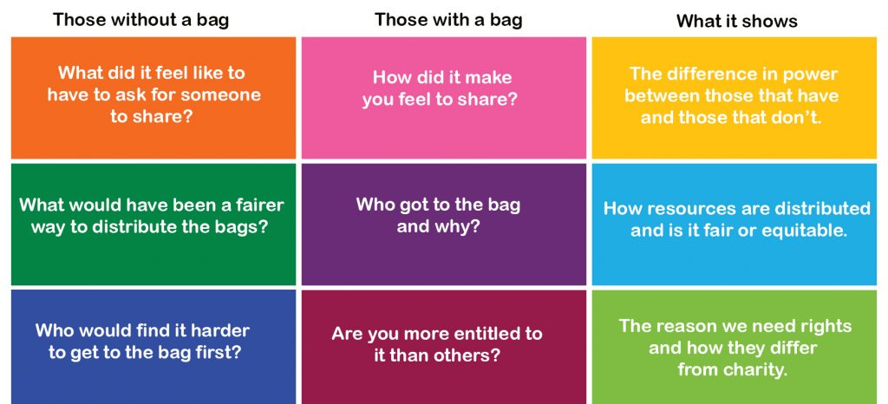
Notes:
Discuss with the group the following questions.

Slide 7
Society is a large group of people who live together in an organized way, making decisions about how to do things and sharing the work that needs to be done.
Societies are governed and have rules to promote the common good.
SOCIAL CONTRACT
Sapiens rule the world, because we are the only animal that can cooperate flexibly in large numbers. We can create mass cooperation networks, in which thousands and millions of complete strangers work together towards common goals.
Notes:
Why should Ireland feel shame over the homeless problem?
Because we live in a society and as member of this society we have all agreed a set of norms that we want everyone to be entitled to. Homelessness breaks those norms and rules.
As people we function at our best when we are organised, when we share roles and decision making. This is what a society is about. A society is an organised structure governed by a set of rules that promote the good of ALL people.
Building societies have helped us survive and thrive globally.
Writer, Yuval Noah Harari wrote in Sapiens our ability to cooperate flexibly in large numbers has enabled us to rule the world. We have created mass cooperation networks, in which thousands and millions of complete strangers work together towards common goals.

Slide 8
SOCIETIES
UN
Government
Organisations
Councils
Parents
Declarations, Charters Conventions & Rights
World
Nation
Community
Individual
Family
Town/City
Constitutions Legislation & Laws
Notes:
Discussion: A society is a large group of people who live together in an organised way. In order to function well together, societies form a social contract. A social contract is an agreement between people to follow certain rules in return for order and protection of their rights. Governments and institutions help to form and govern those rules. This image shows the societal structures that govern our world, from the UN at a global level, to the Taoiseach and Oireachtas at a national level and town councils and organisations at a local level.
Group Work: Split the participants into three groups or "societies". Ask the groups to discuss what type of a society they would like to live in and what rules, principles or rights they would define. Groups should draft their constitution.
Feedback: Amalgamate the responses into one document. Ask participants if there are any rights that stand out that might be different given the issues that are facing society today (rights to a future, sustainable planet, voting rights, new identity rights)? Ask participants how they made decisions as a group? Was it democratic, inclusive or did people take over the discussion?
Poverty not only hurts the individual affected; it hurts communities, the economy and society. At present, there is no explicit right to housing in the Constitution or in Irish law. The Constitutional Convention recommended in February 2014 that the Constitution should be amended to include economic, social and cultural rights, including a specific right to housing, but no decision has yet been made on this recommendation.
A strengthening of the right to housing in the Constitution and strict limits on how long a family spends in emergency accommodation are among the recommendations made by the Oireachtas Committee on Children. In a report on homelessness.
Extensions: Compare the new document with the Irish Constitution and or the first Democratic Programme. Discuss the similarities and differences and compare and contrast the different ways children were treated in the two documents. Analyse the state of the economy in 1919, 1937 and today.

Slide 9
10 most important rights for your society
ACTIVITY 2
All people have the right….
Notes:
Activity:
Break into groups and complete the following.
If you were to create your own set of rules for the kind of society you want to live in what would they be, what would you include. I want you to break out in to 5 groups of 6 people and each group is to come up with a list of fundamental rules that are important for you to have a healthy happy and sustainable society. You have 20 minutes to discuss and list out 10 rights.

Slide 10
Irish Constitution
Article 45 principles of social policy
"justice and charity" must "inform all the institutions of the national life".
Everyone has the right to an adequate occupation.
The free market and private property must be regulated in the interests of the common good.
The state must prevent a destructive concentration of essential commodities in the hands of a few.
The state must supplement private industry where necessary.
The state should ensure efficiency in private industry and protect the public against economic exploitation.
The state must protect the vulnerable, such as orphans and the aged.
No one may be forced into an occupation unsuited to their age, sex or strength.
Equality before the law
Prohibition on titles of nobility
Personal rights
Unenumerated rights
Abortion law
Habeas corpus- personal liberty
Inviolability of the home
Freedom of speech
Freedom of peaceful assembly
Freedom of association
Family and home life
Education
Private property
Religious freedom
Notes:
At present, there is no explicit right to housing in the Constitution or in Irish law. The Constitutional Convention recommended in February 2014 that the Constitution should be amended to include economic, social and cultural rights, including a specific right to housing, but no decision has yet been made on this recommendation. The Oireachtas Committee on Children recommendation states, “A strengthening of the right to housing in the Constitution and strict limits on how long a family spends in emergency accommodation are among fresh demands to alleviate homelessness”.
The new Programme for Government promises to hold a referendum on housing (page 120)
https://static.rasset.ie/documents/news/2020/06/programmeforgovernment-june2020-final.pdf

Slide 11
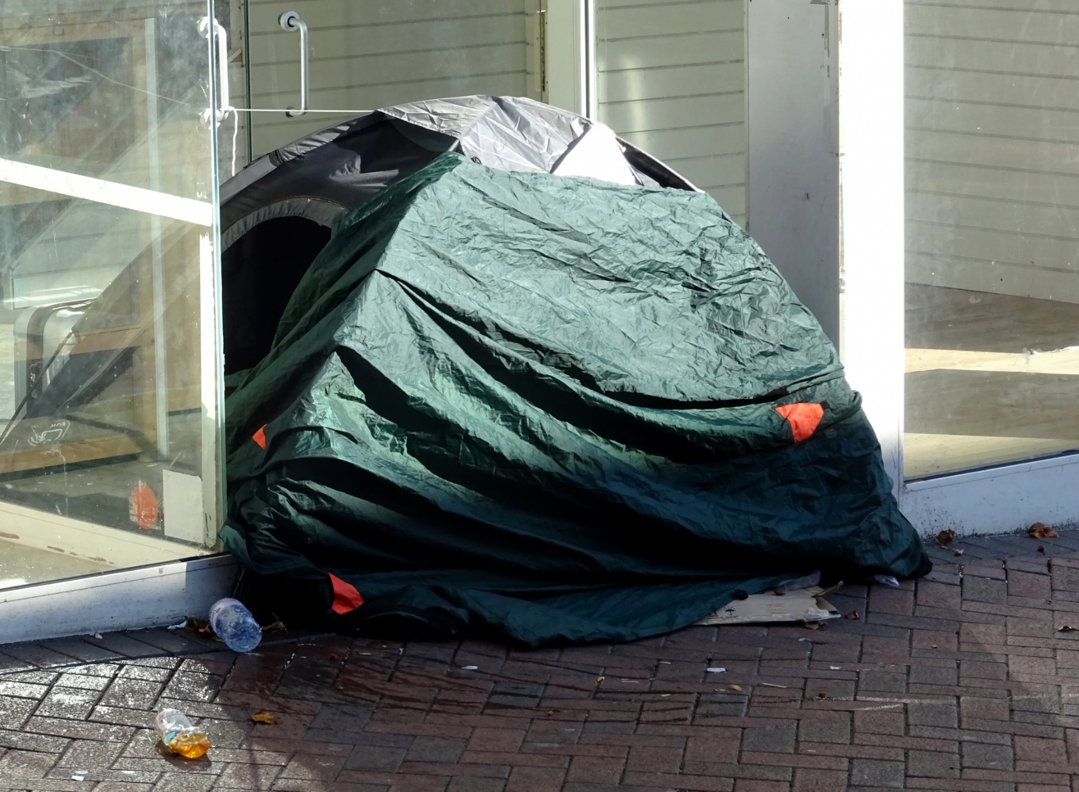
As one of the wealthiest nations in the world, Ireland has more than 760,000 people living below the poverty line.
What’s more we should be ashamed that over 10,000 people are living in emergency accommodation, over 3,000 of which are children.
Notes:
As one of the wealthiest nations in the world, Ireland has more than 760,000 people living below the poverty line.
What’s more we should be ashamed that 10,397 people are living in emergency accommodation, 3,873 of which are children. For the latest data go to https://www.housing.gov.ie/housing/homelessness/other/homelessness-data
These figures do not include people sleeping rough, people couch surfing, homeless people in hospitals and prisons, those in Direct provision centres, and homeless households in Domestic Violence Refuges.
So this is a big problem in Ireland and the reason all of you came here today.
We are going to look at how you can take action to address this serious issue.
Why are so many becoming Homeless?
The root cause of the homeless crisis in Ireland is the broken housing system. Ireland does not have a public housing system to meet the needs of the society. Provision of affordable public housing must form a key part of any country’s housing system. It acts as a safety net for families and individuals pushed out of the private rental market due to the high cost of renting or lack of housing. In the last decade the lack of social housing provision combined with private house building grinding to a half has meant more people than ever are renting their homes. Almost 1 in 5 households now live in a privately rented home compared to 1 in 10 ten years ago. This has led to enormous pressure on the private rental market which has resulted in constantly rising rent levels and a lack of properties to rent.
Some of the problems are long running – such as the decision to cut social housing spending by 72% between 2008 and 2012 (€1.38bn to €390m)
The most recent official assessment of social housing need was published in September 2018 and showed 71,858 households qualified for social housing. Over a quarter of these households have been on the list for over seven years.

Slide 12
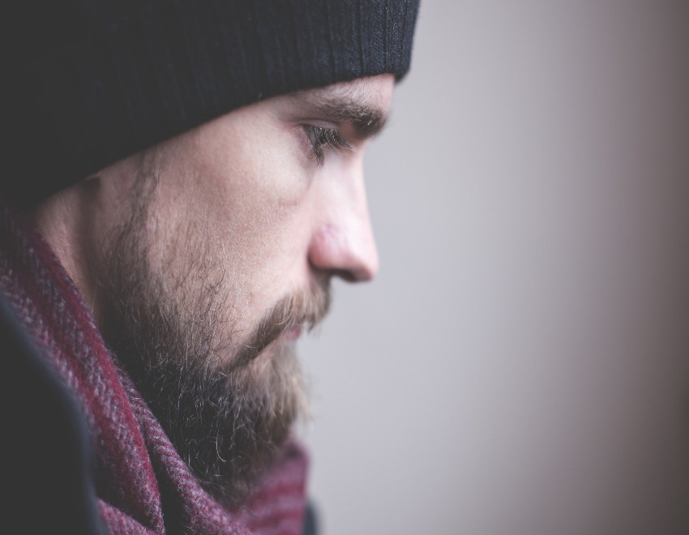
Root Causes of Homelessness
Trauma
Mental health issues – lack of care
Substance abuse
Discharge from institutions
Family breakdown /domestic violence
Lack of affordable housing
Losing job or business
No safety nets
Notes:
Reasons for Homelessness (Root Causes)
Duration: 30 Mins
The aim of this activity is to understand some of the root causes of homelessness
Discussion: Ask participants for the reasons people become homeless.
Lack of affordable housing
Addiction issues
Mental health
Domestic violence
Runaway
Poverty
Leaving care
Scenarios: Ask for two volunteers to role-play the difficulties facing people who are made homeless. Provide two students with Eoin and Siobhan scenario sheets. Ask the volunteer to read out their scenario and decide where they will go for help. Find 3-4 audience members who can give responses to Siobhan or Eoin.
Download Scenarios Siobhan, Eoin
Discussion: What has been lost in these scenarios? Ask participants to write on a post-it note words that describe what home means to them and what they would miss if they had to leave their home. Conclude by showing participants this short video.
According to Ending Homelessness – A Housing-Led Approach (pdf), research shows that the following are the main factors that lead to homelessness:
Housing and financial crises
Discharge from institutions
Family breakdown, including domestic violence
Substance abuse
Mental health issues
The transition from youth to adulthood for young people in care or who were homeless as young people

Slide 14
Rise in Homelessness
More than 1 in 3 people experiencing homelessness in Ireland is a child

Slide 15
Impacts of homelessness on children
HOMEWORK
CHILD
RELATIONSHIPS
SUPPORTS
LEARNING
FAMILY
DEVELOPMENT
EMOTIONAL
MILESTONES
MISSING SCHOOL
CAN’T CONCENTRATE
COMMUTE
WORRY
MISS HOME
MISS PETS
EMBARASSMENT
SADNESS

Slide 16
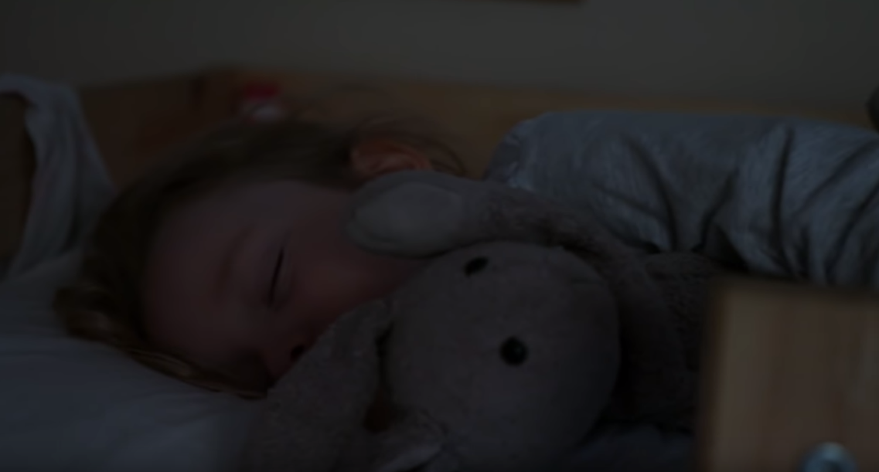
IT’S MOVING DAY TODAY.
IT’S A FUNNY THING, PACKING YOUR HOME AWAY.
https://www.youtube.com/watch?v=zw7JuOjiQKA
© UNICEF/NYHQ2011-0098/NOORANI

Slide 17
Kahoot

Slide 18
Text SPUNTOUT to 0861800280 or go online to spunout.ie
Call 1800666666 or chat online at childline.ie or text to 50101 10-4pm
Call 1800544729 or text “call me” to 0861802880
Call 116123 or 24/7 or email jo@samaritans.org
Call 1800247247 or text HELP to 51444 if feeling Suicidal/Self Harm
Call 016706223 or go to website belongto.org support for LGBTI+
SUPPORT
Notes:
Leave this up at the end of the workshop

