Slide 1
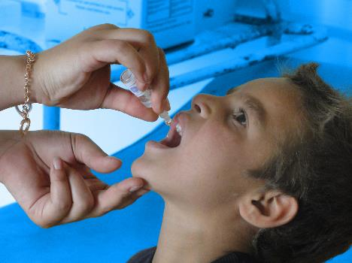
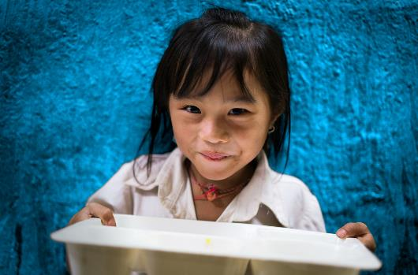
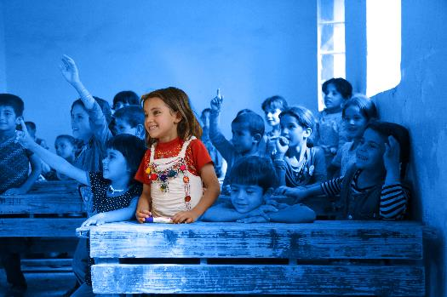
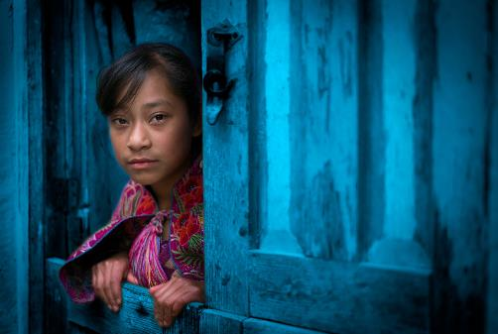
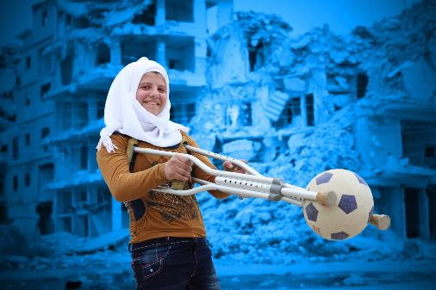
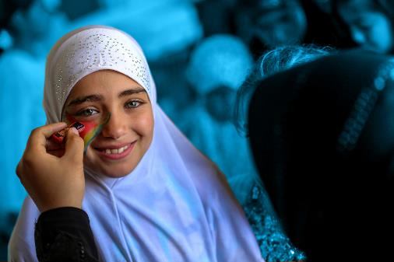
GLOBAL GOALS
Notes:
Delivering this Activity:
*Please Note: UNICEF encourages peer-led learning. If you are a young person delivering this workshop to your peers, follow the steps below for a successful workshop!
Get support from a teacher or adult to run through the workshop with you first.
If it is a challenging issue, that might cause upset to people, only deliver it with the support of an adult in the room. And give prior warning to the participants of topic you are covering as they may or may not wish to participate.
Make sure all the technical things (internet, computer connections, etc) are working before the workshop
Follow the notes and use them to talk through each of the slides and show the different videos. Most slides have notes with more info, but don’t worry if you don't share everything in the notes.
Always encourage discussion during the presentation – being sensitive to everyone’s personal experiences and perspectives.

Slide 2
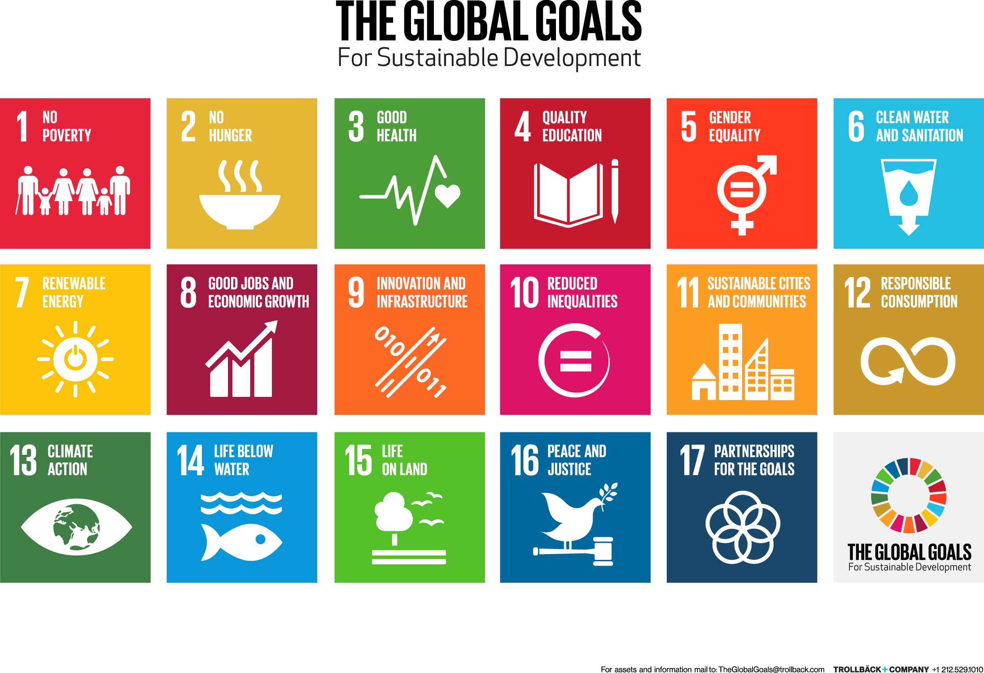
Introducing the SDGs
The Sustainable Development Goals
Use these slides to introduce the SDGs
Combine them with your own slides
Translate them into your own language

Slide 3
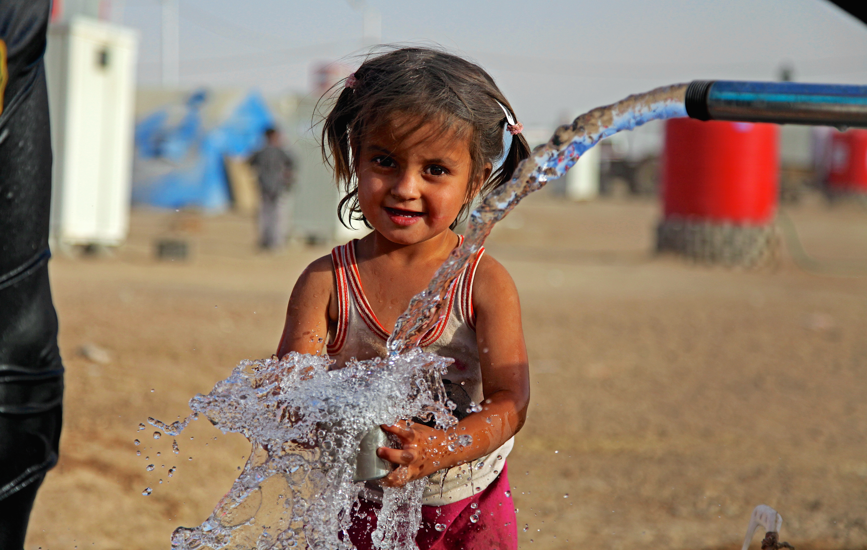

The SDGs are …
A set of 17 goals for the world’s future, through 2030
Backed up by a set of 169 detailed Targets
Negotiated over a two-year period at the United Nations
Agreed to by nearly all the world’s nations, on 25 Sept 2015
Notes:
The Sustainable Development Goals are … ​
A set of 17 goals for the world’s future through 2030​
Backed up by a set of 169 detailed targets​
Consulted widely on. Read what Irish young people had to say about what the goals should be back in 2014. Dublin-Declaration-on-Children-and-Youth
Negotiated over a two-year period at the United Nations​, with Ireland co-facilitating the negotiations alongside Kenya.
Agreed to by nearly all the world’s nations, on 25 Sept 2015​
Universal and apply to every nation, every sector of society and every citizen. Cities, businesses, schools, organizations, all are challenged to act.
Integrated and interdependent. One goal cannot be achieved without the others. You cannot end poverty (Goal 1) without ending inequality (Goal 10), providing for education (Goal 4), well being (Goal 3) and ensuring people have decent jobs (Goal 8) etc.
Key to the goals is the word sustainable. This means development that meets the needs of the present without compromising the ability of future generations to meet their own needs.
​193 Member States of the United Nations reached consensus on the outcome document of a new sustainable development agenda entitled, “Transforming Our World: The 2030 Agenda for Sustainable Development”. This agenda contains 17 goals and 169 targets and will be achieved in 2030 using a set of indicators developed with the help of national statistic offices.
The Goals and targets are centred around: people, planet, prosperity, peace and partnership.
People, as we are determined to end poverty and hunger, in all their forms and dimensions, and to ensure that all human beings can fulfil their potential in dignity and equality and in a healthy environment.
​Planet, to protect the planet from degradation, including through sustainable consumption and production, sustainably managing its natural resources and taking urgent action on climate change, so that it can support the needs of the present and future generations.
Prosperity, to ensure that all human beings can enjoy prosperous and fulfilling lives and that economic, social and technological progress occurs in harmony with nature.
​Peace, to foster peaceful, just and inclusive societies free from fear and violence. There can be no sustainable development without peace and no peace without sustainable development.
​Partnership, to mobilize the means required to implement this Agenda through a revitalised global partnership for sustainable development, based on a spirit of strengthened global solidarity, focussed in particular on the needs of the poorest and most vulnerable and with the participation of all countries, all stakeholders and all people.
​The goals are universal, meaning every nation must take on to achieve them and must help others to do the same. This means Ireland must implement their national plan to achieve these goals by 2030.

Slide 4
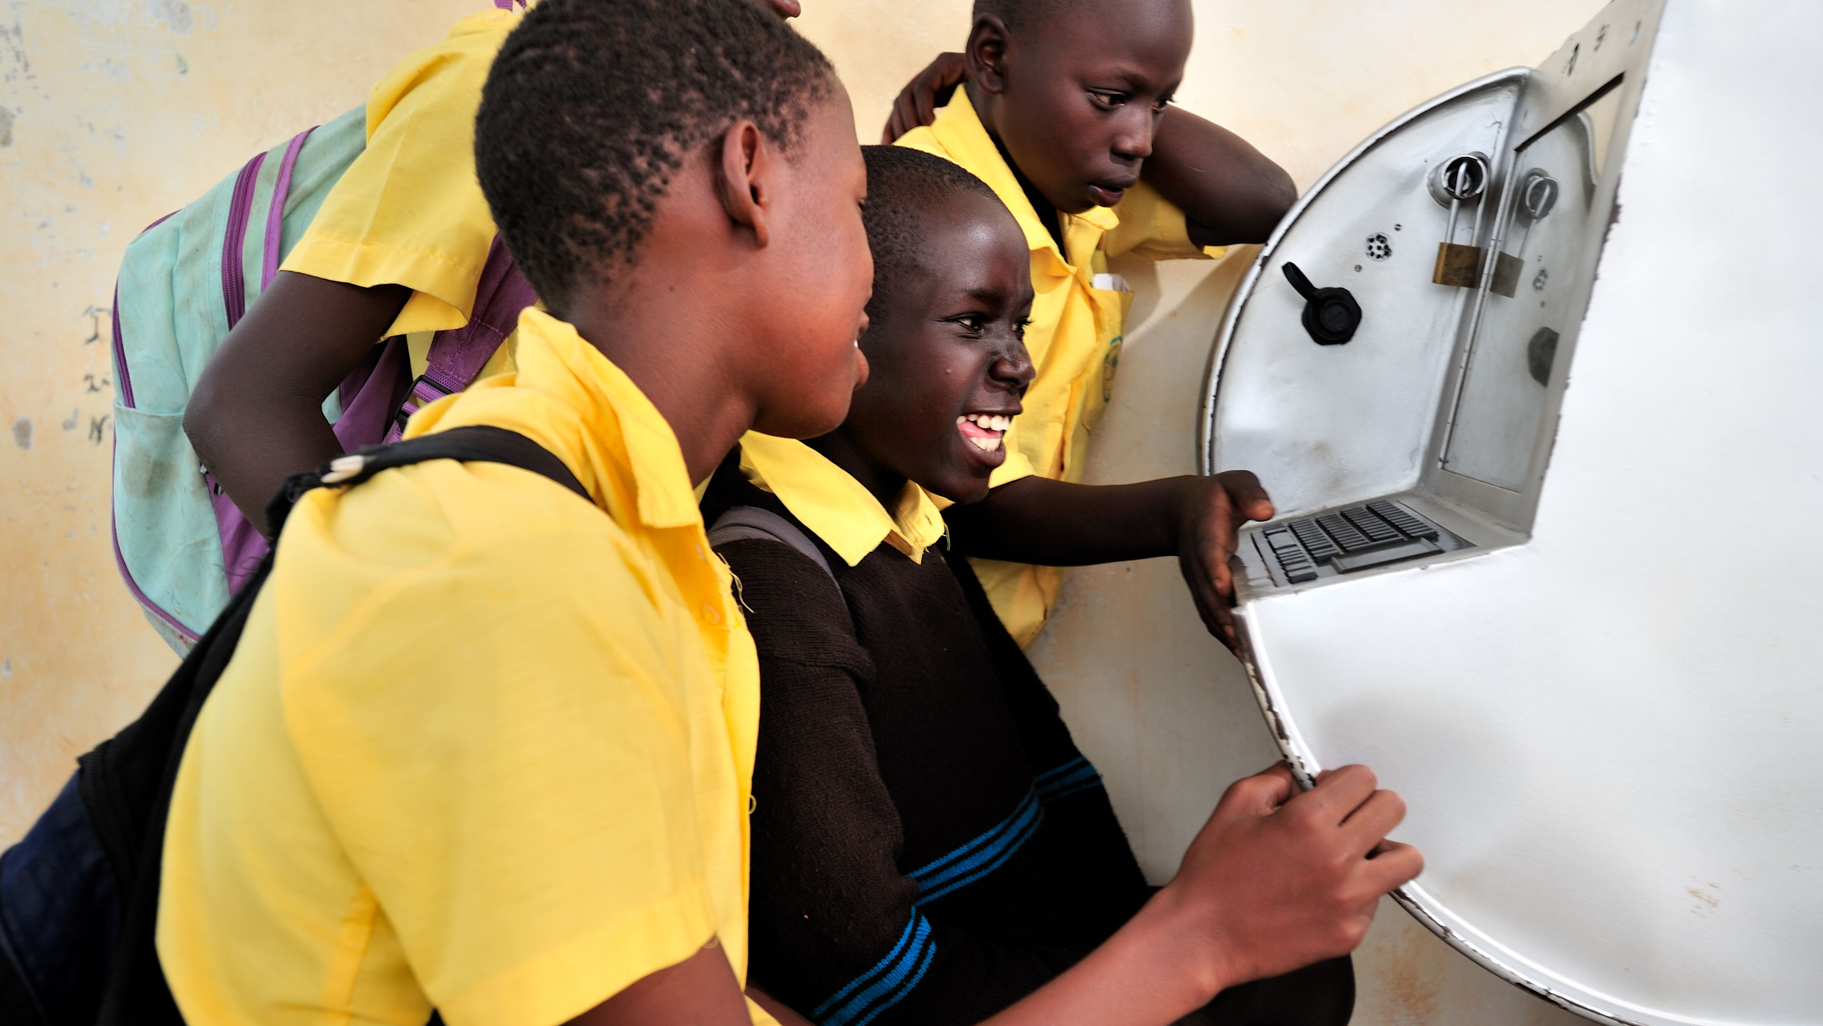
First, and most important, these Goals apply to every nation … and every sector. Cities, businesses, schools, organizations, all are challenged to act.
Universality

Slide 5
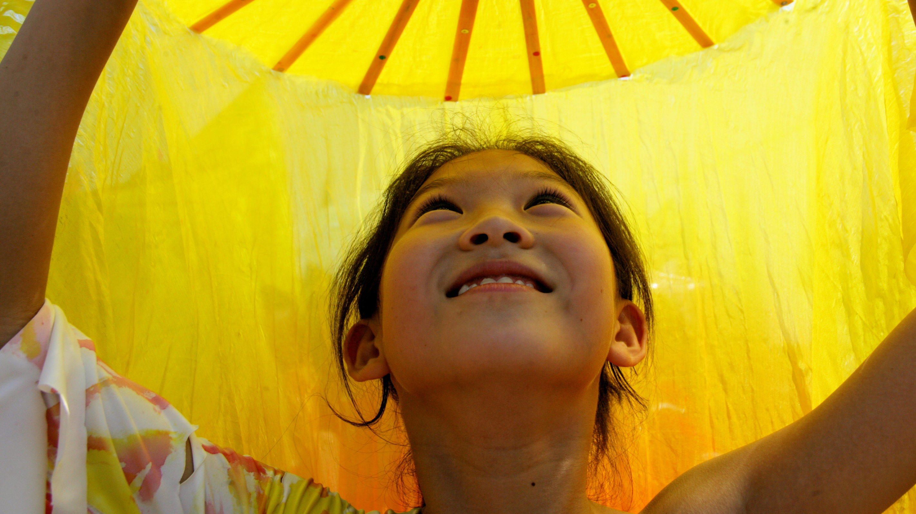
Second, it is recognized that the Goals are all inter-connected, in a system. We cannot aim to achieve just one Goal. We must achieve them all.
Integration

Slide 6
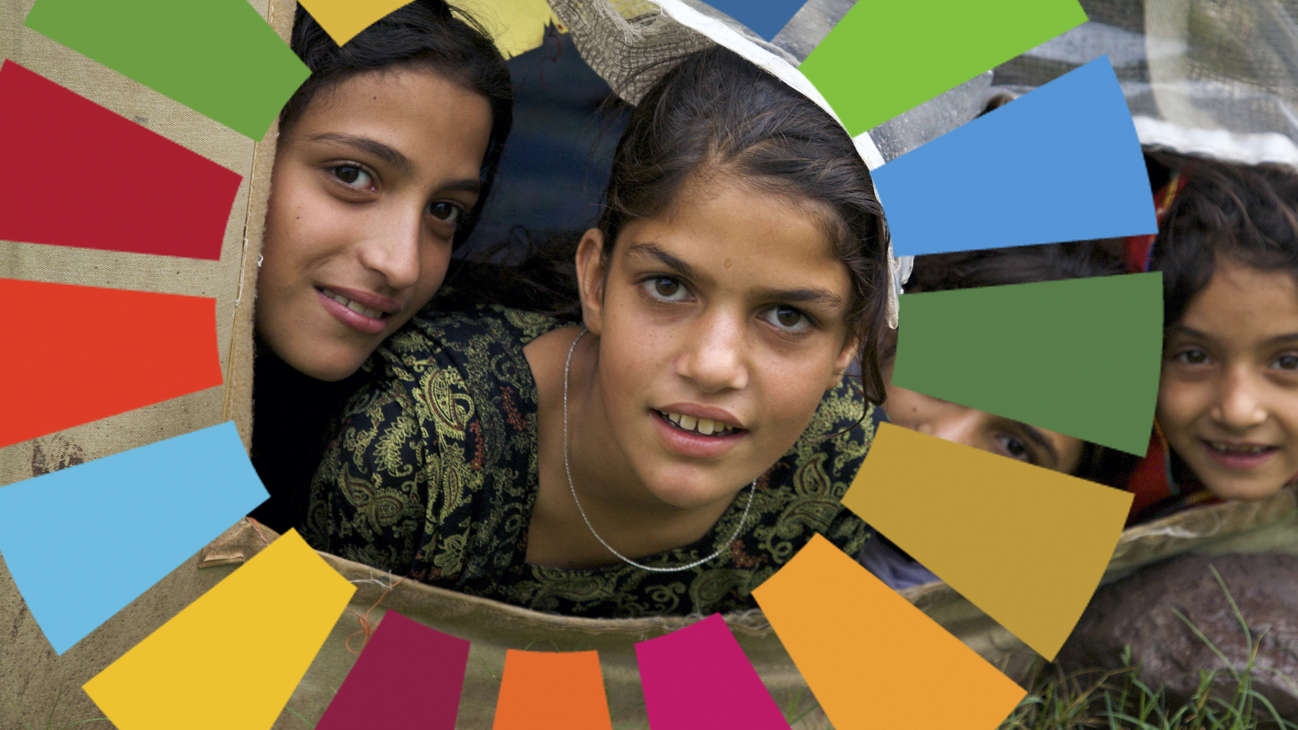
And finally, it is widely recognized that achieving these Goals involves making very big, fundamental changes in how we live on Earth.
Transformation

Slide 7
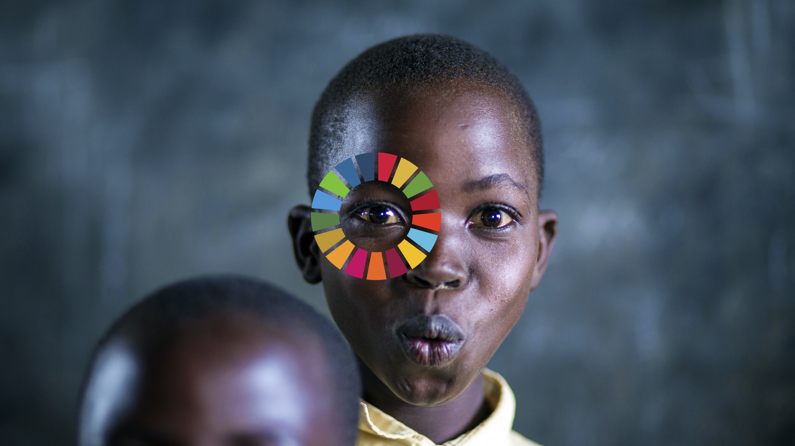
Let’s take a tour …

Slide 8
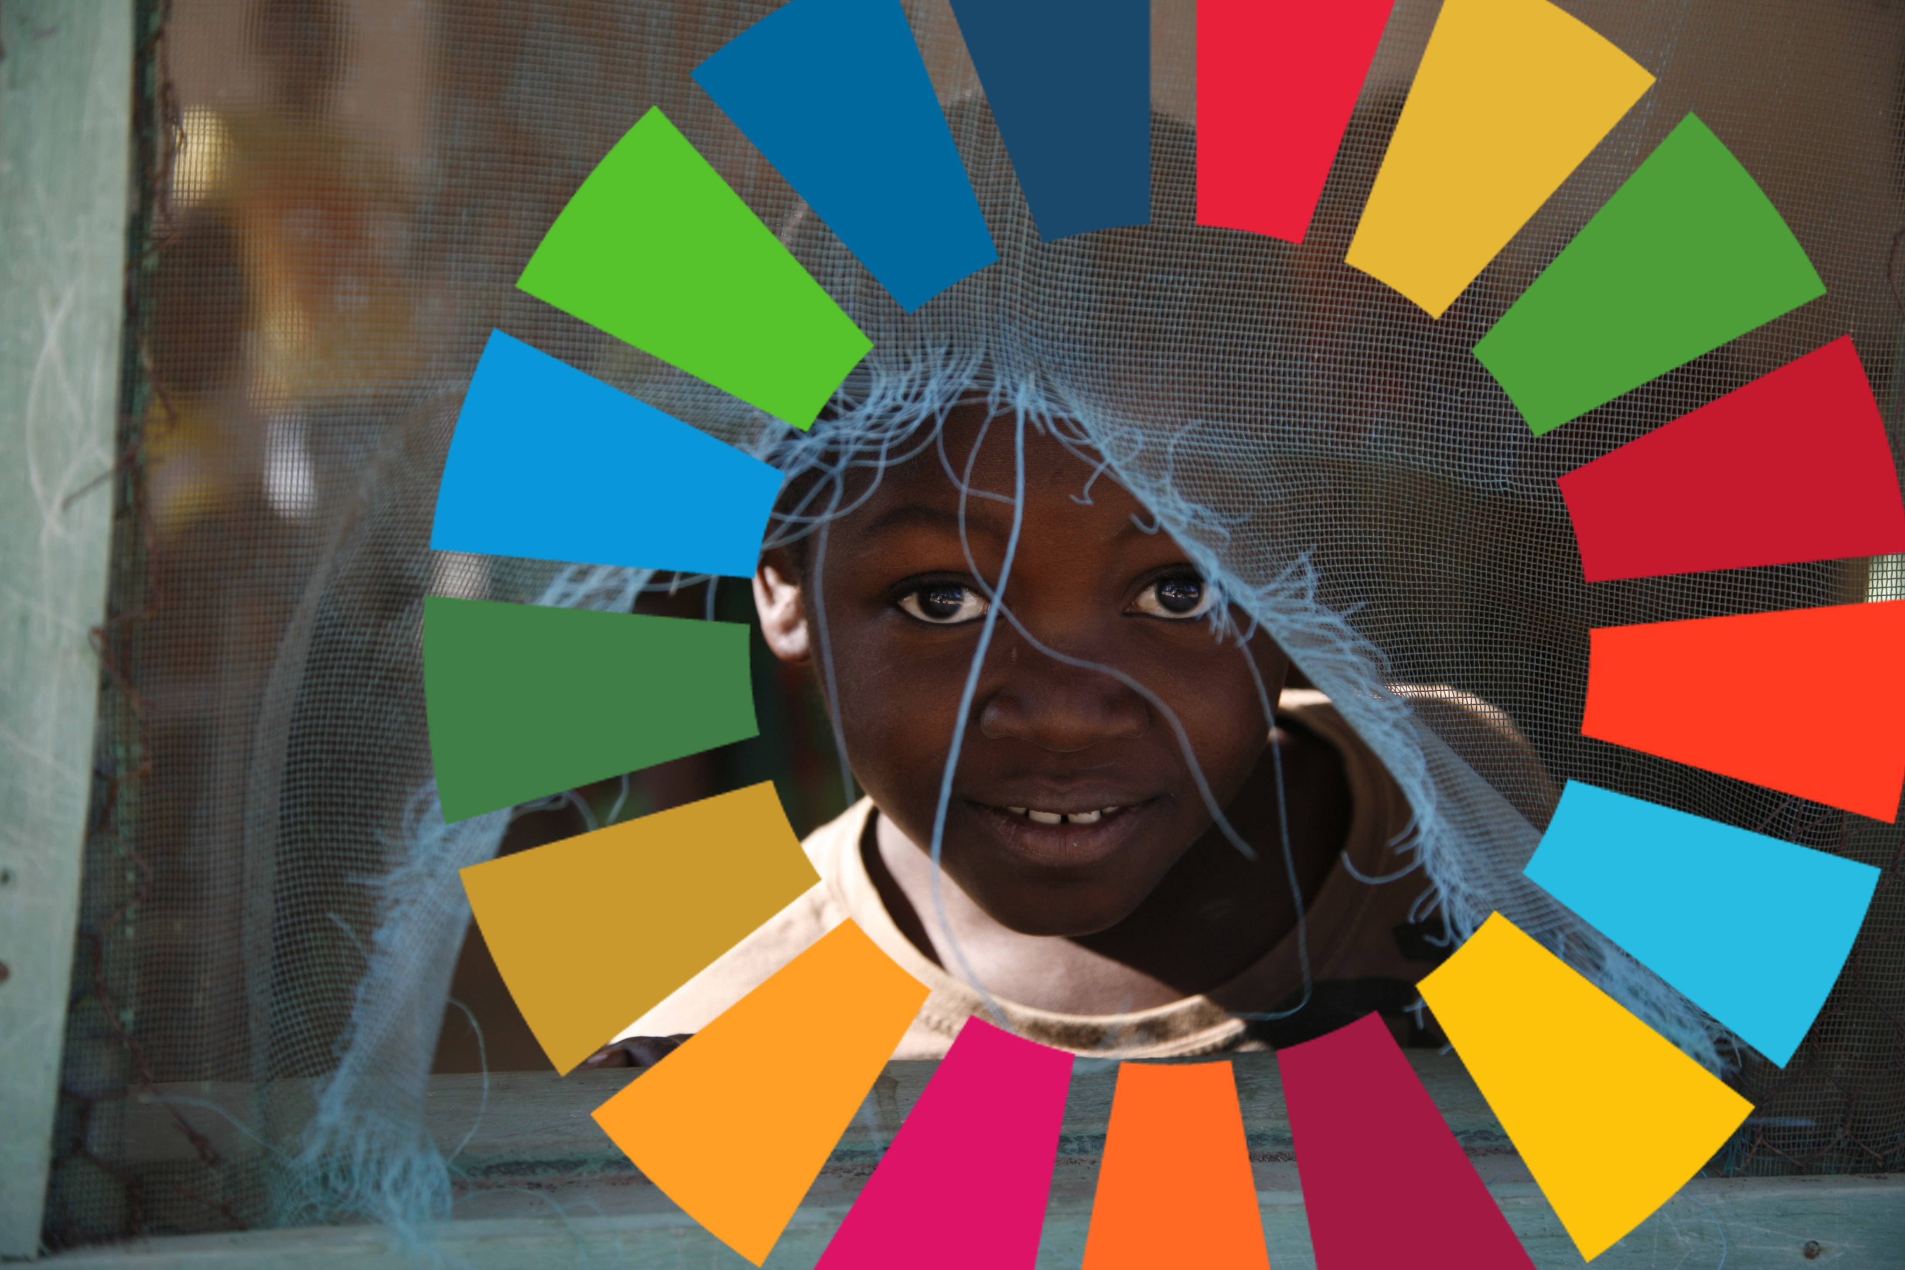
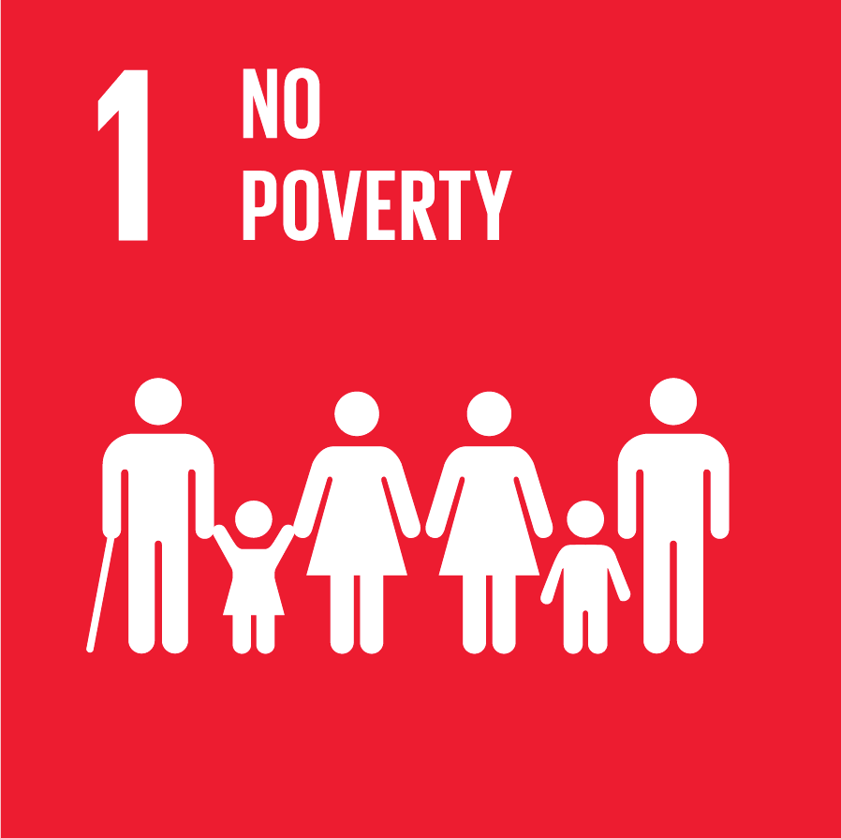

Slide 9
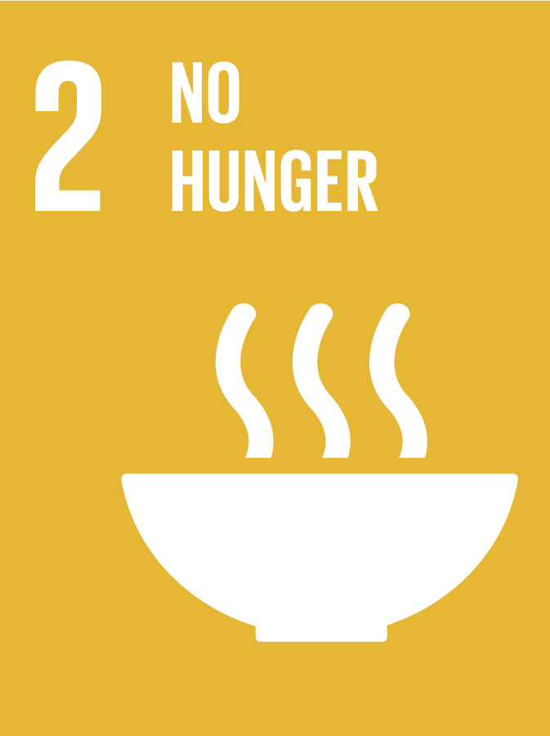
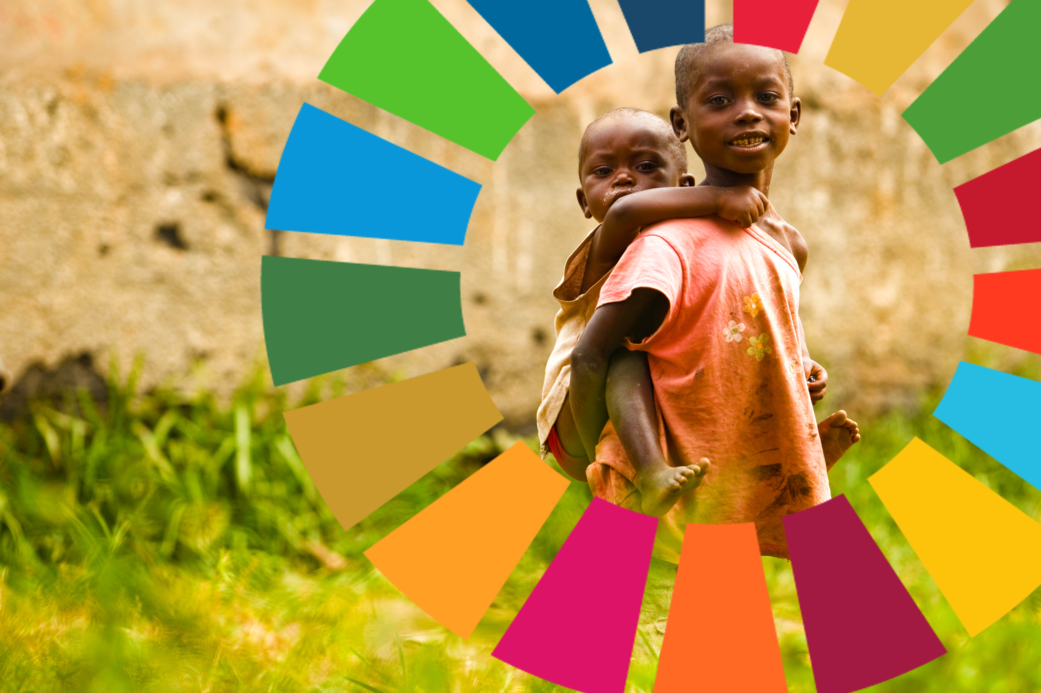

Slide 10
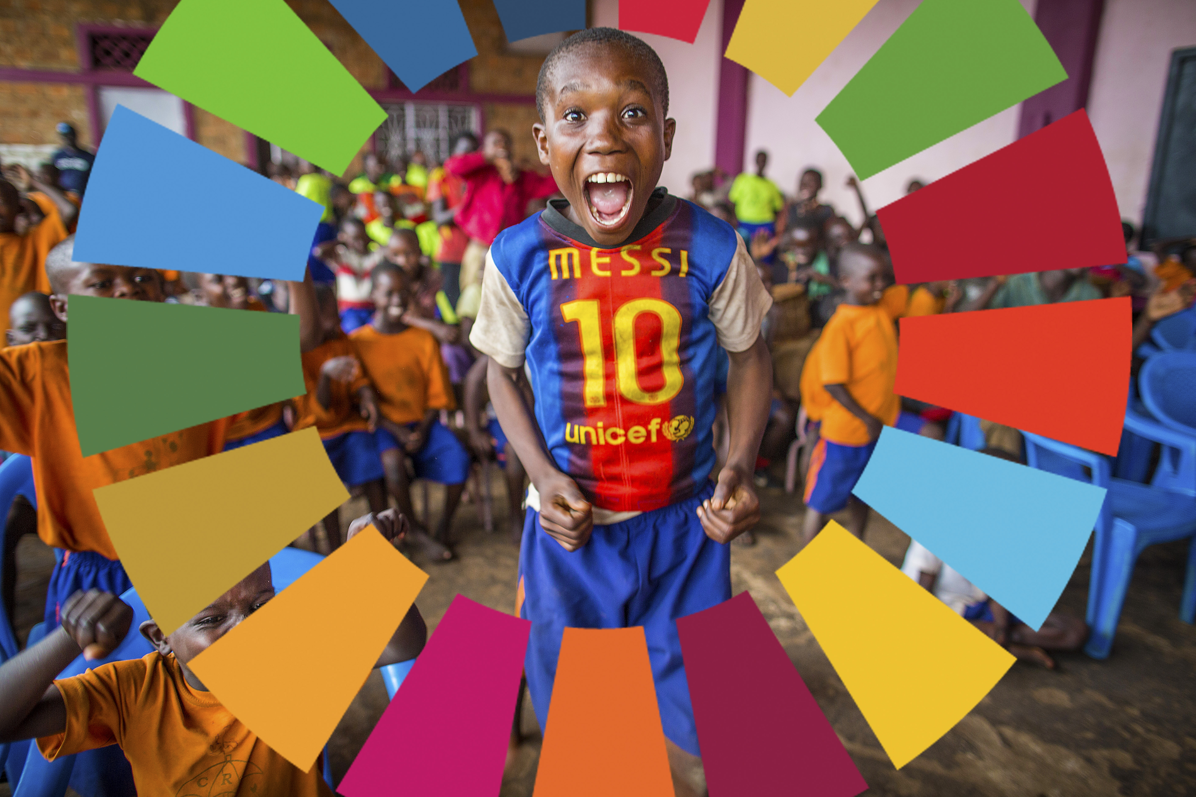

#2: End hunger, achieve food security and improved nutrition and promote sustainable agriculture
#3: Ensure healthy lives and promote well-being for all at all ages

Slide 11
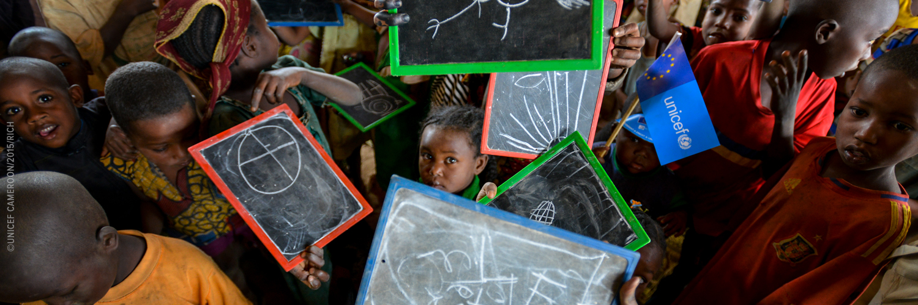


Slide 12
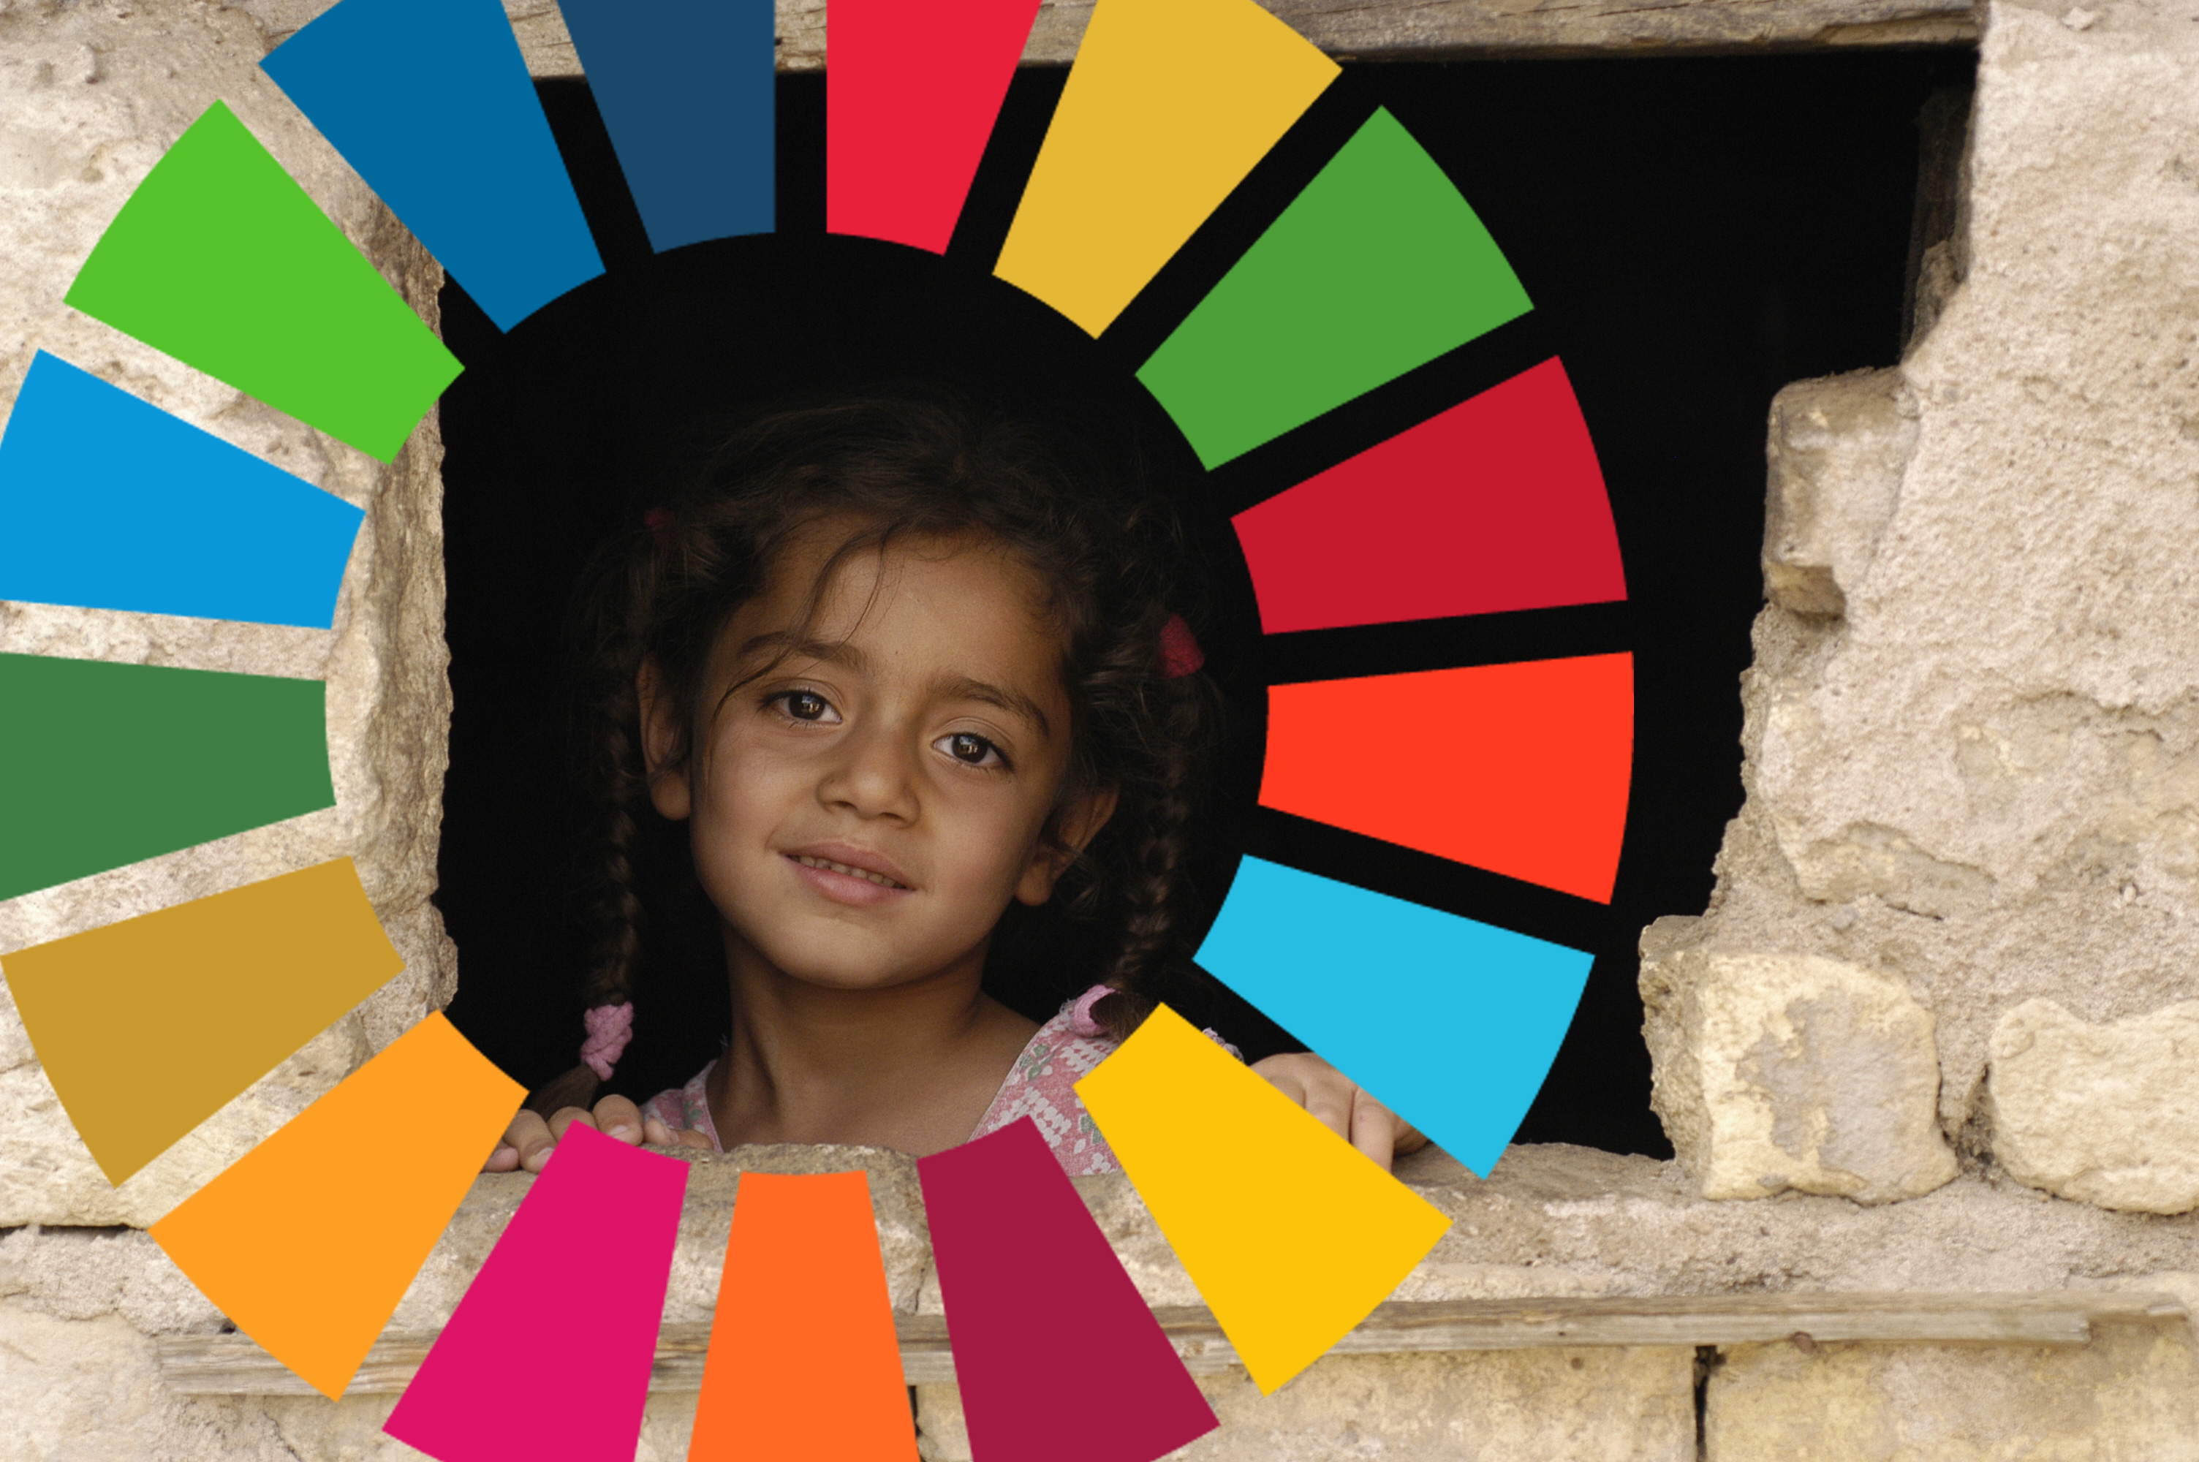
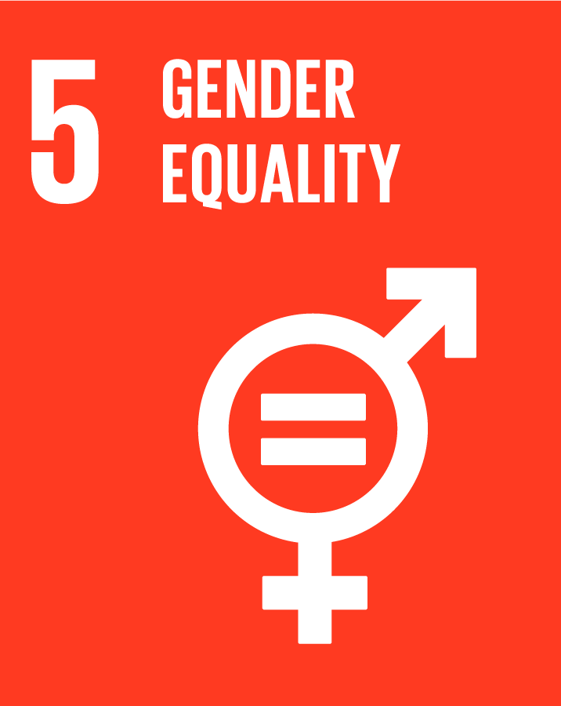

Slide 13
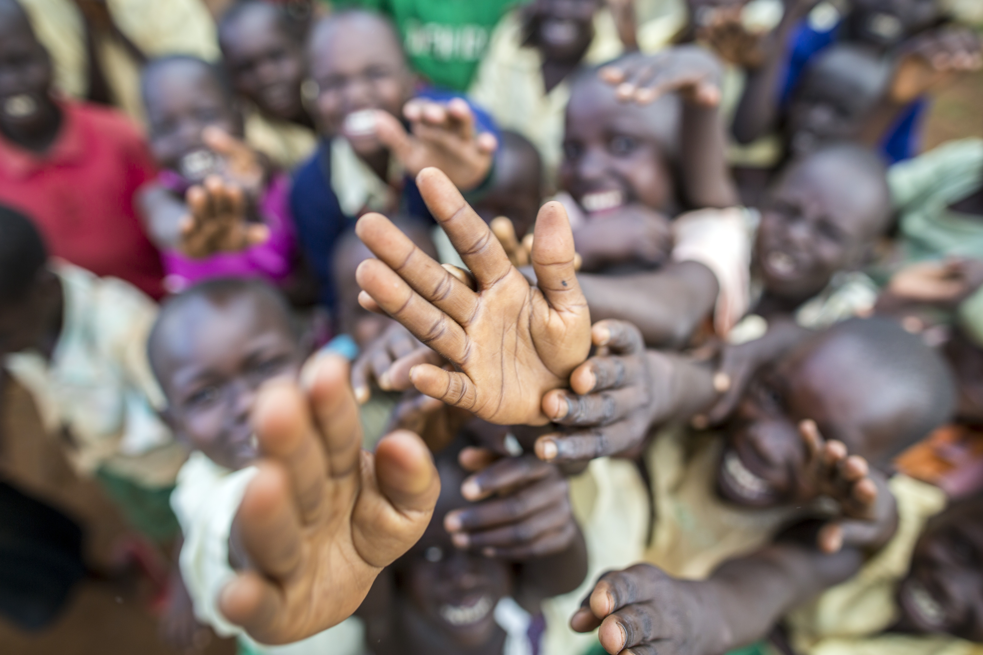
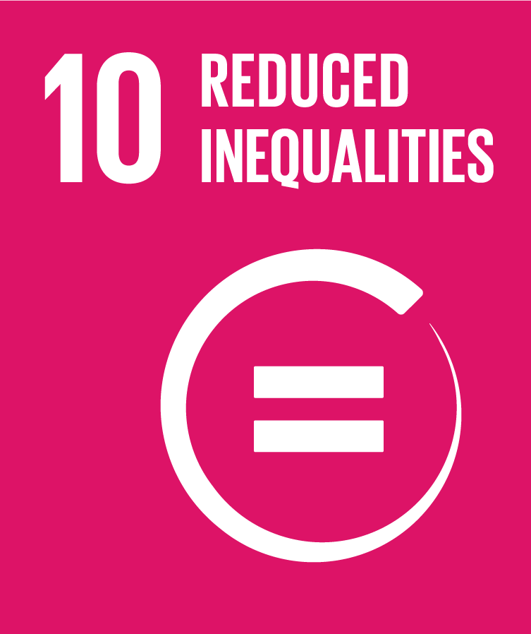

Slide 14
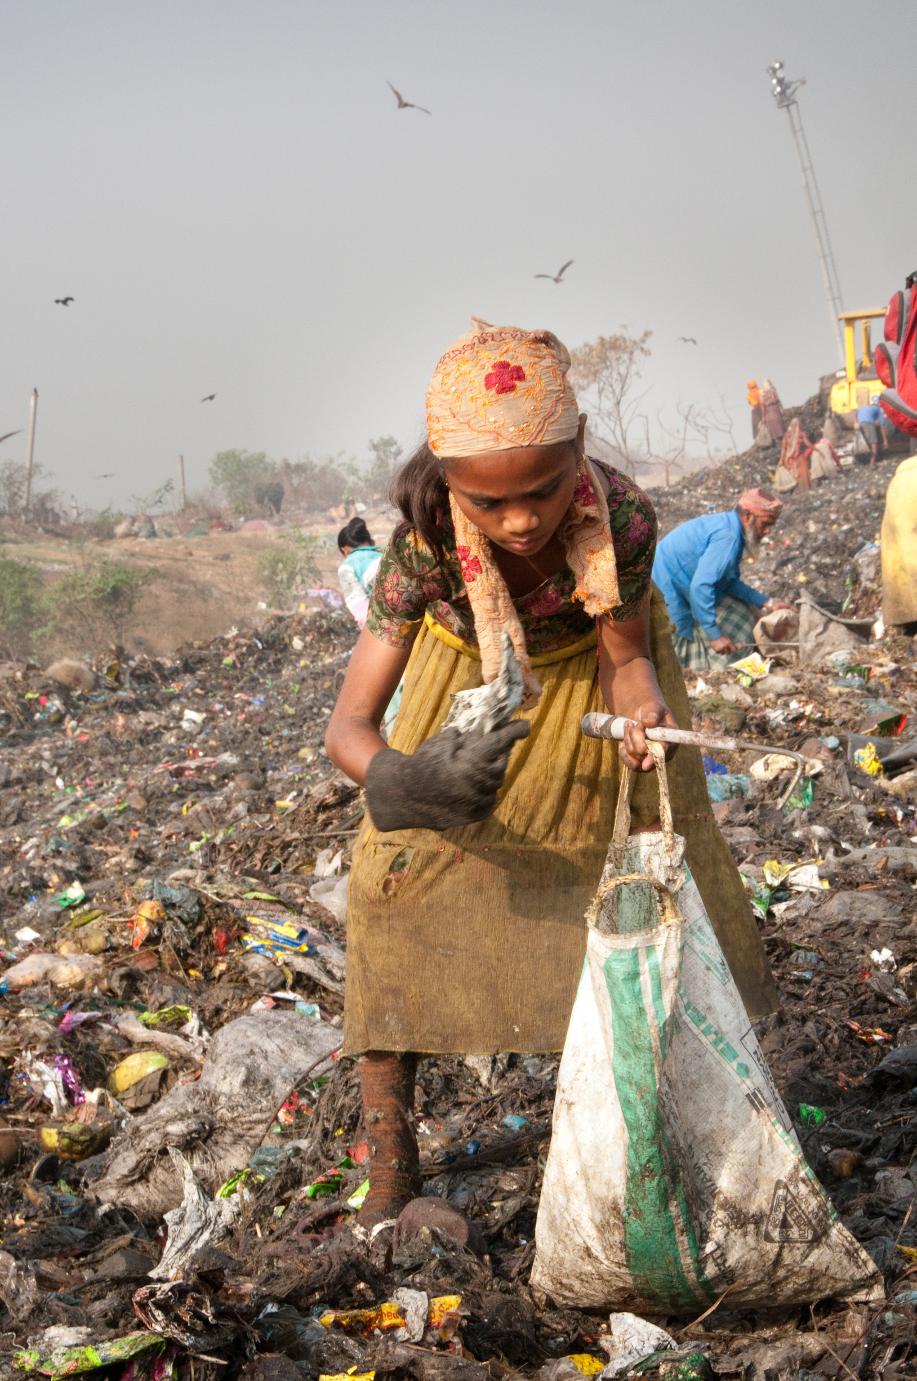
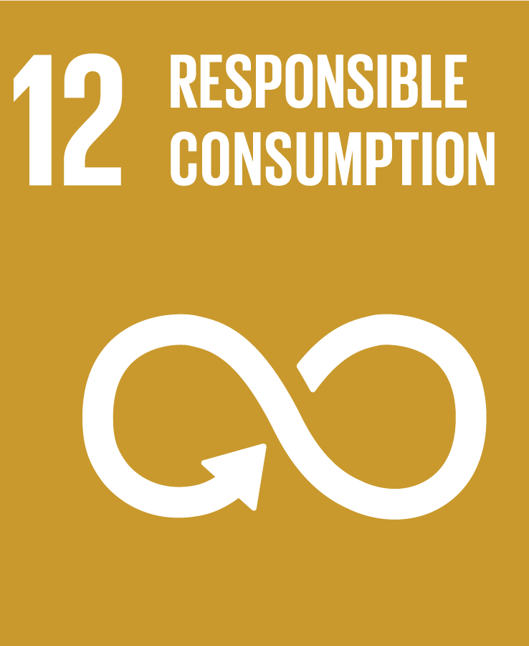

Slide 15
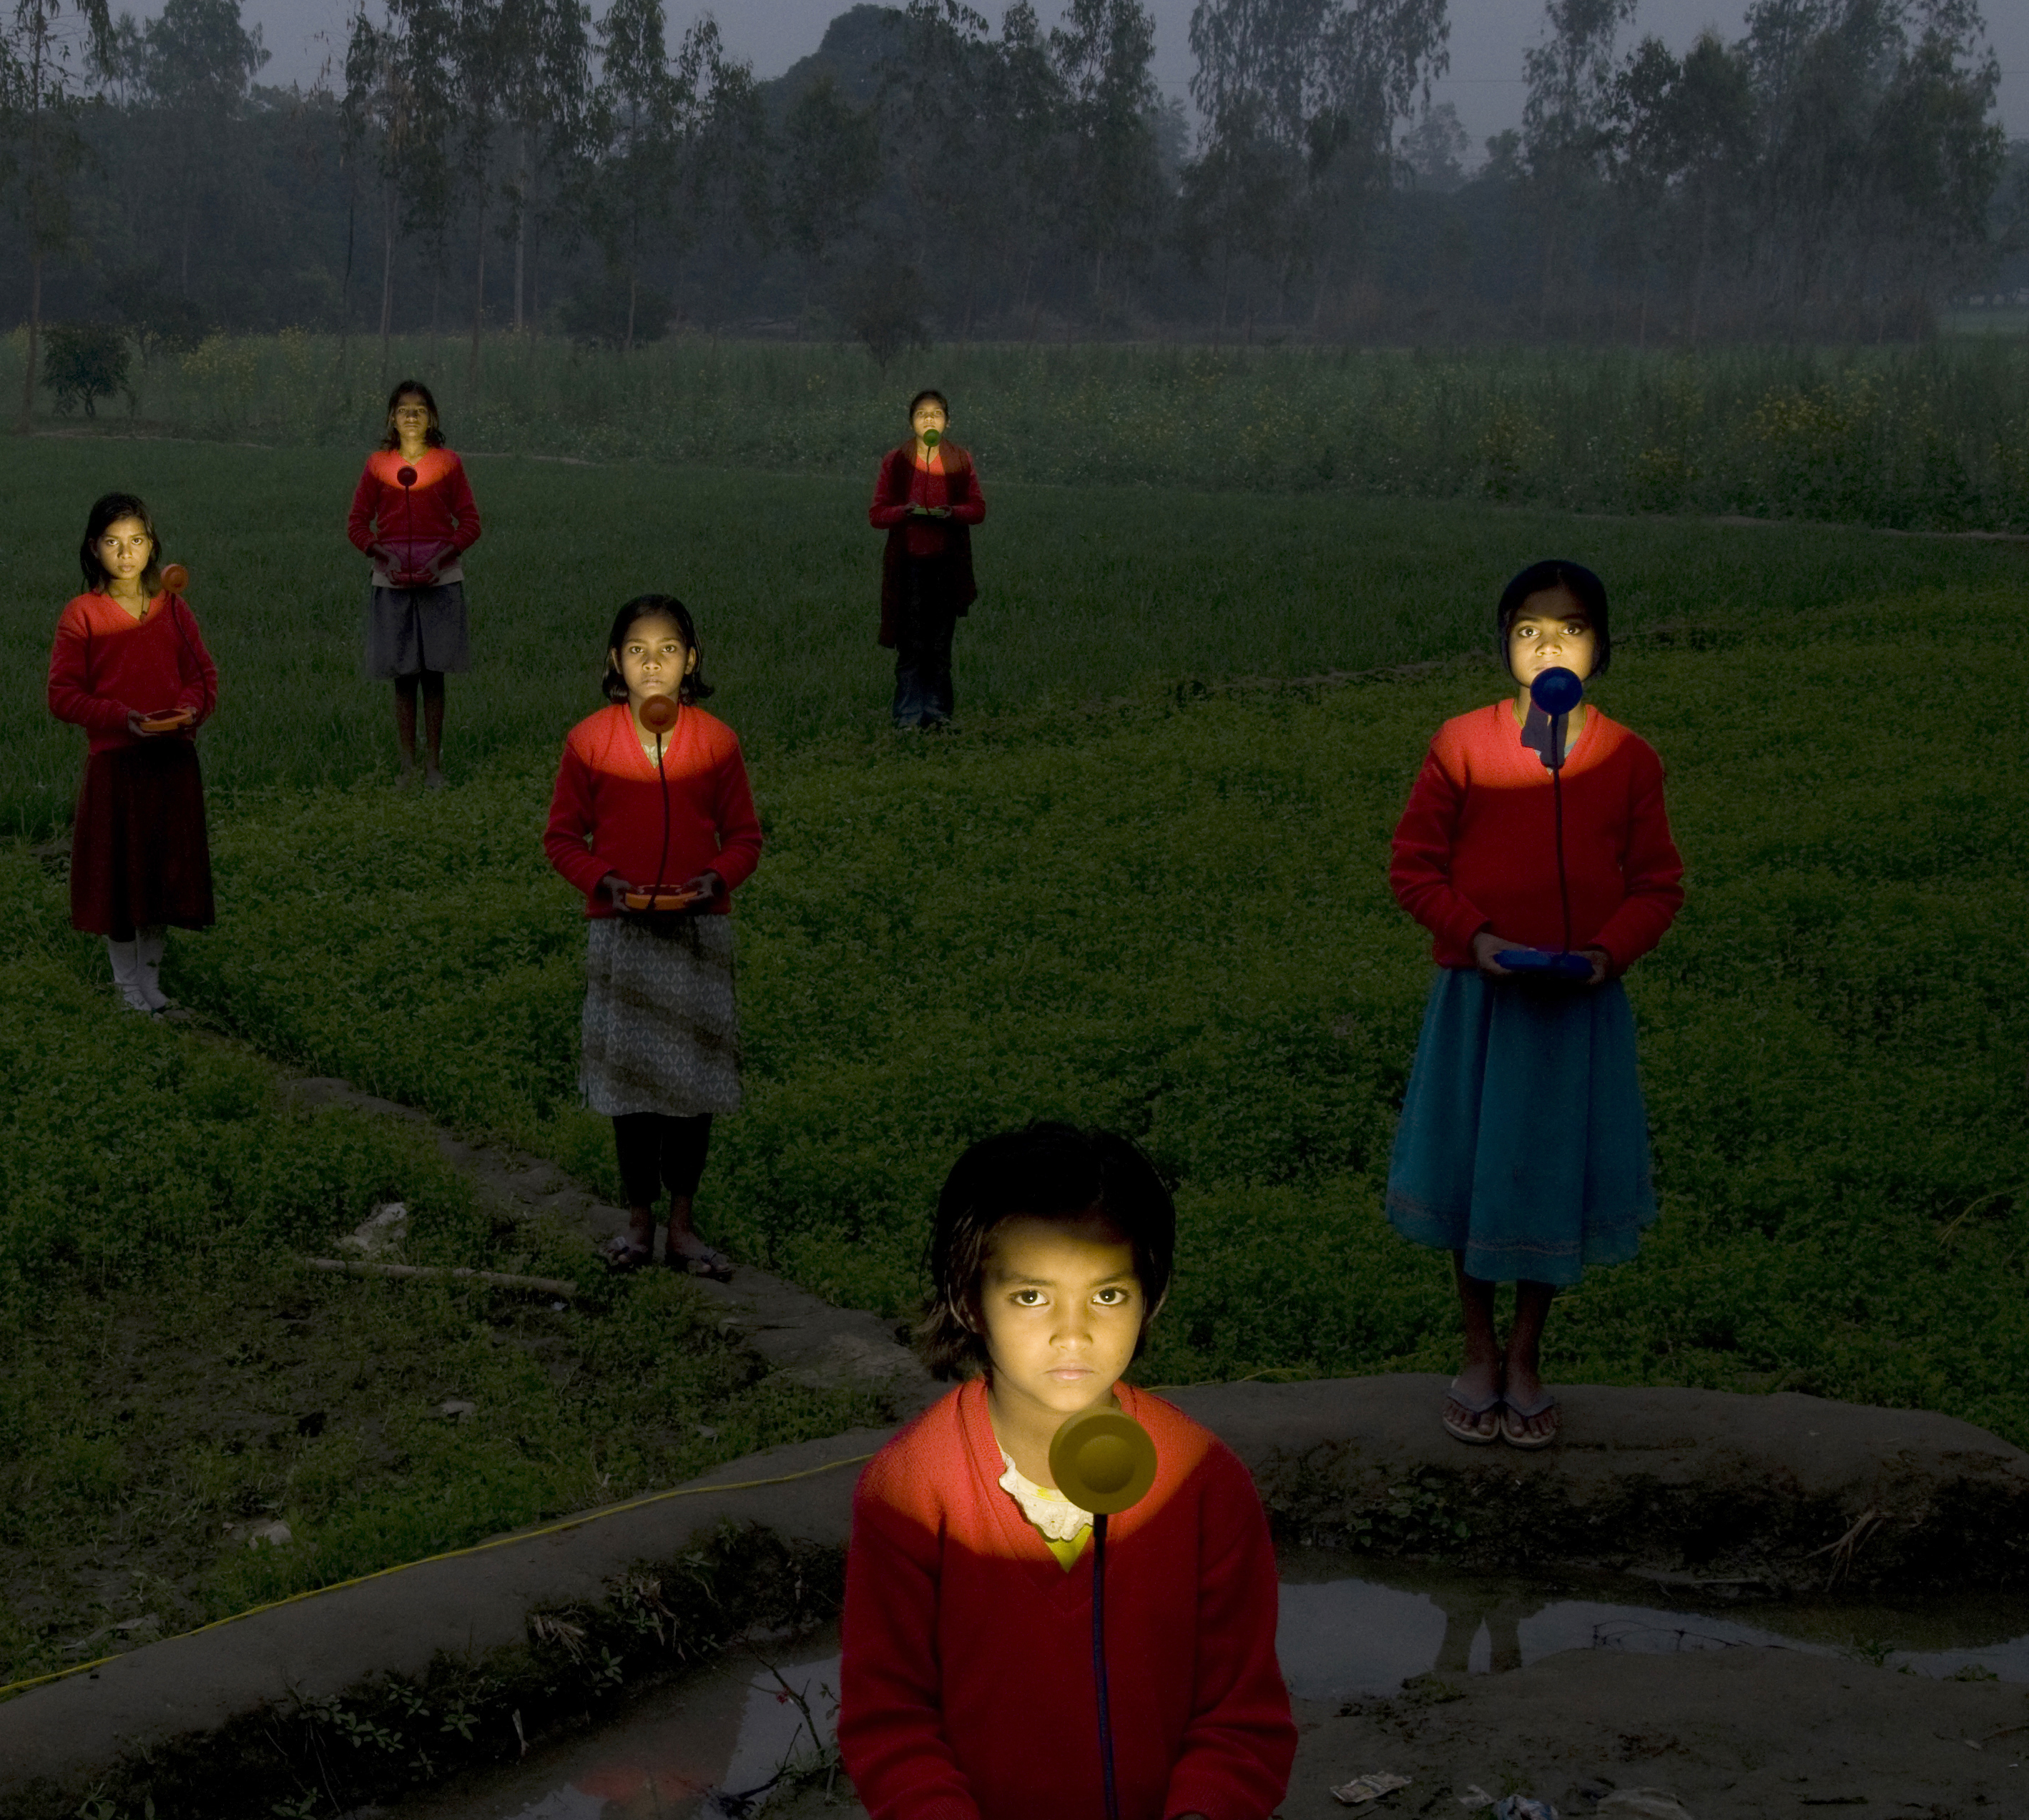
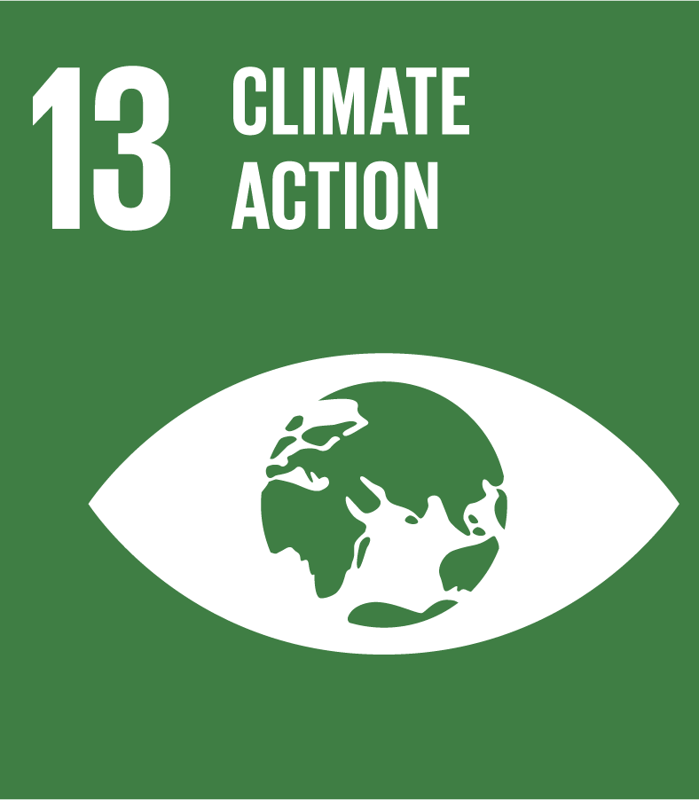
Notes:
The first generation to be impacted by climate change and the last generation who can do something about it..

Slide 16
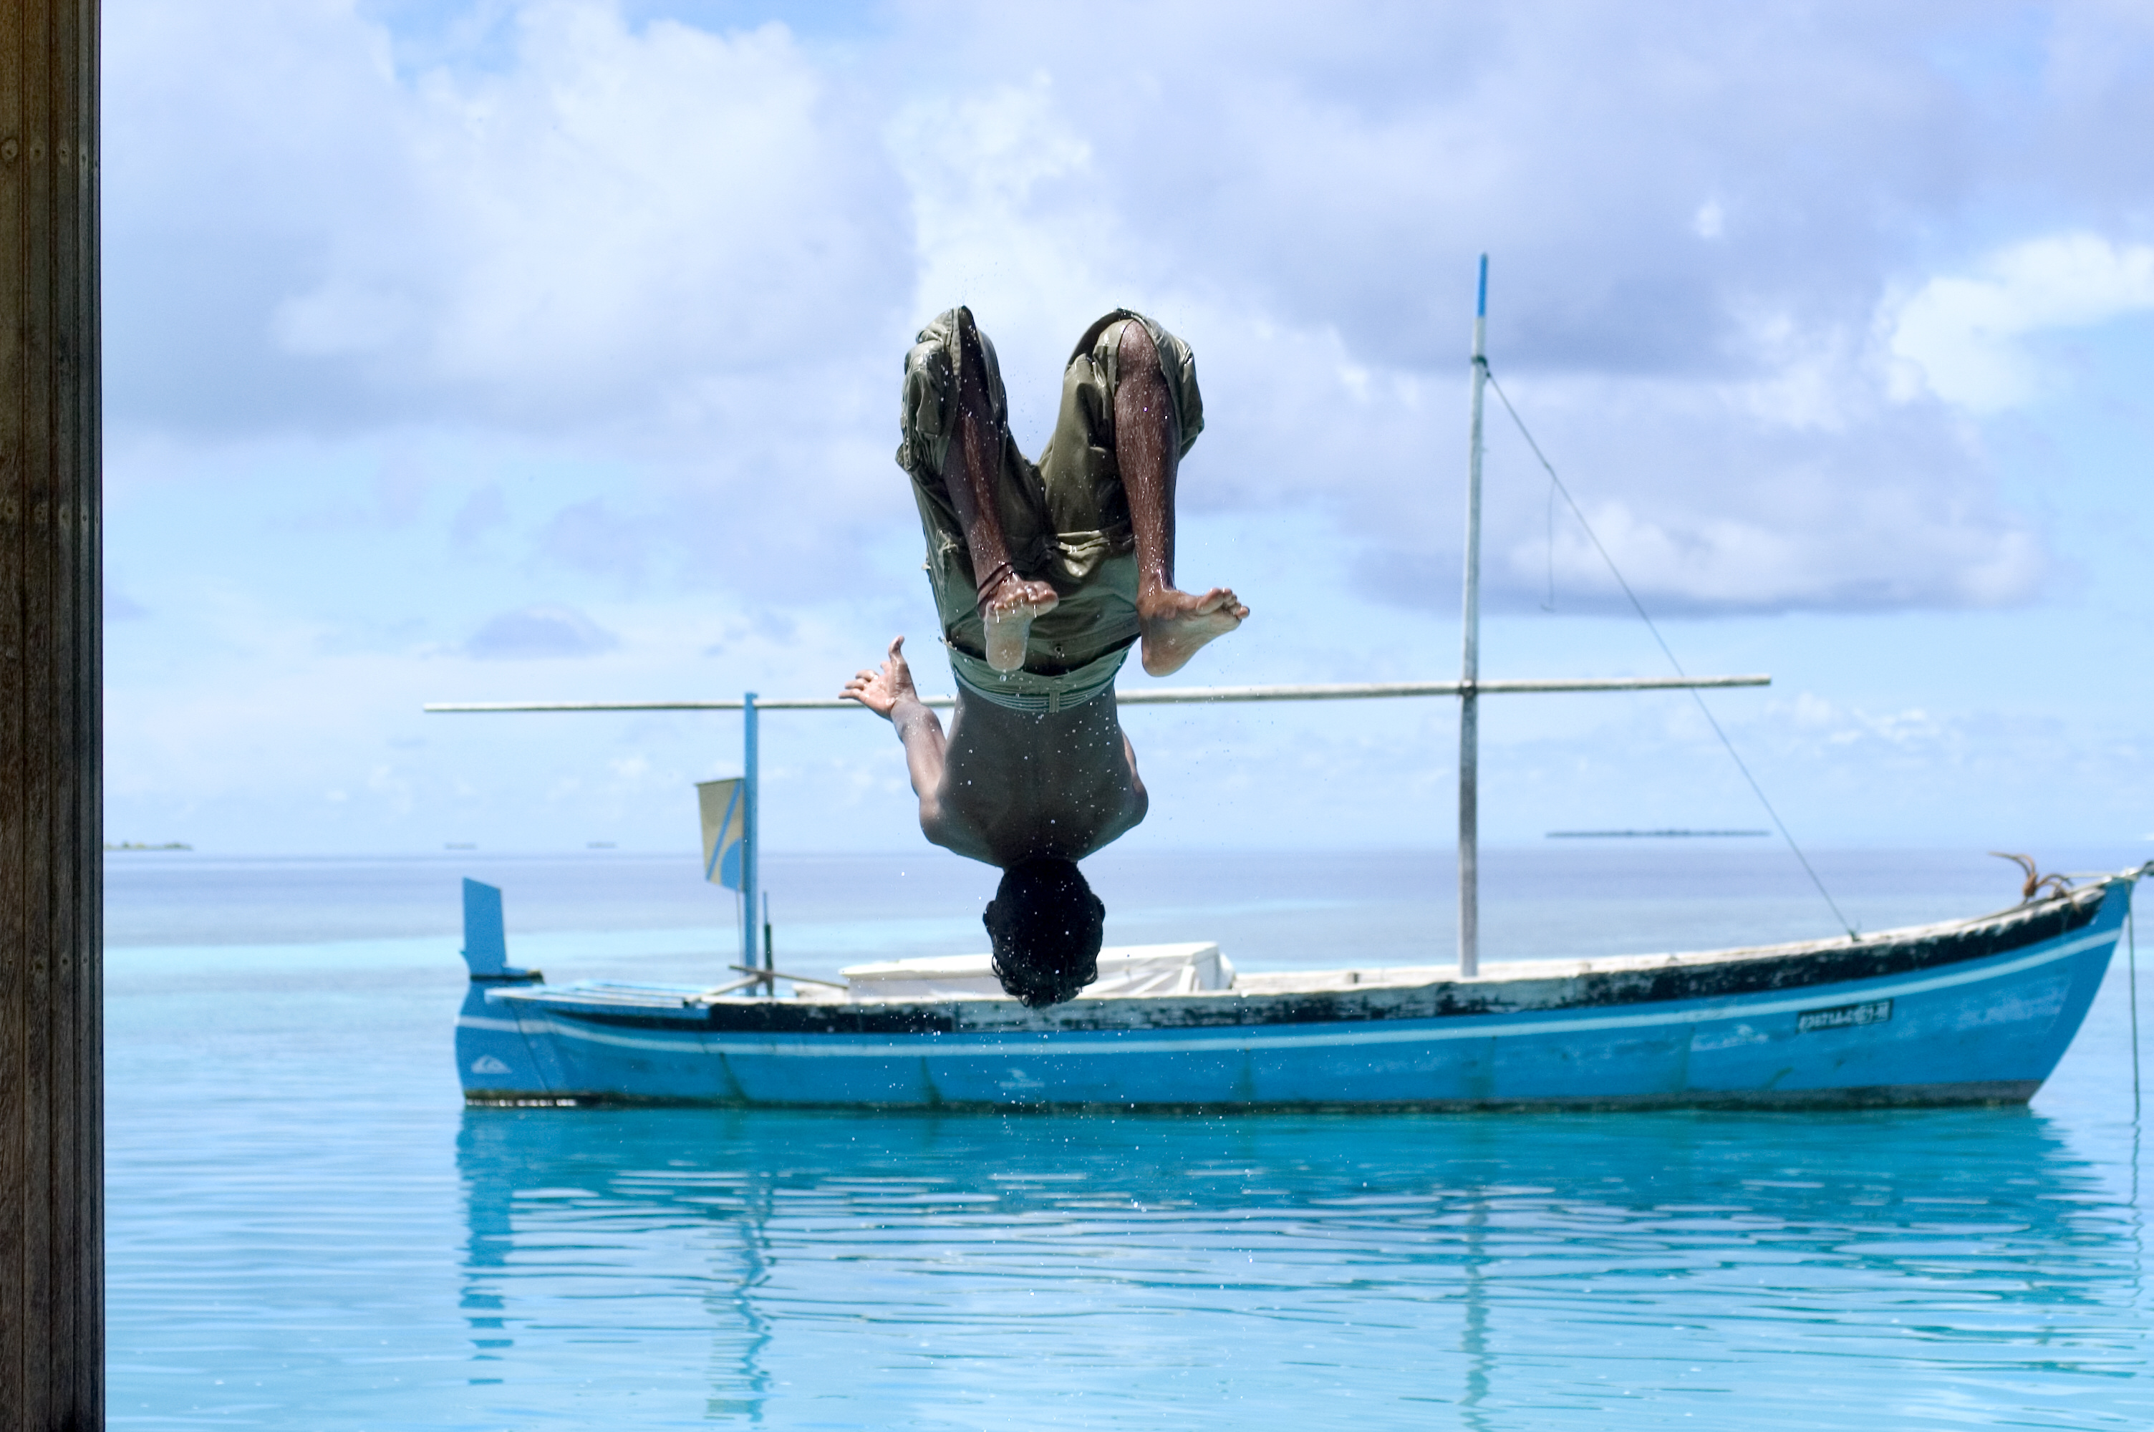
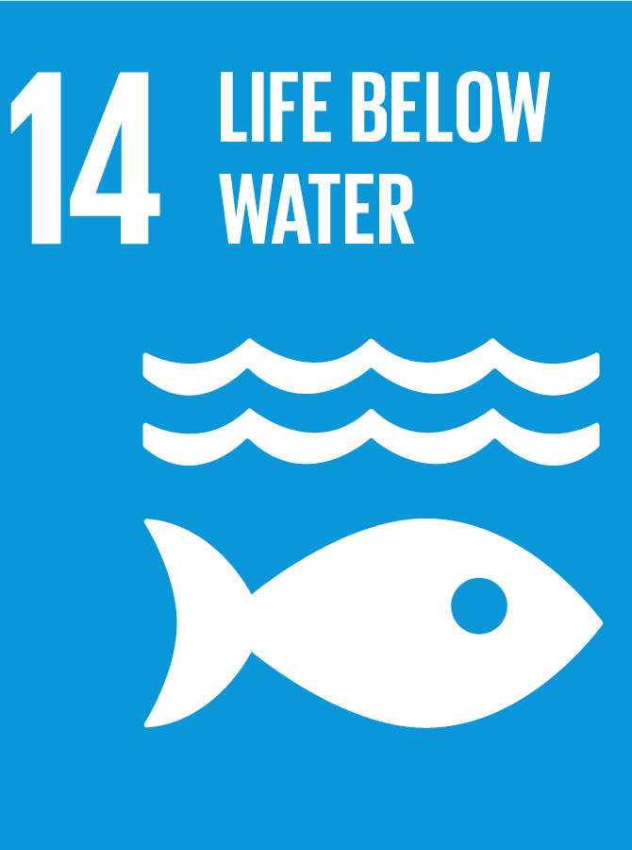

Slide 17
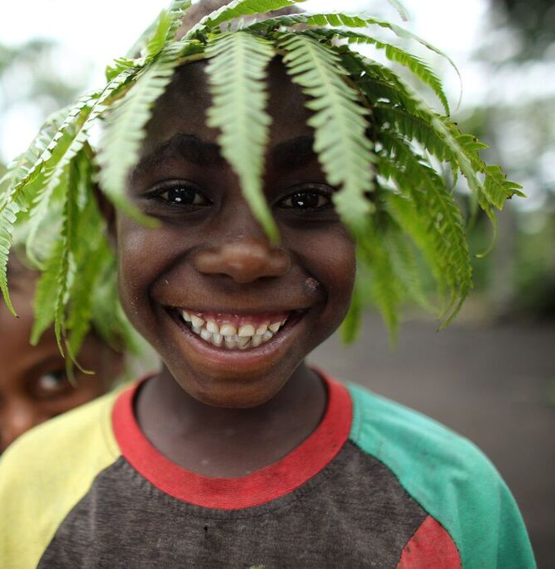
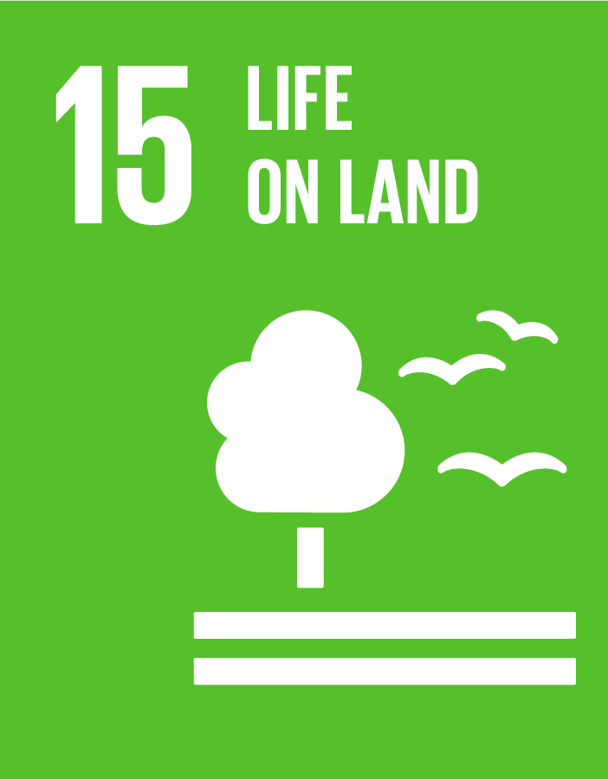

Slide 18
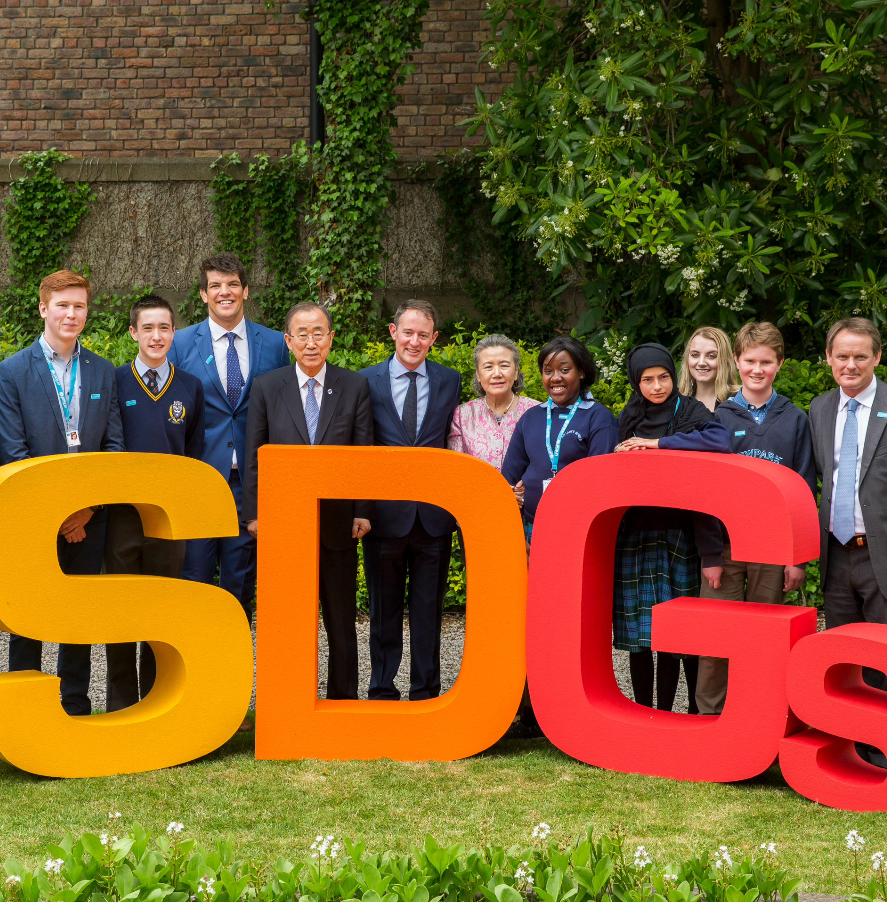
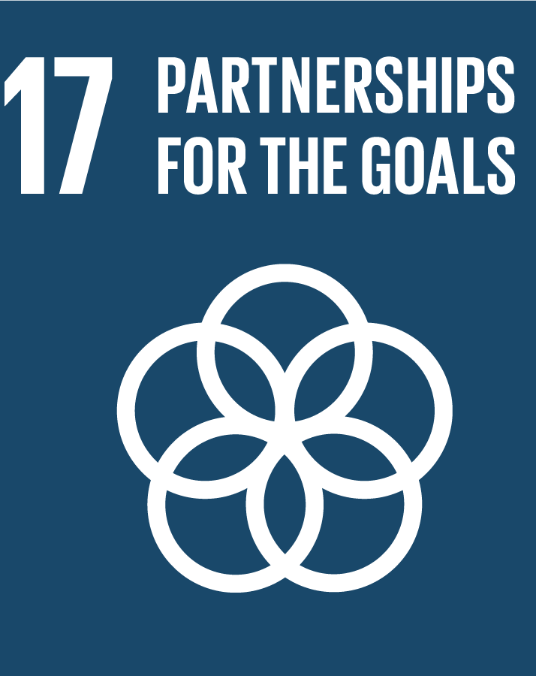

Slide 19
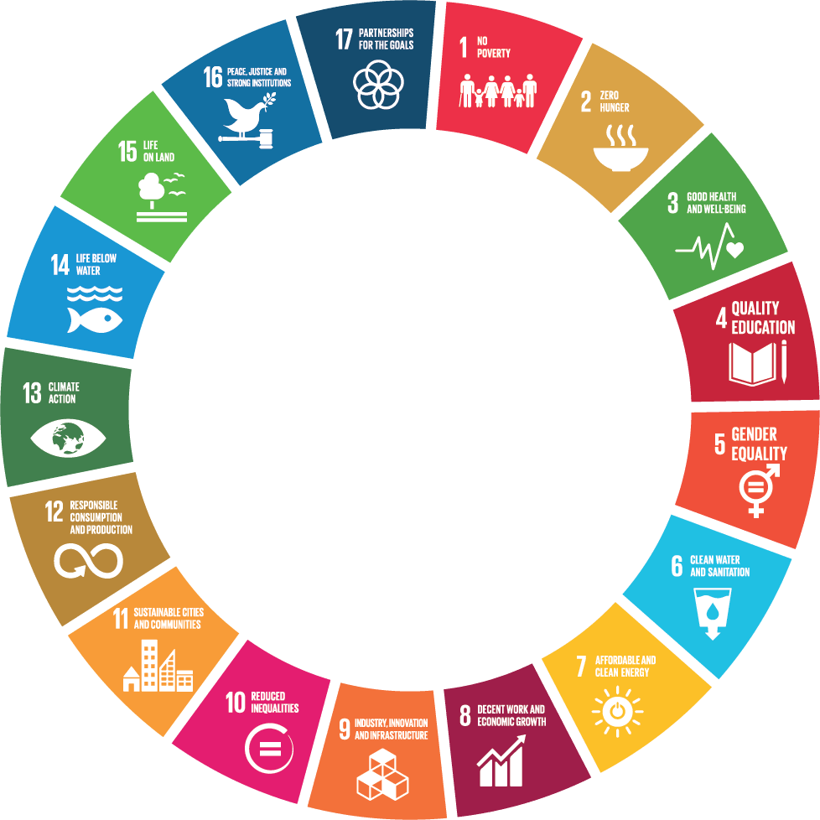
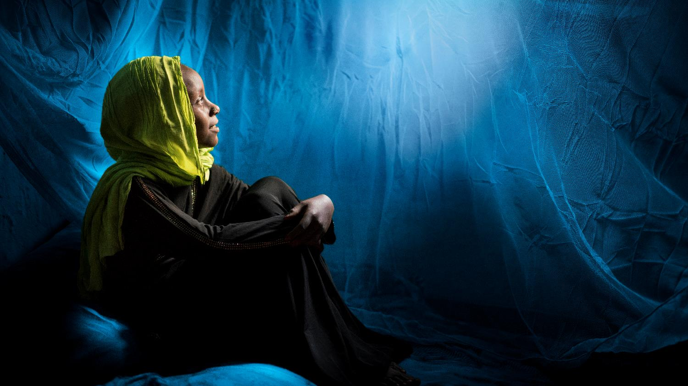

GLOBAL
GOALS
Notes:
Group Work: Divide participants into smaller groups to explore the Sustainable Development Goals. Ask them to identify one goal that is important in their life, one goal that affects their community, and the goal that they think will be most challenging for the global community to solve.
Feedback: Ask participants to share the goals they identified and give their reasons for their choices. Ask participants what they think they can do in their own lives to help achieve the Goals by 2030.

Slide 20
All of the Global Goals are relevant for children, not only those which specifically refer to children. Pair up and divide the Goals among the pairs.
Each pair is to connect their goal to as many Articles / Rights from the CRC.
Example Goal 7. Ensure access to affordable, reliable, sustainable and modern energy for all – relates to Articles 2, 17, 24, 27, 28, 29.
Notes:
https://www.unicef.org/media/60231/file
Example Goal 7. Ensure access to affordable, reliable, sustainable and modern energy for all – relates to
Article 2, all children should have equal access the reliable forms of energy
Article 17, all children should have access to information from a variety of sources today this must include the internet.
Article 24, without access to reliable energy children will be unable to get access to healthcare, heating, cooling, transport etc.
Article 27, children have a right to adequate standard of living this requires affordable sources of clean energy
Article 28, Children need access to energy to support their learning and study

Slide 21
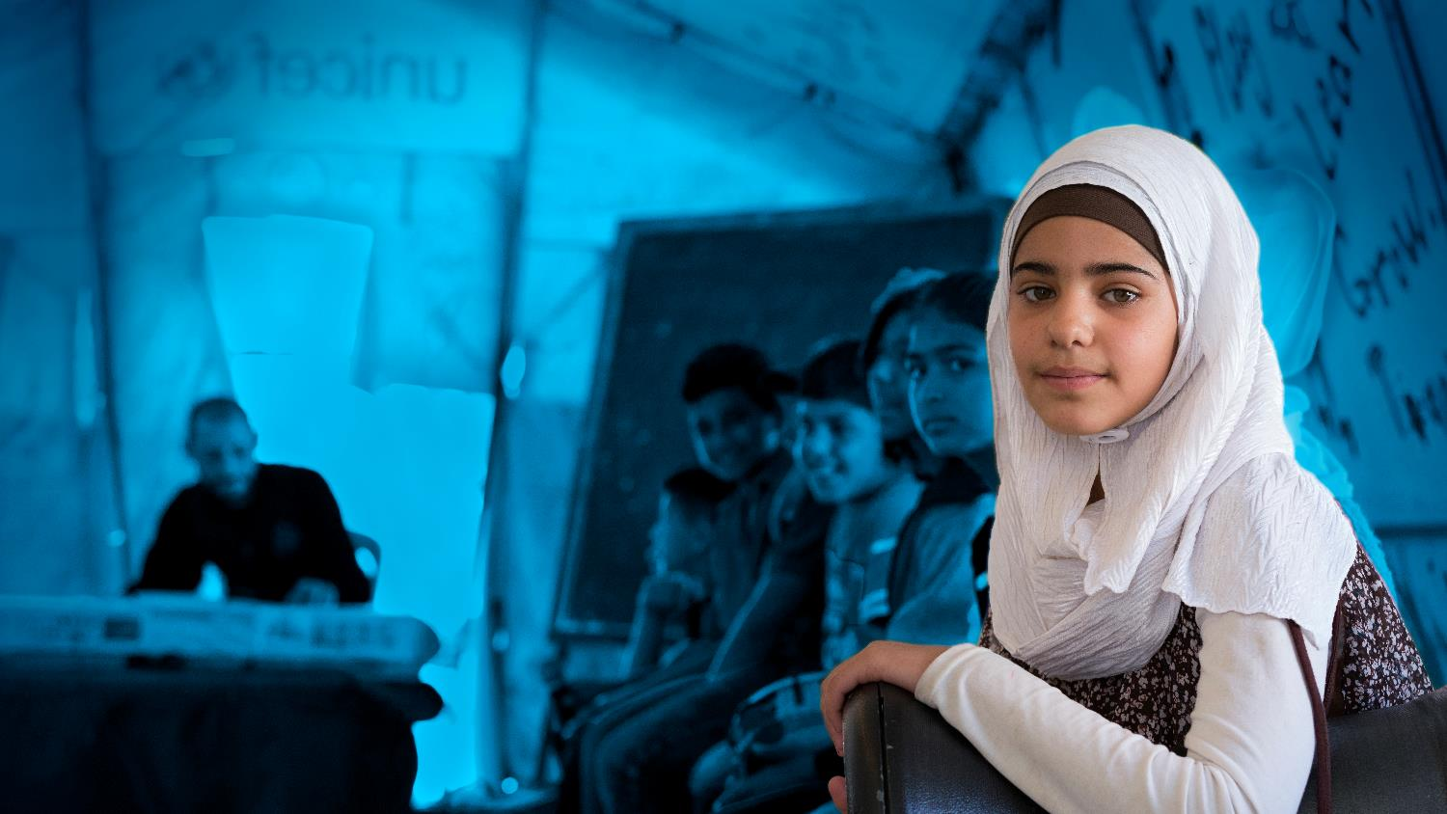
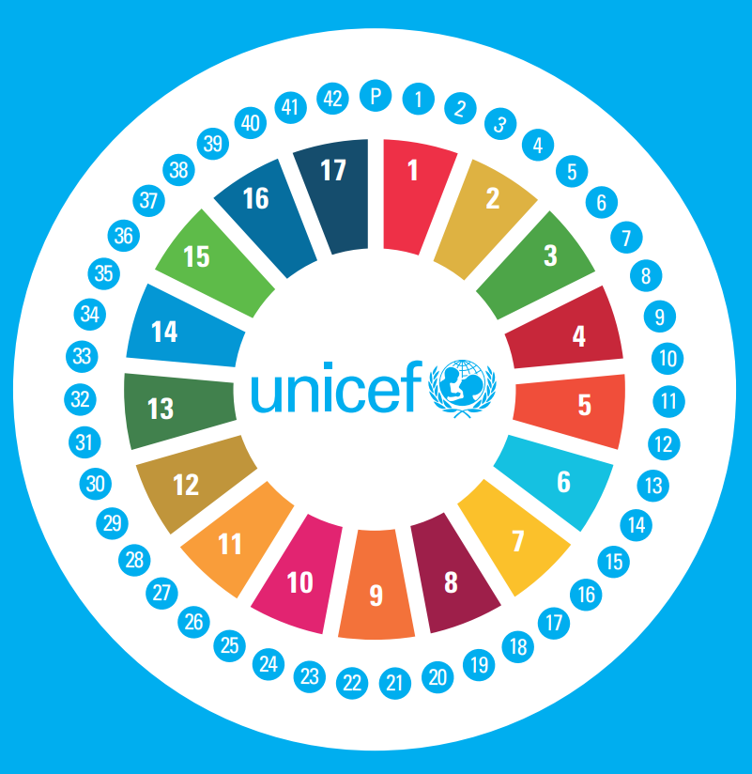
Rights Based Approach to the Global Goals
Notes:
How do these goals relate to your rights? Look at a poster and see what is connected to your rights. Go to this interactive map to find out.
https://www.unicef.org/media/60231/file

Slide 22
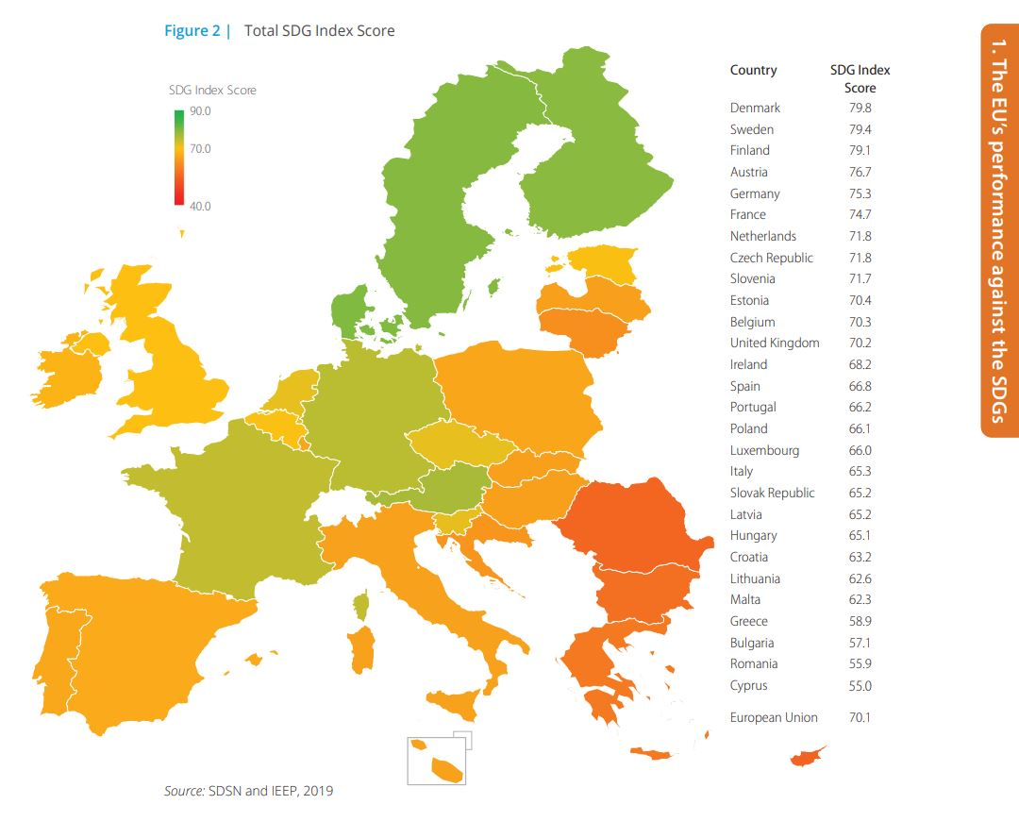

Slide 23
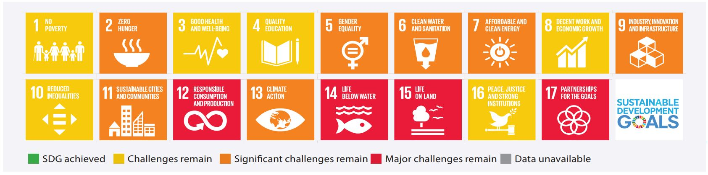
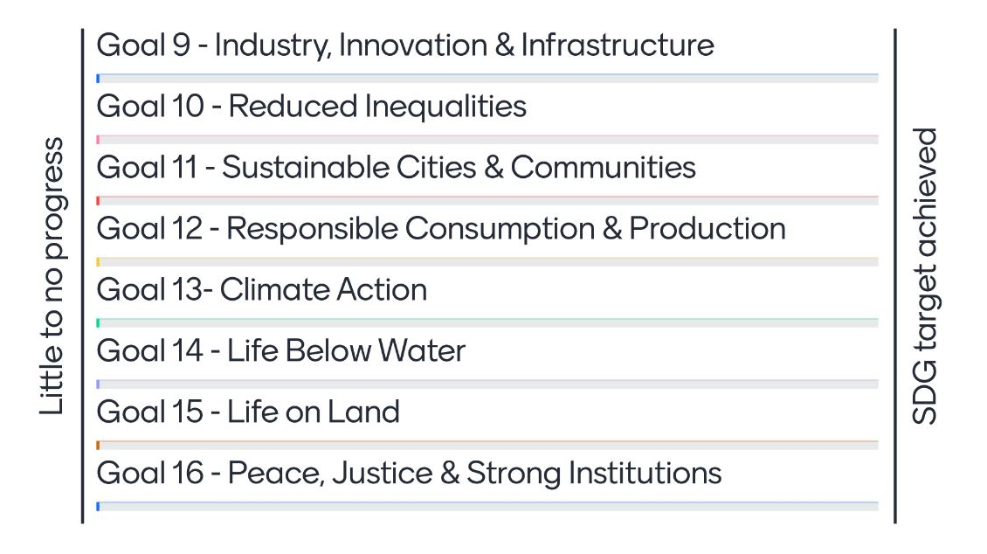
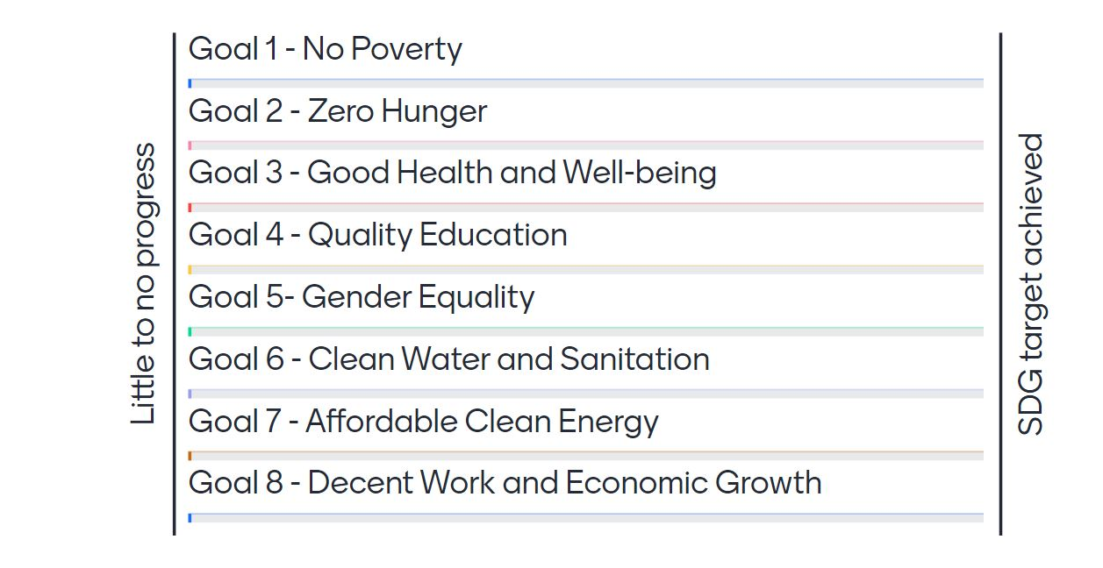
Ireland’s Action on the Goals
Notes:
You will need the 2019 Europe Sustainable Development Report pages 90-91 (Ireland's Report) and a room with space or the use of Mentimeter if working online.
Activity: Assessing the Goals. Ask participants to take a moment and think about each of the 17 Goals and how they relate to Ireland. If in class together get students to line up in the middle of the room/space (hallway or meeting space) and walk toward one wall based on how well they feel Ireland has progressed in achieving each goal. Please note, if they feel Ireland is falling behind on the goal they can also step backwards. If you are delivering the class online use Mentimeter.com and create slides similar to below. With each goals assessment, ask the participants to share their reasoning, particularly those people who are optimistic and pessimistic at the front and at the back of the room.
Group Work: Divide participants into pairs and assign each pair with a Goal. Hand out the progress report for Ireland with performance indicators for each Goal. Ask participants to analyse the targets/indicators in assessing why Ireland is doing well or not so well. Ask participants to consider the indicators and whether or not they offer an accurate reflection of achievement under that Goal. Ask participants to think of other indicators that would better reflect Ireland's performance in achieving the Goal.
Feedback: Ask for feedback for each goal, gather reflections on the indicators: Did any of the indicators or outcomes surprise you? Why were these indicators chosen to measure progress? Are these the same indicators used globally or just in the EU, why/why not? Should wealthier nations set higher targets or use different indicators than poorer nations? Who should be involved in deciding what indicators are used the measure progress?
Extension: Go to Ireland's SDG data hub to allow for more in-depth analysis and exploration of Ireland's indicator data sets.

Slide 24
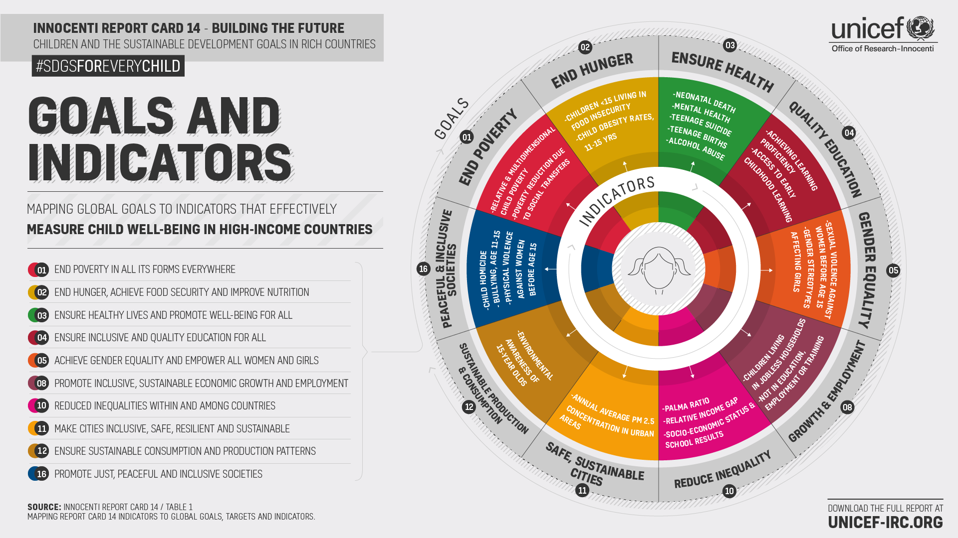
Notes:
Should children and young people have their own set of indicators? For more information about indicators for the wellbeing of children read UNICEF's Report on Children and the Sustainable Development Goals
What might SDG indicators be measured for children.

Slide 25
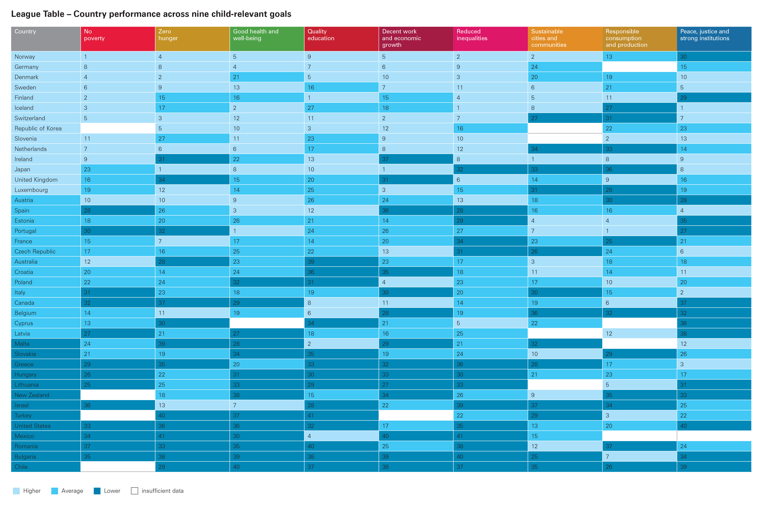
Notes:
The aim of this activity is for participants to consider the progress of the SDG as of 2020. It then prompts learners to think about the interconnectedness of the SDGs.
Discussion: Ask participants which goals they think will are on track to meet their 2030 targets and which goals are behind schedule. Ask them how the Covid pandemic has impacted on the Goals. (3-5 minutes) Watch the video below (10 minutes) and continue the discussion.
Did any information surprise you?
Why do you think some goals have hit their targets while others have not?
What needs to be done to help reach targets?
Group Work: Start by watching the second video below, on life in a remote village in South Sudan. Divide participants into smaller groups, ask them to choose three Goals and discuss their interconnectedness. Ask them to determine how a lack of progress in one goal might impact on the other two. For example, how Poverty, Gender, and Climate affect each other. Ask participants to consider based on their discussions, the difference in impact between children and adults. For example, how might a climate-related, natural disaster impact on a child's life versus and adults life?
Extension: Take the Gapmider test, to find out what you know about the SDGs and what are misconceptions.

Slide 26
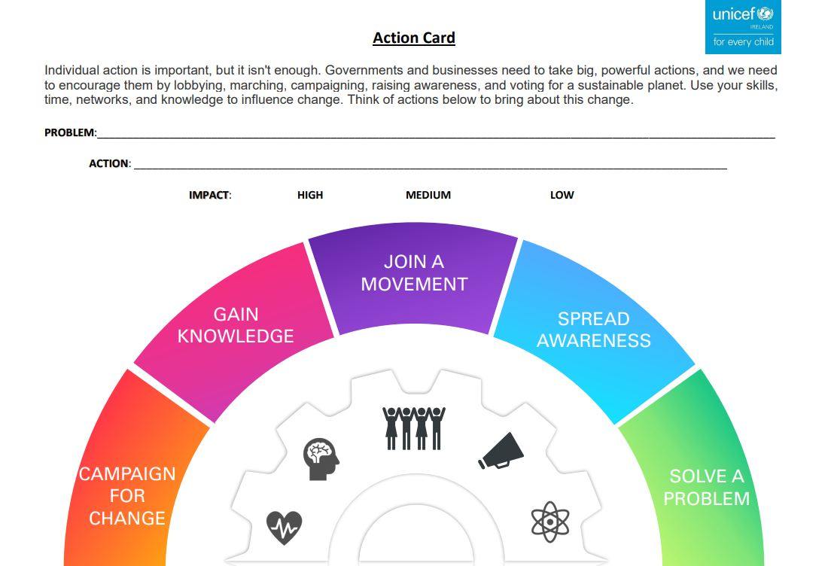
Notes:
Reflection: Ask participants to help make this a decade of action to achieve the Goals by 2030. Ask participants to reflect on their learning and...
Choose an issue they wish to focus on as a changemaker.
Make a personal pledge - one goal/action to undertake for the next year to achieve change for the chosen issue.
Devise indicators that will show progress
Set three dates for assessing and monitoring progress.

Slide 27
