Slide 1
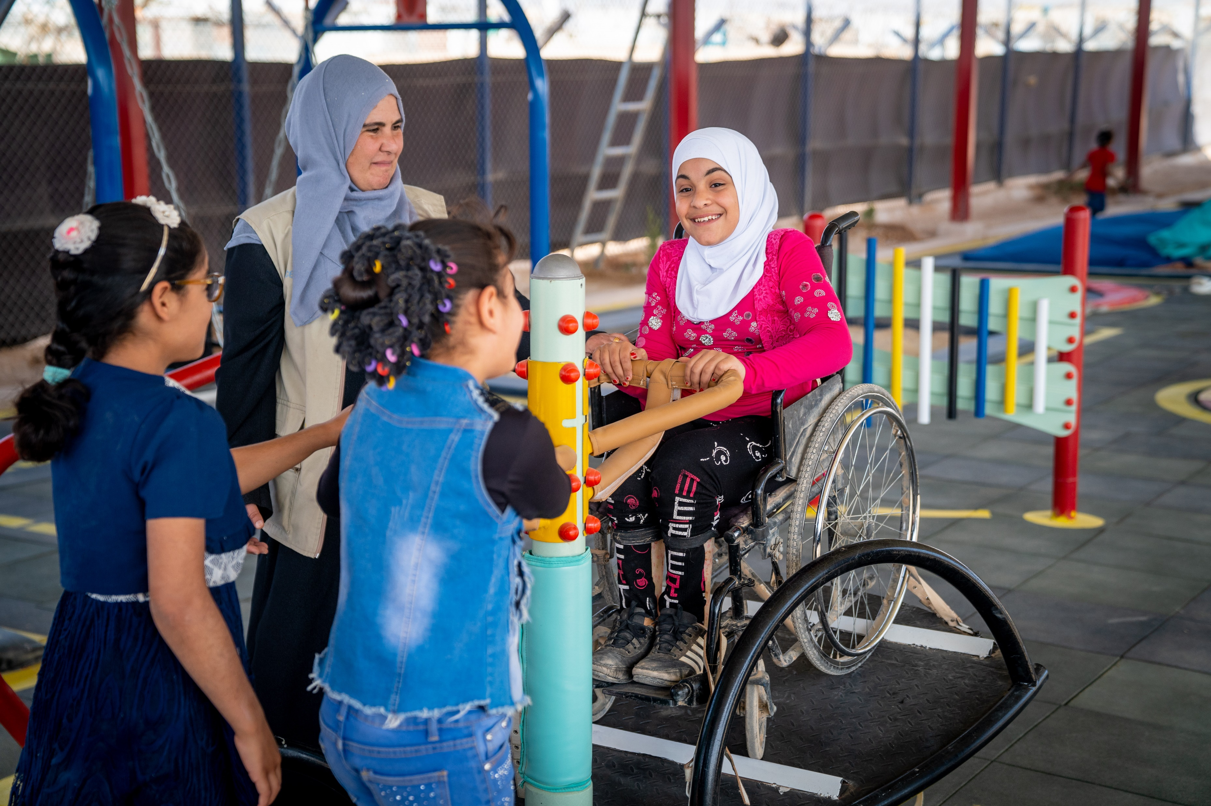

ARTICLE IN FOCUS
UNICEF/HERWIG
Notes:
Children attending classes at inclusive primary school Despot Stefan Lazarevic in Belgrade, Serbia.

Slide 2
BEFORE YOU BEGIN
This is a flexible resource and is intended to provide you with some easy to use, appropriate rights-related learning to share with your children, their families and your colleagues.
Please edit out non relevant slides or activities before sharing with your students. Please check that the content works for your learners and feel free to adapt or add any content that would make the material more relevant for your setting.
This resource was developed by UNICEF UK and adapted by UNICEF Ireland.
Slide 3 – Guess the article
Slide 4 – Introducing Article 2
Slide 5 – Exploring Article 2
Slide 6 – Some possible answers
Slide 7 & 8 – Activities for the classroom
Slide 9 - Reflection
Slide 10 – Further support

Slide 3
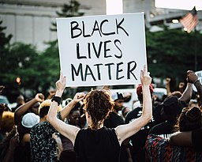
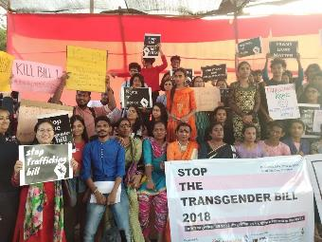
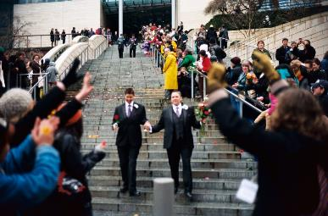
GUESS THE ARTICLE
These pictures provide a clue to the articles in focus.
How do these pictures help you? Can you guess how they are linked together?
Write down your thoughts or discuss with someone in your class.
All WikiCommons – see presenter notes for descriptions
Notes:
From left to right:
1. Mumbai, India, December 2018: Members of the transgender community in India and allies protesting against the regressive provisions of the Transgender (Protection of Rights) Bill. Wikicommons
2. Recently married couples leaving the City Hall in Seattle are greeted by well-wishers on the first day of same-sex marriage in Washington state after enactment of Washington Referendum 74 Dennis Bratland/Wikicommons
3. Baltimore, US, July 2016: An image from a Black Lives Matter march through downtown Baltimore City. John Lucia/Wikicommons – licence: https://creativecommons.org/licenses/by/2.0/deed.en

Slide 4
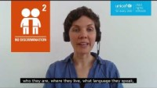

No child should be treated unfairly for any reason.
All children have all the rights in the Convention.
It doesn’t matter:
who they are
where they live
what language they speak
what their religion is
what they think
what they look like
if they are a boy or a girl
if they have a disability
if they are rich or poor
who their parents or families are
what their parents or families believe or do.
INTRODUCING ARTICLE 2
Press play to watch the video or click here to watch on YouTube

Slide 5
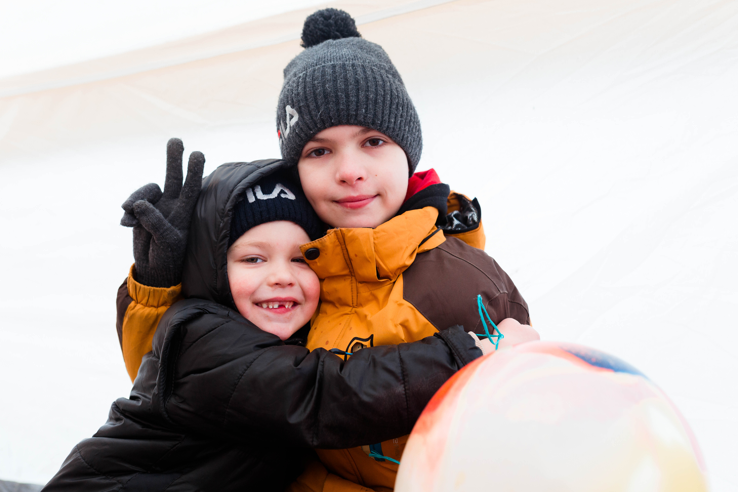
EXPLORING ARTICLE 2
What is needed for every child to be able to enjoy all their rights fairly and equally?
Discuss with the person next to you, write down your thoughts and compare with the next slide.
UNICEF/UN0609301/Vladimir
Notes:
On 16 March 2022, 11-year-old Dima (right) and 5-year-old David (left) from Mykolayiv play at a UNICEF child friendly space in the Blue Dot hub of Palanca, Republic of Moldova.
Children and families continue to flee the war in Ukraine to the Republic of Moldova and other neighboring countries. In collaboration with UNHCR, central and local authorities, as well as other partners, UNICEF Moldova is establishing and operationalizing Blue Dots at the border crossings and the capital city Chisinau to support children and families on the move.
Blue Dots are one-stop hubs that offer a minimum set of key services to families from a range of partners, under one neutral logo (blue dot). They have become a recognizable trade of emergency assistance and have proven to be a good example of collaboration among partners, namely UNHCR, ICRC and UNICEF, always in close collaboration with local authorities and partners.
Blue dot services can include: registration, protection of unaccompanied children, restoring family links, child friendly spaces, dedicated mother and baby/toddler spaces, legal counselling, medical and psychosocial first aid, access to accommodation and transport for the travel onwards.

Slide 6
HOW MANY OF THESE DID YOU GET?
Every young person and child should know that their race, gender, ability, nationality (or other characteristic or identities) should not stop them enjoying all their rights.
Nobody should feel that they are treated differently because of who they are.
All people should accept, respect and value others for who they are.
All schools should teach and practise and actively celebrate respect for all.
Learning should include opportunities to empathise with those who are discriminated against.
Government decisions and the law should show the way against all forms of discrimination.
Everyone should be open to the fact that we all have prejudices and be ready to challenge them.
People challenge and speak up about any discrimination they experience or see.
Newspapers and other information sources should promote and celebrate diversity and inclusion.
What else did you think of? Are there any other characteristics or identities that might cause a person to be discriminated against?

Slide 7
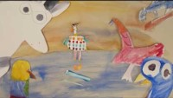
ACTIVITIES FOR THE CLASSROOM
Article 2 uses some words you might not know very well. Look up discrimination, ethnicity, race and gender to find out what they mean.
Explain Article 2 to somebody at home now that you know the meaning of these words.
Imagine that you are treated differently and not allowed to go to school, have friends and play because of the colour of your hair. … How would this feel? What would you say and do?
Being happy and proud about who we are as people is important. Have you read ‘The Flamingo Who Didn’t Want To Be Pink’? Watch the story made by children at William Tyndale School. Discuss with your friends the things they like about themselves and the things they like about you.
Think of somewhere that you go in your community. It might be a library, a park or a swimming pool. Does it welcome everyone? Can all children take part there equally? Discuss what could make this place better for everyone.

Slide 8
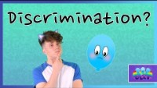
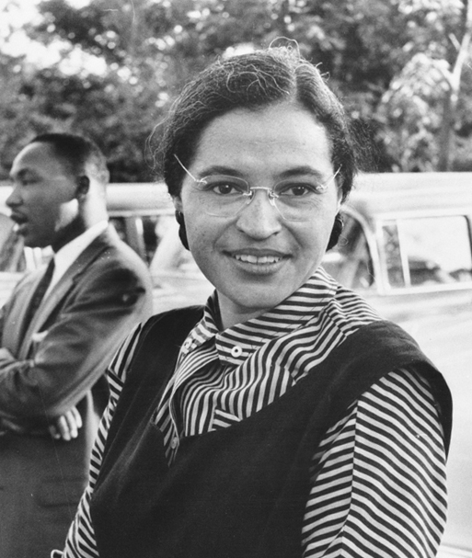
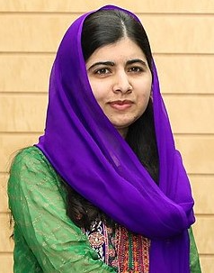
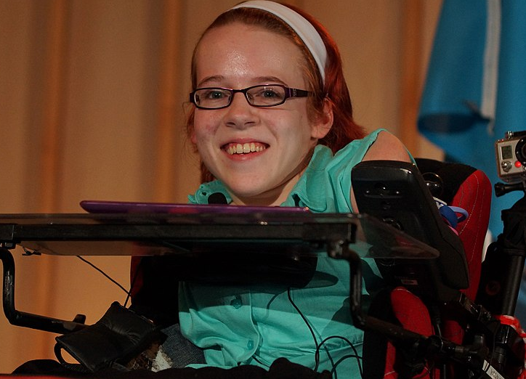
ACTIVITIES FOR THE CLASSROOM
Discrimination is against rights. In Ireland it is also against the law. Watch this video to learn more. The video says ‘set a good example’. How can you do this in school?
Complete this questionnaire to find out if every child feels welcome and accepted at school.
If not, discuss what changes can be made so they do.
Think about people who have campaigned against unfair discrimination. For example Joanne O’ Riordan; Rosa Parks; Malala Yousufzai. Find out more about what they campaigned for and share with your school.
All WikiCommons
Notes:
Photo on left Joanne O’Riordan
Middle photo Rosa Parks
Photo on right Malala Yousufzai

Slide 9
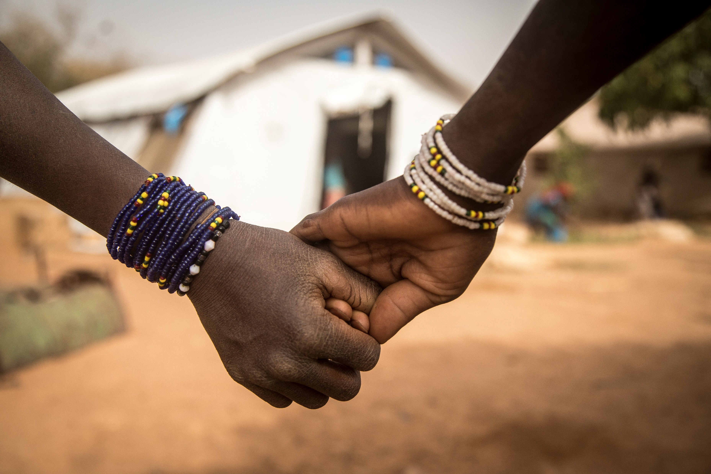
REFLECTION
Find somewhere peaceful and spend a few minutes being quiet and still … then think about these questions…
What makes you different from everyone else? What makes you proud to be you?
What could you do or say to other people to help them feel good about who they are?
When you see or hear racism and other forms of discrimination what do you do to challenge what you see?
UNICEF/UN0692766/Keita

Slide 10


FURTHER CHILD RIGHTS EDUCATION SUPPORT
Child Rights Schools is a programme that supports you to embed child rights across the primary school. Find our more here.
Find more classroom resources here.

Slide 11

THANK YOU

