Slide 1
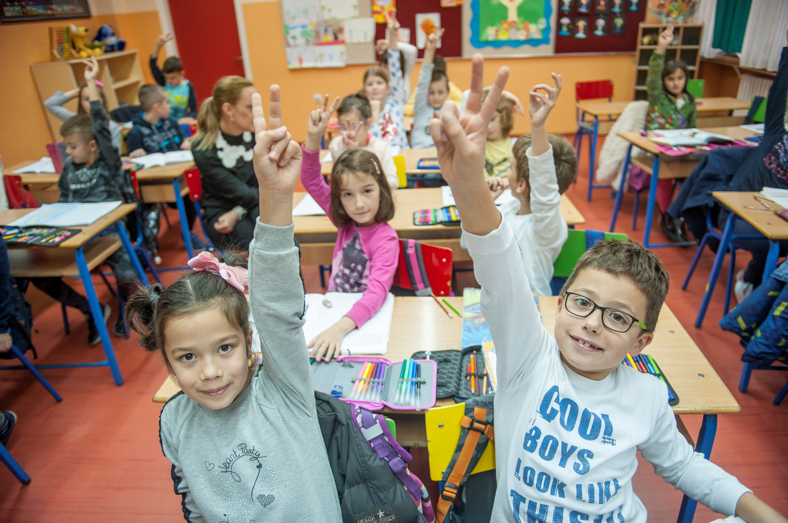
ARTICLE IN FOCUS
UNICEF/PANCIC
Notes:
Children attending classes at inclusive primary school Despot Stefan Lazarevic in Belgrade, Serbia.

Slide 2
BEFORE YOU BEGIN
This is a flexible resource and is intended to provide you with some easy to use, appropriate rights-related learning to share with your children, their families and your colleagues.
Please edit out non relevant slides or activities before sharing with your students. Please check that the content works for your learners and feel free to adapt or add any content that would make the material more relevant for your setting.
This resource was developed by UNICEF UK and adapted by UNICEF Ireland.
Slide 3 – Guess the article
Slide 4 – Introducing Article 1 & Article 42
Slide 5 – Exploring Article 1 & Article 42
Slide 6 – Some possible answers
Slide 7 & 8 – Activities for the classroom
Slide 9 - Reflection
Slide 10 – Further support

Slide 3
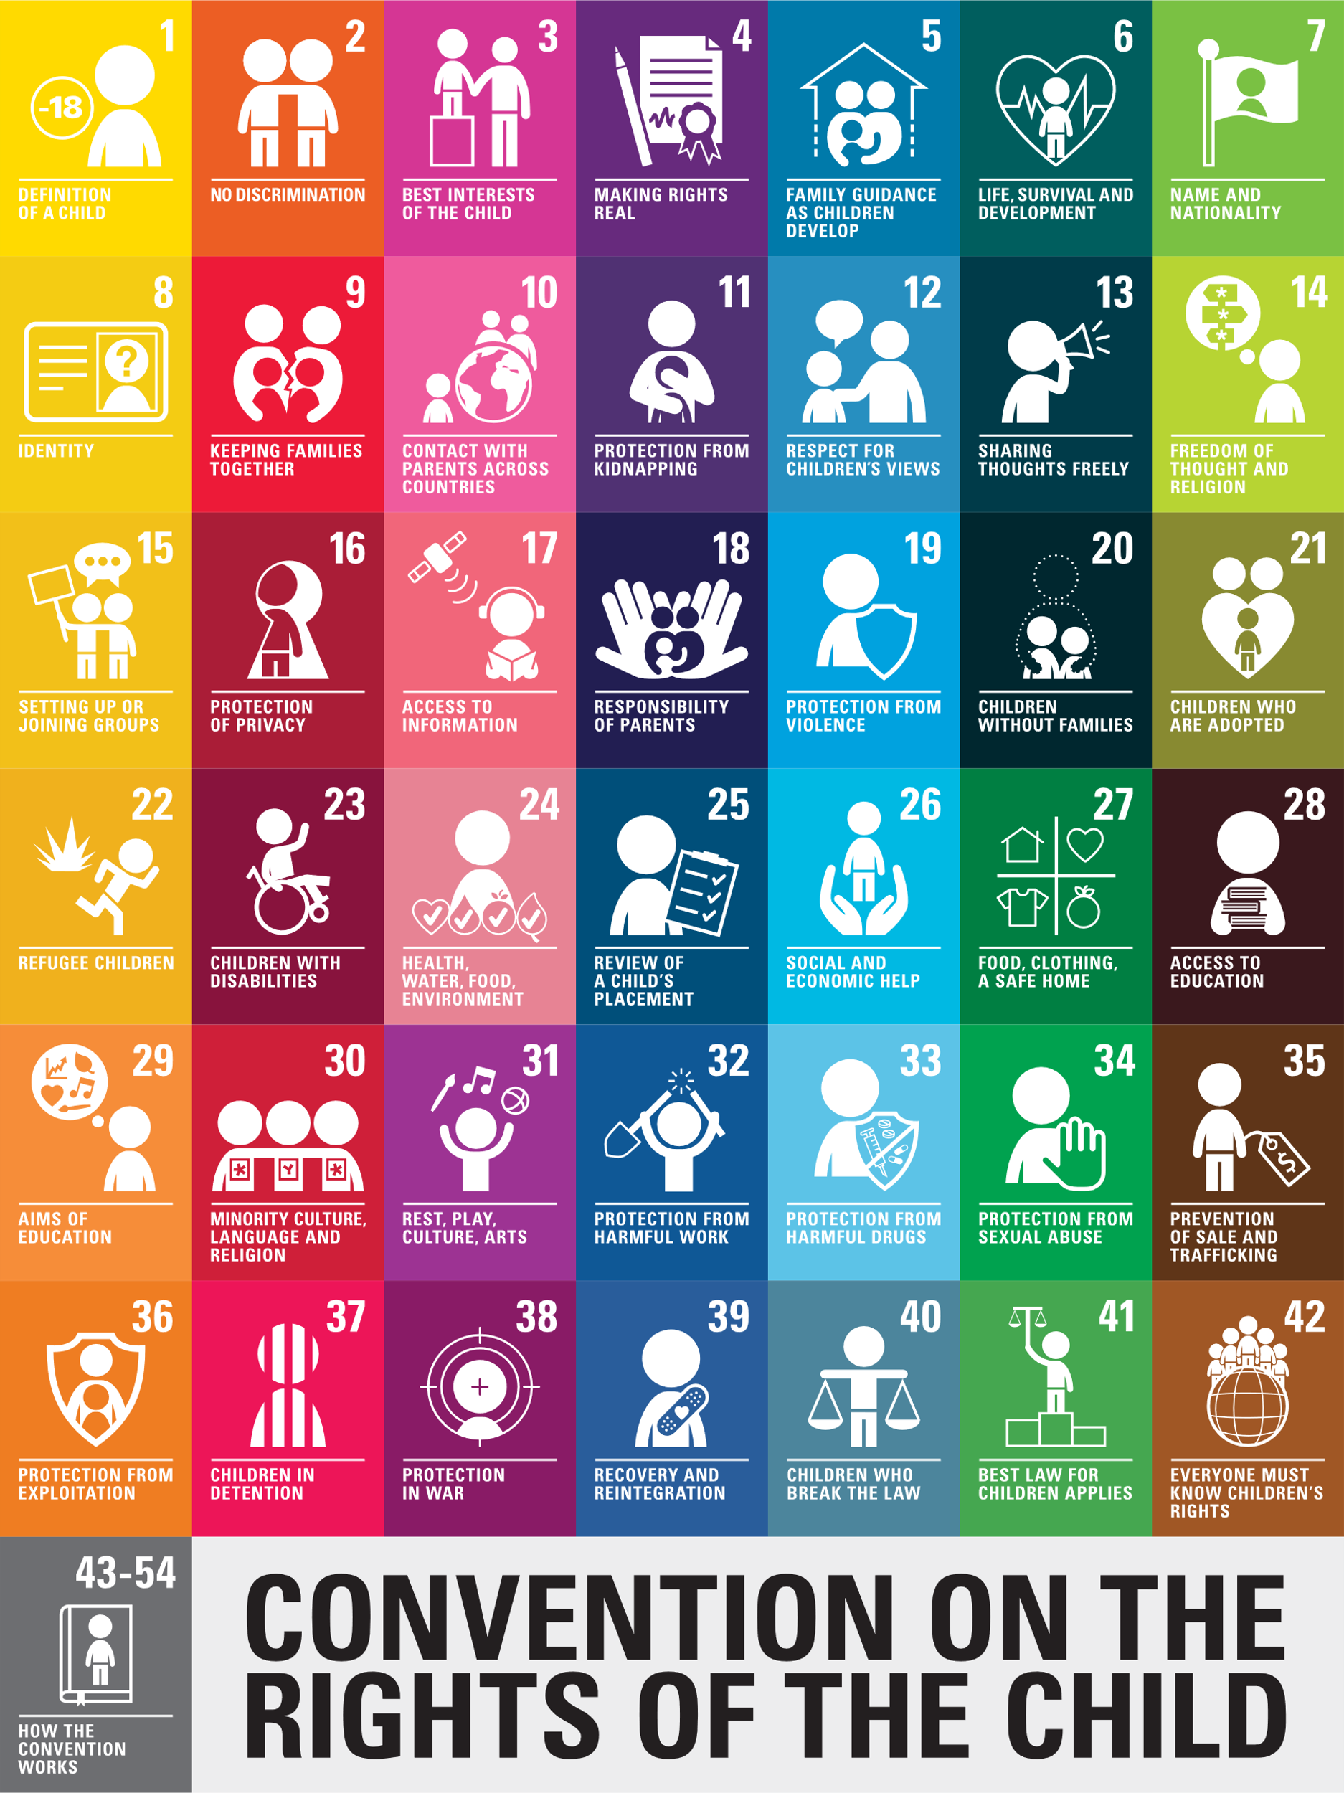
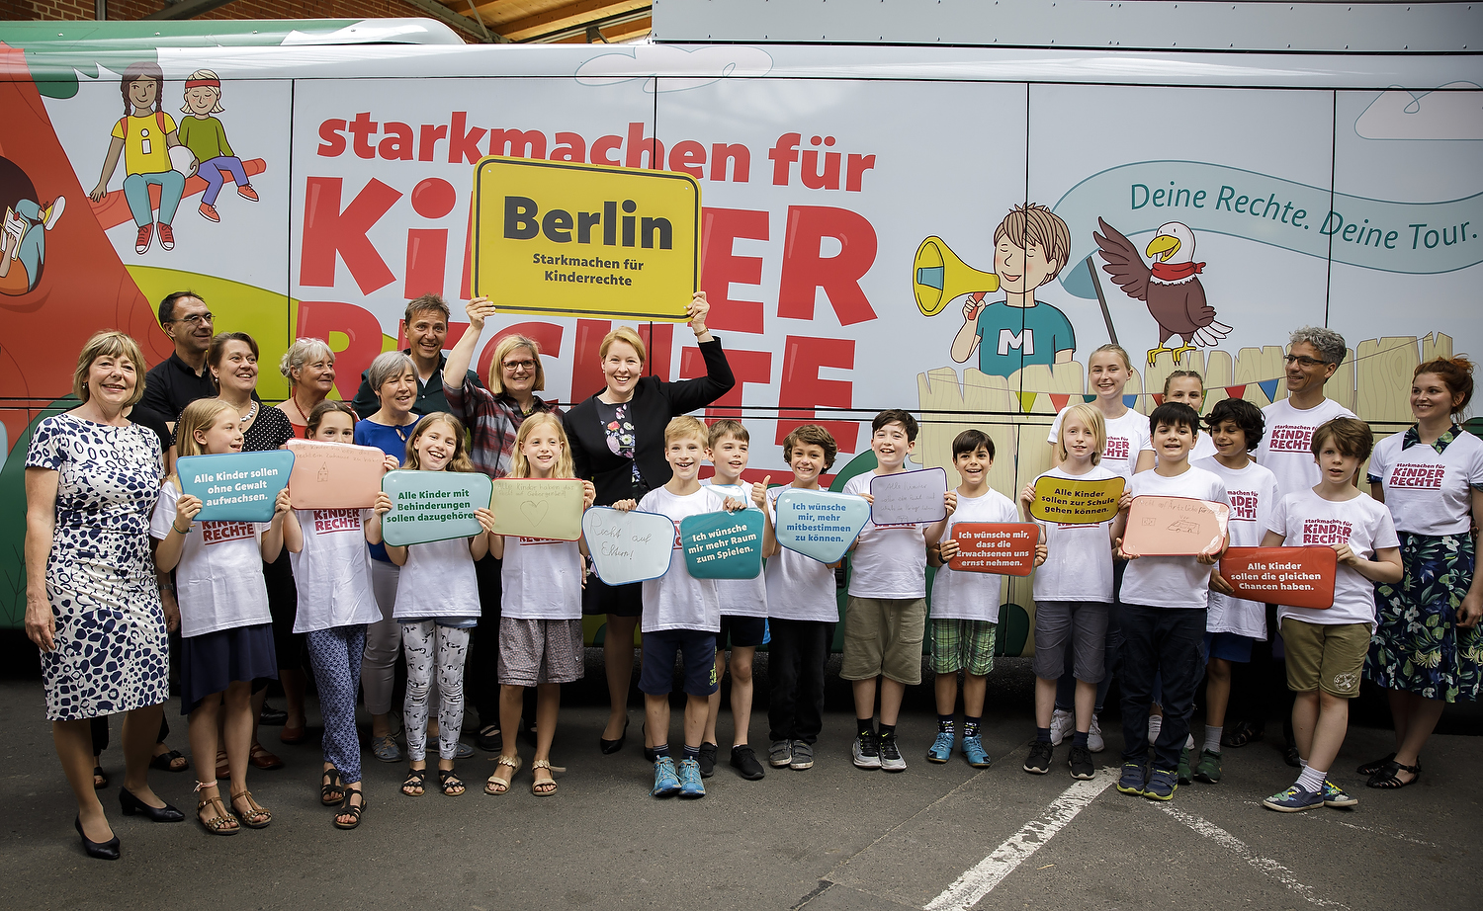
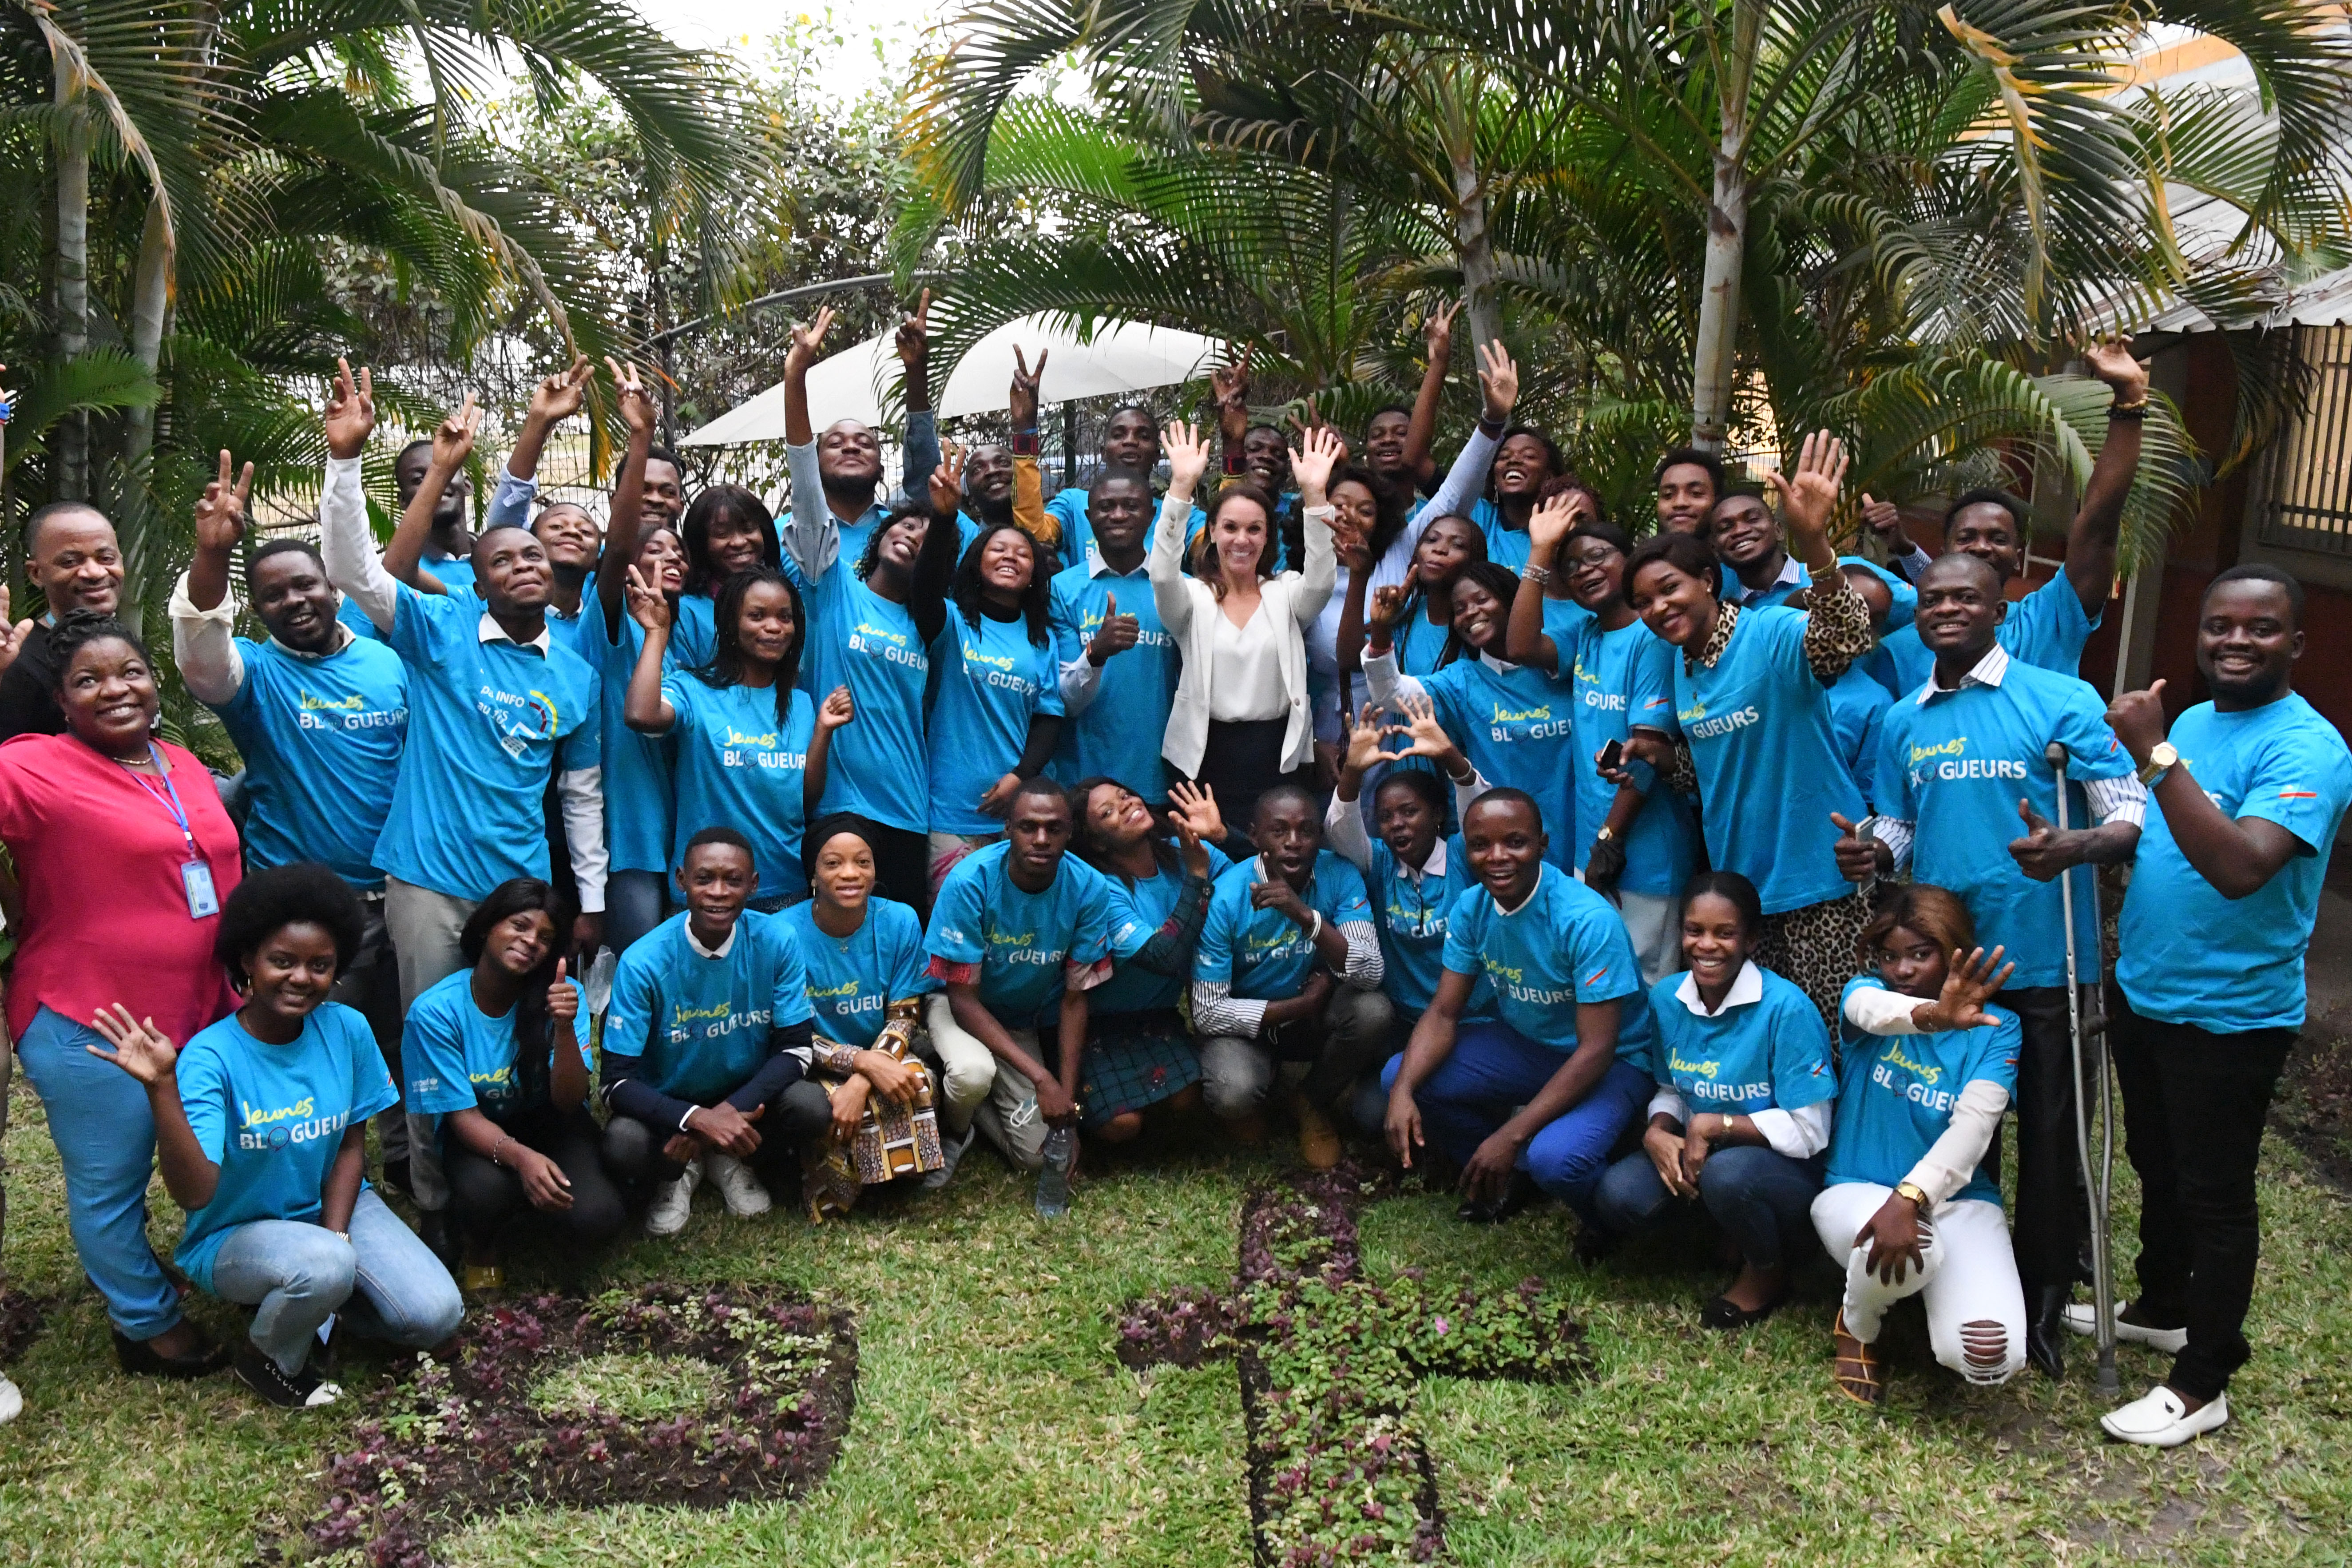
GUESS THE ARTICLE
These pictures provide a clue to the articles in focus.
How do these pictures help you? Can you guess how they are linked together?
Write down your thoughts or discuss with someone in your class.
Unicef/Zahn
Unicef/Dejongh
UNICEF
Notes:
From left to right
The Child Friendly CRC icons, available to download here - www.unicef.org.uk/rights-respecting-schools/resources/teaching-resources/guidance-assemblies-lessons/child-friendly-crc-text-and-icons/
Berlin, 20 June 2019 – The Minister for Family Affairs Dr. Franziska Giffey (in the centre) sends off the Children’s Rights Bus from Berlin. The United Nations Convention on the Rights of the Child was signed 30 years ago. To spread knowledge about children’s rights even more, a so-called Children’s Rights Bus (Kinderrechte-Bus) of Germany’s Federal Ministry for Family Affairs tours through more than 20 cities under the motto „Campaign for children’s rights“ („Starkmachen für Kinderrechte“).
UNICEF Democratic Republic of Congo trains the first 150 out of 500 young Congolese on Blogging: how to identify and debunk false information, defend children’s rights, produce positive content.

Slide 4
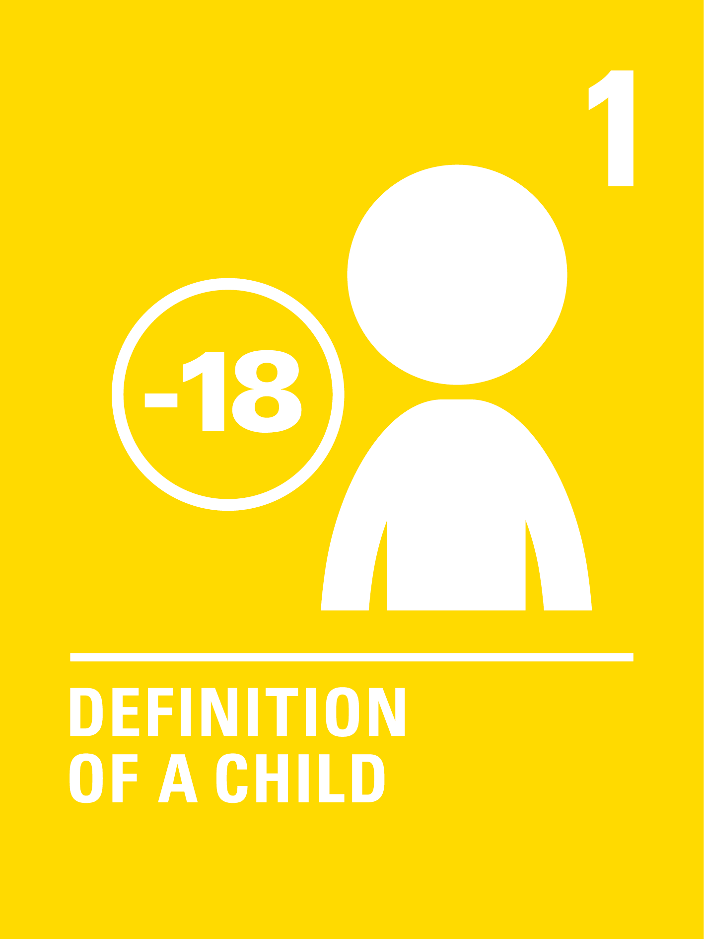
INTRODUCING ARTICLES 1 & 2
Everyone under the age of 18 has all the
rights in the Convention.
Governments must actively work to
make sure children and adults know
about the Convention.
Press play to watch the video or click here to watch on YouTube

Slide 5
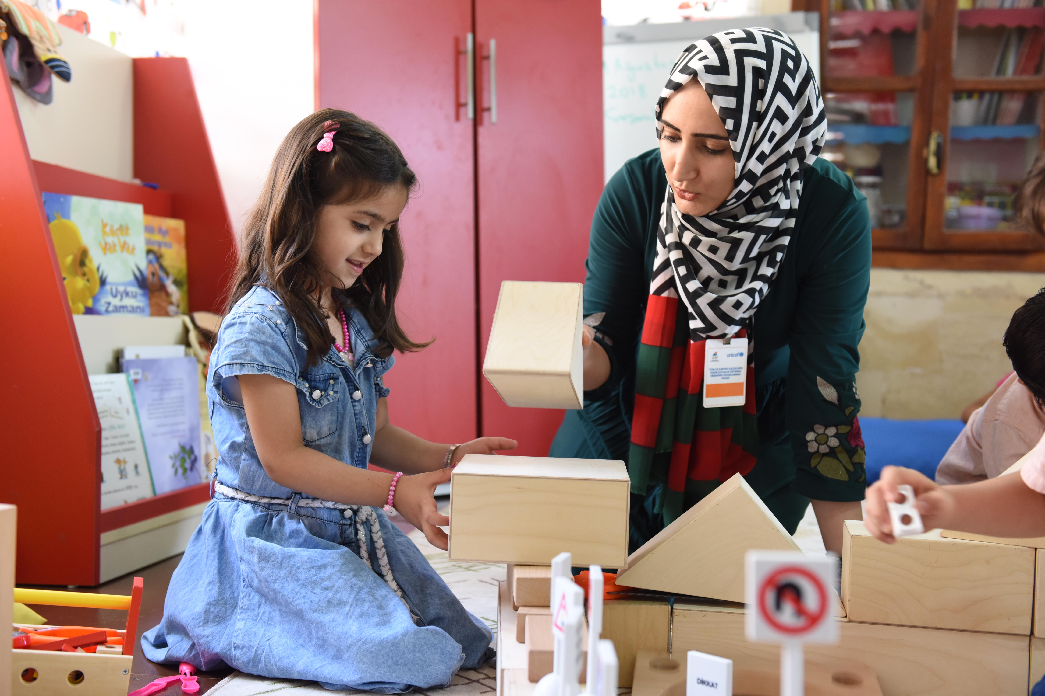
EXPLORING ARTICLES 1 & 42
Teachers have a duty to make sure that children know about their rights and experience their rights in school.
Can you list all the opportunities you have of learning about rights and experiencing them in school?
UNICEF/UN0444256
Notes:
Teachers and student in classroom in Turkey, 2018

Slide 6
HOW MANY OF THESE DID YOU GET?
In assemblies
In lessons and project work
Rights are on displays
By learning about rights issues locally and globally
Through the student council
By learning to respect others’ opinions and differences
Through class charters or agreements
By listening to us
By treating us fairly
Through campaigning
Through our Green Schools and Fair Trade work
What others did you think of?

Slide 7
ACTIVITIES FOR THE CLASSROOM
As soon as we are born, we have human rights because we are human beings. Which rights are particularly important for babies and young children? Who do they depend on to help them enjoy those rights?
Make a poster that could be displayed in a doctor’s surgery showing key rights for babies.
Watch this video from Australia that helps children to understand their rights and describes children’s rights as superpowers!
Choose a right and design a Rights Superpower Shield or Cloak for that right.
Create a poster, song or poem
to show that rights are for all children around the world. Display your artwork or perform your song or poem.
Many things can act as obstacles that hinder children’s access to their rights that need to be removed or overcome by positive actions (for example natural disasters, conflict and poverty).
Create an obstacle course outside, or a simple board game (like snakes and ladders) to show how things hold children back.

Slide 8
ACTIVITIES FOR THE CLASSROOM
This video ‘What are Children’s Rights’ explains what children’s rights are and where they came from. Watch the video and think about who might benefit from watching it? Could you create a workshop for parents and carers using? Do some activities too to help them to understand how they can promote and protect rights too.
Make a set of cards to represent articles of the CRC. Make up some games to play with to help others learn about rights.
Click here for child rights icons that you could use for the cards and here for suggested games.
What can YOU do in school and in the community to help others access their rights?
Make a pledge and a plan for how you will help others every day, month and year - make sure it is realistic.
Small actions can be very important! What can the government do to help?
Create a quiz to share with friends and family about rights and the Convention.
Choose whether you will provide multiple choice answers or not. Don’t forget to write a list of answers too.

Slide 9
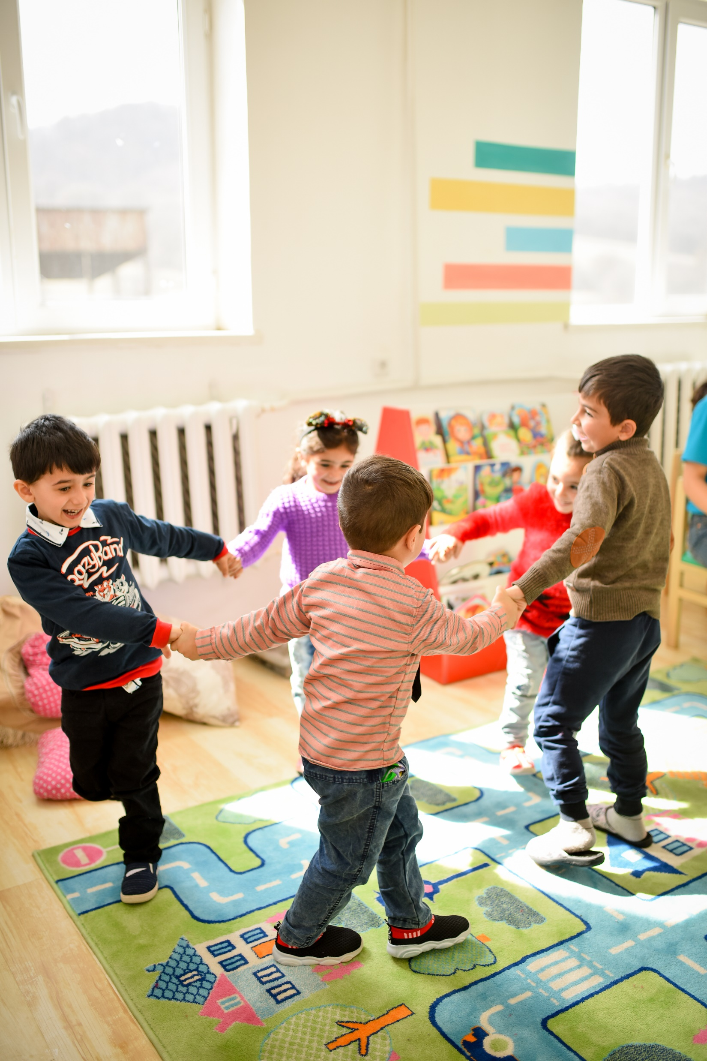
REFLECTION
Try to find somewhere peaceful and spend a few minutes being quiet and still … then think about these questions…
"Where after all do universal human rights begin? In small places close to home – so close and so small that they cannot be seen on any maps of the world … unless these rights have meaning there, they have little meaning anywhere.”
This was said by Eleanor Roosevelt, a champion for human rights. In 1948 she helped draw up the list of rights that everyone in the world should enjoy.
Spend a few moments thinking about ‘those small places’ like home, school, places of work. How can we make sure that rights are known and respected by everyone around us?
UNICEF/UN0366601/Margaryan

Slide 10
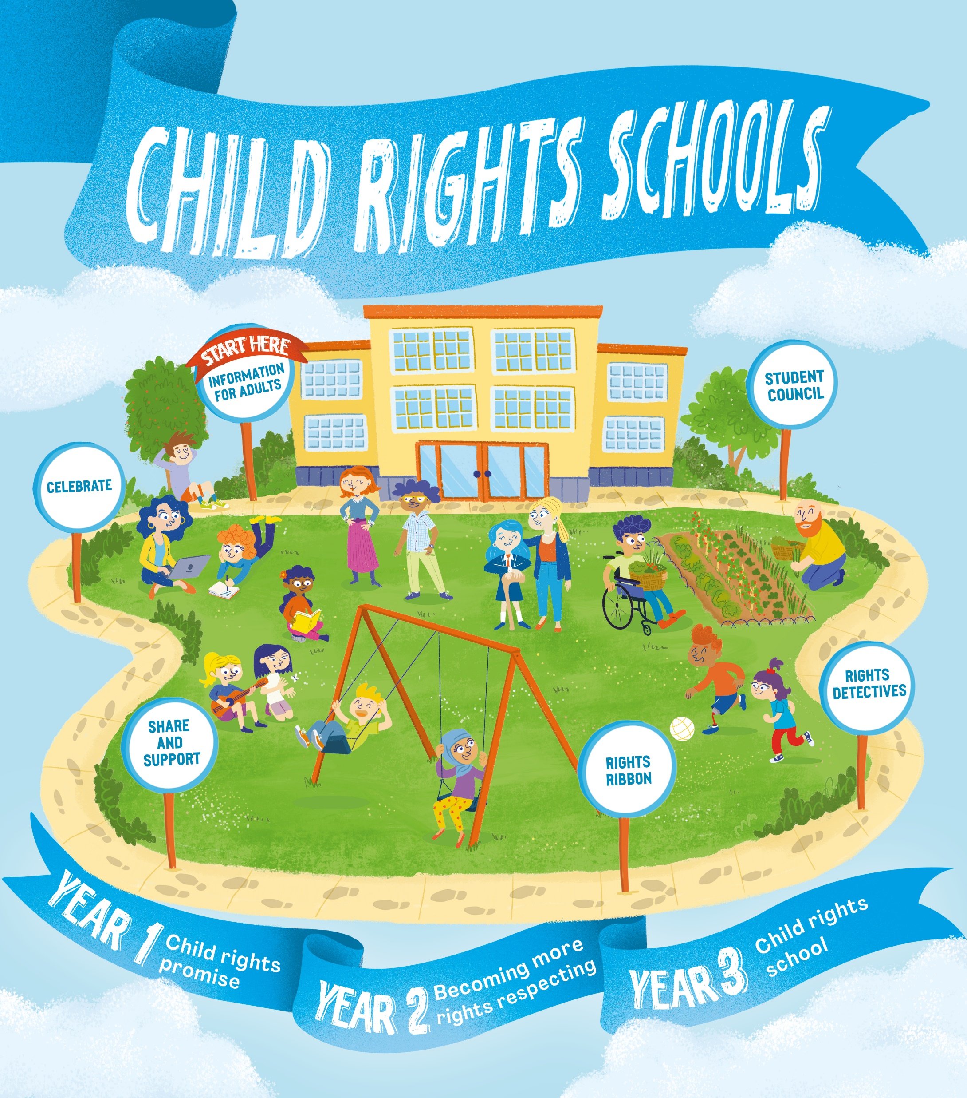
FURTHER CHILD RIGHTS EDUCATION SUPPORT
Child Rights Schools is a programme that supports you to embed child rights across the primary school. Find our more here.
Find more classroom resources here.

Slide 11
THANK YOU

