Slide 1
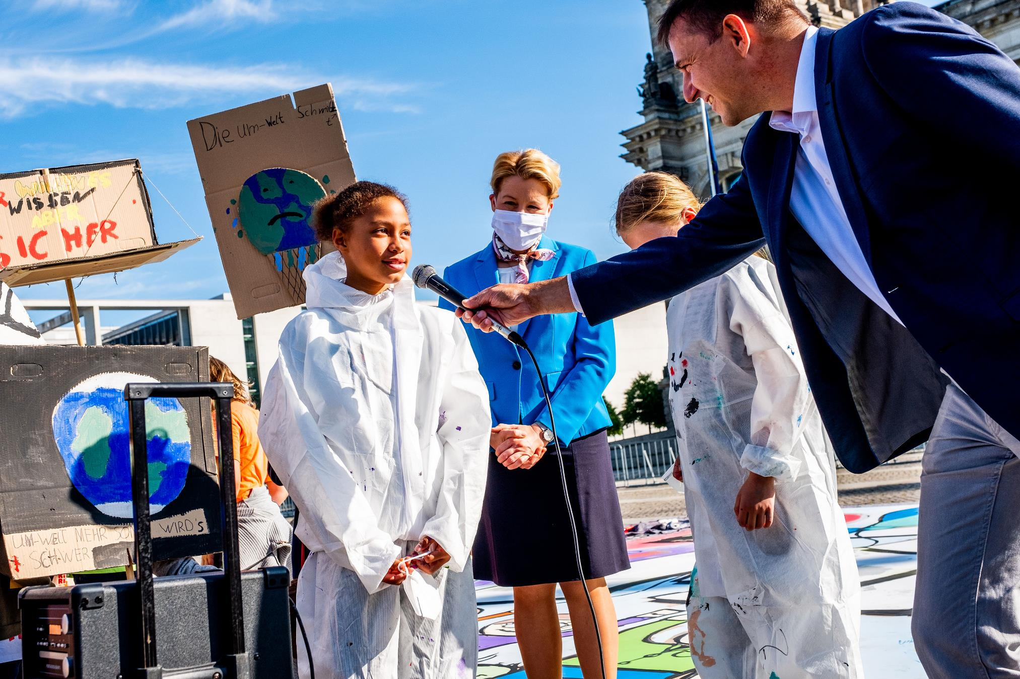
ARTICLE IN FOCUS
UNI372347/Zimmerman
Notes:
Children from Berlin in front of the Reichstag building during the campaign for the World Children's Day 2020 by UNICEF Germany and the Deutsches Kinderhilfswerk (German Children's Fund). In addition to the demonstration for their children's rights, they painted a picture on children's rights, more than 100 square metres large.
Due to the nationwide restrictions imposed by the Corona pandemic, UNICEF Germany and the Deutsches Kinderhilfswerk (German Children's Fund) have initiated alternative campaigns for World Children's Day. The aim is to give children a voice despite the cancelled celebrations: In more than 70 towns and communities throughout Germany, girls and boys conquer public spaces with colourful chalk pictures and show what they miss in their surroundings. They are supported by the voluntary network of UNICEF Germany. The long-standing UNICEF partner IKEA Germany is also calling for participation and supports the campaign with coupons for customers for IKEA street painting chalk.The Deutsches Kinderhilfswerk (German Children's Fund) had called on children all over Germany to make demo posters with the motto "Children's rights create future", which were set up in front of the Reichstag together with the chalk picture and presented personally by around 20 Berlin children. "Children's rights in the Basic Law, everything else is gossip" or "No child shall find its end in the sea" or "The environment must become better": Thus, the children articulated their demands for World Children's Day creatively and colourfully with the posters. The common message of the chalk picture and the posters is: The solution for creating a better future lies in the realisation of children's rights.

Slide 2
BEFORE YOU BEGIN
This is a flexible resource and is intended to provide you with some easy to use, appropriate rights-related learning to share with your children, their families and your colleagues.
Please edit out non relevant slides or activities before sharing with your students. Please check that the content works for your learners and feel free to adapt or add any content that would make the material more relevant for your setting.
This resource was developed by UNICEF UK and adapted by UNICEF Ireland.
Slide 3 – Guess the article
Slide 4 – Introducing Article 3
Slide 5 – Exploring Article 3
Slide 6 – Some possible answers
Slide 7 & 8 – Activities for the classroom
Slide 9 - Reflection
Slide 10 – Further support

Slide 3
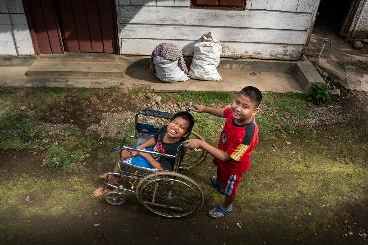
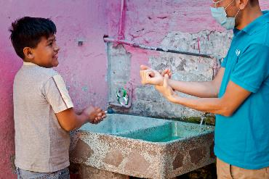
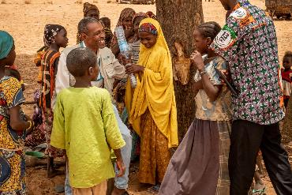
GUESS THE ARTICLE
These pictures provide a clue to this week’s article.
Can you guess how they are linked together? Which article of the Convention do these pictures relate to?
Unicef/Ijazah
Unicef/Armando
Unicef/Gilbertson
Notes:
From left to right:
Unicef/Ijazah - Syaiful (left), 12, a child with a physical impairment, and his best friend Kevin Saputra (right), 9, a child with a visual impairment, play outside near Syaiful's house in Banyumas, Central Java, Indonesia. Syaiful cannot freely move his lower body or his right hand.
Unicef/Armando - A Unicef member of staff demonstrated good handwashing practice with a child in Mexico.
Unicef/Gilbertson - Ramatou (yellow veil), 12, an unaccompanied minor is returned to her father Bahari Inoussa (not pictured) and brothers and sisters in a tiny village in Niger. Moussa, a child protection officer from UNICEF sits with her, and a social worker is on the right.

Slide 4
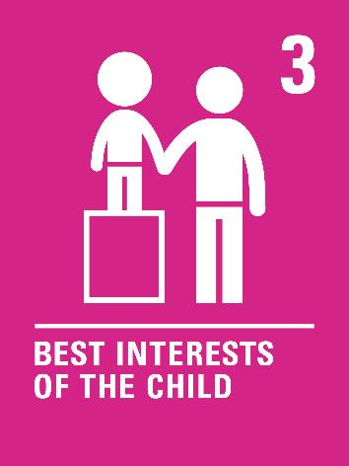
INTRODUCING ARTICLE 3
When adults make decisions, they should think about how their decisions will affect children.
All adults should do what is best for children.
Governments should make sure children are protected and looked after by their parents or carers.
Governments should make sure that people and places responsible for looking after children are doing a good job.
Press play to watch the video or click here to watch on YouTube

Slide 5
EXPLORING ARTICLE 3
There are many adults involved in making decisions that affect your life.
Make a list of the adults. Try to think beyond your family. For example teachers, politicians, shop owners. Write down your thoughts and compare with the next slide.
Notes:
15 year old farmer and climate activist Liadh Dalton meets with Taoiseach Mícheal Martin as part of UNICEF’s Kids Takeover 2021

Slide 6
DID YOU INCLUDE ANY OF THESE?
School principal
Healthcare workers
Social workers
Sports coaches
Youth workers
Gardaí
Members of the government
Courts officials – judges, lawyers
They should all put your best interests first when they make a decision that affects you, considering every part of your life, including your safety, your education, your views and your relationships with people in your family.

Slide 7
ACTIVITIES FOR THE CLASSROOM
This 9-year-old boy has written to an advice page. Working on your own or with a friend, write a reply to him.
“OK, so when I was five, I got scared at the dentist and bit her when she was looking at my teeth. She was hurting me, and I don’t want to go again. For ages, my mum hasn’t made me go, but now she says I must because she’s worried my teeth are rotting. I said I’d run away if she made me go. I don’t get why she would make me do it when I don’t want to. What should I do?”
Some decisions adults make affect one child, or a few children. Some decisions affect a lot of children. Can you think of any examples of a decision that affects one child, a few children, and many children?
Create a special badge, certificate or card to give to an adult you know who always thinks about what is best for you or for other children, to say well done or thank you.

Slide 8
ACTIVITIES FOR THE CLASSROOM
When possible, children should be involved in decisions that affect them.
Write a letter to your local TD or your principal explaining how you would like to be involved in the decisions that affect you.
Lots of changes happened in your school during the Covid 19 pandemic. These decisions were made by adults to keep you safe and healthy. Write a list of the changes and why the decisions were made.
Think about a big decision that has been made recently at school.
Divide the class into two groups – one group discusses why it was made in your best interest and the other group discusses why it may not have been made in your best interest.
Debate the topic and come to a class decision on whether the decision was made in your best interest.
Were children consulted? Share with the principal suggestions for involving children in future decisions made in your school.
Notes:
Photo on left Joanne O’Riordan
Middle photo Rosa Parks
Photo on right Malala Yousufzai

Slide 9
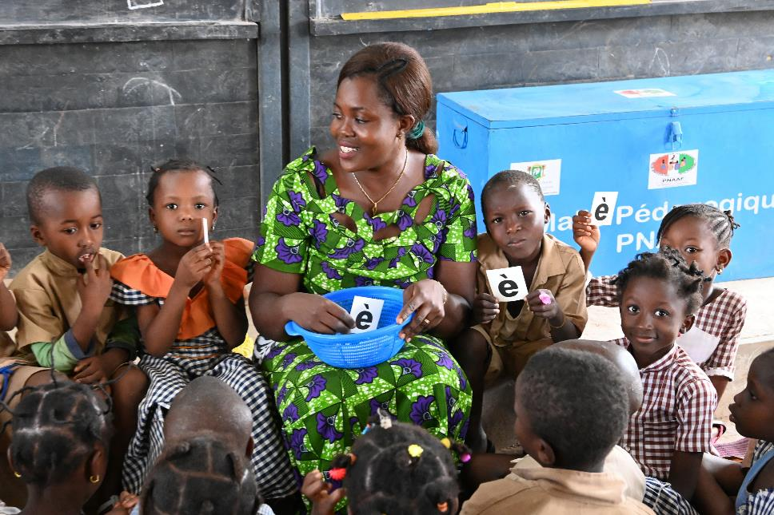
REFLECTION
Find somewhere peaceful and spend a few minutes being quiet and still … then think about these questions…
Who are the adults you trust to make decisions in your best interests?
Think about how they involve you in the decision.
Can you think of decisions made or instructions given to you by adults which you don’t like but you know they are right?
UN0613238/Dejongh
Notes:
Children attending class, in the HKB school, in Man, in the West of Côte d’Ivoire.

Slide 10
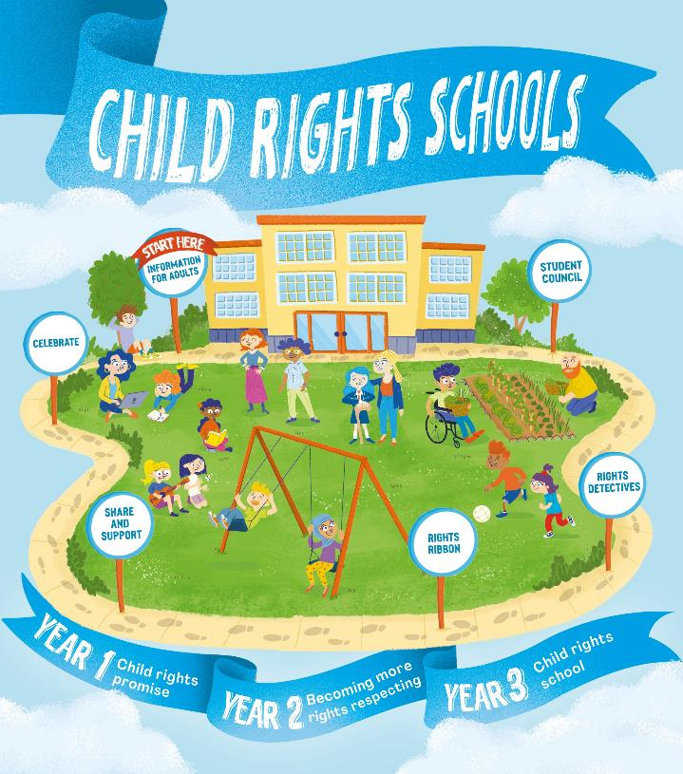
FURTHER CHILD RIGHTS EDUCATION SUPPORT
Child Rights Schools is a programme that supports you to embed child rights across the primary school. Find our more here.
Find more classroom resources here.

Slide 11
THANK YOU

