Slide 1
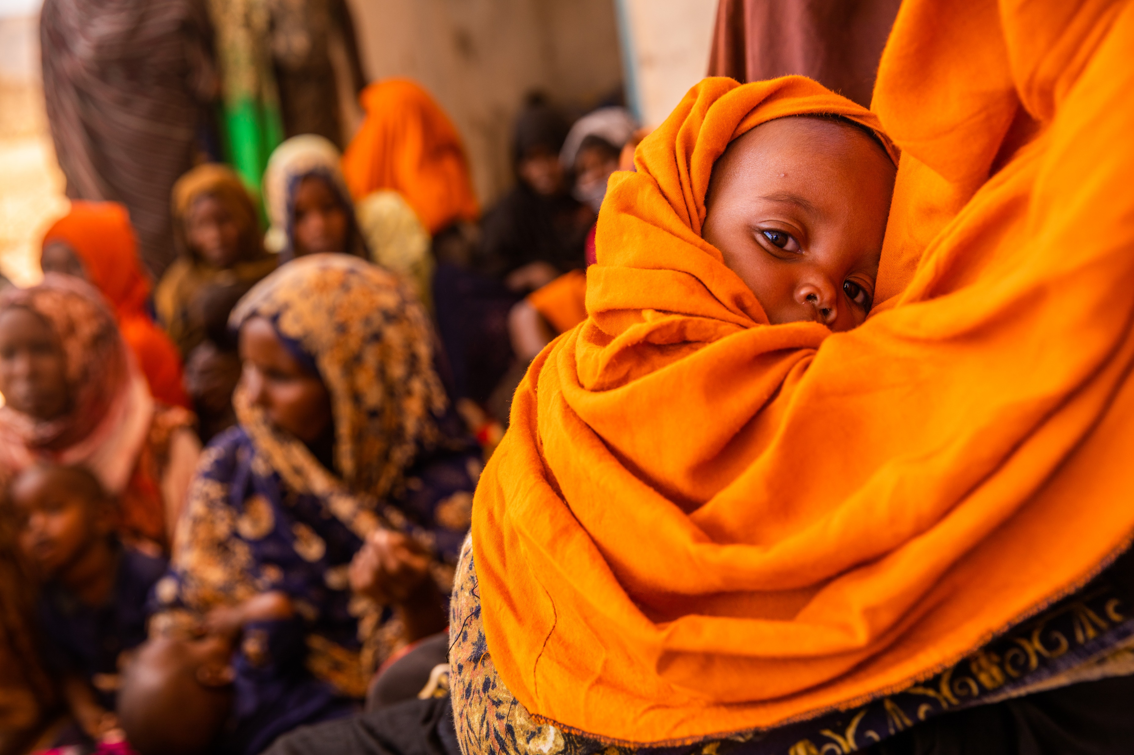

ARTICLE IN FOCUS
UN0625011/AEWUNET
Notes:
A mother and a baby wait for vaccination at a health post in Ba’adley, IDP Site, Shabelle Zone, Somali Region, Ethiopia

Slide 2
BEFORE YOU BEGIN
This is a flexible resource and is intended to provide you with some easy to use, appropriate rights-related learning to share with your children, their families and your colleagues.
Please edit out non relevant slides or activities before sharing with your students. Please check that the content works for your learners and feel free to adapt or add any content that would make the material more relevant for your setting.
This resource was developed by UNICEF UK and adapted by UNICEF Ireland.
Slide 3 – Guess the article
Slide 4 – Introducing Article 6
Slide 5 – Exploring Article 6
Slide 6 – Some possible answers
Slide 7 & 8 – Activities for the classroom
Slide 9 - Reflection
Slide 10 – Extension
Slide 11 – Further Support

Slide 3
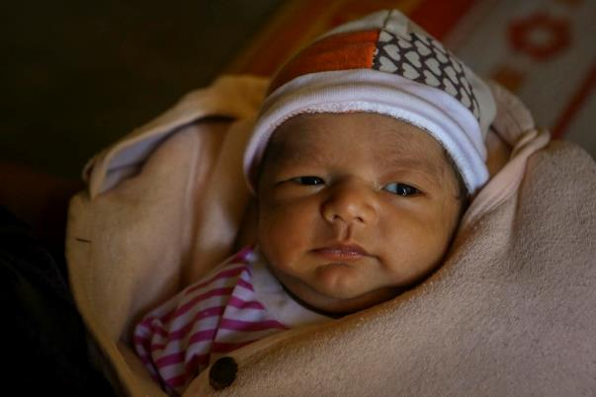
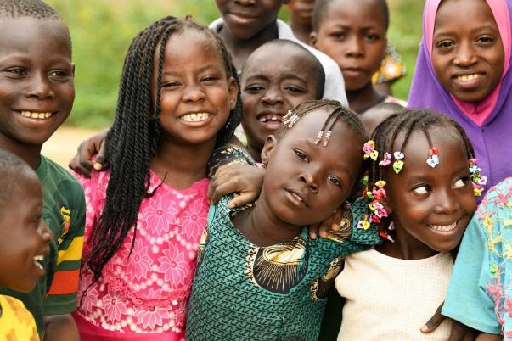
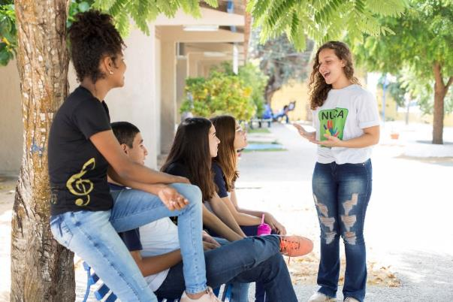
Guess the article
These pictures provide a clue to this week’s article.
Can you guess how they are linked together? Which article of the Convention do these pictures relate to?
Write down your thoughts or discuss with the class.
Unicef/Viet Hung
Unicef/Dejonghe
Unicef/Pinheiro
Notes:
From left to right:
Unicef/Viet Hung - “Thanh is our third child. The two previous children were girls. I am very happy to give birth to this baby boy. Thanh means ‘success’. I hope that when he grows up, he will be a successful man,” Thanh's mother, Ms Y Duch happily shared.
Unicef/Dejongh - Children playing and learning at a child friendly space of Fada, in the East of Burkina Faso.
Unicef/Pinheiro - On 31 October 2018, (right) Letícia Gomes speaks with a group of teenagers as part of her peer-to-peer education work.

Slide 4

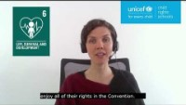
INTRODUCING ARTICLE 6
Every child has the right to be alive.
Governments must make sure that children survive and develop in the best possible way.
Press play to watch the video or click here to watch on YouTube

Slide 5
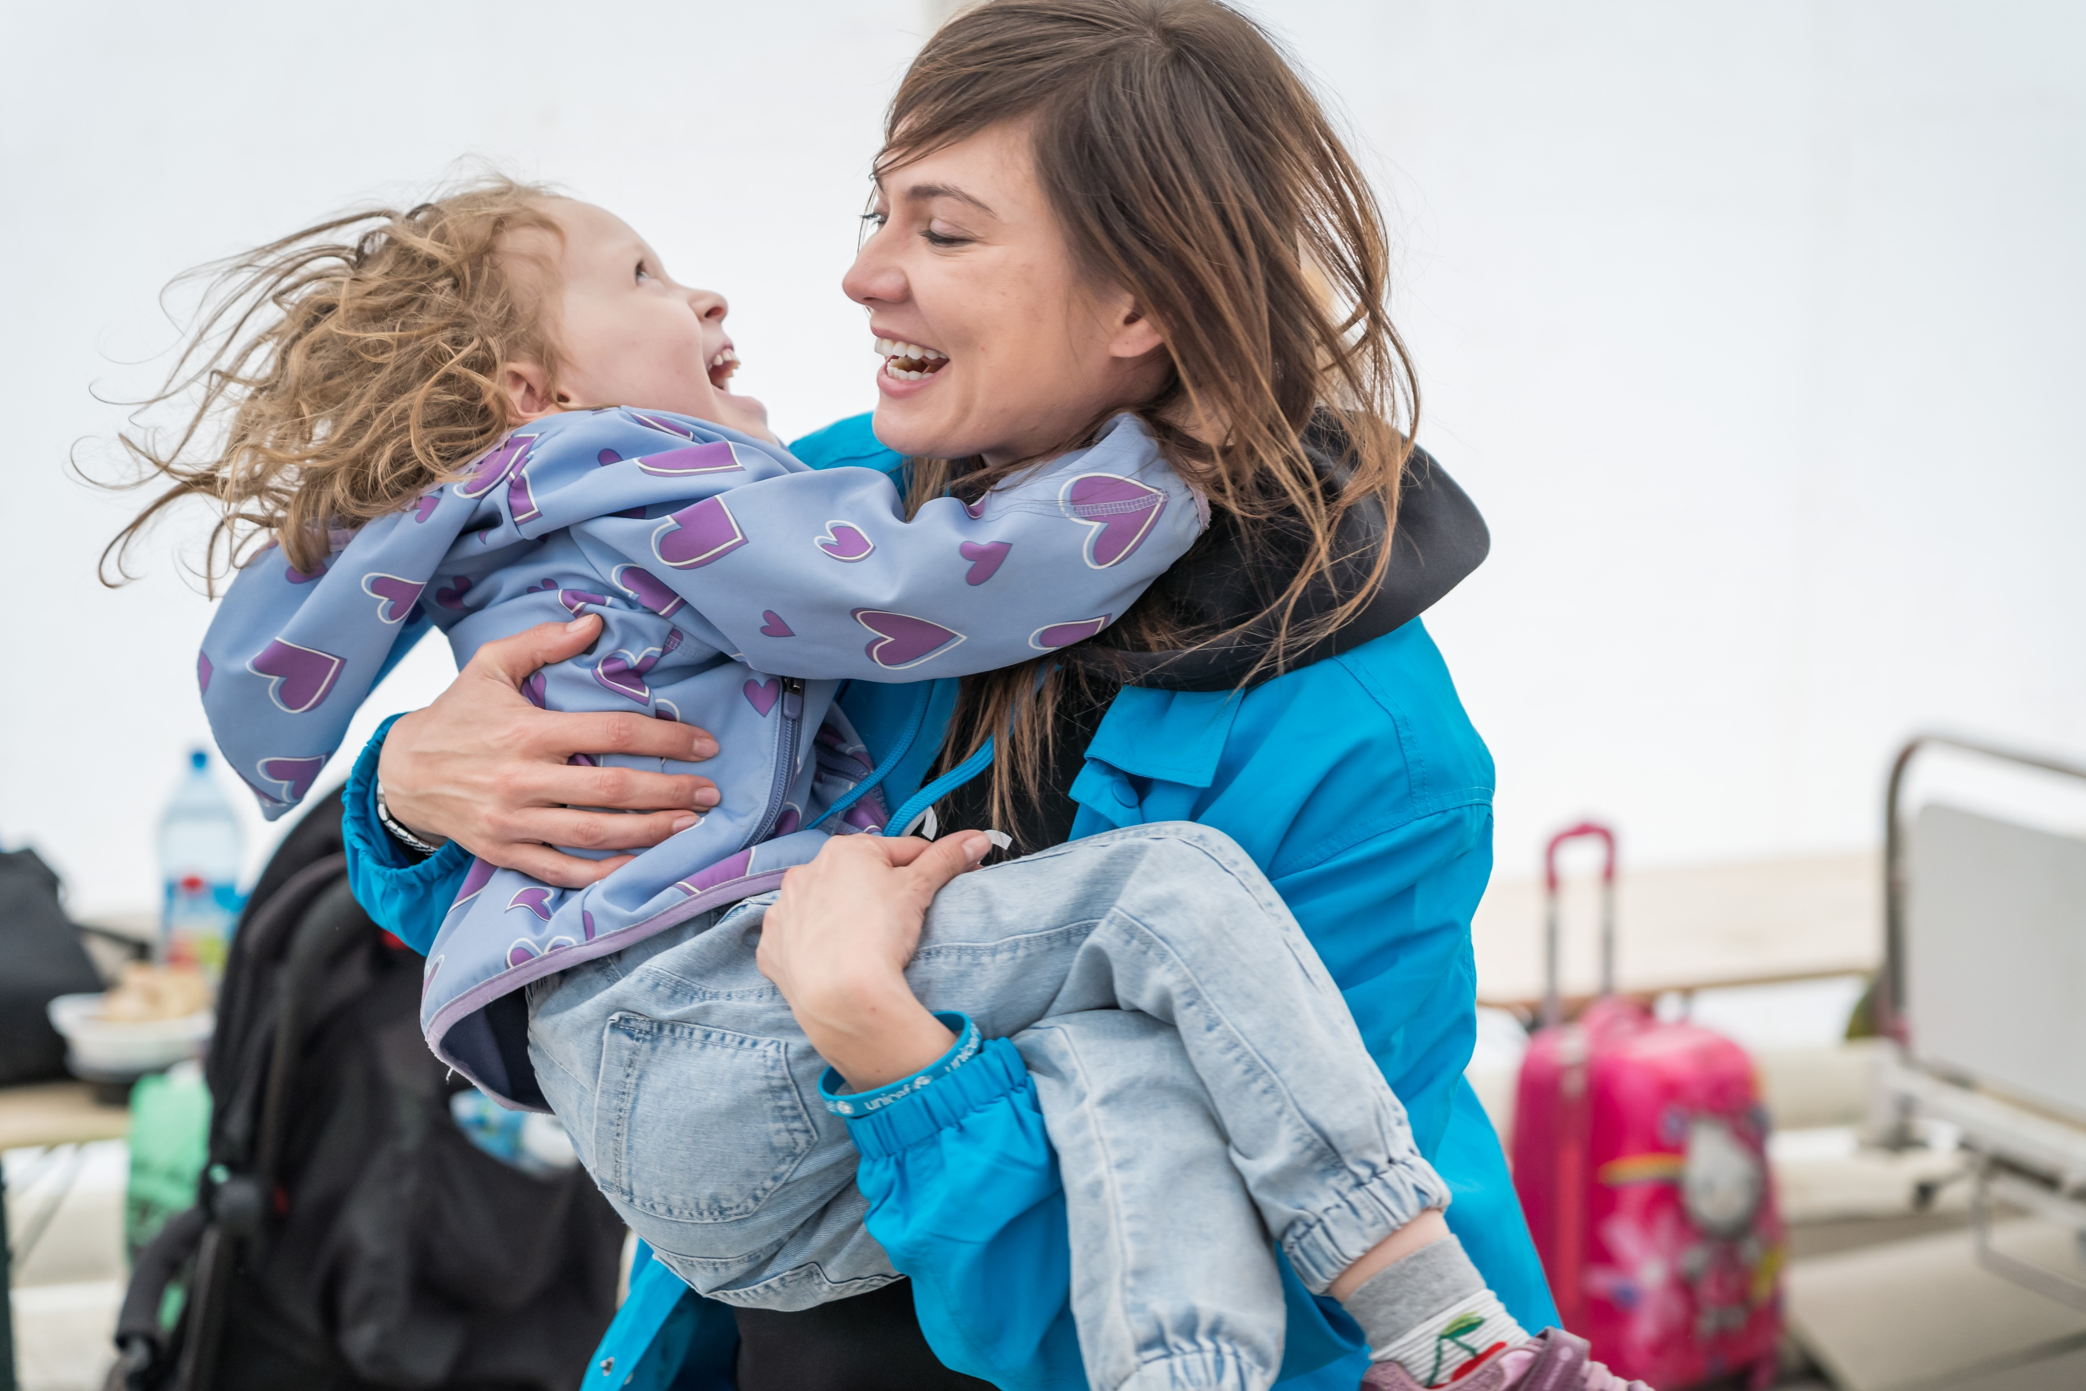
EXPLORING ARTICLE 6
What does a child need to stay alive?
What can governments do to ensure that children survive and develop in the best possible way?
Write them down and compare your answers with the next slide.
UN0622182/HOLERGA
Notes:
Emma, 5 years old, from Odessa, Ukraine, plays with UNICEF staff at the
Blue Dot safe space in Isaccea bord crossing in Romania, where she arrived
with her mother, Yulia, and her little brother.
UNICEF is setting up Blue Dot across Romania and the region, which are
dedicated refugee children and family support hubs and represent an
integrated model that provides support for the most immediate needs of
children and women

Slide 6
DID YOU INCLUDE ANY OF THESE?
Care, protection and nurture from adults
Nutritious food and clean water
The chance to become more independent as you get older
Exercise and sleep
A clean, safe environment
Quality education and a chance to play
Feeling safe, secure and respected
Health care - to see a doctor or a nurse when you need to and to be vaccinated against diseases
All your rights!!

Slide 7

ACTIVITIES FOR THE CLASSROOM
Read the ‘Here we are’ by Oliver Jeffers. Share your questions about the world and think about how we can look after the world around us so that we can all survive and thrive.
Think about a new born baby. What do they need to live, survive and develop?
Compare this list with what you need. Discuss the differences with each other in class.
Will your list be different when you are 14?
Read the book or watch the video of ‘Here We Are’ by Oliver Jeffers.
Think about how the world around us helps us to survive and thrive.
Draw a duty bearer (or adult) and label your picture with everything they do to help you to survive and develop.
How do these things change as you get older?

Slide 8
ACTIVITIES FOR THE CLASSROOM
Think about where you live.
Are there any barriers to realising Article 6?
What can we do about this?
Your education helps you to develop. How do the things you do at school support your life, survival and development?
Write a poem to reflect this.
Help other people in your school to understand the meaning of Article 6.
Design a logo, paint a poster, create a collage of photos, or build an installation to represent your right to life, survival and development.

Slide 9
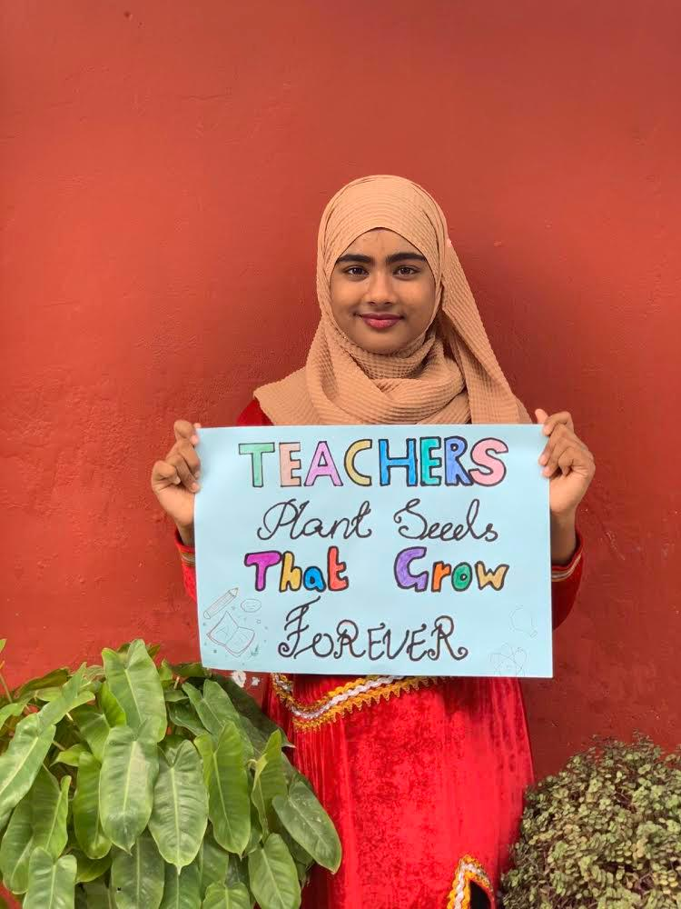
REFLECTION
Find somewhere peaceful and spend a few minutes being quiet and still. Then think about these questions…
How can we show our appreciation to those people who look after us and help us to develop and thrive?
In school how are you supported to develop to your full potential?
UNI368440/ALI

Slide 10
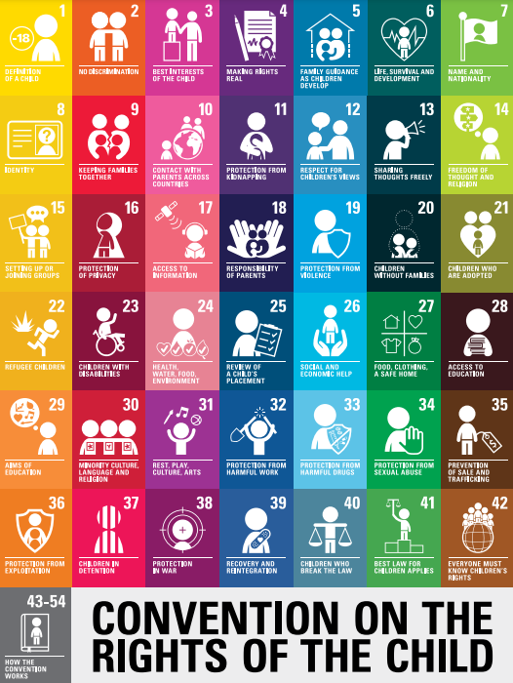
EXTENSION
Thinking about the whole Convention, which other articles are most connected to realising the right to life, survival and development?
You can find a summary of the Convention here.

Slide 11
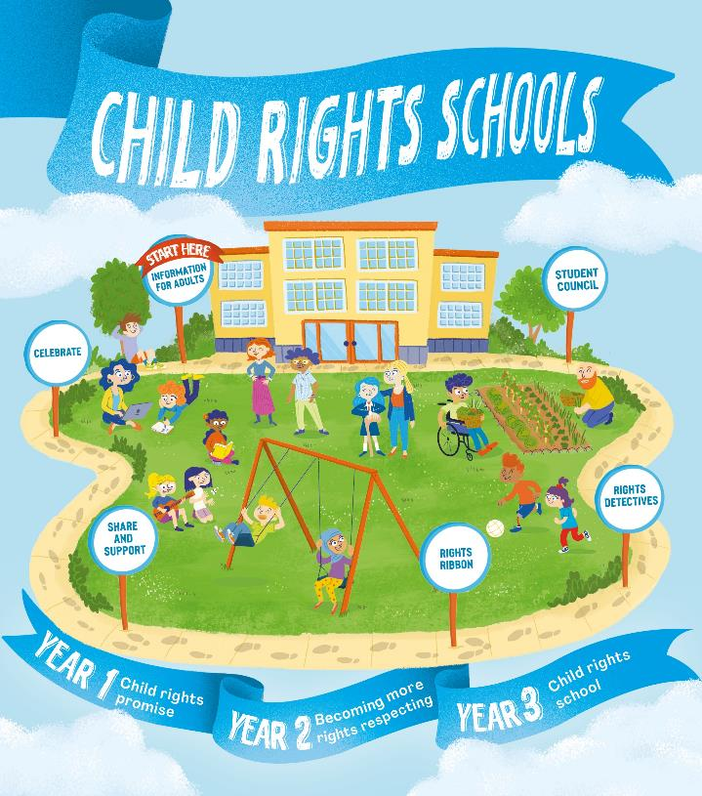

FURTHER CHILD RIGHTS EDUCATION SUPPORT
Child Rights Schools is a programme that supports you to embed child rights across the primary school. Find our more here.
Find more classroom resources here.

Slide 12


THANK YOU

