Slide 1
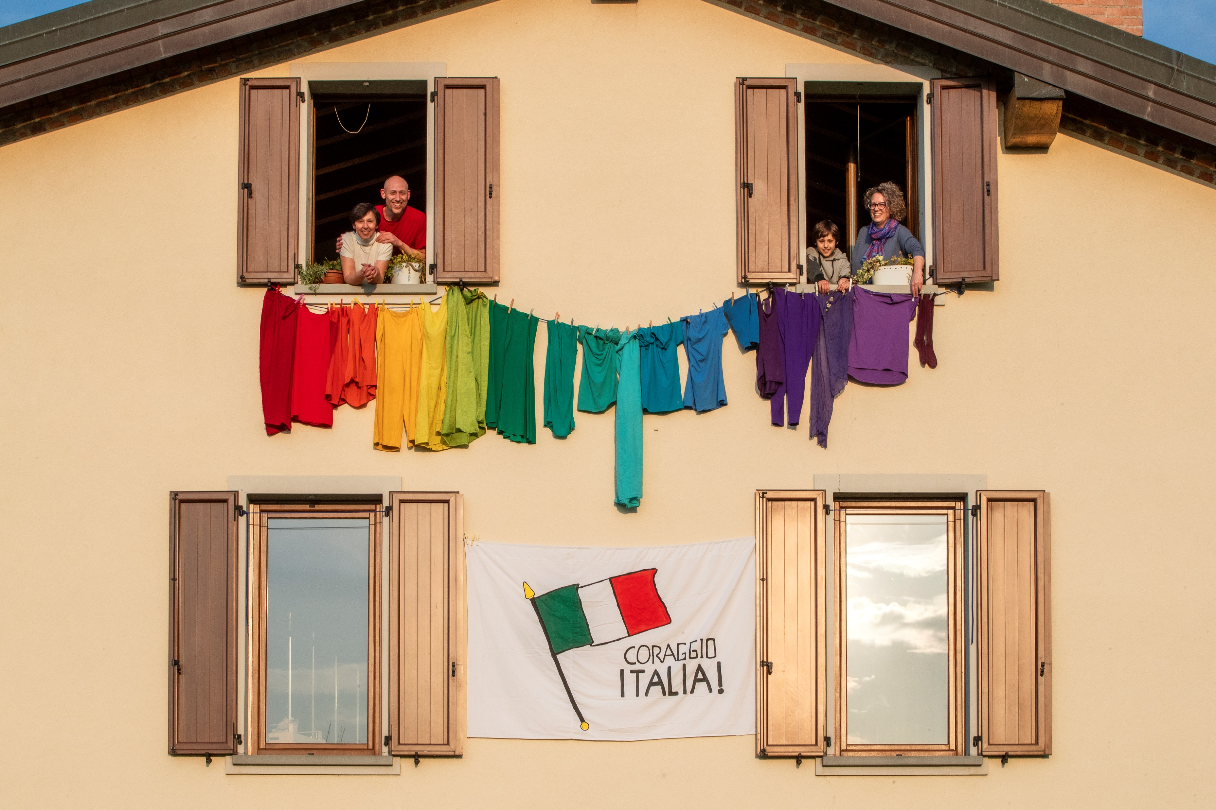

ARTICLE IN FOCUS
UNI313475/Diffedenti
Notes:
(Left) Cristiana made a rainbow out of clothes hung outside her house, involving her children and her next door neighbours in Bergamo, Italy on 20 March 2020. The message on the flag says: "Courage Italy". Cristiana is a school teacher and is helping children to think positively by having them draw rainbow in different forms with positive messages.

Slide 2
BEFORE YOU BEGIN
This is a flexible resource and is intended to provide you with some easy to use, appropriate rights-related learning to share with your children, their families and your colleagues.
Please edit out non relevant slides or activities before sharing with your students. Please check that the content works for your learners and feel free to adapt or add any content that would make the material more relevant for your setting.
This resource was developed by UNICEF UK and adapted by UNICEF Ireland.
Slide 3 – Guess the article
Slide 4 – Introducing Article 8
Slide 5 – Exploring Article 8
Slide 6 – Some possible answers
Slide 7 & 8 – Activities for the classroom
Slide 9 – Reflection
Slide 10 - Extension
Slide 11 – Further Support

Slide 3
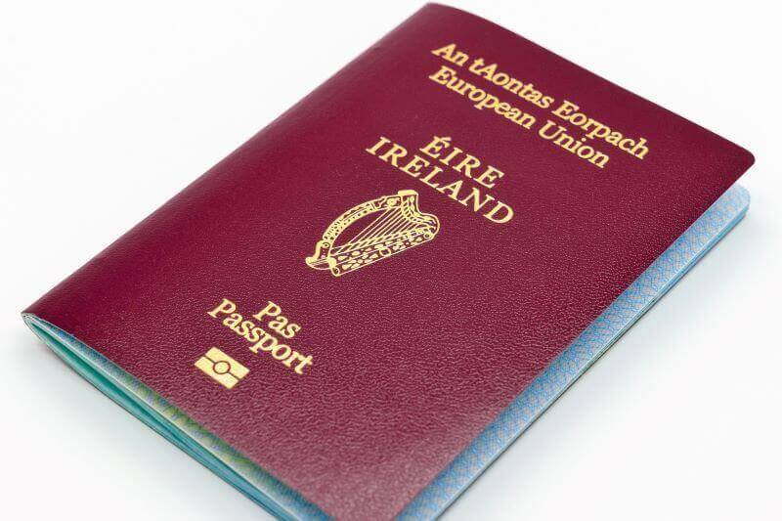
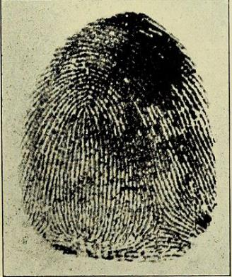
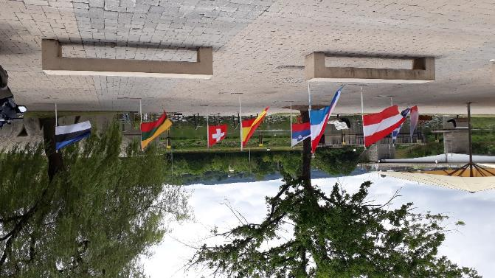
Guess the article
These pictures provide a clue to this week’s article.
Can you guess how they are linked together? Which article of the Convention do these pictures relate to?
All WikiCommons
Notes:
From left to right:
All images WikiCommons
A passport
A finger print
Flags from several nations

Slide 4

INTRODUCING ARTICLE 8
Children have the right to their own identity – an official record of who they are which includes their name, nationality and family relations.
No one should take this away from them, but if this happens, governments must help children to quickly get their identity back.

Slide 5
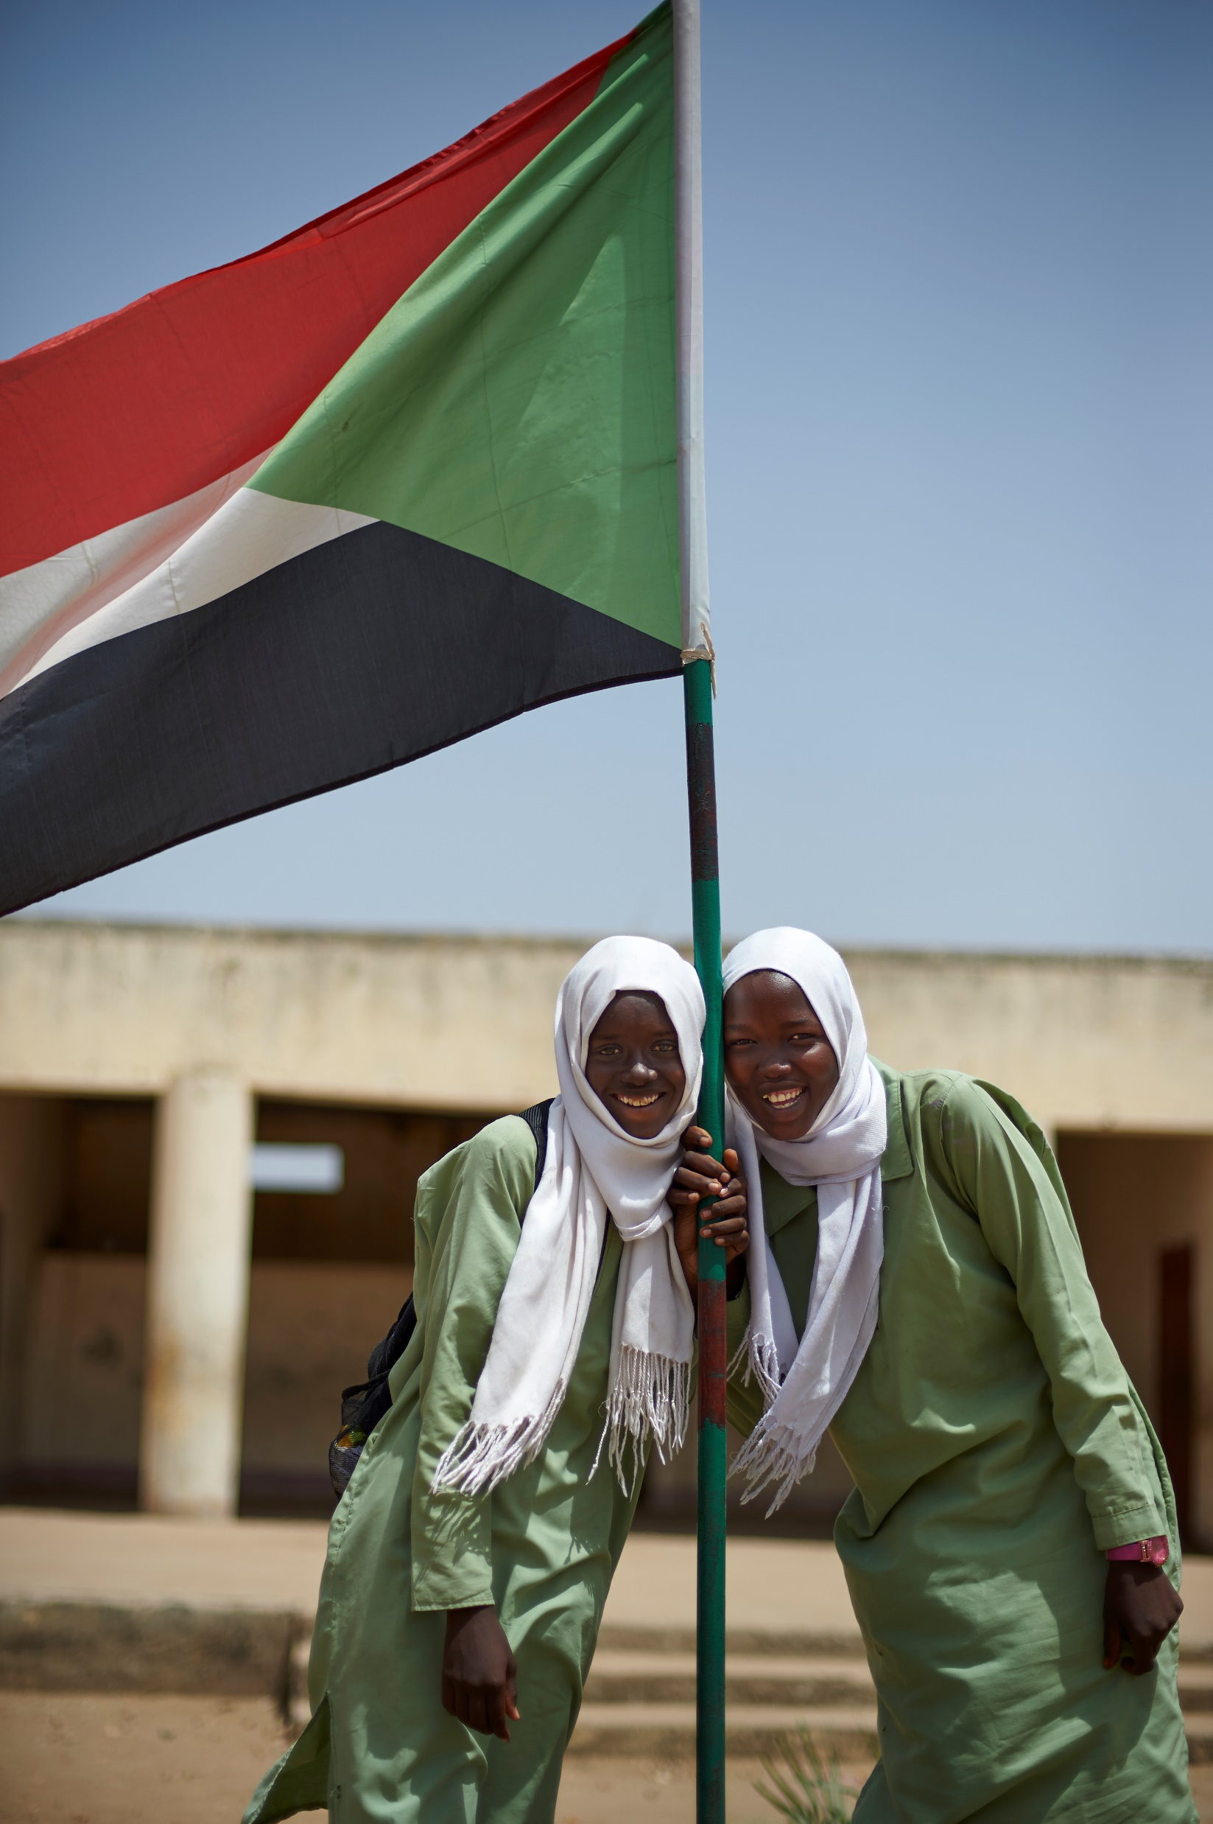
EXPLORING ARTICLE 8
All children have unique identities – the things that make you who you are. Why is your personal identity important?
Write down suggestions and compare your answers with the next slide.
UN0211127/Noorani
Notes:
Children raise the national flag of Sudan at school. South Kordofan State.

Slide 6
DID YOU INCLUDE ANY OF THESE?
We need our identity to access other things like education, healthcare, banking.
Having our identity protected helps to keep us safe.
Identity makes you who you are and each person is a unique individual.
Identity belongs to the individual and must not be taken away.
The government needs to know who each person is.
Identity makes us different from other people.
What others did you think of?

Slide 7

ACTIVITIES FOR THE CLASSROOM
There are lots of things that help to make up our identity such as date of birth, name, nationality, gender, faith, our appearance, personal talents and abilities.
Create an identity card – draw a picture of yourself and list the things that make you, you.
Read the ‘Here we are’ by Oliver Jeffers. Share your questions about the world and think about how we can look after the world around us so that we can all survive and thrive.
Read the story ‘Red’ by Michael Hall and discuss why the crayon is confused about his identity.
Interesting fact! The government must protect the legal identity of children. That means that your name, nationality and the family you are part of can only change if a court agrees to this.

Slide 8
ACTIVITIES FOR THE CLASSROOM
Did you know that you should protect your identity when online? You should only share information about your name, date of birth, location or other details when you are sure it is safe to do so. An adult should always help you with this. Why do you think it could be dangerous to share personal information online when you don’t know that the site is safe and secure?
Do all children feel that their identity is represented in the school? For example are all nationalities and all types of families welcomed and accepted in the school? Could you do more as a school community to be inclusive of diverse identities?
Make a jigsaw puzzle of yourself, by drawing a self portrait and cutting it up into five or six pieces. On the back of each piece write about an aspect of your identity. Discuss how complex identity can be, due to the many factors shaping it.
Swap pieces of your puzzle with your classmates. Discuss how some aspects of your identity can change depending on who you spend time with and what is around you (for example your hobbies and interests).
Each child picks one aspect of the their identity that is very important to them. They represent this on a communal display in a central location in the school to celebrate the diverse identities in your class.

Slide 9
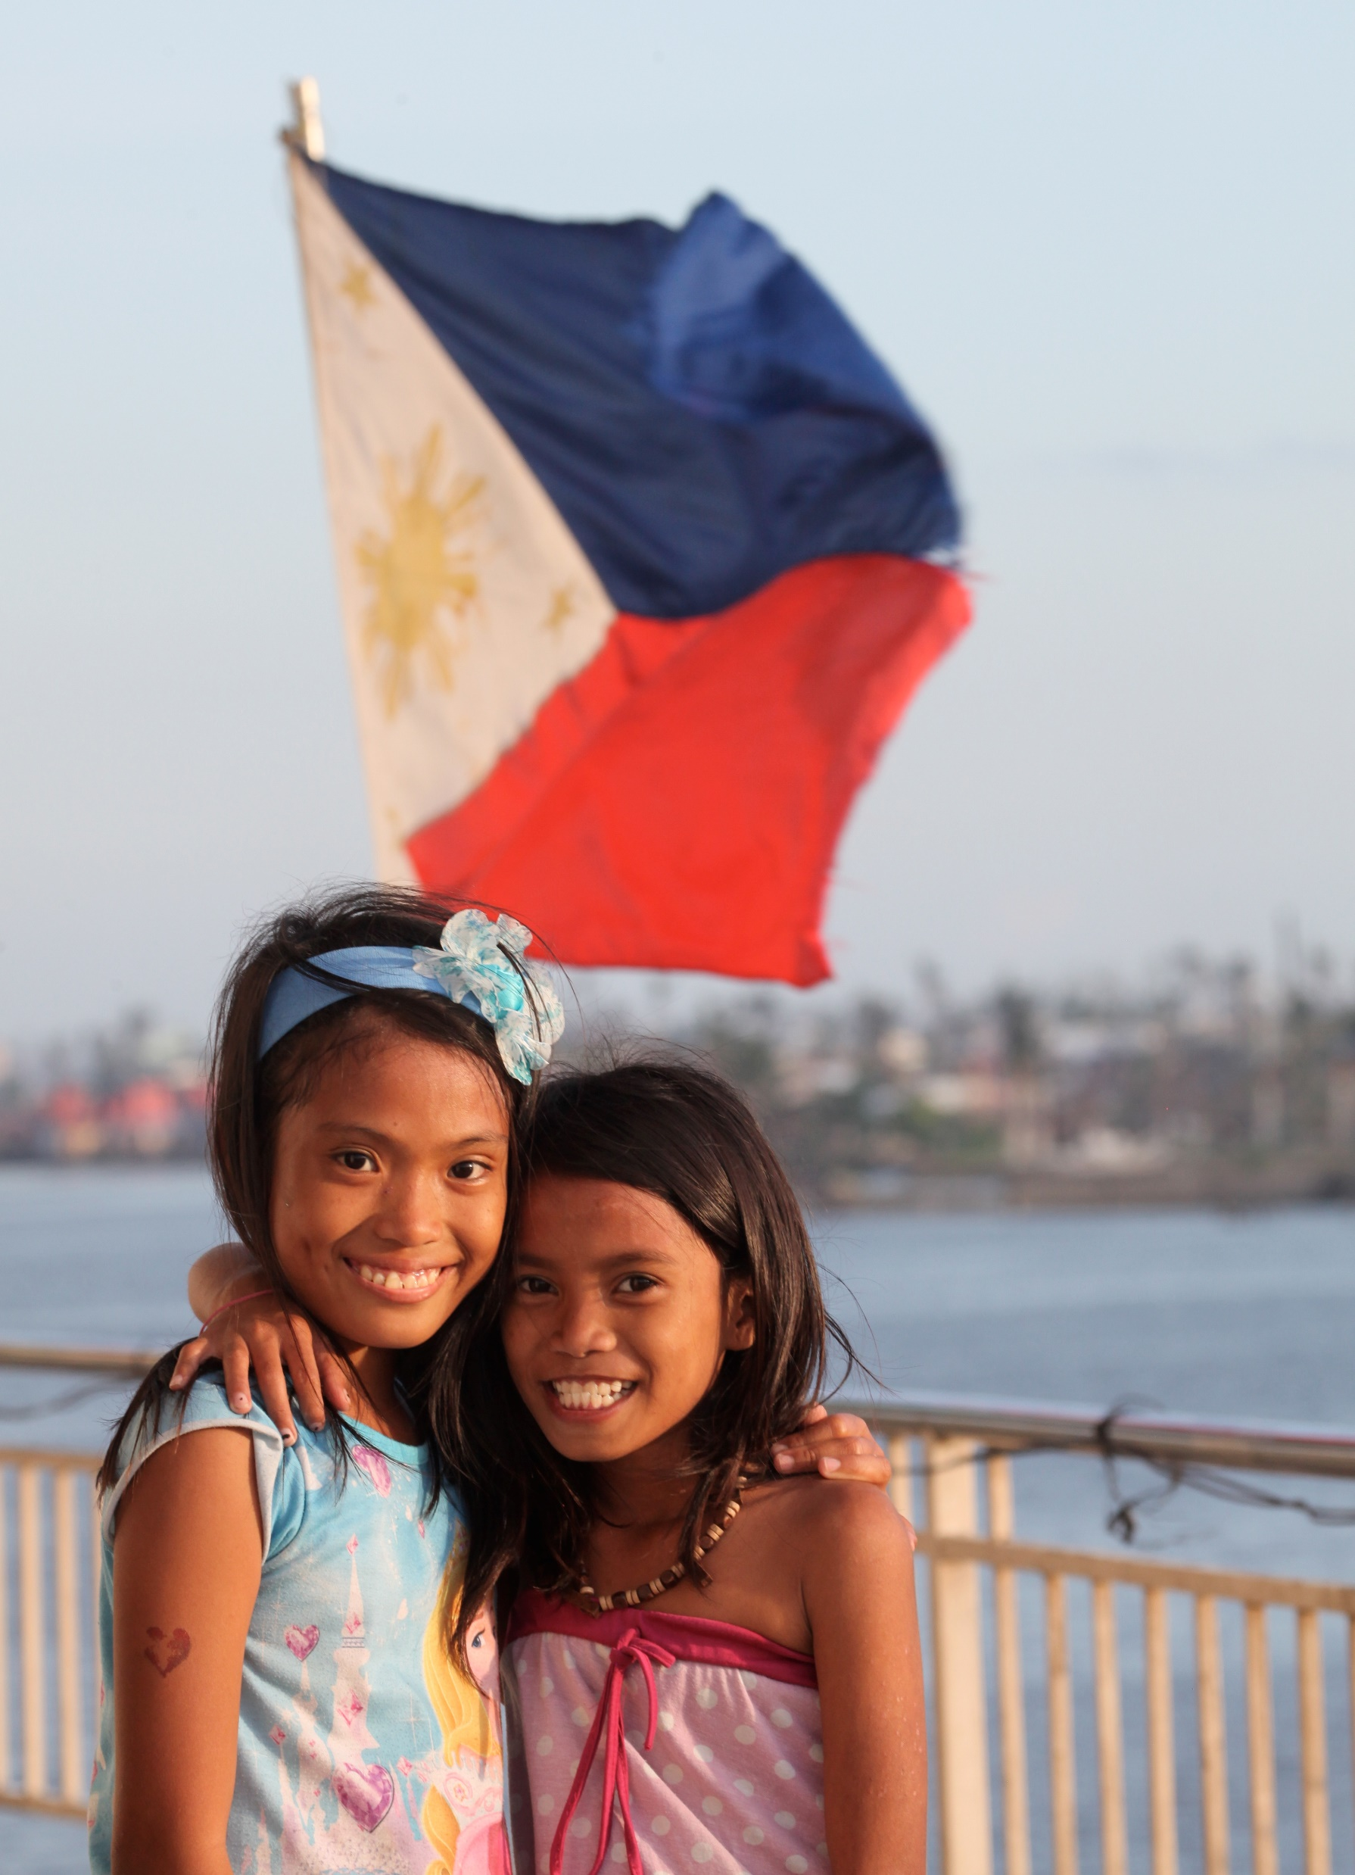
REFLECTION
Find somewhere peaceful and spend a few minutes being quiet and still. Then think about these questions…
Who are you and what makes you the person you are?
Which aspect of your identity makes you feel happy or proud?
How can we show respect and appreciation for other people’s identity?
UN01040/Pirozzi
Notes:
In February 2014, with the national flag of the Philippines behind them, two girls stand alongside a body of water, in the city of Tacloban. They both lost their homes in the typhoon.

Slide 10
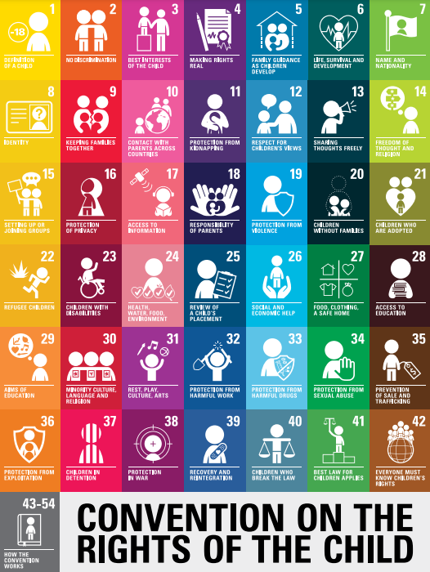
EXTENSION
Rights are indivisible and all equally important. There are links and connections between the articles.
Look at the Convention to find other rights that are related to Article 8.
In other lessons you do this week, try to connect them to Article 8. For example discuss the identity of the character in the class novel you are reading. Discuss how music can form part of somebody’s identity.
You can find a summary of the Convention here.

Slide 11
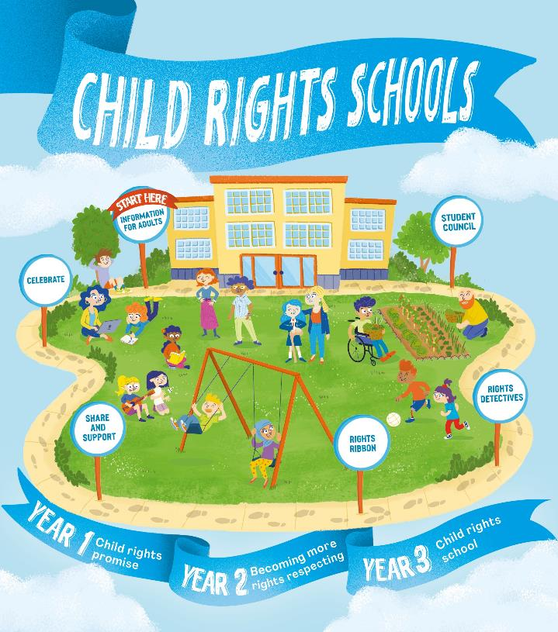

FURTHER CHILD RIGHTS EDUCATION SUPPORT
Child Rights Schools is a programme that supports you to embed child rights across the primary school. Find out more here.
Find more classroom resources here.

Slide 12


THANK YOU

