Slide 1
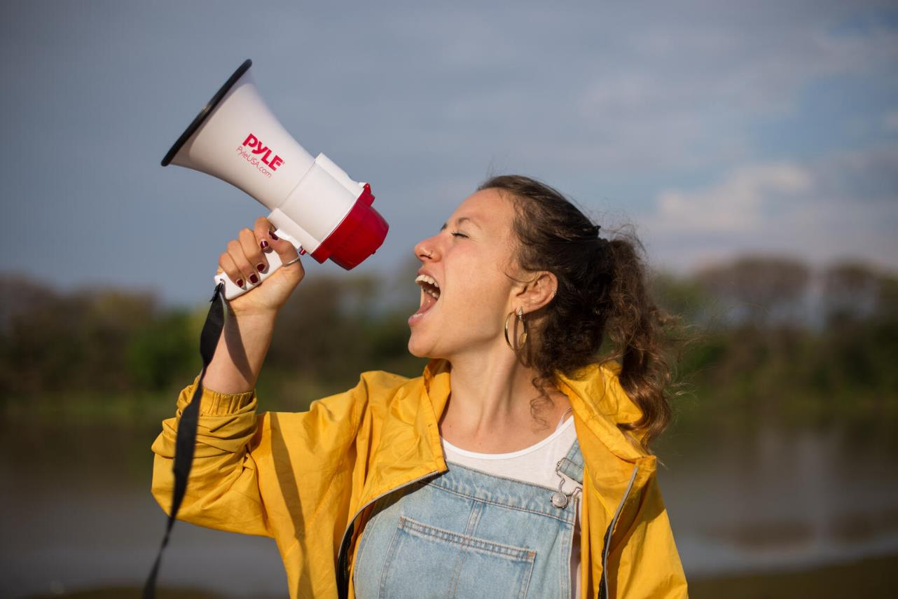

ARTICLE IN FOCUS
UN0364356/Gil
Notes:
Nicole Becker, 19 years old, Argentina. She is an environmental activist, Champion of Escazu Agreement and one of the founders of Youth for Climate Argentina, an environmental social group

Slide 2
BEFORE YOU BEGIN
This is a flexible resource and is intended to provide you with some easy to use, appropriate rights-related learning to share with your children, their families and your colleagues.
Please edit out non relevant slides or activities before sharing with your students. Please check that the content works for your learners and feel free to adapt or add any content that would make the material more relevant for your setting.
This resource was developed by UNICEF UK and adapted by UNICEF Ireland.
Slide 3 – Guess the article
Slide 4 – Introducing Article 12
Slide 5 – Exploring Article 12
Slide 6 – Some possible answers
Slide 7 & 8 – Activities for the classroom
Slide 9 – Reflection
Slide 10 - Extension
Slide 11 – Further Support

Slide 3
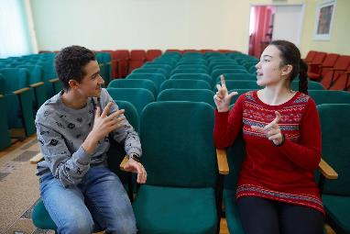
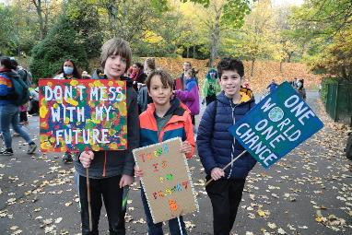
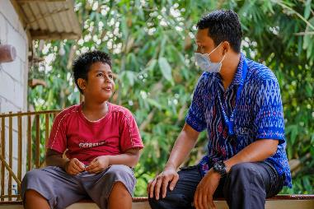
Guess the article
These pictures provide a clue to this week’s article.
Can you guess how they are linked together? Which article of the Convention do these pictures relate to?
@UNICEF/UN0285224
@UNICEF/Elwyn-Jones
@UNICEFJiro Ose

Slide 4
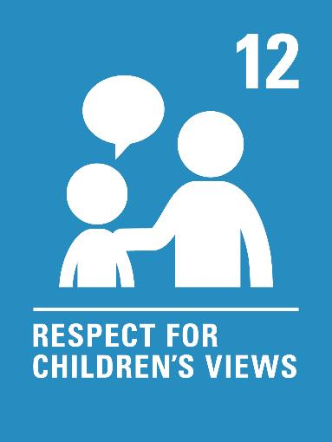
INTRODUCING ARTICLE 12
Children have the right to give their opinions freely on issues that affect them. Adults should listen and take children seriously.

Slide 5
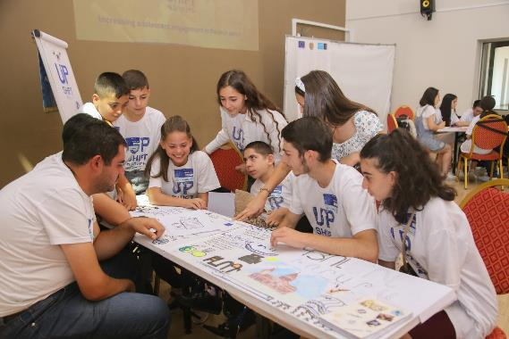
EXPLORING ARTICLE 12
At your school, how do you ensure that every child can have their voice heard, however they like to communicate?
Write down suggestions and compare your answers with the next slide.
UN0572514/Kirakosyan/Hieroglyph
Notes:
Children raise the national flag of Sudan at school. South Kordofan State.

Slide 6
DID YOU INCLUDE ANY OF THESE?
By having a Student Council that represents pupils' views, with democratically elected members.
By having issue-led pupil groups such as Green Schools Committee, ICT group.
Having a Student Council box or worry boxes or that are regularly checked.
Pupil surveys/questionnaires.
Ensuing that everyone receives information about issues so that they can form their own views.
By giving some people additional help or time to communicate their ideas if they need it.
By asking people to give their views in a way that works for them.
By ensuring feedback is given so that you know your views have been heard.
Feeling that your voice counts.
Trusting that you can speak honestly even if your opinion is different from many others.
Believing that your opinion is welcome and respected.
Did you think of anything else?

Slide 7

ACTIVITIES FOR THE CLASSROOM
One way we can communicate our thoughts and ideas is through drawing. Draw a picture of yourself doing your favourite activity and then share these as a class. Ask your teacher to build these activities into their planning over the next few weeks.
Read the ‘Here we are’ by Oliver Jeffers. Share your questions about the world and think about how we can look after the world around us so that we can all survive and thrive.
Watch this video about children’s rights. Draw the page in the storybook where Viz, Leepa and Zooko explain what Article 12 is all about. (It’s at 6 mins).
Think about what your face looks like when you like something, when you don’t like something, or when you are scared or excited. Can you tell how someone else is feeling by looking at their facial expressions? How can we ‘hear’ people even when they don’t speak so that we can respect their views?

Slide 8
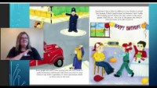
ACTIVITIES FOR THE CLASSROOM
Many schools have worry boxes or tell me boxes so that children can share their thoughts in writing. One school has a box labelled, “I wish my teacher knew...” so that children can share any thoughts, ideas, worries or news. Design a class box so that children in your class can share their views through writing.
Each class should have members on your school’s Student Council to represent the views of children in school decisions. Find out more about your school’s Student Council. More teacher guidance here.
Watch this clip of a story book by Kate Gaynor titled ‘A Birthday for Ben’. Why doesn’t Ben like parties at first? How does Ben make sure that everyone can participate in his party? How can you make sure that everyone feels included and is fully able to participate in your class? (More teacher guidance here).

Slide 9
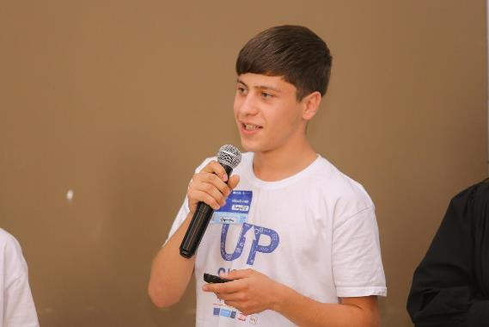
REFLECTION
Take some time to be still, to be quiet and to have a think...
How does it feel when you know you are being listened to and your views are respected?
When has your voice and your views made a difference?
If adults are not creating a space for your views to be heard, how can you respectfully claim this right? Who could help you?
Are there more things you could speak up about in your own life or in the wider world? How might you do this - on your own or with friends?
UN0572491/Kirakosyan/Hieroglyph
Notes:
Narek,16, Armenia. Presenting his team's idea at civic activism project.
“Our project is aimed at recycling waste. We will create a map where we will include all the addresses of sorted garbage collection points. It will be accessible to persons with disabilities so that everyone can be helpful and participate in our amazing project. We will have an animated video about the mission of the project, a map with a QR code, which will record all the points where we will collect sorted garbage. By the way, let me mention our QR codes will made of threads from recycled garbage," he said.

Slide 10
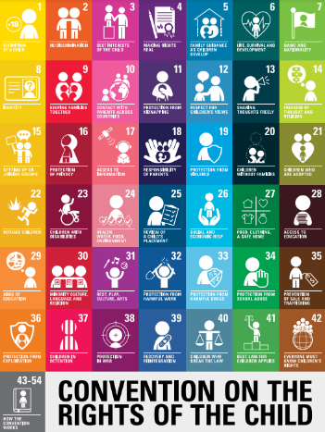
EXTENSION
Article 12 is one of four General Principles of the Convention (the others being Articles 2, 3 and 6)
All rights are equally important but these four Articles have a special role to play. This is because, as well as having full meaning on their own, they all apply to each of the other rights in the Convention too. So, for example, if you look at the right to relax and play, the views of the child should have a role.
Have a look at a variety of rights and ask yourself how does Article 12 apply to or add to our understanding of each right.
You can find a summary of the whole Convention here.

Slide 11
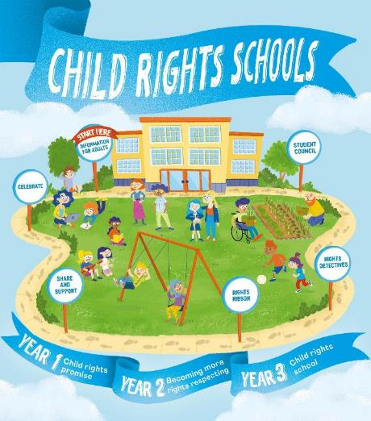

FURTHER CHILD RIGHTS EDUCATION SUPPORT
Child Rights Schools is a programme that supports you to embed child rights across the primary school.
Children are supported to express their views through the Student Council.
Find out more here.
Find more classroom resources here.

Slide 12


THANK YOU

