Slide 1
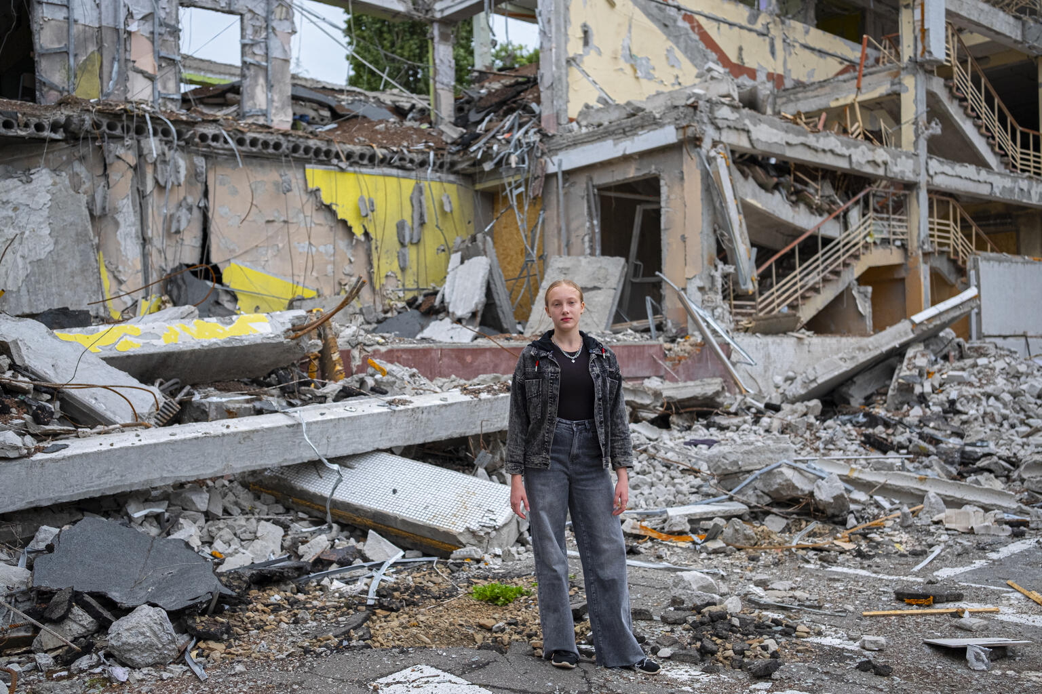

ARTICLE IN FOCUS
© UNICEF/UN0689488/Gilbertson
Notes:
August 2022,Kharkiv, Ukraine, Mariia, 12, stands amidst rubble in front of the school where she was to enter seventh grade in September. Much of the school was recently destroyed in an air strike, so Mariia will now be studying online when classes resume.

Slide 2
BEFORE YOU BEGIN
This is a flexible resource and is intended to provide you with some easy to use, appropriate rights-related learning to share with your children, their families and your colleagues.
Please edit out non relevant slides or activities before sharing with your students. Please check that the content works for your learners and feel free to adapt or add any content that would make the material more relevant for your setting.
This resource was developed by UNICEF UK and adapted by UNICEF Ireland.
Slide 3 – Guidance for teachers
Slide 4 – Guess the article
Slide 5 – Introducing Articles 38 and 39
Slide 6 – Exploring Articles 38 and 39
Slide 7 – Some possible answers
Slide 8 & 9 – Activities for the classroom
Slide 10 – Reflection
Slide 11 – Further Support

Slide 3
GUIDANCE FOR TEACHERS
Discussing war and conflict may be difficult for some children in your class, depending on their personal or family experiences.
Does your class already have an agreement for working together respectfully, or do you need to agree some ground rules especially for this work?
Have an open dialogue with your pupils. Actively encourage them to share their own perspectives and ideas. Be receptive to verbal and non-verbal cues that show children have been moved emotionally. Click here for useful tips. ­
Make time to stress that you understand pupils may be upset and confused when thinking about war that is currently happening, and remind them of the people and places offering support to children within and outside of their school.
Underline the fact that the CRC states the best interests of the child must always be a primary consideration, and the world has a longstanding commitment to put children first. All children must receive the care, respect and protection to which they are entitled, no matter who they are and where they are from. ­It is a sad fact that over the years, and in so many places, there have been, and continue to be, situations when duty bearers fail to do all they can for children. The world is not perfect but by having the CRC we can see when rights are not being accessed and children, and those who care for them, can speak up for their rights.
Consistently emphasise that human rights are a collective promise made by all countries of the world, including those currently in conflict. This promise can be summarised as everyone being able to enjoy a safe, happy and fulfilling life, where their dignity and worth is equally valued. You can also emphasise that the international system of refugee protection is founded on the principle of every country helping fellow human beings in times of need. It is a mutual system.

Slide 4
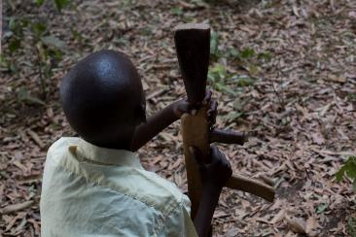
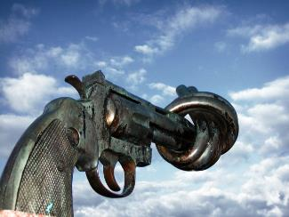
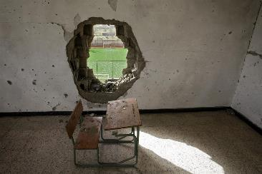
Guess the article
These pictures provide a clue to this week’s article.
Can you guess how they are linked together? Which article of the Convention do these pictures relate to?
Write down your thoughts or discuss with someone in your home.
Unicef/Lomodong
Wikicommons
Unicef/Diffidenti
Notes:
From left to right:
Unicef/Lomodong - Children associated with the Cobra faction wait to be demobilized in Pibor, South Sudan.
Wikicommons - Non-Violence, also known as The Knotted Gun, is a bronze sculpture by Swedish artist Carl Fredrik Reuterswärd of an oversized Colt Python .357 Magnum revolver with its muzzle tied in a knot.
Unicef/Diffidenti – Libya, 2012. A desk, covered with dirt and debris, sits in a classroom damaged during the conflict, in Shohada Yamayer Primary School, in the city of Sirte. An outdoor sporting area is visible through a large rupture in the classroom’s wall. Much of the city, the final stronghold of former Government forces, was destroyed during the weeks-long fighting there.

Slide 5
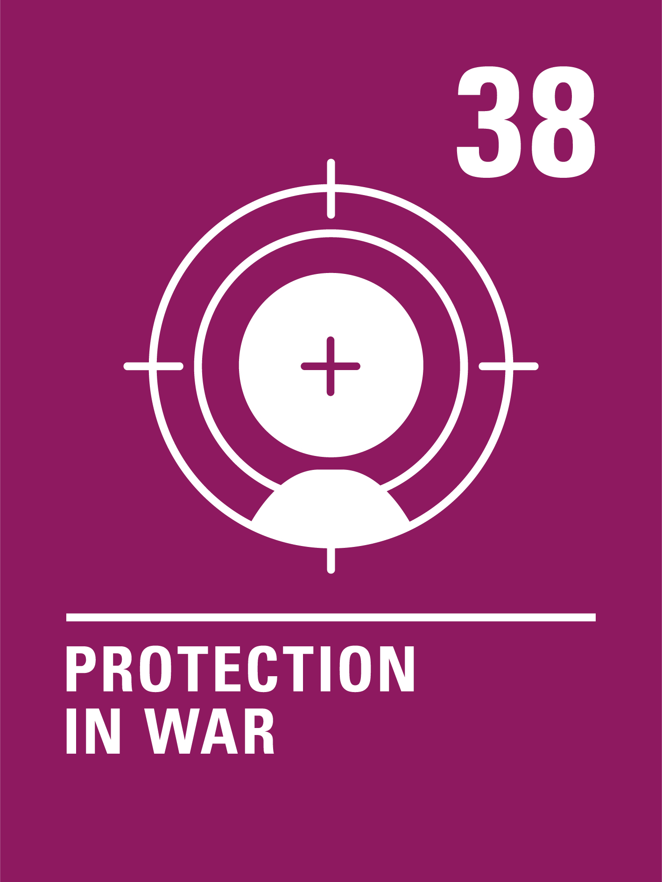

INTRODUCING ARTICLES 38 & 39
Article 38 Protection in War
Children have the right to be protected during war. No child under 15 can join the army or take part in war.
Article 39 Recovery and Reintegration
Children have the right to get help if they have been hurt, neglected, treated badly or affected by war, so that they can get back their health and dignity.

Slide 6
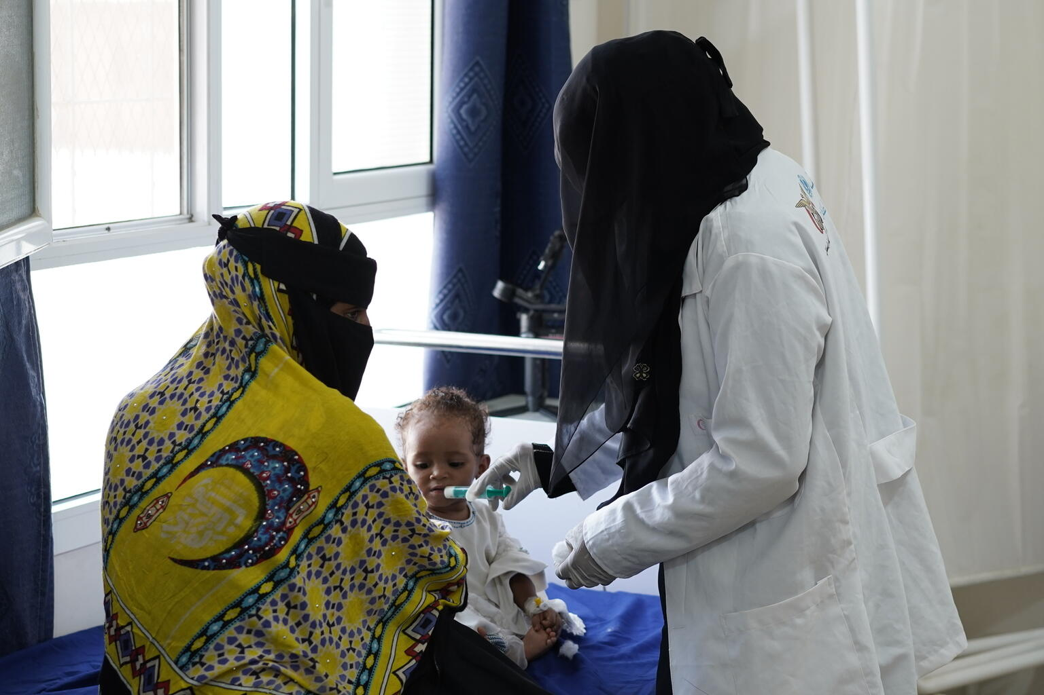
EXPLORING ARTICLES 38 & 39
Why do you think children should be protected during war?
Write down suggestions and compare your answers with the next slide.
Notes:
Ayat, 10 months old, given therapeutic milk by a nurse in Yemen.

Slide 7
Did you think of these?
War impacts children’s ability to enjoy their rights.
War is dangerous. You can be seriously injured or killed and participation in war can have a life-long impact on a person. It’s wrong to make children and young people take part in wars, particularly if they are forced to do so.
Adults make wars happen, why should innocent children be affected?
If children see fighting and war as the answer to problems this may affect their whole lives.
They may be too young to understand what the war is about.
Adults choose to join the armed forces as a profession, and they receive training and support to do their work. Child soldiers are often coerced or forced to take part and receive no training or support.
They are still growing and may not have the physical or emotional maturity to cope.
What else did you think of?

Slide 8
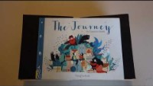
ACTIVITIES FOR THE CLASSROOM
Watch this video of the book The Journey by Francesca Sanna about a family fleeing war. What difficult things does the family experience? When they finally arrive in a safe place, what will they need to ‘begin their story again’?
When something bad has happened to someone, it is important that they feel safe. Think about where you feel safe. Draw a picture of your safe place and share it with a friend. Create a cosy corner in your classroom where people can go to feel safe and secure.
If there was peace all over the world, all children would be safe from war. That’s one of the goals of the United Nations. Design a poster to promote peace. You could include why war is so dangerous for children and emphasise that children have the right to be protected in war.

Slide 9
ACTIVITIES FOR THE CLASSROOM
The rights within the Convention are indivisible – a child should have all of their rights, all the time. Look at the Convention and try to identify how many other rights might be affected when a child or young person’s life is disrupted by armed conflict or war.
A growing number of children and young people joining schools in Ireland are asylum seekers and refugees fleeing from countries at war. How can schools support such pupils and help them to feel welcome? What role could fellow students play in this?
“Children bear no responsibility for war. Yet they suffer its consequences for life.”
Can you explain why UNICEF uses this statement? How do you feel about it?

Slide 10
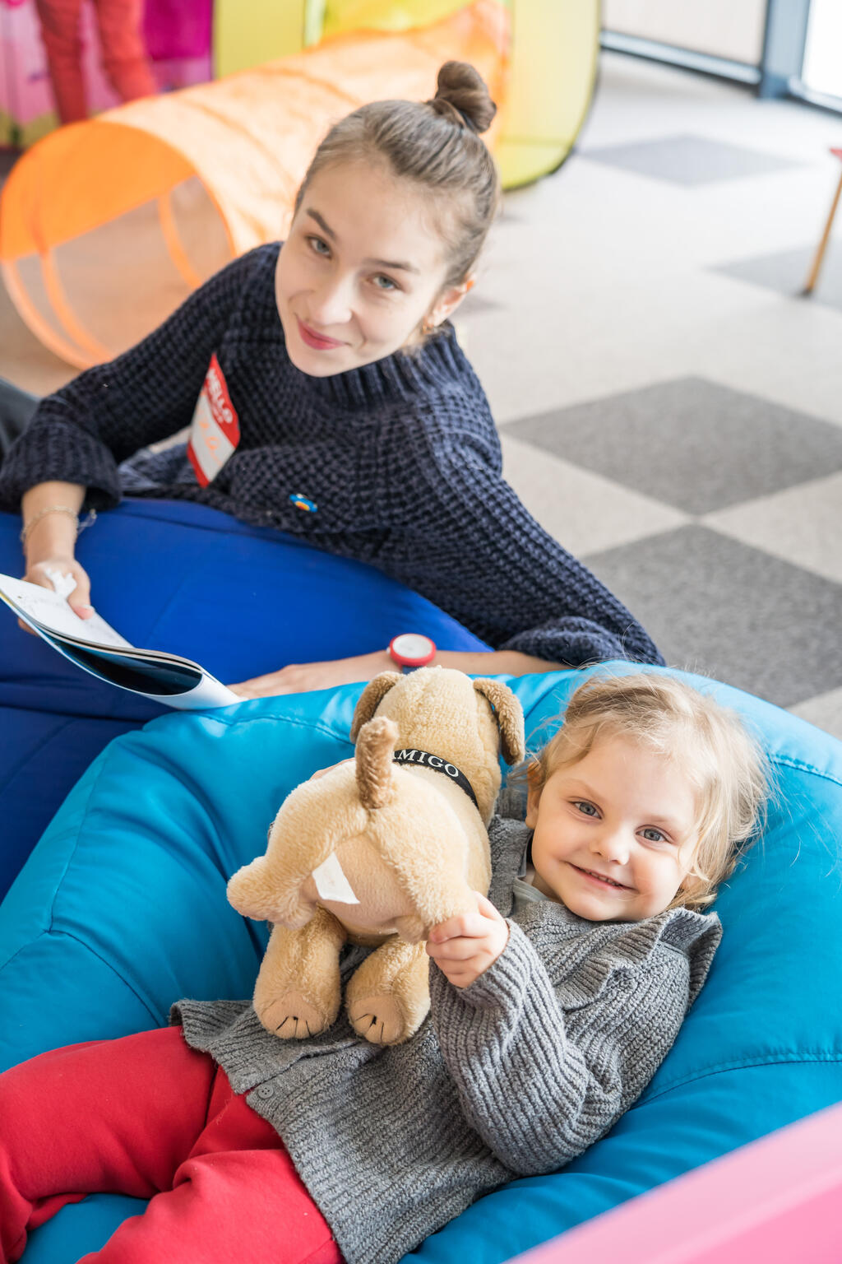
REFLECTION
You may like to reflect as a class or in an assembly…
When there is war and conflict we often try to think of peace.
What makes you feel peaceful and calm?
How can your thoughts, words and actions bring a sense of peace to your friends and family?
What does it take to be a peace maker?
© UNICEF/UN0633870/Holerga
Notes:
In April 2022, volunteer Liza plays with a young child in the children's activity room in a UNICEF Blue Dot in Romania.
The Blue Dots safe spaces, protection and support hubs, established jointly with UNHCR and partners, provide practical support and information to children and families in their onward journeys. Blue Dots also provide specialist support for those in need of protection, such as children traveling on their own, women with young children, persons with disabilities or survivors of sexual violence. Child-friendly spaces offer a welcoming space for kids to rest, play, and simply be a child at a time when their world has been turned upside down in fear and they are facing the trauma of leaving friends, family and all that is familiar to them.

Slide 11
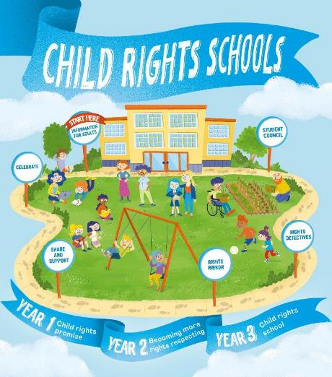

FURTHER CHILD RIGHTS EDUCATION SUPPORT
Child Rights Schools is a programme that supports you to embed child rights across the primary school.
Children are supported to express their views through the Student Council.
Find out more here.
Find more classroom resources here.

Slide 12


THANK YOU

