Slide 1
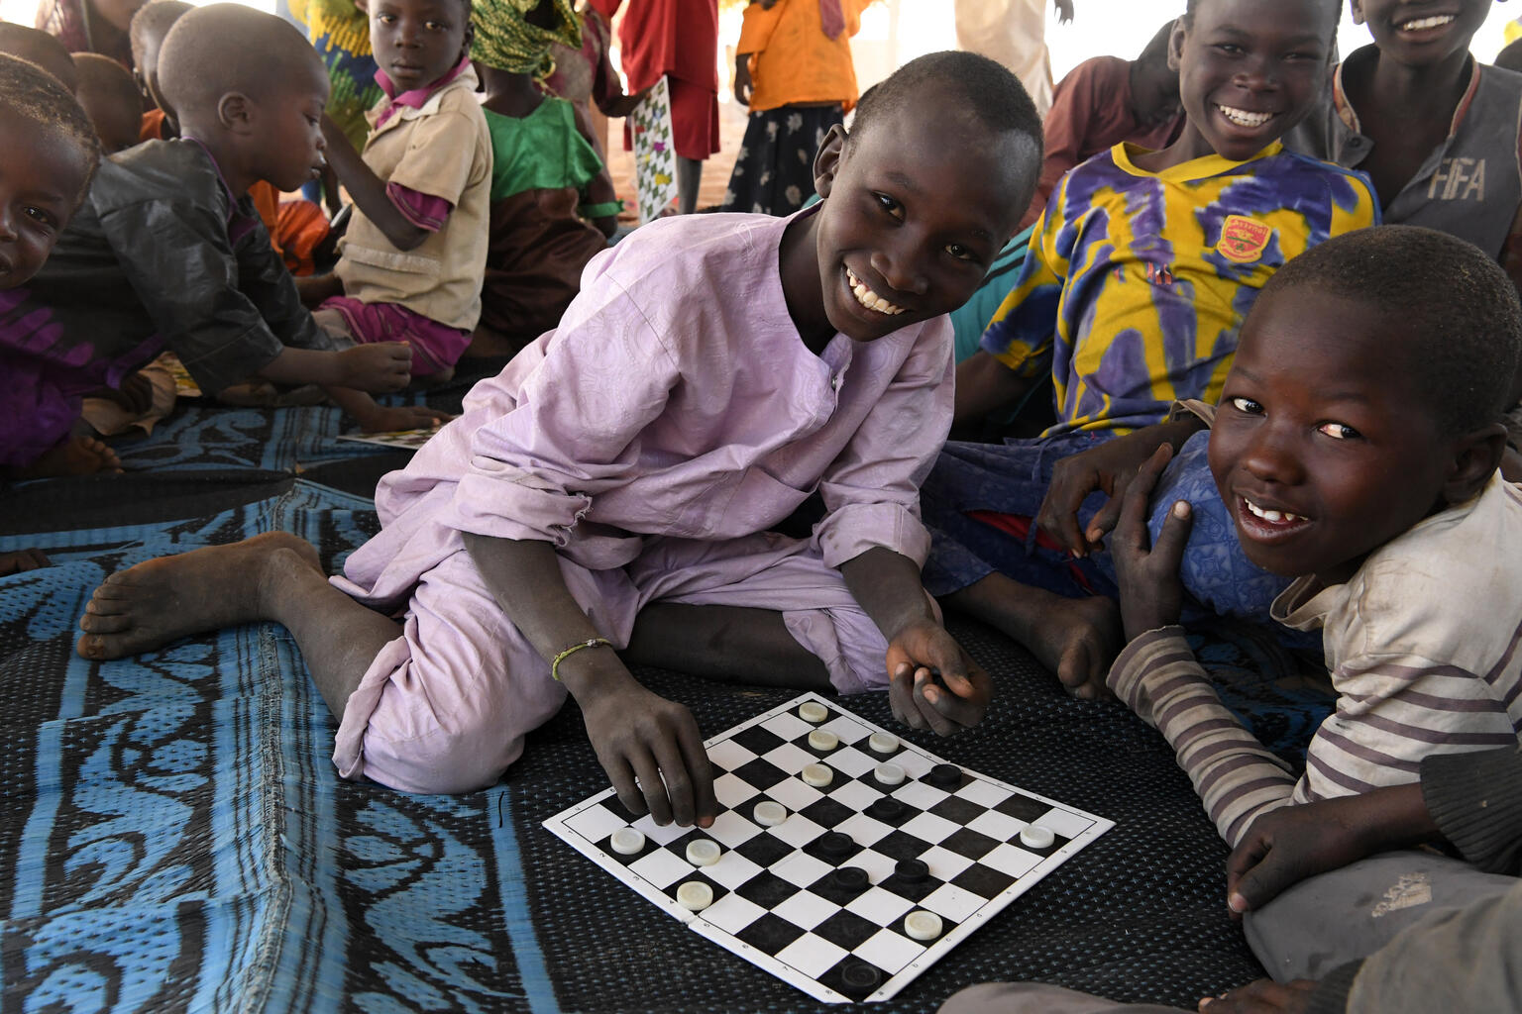

ARTICLE IN FOCUS
© UNICEF/UN0594598/Dejongh
Notes:
Mohamed a 12 years old boy, at a refugee camp, in the West of Chad. He likes to play checkers with his friends.

Slide 2
BEFORE YOU BEGIN
This is a flexible resource and is intended to provide you with some easy to use, appropriate rights-related learning to share with your children, their families and your colleagues.
Please edit out non relevant slides or activities before sharing with your students. Please check that the content works for your learners and feel free to adapt or add any content that would make the material more relevant for your setting.
This resource was developed by UNICEF UK and adapted by UNICEF Ireland.
Slide 3 – Guess the article
Slide 4 – Introducing Article 15
Slide 5 – Exploring Article 15
Slide 6 – Some possible answers
Slide 7 & 8 – Activities for the classroom
Slide 9 – Reflection
Slide 10 – Further Support

Slide 3
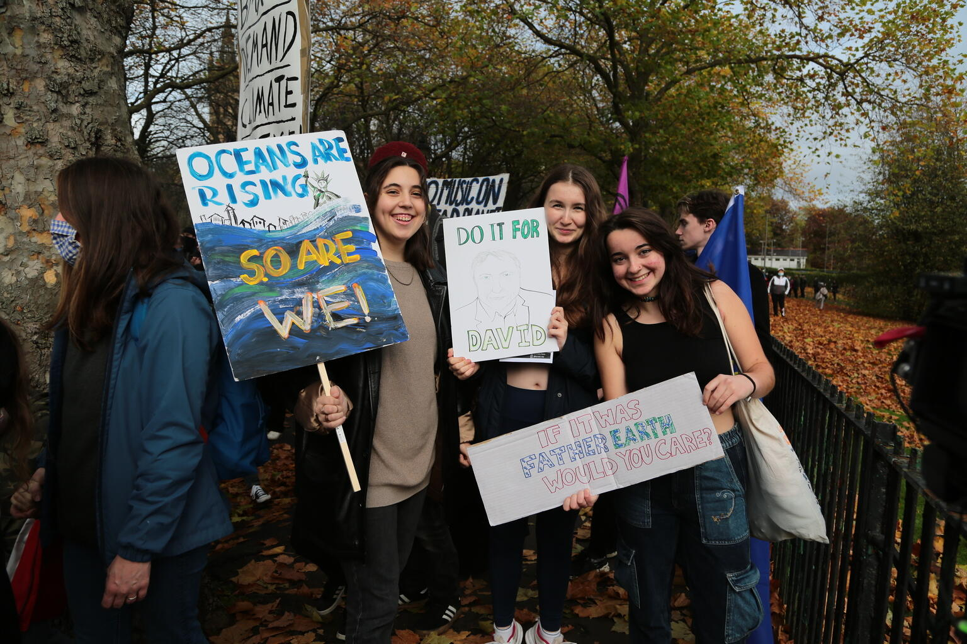
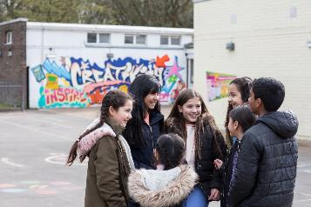
Guess the article
These pictures provide a clue to this week’s article.
Can you guess how they are linked together? Which article of the Convention do these pictures relate to?
Write down your thoughts or discuss with someone in your home.
Unicef/Herwig
Unicef/Howard Elwyn-Joness
Unicef/Dawe

Slide 4

INTRODUCING ARTICLES 38 & 39
Article 15 Setting Up or Joining Groups
Children can join or set up groups or organisations, and they can meet with others, as long as this does not harm other people.

Slide 5
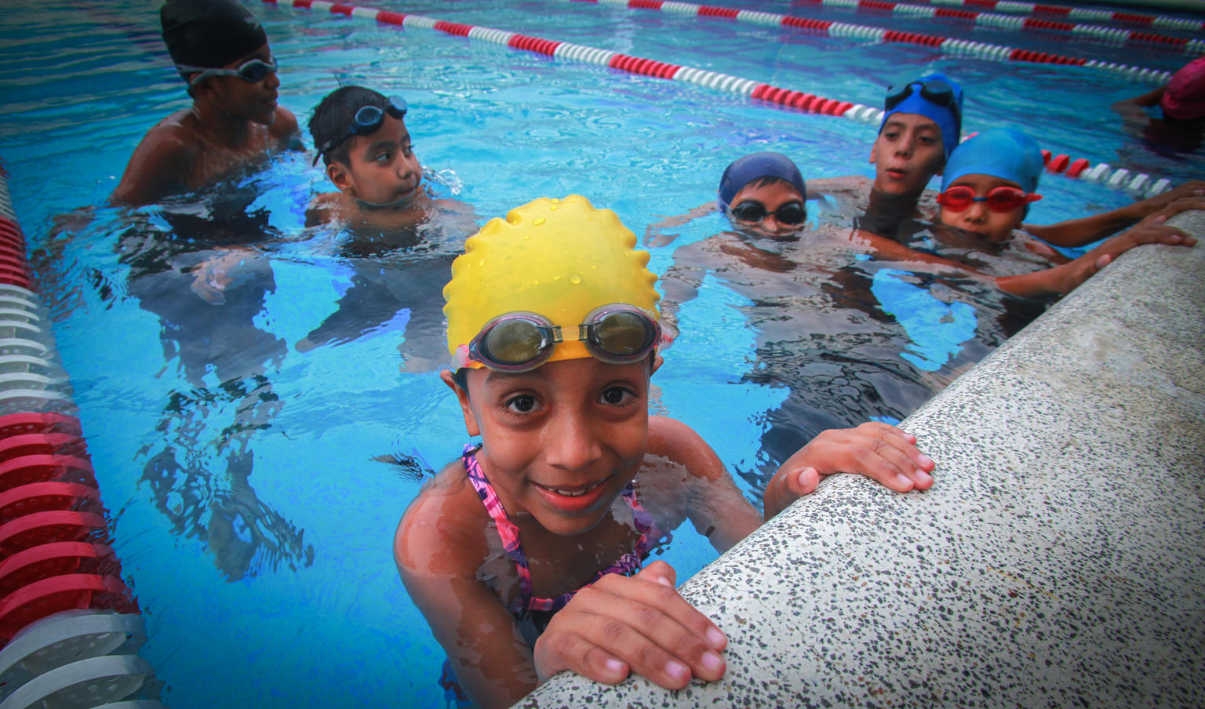
EXPLORING ARTICLE 15
What is needed for you to enjoy the right to get together with other children?
Write down suggestions and compare your answers with the next slide.
© UNICEF/UN0156174/Martinez
Notes:
Natividad 7, spends time in the pool at her local recreation centre. She has been taking swimming lessons there for the past year and a half, as a way to avoid the dangerous streets in her neighbourhood in San Salvador.

Slide 6
Did you think of these?
Clubs, organisations and groups that are near to you or can be accessed safely.
Groups and organisations that have fun and appropriate activities.
Safe places to meet.
Choice of clubs in school.
Encouragement from parents and carers to get involved.
Activities to join in with that do not disrupt the rights of others.
Freedom to start a group if there is something you feel strongly about.
Clubs and organisations should not be too expensive to join.
What else did you think of?

Slide 7
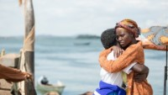
ACTIVITIES FOR THE CLASSROOM
Queen of Katwe is the true story of a young girl selling corn on the streets of rural Uganda whose world rapidly changes when she joins a chess club. Watch the trailer here. The movie is rated PG and is available on streaming services.
Share some memories of going to your first preschool or playgroup. Can you remember what it was like? How did you feel? What did you enjoy most? Talk to a partner to come up with ways you would help new children coming to nursery for the first time.
Work together to make a short video that could go on your school’s website to show any new pupils and families the range and purpose of the pupil groups in your school. Link it to Articles 15 and 12. Make it clear what the groups do, how to join and what positive changes they have made and could make.

Slide 8
ACTIVITIES FOR THE CLASSROOM
If you belong to a few different clubs and/or groups, what's the difference between them? Are some just for fun? Do others help you to learn a new skill? Do others help you to make a difference or change something in your school or local community? How do they help you to enjoy your rights?
It is a common misunderstanding that Article 15 means ‘children have the right to friends’. Can you try to explain it differently - perhaps a more catchy way to help others remember what it means more accurately? It might help to research the meaning of ‘freedom of association’.
Think about what adults can do to help you enjoy your right to set up or join groups. Not just teachers or parents, but think about all duty bearers in the wider community. What can you do to claim your right, relating to Article 15? Perhaps create two separate columns to capture your ideas for what adults as duty bearers can do and you as the rights holders can do.

Slide 9
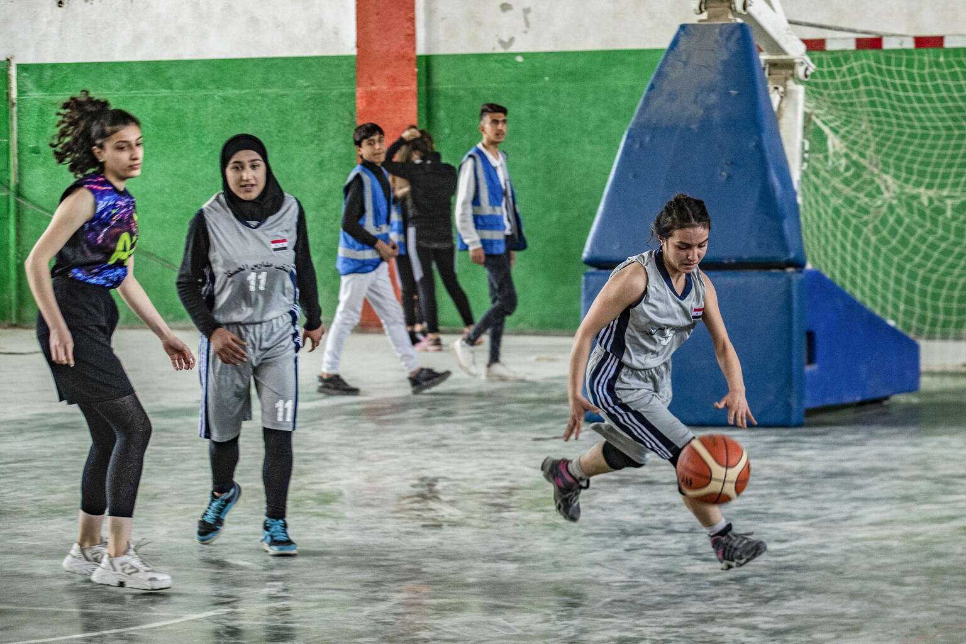
REFLECTION
You may like to reflect as a class …
Why is it good to meet up with other children?
What’s important about belonging?
How can you help to make others feel that they are welcome and really belong to groups you are part of?
How can you show appreciation for what others bring to groups you are in?
Who are the duty bearers who help to make your groups happen? How could you thank them?
© UNICEF/UN0620839/Souleiman

Slide 10
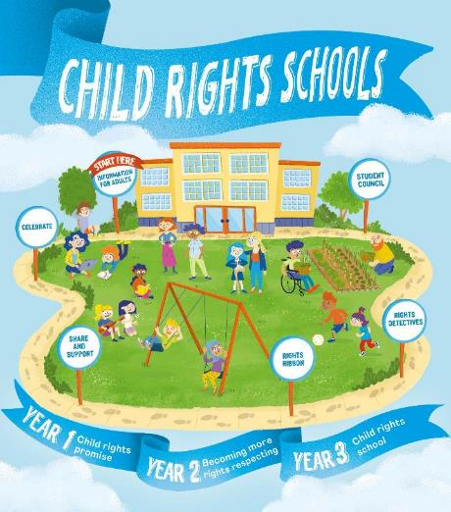

FURTHER CHILD RIGHTS EDUCATION SUPPORT
Child Rights Schools is a programme that supports you to embed child rights across the primary school.
Children are supported to express their views through the Student Council.
Find out more here.
Find more classroom resources here.

Slide 11


THANK YOU

