Slide 1
ARTICLE IN FOCUS
© UNICEF/UN0668511/Dejongh
Notes:
Young deaf and hard of hearing girls during a training session in the East of Cameroon.

Slide 2
BEFORE YOU BEGIN
This is a flexible resource and is intended to provide you with some easy to use, appropriate rights-related learning to share with your children, their families and your colleagues.
Please edit out non relevant slides or activities before sharing with your students. Please check that the content works for your learners and feel free to adapt or add any content that would make the material more relevant for your setting.
This resource was developed by UNICEF UK and adapted by UNICEF Ireland.
Slide 3 – Guess the article
Slide 4 – Introducing Article 23
Slide 5 – Exploring Article 23
Slide 6 – Some possible answers
Slide 7 & 8 – Activities for the classroom
Slide 9 – Reflection
Slide 10 – Further Support

Slide 3
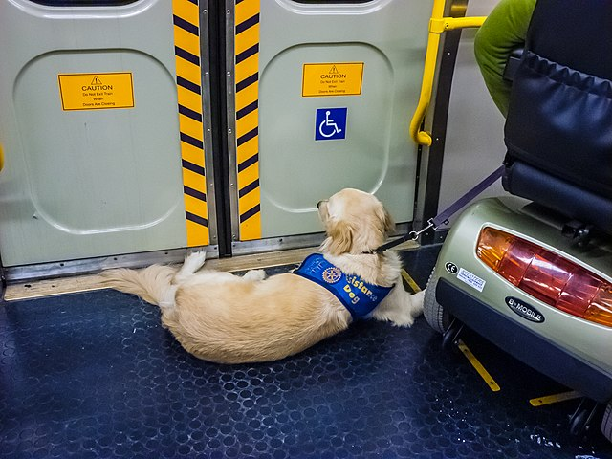
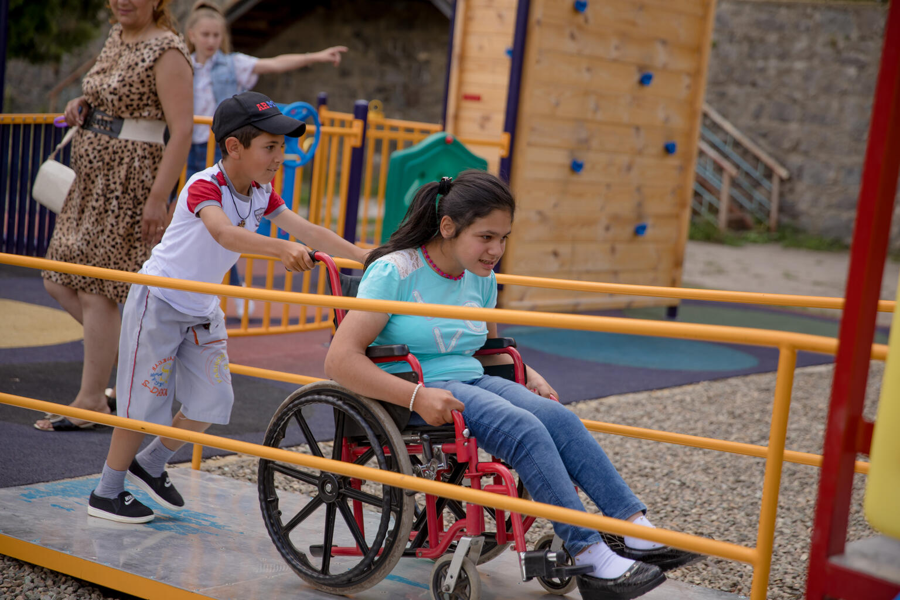
Guess the article
These pictures provide a clue to this week’s article.
Can you guess how they are linked together? Which article of the Convention do these pictures relate to?
Write down your thoughts or discuss with someone in your home.
Wikimedia Commonss
© UNICEF/UN0460479/Gevorgyan
Notes:
Picture 1
Assistance dog on train
Picture 2
Children playing in an incluisve playground, Yemen

Slide 4
INTRODUCING ARTICLE 23
Article 23 Children with disabilities
Every child with a disability should enjoy the best possible life in society. Governments should remove all obstacles for children with disabilities to become independent and to participate actively in the community.

Slide 5
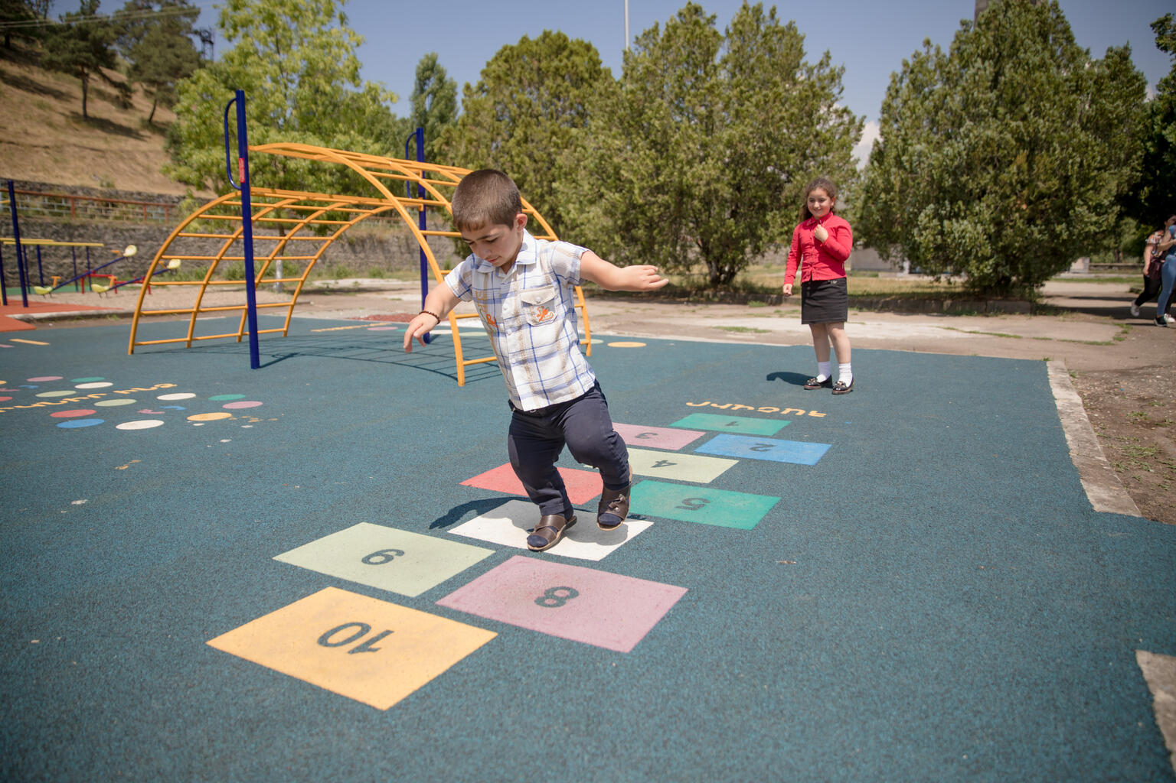
EXPLORING ARTICLE 23
What can your school do to support children who have a disability?
Remember that not all disabilities are visible.
© UNICEF/UN0460505/Gevorgyan
Notes:
Gevorg playing in an inclusive playground with his friend Syuzanna

Slide 6
Did you think of these?
Make sure the building is physically accessible (ramps and lifts for example)
Work with specialist services to meet the needs of the child such as accessible buildings, specialist equipment or audio descriptions
Make lessons and activities accessible for all (easy read, sign language, Braille)
Have quiet, calm and relaxing spaces such as a nurture room
Use special equipment such as a microphone or hearing loop
Listen to the child’s opinions about how they would like to be included – every child is unique
Work together and create a plan – making sure the child is heard
Have toilets that are accessible
Make sure all children can enjoy the playground
What else did you think of?

Slide 7
ACTIVITIES FOR THE CLASSROOM
It is important that a child with a disability is included and treated with respect. Watch this video and listen to Phoebe, who has Cerebral Palsy, share her story. The talks about the importance of being included in everything that she wants to do. Think about what you would ask Phoebe.
How would you feel if there was an area in your school that you couldn’t go because of your disability? Carry out an accessibility survey of your school to understand if your school needs any improvements.
Invite your school principal into your classroom to discuss the survey results and develop an action plan to make improvements. Do you have a student council? Bring the issues that concern you the most to the student council.

Slide 8
ACTIVITIES FOR THE CLASSROOM
Sign language is a way of communicating using your hands, mostly used by people with loss of hearing. Watch this video and learn the ABC in Irish Sign Language.
Find out about a Paralympic sport that interests you. Ellen Keane was Ireland’s youngest ever paralympic athlete when she swam in the 2008 Beijing Paralympic Games. Find out more about Ellen’s achievements.

Slide 9
REFLECTION
Find somewhere peaceful and spend a few minutes being quiet and still. Think about …
Do you have a disability? How do people include you?
If you don’t have a disability, what do you do to respect the rights of children living with a disability?
Notes:
A young girl is standing on her own in a studio with a blue background, her robotic arms are crossed and she's looking at the camera smiling in the UK.

Slide 10
FURTHER CHILD RIGHTS EDUCATION SUPPORT
Child Rights Schools is a programme that supports you to embed child rights across the primary school.
Children are supported to express their views through the Student Council.
Find out more here.
Find more classroom resources here.

Slide 11
THANK YOU

