Slide 1
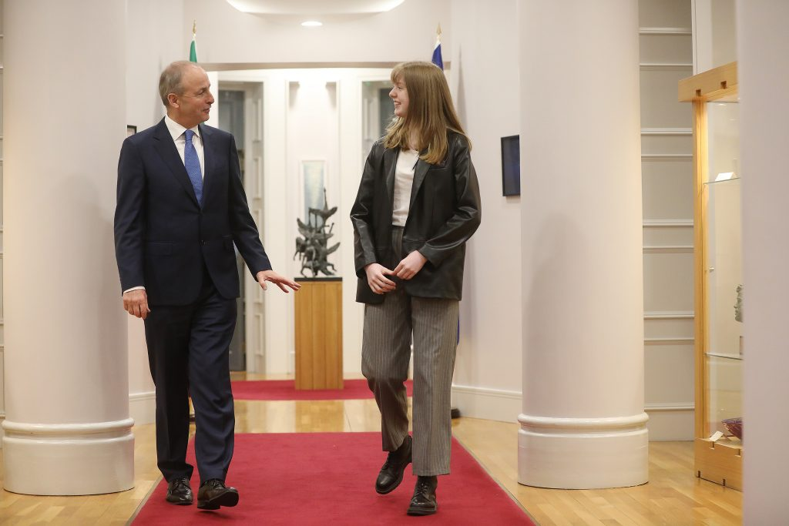

ARTICLE IN FOCUS
© UNICEF/UN0594598/Dejongh
Notes:
Each year around World Children’s Day, UNICEF organises a #KidsTakeOver event. Kids from all around the world take over key roles in media, politics, business, sport, and entertainment. Here in Ireland, UNICEF helps arrange a meeting with the Taoiseach to give young people, who are passionate about different issues, a chance to advocate for the change they want to see. In 2021 climate activist Liadh Dalton, from Co Offaly, met the Taoiseach, to discuss the impact of climate change on young farmers in Ireland.

Slide 2
BEFORE YOU BEGIN
This is a flexible resource and is intended to provide you with some easy to use, appropriate rights-related learning to share with your children, their families and your colleagues.
Please edit out non relevant slides or activities before sharing with your students. Please check that the content works for your learners and feel free to adapt or add any content that would make the material more relevant for your setting.
This resource was developed by UNICEF UK and adapted by UNICEF Ireland.
Slide 3 – Guess the article
Slide 4 – Introducing Article 4
Slide 5 – Exploring Article 4
Slide 6 – Some possible answers
Slide 7 & 8 – Activities for the classroom
Slide 9 – Reflection
Slide 10 – Further Support

Slide 3
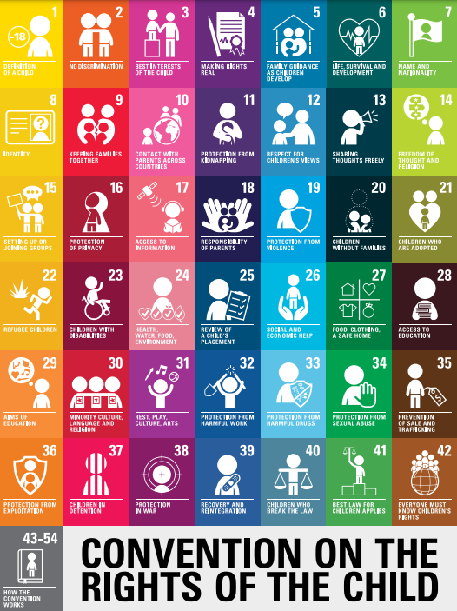
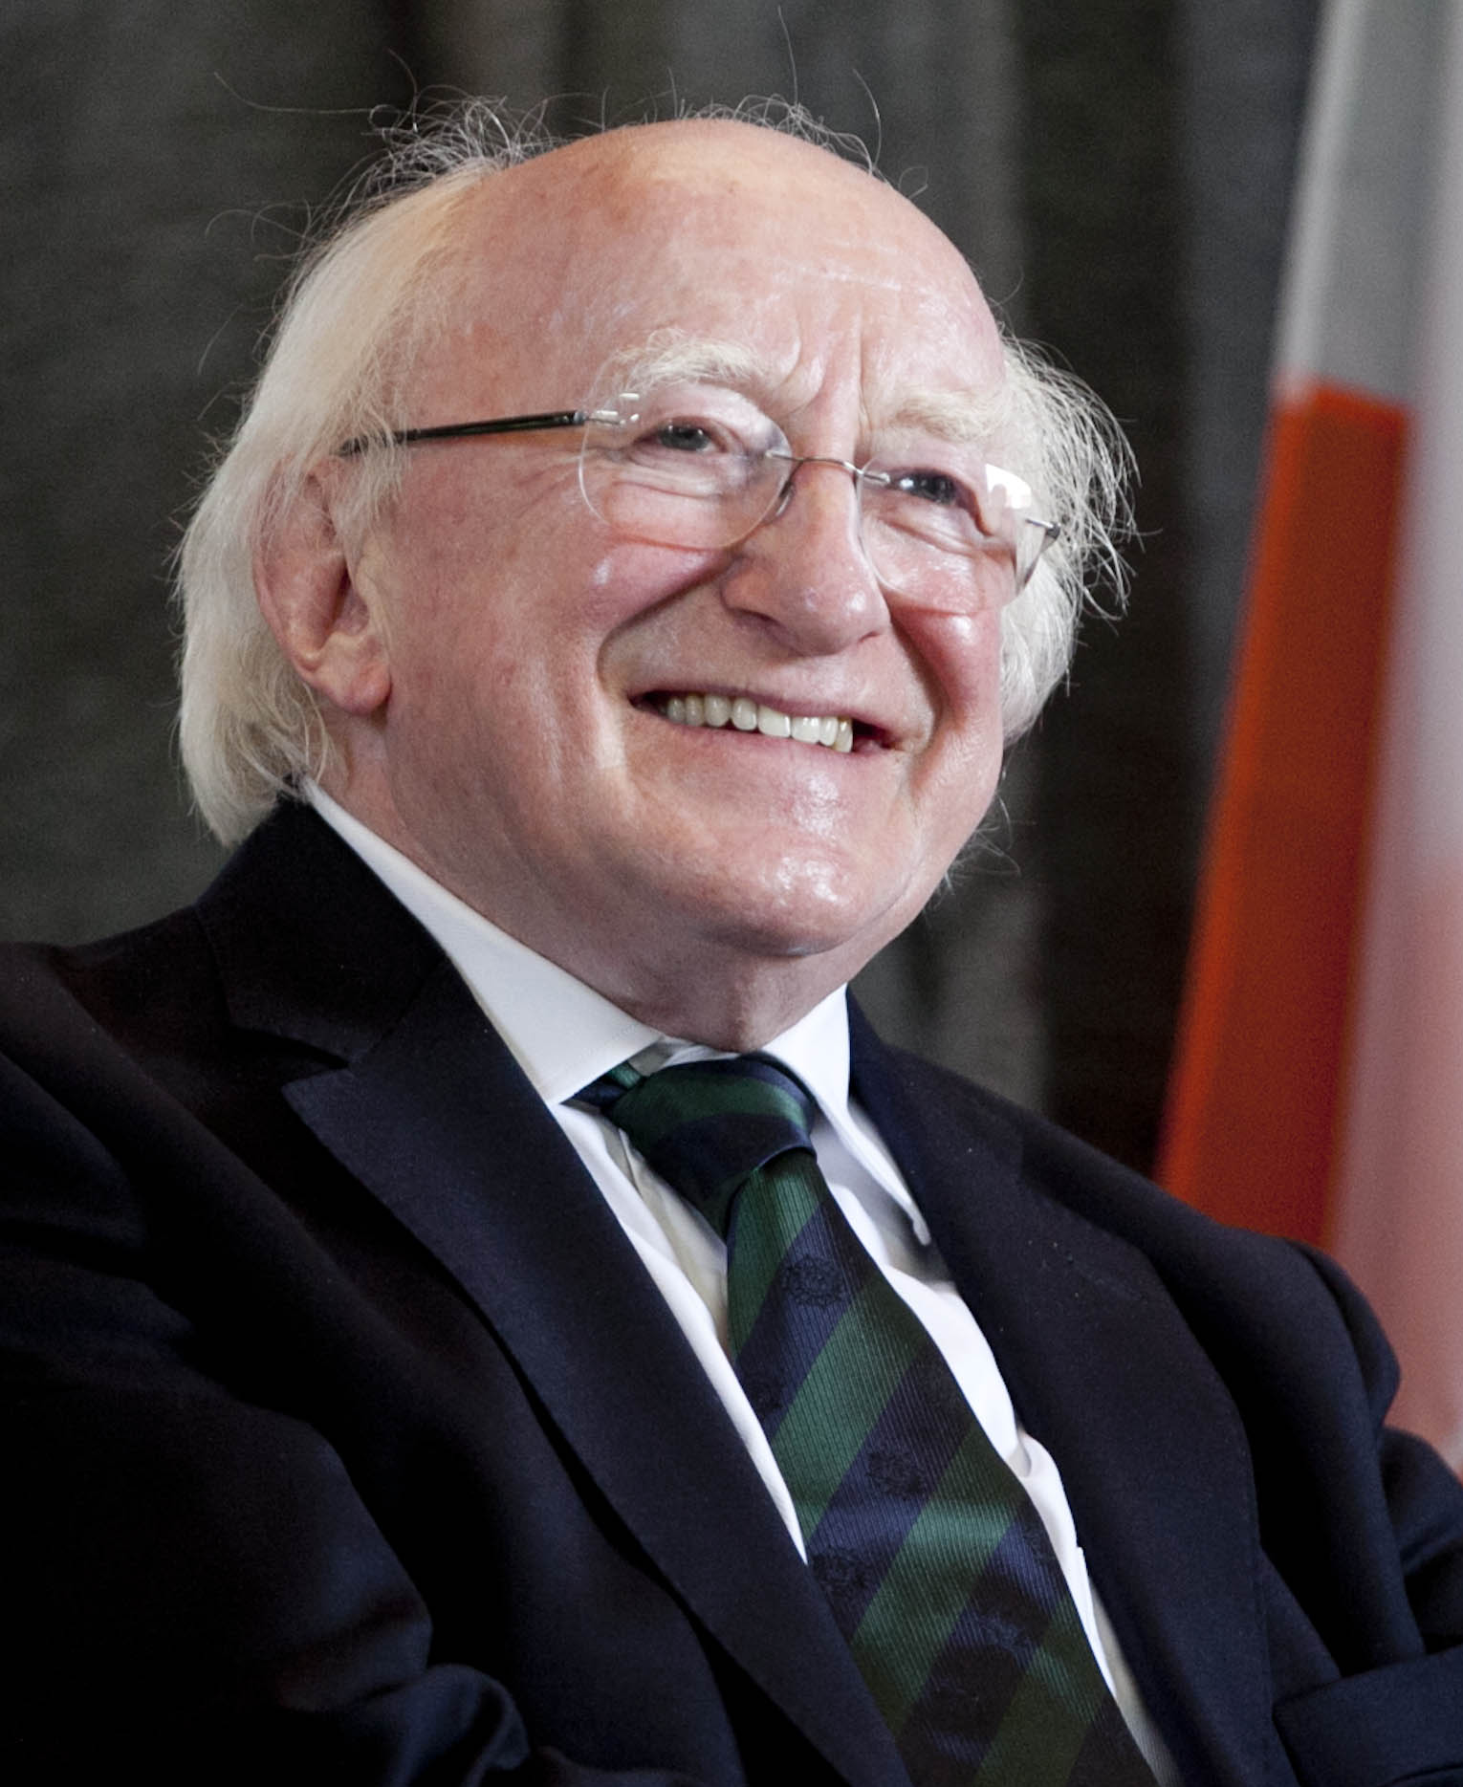
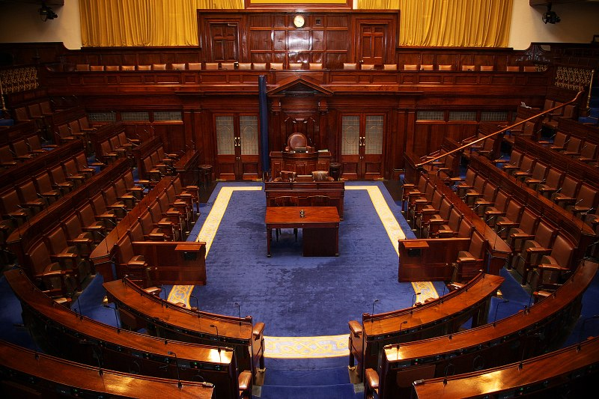
Guess the article
These pictures provide a clue to this week’s article.
Can you guess how they are linked together? Which article of the Convention do these pictures relate to?
Write down your thoughts or discuss with someone in your home.
Wikimedia Commonss
Wikimedia Commons

Slide 4

INTRODUCING ARTICLE 4
Article 4 Making Rights Real
Governments must do all they can to make sure that every child in their countries can enjoy all the rights in this Convention.

Slide 5
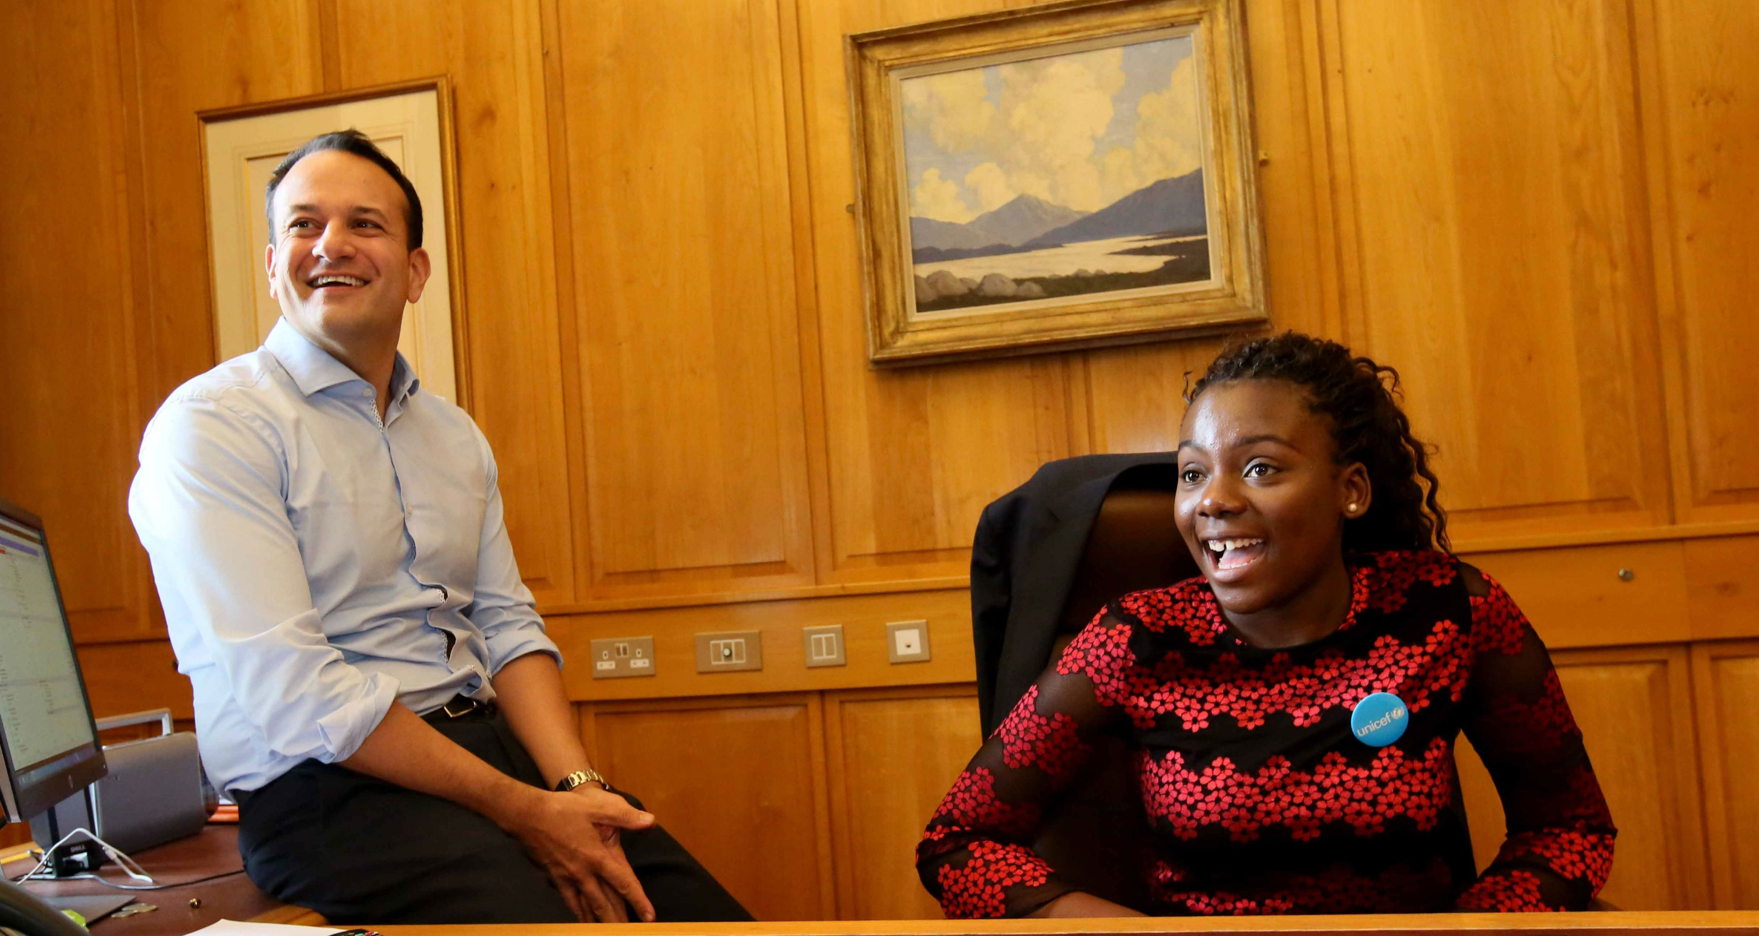
EXPLORING ARTICLE 4
We all have human rights. Why did the UN add the Convention on the Rights of the Child for children and young people?
Notes:
In 2017, Joella Dhlamini (16) from Drogheda, Co. Louth spent World Children’s Day with An Taoiseach Leo Varadkar. Joella and Mr. Varadkar attended a number of events across counties Meath and Dublin before returning to Leinster House for World Children’s Day celebrations. Mr. Varadkar heard how Joella would educate people about the impact of racism if she could change one thing about Ireland. Joella is originally from Soweto, Johannesburg, South Africa but moved to Ireland in 2013 to escape violent crime, and to benefit from Ireland’s education system. Joella also spoke to Mr. Varadkar about issues of concern for young people in Ireland, as expressed to UNICEF Ireland, including disability rights, poverty, climate change and the Sustainable Development Goals.

Slide 6
Did you think of these?
Children need a set of rights just for them because childhood is a time when children and young people need special consideration and protection as they grow.
The Convention is an agreed set of standards so we all know what children need and are entitled to so they can grow up healthy and safe.
The Convention gives the world a vision or a goal for how life should be for children everywhere.
Children have less power to make decisions than adults, so they need to be given a say in decisions affecting them.
Children need special protection from harm as they may not be as big or strong as adults.
Children need a good quality education to help them have a good life and this is guaranteed by the Convention.
The Convention ensures and encourages governments to help children for example, families often need extra support from government to look after their children.
What else did you think of?

Slide 7
ACTIVITIES FOR THE CLASSROOM
Look at the different articles in the Convention on the Rights of the Child here. Discuss the things that might stop children from enjoying their rights.
It is the job of duty bearers, especially governments, to ensure children enjoy their rights. Write a letter or design a poster and send it to your local TD. Ask them to mention children’s rights in the Dáil.
Imagine that for one day only, you have been made the principal of your school. What changes will you make? Are there things which you could change to uphold the rights of pupils in the school? Explore your ideas using role play or ‘hot seating’, taking it in turns to be the principal.

Slide 8
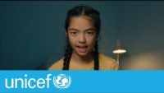
ACTIVITIES FOR THE CLASSROOM
Children cannot vote because they are younger than 18. However your voice can still be heard by politicians and decision makers. Watch this video to learn about some inspirational children who spoke up for change.
Are children being denied any of their rights in your local community? Invite a local politician into your school to talk about the issue and ask them to do something about it.

Slide 9
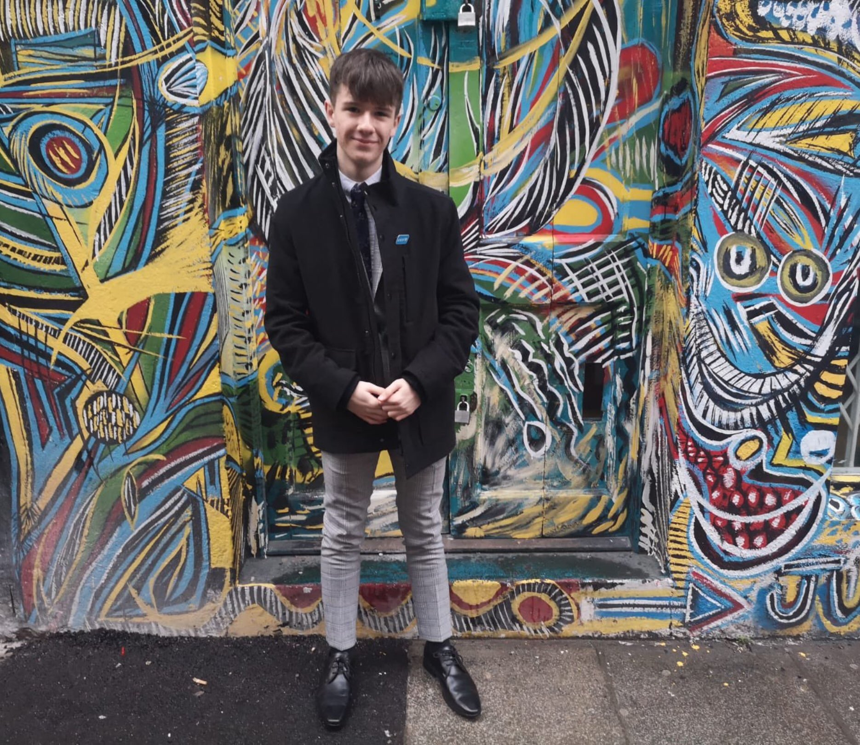
REFLECTION
You may like to reflect as a class …
Can you remember a time when you did not know you had rights?
Why are your rights special to you?
Which duty bearers do you particularly appreciate and value for making sure you get your rights? (Could you tell them?)
Notes:
Ruairi Holohan is an advocate for LGBT rights in Ireland as well as being the winner of UNICEF Taoiseach Takeover 2020.

Slide 10
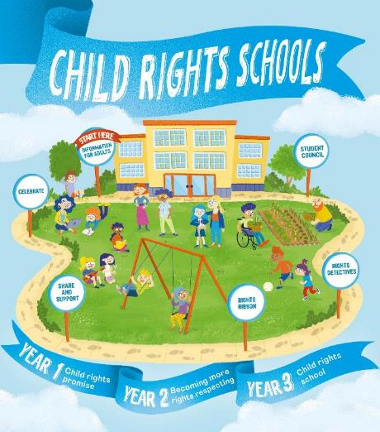

FURTHER CHILD RIGHTS EDUCATION SUPPORT
Child Rights Schools is a programme that supports you to embed child rights across the primary school.
Children are supported to express their views through the Student Council.
Find out more here.
Find more classroom resources here.

Slide 11


THANK YOU

