Slide 1
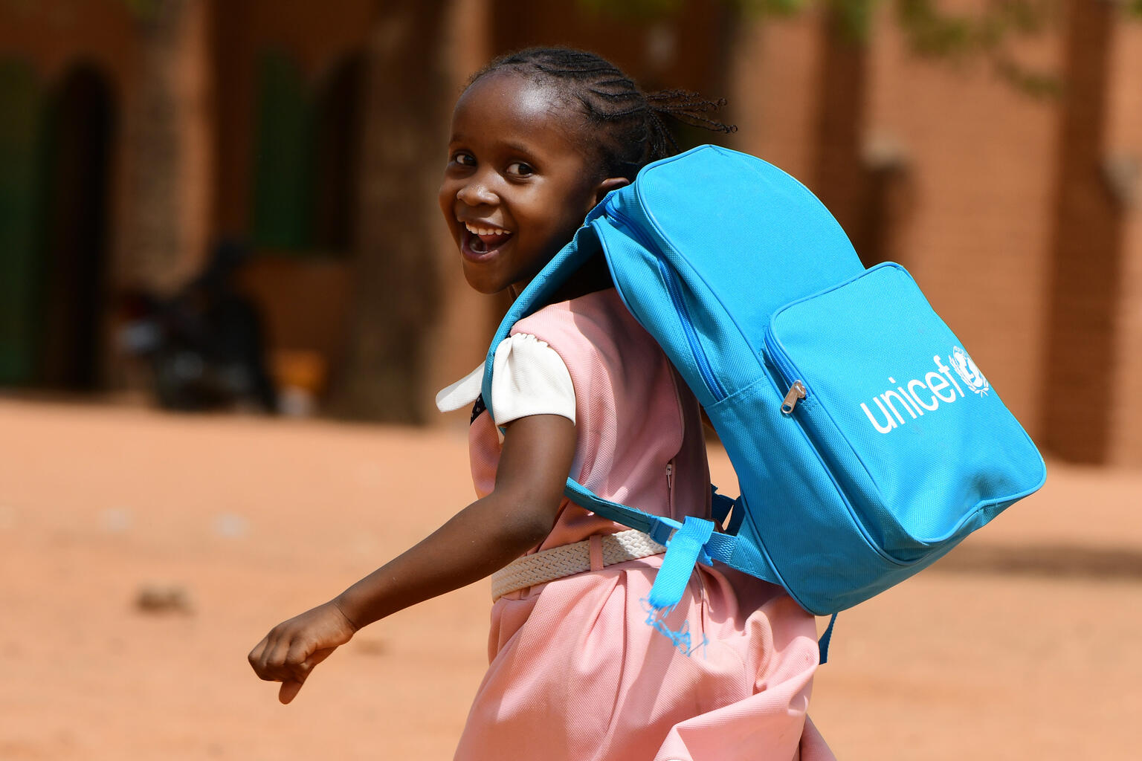

ARTICLE IN FOCUS
© UNICEF/UN0439618/Dejongh
Notes:
Child in the playground of her school in Niamey. Niger

Slide 2
BEFORE YOU BEGIN
This is a flexible resource and is intended to provide you with some easy to use, appropriate rights-related learning to share with your children, their families and your colleagues.
Please edit out non relevant slides or activities before sharing with your students. Please check that the content works for your learners and feel free to adapt or add any content that would make the material more relevant for your setting.
This resource was developed by UNICEF UK and adapted by UNICEF Ireland.
Slide 3 – Guess the article
Slide 4 – Introducing Article 28
Slide 5 – Exploring Article 28
Slide 6 – Some possible answers
Slide 7 & 8 – Activities for the classroom
Slide 9 – Reflection
Slide 10 – Further Support

Slide 3
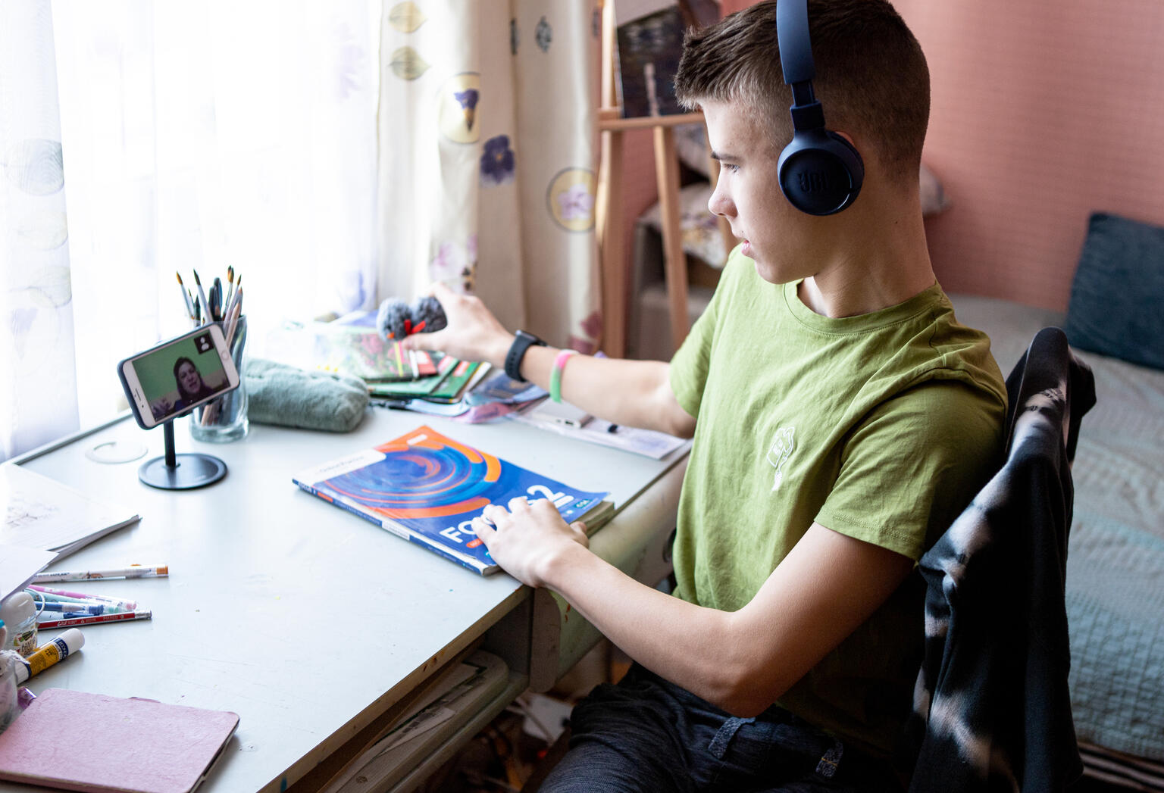
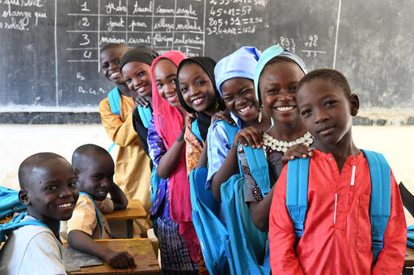
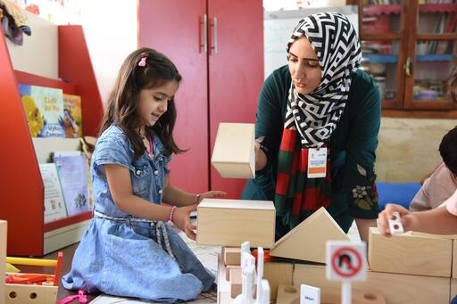
Guess the article
These pictures provide a clue to this week’s article.
Can you guess how they are linked together? Which article of the Convention do these pictures relate to?
Write down your thoughts or discuss with someone in your home.
UNICEF/UN0633055/Latayko
UNICEF/UN0535952/Dejongh
UNICEF/UN0444256
Notes:
Picture 1
12 year old Arseniy attends online classes
Picture 2
Children attending class in the south of Niger
Picture 3
Child and tecaher

Slide 4

INTRODUCING ARTICLE 28
Article 28 Access to Education
Every child has the right to an education. Primary education should be free. Secondary and higher education should be available to every child. Children should be encouraged to go to school to the highest level possible. Discipline in schools should respect children’s rights and never use violence

Slide 5
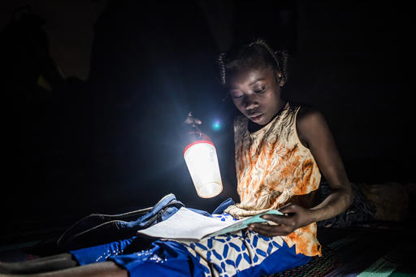
EXPLORING ARTICLE 28
Why do you think
education is important
for children?
© UNICEF/UNI280372/Tremeau
Notes:
Nabyla, 13, studies at night with a handheld light in her family’s temporary home in Burkina Faso

Slide 6
Did you think of these?
Education is important to children because it will help them to:
have skills to improve things and help people
form opinions and views about things
learn things, gain knowledge and pass exams
know how to stay safe and healthy
learn how to respect other people’s ideas and get on with other people
get a job they enjoy and earn money
make informed choices
have more opportunities in life
learn about things that are important for the world
grow up to be responsible adults
What else did you think of?

Slide 7

ACTIVITIES FOR THE CLASSROOM
Read the book ‘All are Welcome’ or listen to it on YouTube, about a school where all children are included.
How are all children welcomed in your class?
What do classrooms look like across the world? Have a look at these photos gathered by UNICEF or find some images through your own research. Can you find five similarities and five differences from your classroom?
Imagine you have been asked to create your ideal lesson timetable for a day or a week at school. Plan it out and decide what you would include and what you would leave out. Make sure it will provide children with a really good quality education!

Slide 8

ACTIVITIES FOR THE CLASSROOM
What do you think makes a good teacher? This video might give you some ideas. Draw an outline of your ideal teacher and surround it with words that describe what that teacher is like.
Schools and teachers do so much more than teach you facts. Think of everything that happens at your school – how the adults look after you and treat you with dignity and respect, how you look after each other. Now write a ‘recipe’ for a Rights Respecting School. What are the ingredients? How do you mix them together to create the best rights respecting learning environment?
.

Slide 9
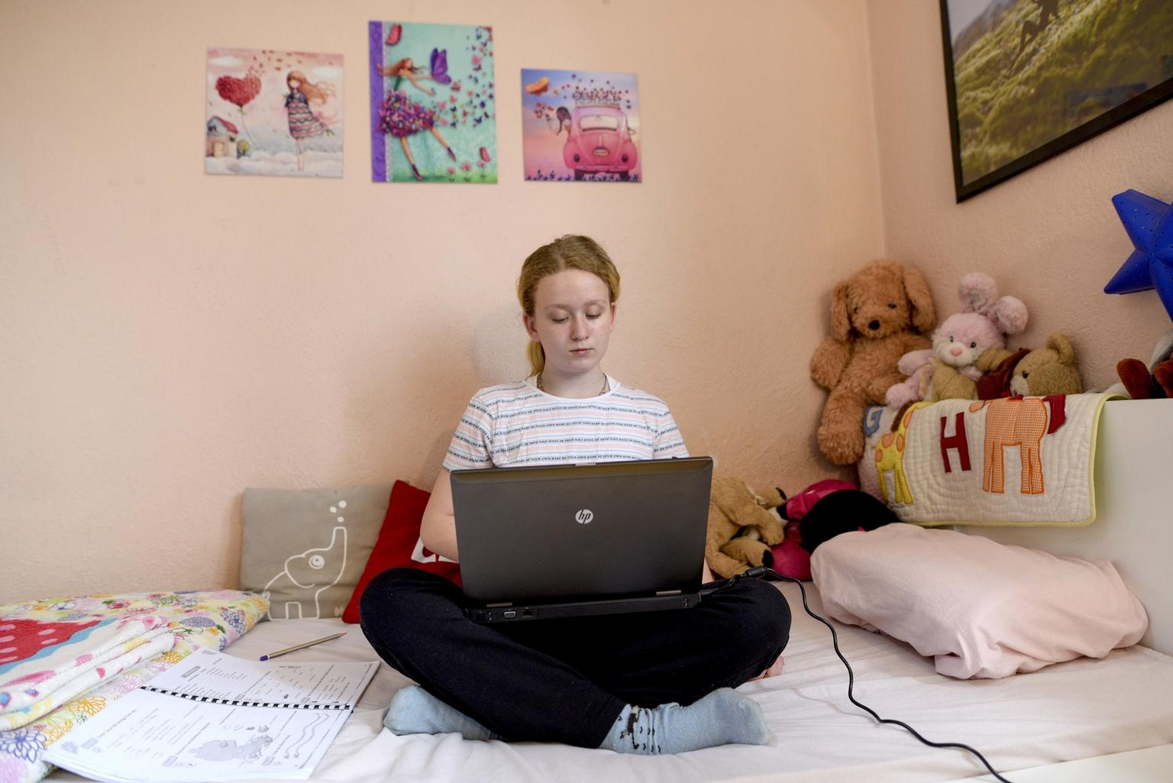
REFLECTION
Find somewhere peaceful and spend a few minutes being quiet and still. Think about …
What’s the best thing about your education?
Children’s rights are universal and indivisible, and the right to a good quality education is an example of how rights are interdependent. For a child to enjoy a good quality education lots of other rights need to be accessed too – health, for example. You can’t learn effectively if you are unwell. How does your education support your engagement with other articles of the Convention?
UNICEF/UNI313766/Georgiev
Notes:
Lea, 10 attending school through an e-classroom during covid pandemic

Slide 10
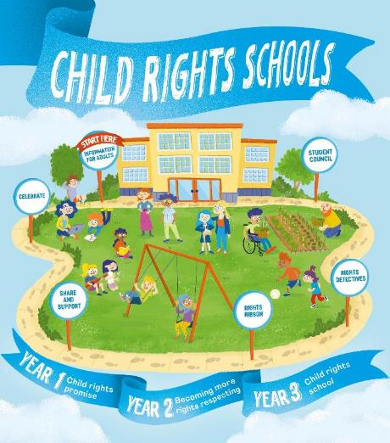

FURTHER CHILD RIGHTS EDUCATION SUPPORT
Child Rights Schools is a programme that supports you to embed child rights across the primary school.
Children are supported to express their views through the Student Council.
Find out more here.
Find more classroom resources here.

Slide 11


THANK YOU

