Slide 1
UNICEF/ UN0749688
Notes:
On 24 October 2022 in Pokotylivka, Kharkivska Region, Ukraine, Yevhen Khorolets, 52, plays with his 6-year-old daughter Milana Khorolets on a playground close to the new house they call home for the past nine months.

Slide 2
BEFORE YOU BEGIN
This is a flexible resource and is intended to provide you with some easy to use, appropriate rights-related learning to share with your children, their families and your colleagues.
Please edit out non relevant slides or activities before sharing with your students. Please check that the content works for your learners and feel free to adapt or add any content that would make the material more relevant for your setting.
This resource was developed by UNICEF UK and adapted by UNICEF Ireland.
Slide 3 – Introducing Articles 5 & 18
Slide 4 – Exploring the Articles
Slide 5 – Some possible answers
Slides 6,7,8,9 – Activities for the classroom
Slide 10 – Reflection
Slide 11– Further Support

Slide 3
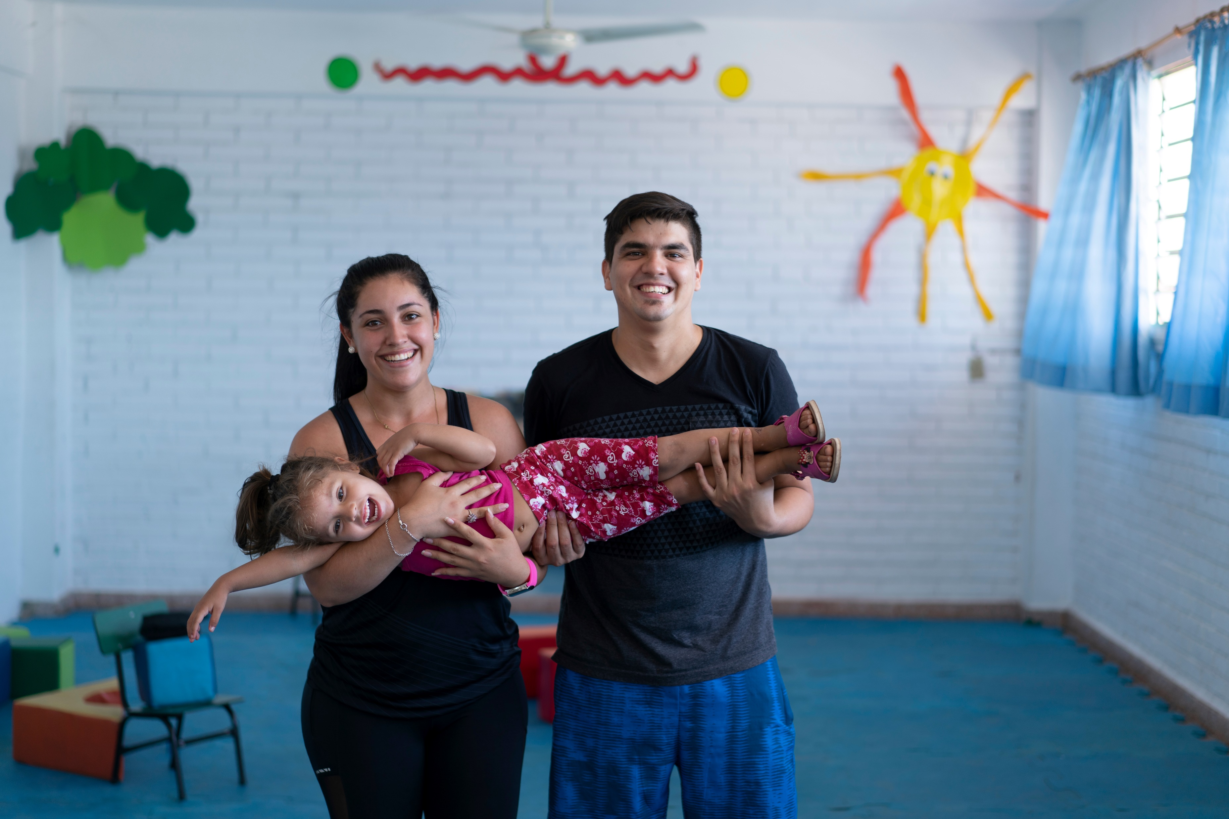
Introducing Articles 5 and 18
Article 5 (parental guidance and a child’s evolving capacities): Governments must respect the rights and responsibilities of parents and carers to provide guidance and direction to their child as they grow up, so that they fully enjoy their rights. This must be done in a way that recognises the child’s increasing capacity to make their own choices.
Article 18 (parental responsibilities and state assistance): Both parents (or legal guardians) share responsibility for bringing up their child and parents and carers should always consider what is best for the child. Governments must support parents and legal carers by creating support services for children and giving parents the help they need to raise their children.
UNICEF/UN0312248
Notes:
David Fretes Paniagua, 27, and his wife, Leticia, 23, hold their daughter, Xiomara (pronounced: see-oh-ma-ra), age 3, at the same UNICEF-supported Early Childhood Development (ECD) centre David attended 25 years ago in Mercado No. 4, Asunción, Paraguay on 29 January 2019

Slide 4
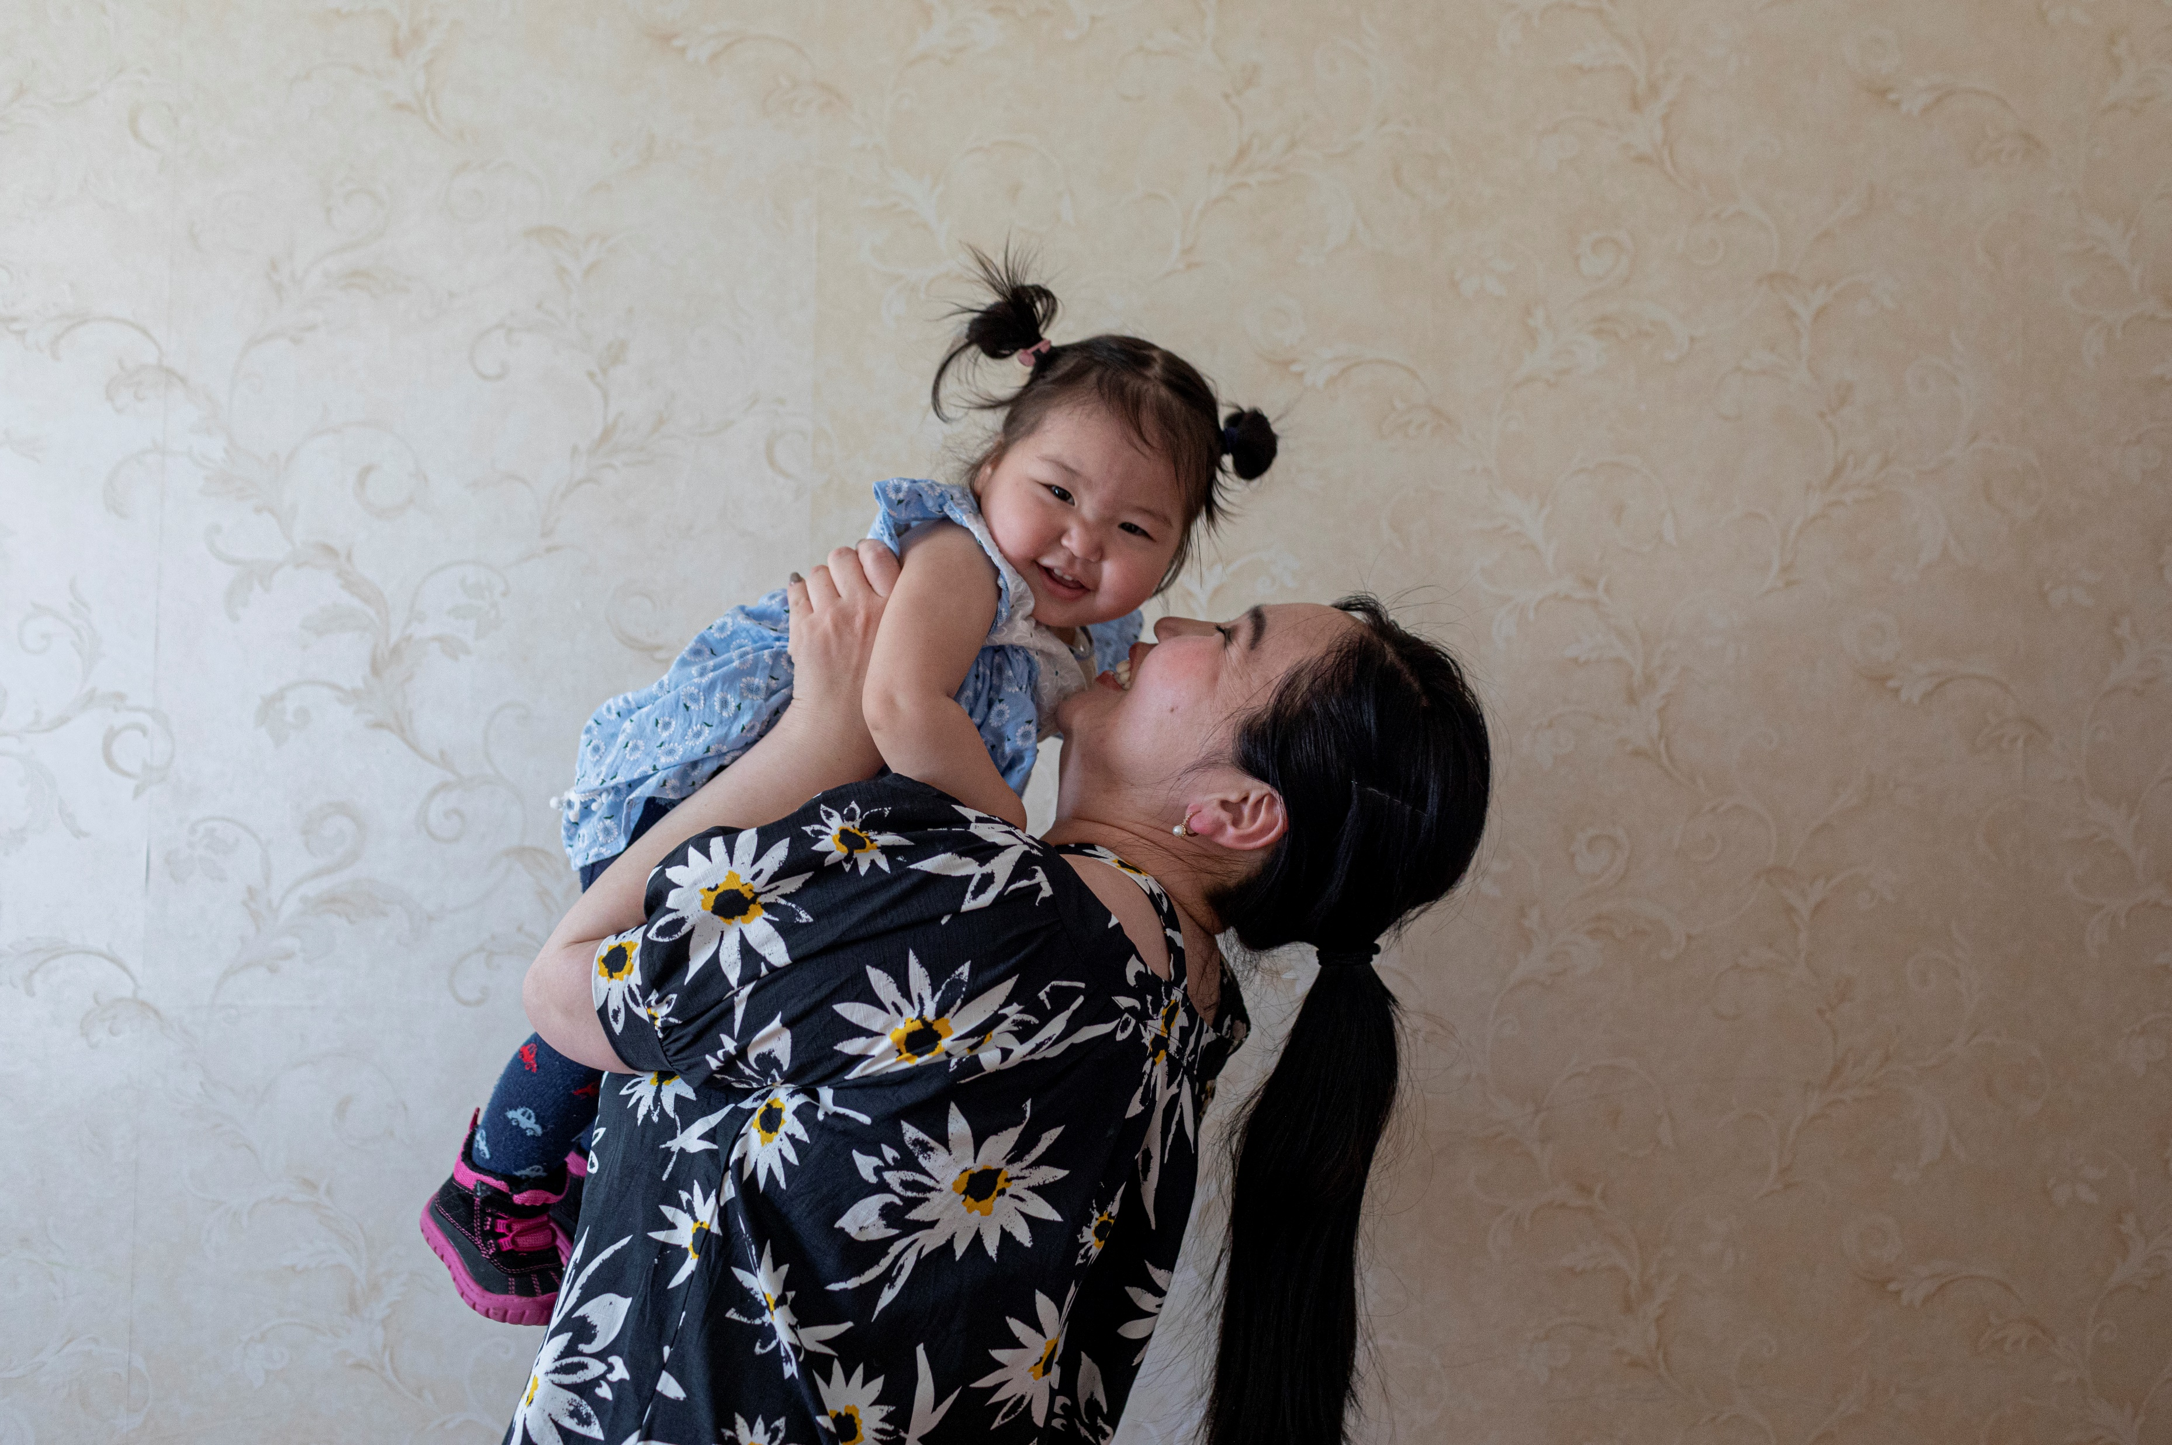
EXPLORING ARTICLES 5&18
Articles 5 and 18 are all about the job of parents and carers in the upbringing of children and young people.
What are some of the important things that carers and parents do for children?
UNICEF/UN0339584
Have a think and write down some answers!
Notes:
On 20 May 2019, Bayarmaa Erdenejargal, 31, holds her daughter, Uuriintsolmon, 1, at their home in Murun, Khövsgöl province, Mongolia.

Slide 5
DID YOU INCLUDE ANY OF THESE?
Provide you with a home.
Care for you and show you love.
Provide food and clothes.
Set you a good example.
Help you to become independent.
Give you emotional support.
Support your learning and going to school.
Make sure you have opportunities to be fit and healthy.
Prepare you for adult life.
Share their culture and identity and beliefs and values with you.
Allow you to be yourself.
Help you to enjoy all of your rights!
Did you think of anything else?

Slide 6
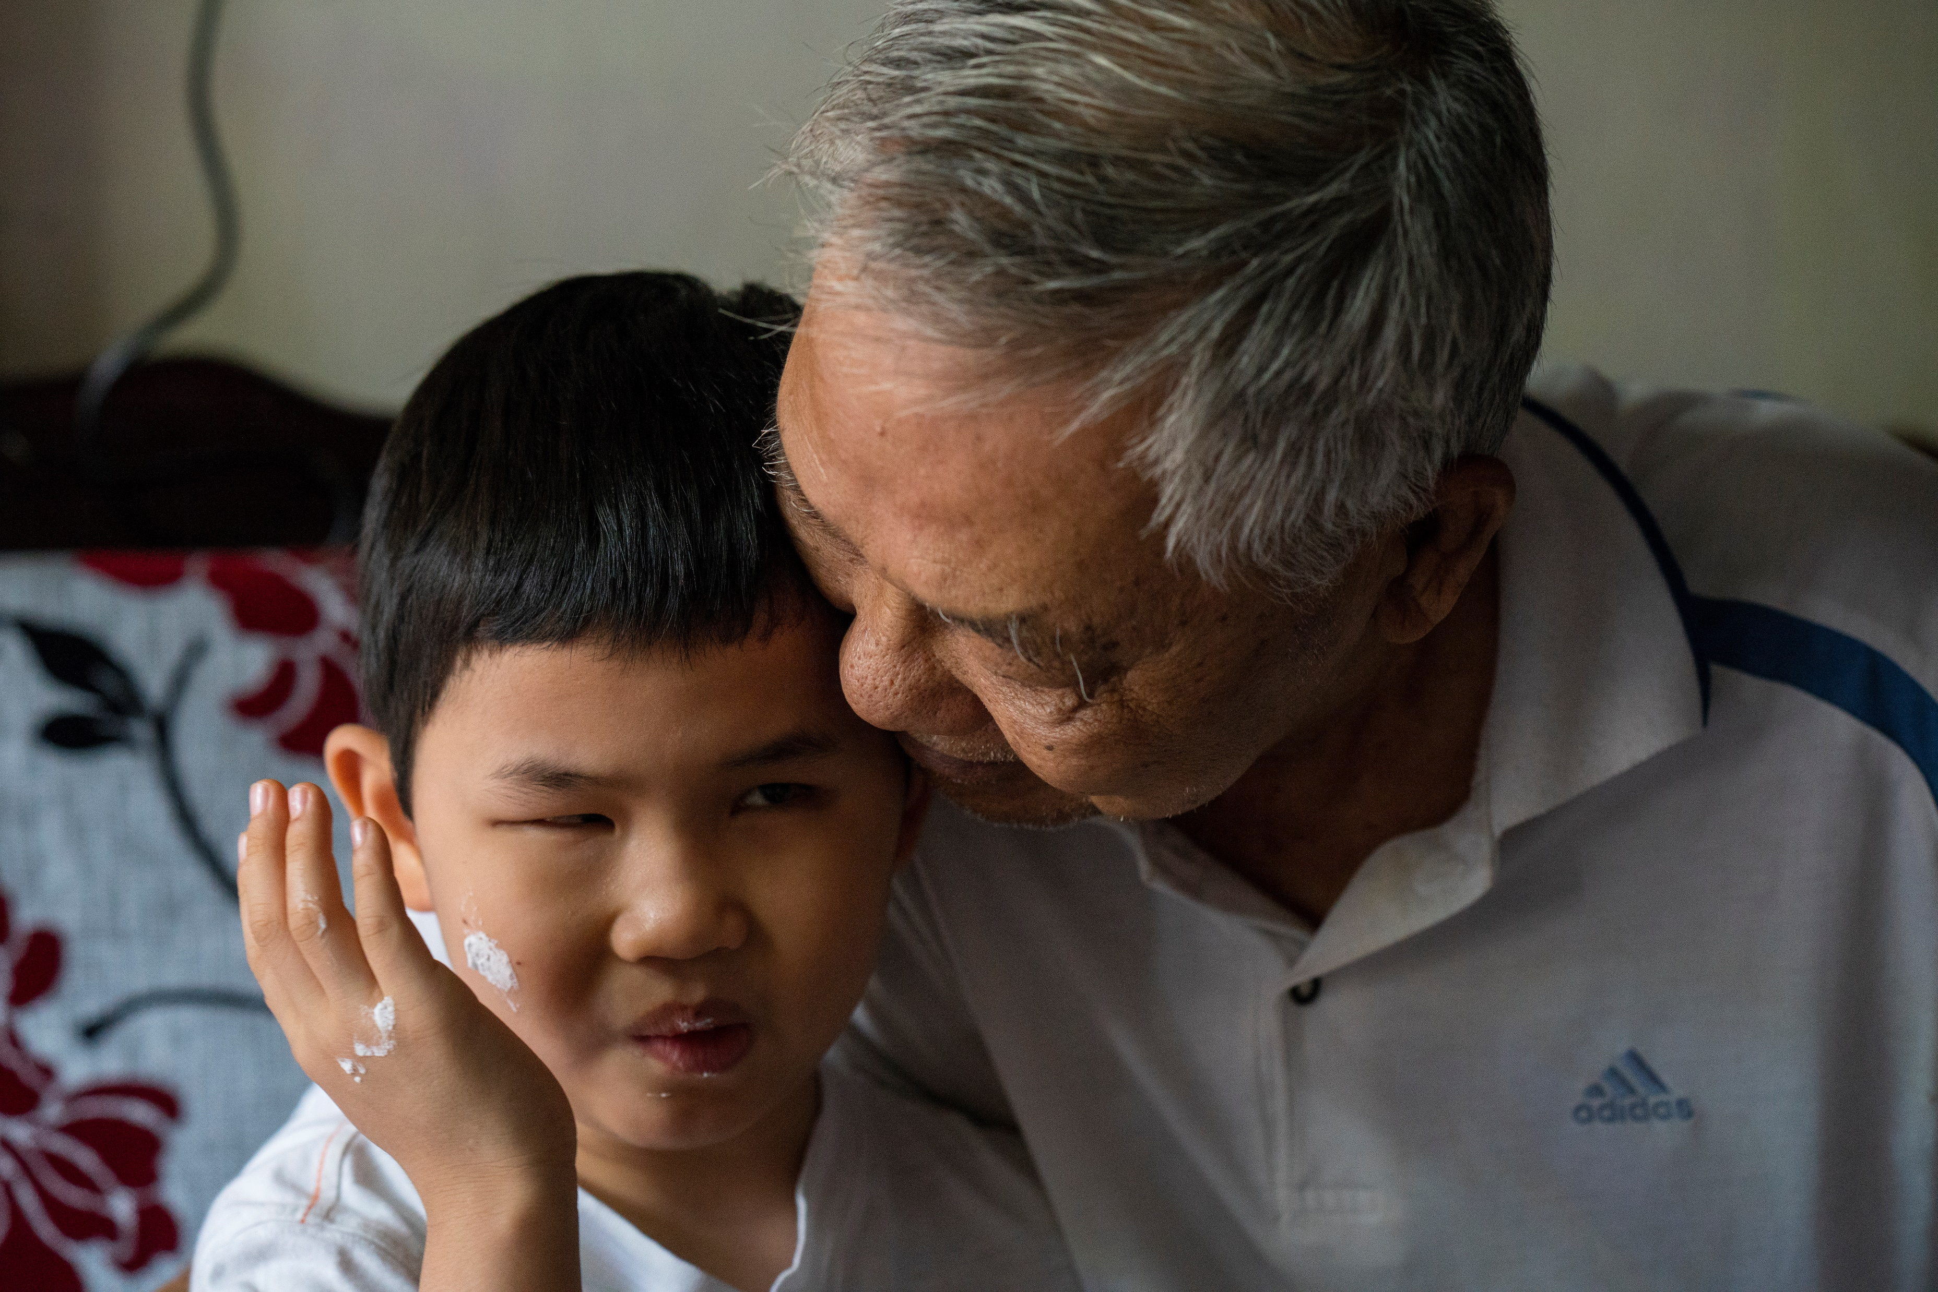
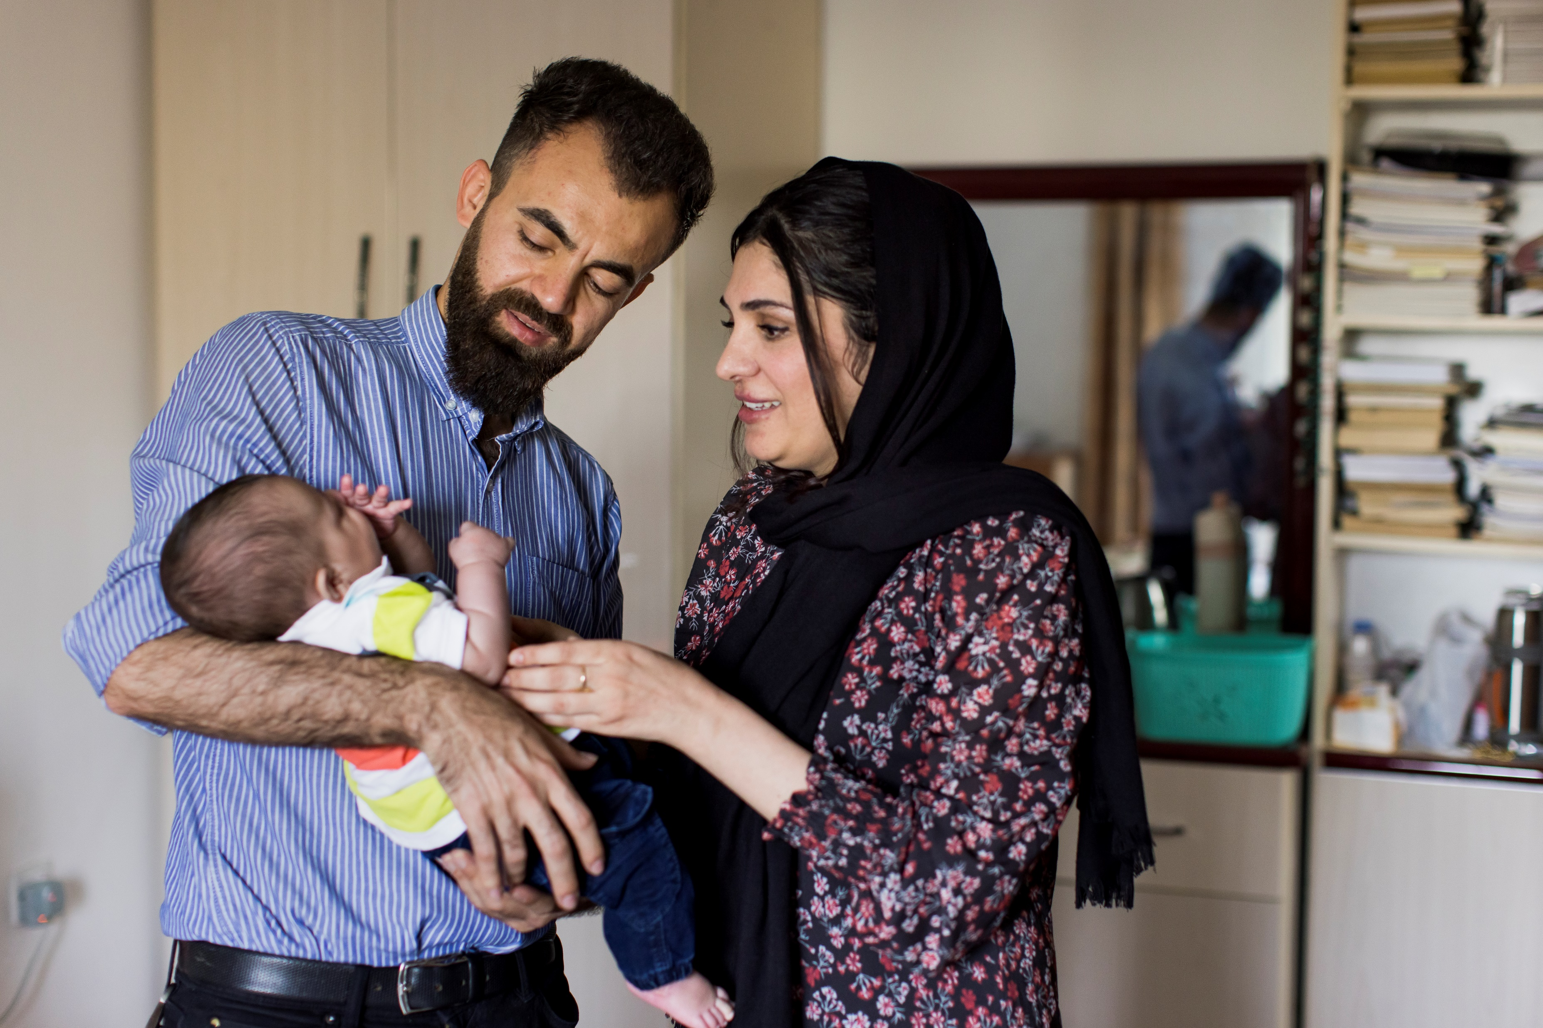
ACTIVITIES FOR THE CLASSROOM
You do not need to complete every activity but if you have time, you can try to complete more than one.
Write a thank you card to a parent or carer who has looked after you and helped you with choices that matter to you
Create a display in class to show how the actions of parents and carers help children to enjoy lots of different rights. You could start with giving them their name and registering their birth, Article 7.
What other rights can you think of?
Parents and carers are mentioned in a number of other articles. Read over a summary of the Convention and highlight the words PARENT, CARER and FAMILY. Discuss in class why you think these words occur so often in the CRC.
UNICEF/UNI310404
Write a thank you card to a parent or carer who has looked after you and helped you with choices that matter to you
UNICEF/UN0648689
Notes:
On 27 February 2020, Tung, 7, shares a tender moment with his grandfather, Troung Thi Thi, in their home in the city of Da Nang, in central Viet Nam. Tung’s mother, Dao, had heart disease and gave birth to him two months prematurely, which left him visually impaired.
On 11 April 2022 in Sulaymaniyah, Iraq, Zheer (left), 31, and Sazan (right), 30, hold their 6-month-old son Mohammed.

Slide 7
ACTIVITIES FOR THE CLASSROOM
You do not need to complete every activity but if you have time, you can try to complete more than one.
If you have class charters in your school, check to see if all charters have actions for the adults as ‘duty bearers’ as well as for you as the ‘rights holders’.
If you had a rights charter at home, what rights would you choose and what actions could be included for parents or carers? Design one for home and share it with your parents or carers.
Read a book about families from your class library such as ‘All About Families’ or watch this video of ‘The Family Book’ and use this as a starter for a conversation about the role of parents and carers in family life.

Slide 8
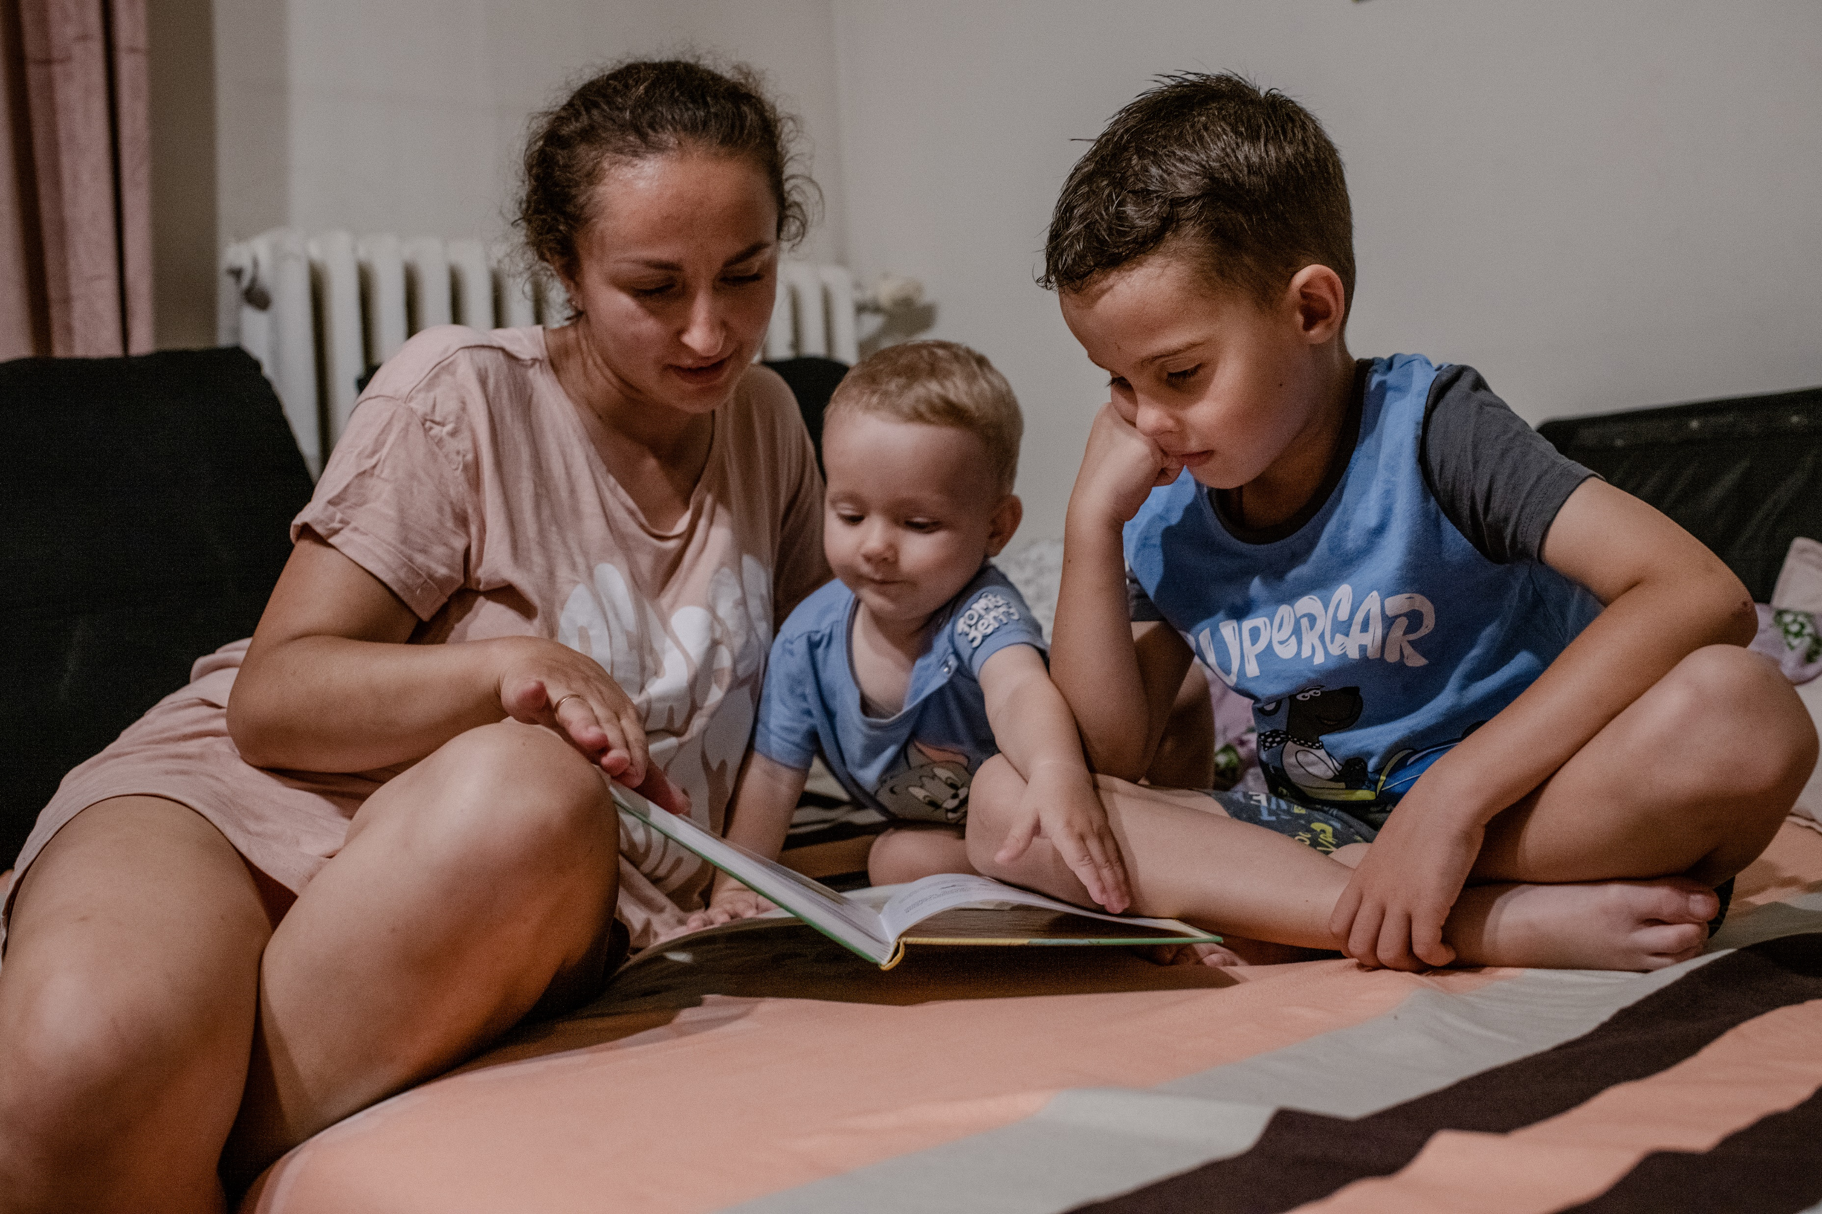
ACTIVITIES FOR THE CLASSROOM
You do not need to complete every activity but if you have time, you can try to complete more than one.
It is important that parents and carers know and understand your rights, but also their role in helping you access your rights appropriately. Create an information leaflet for parents and carers to share your knowledge of rights and to help them understand what they should be doing to respect and protect your rights.
If you felt that your parents or carers were not protecting and upholding your rights – do you know what you should do and who you can contact to get help? With your class, discuss all the different things you can do and people you can contact for help. Create a display or a short presentation (or video) to share at an assembly to make sure everyone in your school knows who the trusted adults are in and out of school.
UNICEF/UN0705549
Notes:
On 16 August 2022 in Kraków, Poland, Kateryna (left) reads bedtime stories to her sons, 1-year-old Matviy (center) and 6-year-old Mykyta at their new apartment. The family had to leave the Kyiv region of Ukraine on 2 March 2022, escaping the ongoing conflict.Bedtime stories are part of their daily routine. “When it comes to books, I instilled in [Mykyta] a love of books from an early age, because I adore reading books. I left my library at home,” says Kateryna.

Slide 9
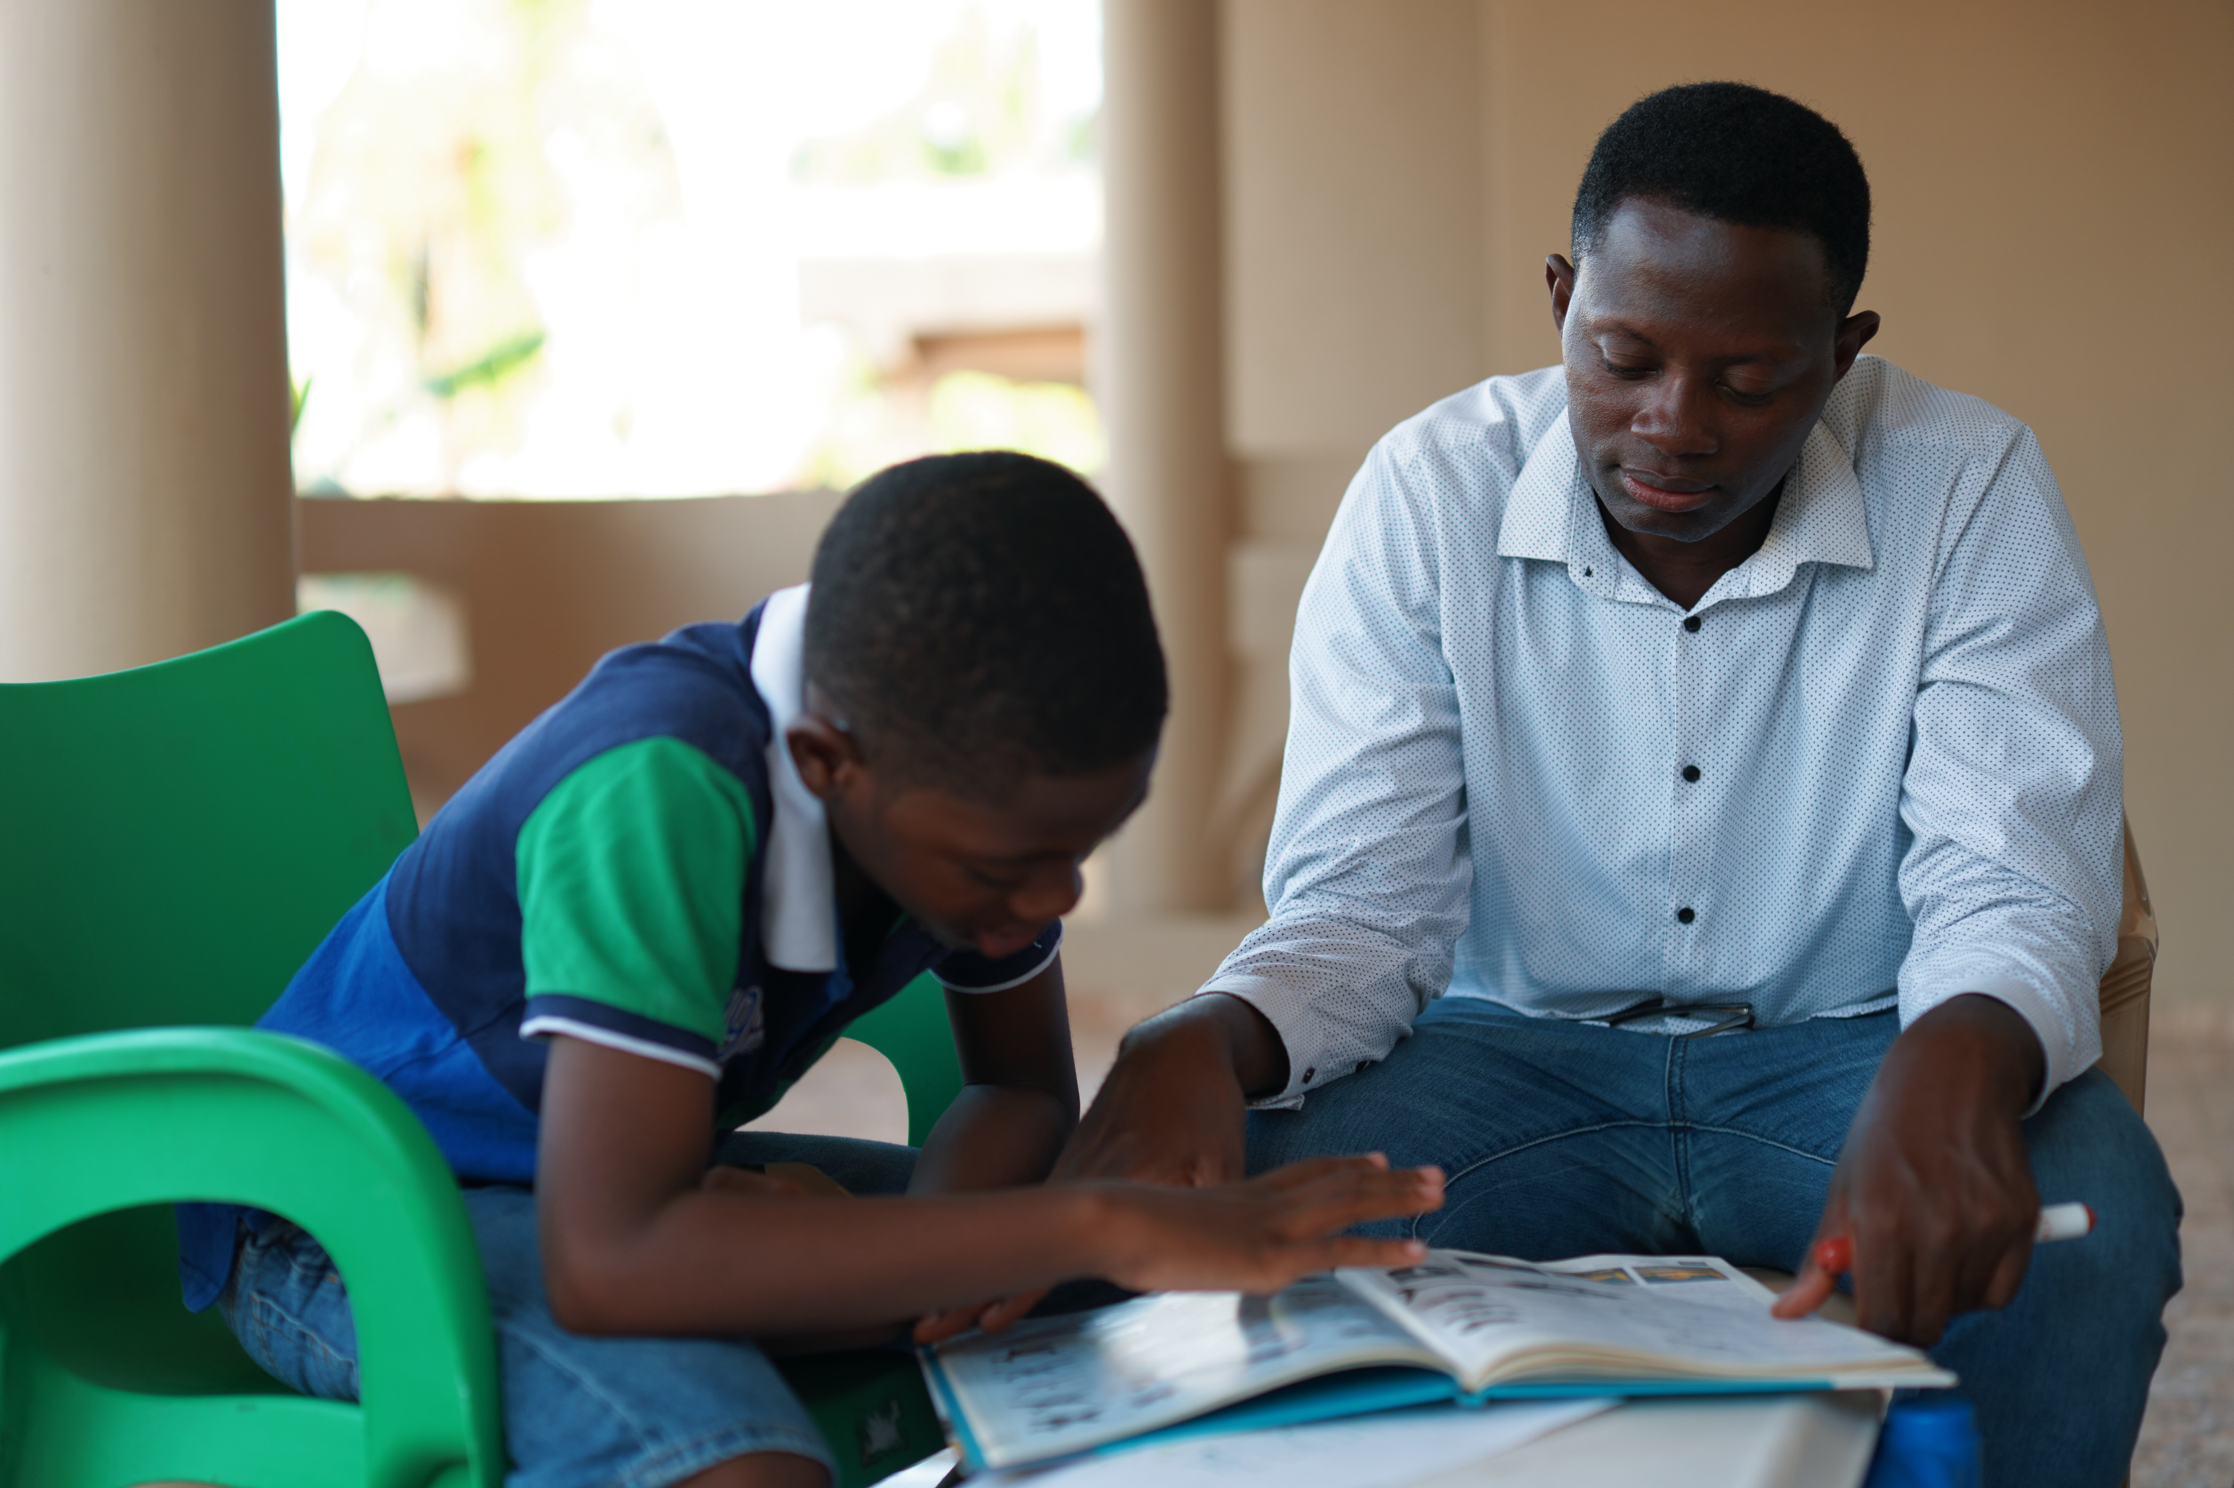
ACTIVITIES FOR THE CLASSROOM
You do not need to complete every activity but if you have time, you can try to complete more than one.
The Scottish charity, Children’s Parliament, created a leaflet to show what rights-based homes, communities and schools might look like. What do you think? Does this reflect your home, community and school? Is there anything else you would add? Discuss in small groups.
Parents and carers have a right to support from the government to help them bring up their children. Governments often provide this help through local councils or through charities. Barnardos is one example of a charity that supports families.
Do some research about this or another charity or organisation that supports families in your area (a teacher or other staff members may have useful information on this!) Create a short presentation on your findings to make sure all parents and carers in your school community know where they can access support.
UNICEF/UN0654851
Notes:
On 10 April 2022 in Accra, Ghana, Jennifer Boateng’s 9-year-old son Aaron (left) talks to his father Godwin about a book at their home.

Slide 10
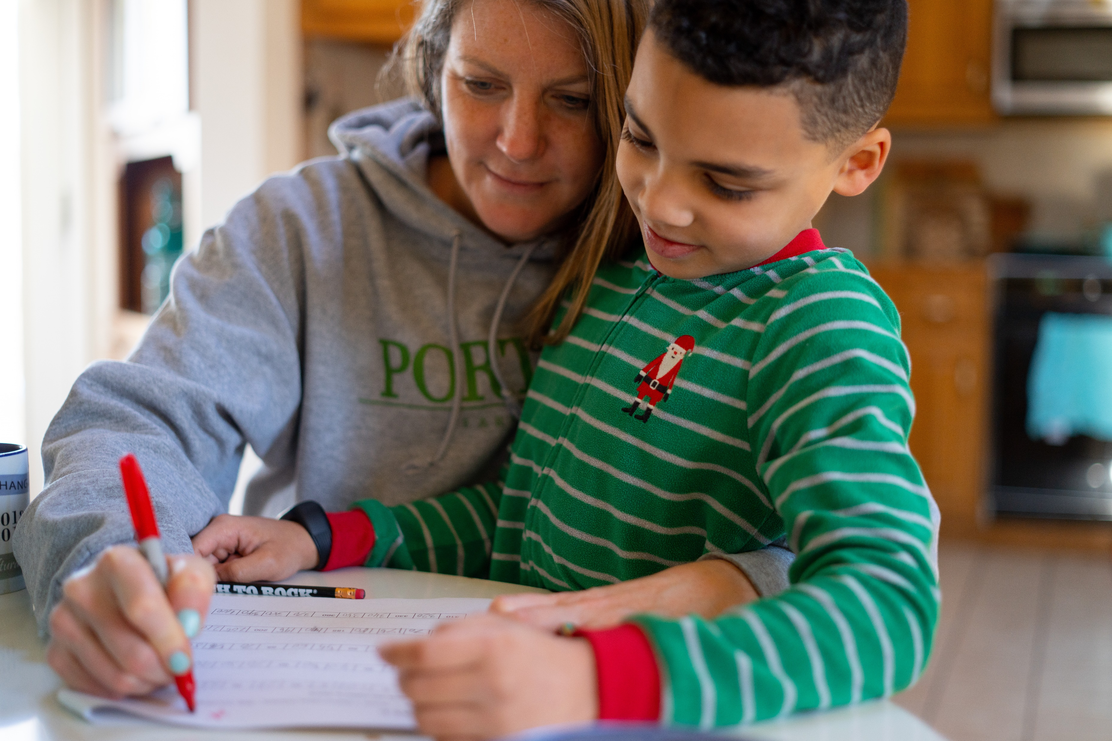
REFLECTION
Find some quiet time... give yourself some space. Take a couple of minutes to think about these questions.
Think about the people you know who are parents or carers…
Do you think it’s sometimes challenging or difficult to be a parent or carer? What sort of things might make it difficult?
What are the positives of being a parent or carer?
How do you show appreciation to the adults who support you in your home and family?
UNICEF/UNI313395
Notes:
On the morning of 16 March 2020, 8-year-old second grader Luka works on a mathematics assignment at home in Connecticut, United States of America, with help from his mother, Sophia

Slide 11
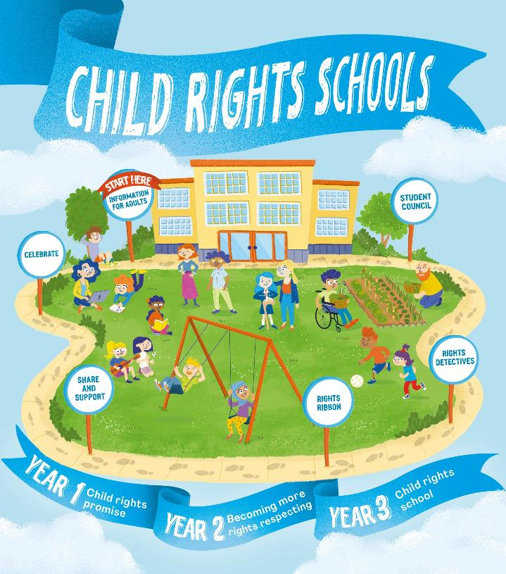
FURTHER CHILD RIGHTS EDUCATION SUPPORT
Child Rights Schools is a programme that supports you to embed child rights across the whole school community, including with parents and carers. Find our more here.
Find more classroom resources here.

Slide 12
THANK YOU
UNICEF/UN0306259
Notes:
Christophe and Theodette hold their son Kevin, 2, while on break in a field of the Sorwathe Tea Factory where they both work — Christophe in the fields and Theodette as a caregiver — in Kinihira sector, Rulindo District, Northern Province, Rwanda on 22 November 2018

