Slide 1
UNICEF/ UN0841967
Notes:
Three friends in a child friendly space at a temporary accommodation shelter in Hatay, after two devastating earthquakes hit south-east Türkiye on 6 February 2023.
Thousands of children and families lost their homes and are now living in temporary shelters after 7.7 and 7.5 magnitude earthquakes and dozens of aftershocks hit 11 provinces in south-east Türkiye and Syria on 6 February 2023.The earthquakes affected 13.5 million Turkish citizens and 1.7 million registered refugees, including 5.4 million children – 811,000 of whom are refugees.

Slide 2
BEFORE YOU BEGIN
This is a flexible resource and is intended to provide you with some easy to use, appropriate rights-related learning to share with your children, their families and your colleagues.
Please edit out non relevant slides or activities before sharing with your students. Please check that the content works for your learners and feel free to adapt or add any content that would make the material more relevant for your setting.
This resource was developed by UNICEF UK and adapted by UNICEF Ireland.
Slide 3 – Introducing World Refugee Day
Slide 4 – Linked Articles
Slide 5 – Exploring World Refugee Day
Slides 6 – Some Possible Answers
Slides 7 – 10 – Classroom Activities
Slide 11– Reflection
Slide 12 – Further Support

Slide 3
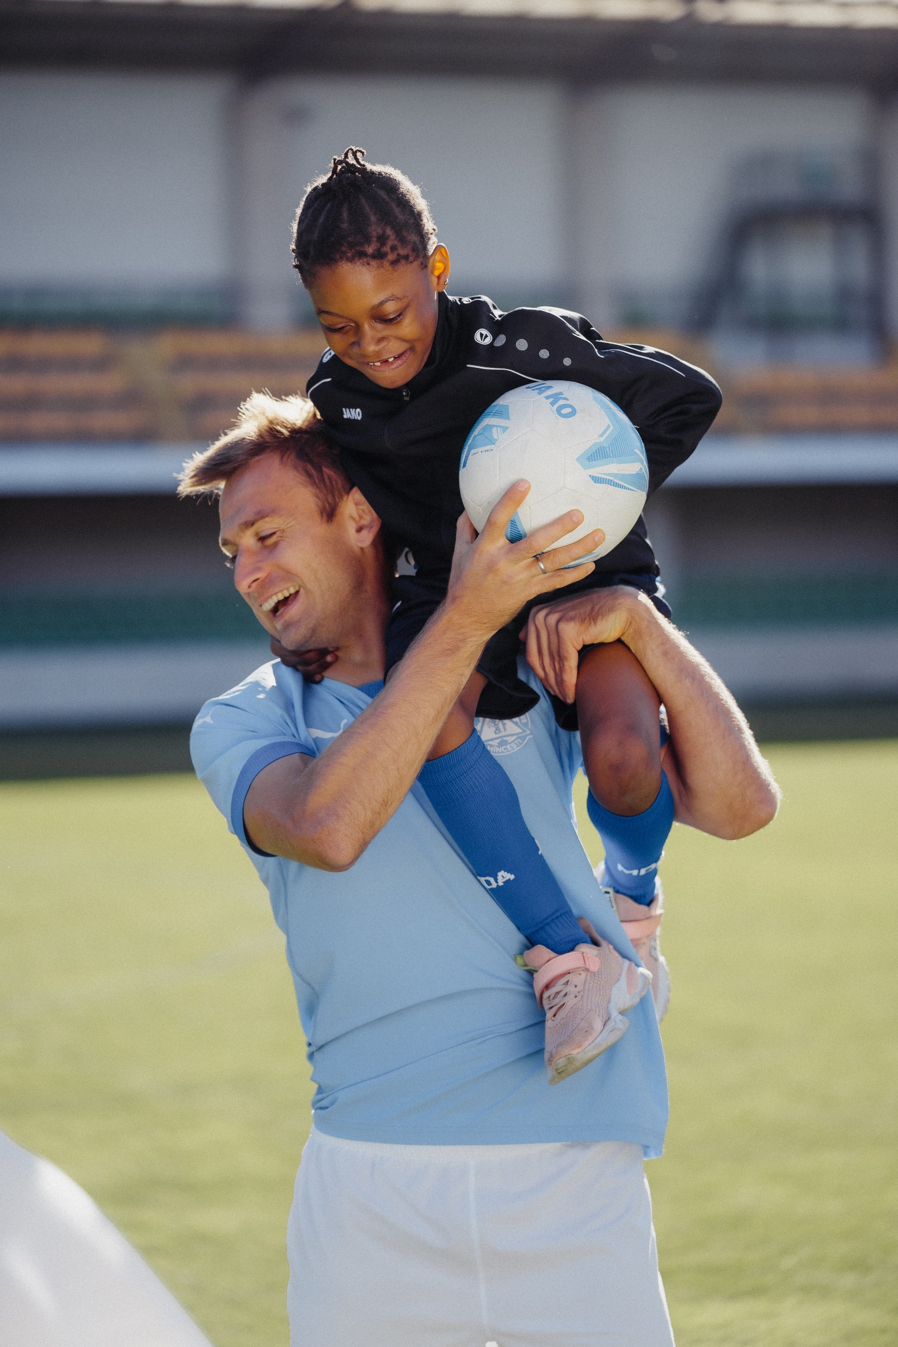
Introducing World Refugee Day
World Refugee Day is an international day designated by the United Nations to honour refugees around the globe.
It falls each year on June 20 and celebrates the strength and courage of people who have been forced to flee their home country to escape conflict or persecution.
The first ever Irish Refugee Week is taking place this year from 19-25 of June. Refugee week is a festival of welcome, with creativity and compassion at its core.
UNICEF/UN0735559
Notes:
Delicia, eight years old, is a refugee from Angola, and one of the beneficiaries of a project implemented by UNICEF in partnership with the Moldovan Football Federation regarding integrating children into the community. Her passion is football, and she is very inspired by the activity of football players from Moldova and not only. On World Children's Day, Delicia appeals to everyone to respect children's right to equality.

Slide 4
Linked Articles 10 and 22
Article 10 (family reunification):Governments must respond quickly and sympathetically if a child or their parents apply to live together in the same country. If a child’s parents live apart in different countries, the child has the right to visit and keep in contact with both of them.
Article 22 (refugee children):If a child is seeking refuge or has refugee status, governments must provide them with appropriate protection and assistance to help them enjoy all the rights in the Convention. Governments must help refugee children who are separated from their parents to be reunited with them.

Slide 5
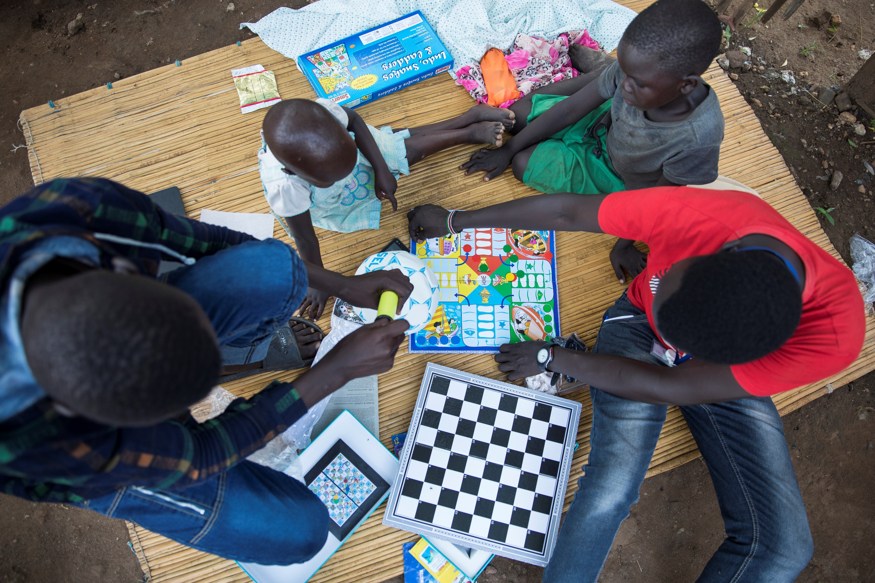
EXPLORING WORLD REFUGEE DAY
What events may lead to children and their families becoming refugees?
Have a think and write down some answers!
UNICEF/UN0231842
Notes:
Juba, South Sudan, A few days after the family reunification the family is getting used to each others presence again. After being apart for years now Deng (14, blue blocked shirt), Mami (16, brown/blue dress), Achuei (25, blue and black dress) and Alew (19, pink shirt) are playing games together and they go for a walk in Lologo 2, the area in Juba where they live. Since December 2013, UNICEF and partners have reunited over 5,600 children across South Sudan.

Slide 6
DID YOU INCLUDE ANY OF THESE?
Natural disasters like floods, hurricanes, earthquakes, tsunamis, volcanic activity, snow storms or bushfires.
Drought or famine which leads to lack of food and water.
War and conflict.
Climate change. Changes in weather may affect children’s access to food, water and education.
Discrimination around race, religious beliefs, sex, nationality, or political beliefs.
Civil unrest in a country making people feel unsafe.
Poverty or loss of income.
Family disputes or problems.
Did you think of anything else?

Slide 7
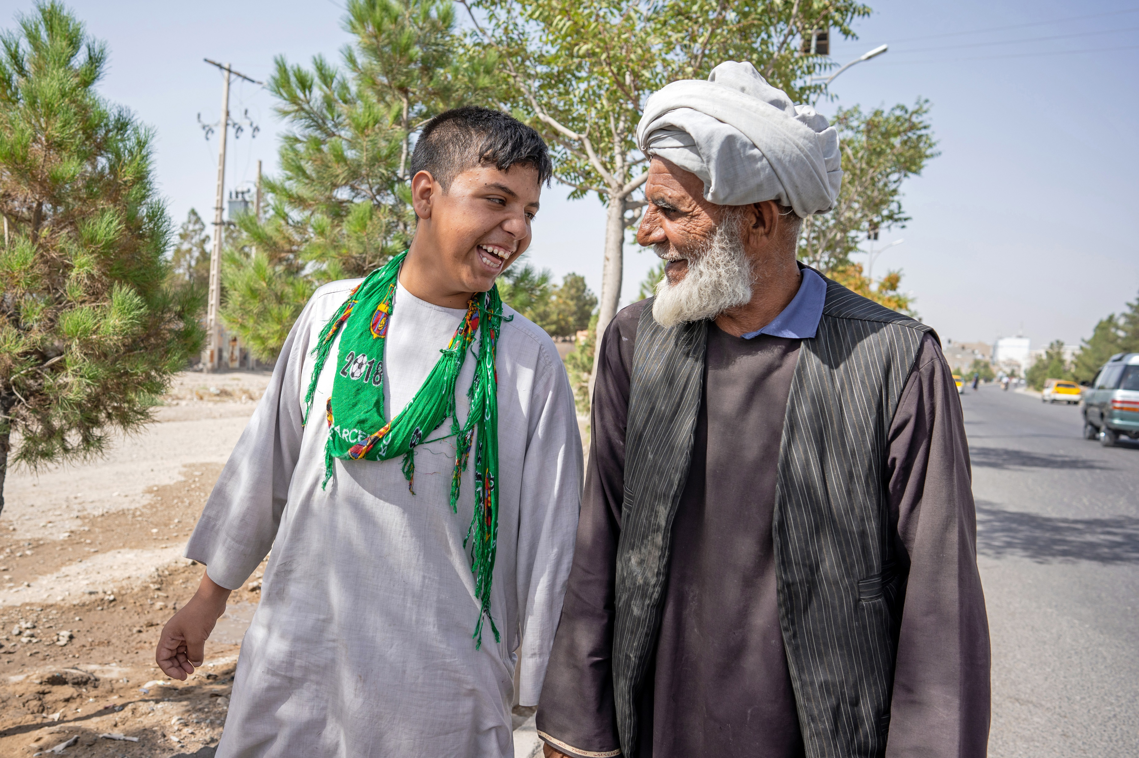
ACTIVITIES FOR THE CLASSROOM
You do not need to complete every activity but if you have time, you can try to complete more than one.
Write a thank you card to a parent or carer who has looked after you and helped you with choices that matter to you
Paddington Bear was a refugee. Read some of his story or watch the Paddington film and then discuss how you think Paddington felt when he was in the lifeboat after leaving Aunt Lucy in Peru or how he felt being at the train station on his own. How do you think he felt when he met the Brown family?
Watch or read My Name is Not Refugee or The Suitcase.
Use the themes of the stories to open up a simple exploration of what it is to be a refugee.
UNICEF/UN0662999
There are many rights related to being kept safe and protected from harm. Do you have a special place where you feel really safe? Maybe at home or a grandparent’s home, or somewhere else? Draw a picture of where you feel safe.
Notes:
On 16th June 2022, Mohammed walks through Herat with his 13 year old son, Ashraf*, following their reunification at the UNICEF and EU-supported Gazargah Transit Centre in Herat, Afghanistan.

Slide 8
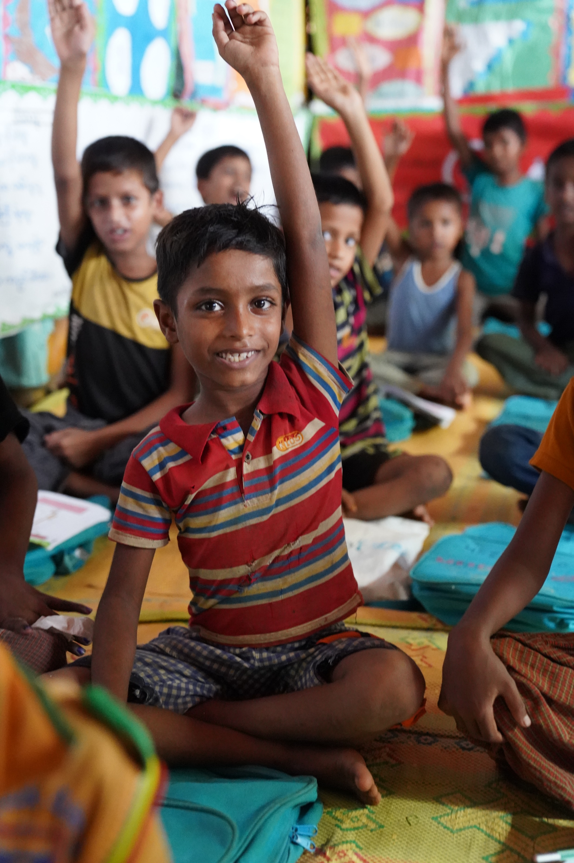
ACTIVITIES FOR THE CLASSROOM
You do not need to complete every activity but if you have time, you can try to complete more than one.
Imagine a new refugee family is arriving in your neighbourhood. Write a letter to welcome them. Tell them everything they need to know about places to visit, who can help and perhaps a bit about yourself too.
If you had to flee your home suddenly, what would you take with you? Draw or list what you would take and remember that you might have to carry it a long way. Compare your list with other people in your class.
UNICEF/UN0751763
Notes:
A Rohingya refugee boy raises his hand at a UNICEF learning centre. Over 866,000 Rohingya refugees are living in Cox’s Bazar, 54.2 % of whom are children. UNICEF is implementing the Myanmar formal education curriculum in the camps. Education offers Rohingya children stability and structure to help them cope with trauma and gives them a sense of hope. It also protects them from child marriage, child labour, sexual exploitation and other social ills.

Slide 9
ACTIVITIES FOR THE CLASSROOM
You do not need to complete every activity but if you have time, you can try to complete more than one.
Check out this extraordinary art project called Little Amal. Little Amal is a giant puppet – a 3.5 metre-tall living artwork character that represents child refugees, especially those who have been separated from their families. Since July 2021, Amal has travelled over 9,000km in 13 countries and has been welcomed by millions in person and online. Her urgent message to the world is, “Don’t forget about us.”
Can you think how you could use puppets or another type of artform to raise awareness of the lives of children forced to be refugees?
Watch this video explaining what a refugee is. Can you create your own film or a simple PowerPoint presentation to help other children in your school understand what it means to be refugee?

Slide 10
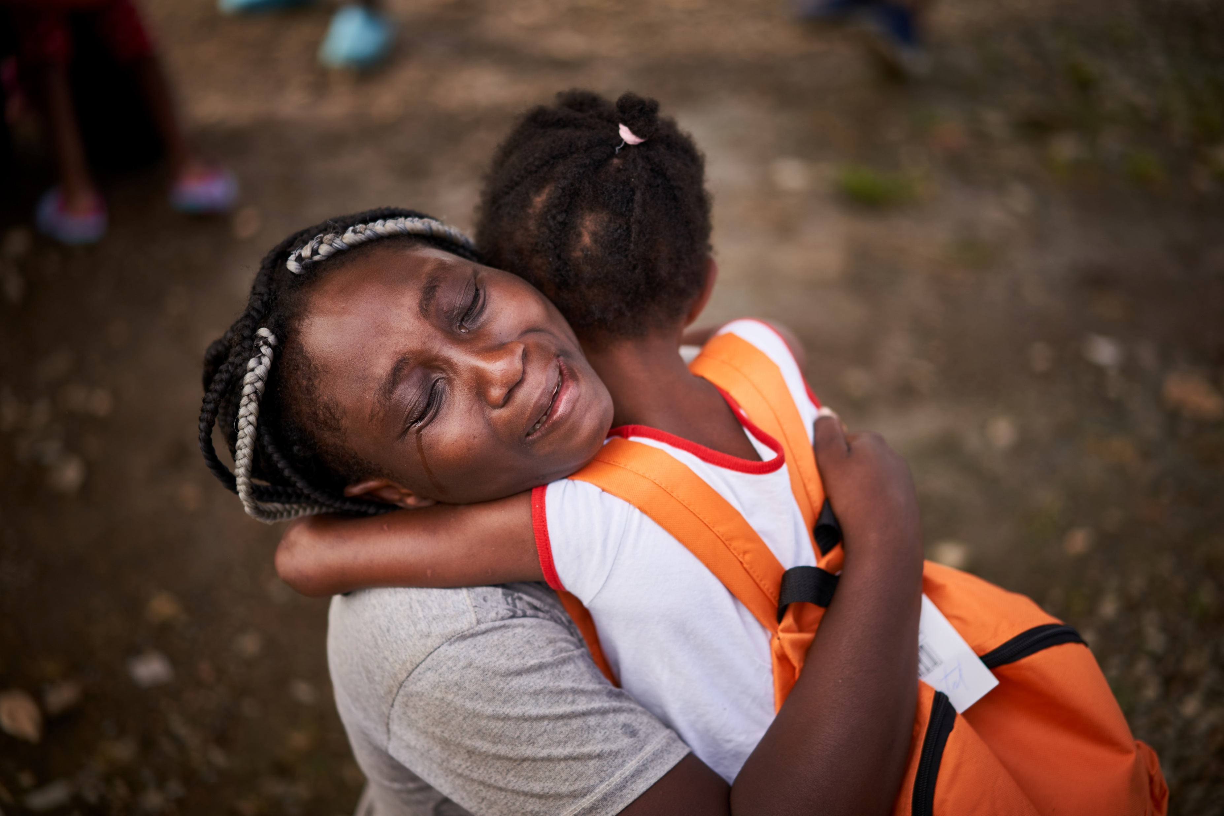
ACTIVITIES FOR THE CLASSROOM
You do not need to complete every activity but if you have time, you can try to complete more than one.
Check out what is happening around Ireland for Refugee week! What could your school community do to show your support for refugees?
Research the work of charities in Ireland who support refugees and asylum seekers, including the Irish Refugee Council, Irish Red Cross, Nasc and Doras, to name a few. Are there organisations near your school that support refugees? Can you support their work in any way?
Who do you think of as family? Is it the people who share your home? Anyone else? Do any of your family live in different countries? How often do you get to see them? Think about how you would feel if the Government stopped you from seeing any of those people?
UNICEF/UN0560258
Notes:
Family reunification. Nelda (haitian) reunites with her daughter, Neldaisha, after being separated for several days. Nelda and her husband got sick in the fifth day and handled their oldest daughter to a friend , who crossed her safley and handled her to the panamanian authorities. UNICEF, together with its implementing partner ALDEAS SOS are providing a safe place, "La Casita" where unaccompanied children are being taken care of until their families arrive.

Slide 11
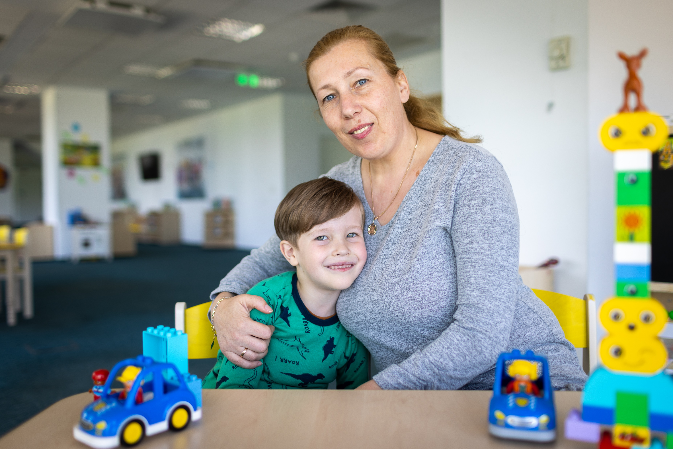
REFLECTION
Imagine how you would feel if you were forced to leave your home.
Think about people in your community who have been in this situation:
How can we make sure that people feel welcomed and supported?
UNICEF/UN0850319

Slide 12
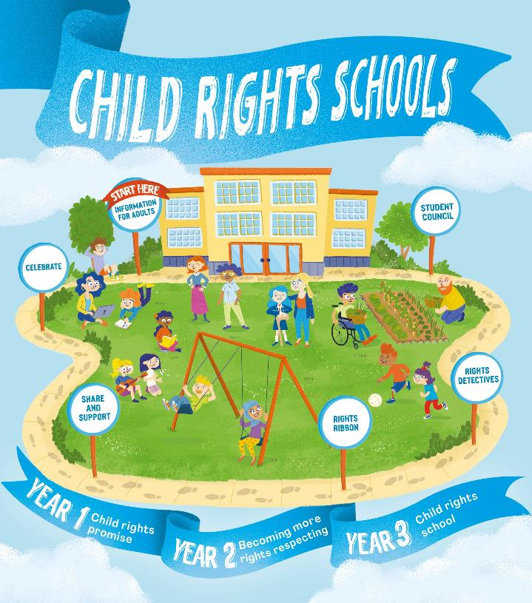
FURTHER CHILD RIGHTS EDUCATION SUPPORT
Child Rights Schools is a programme that supports you to embed child rights across the whole school community, including with parents and carers. Find our more here.
Find more classroom resources here.

Slide 13
THANK YOU
UNICEF/UN0714803

