Slide 1
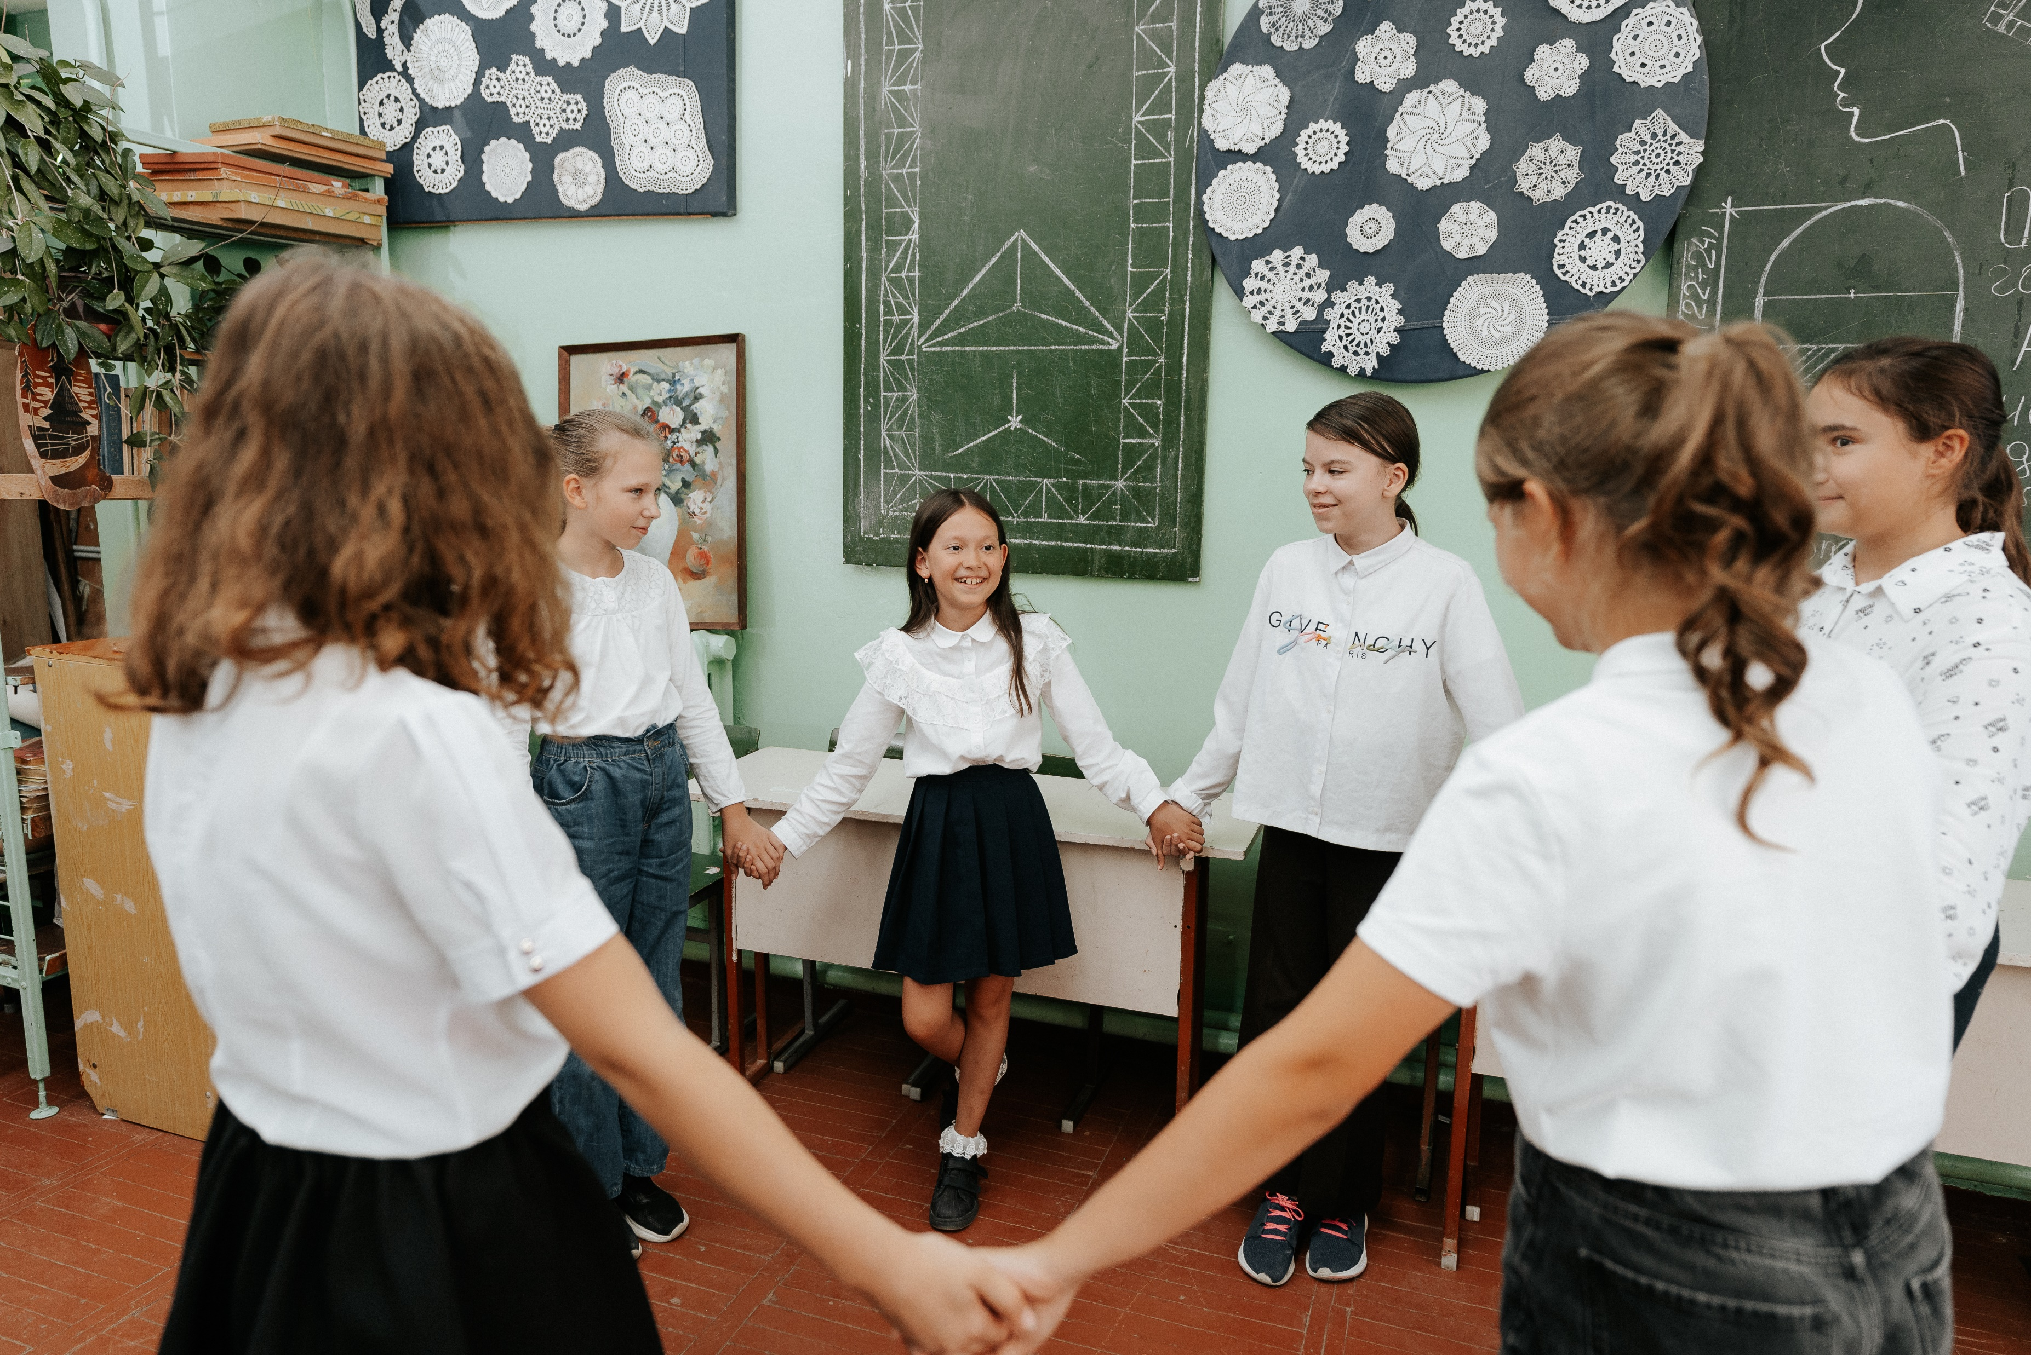
Child Rights Refresher
UNICEF/UNI44921
Notes:
Ten-year-old Darya from Ukraine chats with her peers at school in Moldova during the breaks between lessons.

Slide 2
BEFORE YOU BEGIN
This is a flexible resource and is intended to provide you with some easy to use, appropriate rights-related learning to share with your children, their families and your colleagues.
Please edit out non relevant slides or activities before sharing with your students. Please check that the content works for your learners and feel free to adapt or add any content that would make the material more relevant for your setting.
Element of this resource were developed by UNICEF UK and UNICEF Norway and adapted by UNICEF Ireland.
Slides 3 – 12 – Flash Quiz
Slides 13 -14 – Rights Recap
Slide 15 – CRC General Principles
Slide 16 – Animated Video on CRC
Slides 17-18 – Exploring the CRC in School
Slide 19-21 – #7Word Story
Slide 10 – Further support

Slide 3
Quick Quiz!
Q1. When are you a Child?
Up to the age of 10
Up to the age of 18
Up to the age of 21
Up to the age of 16
UNICEF/UN0714803

Slide 4
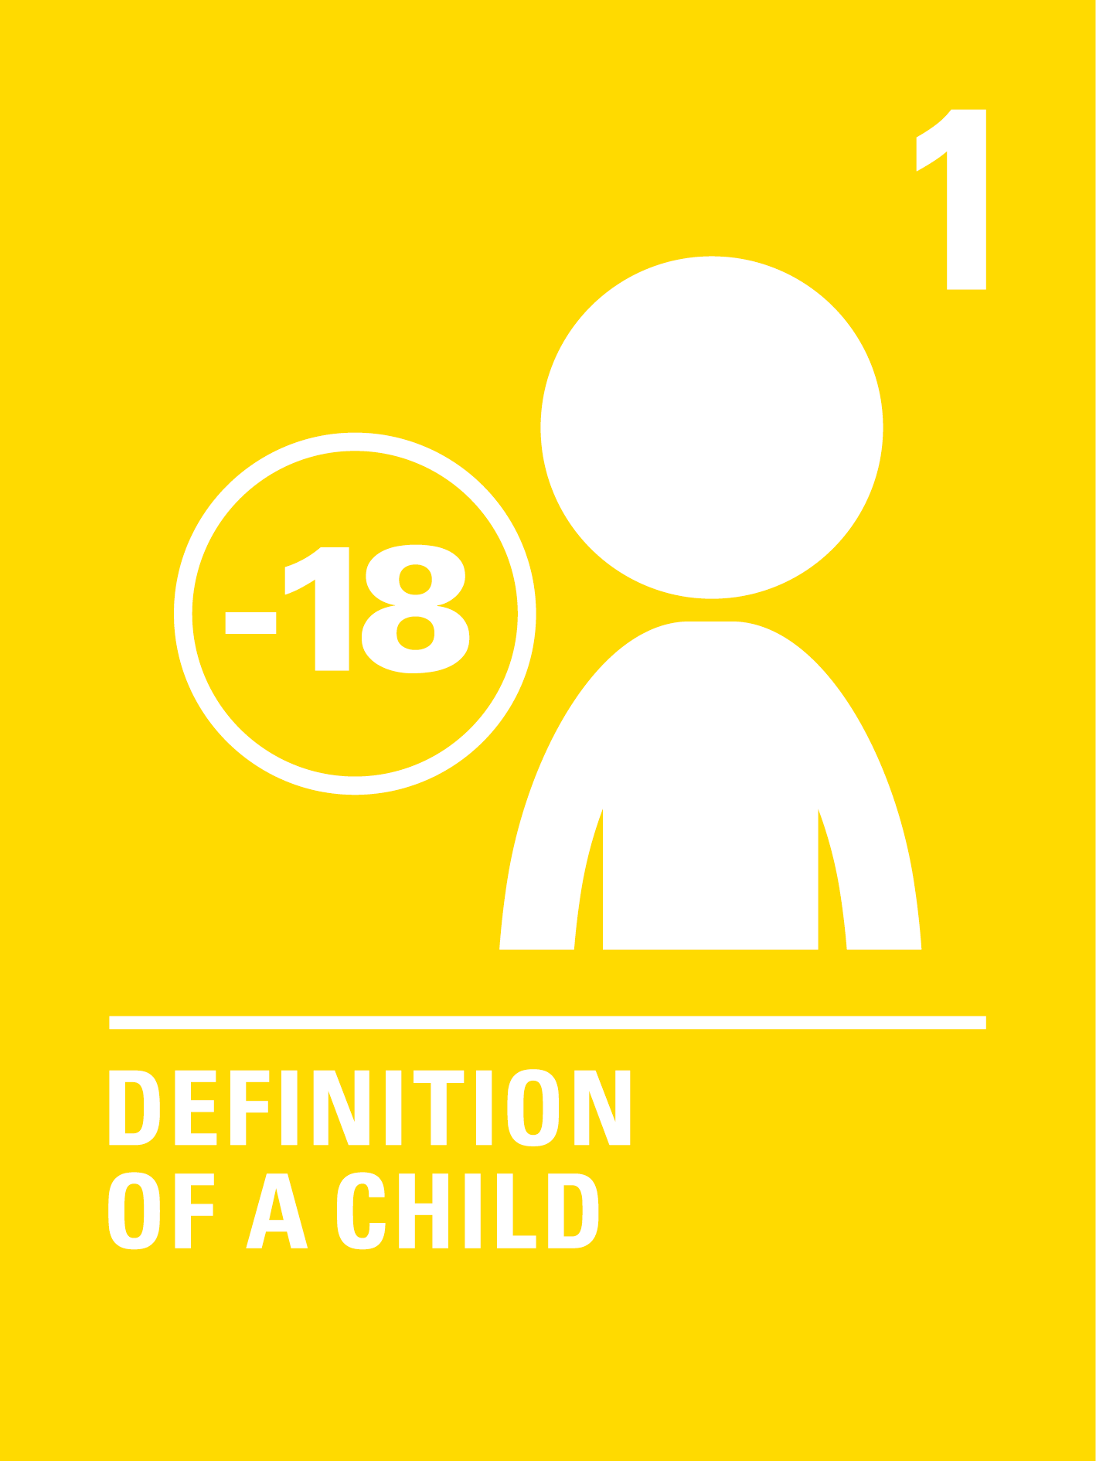
ANSWER:
A Child is any person under the age of 18

Slide 5
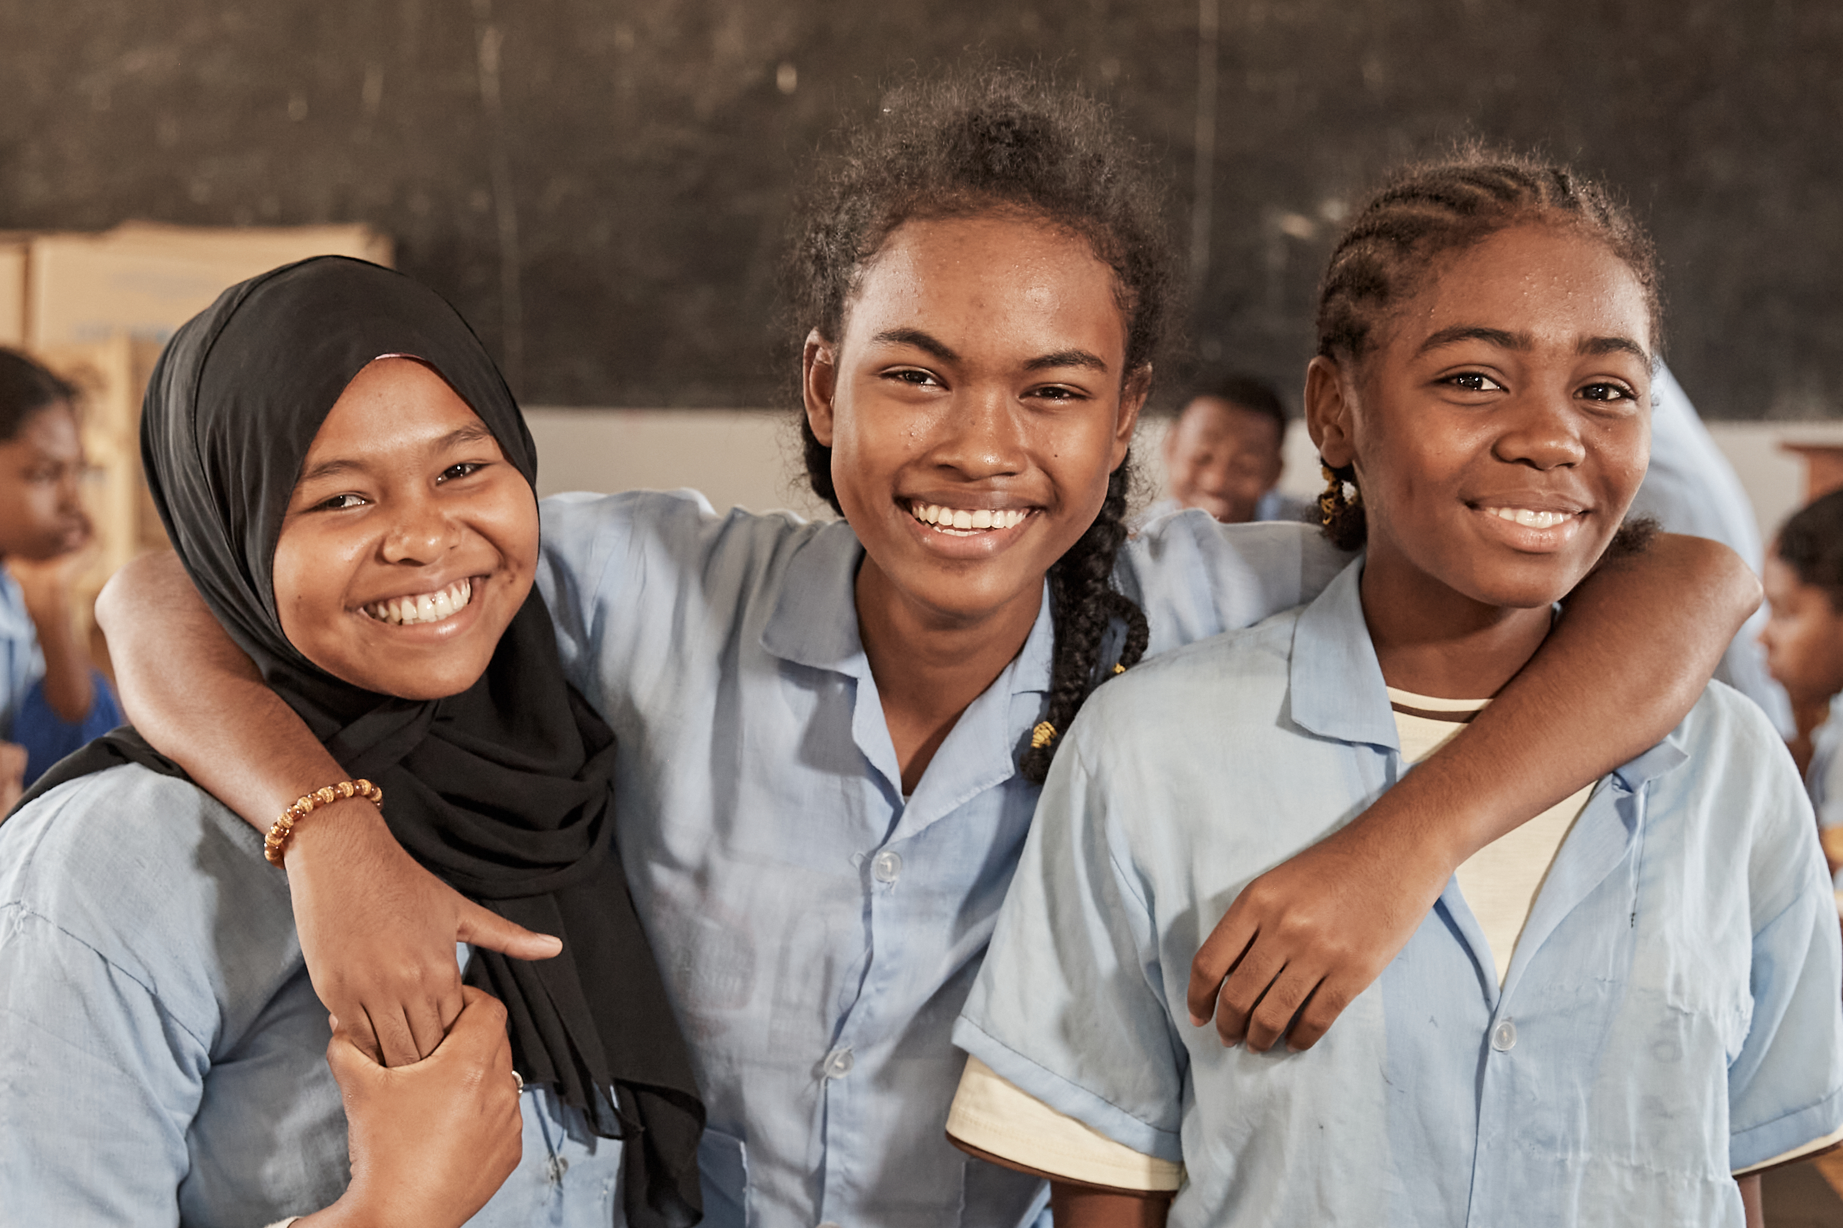
Q.2: Who do Child Rights Protect?
Every child who lives in poverty
Every child who lives in war
Every child, no matter where they live
Every child who lives in a rich country
UNICEF/UNI441163
Notes:
Mahajanga, Boeny (Madagascar)- Rouweidah and other children after an IT class

Slide 6
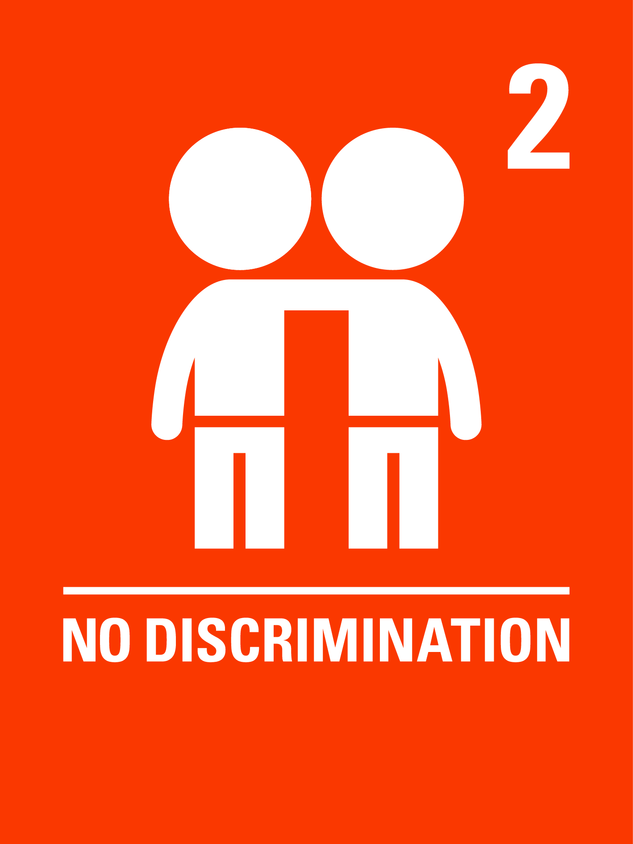
ANSWER:
Every Child, no matter where they live, where they are from, what language they speak, what religion they practice, is protected by Child Rights

Slide 7
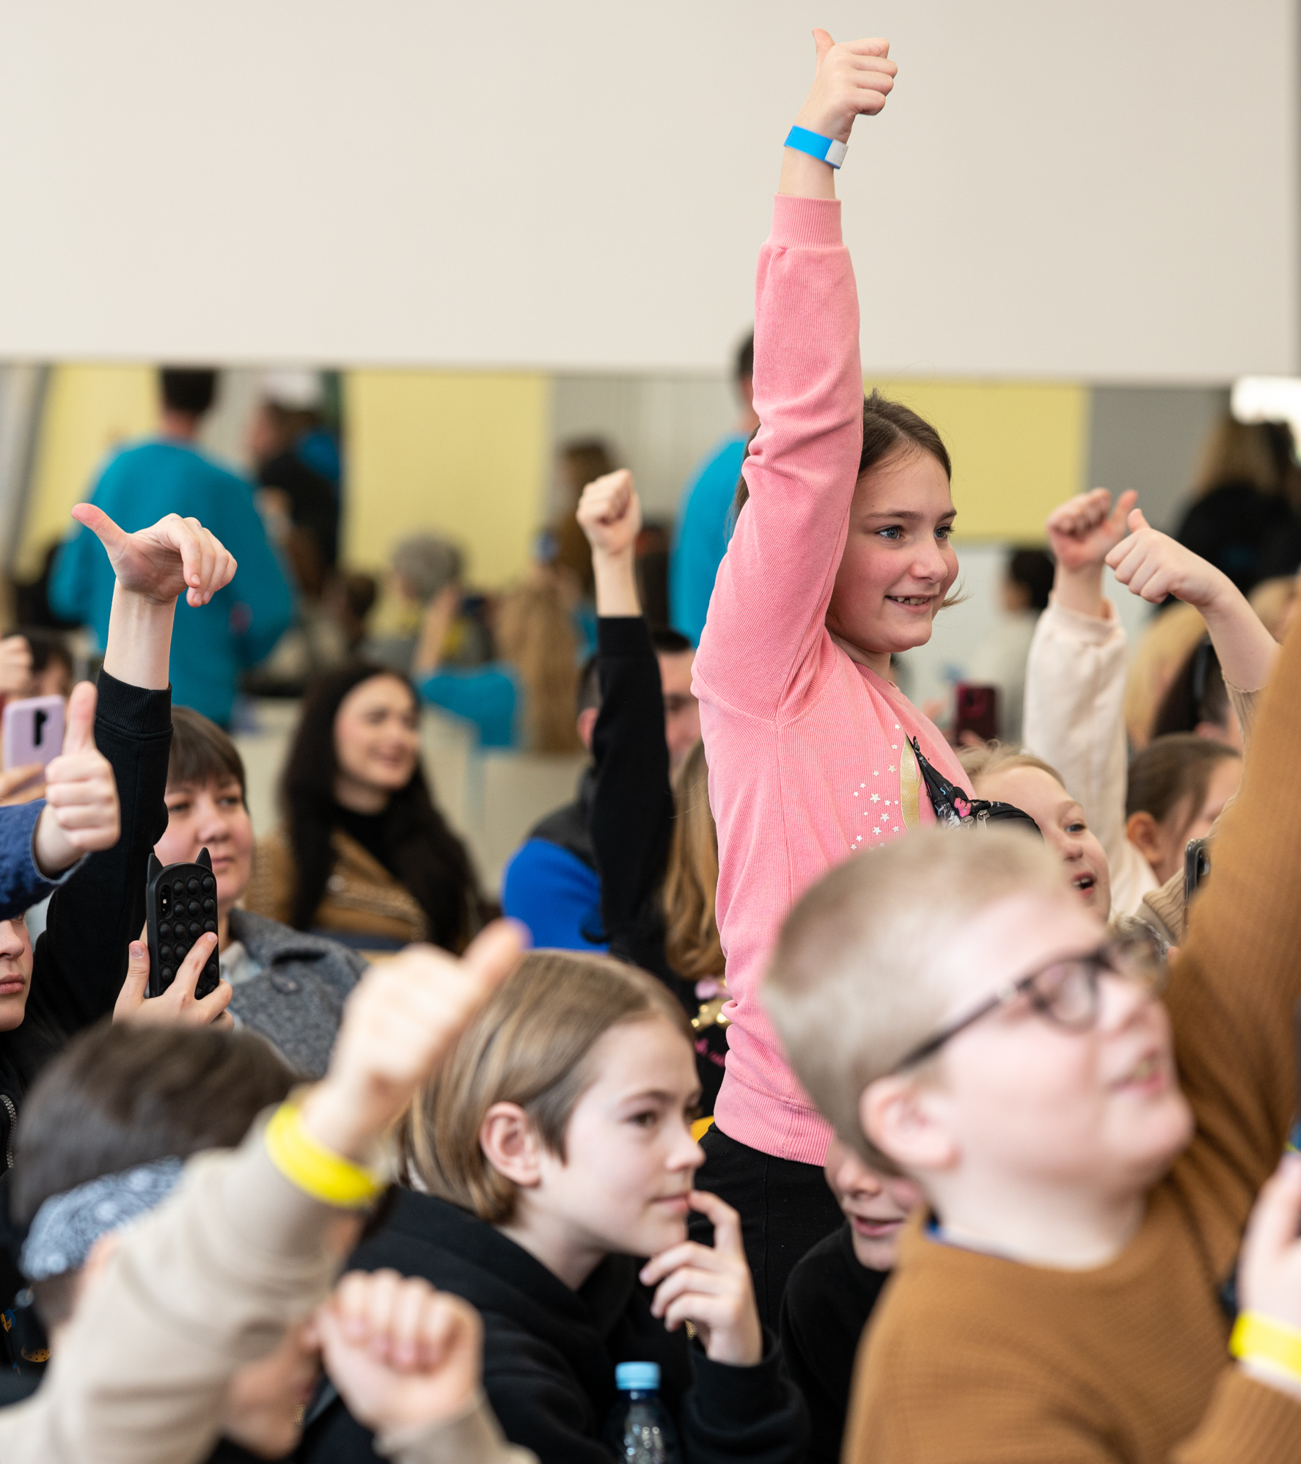
Q.3: Why do Children have their own Rights?
To be protected and respected
To get all their wishes fulfilled
To be allowed to decide when to go to bed
Because children are more important than adults
UNICEF/UN0821093
Notes:
Children greet UNICEF Goodwill Ambassador Orlando Bloom on the stage of the school’s assembly hall, during an event dedicated to mine safety in Ukraine on 26 March 2023.

Slide 8
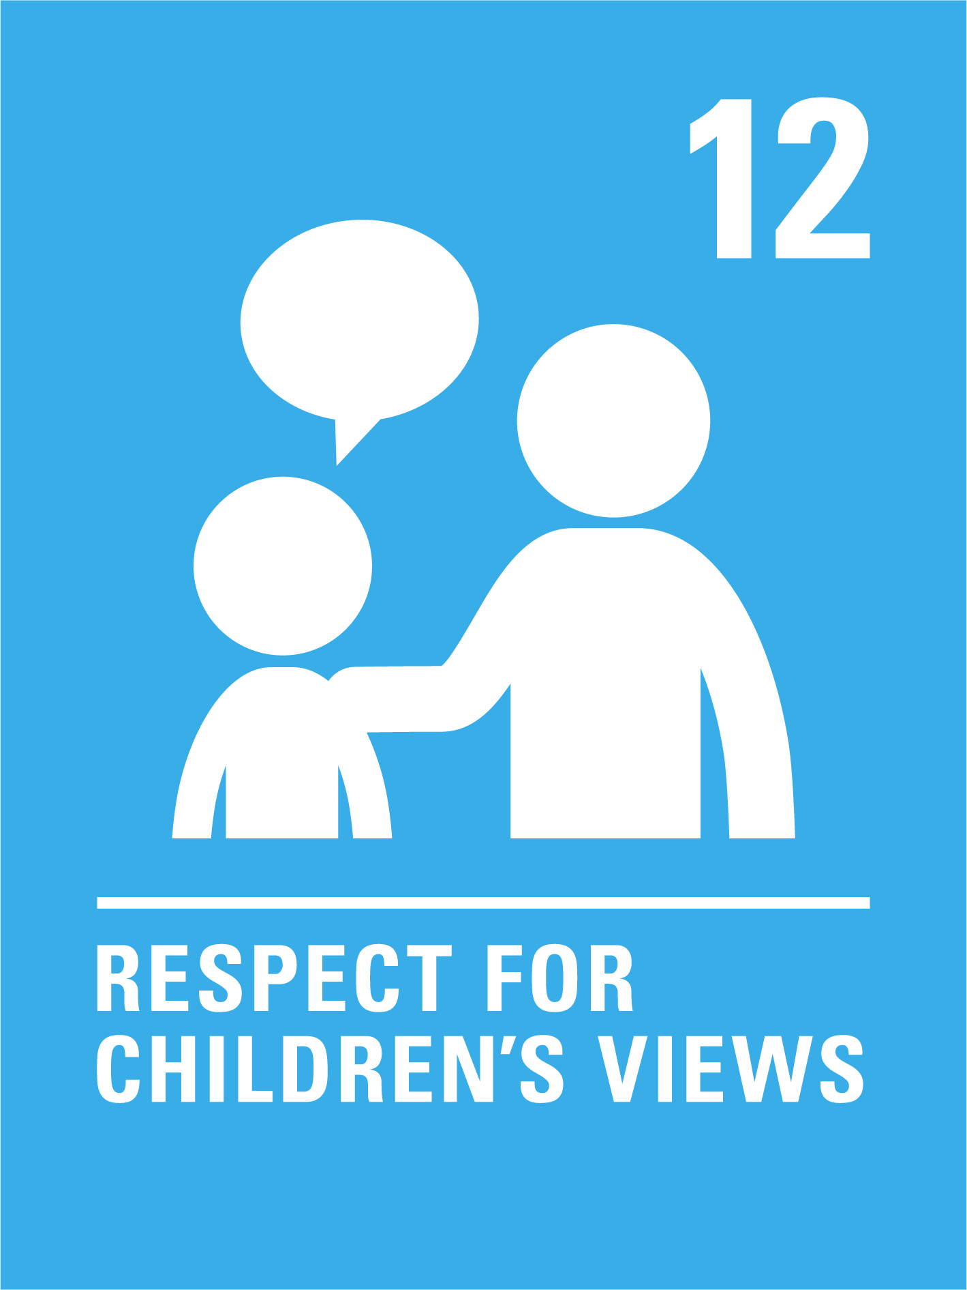
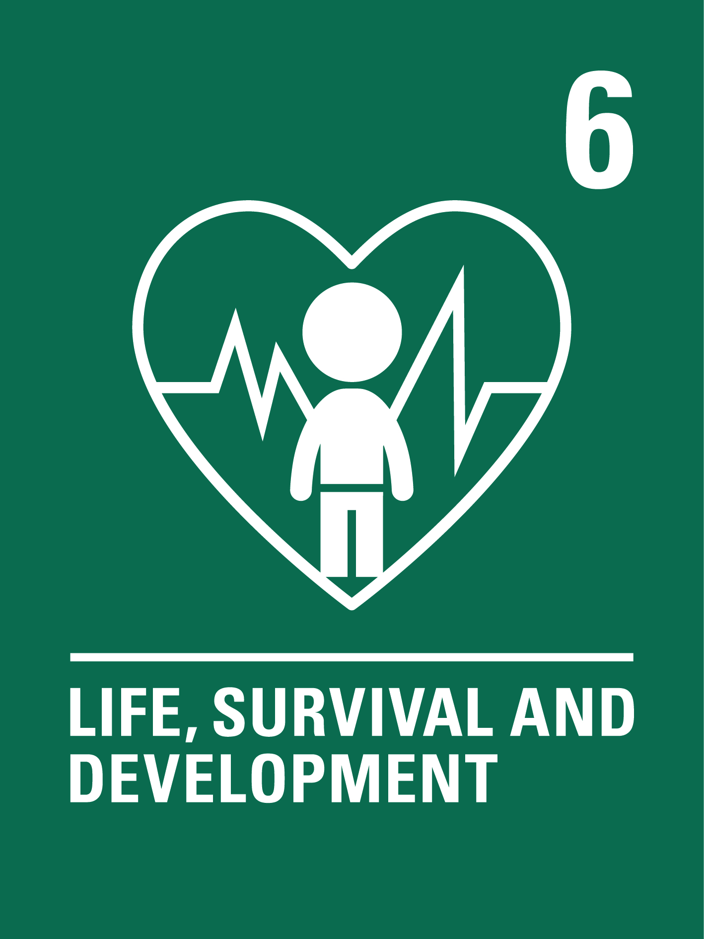
ANSWER:
Children have their own rights to ensure that they are protected, supported and empowered to take part in society

Slide 9
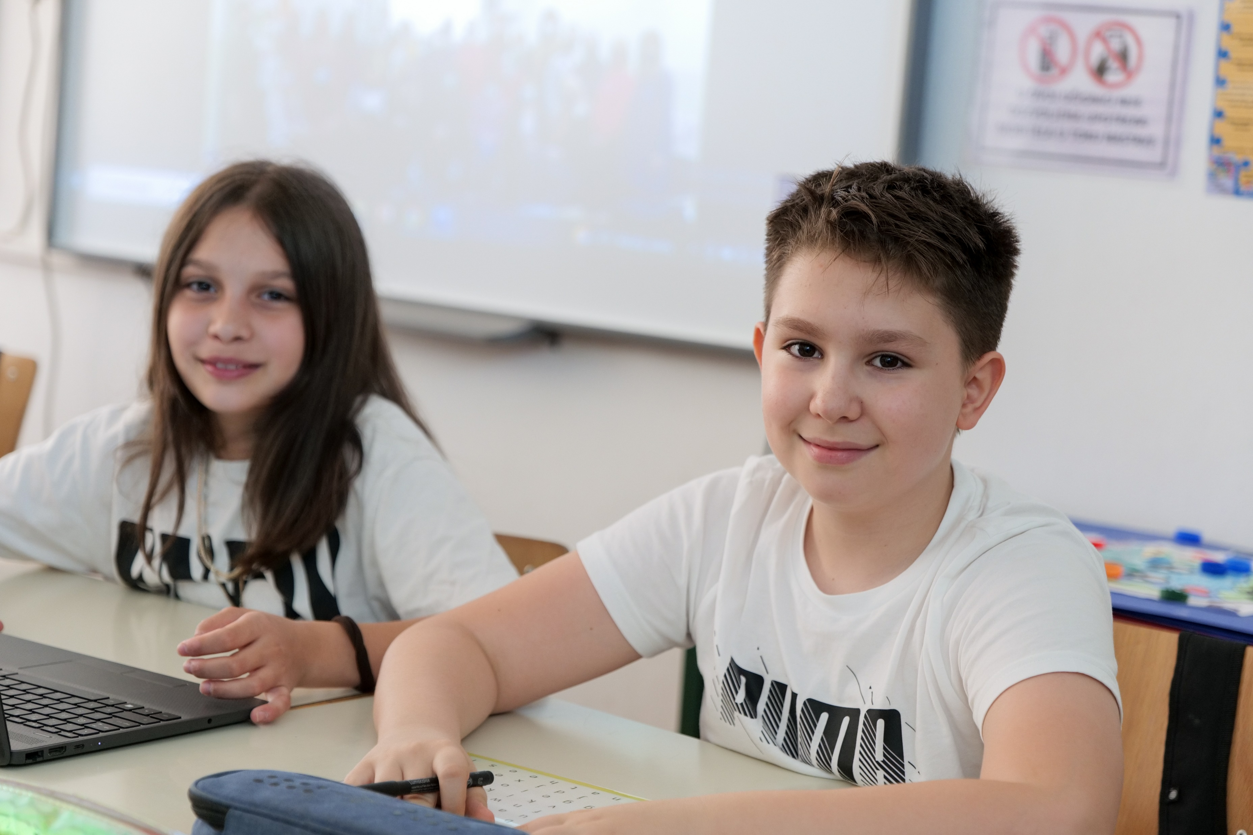
Q.4: Who are the main people responsible for protecting children and their rights?
Children
The Government
Teachers
Doctors
UNICEF/UNI432577
Notes:
Children in Bosnia Herzegovina engaging in technology-assisted education classes

Slide 10
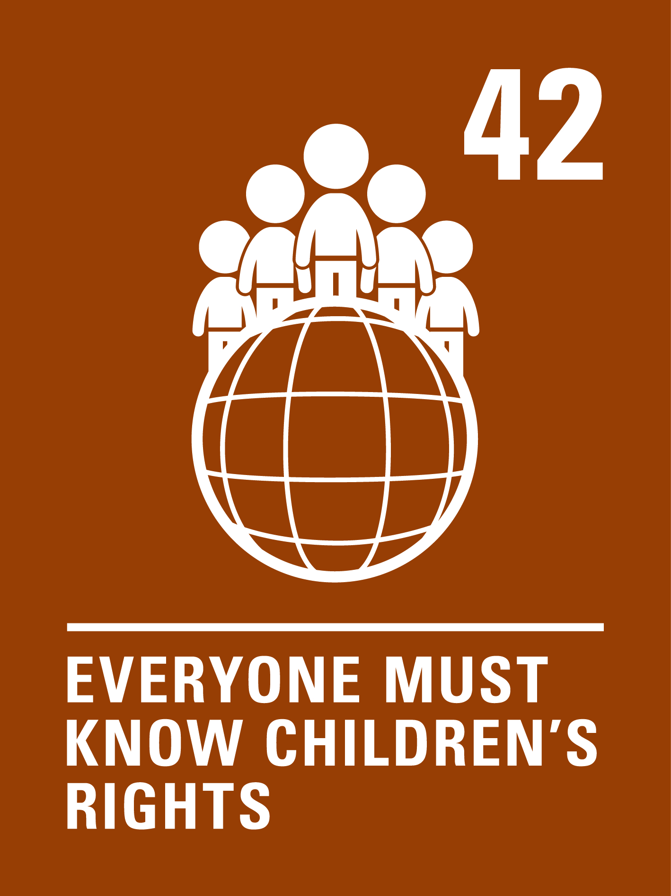
ANSWER:
The Irish Government ratified the CRC in 1992.
The Government, and everyone who works for the Government, is responsible for ensuring children’s rights are realised and everyone should know about these rights.

Slide 11
Q.5: As a Child I have the right to …
Play
Eat healthy Food
Learn
Eat sweets
UNICEF/UNI432199

Slide 12
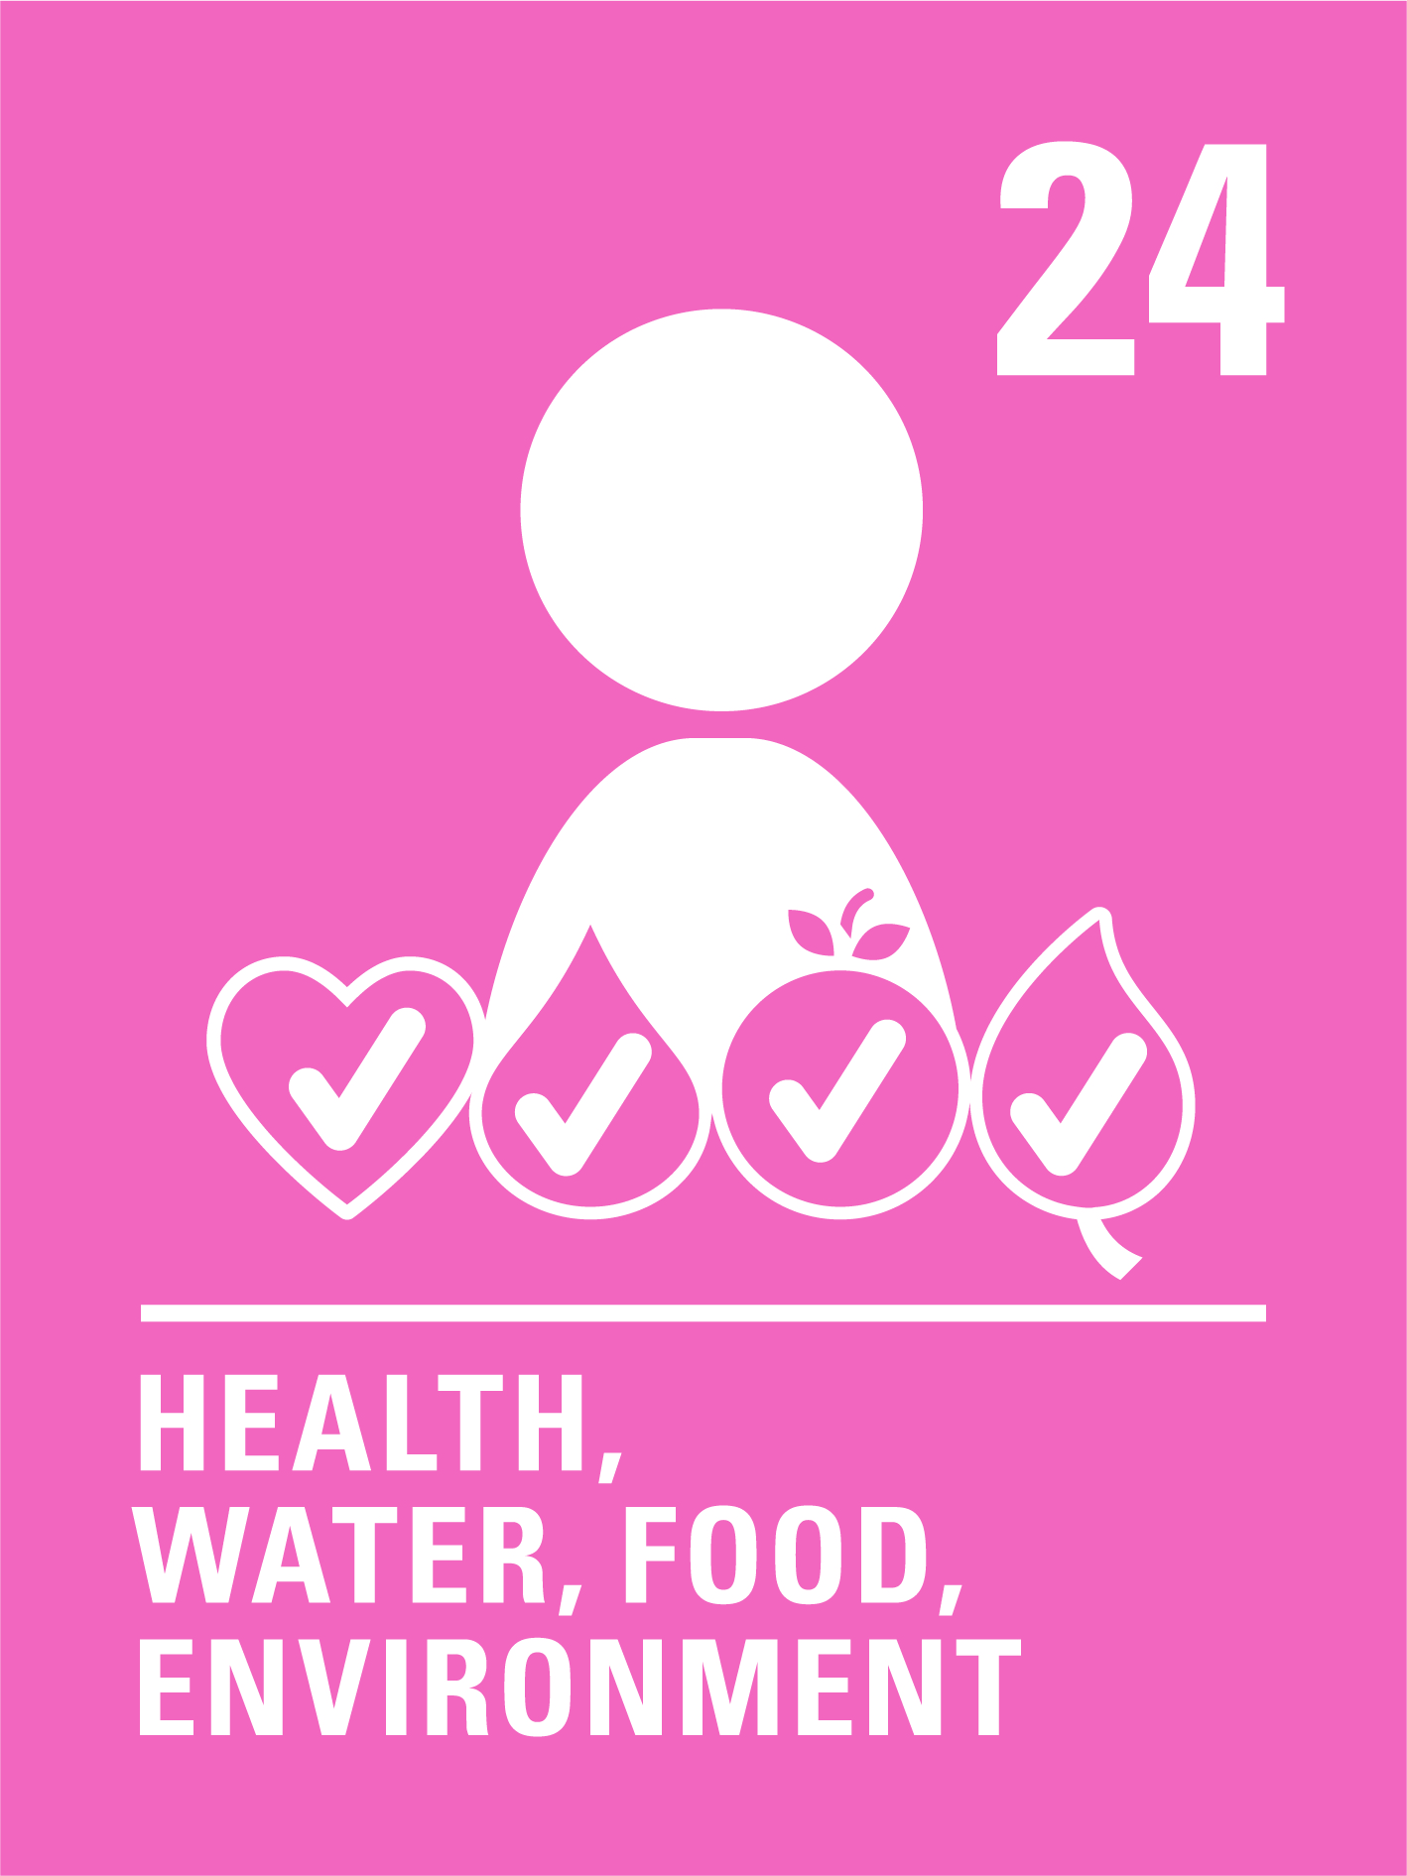
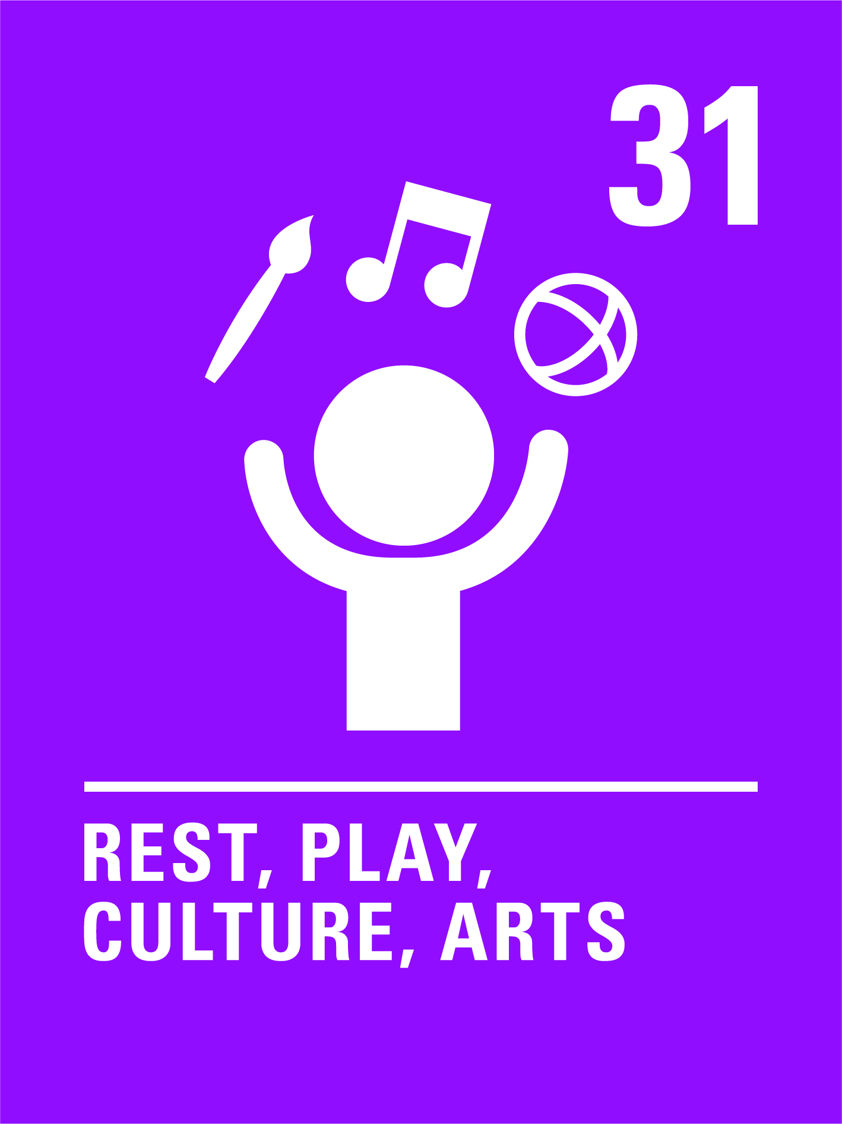
ANSWER:
All children have the right to play, to relax, to healthy food and clean water, and to an education.

Slide 13
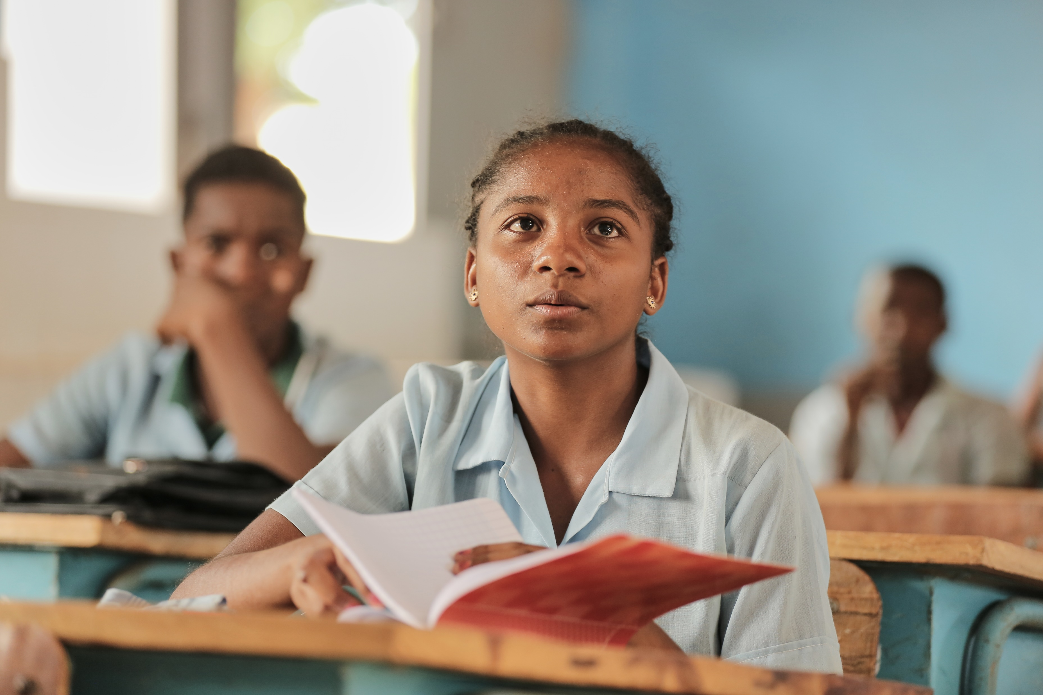
RIGHTS RECAP
What are Child Rights?
Everyone in the world has human rights, including children. Because children are in a special stage of development they also have a special set of rights to ensure they are protected, nurtured and empowered.
Every child has the same rights.
UNICEF/UNI440954
Notes:
September 2023, school in Mahajanga, Boeny - Charle Renel-Classes resume after the summer vacations.

Slide 14
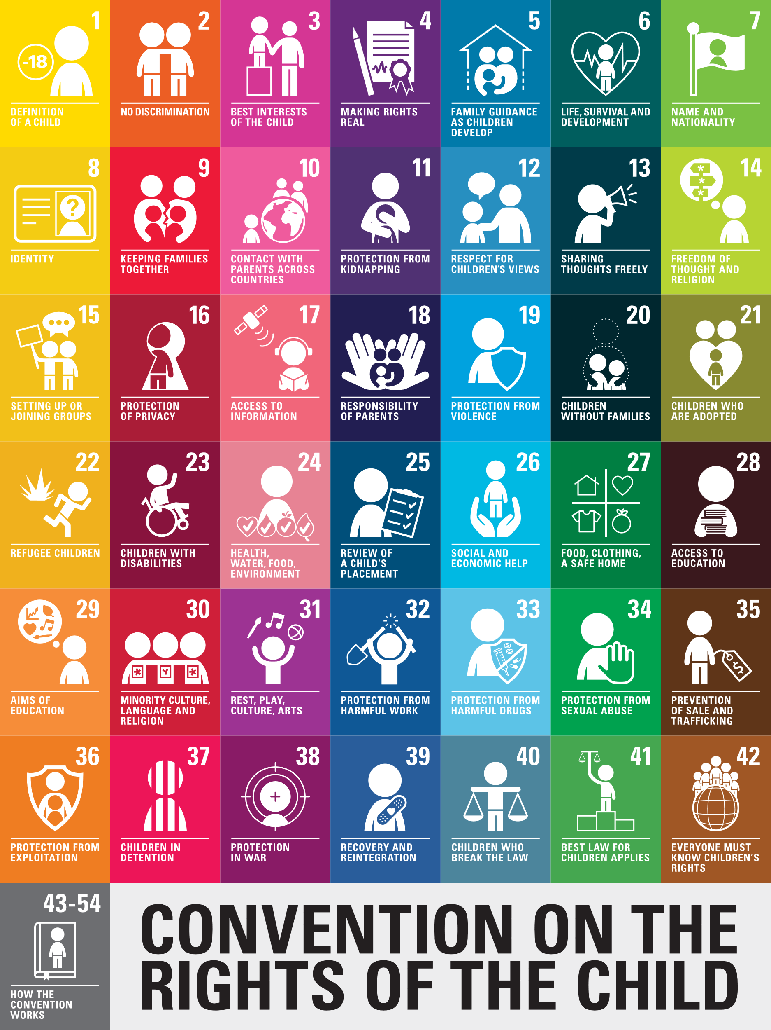
The Convention on the Rights of the Child (CRC) lists the rights that children have through 42 articles.
Ireland ratified (agreed to uphold) the Convention in 1992
Check out a summary or read the full Convention.
Notes:
The United States of America is the only country which has not ratified the Convention – any guesses as to why that might be?

Slide 15
All the rights of the Convention are connected, and all are equally important
4 Articles are known as “General Principles” – they help us understand and uphold all the articles

Slide 16
Notes:
Check out this animated overview of the Convention on the Rights of the Child in the Irish context!

Slide 17
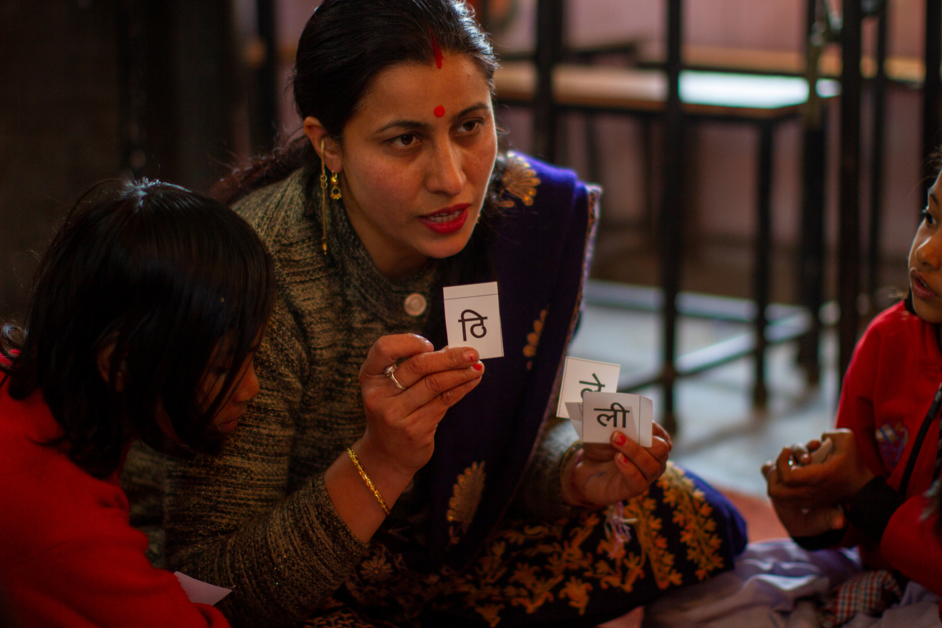
Connecting the CRC and School
Every aspect of school life is connected with, and underpinned by, child rights.
Can you identify all the rights you enjoy in school?
UNICEF/UN0790641
Notes:
Teachers and student in classroom in Turkey, 2018
You could use this as a classroom exercise to label parts of the classroom with relevant articles – e.g. Article 17 Access to Information on computer, Article 31 Right to Play on toys, etc.

Slide 18
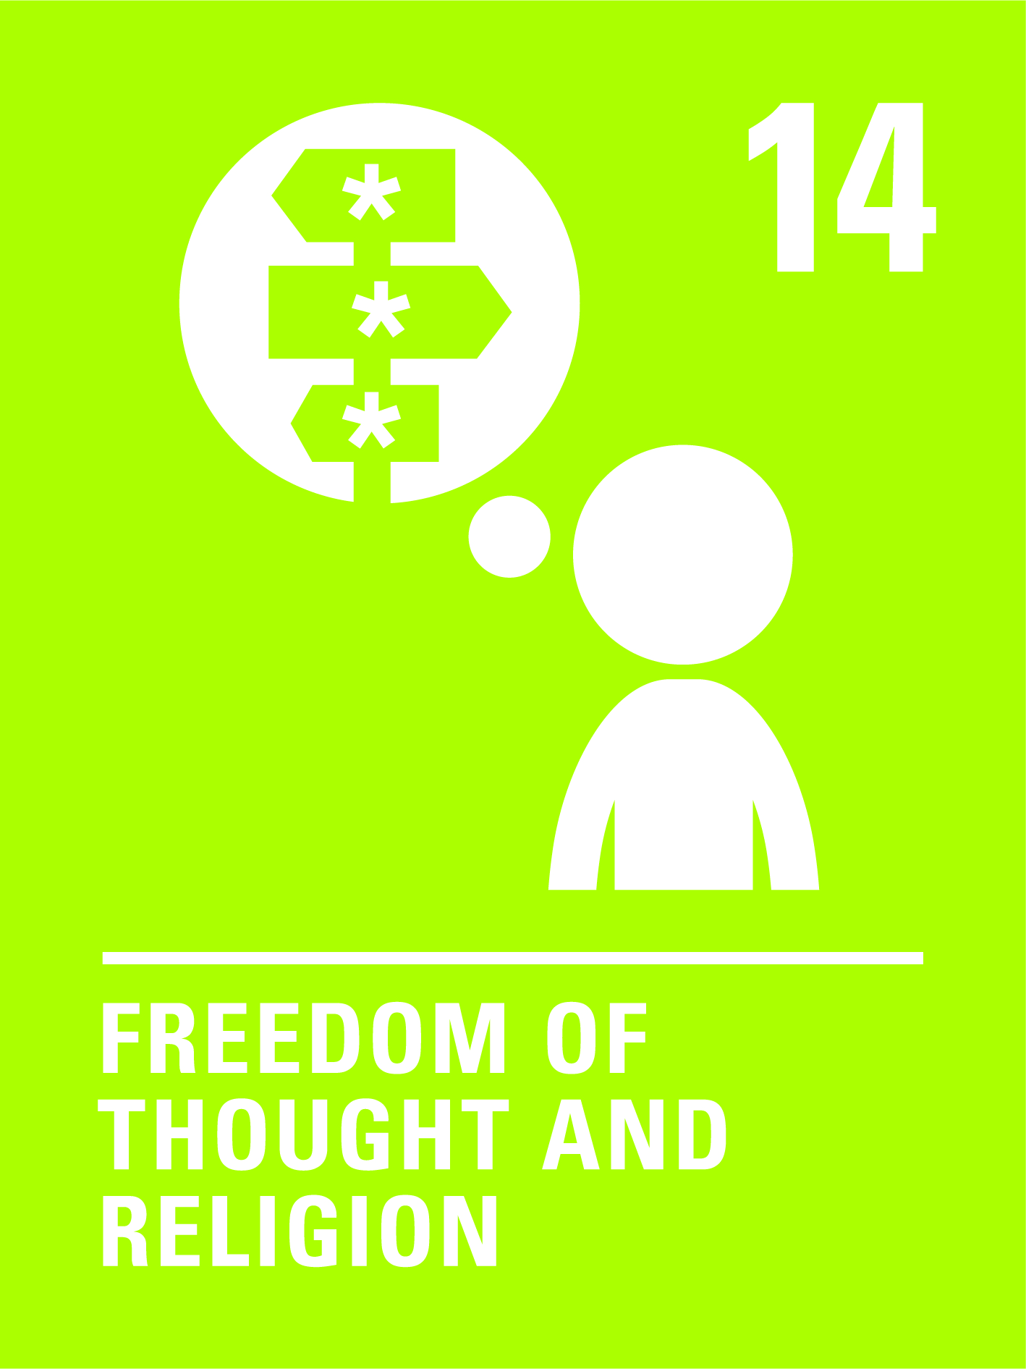
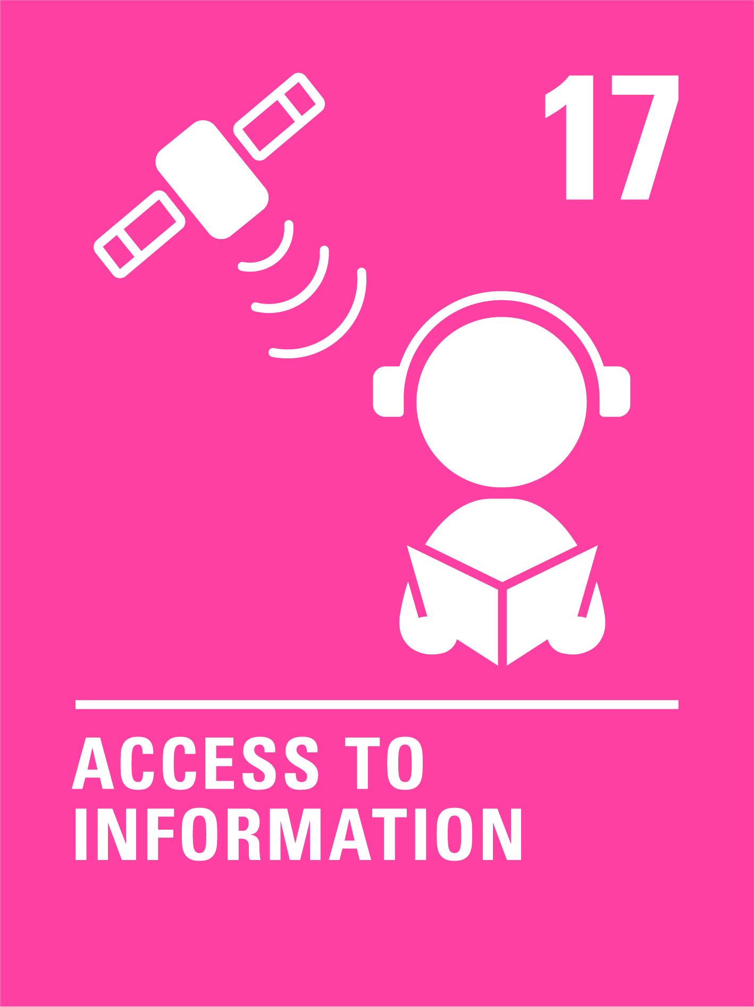
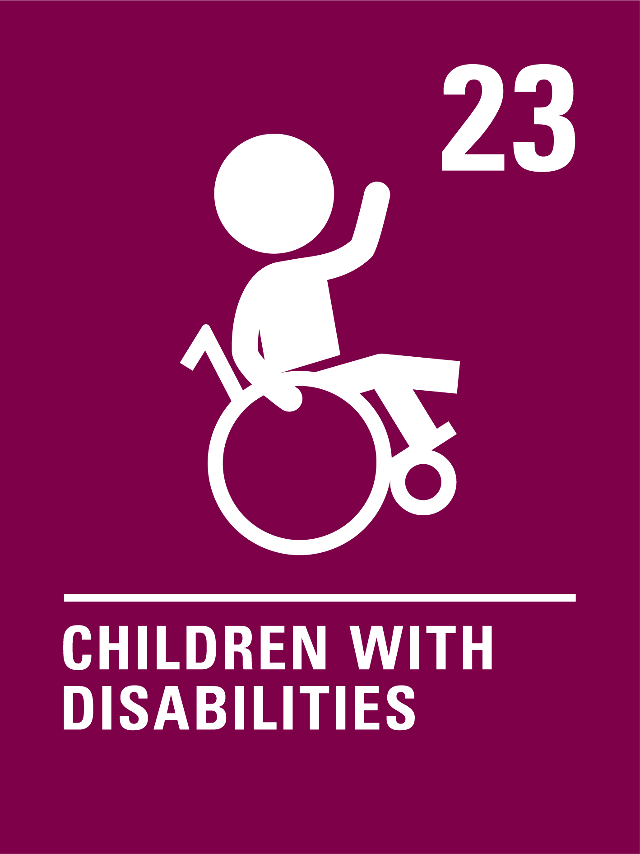
HOW MANY OF THESE DID YOU GET?
What others did you think of?
Notes:
Might also consider Article 16 – right to privacy, Article 7& 8 on Nationality and Identity, Article 30 Minority Culture etc.

Slide 19
#7WordStory
In 7 words write down what rights are/why you think rights are important
Feel free to get creative and make your #7WordStory as colourful as you can!
Notes:
In 2019 to celebrate the 30th anniversary of the CRC Bruce Adamson (Children and Young People’s Commissioner in Scotland at the time) asked children to describe human rights in 7 word stories – examples on the following slides.
Ask your class to write their #7word story on a piece of paper, then scrunch it up and throw them into the middle of the room (or pass to someone on a different desk). Ask each child to read out the story on the piece of paper they have received.
Note: you may decide to keep this exercise for later in the year when you have explored rights further with your class

Slide 20
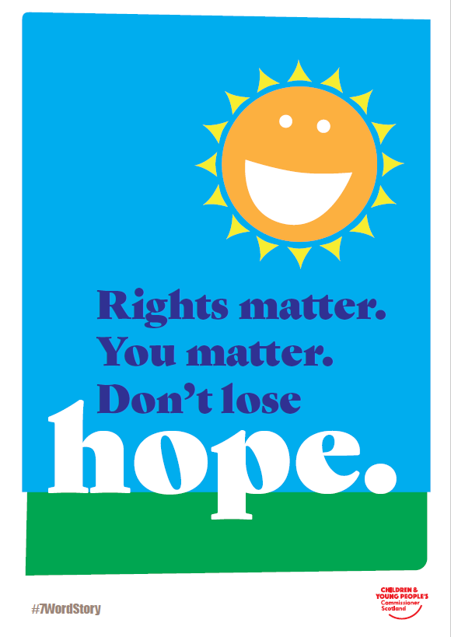
Notes:
Some examples from the workshop with children led by Bruce Adamson, the Children and Young People’s Commissioner in Scotland in 2019

Slide 21
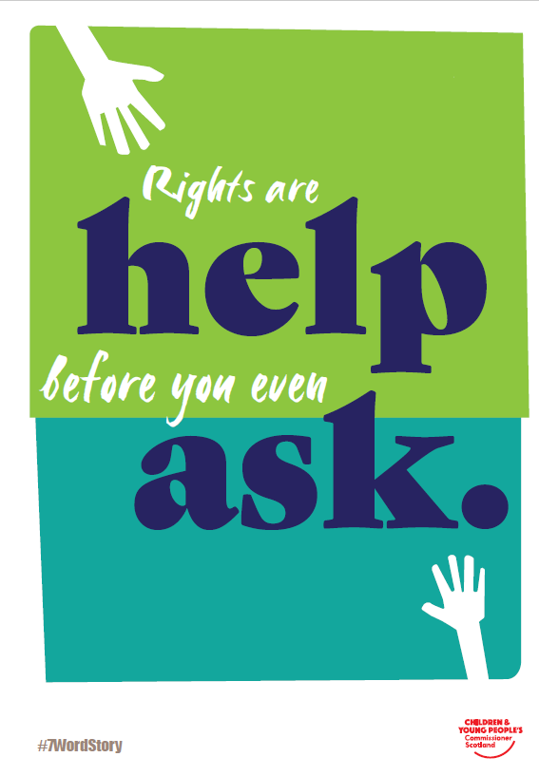

Slide 22
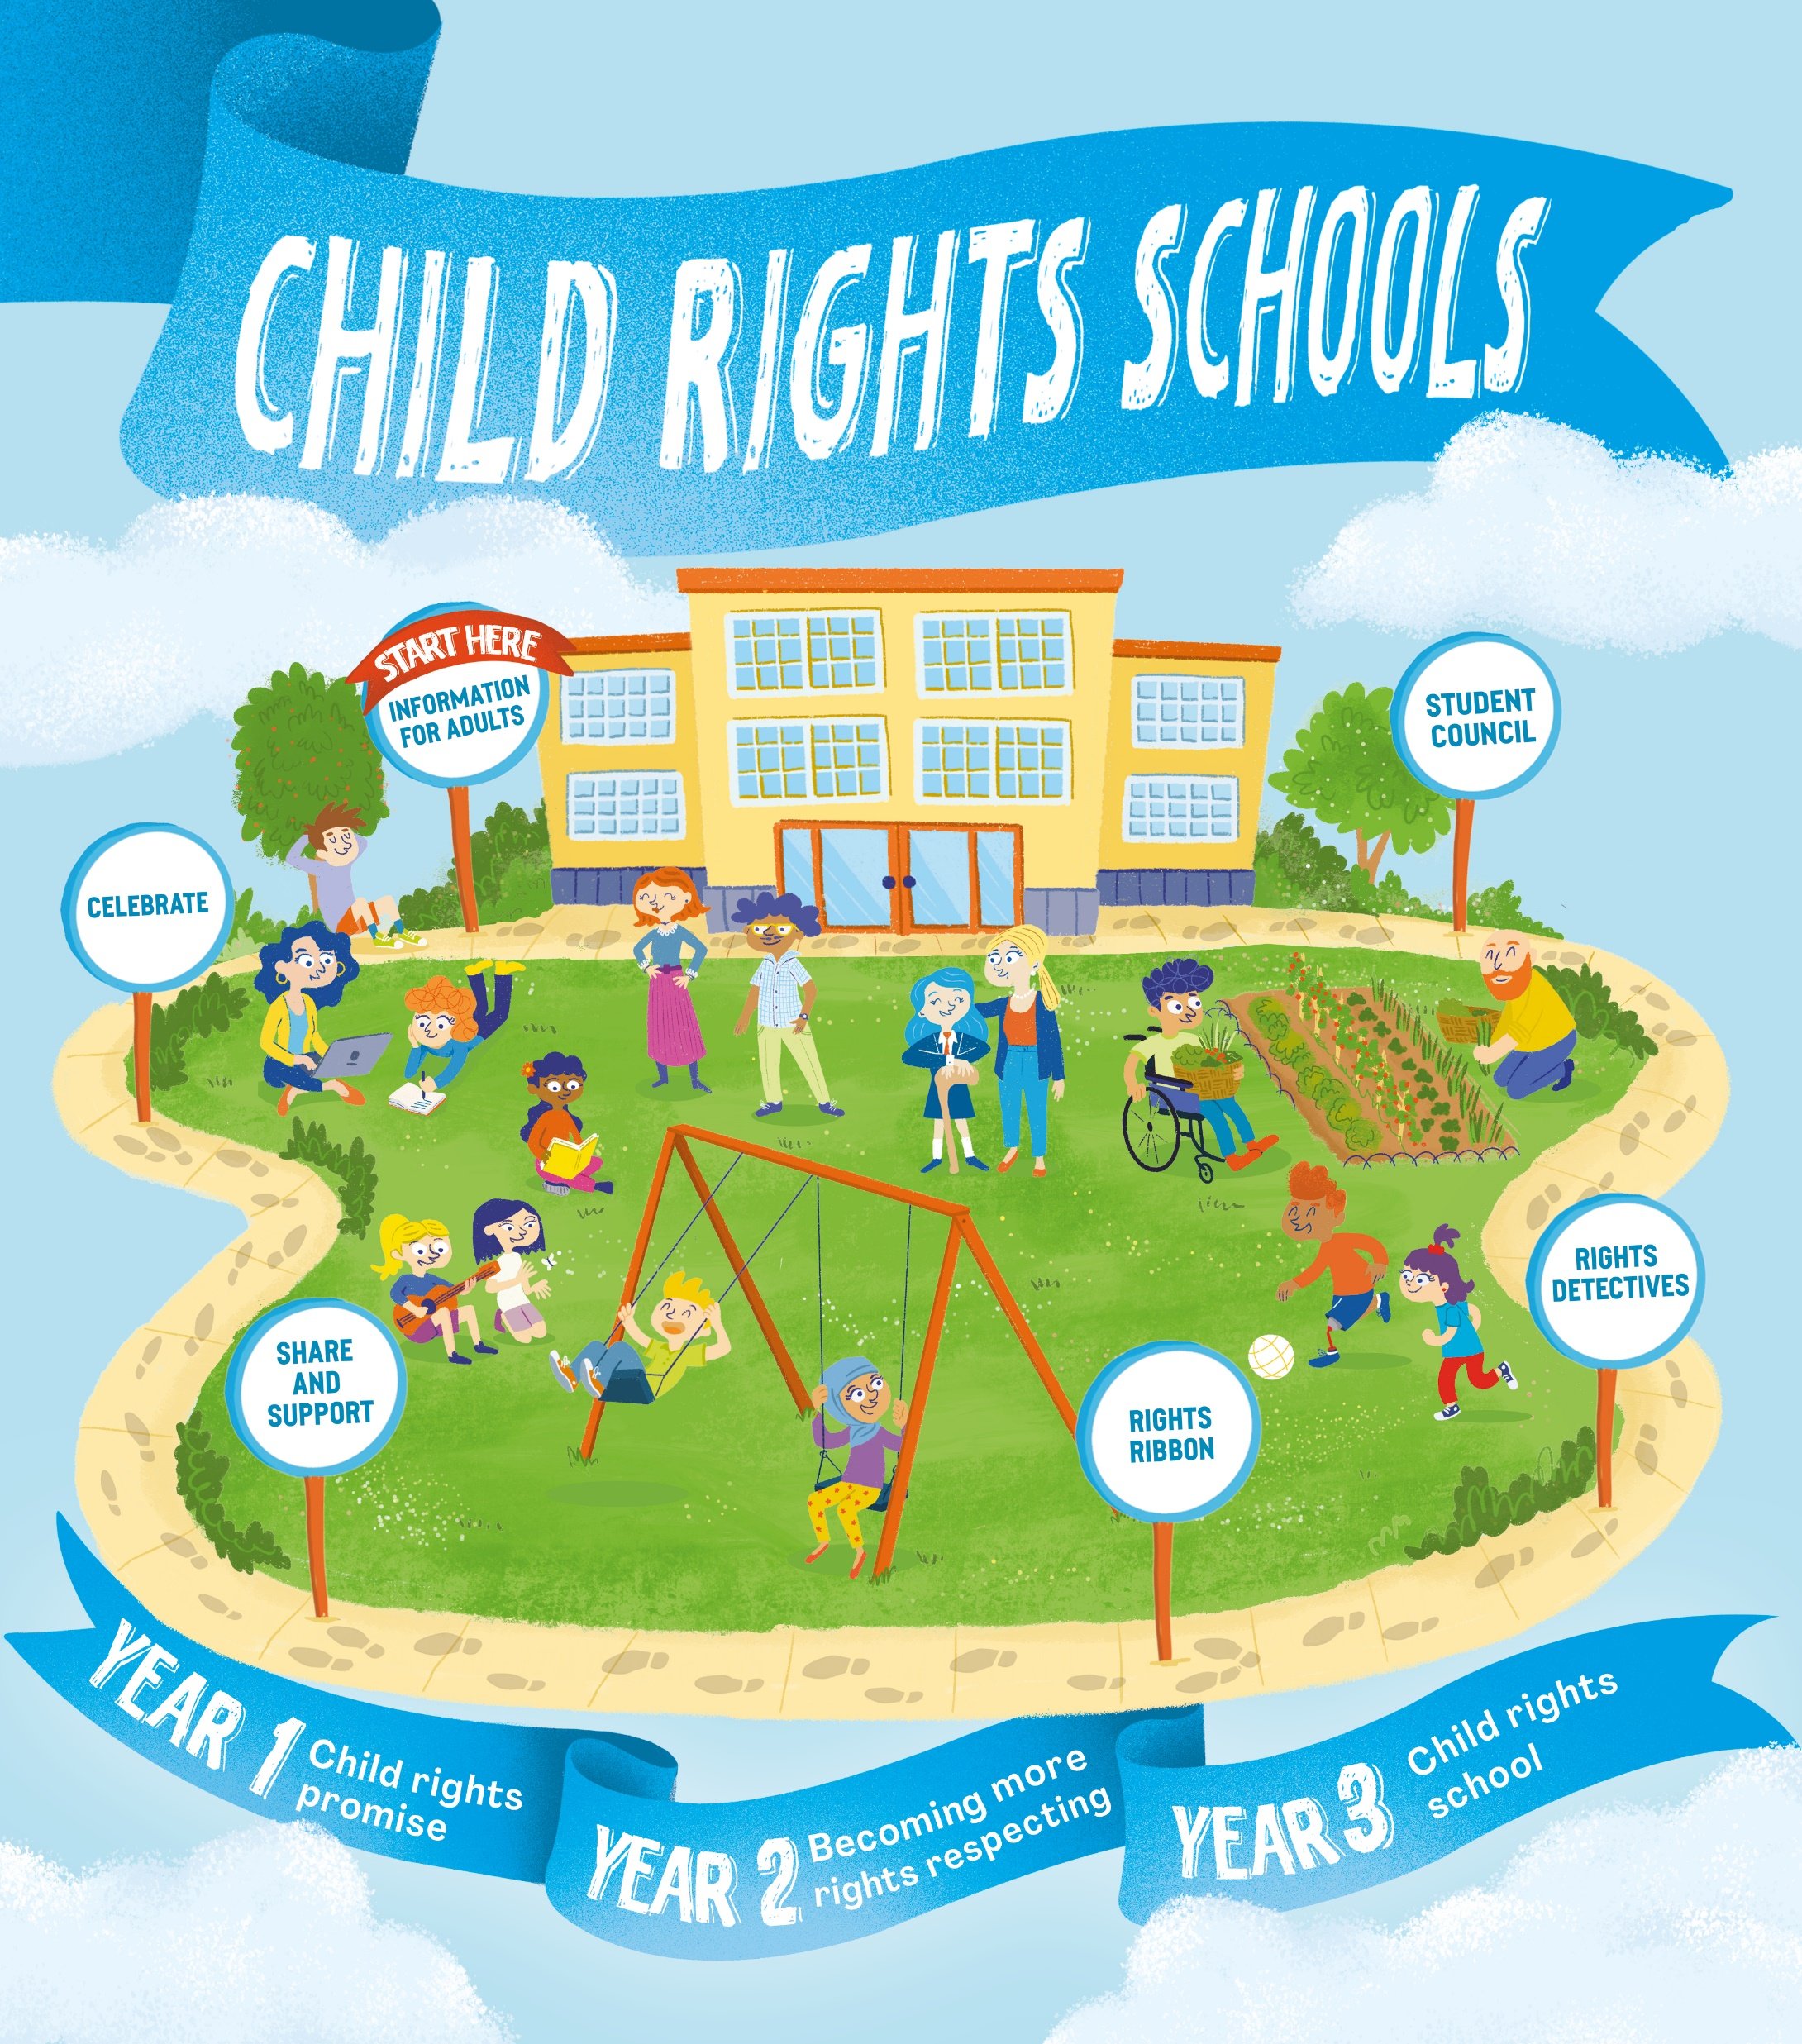
FURTHER CHILD RIGHTS EDUCATION SUPPORT
Child Rights Schools is a programme that supports you to embed child rights across the primary school. Find our more here.
Find more classroom resources here.

Slide 23
THANK YOU

