Slide 1
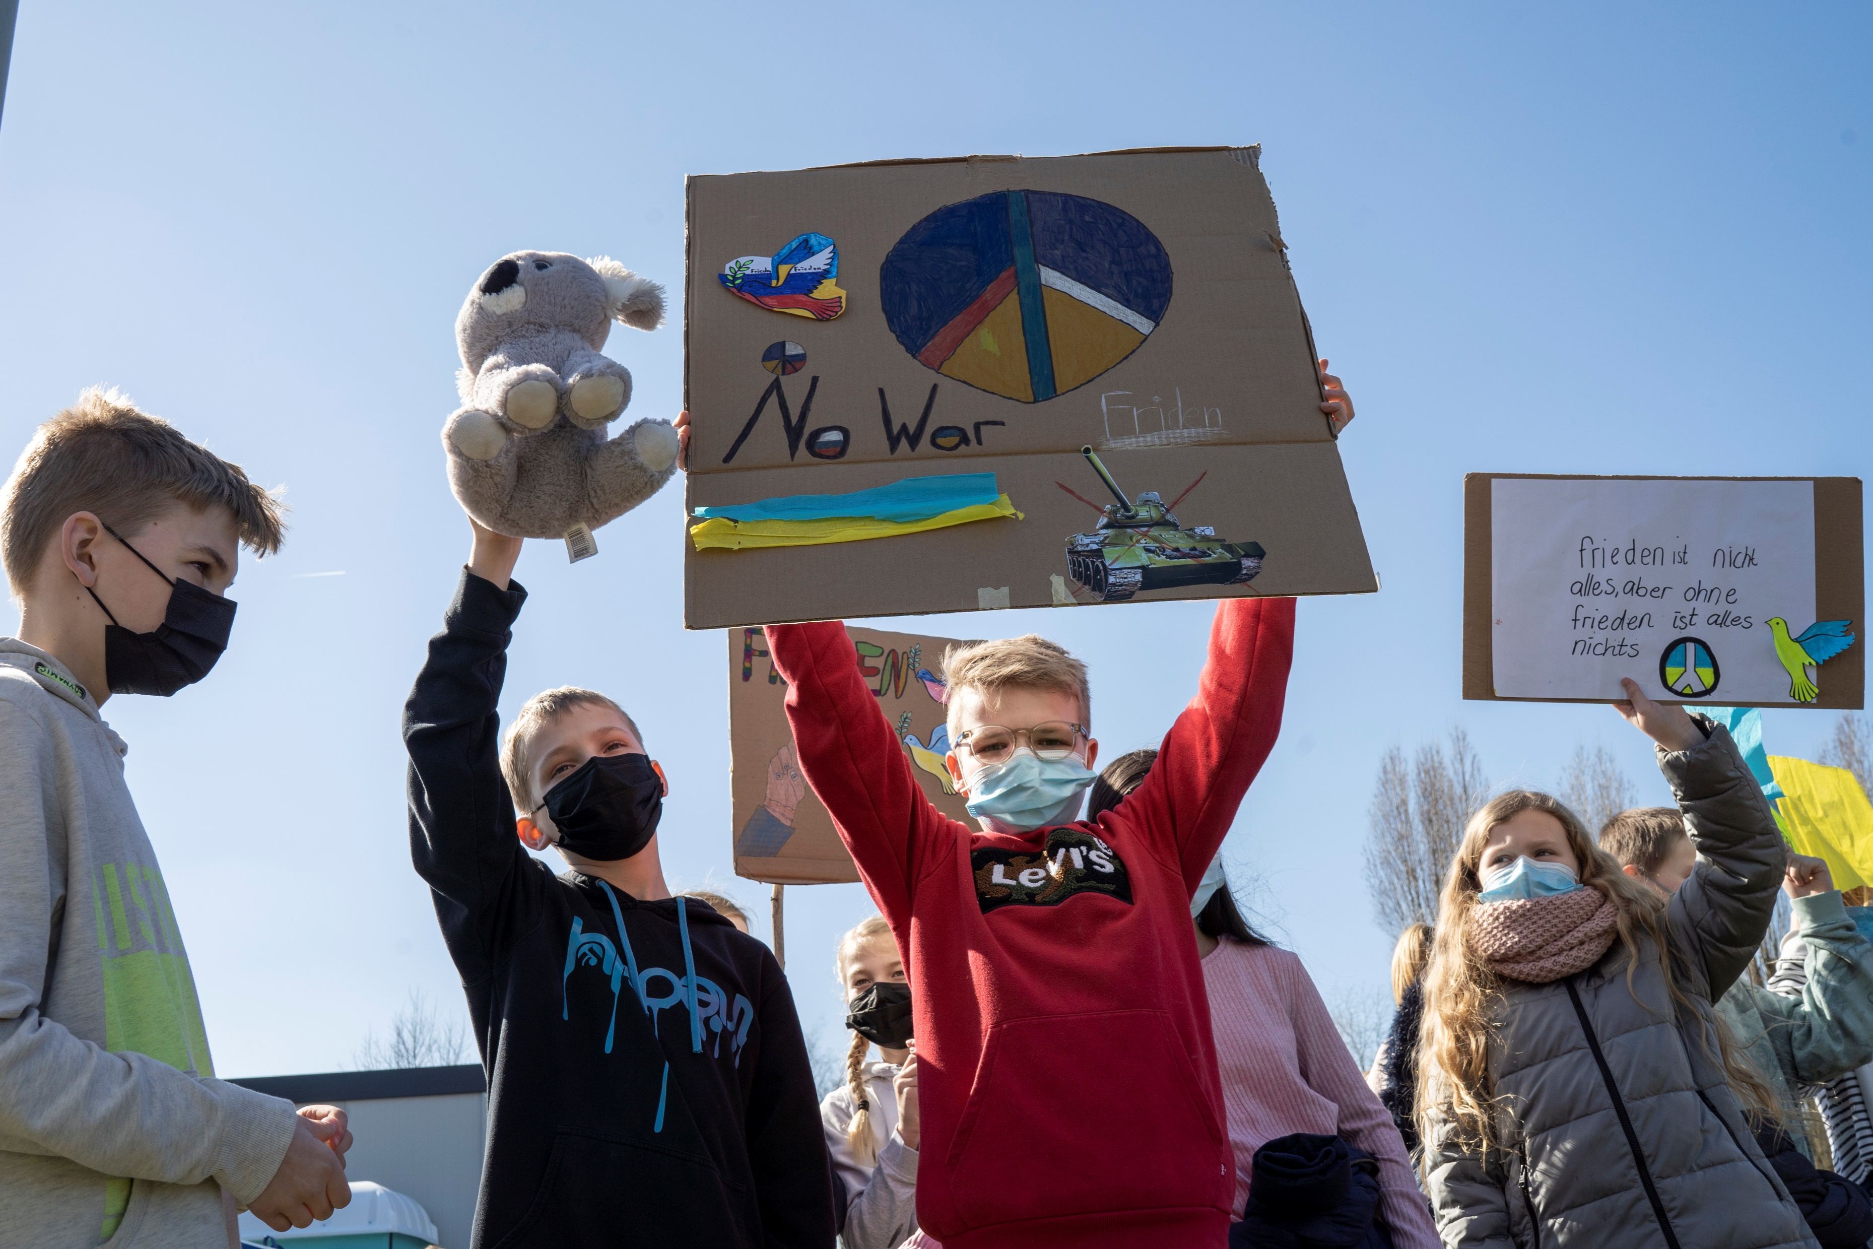
Article of the Week: Speaking to your Class about International Conflict
© UNICEF/UN0621900
Notes:
Germany 2022; Pupils at the big demonstration of the Warendorf schools on 18.03.2022. Around 3,500 pupils marched through the city center to the Lohwall to demonstrate against the war and for peace in Ukraine.

Slide 2
BEFORE YOU BEGIN
This is a flexible resource and is intended to provide you with some easy to use, appropriate rights-related learning to share with your students, their families and your colleagues.
Please edit out non relevant slides or activities before sharing with your students. Please check that the content works for your learners and feel free to adapt or add any content that would make the material more relevant for your setting.
This resource was developed by UNICEF UK and adapted by UNICEF Ireland.
Slide 3 & 4 – Guidance for teachers
Slide 5 – Guess the article
Slide 6 – Introducing Articles 38 and 39
Slide 7 – Exploring Articles 38 and 39
Slide 8 – Some possible answers
Slide 9 & 10 – Activities for the classroom
Slide 11 – Reflection
Slide 12 – Further Support

Slide 3
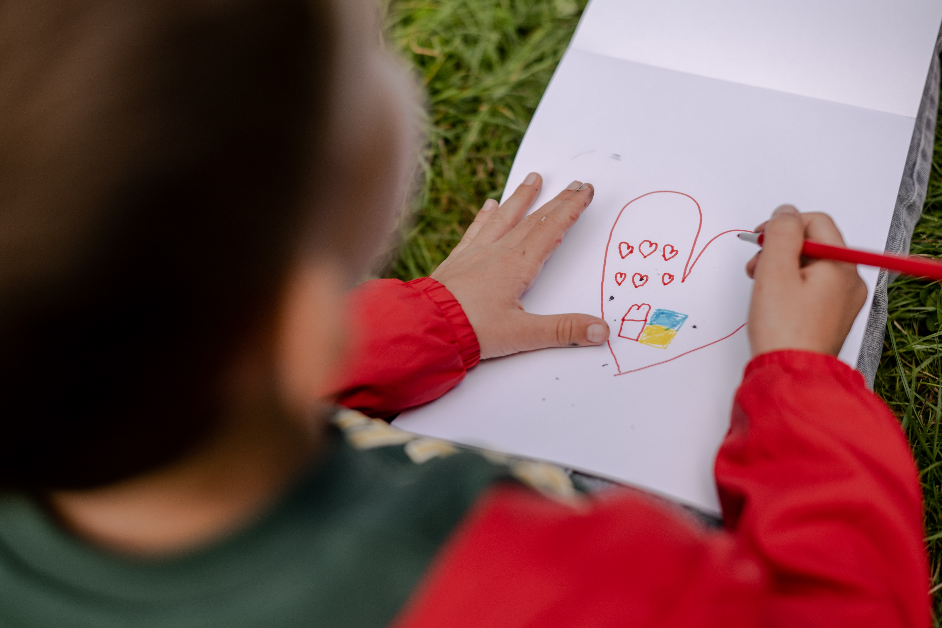
GUIDANCE FOR TEACHERS
War and conflict are incredibly difficult subjects for people of any age. Working with children to try and untangle complicated thoughts and feelings is not easy. However, safe spaces in which to gently explore disturbing world events can provide huge reassurance to children and young people, and prompt them to seek help when they need it.
When speaking to children and doing activities from this pack, keep in mind different lived experiences children in your school might have in relation to war and conflict, fleeing violence or other trauma in their lives.
See the next slide for a few pointers on how to approach this topic.
UNICEF/UN0715472
Notes:
On 6 September 2022, in Krakow, Poland, a boy draws a picture as part of a school assignment, while sitting on the grass at Kraków’s Park Jordana.
Classes are run by Unbreakable Ukraine a school that was founded for Ukrainian refugees and supported by UNICEF; they are holding lessons in the park while renovations on their new school building are completed.

Slide 4
GUIDANCE FOR TEACHERS
Discussing war and conflict may be difficult for some children in your class, depending on their personal or family experiences.
Does your class already have an agreement for working together respectfully, or do you need to agree some ground rules especially for this work?
Have an open dialogue with your pupils. Actively encourage them to share their own perspectives and ideas. Be receptive to verbal and non-verbal cues that show children have been moved emotionally. Click here for useful tips. ­
Make time to stress that you understand pupils may be upset and confused when thinking about war that is currently happening, and remind them of the people and places offering support to children within and outside of their school.
Underline the fact that the Convention on the Rights of the Child states the best interests of the child must always be a primary consideration, and the world has a longstanding commitment to put children first. All children must receive the care, respect and protection to which they are entitled, no matter who they are and where they are from. ­It is a sad fact that over the years, and in so many places, there have been, and continue to be, situations when duty bearers fail to do all they can for children. The world is not perfect but by having the CRC we can see when rights are not being accessed and children, and those who care for them, can speak up for their rights.
Consistently emphasise that human rights are a collective promise made by all countries of the world, including those currently in conflict. This promise can be summarised as everyone being able to enjoy a safe, happy and fulfilling life, where their dignity and worth is equally valued. You can also emphasise that the international system of refugee protection is founded on the principle of every country helping fellow human beings in times of need. It is a mutual system.

Slide 5
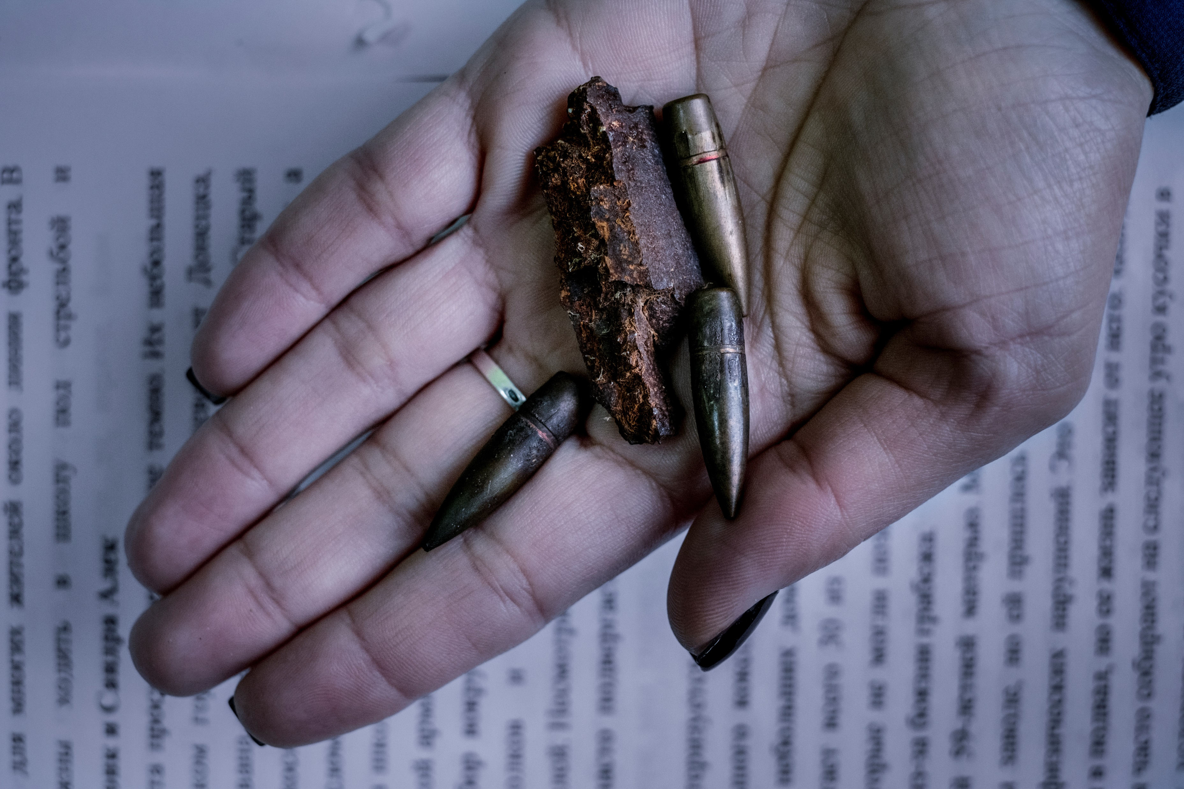
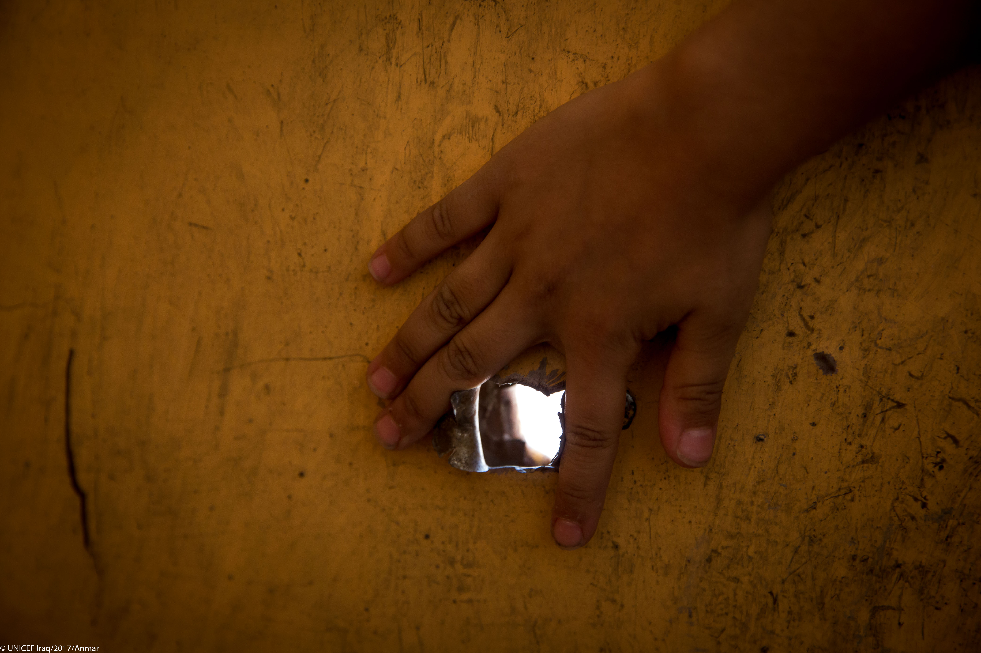
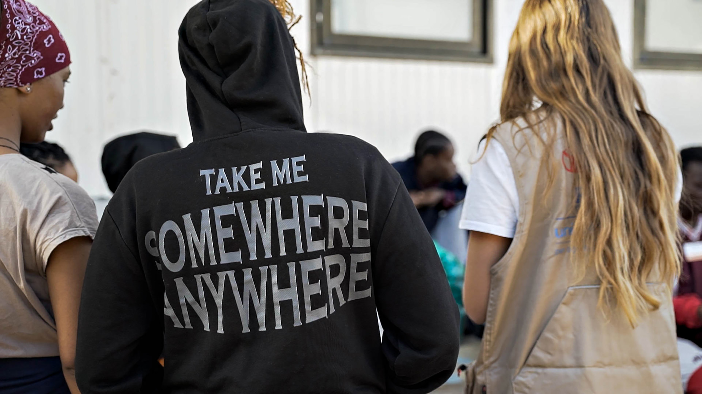
Guess the article
These pictures provide a clue to this week’s article.
Can you guess how they are linked together? Which article of the Convention do these pictures relate to?
Write down your thoughts or discuss with someone in your class.
UNICEF/UNI4431160
UNICEF/UN01150881
Unicef/UN068290
Notes:
From left to right:
Unicef/UN11441160 - On 26 September 2023, migrant youth participate in activities at the ‘hotspot’ reception centre on the island of Lampedusa, Italy.
UNICEF/UN01150881:Oksana Deynega, the director of a school, holds a shell fragment and bullets recently collected from the school grounds in Avdiivka, Donetsk Oblast, Ukraine, Monday 27 November 2017. Nearby fighting took place throughout the school day, with shells landing hundreds of meters from the school.
Unicef/ UN06890: Iraq 2017 - Farahedee School for boys and girls was rehabilitated by UNICEF.

Slide 6
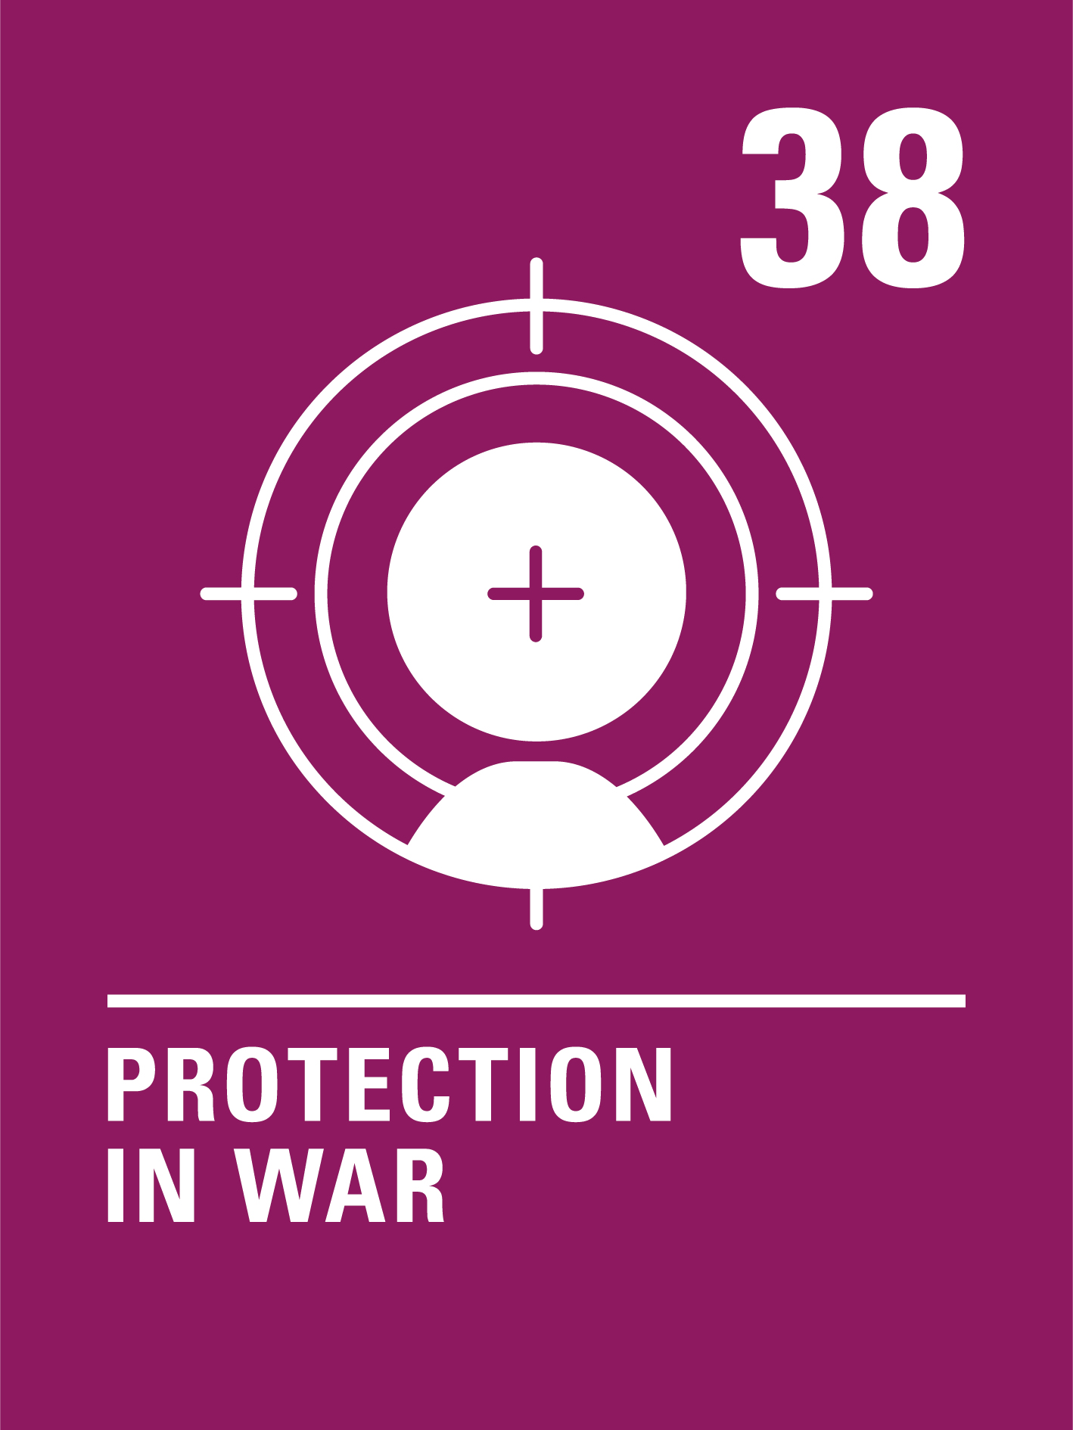
INTRODUCING ARTICLES 38 & 39
Article 38 Protection in War
Children have the right to be protected during war. No child under 15 can join the army or take part in war.
Article 39 Recovery and Reintegration
Children have the right to get help if they have been hurt, neglected, treated badly or affected by war, so that they can get back their health and dignity.

Slide 7
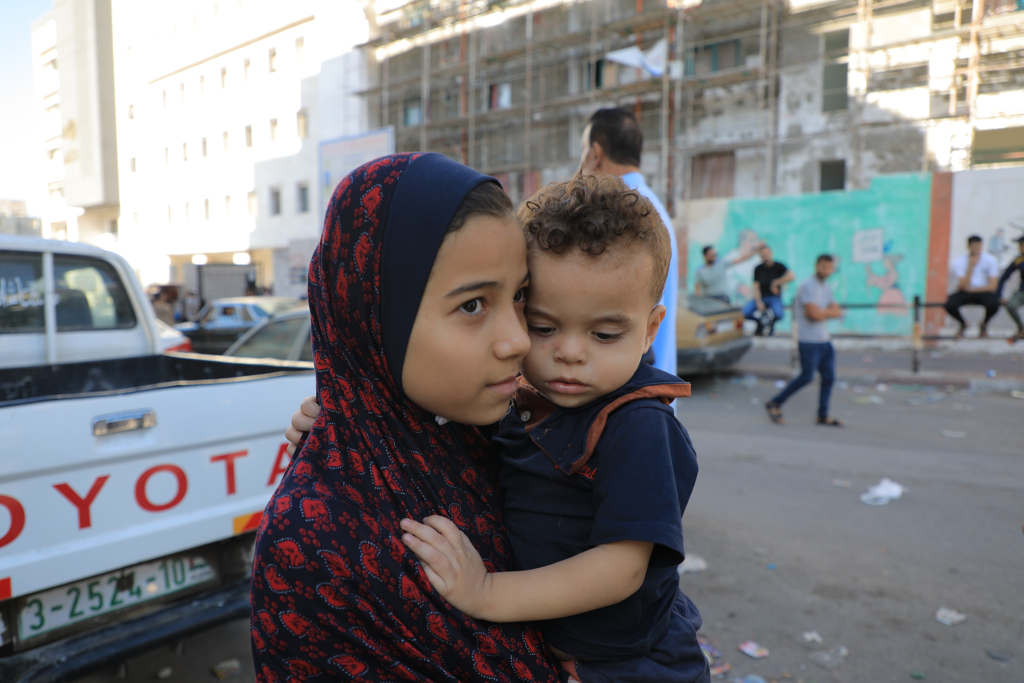
EXPLORING ARTICLES 38 & 39
Why do you think children should be protected during war?
Write down suggestions and compare your answers with the next slide.
UNICEF/UNI456105
Notes:
October 2023: Children evacuate their residences in northern Gaza on foot and by cars, seeking refuge in the southern region.

Slide 8
Did you think of these?
War impacts children’s ability to enjoy their rights.
War is dangerous. You can be seriously injured or killed and participation in war can have a life-long impact on a person. It’s wrong to make children and young people take part in wars, particularly if they are forced to do so.
Adults make wars happen, why should innocent children be affected?
If children see fighting and war as the answer to problems this may affect their whole lives.
They may be too young to understand what the war is about.
Adults choose to join the armed forces as a profession, and they receive training and support to do their work. Child soldiers are often coerced or forced to take part and receive no training or support.
They are still growing and may not have the physical or emotional maturity to cope.
What else did you think of?

Slide 9
ACTIVITIES FOR THE CLASSROOM
Listen to Nicola Davis read her book The Day War Came about a child’s experience of war. What difficult things does the child experience? When they arrive in a new place what helps them to leave war behind?
When something bad has happened to someone, it is important that they feel safe. Think about where you feel safe. Draw a picture of your safe place and share it with a friend. Create a cosy corner in your classroom where people can go to feel safe and secure.
If there was peace all over the world, all children would be safe from war. That’s one of the goals of the United Nations. Design a poster to promote peace. You could include why war is so dangerous for children and emphasise that children have the right to be protected in war.

Slide 10
ACTIVITIES FOR THE CLASSROOM
Have you read any story books that show what living through war might be like for a child? Look at the Convention on the Rights of the Child and discuss the possible impact of war on children - what rights might be affected?
Learn about peacebuilding through Minecraft! The Minecraft Peacebuilders Game is inspired by the Nobel Peace Prize and the lives of 4 Nobel Laureates.
Watch Poems for Peace and listen to children and young people living in conflict using poetry to call for peace. While you watch, pick out a line or a phrase that really sticks in your mind. Use it to help you create a poem of your own about peace.

Slide 11
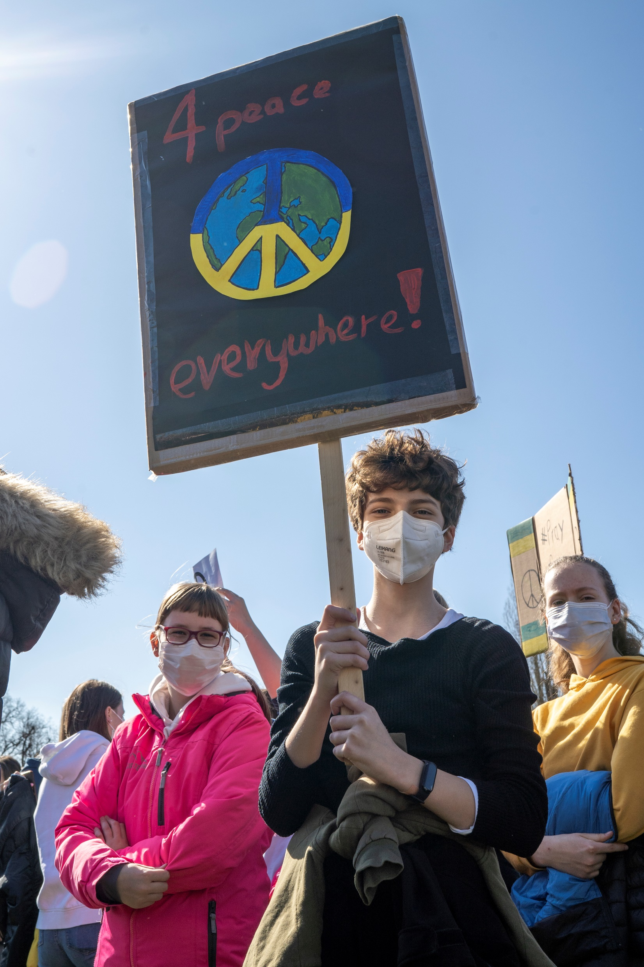
REFLECTION
You may like to reflect as a class or in an assembly…
When there is war and conflict we often try to think of peace.
What makes you feel peaceful and calm?
How can your thoughts, words and actions bring a sense of peace to your friends and family?
What does it take to be a peace maker?
© UNICEF/UN0621897
Notes:
In April 2022, volunteer Liza plays with a young child in the children's activity room in a UNICEF Blue Dot in Romania.
The Blue Dots safe spaces, protection and support hubs, established jointly with UNHCR and partners, provide practical support and information to children and families in their onward journeys. Blue Dots also provide specialist support for those in need of protection, such as children traveling on their own, women with young children, persons with disabilities or survivors of sexual violence. Child-friendly spaces offer a welcoming space for kids to rest, play, and simply be a child at a time when their world has been turned upside down in fear and they are facing the trauma of leaving friends, family and all that is familiar to them.

Slide 12
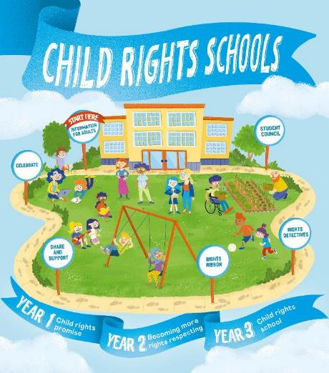
FURTHER CHILD RIGHTS EDUCATION SUPPORT
Child Rights Schools is a programme that supports you to embed child rights across the primary school.
Children are supported to express their views through the Student Council.
Find out more here.
Find more classroom resources here.

Slide 13
THANK YOU

