Slide 1
ARTICLE IN FOCUS
UNICEF/UNI0585528
Notes:
In October 2021, Derik and Geovani take a selfie on the main square of Guatemala city before an activity to raise awareness about climate change

Slide 2
BEFORE YOU BEGIN
This is a flexible resource and is intended to provide you with some easy to use, appropriate rights-related learning to share with your children, their families and your colleagues.
Please edit out non relevant slides or activities before sharing with your students. Please check that the content works for your learners and feel free to adapt or add any content that would make the material more relevant for your setting.
This resource was developed by UNICEF UK and adapted by UNICEF Ireland.
Slide 3 – Guess the Article
Slide 4 – Introducing Article 16
Slide 5 – Exploring the Article
Slides 6 – Some Possible Answers
Slide 7,8,9 – Activities for the classroom
Slide 10 – Reflection
Slide 11– Further Support

Slide 3
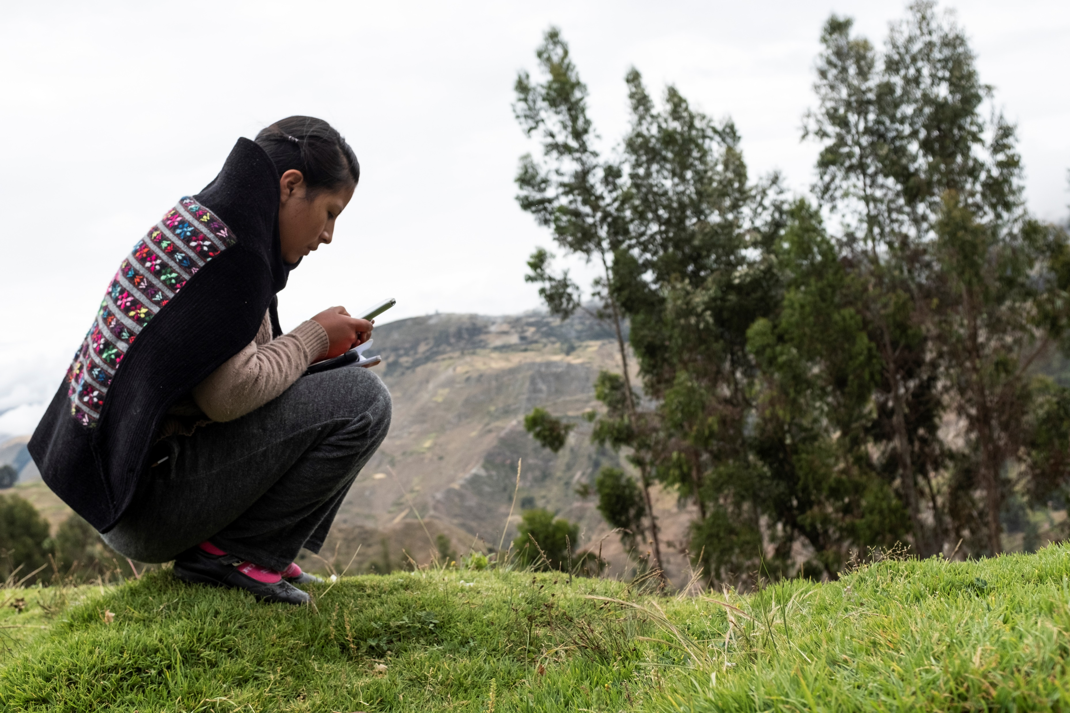
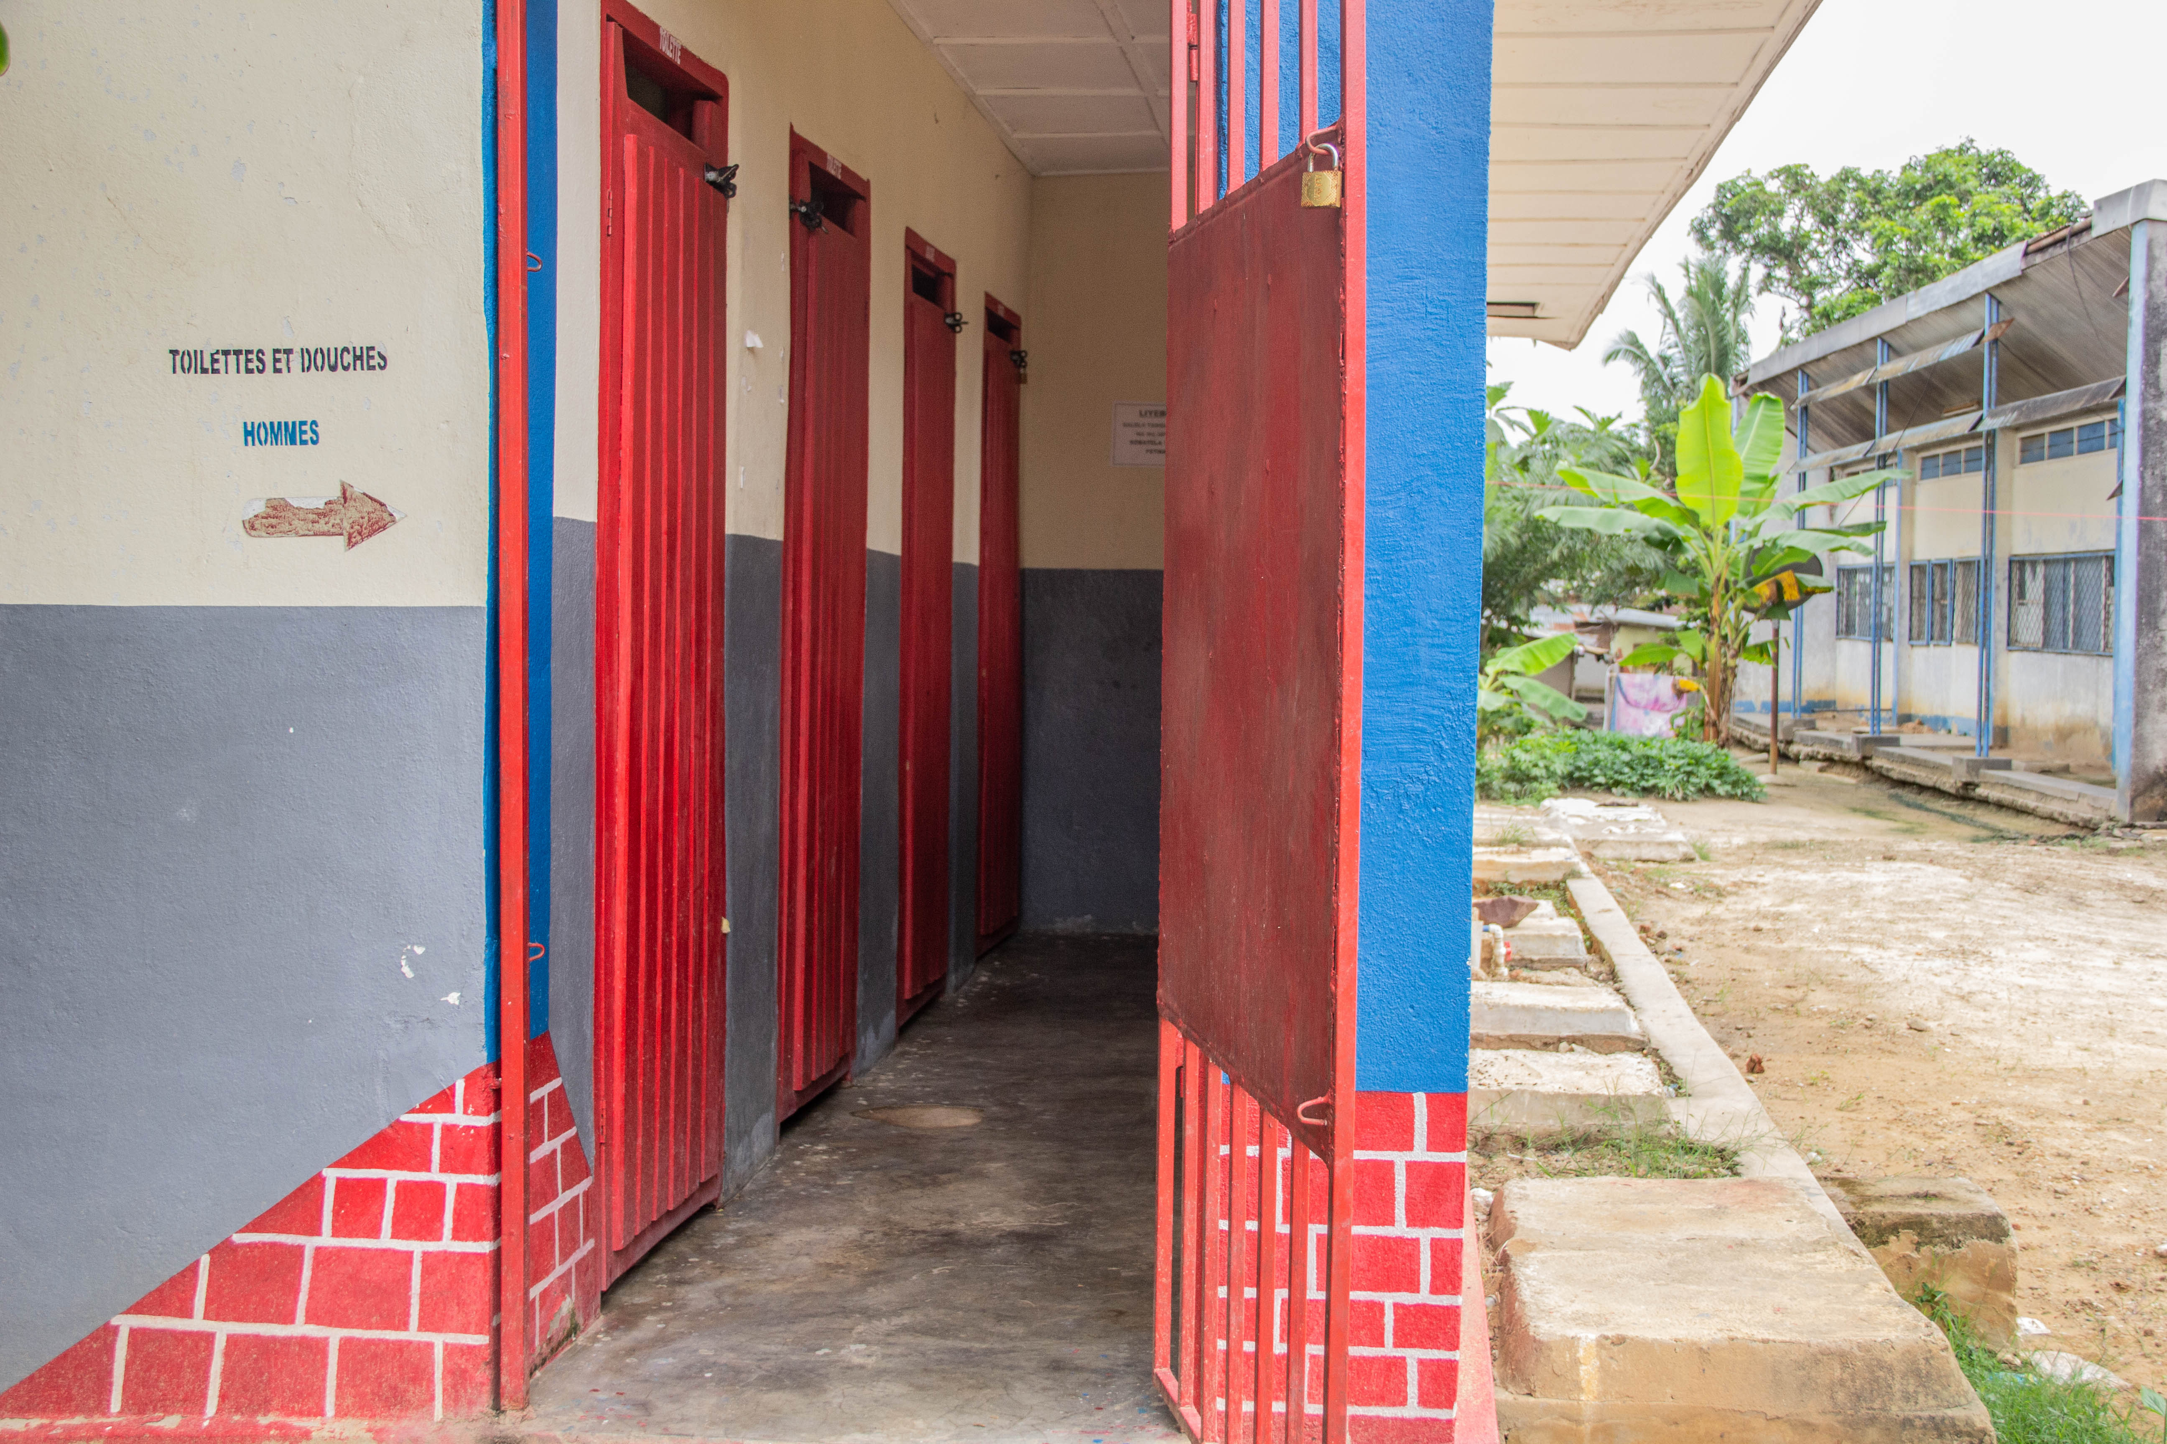
GUESS THE ARTICLE
These pictures provide a clue to this week’s article.
How do these pictures help you? Can you guess how they are linked together?
Write down your thoughts or discuss with someone in your class.
UNICEF/UN0749676
UNICEF/UN0642548
UNICEF/UN0679881
Notes:
In October 2022 in Pokotylivka, Kharkivska Region, Ukraine, Doctor Kateryna Kushiova (left), 27, talks with Daryna, 23, as part of a general medical consultation.
UNICEF carries out the social mobilization and fundraising campaign “Mission Possible” for Education” to make visible the challenges of education in Peru; pictured here is Elizabeth, a teenager from the Huancavelica region.
UNICEF has built latrines and showers at the Mangobo General Referral Hospital in Tshopo Province of the Democratice Republic of the Congo with support from USAID.

Slide 4
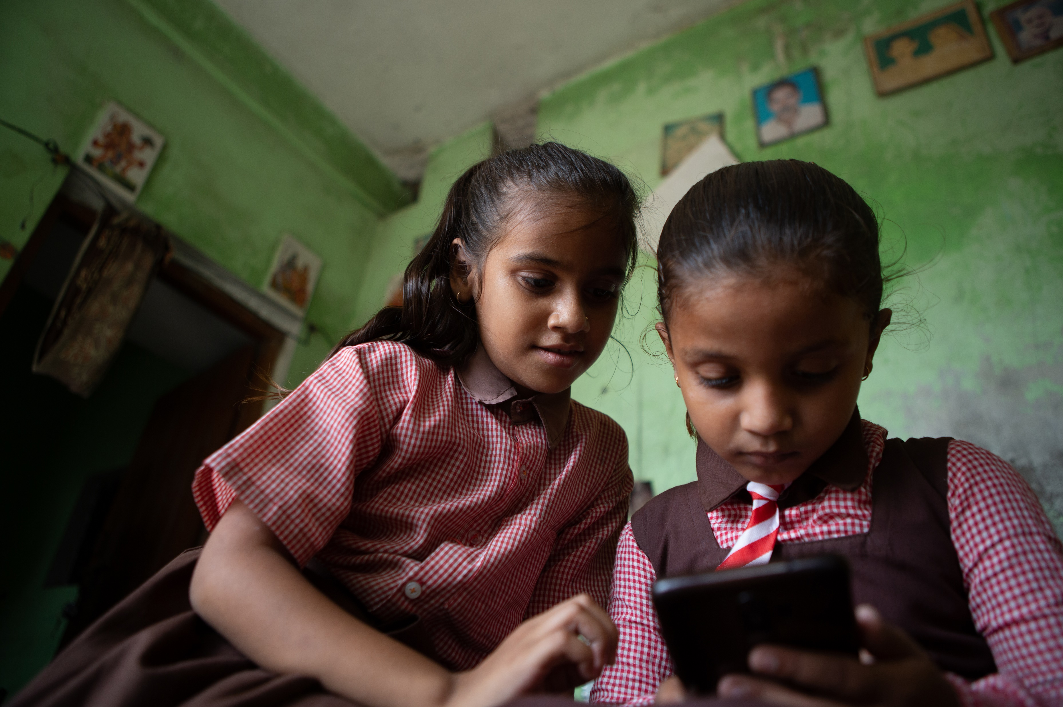
ARTICLE 16 – Right to Privacy
UNICEF/UN0657546
Article 16: Every child has the right to privacy. The law should protect the child’s private, family and home life, including protecting children from unlawful attacks that harm their reputation.
Notes:
Ayushi and Ankita, both 8 years old, study in the same class in Uttar Pradesh, India. They play a game of Ludo on Ankita’s mobile phone.

Slide 5
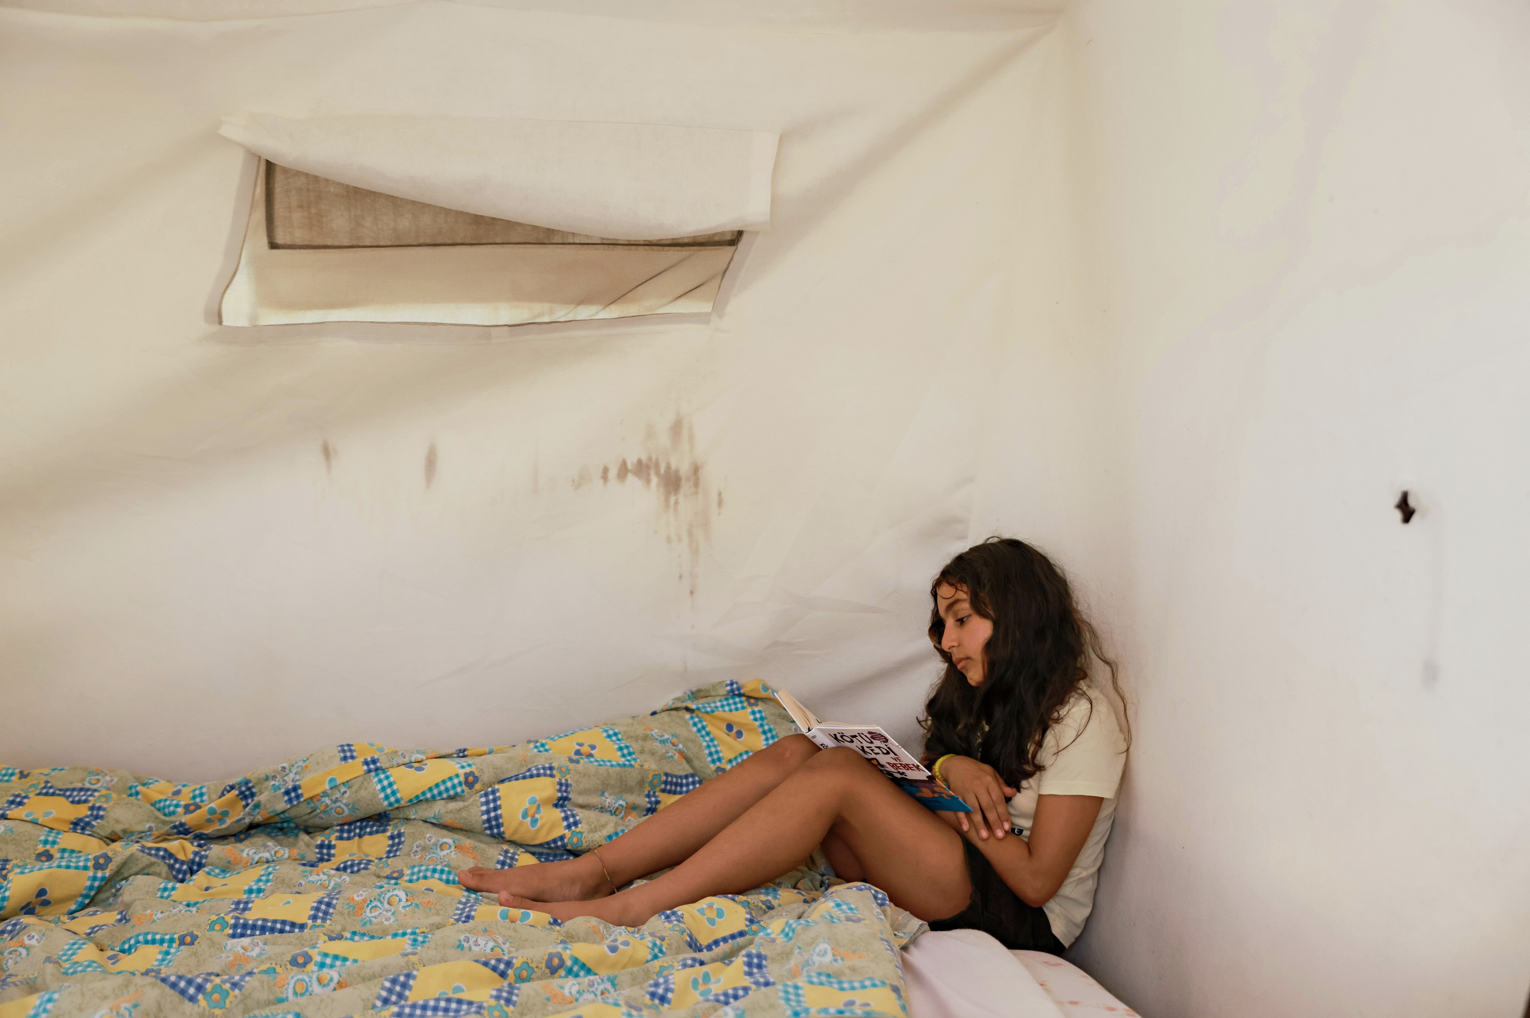
EXPLORING ARTICLE 16
Why is privacy important to you/for children?
Have a think and write down some answers.
UNICEF/UNI452158
Notes:
On 24 September 2023, Sidra (10) reads a book in one of the tents her extended family now live in along with two containers, in the garden of her grandparents’ destroyed home in Antakya, Hatay, Türkiye. The extended family’s homes were destroyed by the devastating earthquakes that struck southern Türkiye and Syria in February.

Slide 6
EXPLORING ARTICLE 16
Did you think of these?
Not everyone should know everything about me.
It helps me to have personal space.
It helps to keep me safe online and in the real world.
Children are at risk of being harmed if the wrong people know too much about them.
Things about identity, location, health and personal life, are private to me.
I should be able to record my thoughts and feelings without others looking at them.
People might judge me or make assumptions about me.
People might not understand me for who I am.
I should be able to choose the right time to share and with whom.
What else did you think of?

Slide 7
ACTIVITIES FOR THE CLASSROOM
You do not need to complete every activity but if you have time, you can try to complete more than one.
Can you design a special box to keep your special things in? How would people know it belonged to you and know not to look in it without asking? You might use your design to decorate a shoe box or other empty box
Listen to “Stop Think Check – The Online Safety Code” and think about how we can keep our personal information private in the real and digital worlds!
Listen to “My Body has a Bubble” by Nell Harris and use to explore the concept of personal space (could link in with (Stay Safe lessons)
Open up the conversation about privacy for younger children by reading a traditional fairy tale like Goldilocks or Cinderella. Think about how the right to privacy was affected by what happens in the stories; for example, how would the three bears feel about a stranger coming into their house when they were not there?

Slide 8
ACTIVITIES FOR THE CLASSROOM
You do not need to complete every activity but if you have time, you can try to complete more than one.
How is the right to privacy supported in your school? Discuss in your class how privacy is respected in your school and if more could be done. You might ask your principal to follow up any suggestions..
Imagine this: While playing you grab your friend’s phone as a joke and look at their photos. Is this a funny joke or is it going against their rights?
Funny joke
Rights Violation
You have the right to privacy. Think about a two-year-old, a 10-year-old and a 16-year-old. What are the similarities and differences in the types of privacy that should be respected at these ages?
Watch this video about privacy online. Use this as a starting point for a class discussion.

Slide 9
ACTIVITIES FOR THE CLASSROOM
You do not need to complete every activity but if you have time, you can try to complete more than one.
CLASH!
Children’s rights exist to ensure children’s survival, protection, development and full participation in society. But what happens when rights conflict with one another??
Before I go to sleep at night I have to give my phone to my mother. She says she doesn’t want me to stay up too late but I know better. She secretly reads my messages. It really annoys me.
DISCUSS:
I admit I look at Emma’s phone, but not because I don’t trust her – I want to protect her. I want to know who she’s in contact with and to make sure she’s not being bullied like a few years ago.
Which rights are conflicting here? (Check out the child-friendly poster of the UN CRC)
Emma, 13
Who do you agree with – Emma or Emma’s mother? Why?
Emma’s mother
How can Emma and her mother resolve this without violating any rights?
Exercise from “Know Your Rights” Student Workbook developed by UNICEF

Slide 10
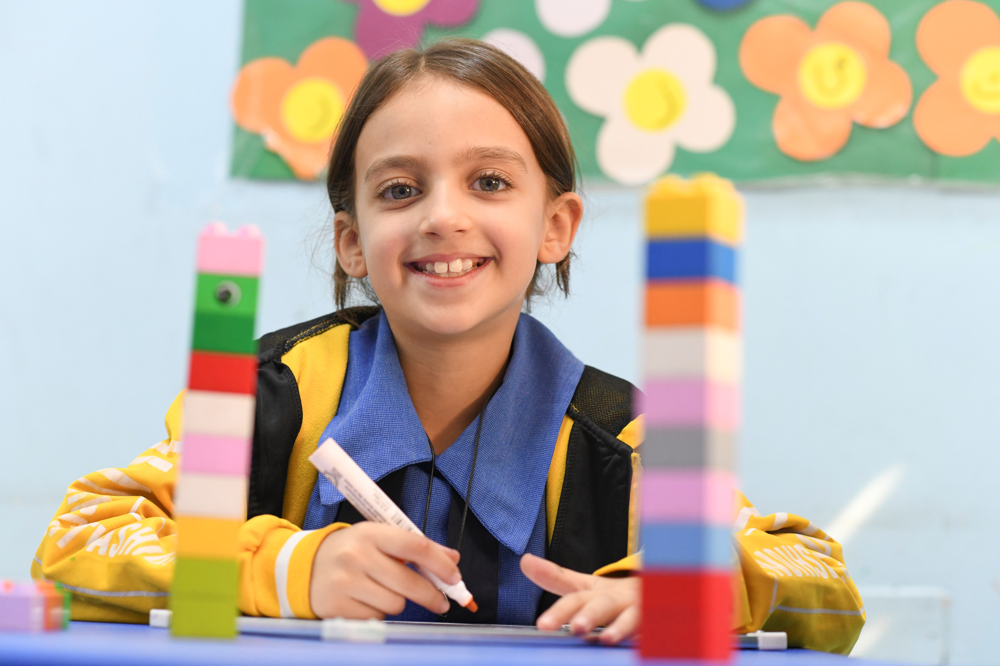
REFLECTION
Give yourself some time and space – a moment of privacy!
Have a think about the following questions:
What do you do in your school/home/community to respect each other’s right to privacy?
What other rights are connected to the right to privacy?
UNICEF/UNI500680
Notes:
Mariam, 8, is in second grade and is a Syrian refugee. She lives with her parents and two siblings in Amman. She attends her local UNICEF-supported Makani centre in Amman where she received integrated services including learning support and child protection (2023).

Slide 11
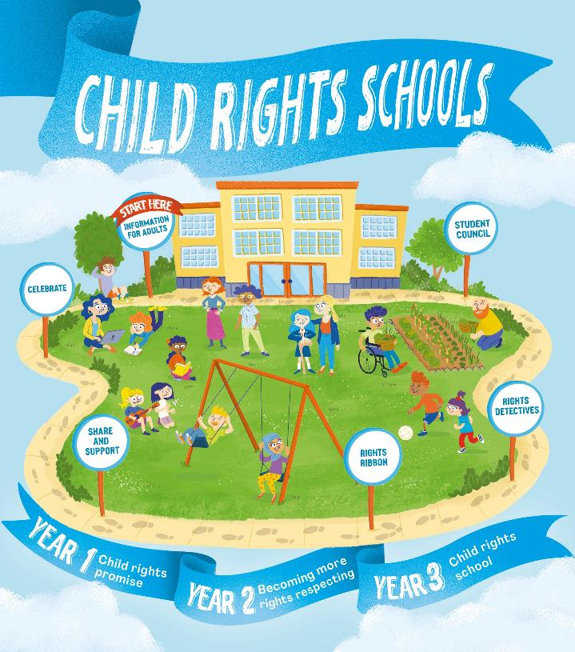
FURTHER CHILD RIGHTS EDUCATION SUPPORT
Child Rights Schools is a programme that supports you to embed child rights across the whole school community, including with parents and carers. Find our more here.
Find more classroom resources here.

Slide 12
THANK YOU!
UNICEF/UNI471950
Notes:
Diba (16), student of SMAN 112 Jakarta, West Jakarta, browses on her mobile phone in front of her classroom.

