Slide 1
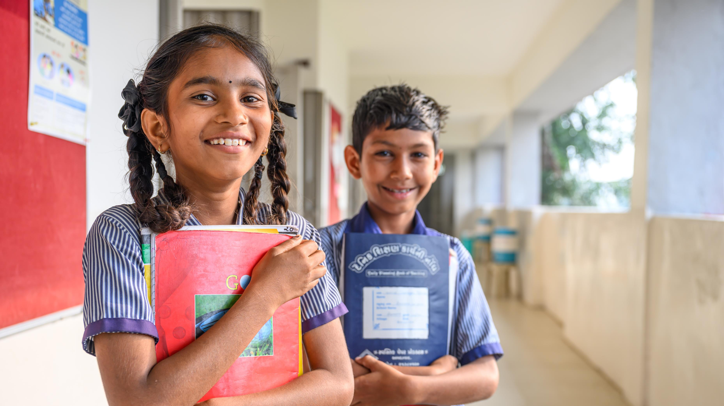
ARTICLE OF THE WEEK
UNICEF/UNI489332
Notes:
Kids at Tentalav Primary school in Gujarat, India.

Slide 2
BEFORE YOU BEGIN
This is a flexible resource and is intended to provide you with some easy to use, appropriate rights-related learning to share with your children, their families and your colleagues.
Please edit out non relevant slides or activities before sharing with your students. Please check that the content works for your learners and feel free to adapt or add any content that would make the material more relevant for your setting.
This resource was developed by UNICEF UK and adapted by UNICEF Ireland.
Slide 3 – Guess the Article
Slide 4 – Introducing Article 29
Slide 5 – Exploring the Article
Slides 6 – Some Possible Answers
Slide 7,8,9 – Activities for the classroom
Slide 10 – Reflection
Slide 11– Further Support

Slide 3
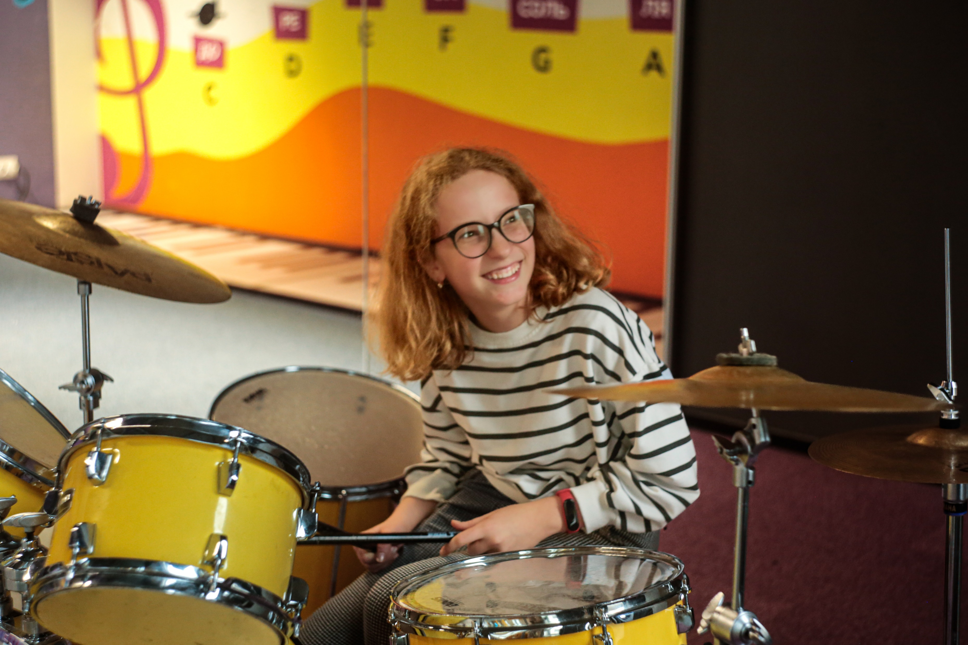
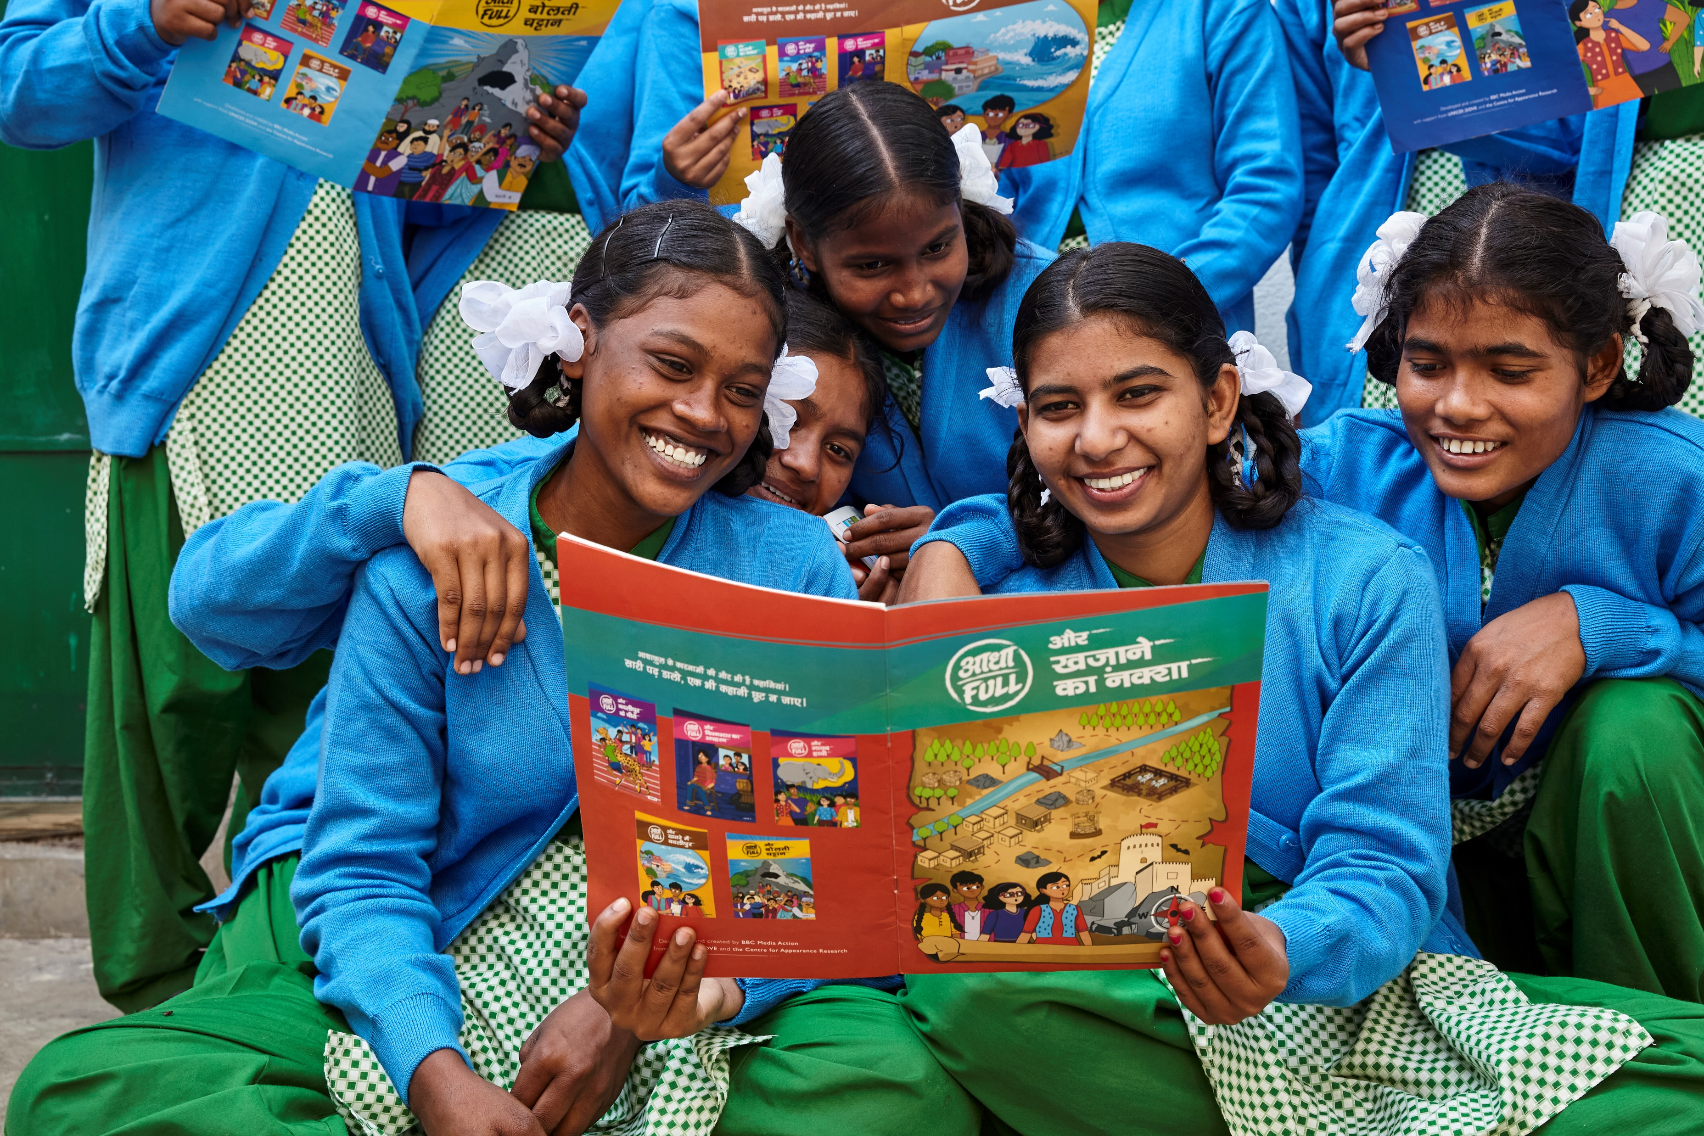
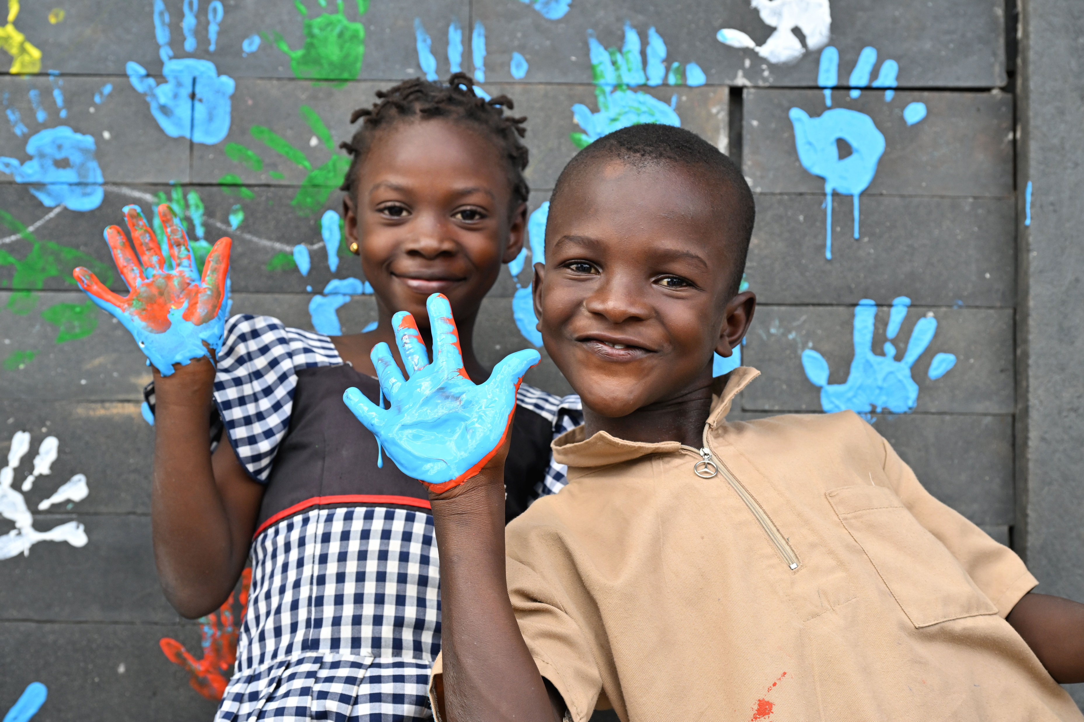
GUESS THE ARTICLE
UNICEF/UNI484700
UNICEF/UNI496296
UNICEF/UNI479648
These pictures provide a clue to this week’s articles.
How do these pictures help you? Can you guess how they are linked together?
Write down your thoughts or discuss with someone in your class.
Notes:
Twelve-year-old Tetiana is enjoying her time at the science museum in Lviv
Students reading comic books as part of their life skills program at the Kasturba Gandhi Balika Vidyalaya, West Singhbhum, Sadar, Jharkhand, India
Children painting their school made out of recycled plastic bricks, in Tiassalé, in the South of Cote d’Ivoire

Slide 4
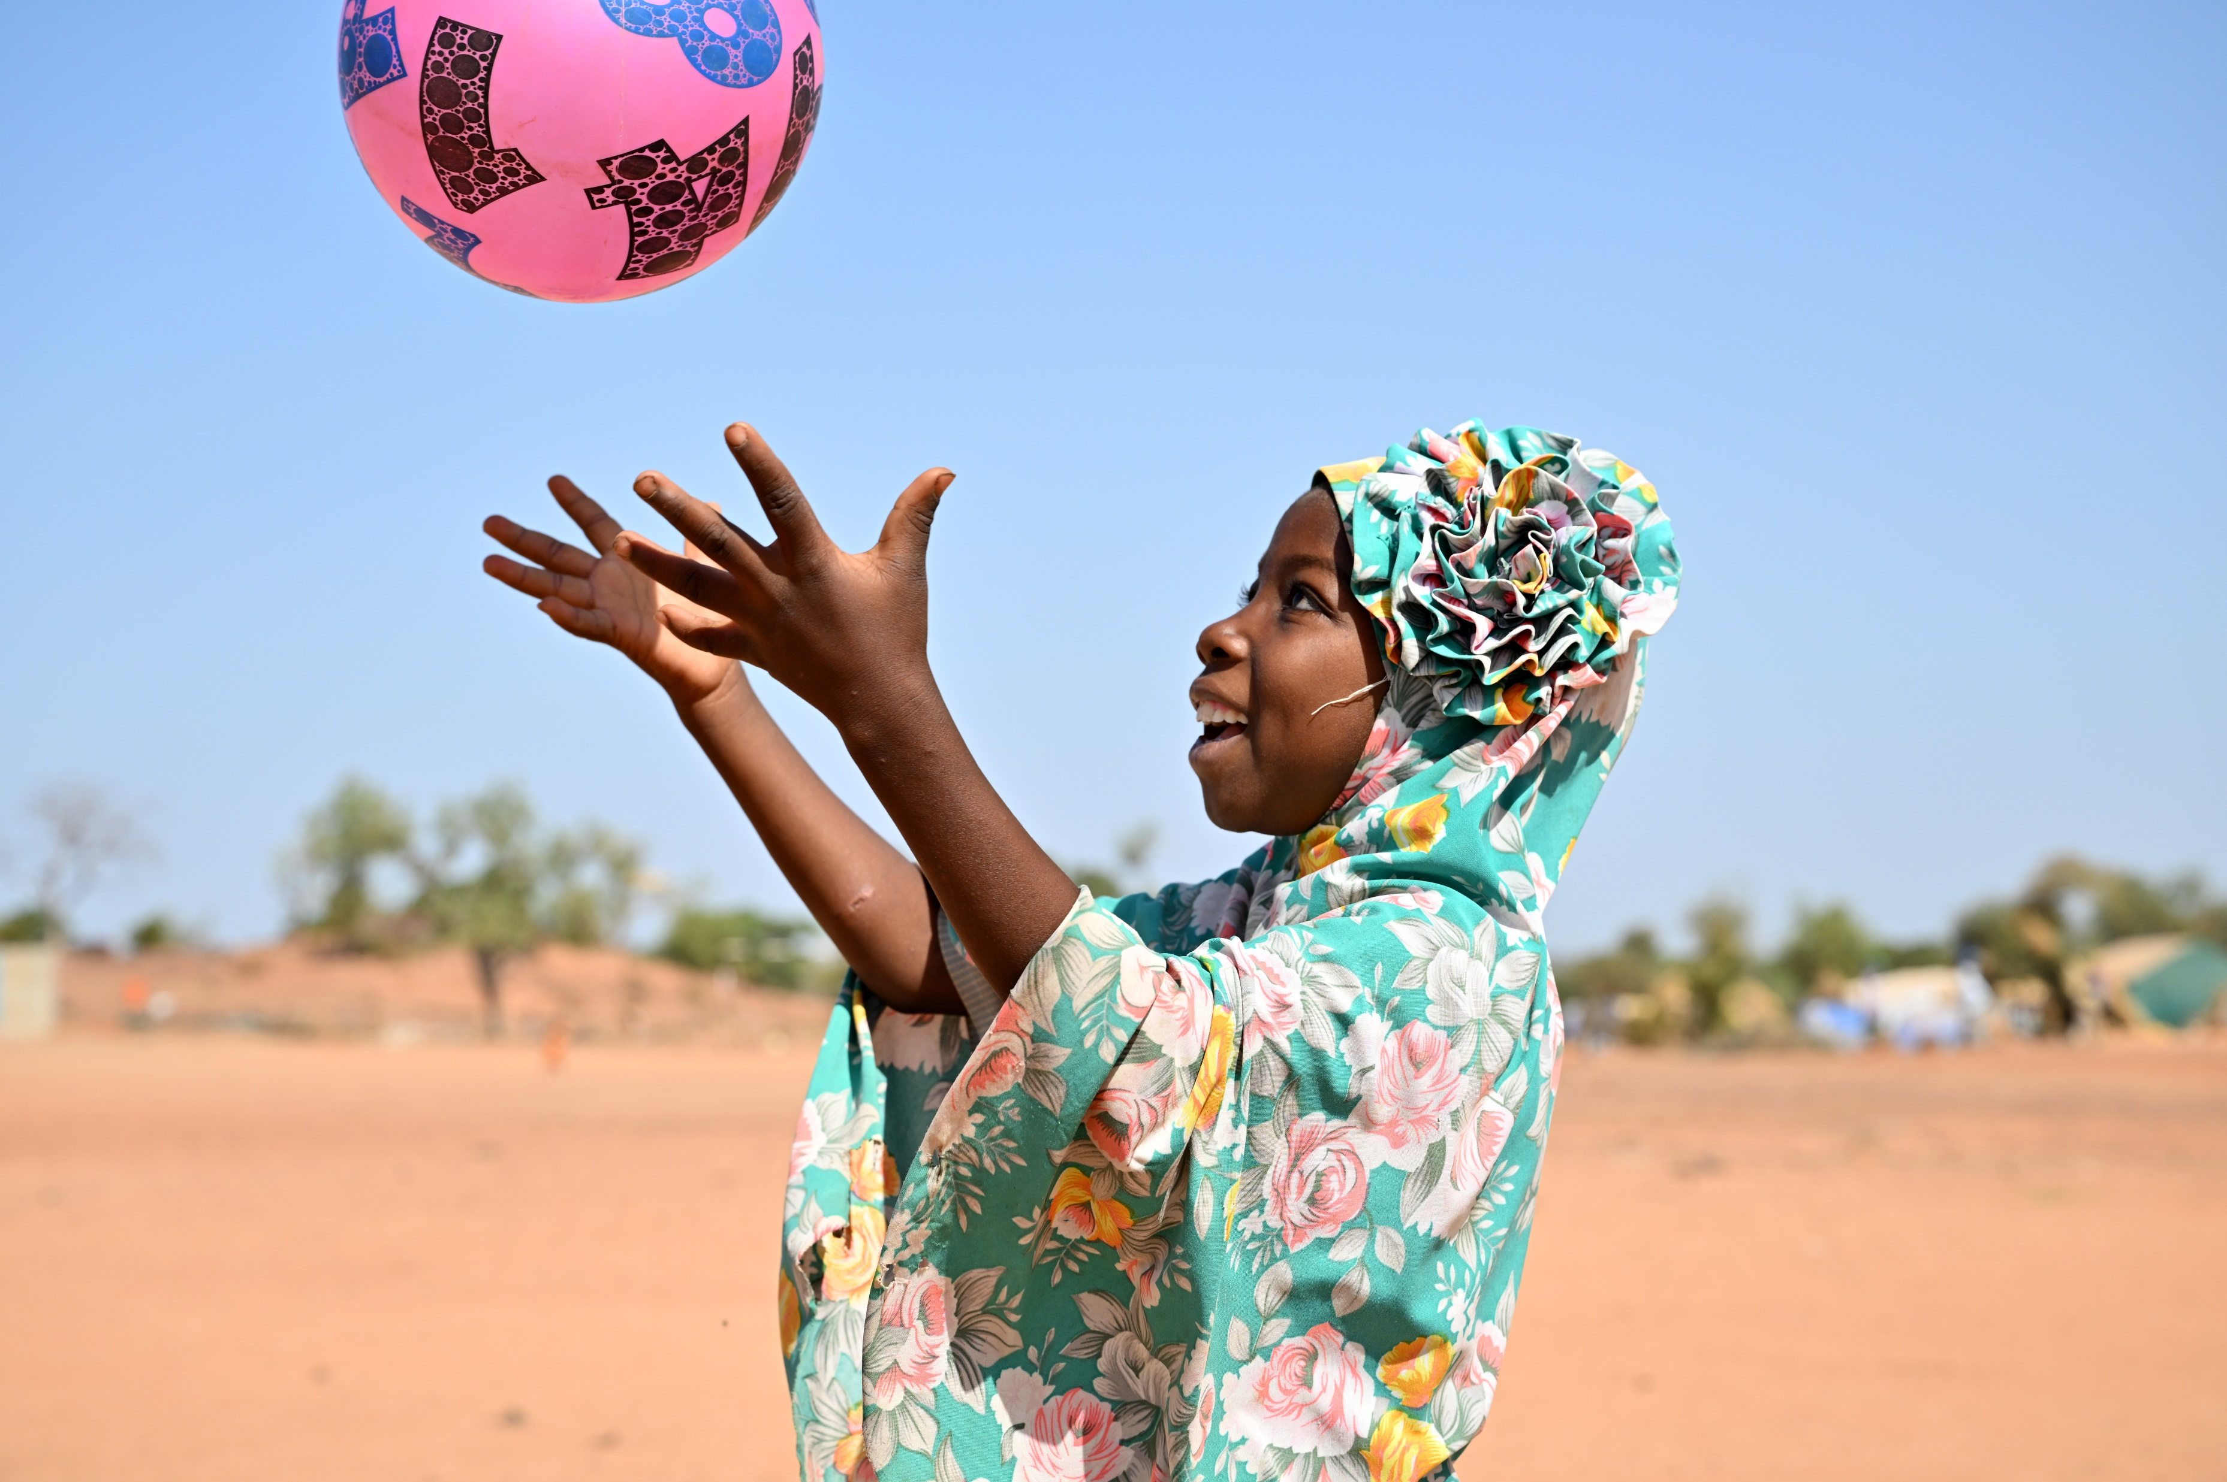
ARTICLE 29 – AIMS OF EDUCATION
UNICEF/UNI486305
Article 29: Education must develop every child’s personality, talents and abilities to the full. It must encourage the child’s respect for human rights, as well as respect for their parents, their own and other cultures, and the environment.
Notes:
A girl playing at the Child Friendly Space of Fada N’gourma, in the east of Burkina Faso, 2023.

Slide 5
EXPLORING ARTICLE 29
How can education support you to develop your personality, talents and abilities?
Have a think and write down some answers.
Notes:
A science museum in Lviv, Ukraine is helping to rekindle children’s love of learning through new interactive exhibits, bridging an educational gap caused by nearly two years of war and disrupted face-to-face education, October 2023.

Slide 6
EXPLORING ARTICLE 29
Did you think of these?
Support health and wellbeing
Understanding human rights
Provide a safe space
Treating you as an individual
Learning about different careers
Providing access to music, art and sports
Giving you a voice
Encourage friendships
Trips
Residentials
Outdoor learning
Clubs
What else did you think of?

Slide 7
ACTIVITIES FOR THE CLASSROOM
You do not need to complete every activity but if you have time, you can try to complete more than one.
Which of the hobbies or activities in this video do you enjoy? What other hobbies can you think of? Make a list of all the hobbies that people in your class do.
Work with a partner or small group. Talk about the things that you think each person is really good at or has a special talent for. Consider making a ‘Talent Tree’ for your class with each person’s picture on a leaf with their talents on the other side.
Watch and listen to this story. What new activity would you like to try? How might you get started? Share your ideas with a partner or your class.

Slide 8
ACTIVITIES FOR THE CLASSROOM
You do not need to complete every activity but if you have time, you can try to complete more than one.
Article 29 talks about developing talents, but what is talent? Take a look at this Sport Scotland video discussing the role of talent in sport and work with a partner to decide on your top tips for how to develop a talent.
Article 29 includes developing respect for human rights. How does your school community show that this is an important part of your education?
Article 29 says that education should develop your personality, abilities and talents. Look up these words and discuss their meaning as a class. Create a drawing or write a poem or story to show some of your abilities and talents or an aspect of your personality.
Read The Dot by Peter H Reynolds. At the start of the story Vashti feels like she isn’t very good at art. Can you think of a time where you have found something difficult but you have kept trying until it becomes easier or is there something you wish you could be better at? Share with a friend and make a plan.

Slide 9
ACTIVITIES FOR THE CLASSROOM
You do not need to complete every activity but if you have time, you can try to complete more than one.
Article 29 says we should learn about how to respect our environment – in this video, children talk about the importance of nature and what they’ve been doing to raise awareness. Upload your own tree picture to the digital forest and explore what your school does to be nature positive!
Article 29 says that children should be encouraged to respect their own and other cultures. How do you celebrate different cultures at your school? Create a display showing how this happens at your school and talk about why this is important.
Carry out a survey in your class to find out what the most popular hobbies and interests are. How can your school help people to enjoy their favourite things to do? How can your school celebrate everyone’s talents? Share your ideas with your school council.
Read the SEAI’s “Climate SOS”, a thrilling adventure about climate change with great ideas about how you can get involved in climate action (ar fáil as Gaeilge freisin!) Then checkout their Creative Illustration Workshop to make your own climate comic strip!

Slide 10
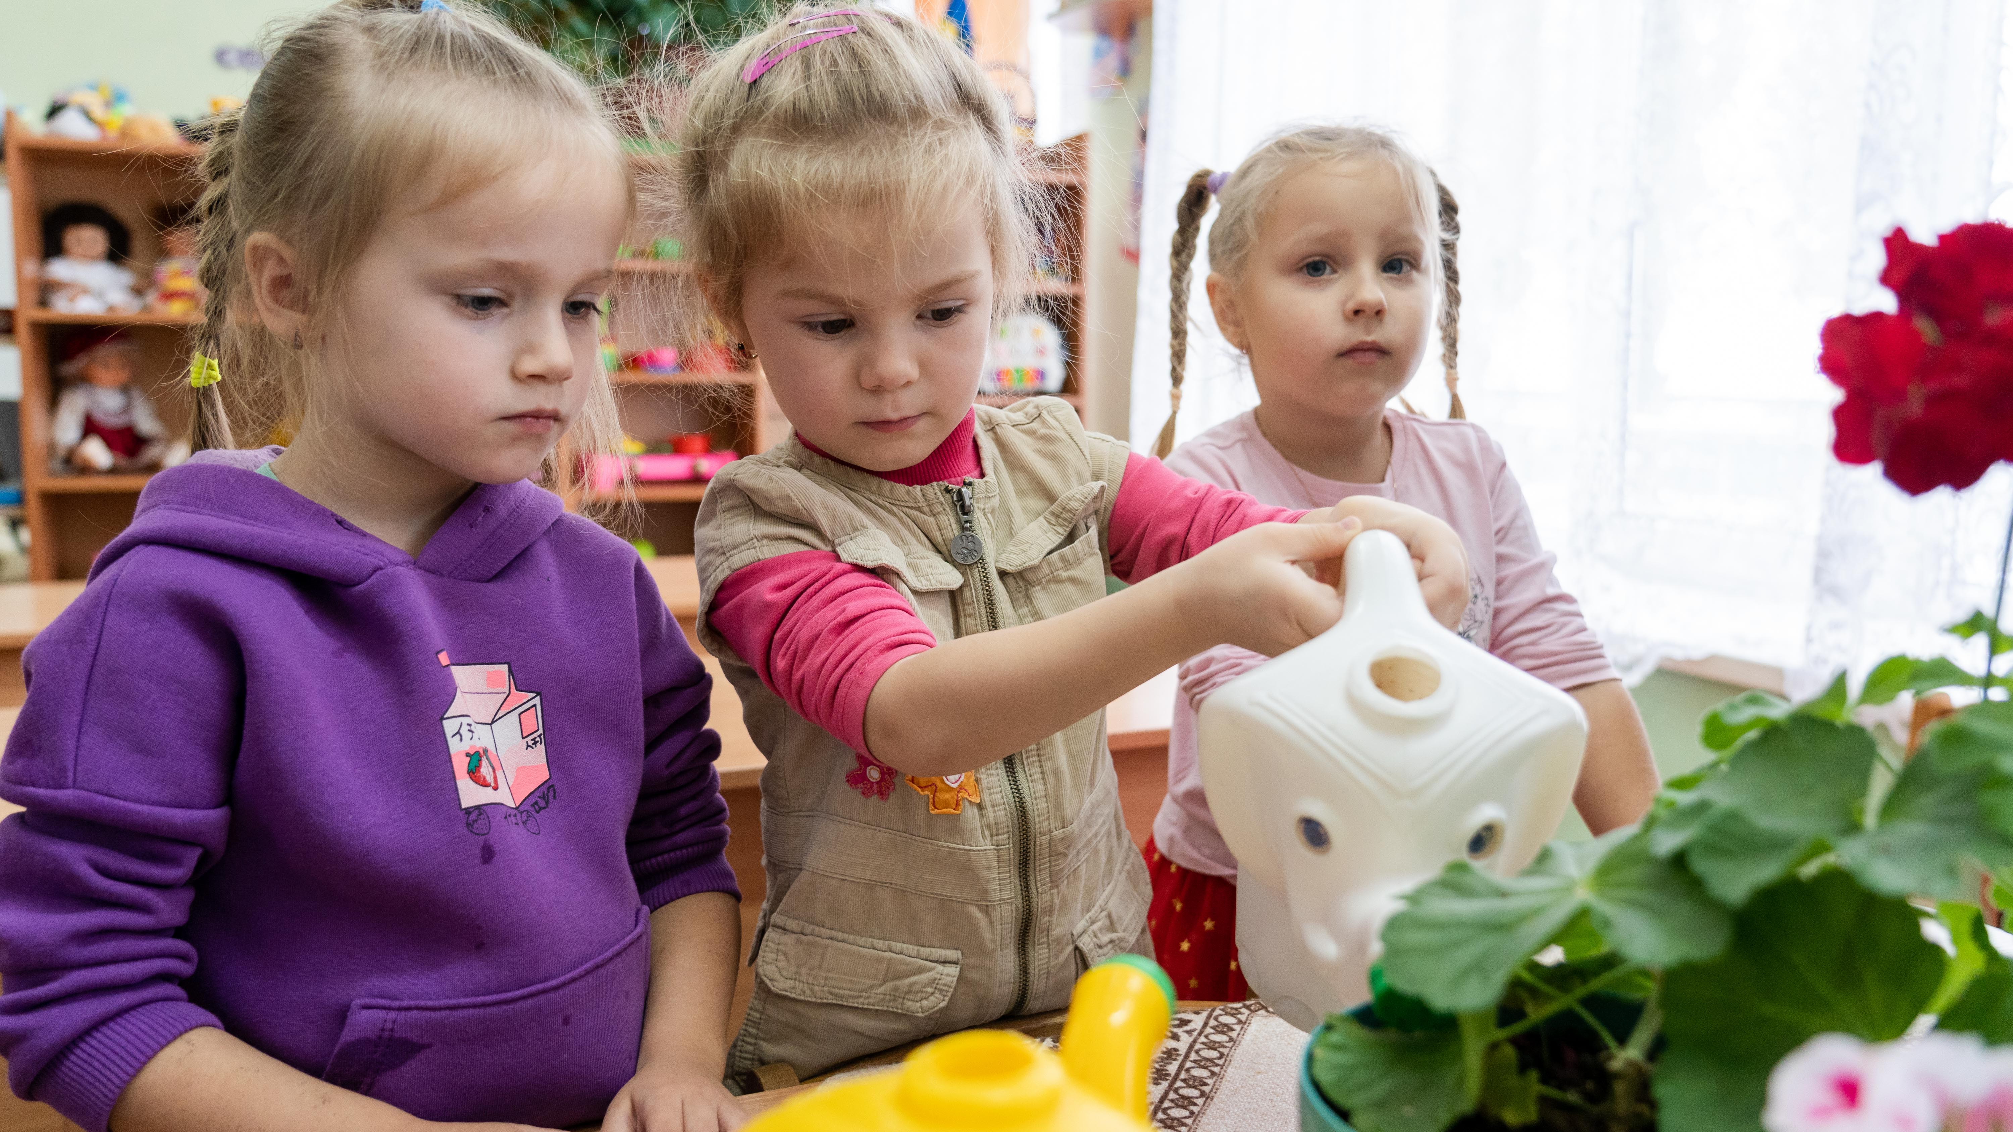
REFLECTION
Article 29 speaks of your talents and abilities - how can you develop these?
Who can help you? What might help you?
How can you help a friend or family member to develop and become the best person they can be?
UNICEF/UNI497935
Notes:
November 22, 2023, Vasylkiv, Ukraine. Every day children at the preschool interact with water: in addition to hygienic procedures, they are shown how to water flowers.

Slide 11
FURTHER CHILD RIGHTS EDUCATION SUPPORT
Child Rights Schools is a programme that supports you to embed child rights across the whole school community, including with parents and carers. Find our more here.
Find more classroom resources here.

Slide 12
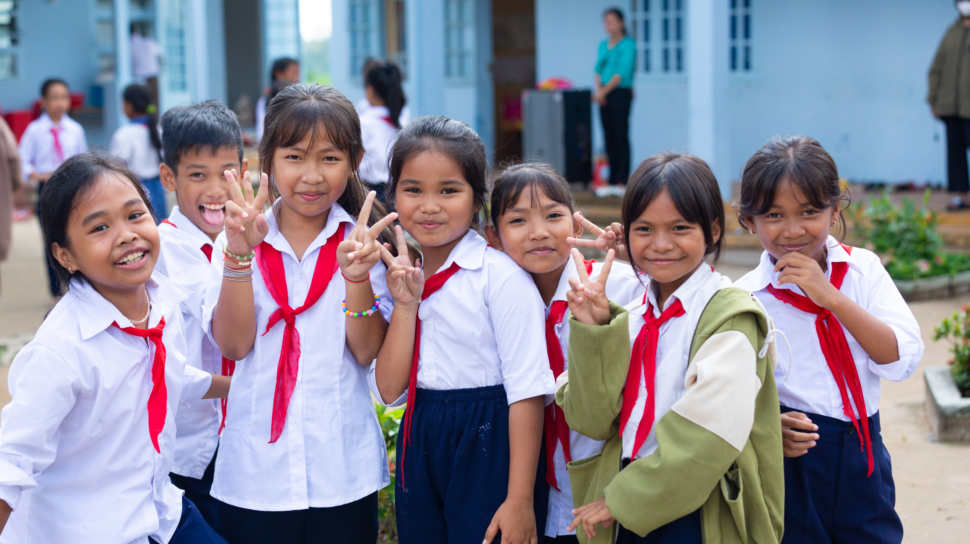
THANK YOU!
UNICEF/UNI497503
Notes:
Students of Long Phu C primary school where UNICEF implement the Climate Smart School Initiative to tackle the effects of climate change on education and provides students with essential adaptation, green skills and green lifestyle; Viet Nam 2023.

