Slide 1
ARTICLE IN FOCUS
UNICEF/UNI0509120
Notes:
December 14, 2023, Zaporizhzhia, Ukraine; a girl is studying at the computer at the Digital Learning Center, established by UNICEF

Slide 2
BEFORE YOU BEGIN
This is a flexible resource and is intended to provide you with some easy to use, appropriate rights-related learning to share with your children, their families and your colleagues.
Please edit out non relevant slides or activities before sharing with your students. Please check that the content works for your learners and feel free to adapt or add any content that would make the material more relevant for your setting.
This resource was developed by UNICEF UK and adapted by UNICEF Ireland.
Slide 3 – Safer Internet Day
Slide 4 – Linked Articles
Slide 5 – Exploring Safer Internet Day
Slides 6 – Some Possible Answers
Slide 7,8,9 – Activities for the classroom
Slide 10 – Reflection
Slide 11– Further Support

Slide 3
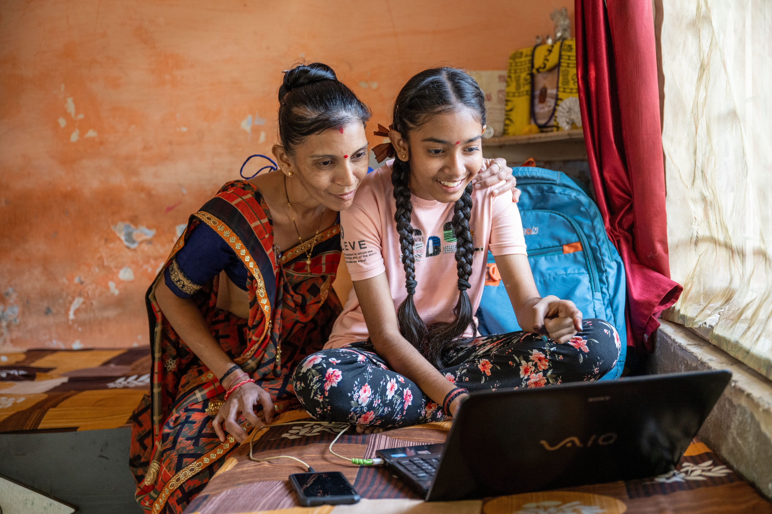
Safer Internet Day- Tuesday 6th February
We all have a right to feel safe and secure, including when we are online. Safer Internet Day is an annual event that promotes the safe, responsible and positive use of the internet.
Many articles of the Convention connect with being online. This week’s activities have a particular focus on Article 19 (the right to protection from harm), Article 17 (the right to reliable information), and Article 34 (protection from exploitation).
The internet can be a great place but needs to be used carefully. Please use these activities to start the conversation about internet issues that matter to you, what changes you would like to see and how we can make the internet a more positive and rights respecting place!
UNICEF/UNI490386
Notes:
Harshita Rawal (14 years) undetakes the P2E program at home and school.Her family is happy to see the changes in her.

Slide 4
LINKED ARTICLES
This week’s activities link to the following articles:
Article 19: Protection from violence, abuse and neglect. Governments must do all they can to ensure that children are protected from all forms of violence, abuse, neglect and bad treatment by their parents or anyone else who looks after them.
Article 17: Access to information from the media. Every child has the right to reliable information from a variety of sources and governments should encourage the media to provide information that children can understand. Governments must help protect children from materials that could harm them.
Article 34: Protection From Sexual Abuse. Governments must protect children from forms of sexual abuse and exploitation.

Slide 5
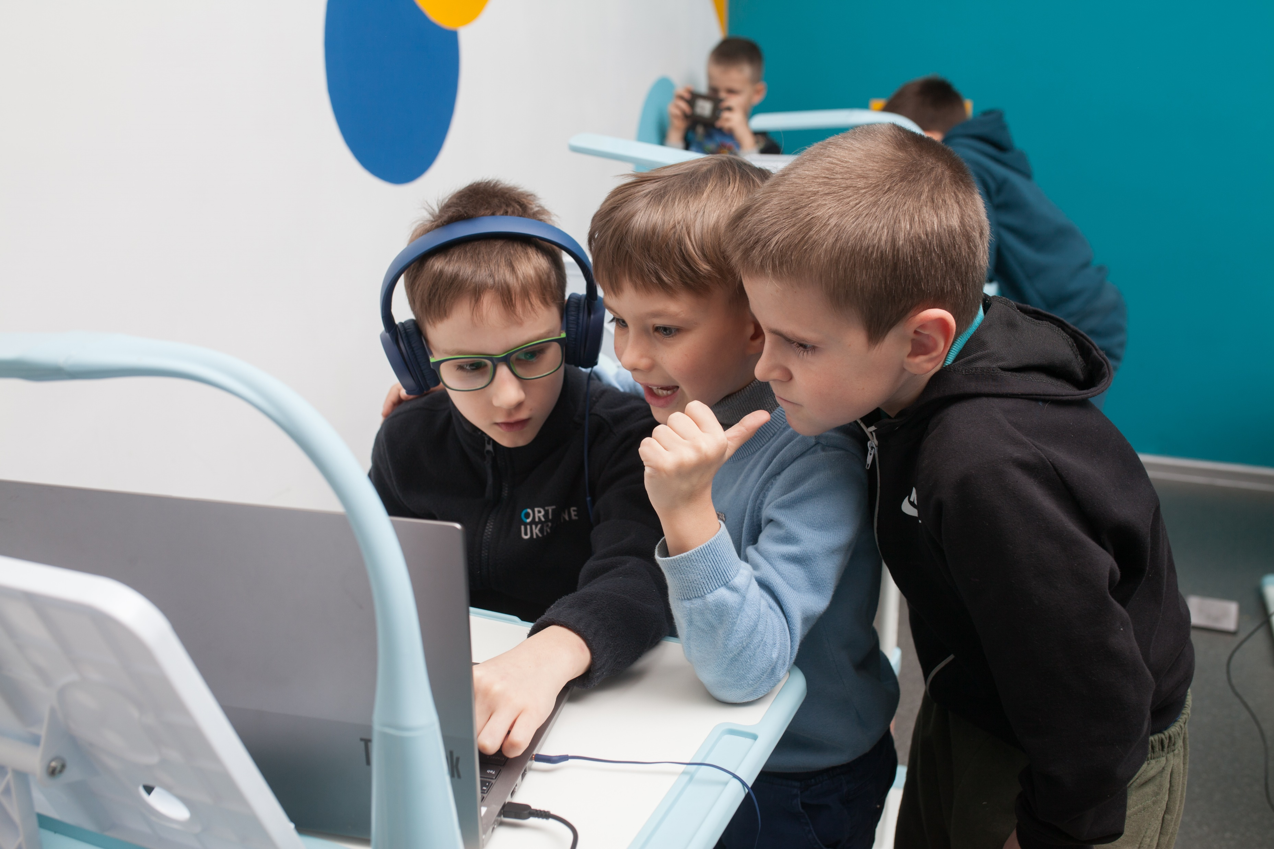
EXPLORING SAFER INTERNET DAY
What do you feel are some of the great things about the internet and life online?
What don’t you like about the internet and life online?
Write down some ideas, or discuss them in a group and then compare thoughts with the rest of the class.
UNICEF/UNI509138
Notes:
December 14, 2023, Zaporizhzhia, Ukraine: Three boys of school age are looking at the laptop at the at the Digital Learning Center, established by UNICEF.

Slide 6
EXPLORING SAFER INTERNET DAY
Great Things …
You can find out lots of information quickly and easily
You can connect with your friends even if you can’t meet face-to-face.
Learning is possible even if you haven’t got books at home or access to a library.
There are lots of fun games and activities to do online.
You can keep in touch with family and friends who live far away.
It can increase equality and democracy because more people can have their voices heard.
You can shop and bank online which is good for people who are busy, not near the shops or have mobility issues.
You can visit places remotely that you can’t get to in person.
It helps you find places in the car and people you want to contact with.
I don’t like it when …
People don’t respect each other and make unkind comments.
Children use it to bully other children.
People’s right to privacy is not always respected.
Some information is not reliable and there is a lot of fake news.
People are sometimes tricked out of money and savings.
Companies and businesses are hacked and your information can be shared without your consent.
I spend too much time online instead of doing other things.
People make fun of others because they don’t have the latest technology.
What else did you think of?

Slide 7
ACTIVITIES FOR THE CLASSROOM
You do not need to complete every activity but if you have time, you can try to complete more than one.
Have a discussion and perhaps create a display about safe play and friendship in the playground and safe play and friendship online. Remember every child has the right to be safe.
Listen to Chicken Clicking, introducing younger children to internet safety. What steps could Chick have taken to be safer online?
Read or listen to Smartie the Penguin, a story to share with younger children about how to stay safe online and the importance of talking to an adult if they are worried about something they see.
Draw a picture of your favourite online game or character. Discuss the sort of helpful message they might give to you and other children.
You could add these to the pictures as speech bubbles.
Notes:
https://www.youtube.com/watch?v=bRQgIbfGfTU

Slide 8
ACTIVITIES FOR THE CLASSROOM
You do not need to complete every activity but if you have time, you can try to complete more than one.
As a class take some time to talk about any worries you might have about the internet. Decide on some conversation guidelines that include listening respectfully and being supportive.
As part of your discussions decide on three things you will do as a group to address your worries.
You might know more about the internet than the adults who care for you. Think about talking through “The Internet Legends Code” with them so together you can stay safe online.
The Gardaí have developed with WebWise a programme called Be Kind Online. Watch Donal’s story and discuss what steps Donal and his classmates could take in this situation.
Your right to be safe and protected is always important, including when you use computers, phones and the internet. Can you think of three top tips for staying safe online? Use WebWise to help. Discuss this with adults in your house or share with your class.

Slide 9
ACTIVITIES FOR THE CLASSROOM
You do not need to complete every activity but if you have time, you can try to complete more than one.
All children have the right to reliable information and media, but increasingly we see stories, photos and videos online that are not accurate or real. Do you know how to spot them? Check out WebWise’s video on False News, and the explainer on “Deep Fakes”, and make your own video/poster informing other children about Article 17 and how can they check the information they are receiving.
Talk about how things might go wrong with friendships online.
Try to make up some examples and then work out ways of resolving or sorting out these difficulties. Remember some situations might require adult help.
Work as class to design an advice guide to share your ideas.
Are you an Internet Legend? Test your skills at navigating the internet safely by playing Interland, where you will explore security, privacy and respect on the internet.
Watch this video about safe and respectful relationships online and discuss its lessons. Could you make your own class version of the video or act out your own version for an assembly? The children in the video don’t mention their rights but you could!

Slide 10
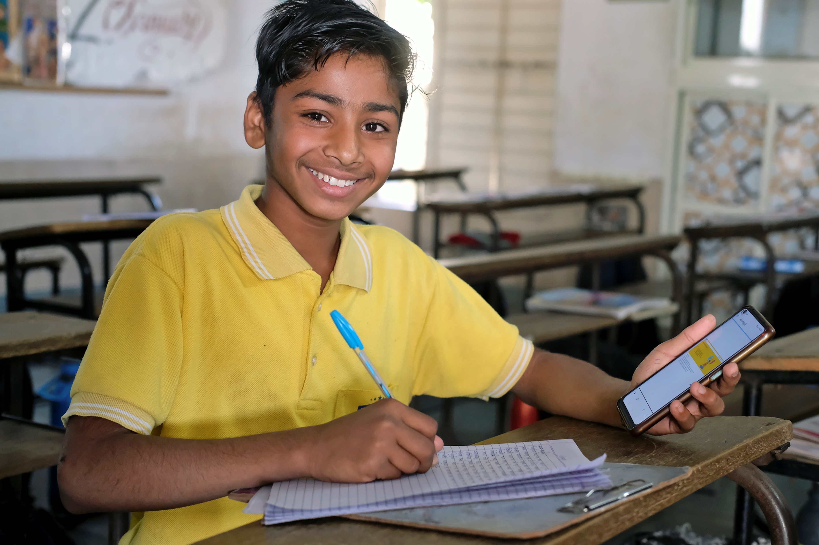
REFLECTION
Create some quiet time and find a safe and comfortable space.
Thinking about our lives online:
How can we make sure that the internet is a good place to talk?
What changes need to be made and who would you talk to if you had concerns about your own online life or someone else’s?
UN0771919
Notes:
14 year old Piyush.N. Prajapati an 8th class student at the Life Skill class.

Slide 11
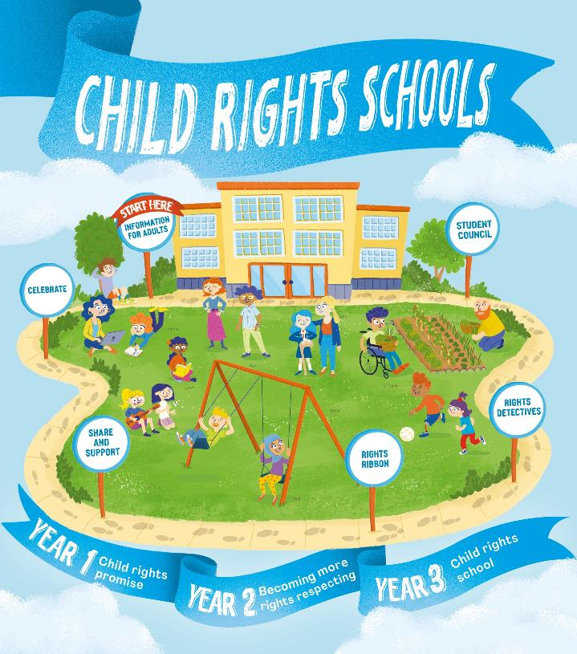
FURTHER CHILD RIGHTS EDUCATION SUPPORT
Child Rights Schools is a programme that supports you to embed child rights across the whole school community, including with parents and carers. Find our more here.
Find more classroom resources here.

Slide 12
THANK YOU!
UNICEF/UNI421587
Notes:
Lisa, 12 years old, has found solace and strength in Romania, amidst the challenges of being a Ukrainian refugee

