Slide 1
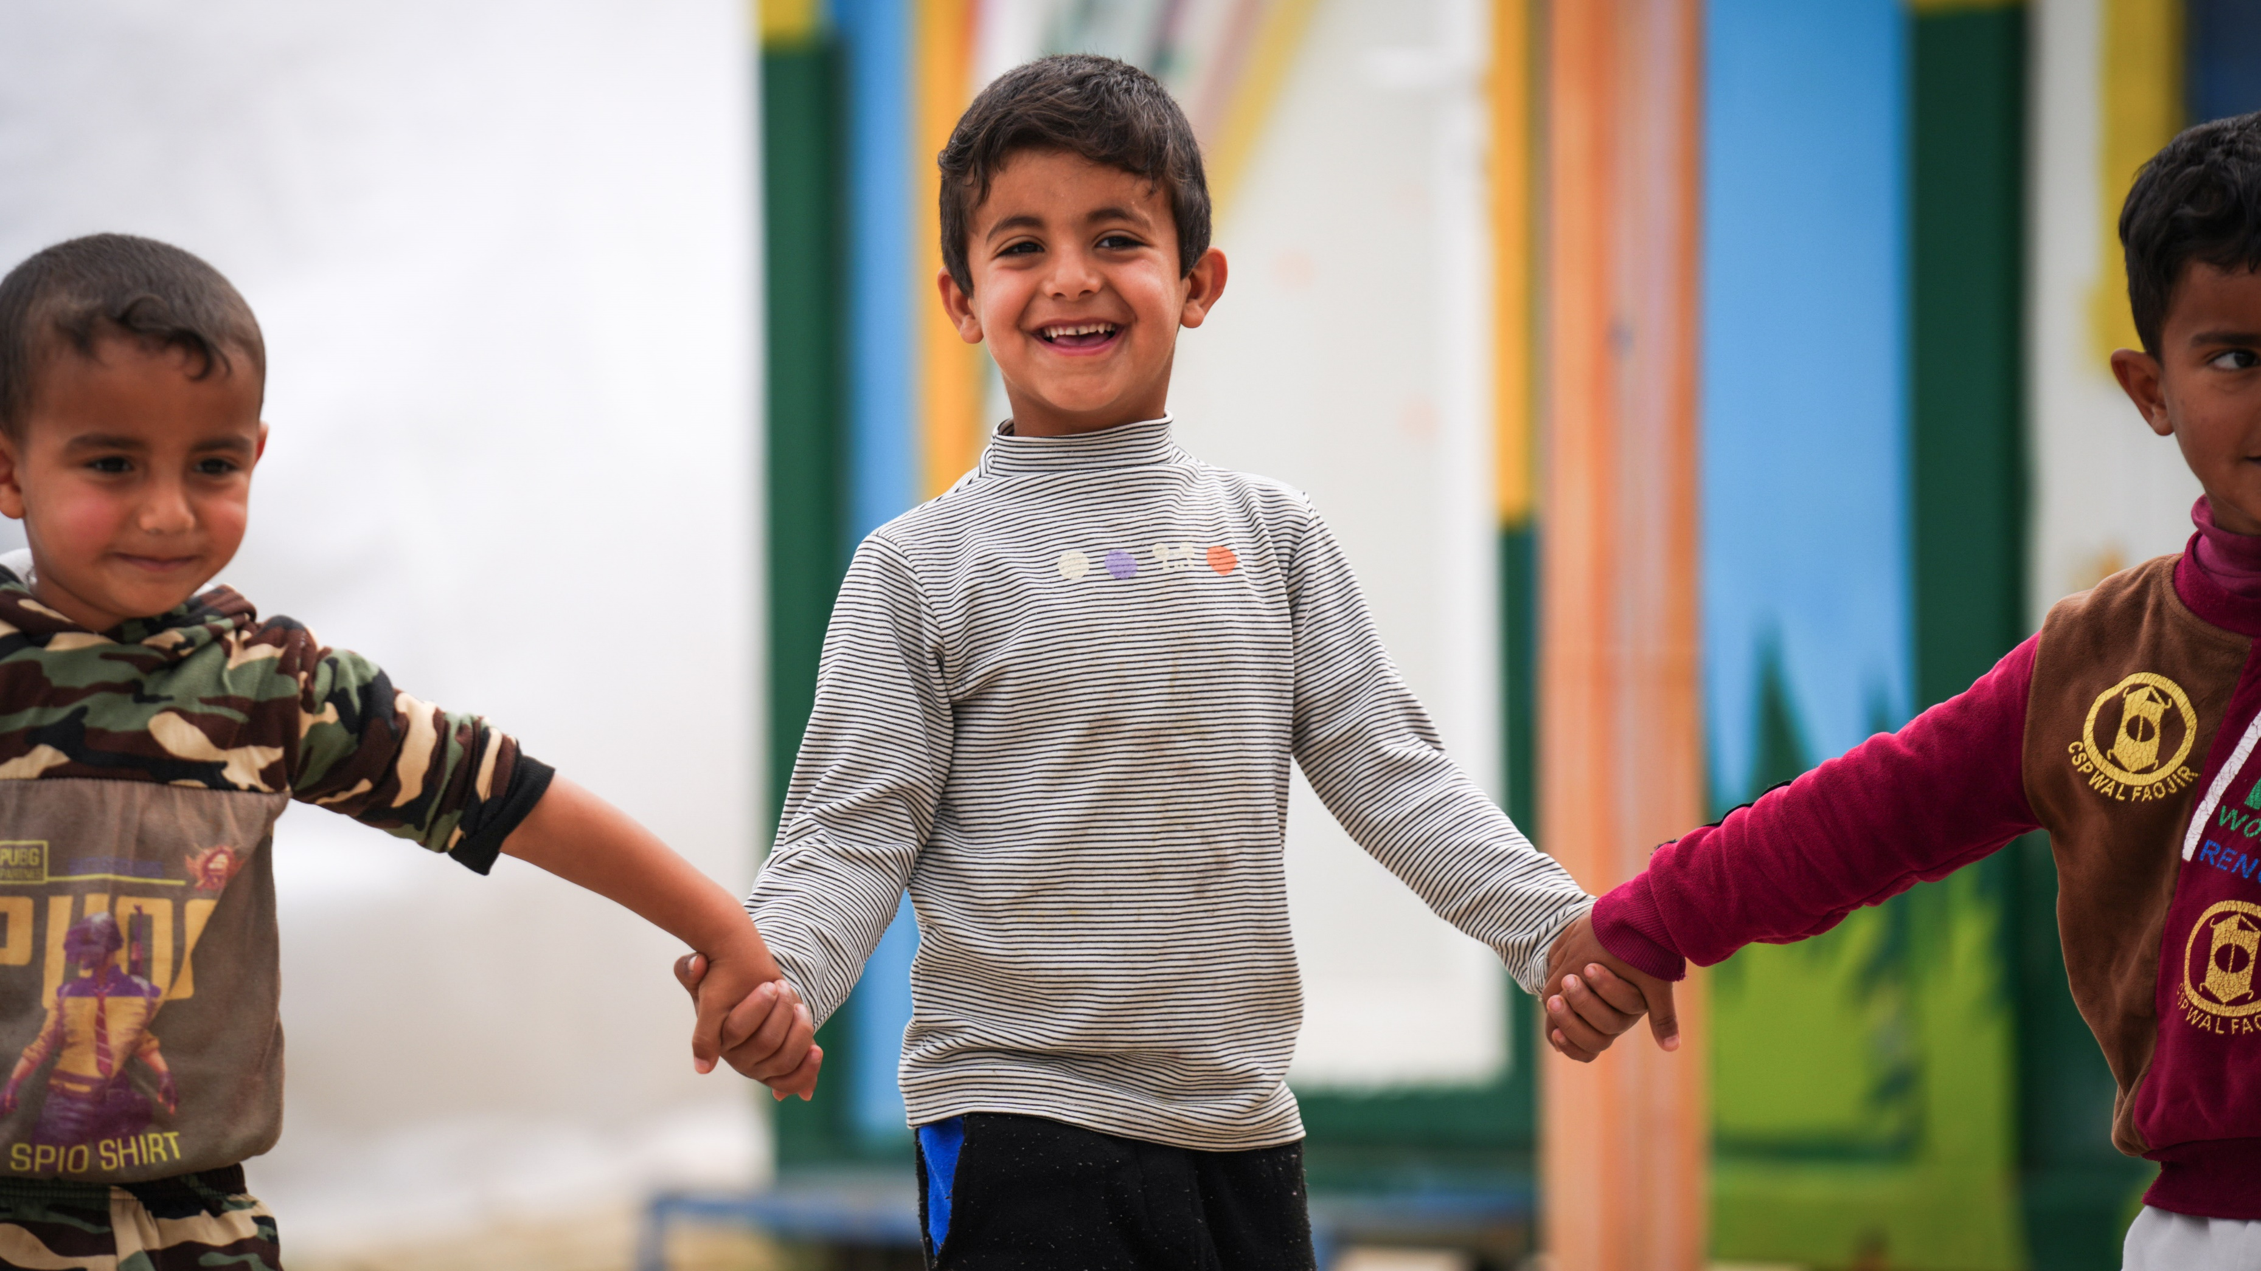
ARTICLE IN FOCUS
UNICEF/UNI549995
Notes:
Iraq, 2024. The camp is located in Debaga, housing 1,253 families or 6,558 individuals. Educational programs, supported by UNICEF and funded by ECHO, focus on both formal and non-formal learning through teacher training, school environment improvements, and catch-up classes, benefiting 1,200 girls and 900 boys in two temporary learning spaces

Slide 2
BEFORE YOU BEGIN
This is a flexible resource and is intended to provide you with some easy to use, appropriate rights-related learning to share with your children, their families and your colleagues.
Please edit out non relevant slides or activities before sharing with your students. Please check that the content works for your learners and feel free to adapt or add any content that would make the material more relevant for your setting.
This resource was developed by UNICEF UK and adapted by UNICEF Ireland.
Slide 3 – Guess the Article
Slide 4 – Introducing Articles 32 & 35
Slide 5 – Exploring the Article
Slides 6 – Some Possible Answers
Slide 7,8,9 – Activities for the classroom
Slide 10 – Reflection
Slide 11– Further Support

Slide 3
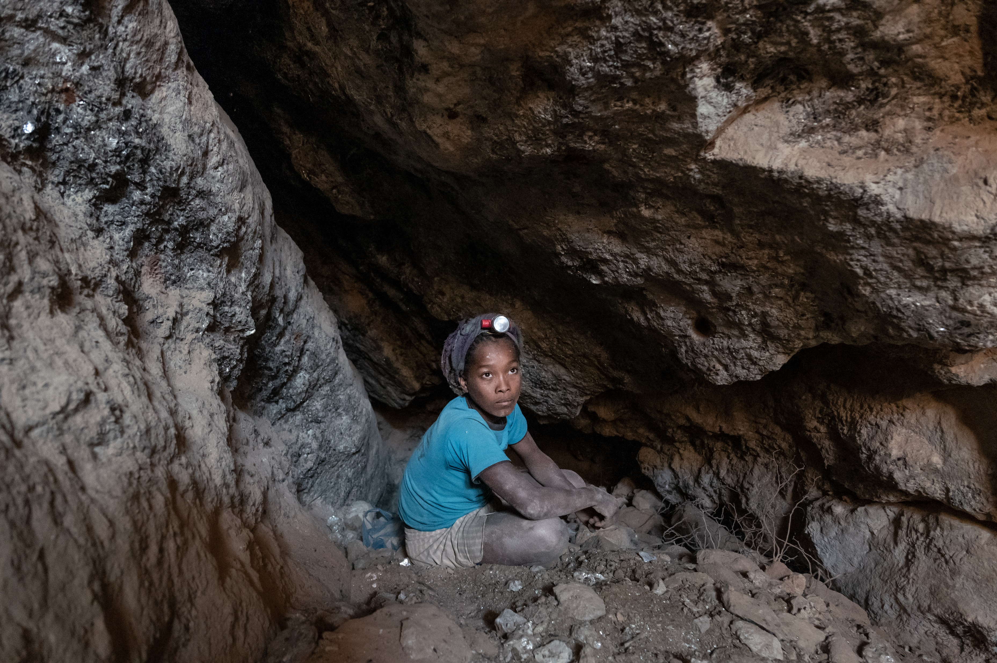
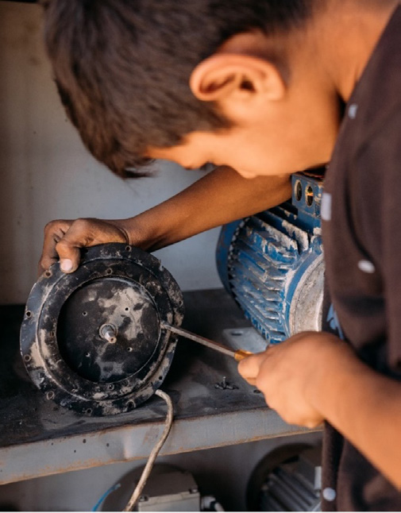
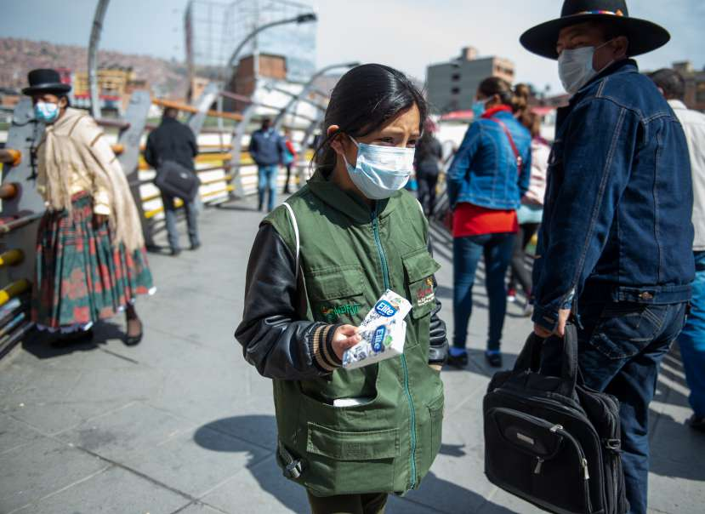
GUESS THE ARTICLE
These pictures provide a clue to this week’s article.
How do these pictures help you? Can you guess how they are linked together?
Write down your thoughts or discuss with someone in your class.
UNICEF/UN0673622
UNICEF/Safadi/2023
UNICEF BOLIVIA/2020/RADOSLAW CZAJKOWSKITO
Notes:
Left to right: Nina 13 years old, dropped out of school and works at the Vohibola mica mine in the Anosy region of Madagascar, the photography was taken 15 meters under the ground during the winter of June 2022; Abdullah, a 12-year-old Syrian refugee, works at a mechanics in Sahab, Jordan; In Bolivia, La Paz, a 9-year-old girl walks through the centre selling tissues.

Slide 4
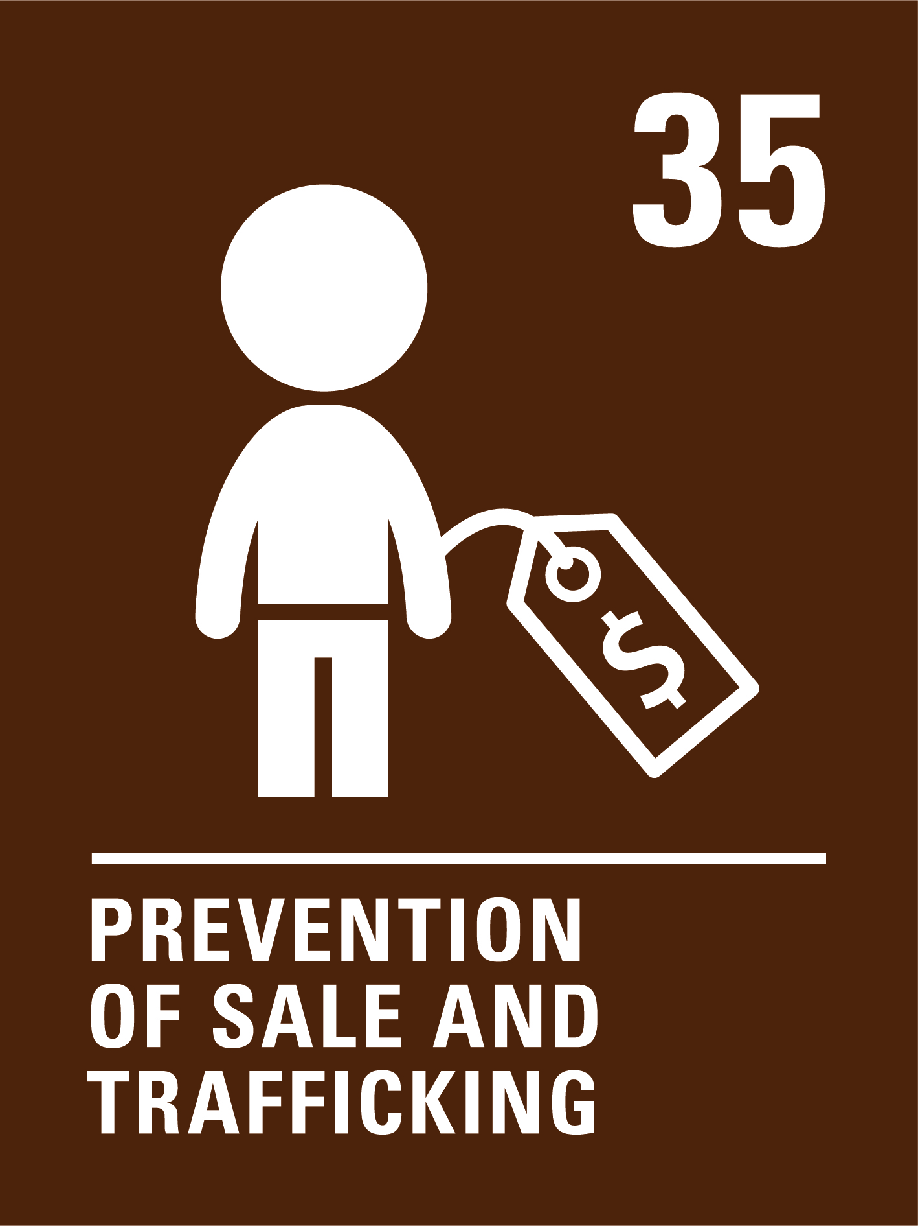
ARTICLES 32 & 35
Article 32: Children have the right to be protected from work that is dangerous or bad for their education, health or development. If children work they have the right to be safe and paid fairly.
Article 35: Governments must make sure that children are not kidnapped or sold, or taken to other countries or places to be exploited (taken advantage of)

Slide 5
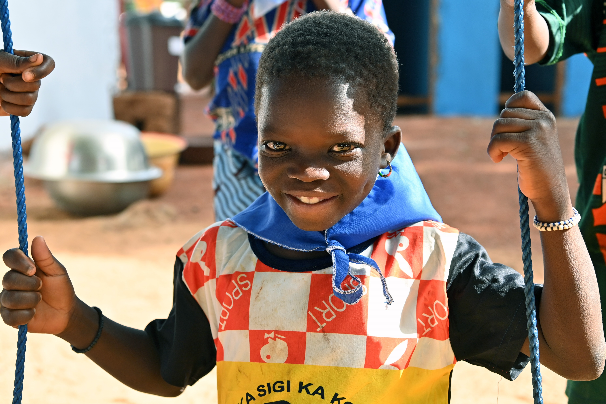
EXPLORING ARTICLES 32 & 35
Why should children be protected from working, especially in dangerous conditions?
Have a think and write down some answers!
UNICEF/UNI557589
Notes:
UNICEF supports the government of Côte d'Ivoire in implementing innovative strategies to prevent malnutrition, involving several sectors, health, agriculture, social policies, education, water, hygiene and sanitation and putting communities at the heart of action for a sustainable approach based on local solutions

Slide 6
EXPLORING ARTICLE 30
Did you think of these?
All families should have a good enough standard of living without their children working.
Children should be in education.
Their health and safety should be protected.
Children’s views and best interests should be considered.
Other harm could come to them in the workplace.
It could lead to further exploitation or trafficking.
They should have time to be a child and have all their rights.
They should have time to rest and play, and to develop their talents.
What else did you think of?

Slide 7
ACTIVITIES FOR THE CLASSROOM
You do not need to complete every activity but if you have time, you can try to complete more than one.
Ask your family, grandparents or older friends if they had a job when they were children. What work did they do? How did their work impact on their rights?
Talk about the jobs you would like to do when you grow up. Draw a picture of yourself doing that job or pick a day to dress up as that role! Discuss why children should not have to work.
As a class, listen to a short retelling of Cinderella. In circle time, discuss how she was treated by her stepmother and stepsisters.
How should her life have been different? Can you talk about the rights she should have enjoyed?
Explore how children ‘help out’ with ‘jobs’ at home and in school. What would it be like to do these all the time and have no time for play or learning?
Notes:
https://www.youtube.com/watch?v=Rp7S1drKzEk&ab_channel=ARCStories

Slide 8
ACTIVITIES FOR THE CLASSROOM
You do not need to complete every activity but if you have time, you can try to complete more than one.
Watch this video on Goal 8 of the Sustainable Development Goals, which includes ending child labour. Explore the rest of the SDGs and discuss which Goals connect with Rights 32 and 35!
Find out about Fairtrade and discuss how it helps to protect children’s rights, particularly Article 32. How could your school community support the Fairtrade movement?
Draw a large clock on a piece of paper and divide it up into 12 equal segments. In each segment write or draw what you are doing on a normal day. Are you at school, sleeping, playing or watching TV? Now imagine you have to fit a job into your day too. What would you have to stop doing to be able to work?
Listen to Anas describe how his childhood has changed since he became the breadwinner for his family. Create a poem or a piece of art, drama or music to explore some of the feelings involved in what you have seen

Slide 9
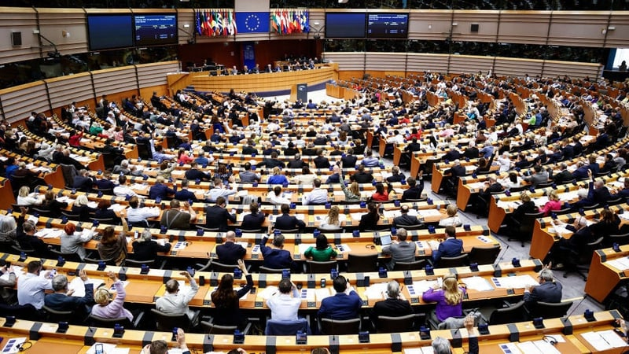
ACTIVITIES FOR THE CLASSROOM
You do not need to complete every activity but if you have time, you can try to complete more than one.
This week the European Parliament voted to ban the sale, import and export of goods using forced labour; however there is much more to be done! Research what measures politicians in Ireland and in Europe can take to end child labour, and send a letter to those running for election in your area!
How does the government protect children in Ireland who work? Use the Ombudsman for Children’s Officer explainer and this website to help you. Create a poster to make sure everyone in your school knows the facts about working in Ireland.
@RTE
What could you do if you felt one of your friends was involved in harmful work? As a class discuss steps that you could take and who would need to be involved – remember that adults who work for the state (like teachers, gardaí, doctors) are duty bearers, and have an obligation to uphold children’s rights!
Child labour often involves children being sold or moved illegally. This links to Article 35 and is sometimes called trafficking. Watch this short clip about Sir Mo Farah. He was trafficked to the UK to work as a domestic servant before growing up to become an Olympic gold medallist. In February 2024 Mo Farah became the International Organisation for Migration’s first Global Goodwill Ambassador

Slide 10
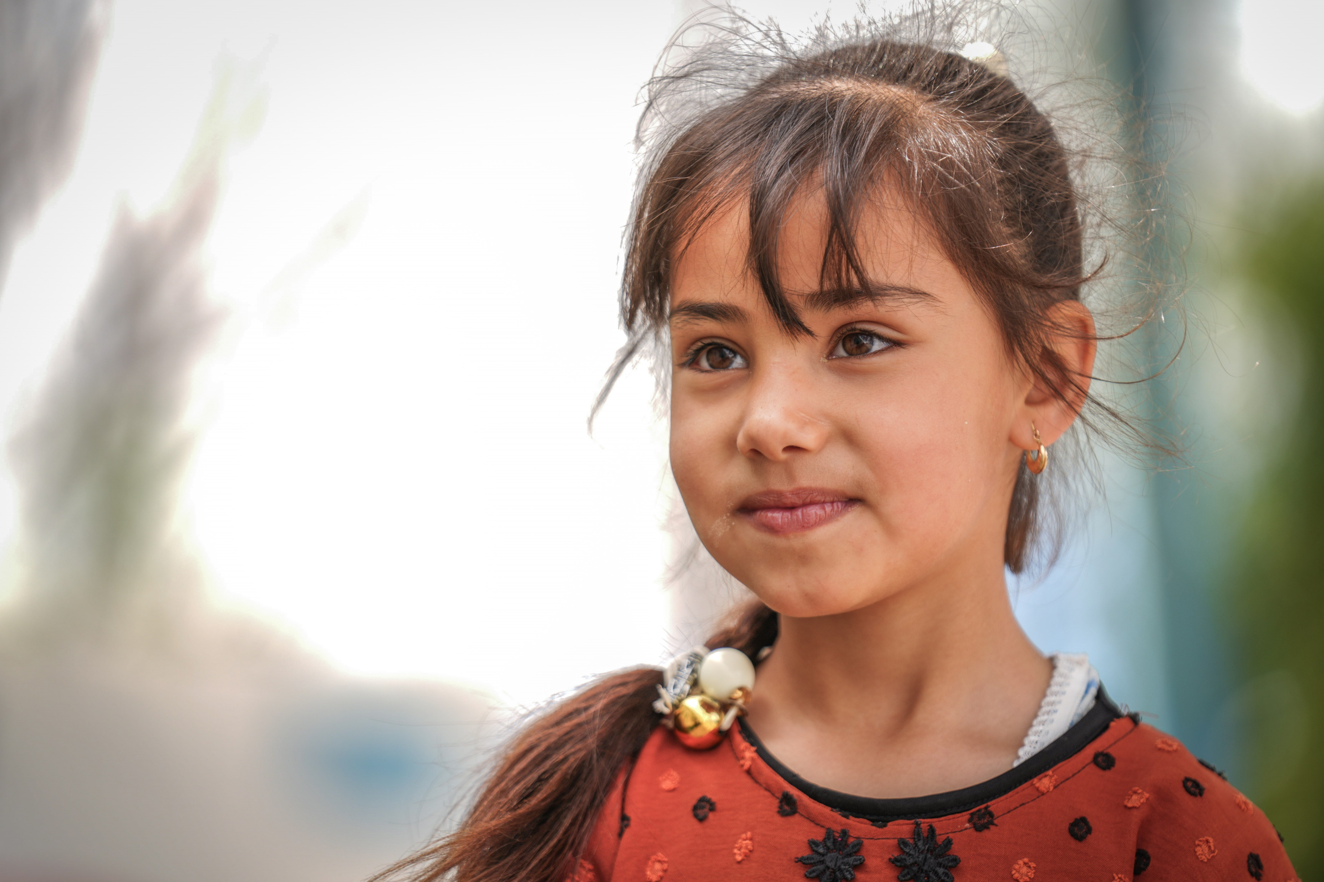
REFLECTION
Find someplace quiet and take a little time to think about the following prompts ….
Rights are indivisible and all equally important. Imagine you were engaged in child labour; how might your other rights be affected?
What should adults do to make sure any work children do is safe?
Who would you talk to or contact if you were worried about yourself or someone you know in connection with child labour or trafficking?
UNICEF/UNI550006

Slide 11
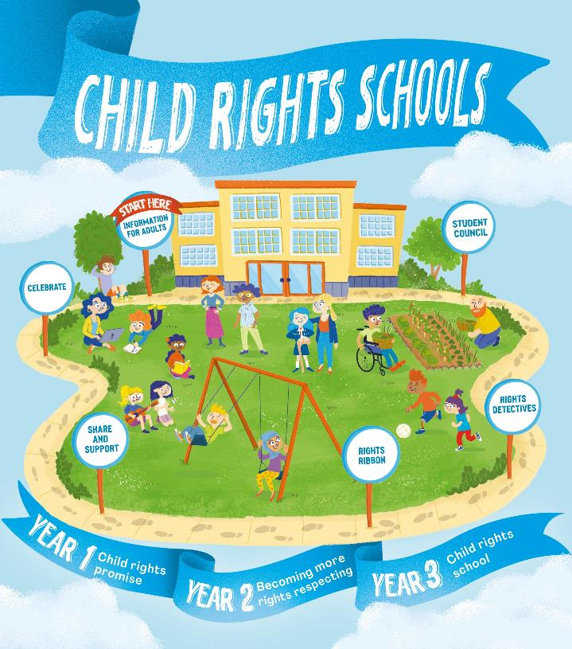
FURTHER CHILD RIGHTS EDUCATION SUPPORT
Child Rights Schools is a programme that supports you to embed child rights across the whole school community, including with parents and carers. Find our more here.
Find more classroom resources here.

Slide 12
THANK YOU!
UNICEF/UNI552233
Notes:
Bisit to the Mama Faita Preschool of Yopougon, a suburban of Abidjan, in the South of Côte d’Ivoire, 2024

