Slide 1
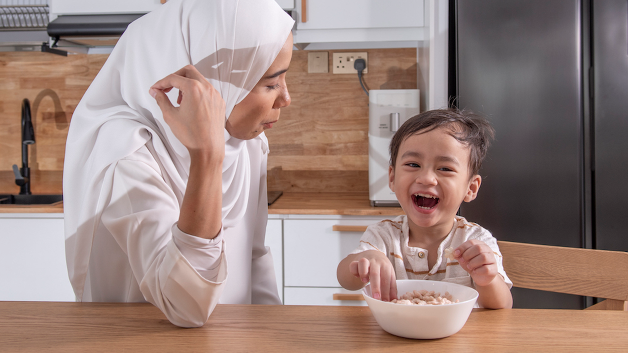

A CHILD RIGHTS APPROACH TO MENTAL HEALTH & WELL-BEING
UNICEF/UNI485316
Notes:
A mother entertains her 3-year-old son eating rice cereal in the kitchen at their home in Puchong, Selangor.

Slide 2
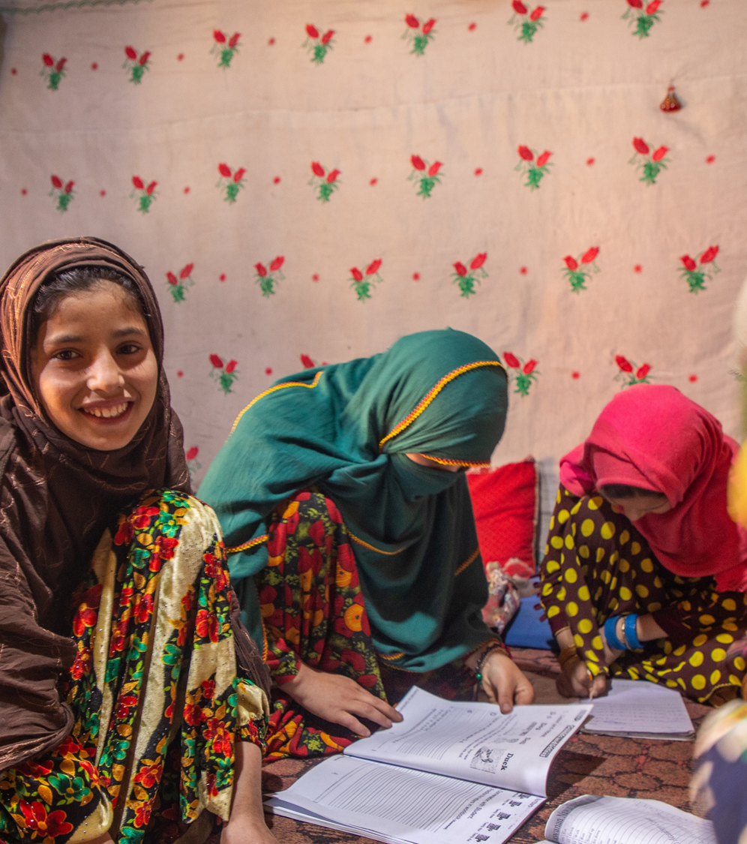
BEFORE YOU BEGIN
  We strongly recommend completing this week’s pack in class with teacher supervision and not setting this pack, or activities from this pack, as homework. This is a flexible resource and is intended to provide you with some easy to use, appropriate rights-related learning to share with your children, their families and your colleagues.
  Please edit out non relevant slides or activities before sharing with your students. Please check that the content works for your learners and feel free to adapt or add any content that would make the material more relevant for your setting.
UNICEF/UNI482372
Notes:
On 28 November 2023, 10-year-old Farzana works on her school lessons inside her one-room home in Parun district, Nuristan province, Afghanistan.

Slide 3


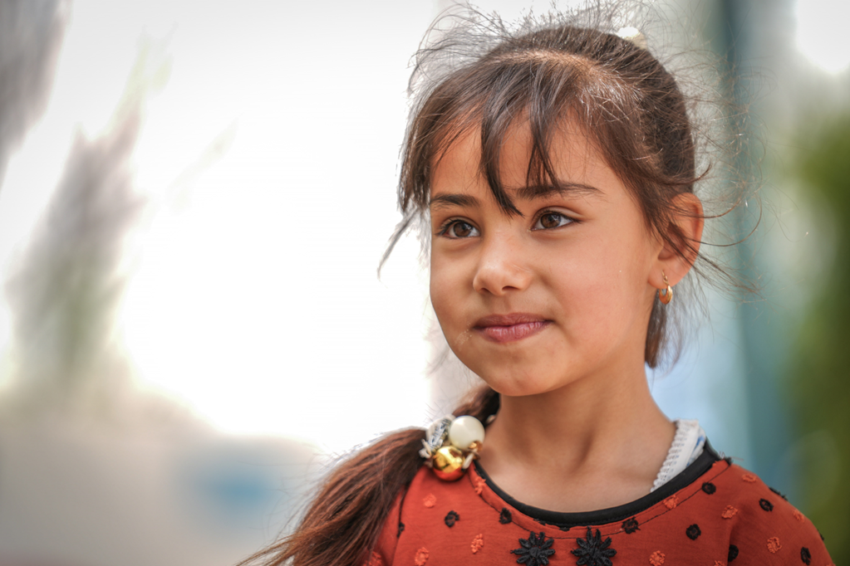


UNICEF/UNI550006
The energy sources we use today are highly disruptive and damaging to the environment, especially due to the use of hydrocarbon fuels that have increasingly caused global warming.
WHAT IS MENTAL HEALTH?
Notes:
Introduction: What Are We Talking About Today?
Content to ask:
Ask: "How are you feeling today? Did you know your feelings are part of your mental health?"
Explain that mental health is about how we think, feel, and act.
Learning how to identifying feelings in you and in others is an important step for us to understand what are needs are.
For ages 4-6: Show animal images (next slide) of different moods see if the children can identify how the animals are feeling.
For ages 7-9: Ask them to act out different feelings like in charades and get the class to identify what the feeling they are acting out is.
For ages 10-12: Ask students in groups to identify what puts them in a good mood and what puts them in a bad mood, if they have access to GIFs you can get them to identify the best GIFS to describe their current mood and create a classroom mood board.
Image:

Slide 4
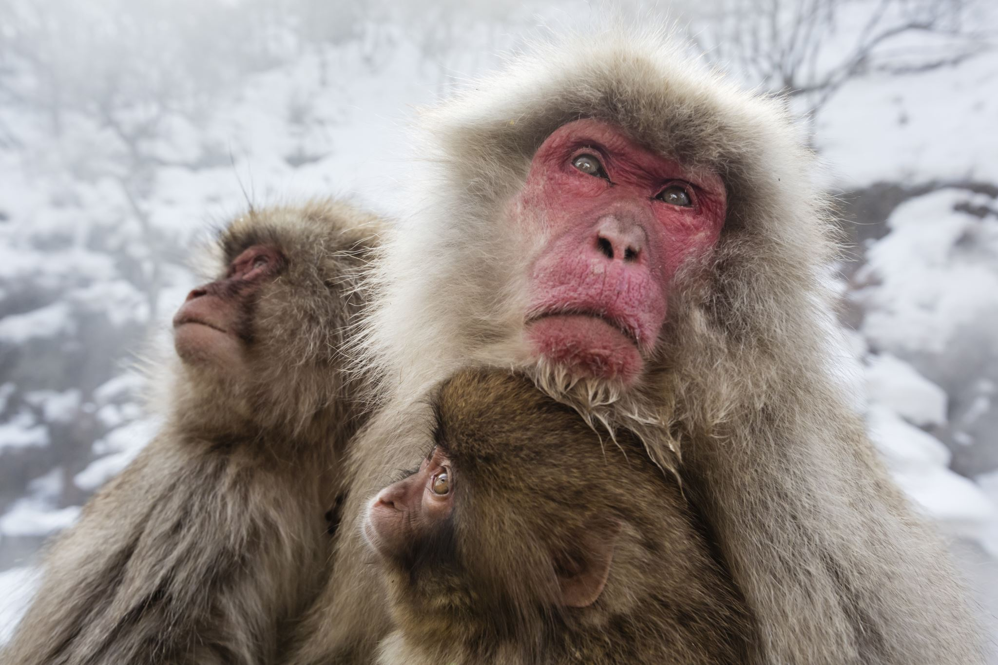
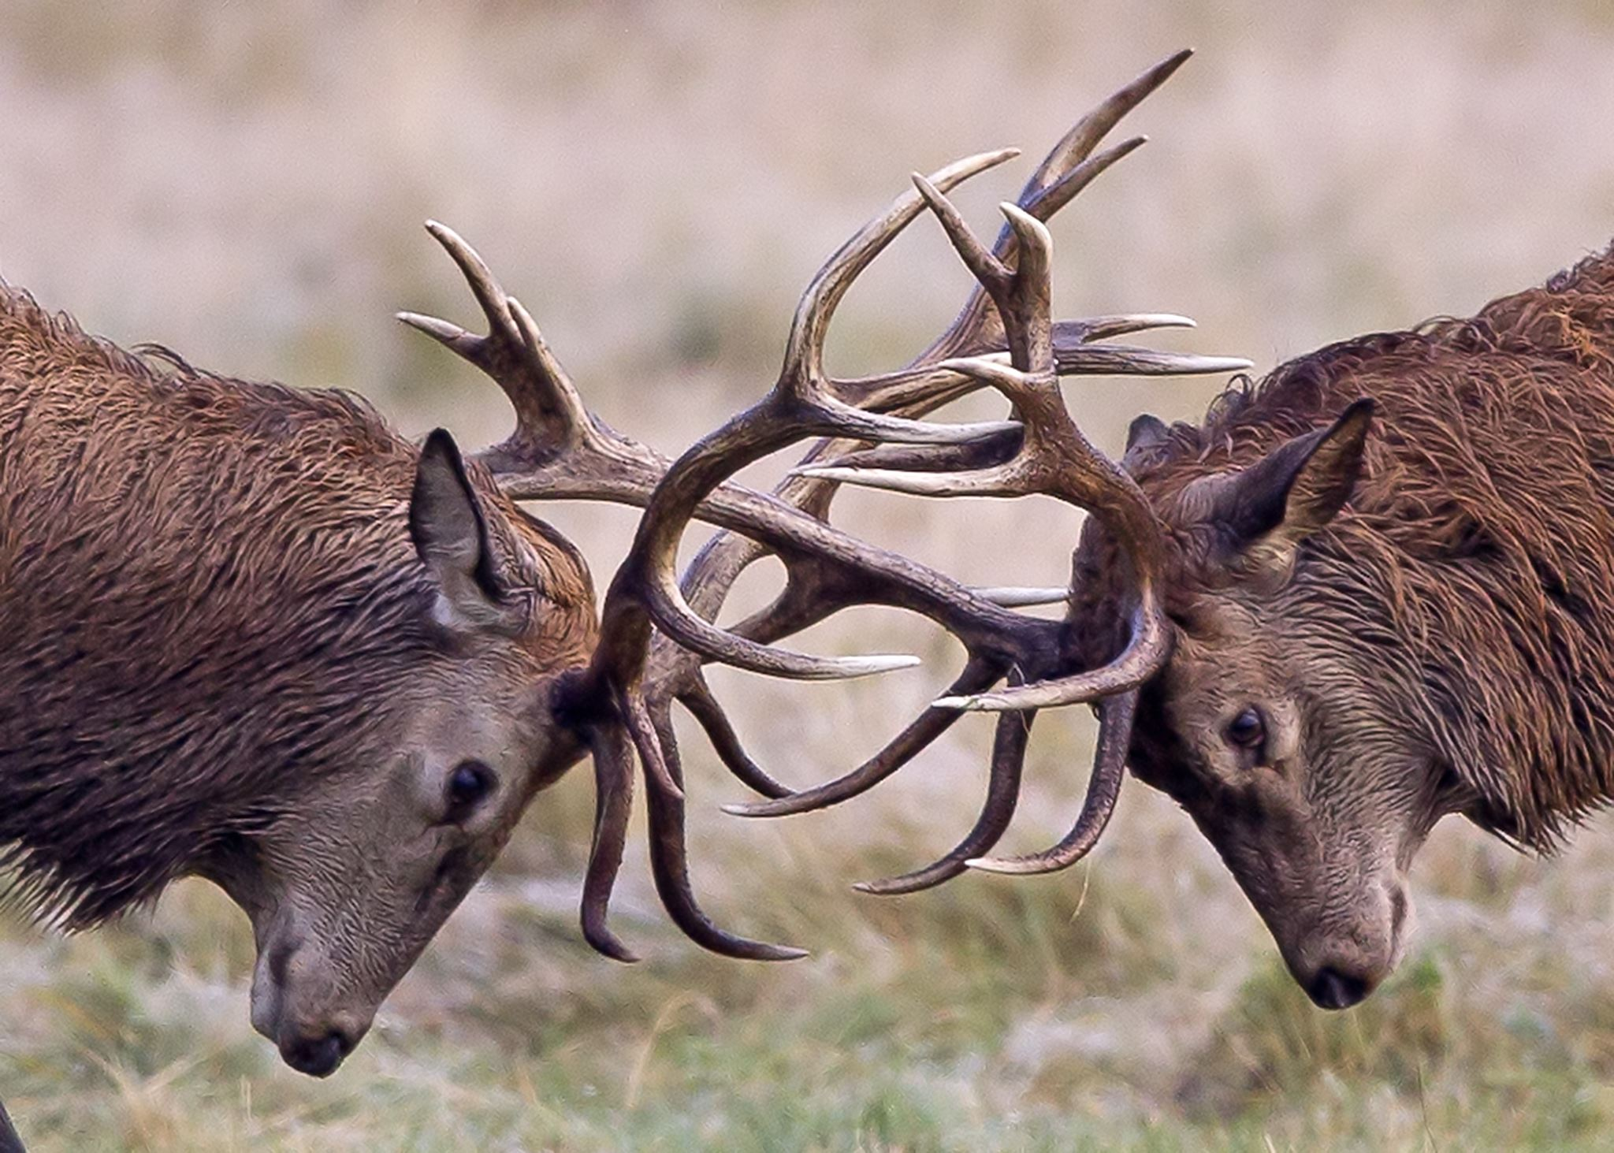
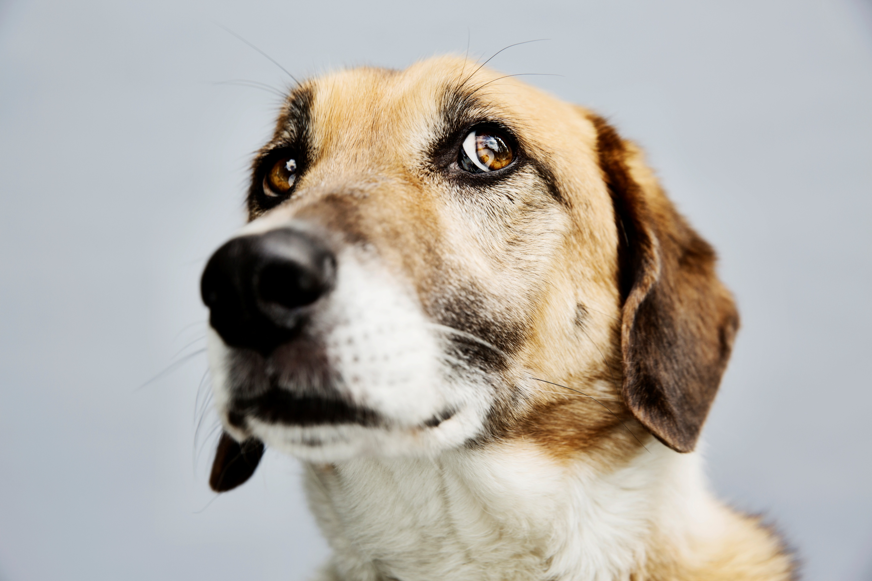
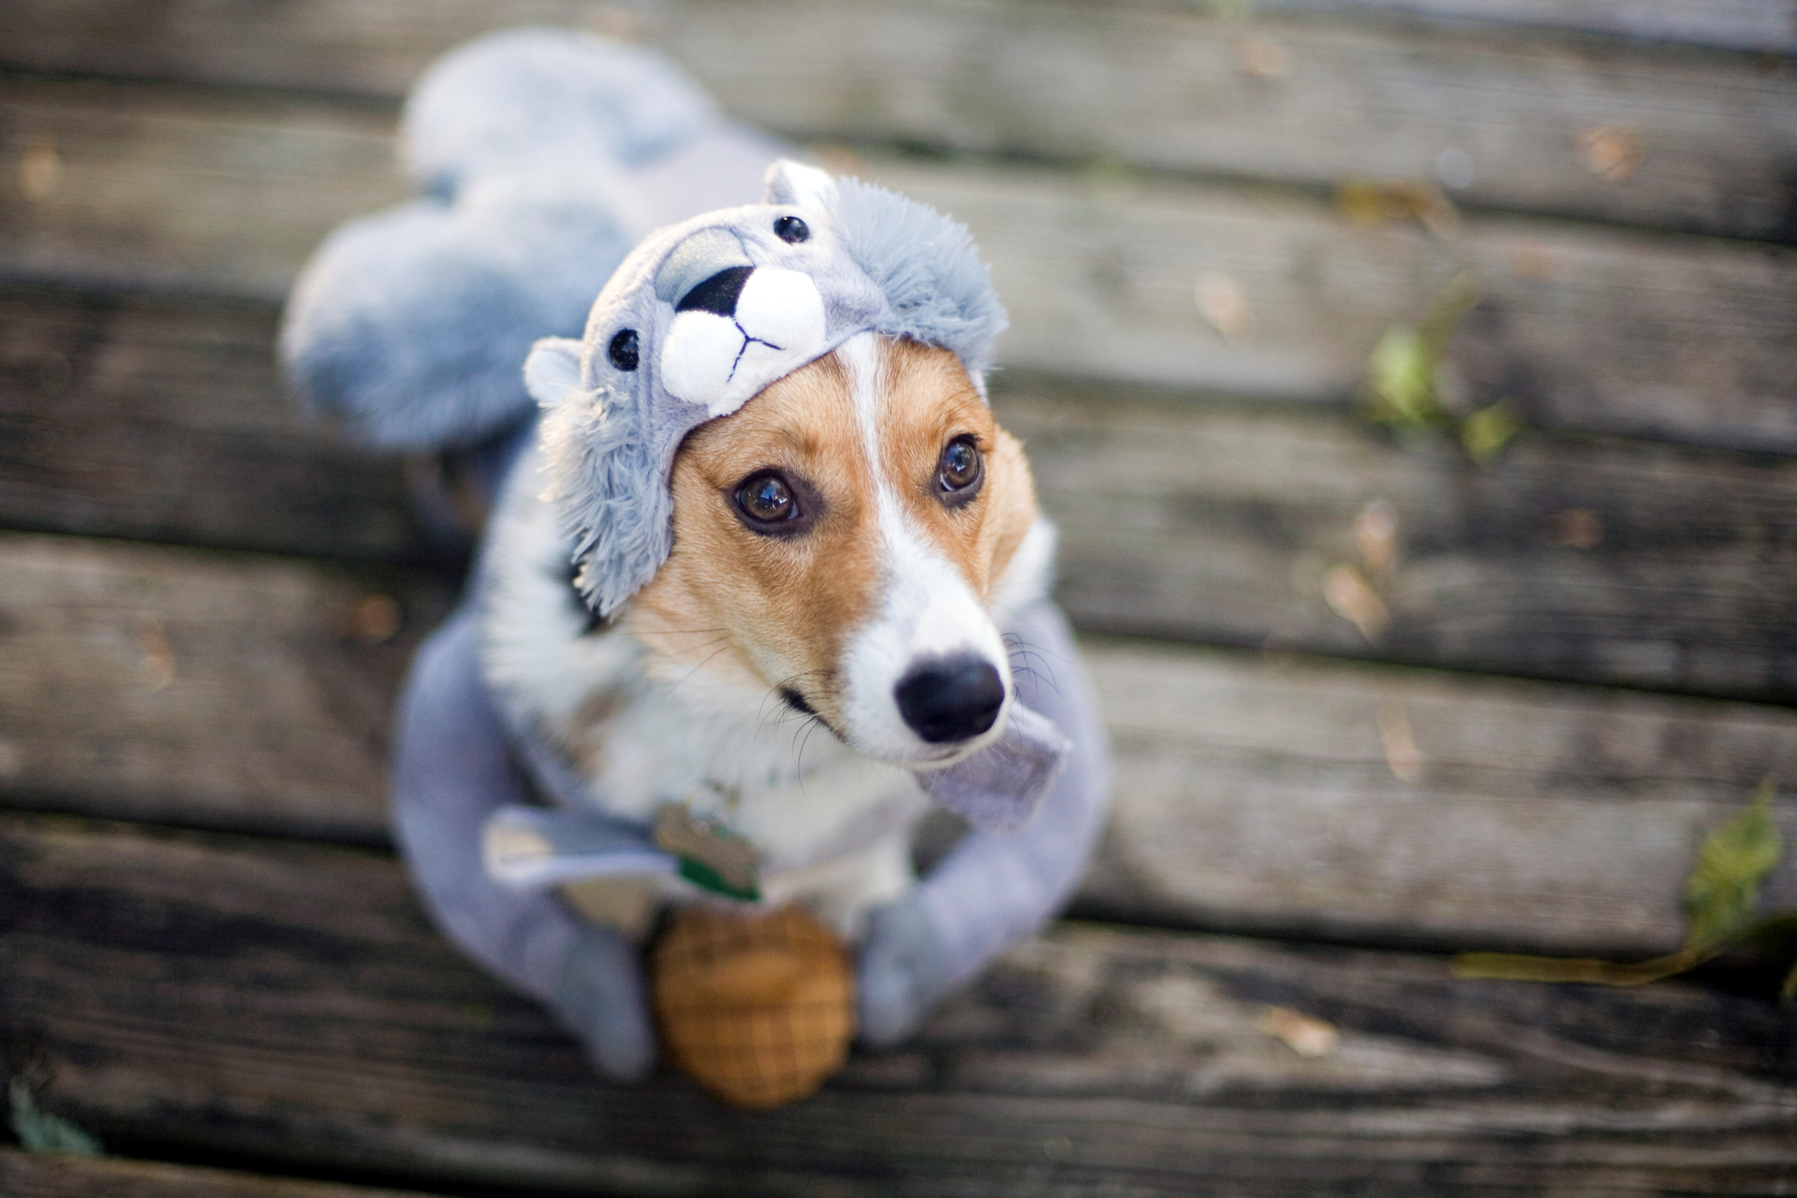

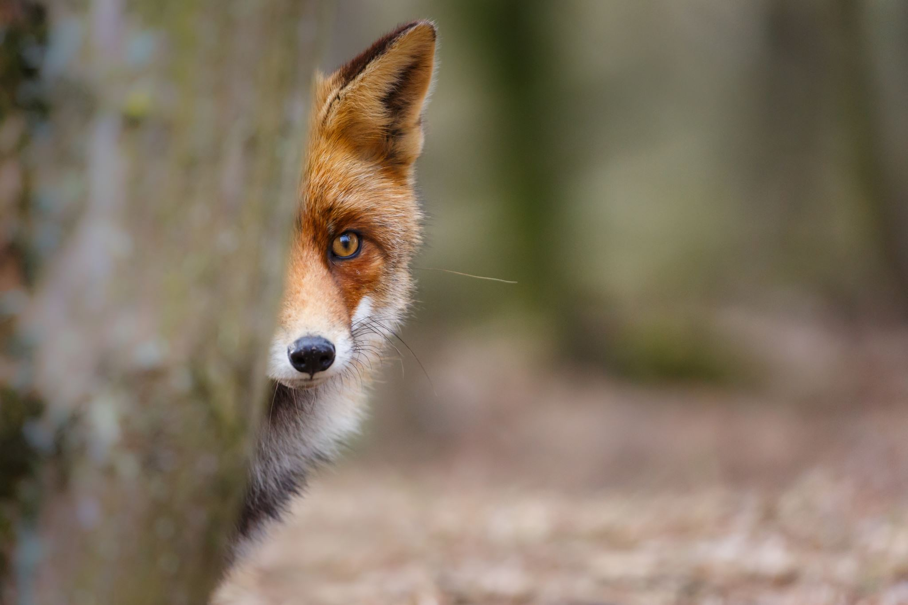

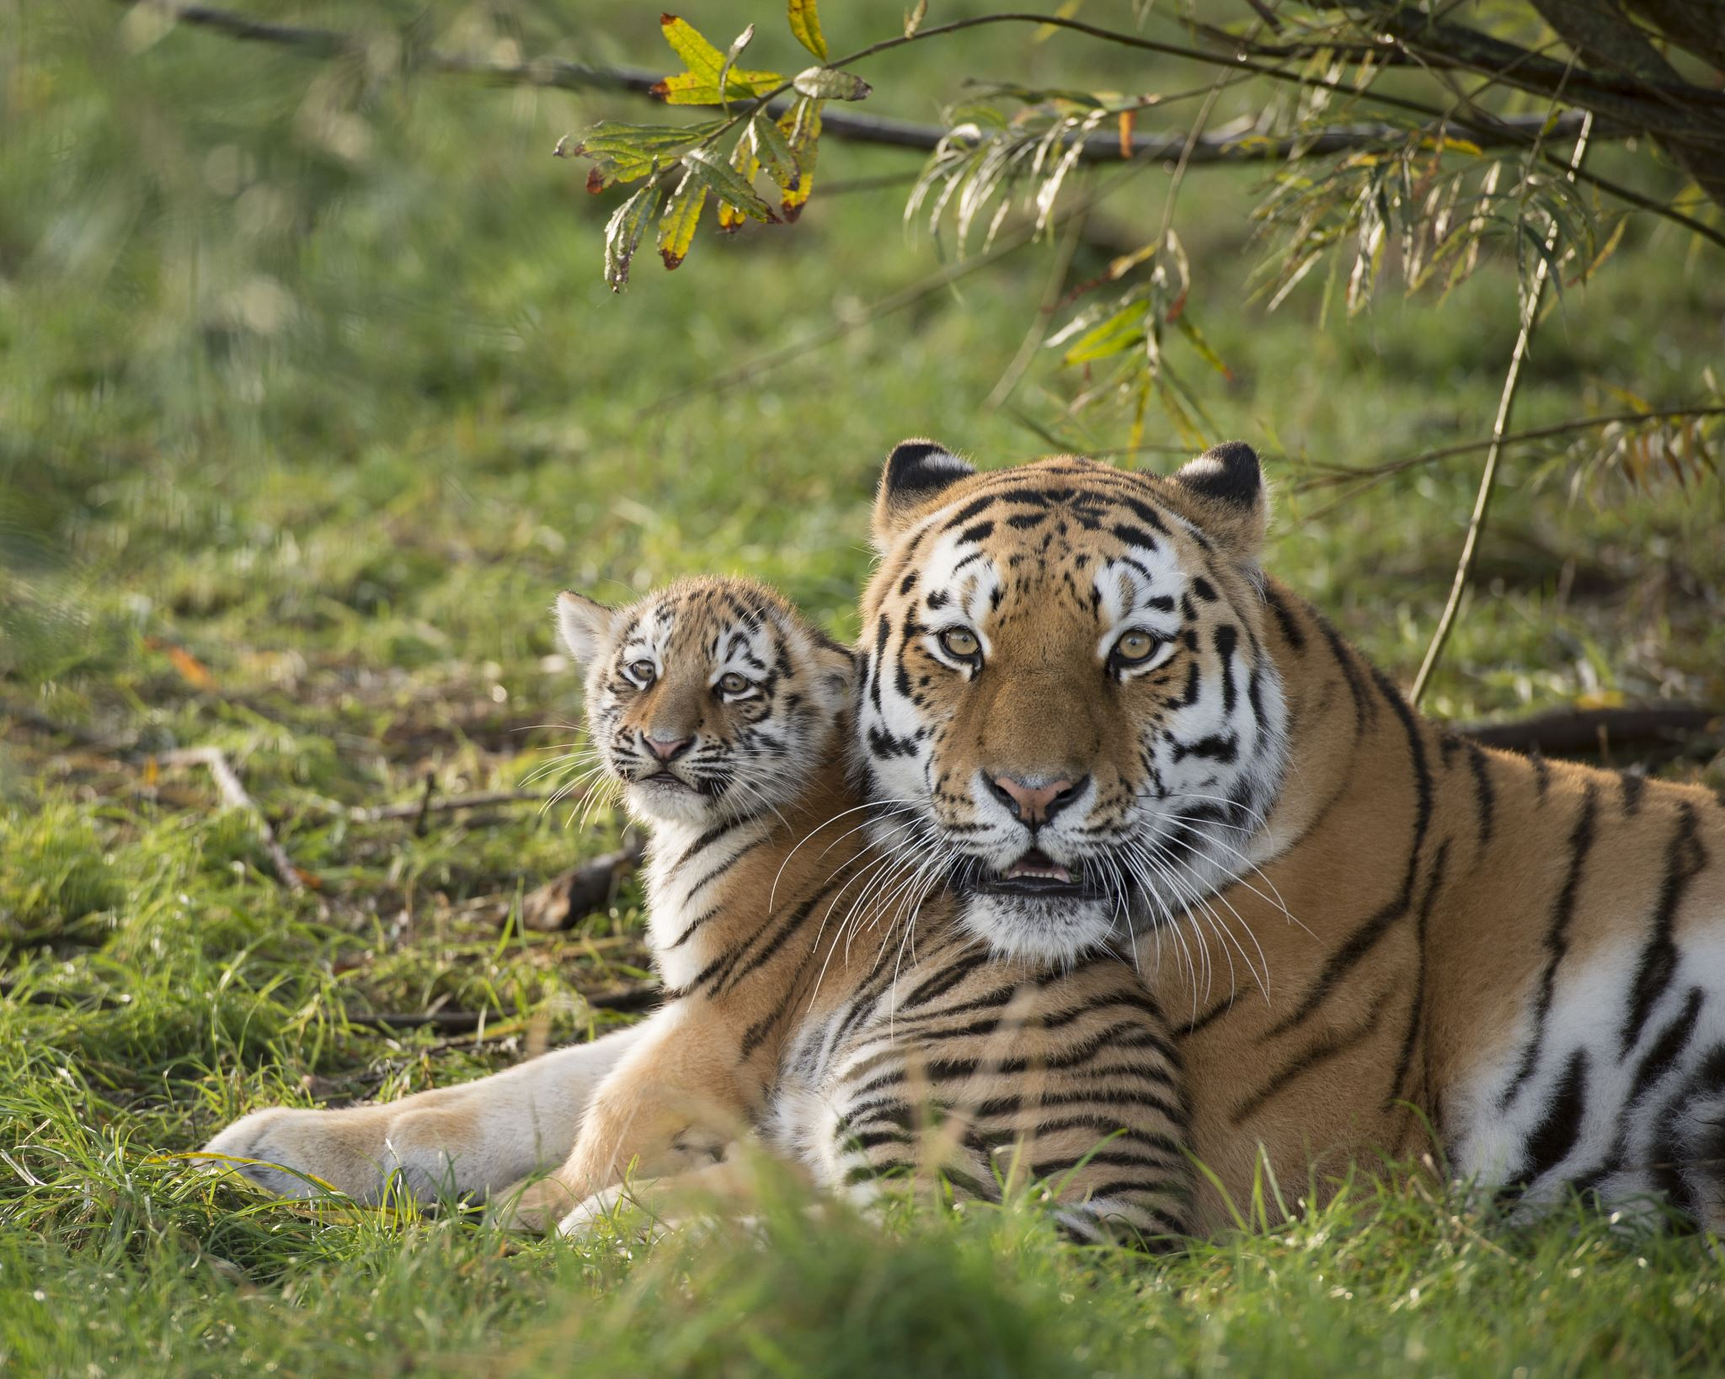
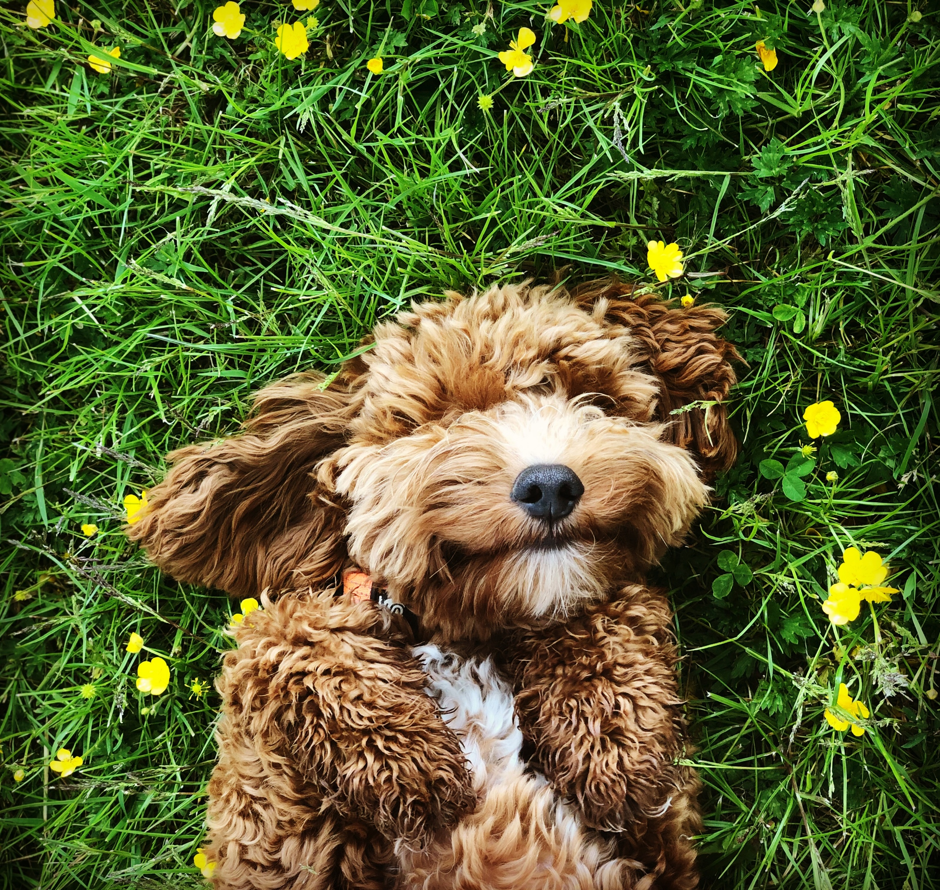
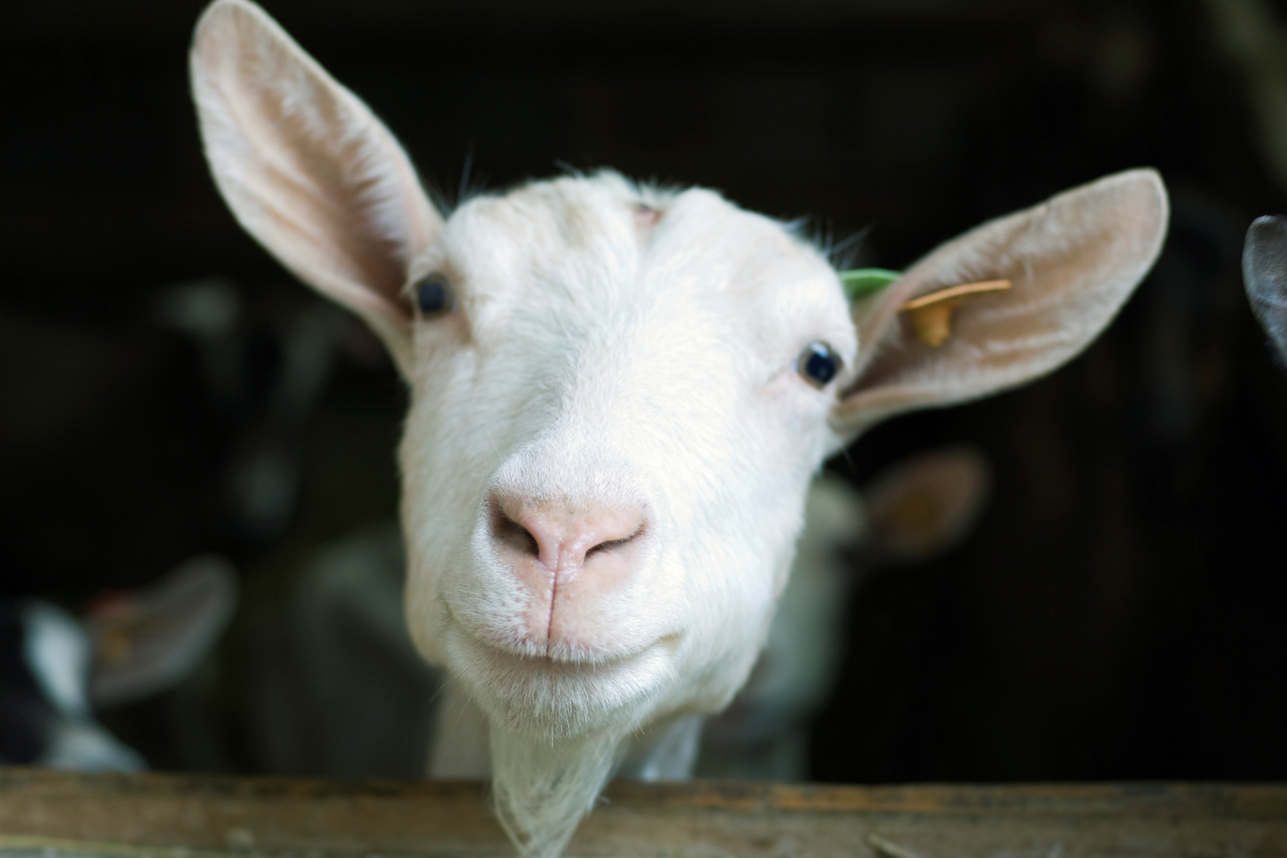

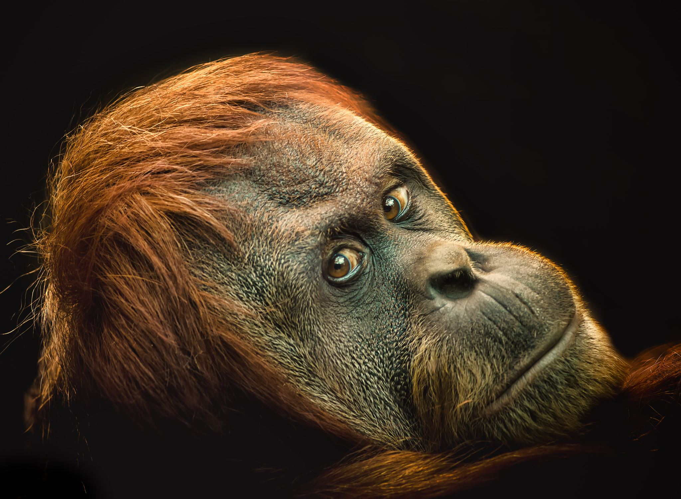

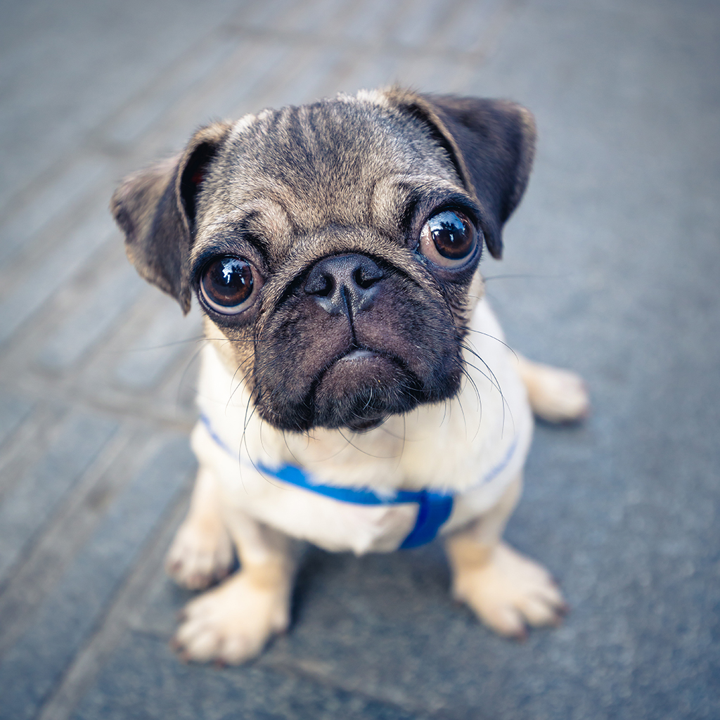
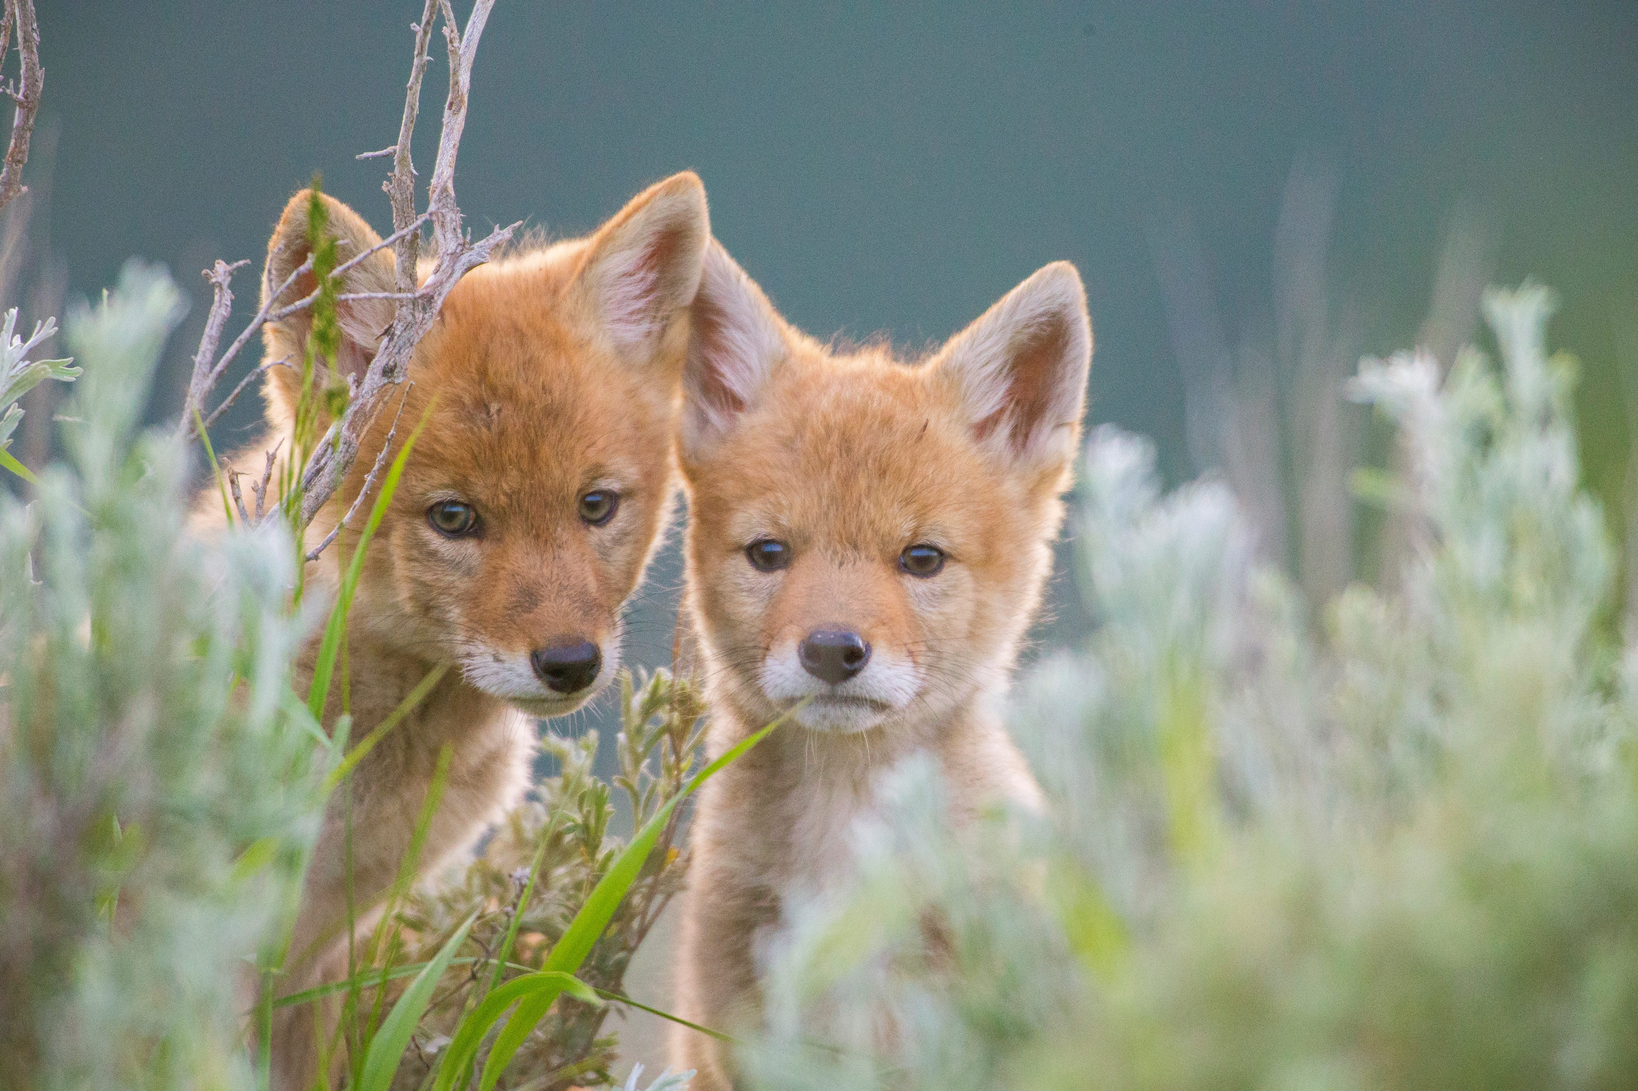
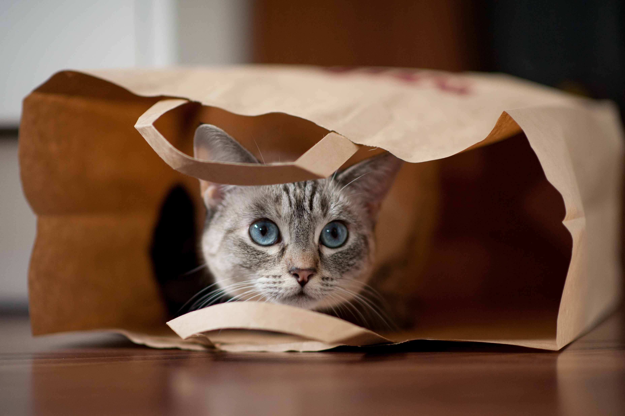
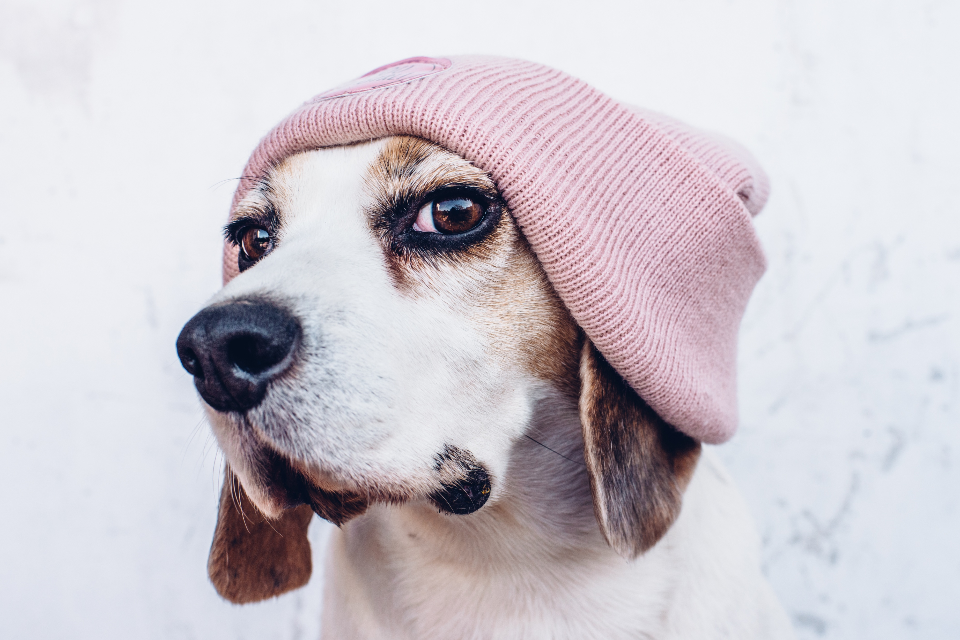


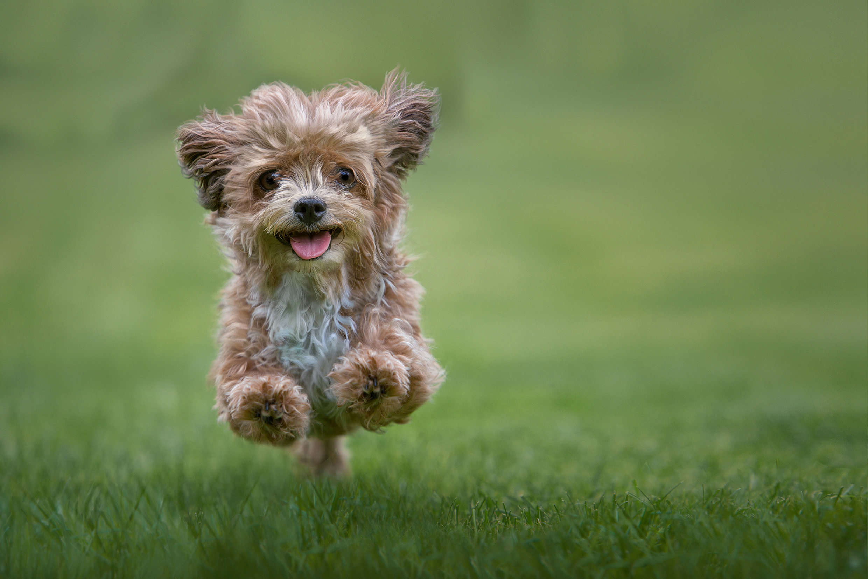
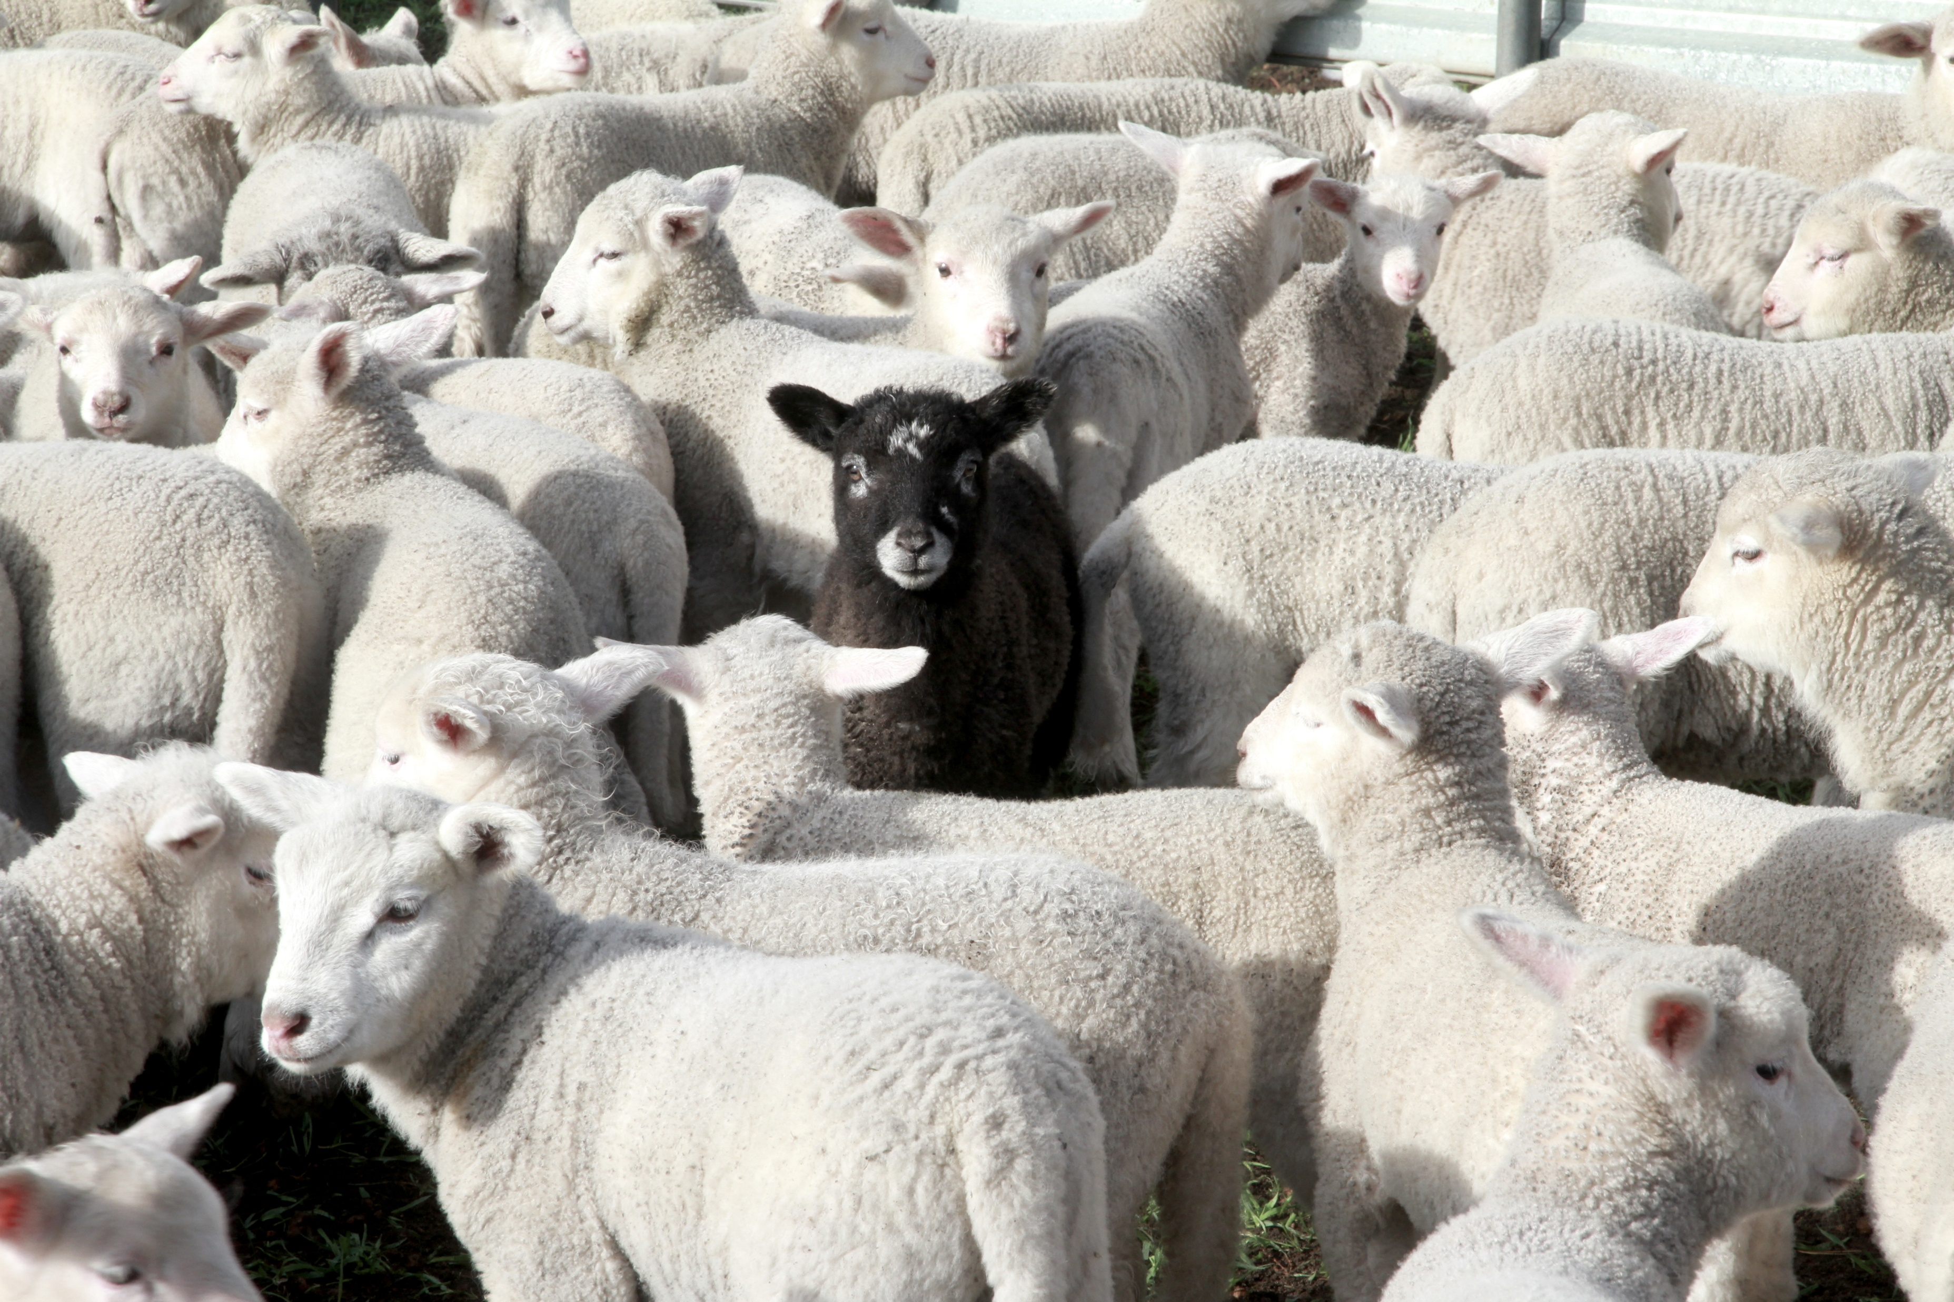

Slide 5
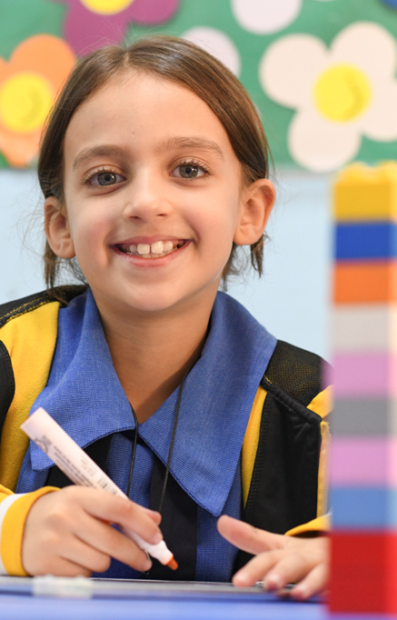



WHAT IS MENTAL HEALTH & WELL-BEING?
Mental health is something that everyone has – just like physical health. Sometimes we feel well, and sometimes we don’t.
Mental health refers to how we think, feel and behave, and this changes.
When our mental health is good, we might enjoy being around other people and feel able to take on challenges and new experiences.
But when our mental health is not so good, we can find it much harder to cope.
UNICEF/UNI557589
Source: adapted from Young Minds
UNICEF/UNI500680
Notes:
Mental health is something that everyone has – just like physical health. Sometimes we feel well, and sometimes we don’t. Mental health refers to how we think, feel and behave, and this changes. When our mental health is good, we might enjoy being around other people and feel able to take on challenges and new experiences. But when our mental health is not so good, we can find it much harder to cope.

Slide 6
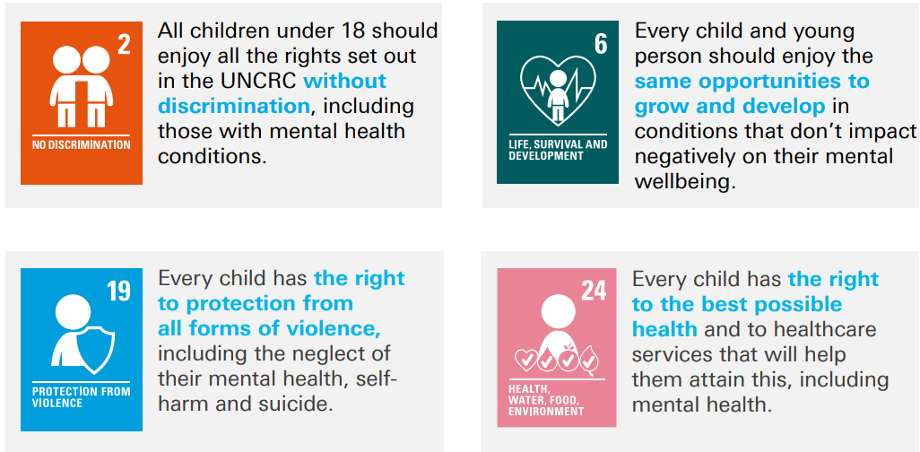
Child Rights and Mental Health & Well-Being
The term "alternative" refers to a technology other than the technology used in fossil fuels to produce energy.

Slide 7
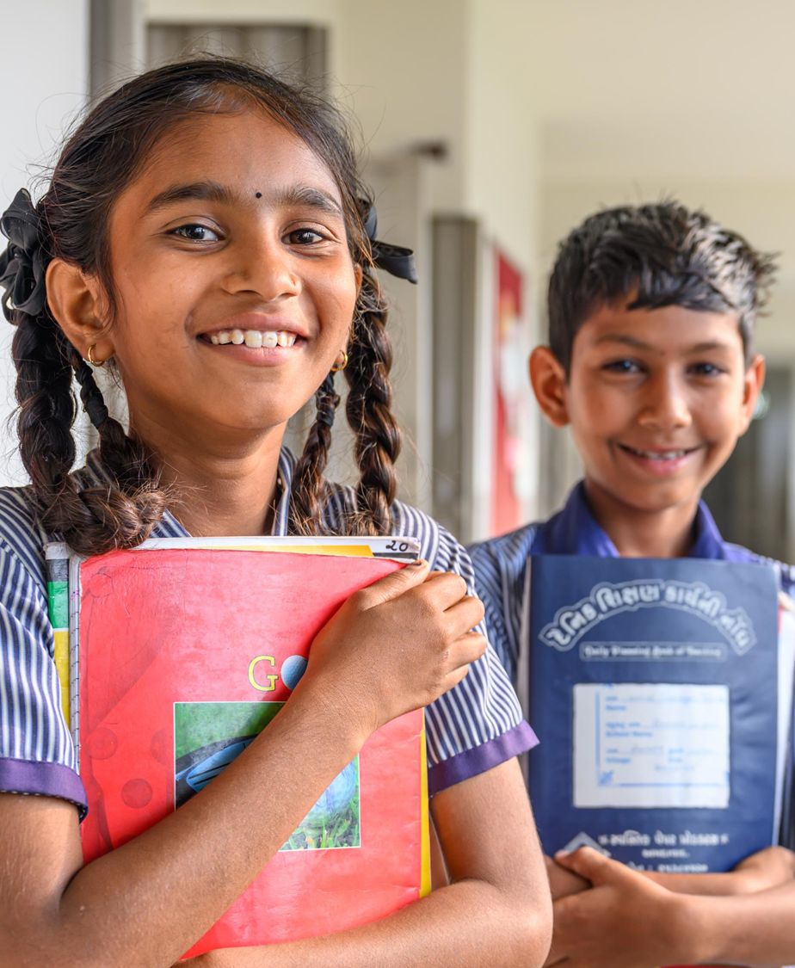
EXPLORING MENTAL HEALTH
What do you need for positive mental health?
Have a think and write down some answers.
UNICEF/UNI489332
Notes:
Kids at Tentalav Primary school in Gujarat, India.

Slide 8
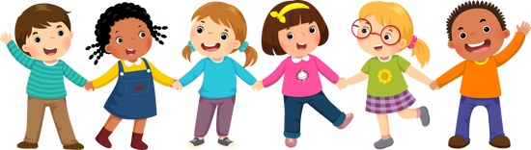
EXPLORING MENTAL HEALTH
Understanding the different types of emotions you have. Knowing that it is usual and ok to have times when you might feel sad or worried Learning different ways to look after your mental health Having a trusted adult to speak with about your feelings. Making sure you exercise regularly. Making sure you have a healthy diet. | Spending relaxation and fun time with friends and or family. Taking part in hobbies or activities that you enjoy. Being involved in activities to help others. Limiting screen time or access to other online platforms. Health care – being able to see a doctor, nurse or counsellor if you need to. Being able to enjoy all your rights.
Did you think of these?
Did you think of anything else? Can you connect this to any of the rights?

Slide 9
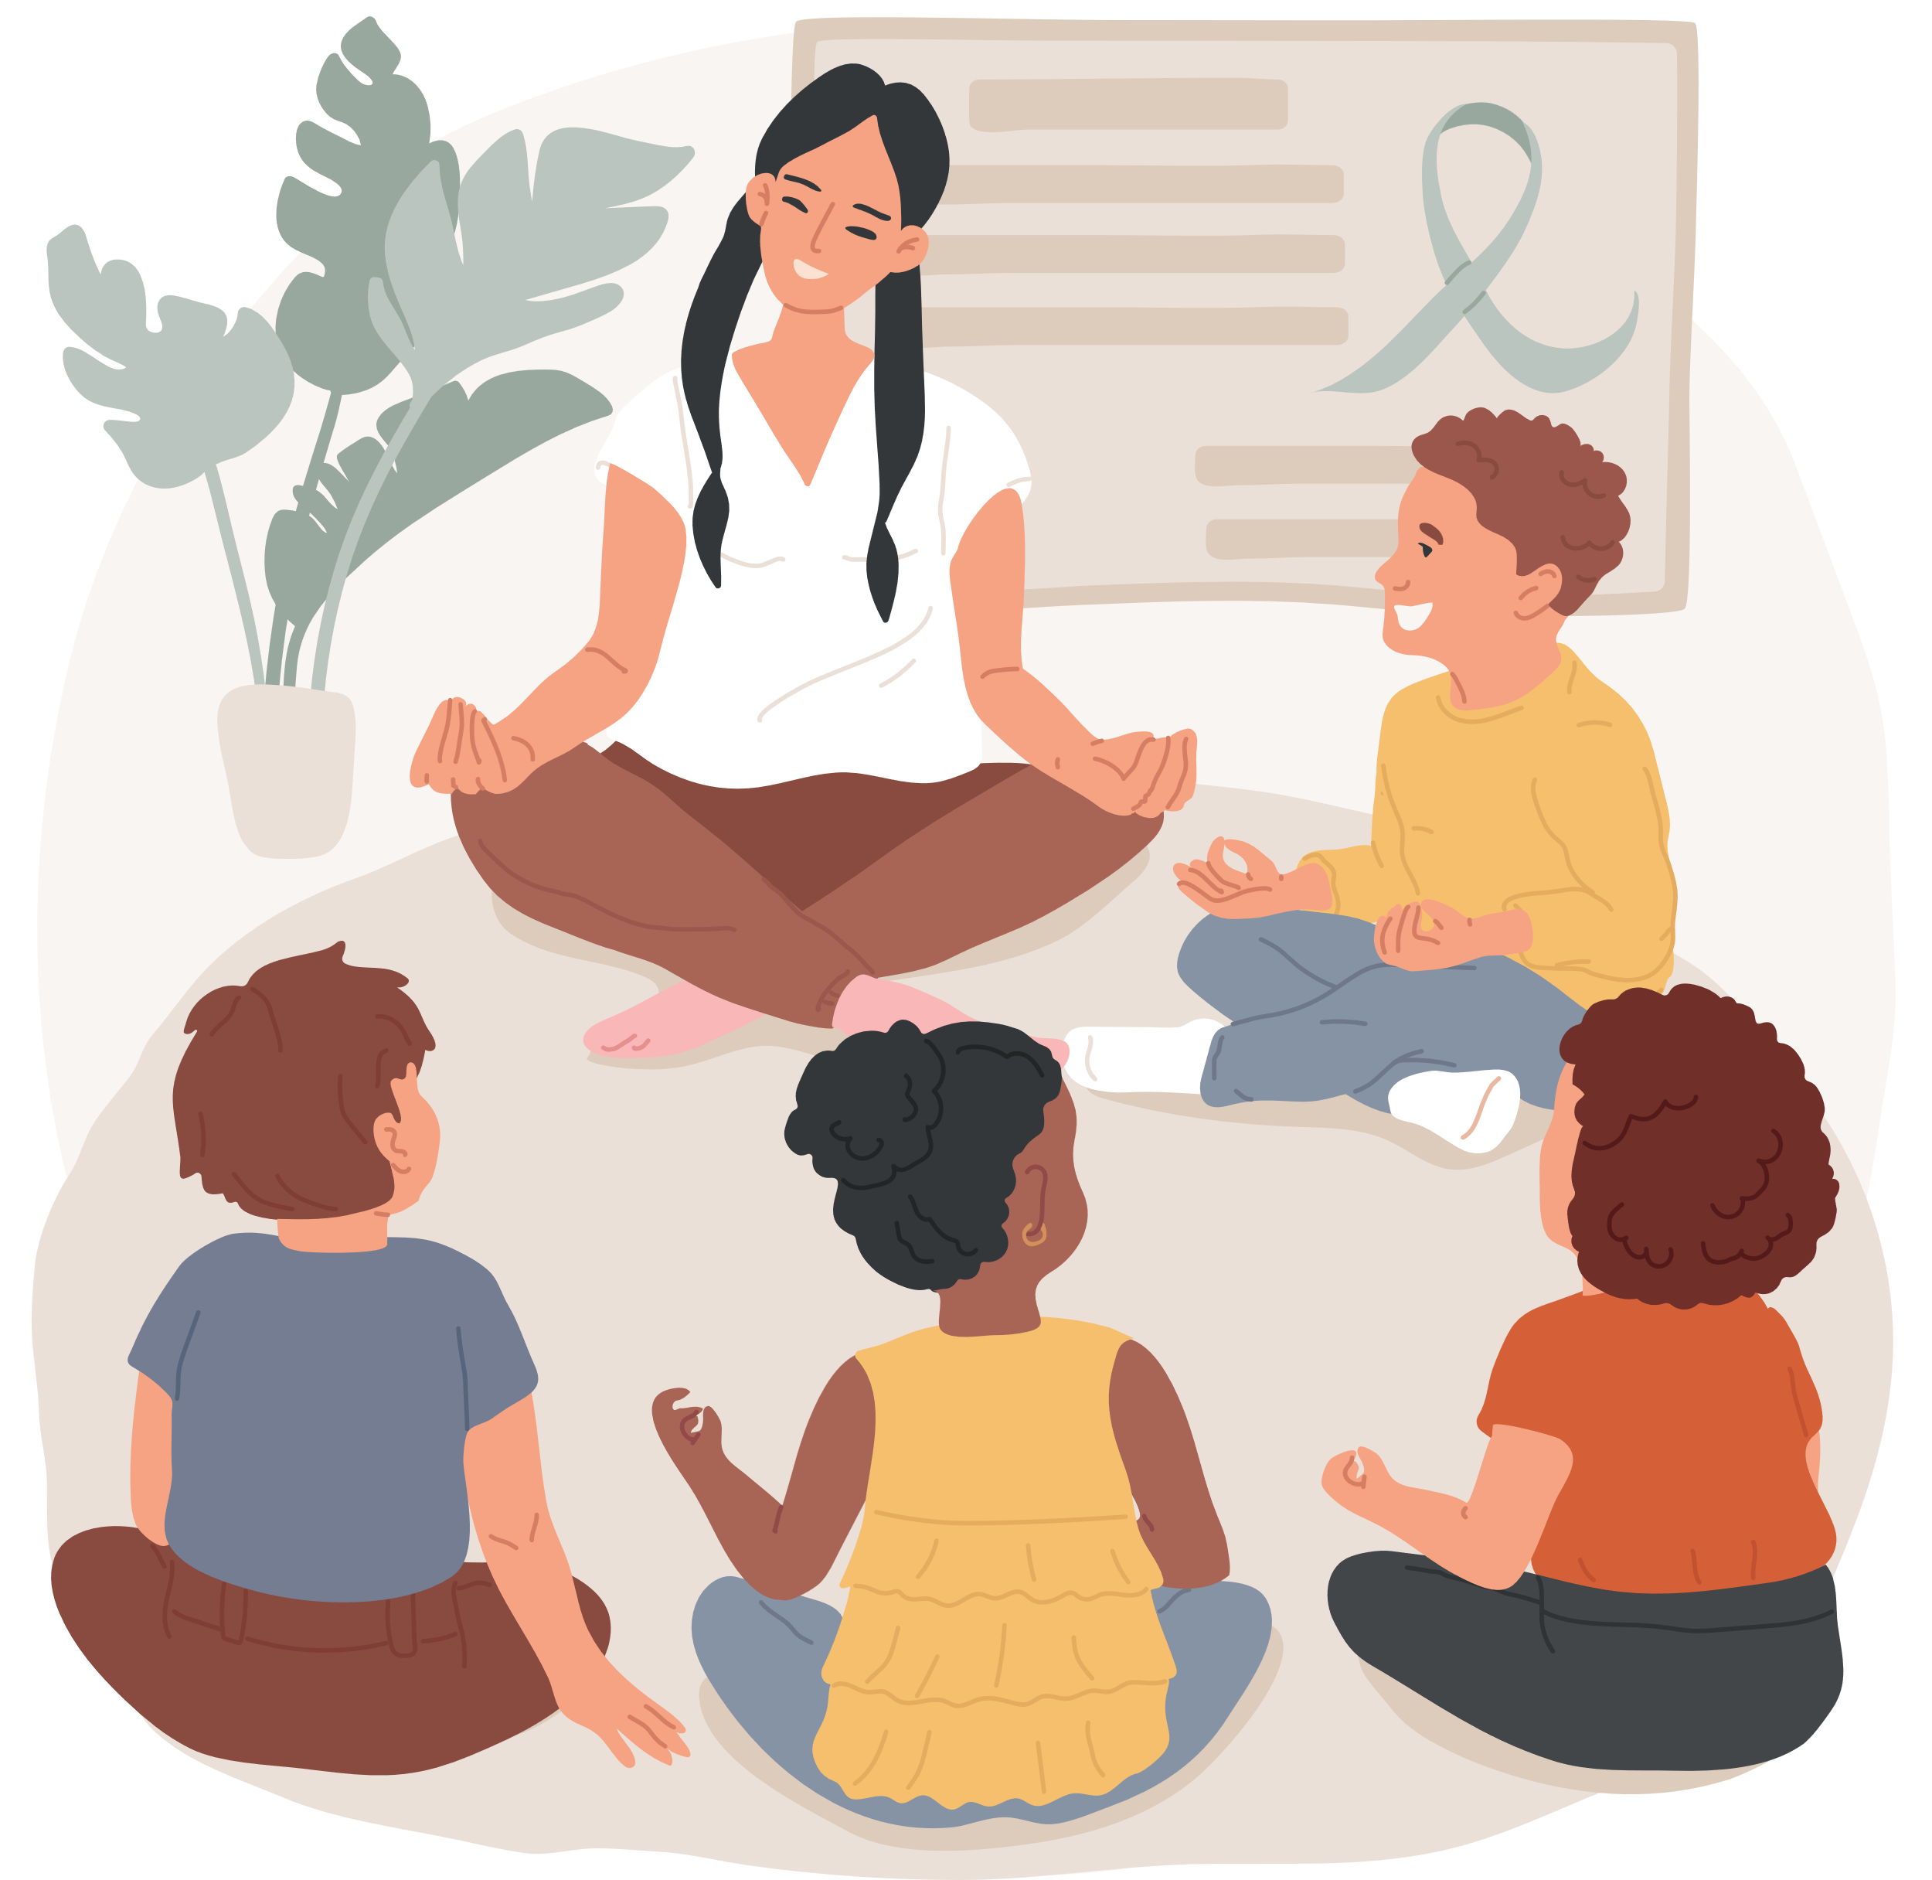
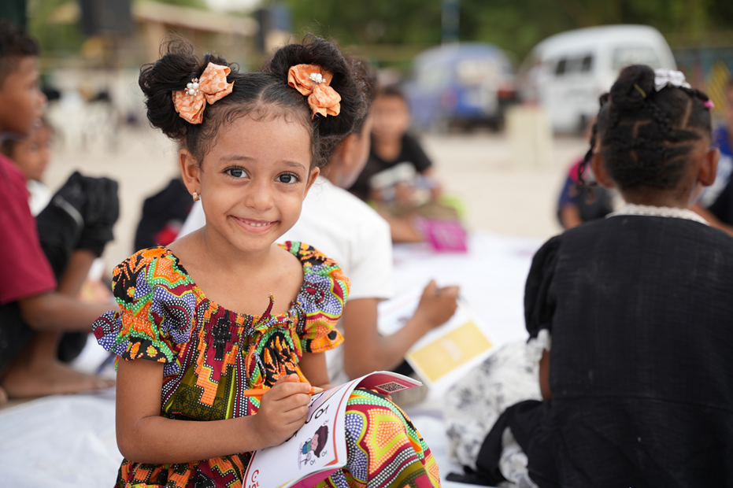
The energy sources we use today are highly disruptive and damaging to the environment, especially due to the use of hydrocarbon fuels that have increasingly caused global warming.
ACTIVITES FOR AGES 4-6
UNICEF/UNI422143

Slide 10
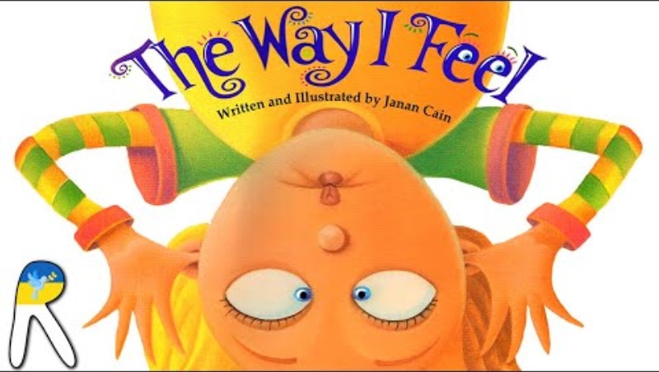
Listen to the read-aloud for the book ‘’The Way I Feel’’ by Janan Cain.

Slide 11
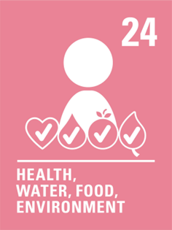
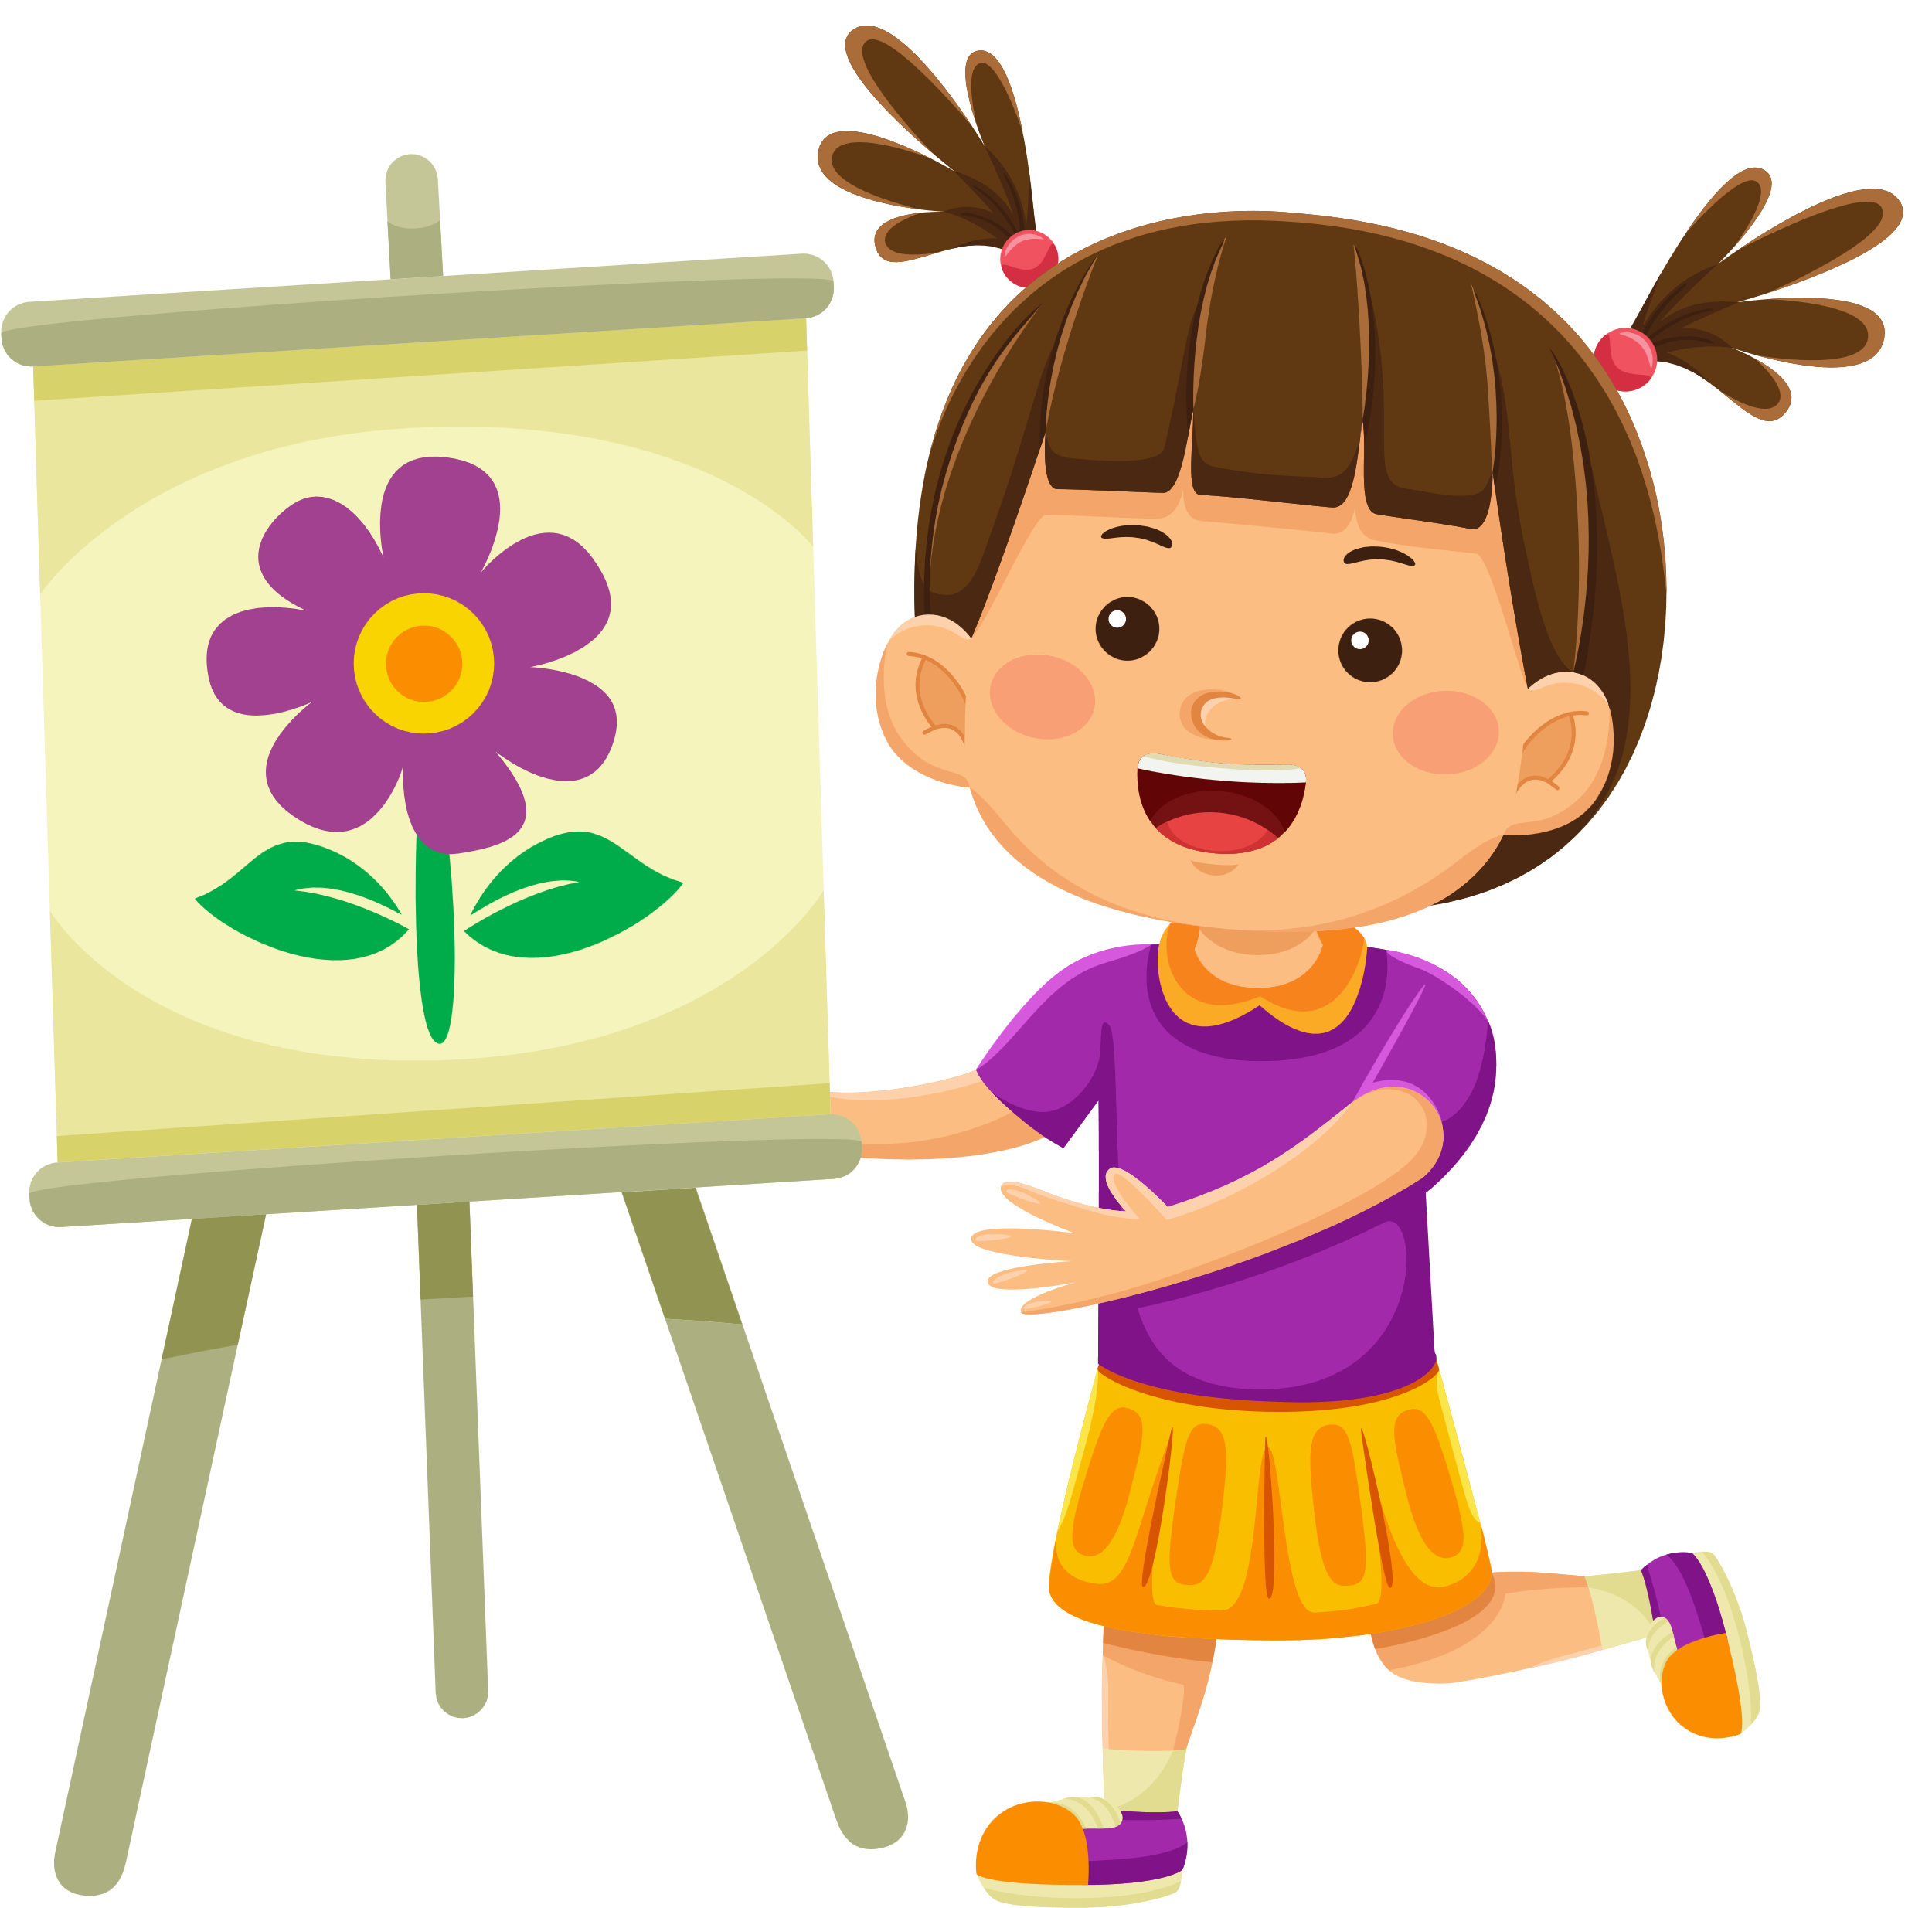
SHOW & TELL: THE RIGHT TO BE HEALTHY & HAPPY
Bring in something from home that brings you comfort. In a circle, share what item you brought and why you chose it.
Notes:
Content:
“Every child has the right to be as healthy as possible. This means it’s important to take care of your body AND your mind!"
Simple examples: "Exercise, play, eat well, and sleep to feel good.“
Ask children: What are the things you need to feel healthy and happy?
ACTIVITY: Ask the children to bring in something from home that brings them comfort. And in a circle ask them to share what that item is and why they choose it.

Slide 12
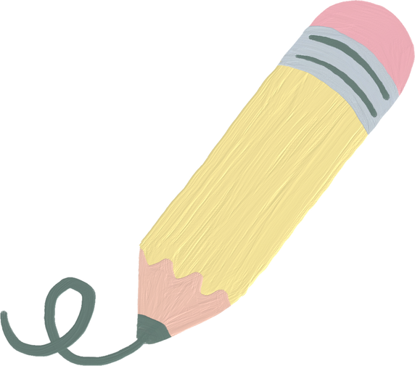

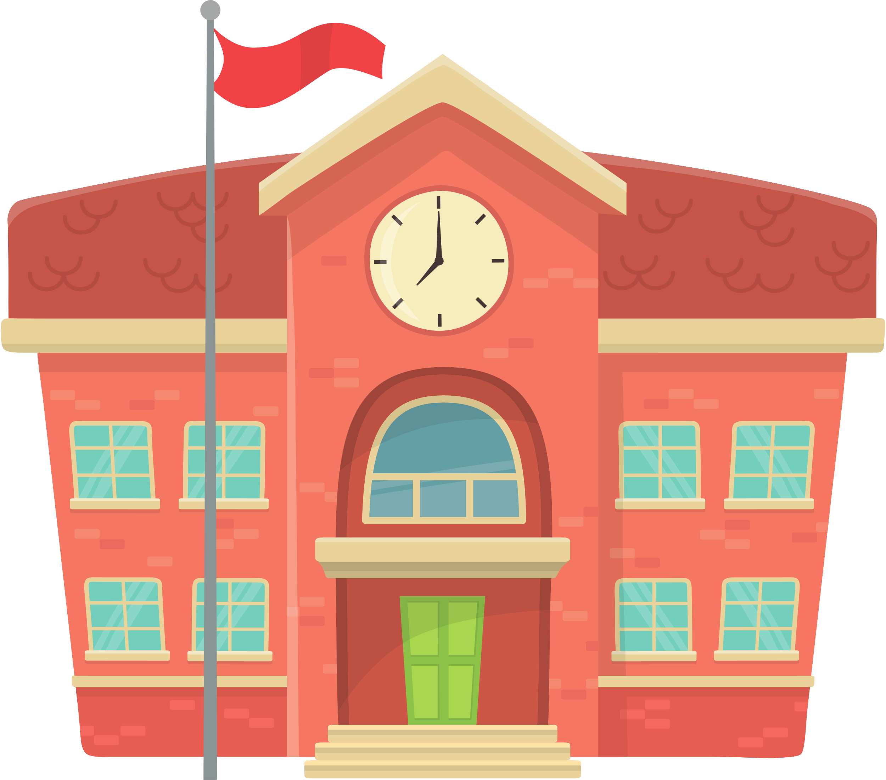
THE RIGHT TO LEARN: MY SAFE SPACE
Draw a picture of our school. Include your favouite and safest places (eg. the classroom, playground or library). Share with the class where you feel the safest and why.
Discussion: What makes a place safe or fun at school?
The energy sources we use today are highly disruptive and damaging to the environment, especially due to the use of hydrocarbon fuels that have increasingly caused global warming.
Notes:
Content:
"Going to school helps you learn new things, make friends, and grow. When you have a good school and feel safe, it’s easier to be happy."
"If something makes you feel sad or stressed at school, you should tell a grown-up."
ACTIVITY: Ask the children to draw a picture of their school, including their favourite and safest places (e.g., the classroom, playground, or library).
Task: Have them share with the class where they feel safest and happiest at school and why.
Discussion Question: "What makes a place safe or fun at school?“

Slide 13


ROLE PLAY: WHO CAN I TALK TO?
As the teacher, pretend to be different people a child might talk to (e.g., a parent, teacher, friend). Ask each child to choose a "feeling" (worried, sad, or scared) and practice talking to one of the trusted adults or friends in the role-play.
Reflection for Children: Who do you feel safe talking to when you feel upset?
The energy sources we use today are highly disruptive and damaging to the environment, especially due to the use of hydrocarbon fuels that have increasingly caused global warming.
Notes:
Content:
"Your feelings are important! If you’re worried, sad, or scared, it’s okay to talk to someone you trust."
ACTIVITY: Role Play: "Who Can I Talk To?"
Description: Create a simple role-playing game where the teacher pretends to be different people a child might talk to (e.g., a parent, teacher, friend).
Task: Ask each child to choose a "feeling" (like being worried, sad, or scared) and practice talking to one of the trusted adults or friends in the role-play.
Example: "What would you say to your mum if you were sad about something at school?"
Reflection Question: "Who do you feel safe talking to when you feel upset?"

Slide 14
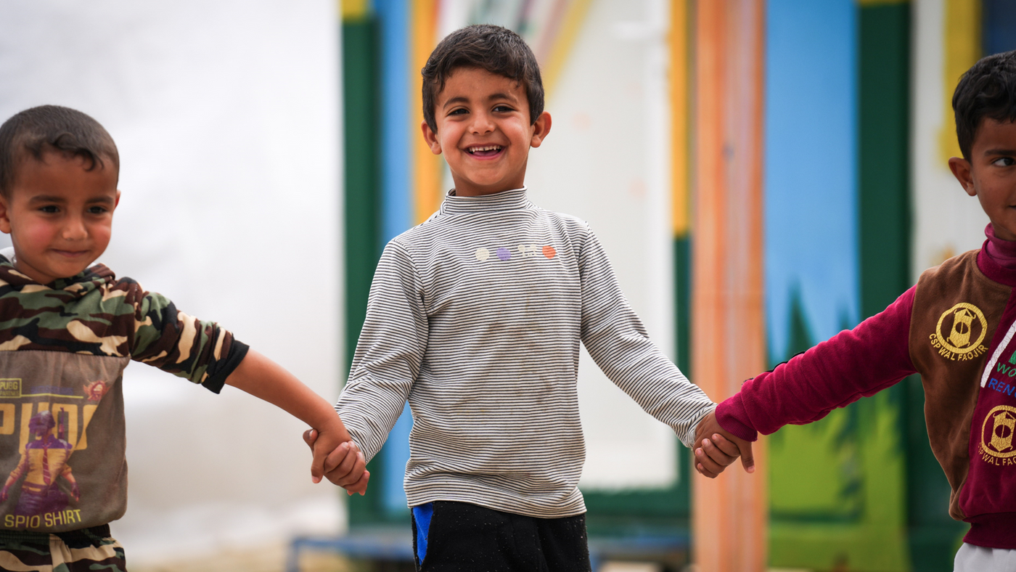
UNICEF/UNI549995
The energy sources we use today are highly disruptive and damaging to the environment, especially due to the use of hydrocarbon fuels that have increasingly caused global warming.
ACTIVITES FOR AGES 7-9
3
Notes:
Iraq, 2024. The camp is located in Debaga, housing 1,253 families or 6,558 individuals. Educational programs, supported by UNICEF and funded by ECHO, focus on both formal and non-formal learning through teacher training, school environment improvements, and catch-up classes, benefiting 1,200 girls and 900 boys in two temporary learning spaces.

Slide 15
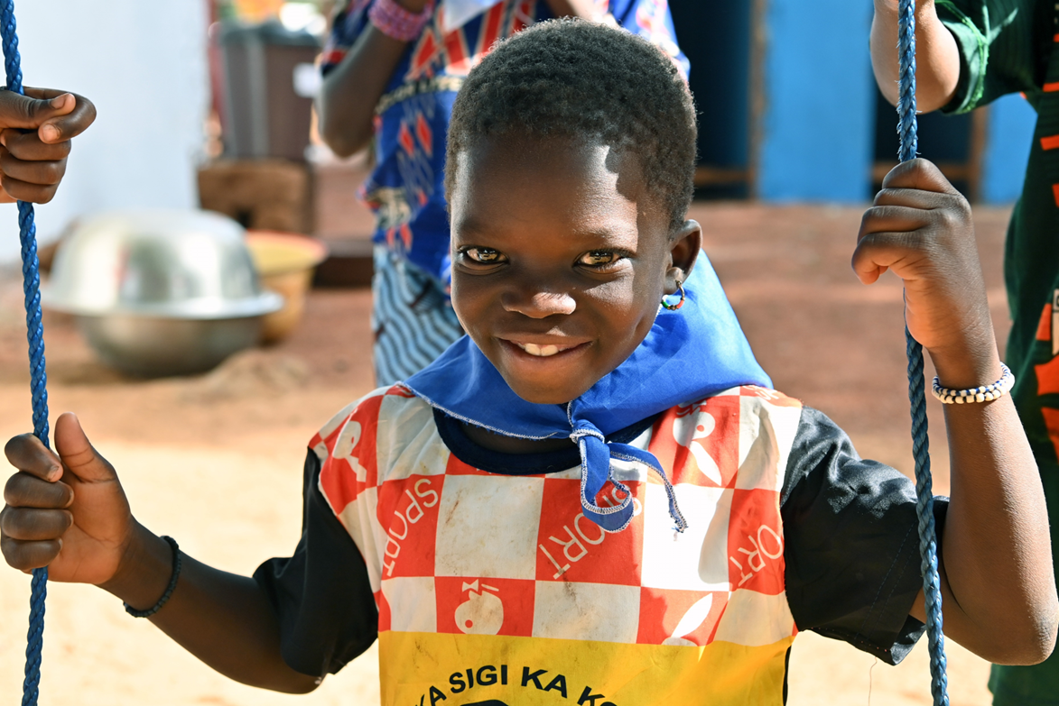
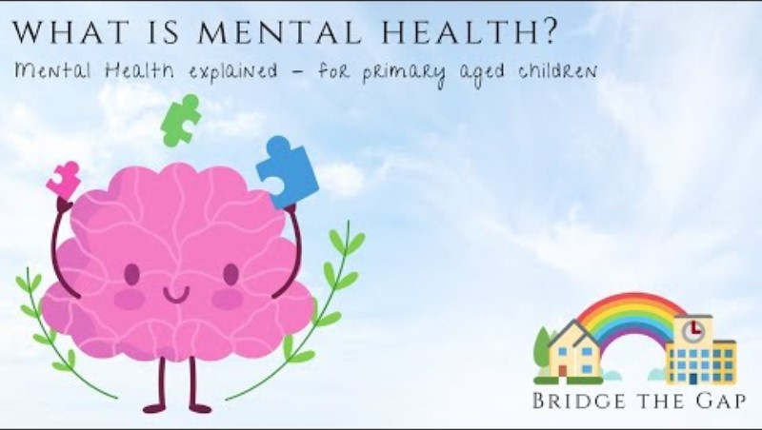
WHAT IS MENTAL HEALTH & WELL-BEING?
UNICEF/UNI557589
Notes:
UNICEF supports the government of Côte d'Ivoire in implementing innovative strategies to prevent malnutrition, involving several sectors, health, agriculture, social policies, education, water, hygiene and sanitation and putting communities at the heart of action for a sustainable approach based on local solutions

Slide 16

YOUR WELL-BEING HAND: THE RIGHT TO BE HEALTHY & HAPPY
Draw an outline of your hand. Think about what you need to feel happy and health. Examples include food, a home, your family, music, etc. Write your list in your ‘’Well-Being Hand’’. Look back at this hand whenever you are in need of comfort.
Notes:
Content:
“Every child has the right to be as healthy as possible. This means it’s important to take care of your body AND your mind!"
Simple examples: "Exercise, play, eat well, and sleep to feel good.“
Ask children: What are the things you need to feel healthy and happy?
ACTIVITY: Ask children to identify what they need to support them feeling happy and healthy, get them to write their own list, that they can go to when they are feeling in need of comfort

Slide 17

THE RIGHT TO LEARN: OUR SCHOOL SAFETY PLEDGE
As a class, work together to create a "School Safety Pledge" where everyone writes one promise about how they will help make school a safe and happy place for everyone. Examples: "I will be kind to others," "I will listen when someone is talking," "I will tell an adult if someone feels unsafe."
Hang the pledge in the classroom to remind everyone of their role in making school a safe place to learn.
The energy sources we use today are highly disruptive and damaging to the environment, especially due to the use of hydrocarbon fuels that have increasingly caused global warming.
Notes:
Content:
"Going to school helps you learn new things, make friends, and grow. When you have a good school and feel safe, it’s easier to be happy."
"If something makes you feel sad or stressed at school, you should tell a grown-up."
ACTIVITY: - As a class, work together to create a "School Safety Pledge" where everyone writes one promise about how they will help make school a safe and happy place for everyone. Examples: "I will be kind to others," "I will listen when someone is talking," "I will tell an adult if someone feels unsafe."
Display: Hang the pledge in the classroom to remind everyone of their role in making school a safe place to learn.

Slide 18

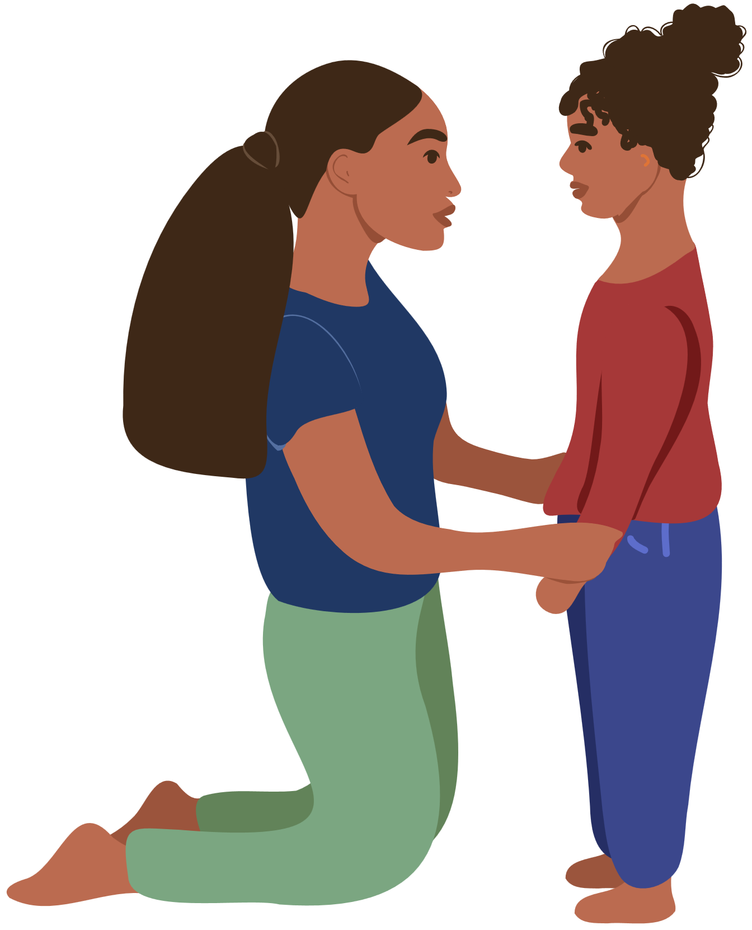
MY CIRCLE OF TRUST: THE RIGHT TO BE HEARD
Draw a circle on a piece of paper and write your name in the centre. Around your name, draw the names of people you trust to talk to when you feel sad, scared or worried. Examples include your parents, teachers, siblings, or friends. Share some of the names you wrote with your class and explain why you trust them.
Discussion: Why is it important to talk to someone when you feel upset?
The energy sources we use today are highly disruptive and damaging to the environment, especially due to the use of hydrocarbon fuels that have increasingly caused global warming.
Notes:
Content:
"Your feelings are important! If you’re worried, sad, or scared, it’s okay to talk to someone you trust."
ACTIVITY: My Circle of Trust
Description: Have students draw a circle on a piece of paper and write their name in the centre.
Task: Around their name, they should write or draw the names of people they trust to talk to when they feel sad, scared, or worried (e.g., parents, teachers, siblings, friends).
Ask them to share a couple of names with the class and explain why they trust that person.
Discussion Question: "Why is it important to talk to someone when you feel upset?“

Slide 19
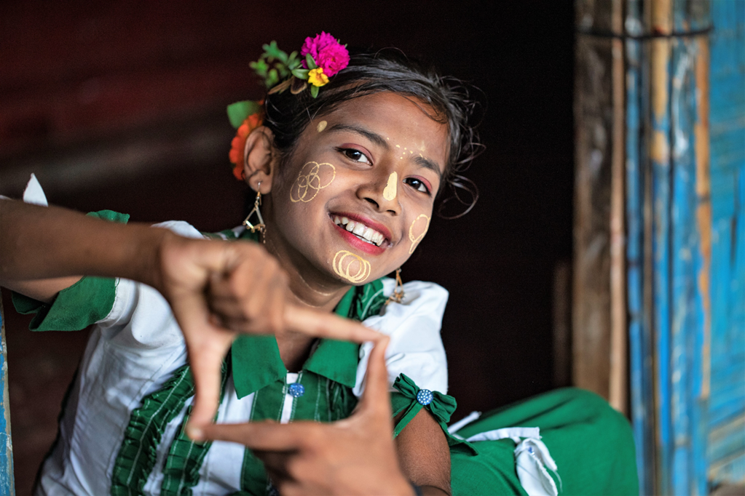
UNICEF/UNI406810
ACTIVITES FOR AGES 10-12
UNICEF/UNI509138
The term "alternative" refers to a technology other than the technology used in fossil fuels to produce energy.
Notes:
Umme Solima, 12, a Rohingya refugee girl stands in front of her home, posing for a portrait on 11 June, 2023 at a Rohingya refugee camp in Cox's Bazar, Bangladesh. Solima attended the One Minute's Jr. Workshop and learned how to film and edit videos from experts. In her one-minute film titled 'Preserving Our Tradition,' Solima showcases the rich tapestry of her community's vibrant heritage and culture.

Slide 20
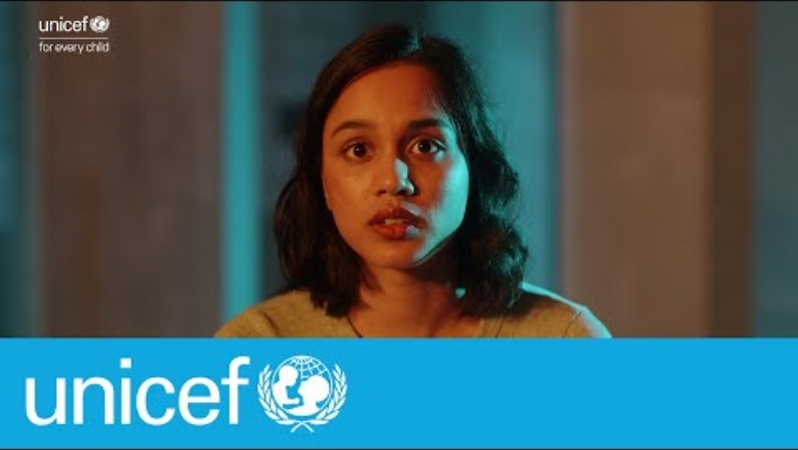
Watch this video. Write down your immediate thoughts and reactions.

Slide 21
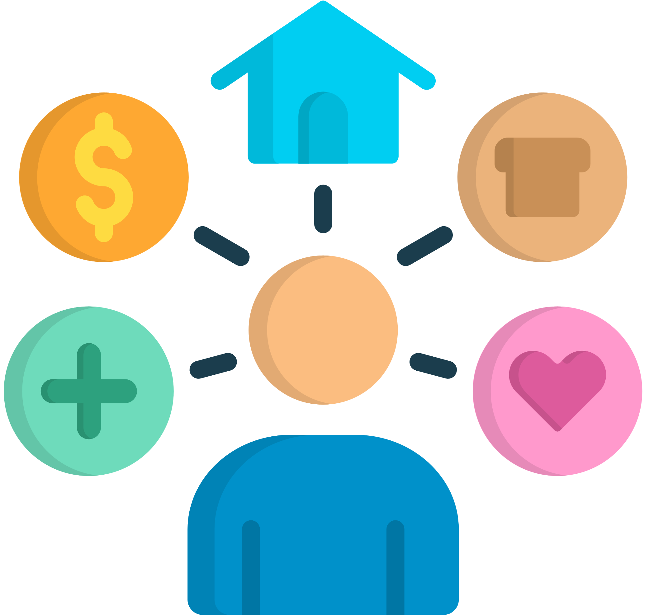
RIGHTS VS. WANTS: THE RIGHT TO BE HEALTHY & HAPPY
In groups, identify and discuss what supports your mental health. On a piece of paper, draw a table of Rights VS. Wants. From your list, write down which are rights and wants. Discuss with each other if any of them should be a right. Share with the class.
Notes:
Content:
“Every child has the right to be as healthy as possible. This means it’s important to take care of your body AND your mind!"
Simple examples: "Exercise, play, eat well, and sleep to feel good.“
Ask children: What are the things you need to feel healthy and happy?
ACTIVITY: Split the class into groups to discuss and identify what supports their mental health and ask them to identify if this is a right or a want or should it be a right.

Slide 22
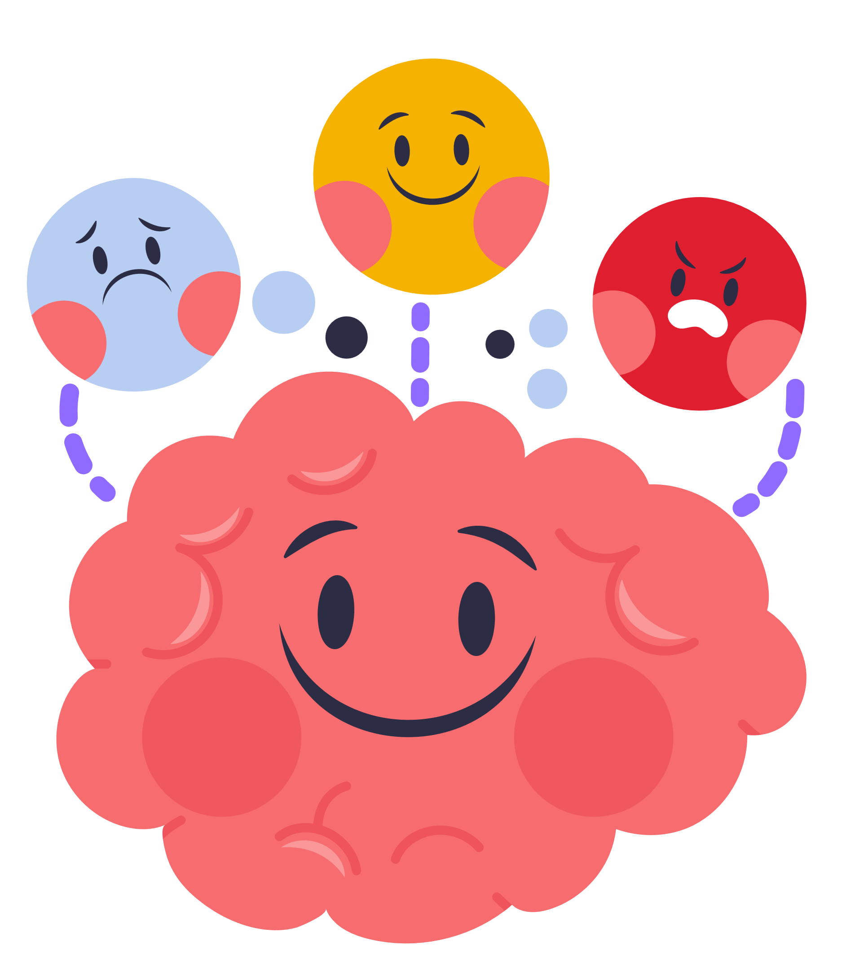
THE RIGHT TO LEARN: OUR SCHOOL, OUR SPACE
In groups, brainstorm how your school can support your mental health and well-being more. Examples can include quiet spaces to relax during break, teachers talking more about mental health in class, or having more activities/clubs that helps students feel more included.
Present your ideas to the class and discuss whether these ideas should be a part of every school to support the right to learn and feel safe.
The energy sources we use today are highly disruptive and damaging to the environment, especially due to the use of hydrocarbon fuels that have increasingly caused global warming.
Notes:
Content:
"Going to school helps you learn new things, make friends, and grow. When you have a good school and feel safe, it’s easier to be happy."
"If something makes you feel sad or stressed at school, you should tell a grown-up."
ACTIVITY: Put class into groups and have them discuss ways their school could support their mental health and well-being more. Examples could include: Quiet spaces to relax during breaks, teachers talking more about mental health in class, ativities or clubs that help students feel included.
Task: After brainstorming, have them present their ideas as a group and discuss whether these ideas should be a part of every school to support the right to learn and feel safe.

Slide 23
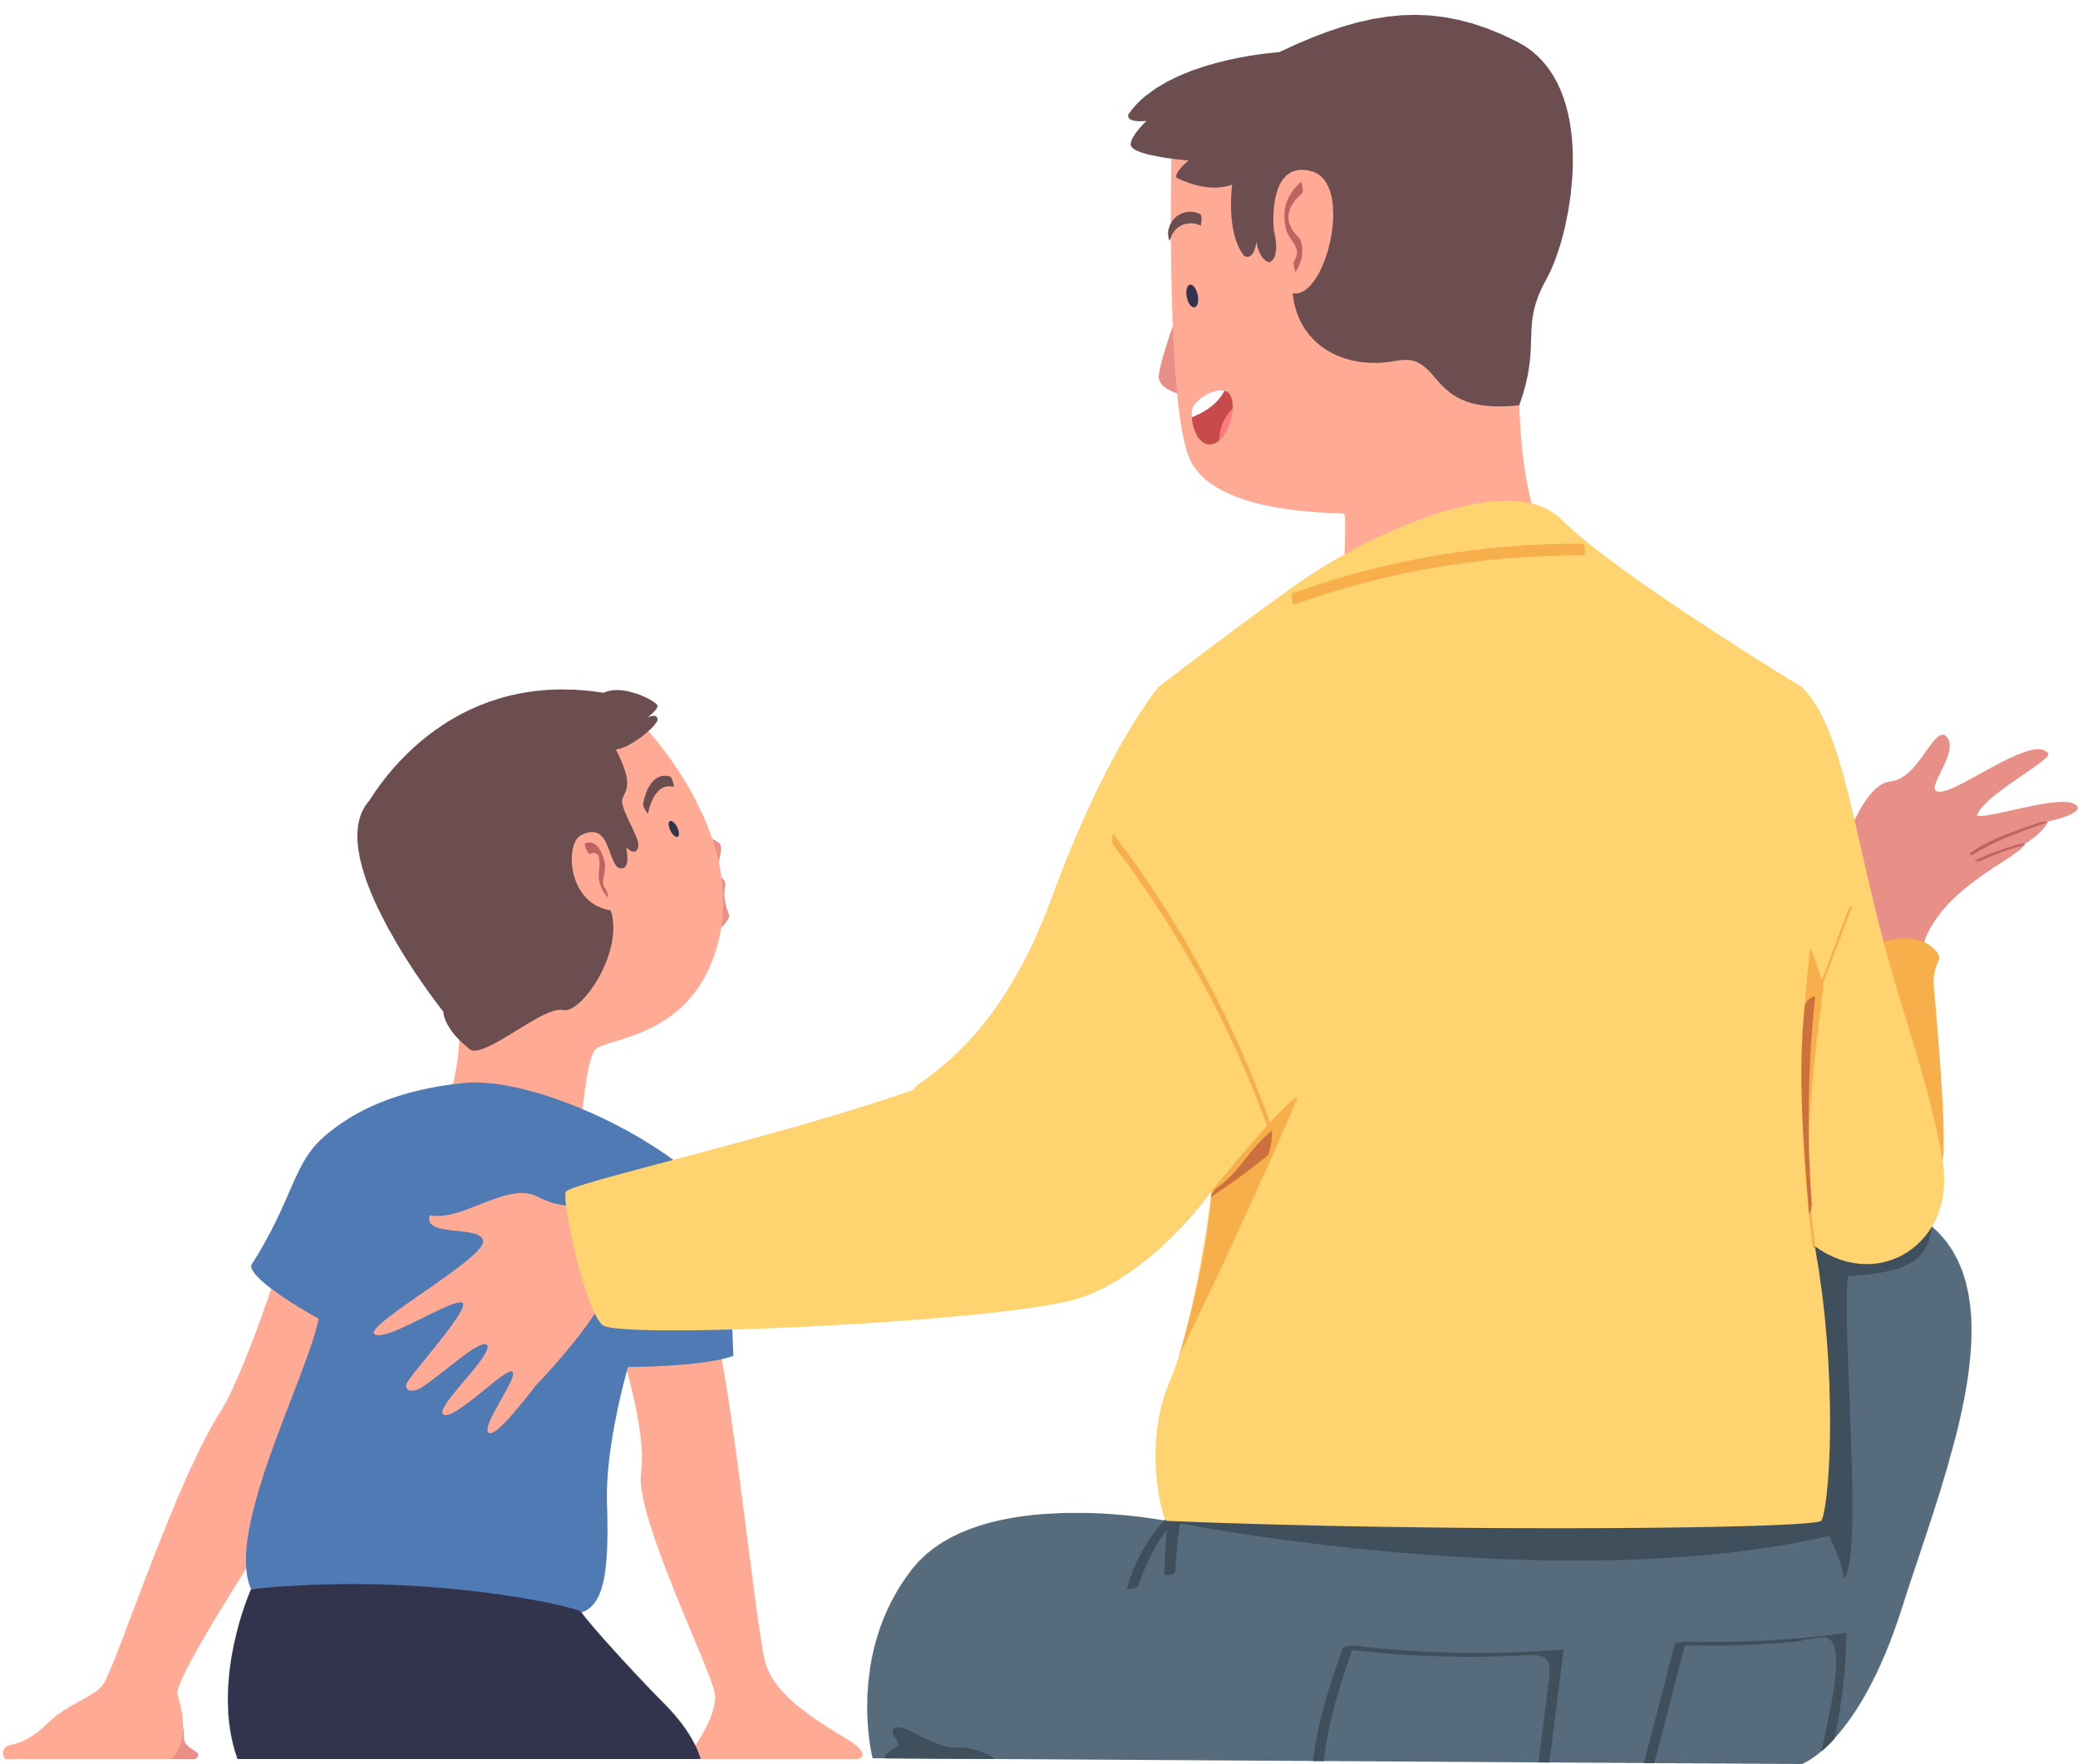
‘’WHAT COULD I SAY?’’: THE RIGHT TO BE HEARD
In groups, create a set of scenario cards that describe situations where children might feel worried, scared, or sad (e.g., "You lost your favourite toy and feel really sad," "You are worried about an upcoming school project," or "A friend said something that hurt your feelings"). Then, pick a card and act as if you are telling someone you trust about how you feel.
Discussion: "Why is it important to talk about your feelings in these situations?"
The energy sources we use today are highly disruptive and damaging to the environment, especially due to the use of hydrocarbon fuels that have increasingly caused global warming.
Notes:
Content:
"Your feelings are important! If you’re worried, sad, or scared, it’s okay to talk to someone you trust."
Activity: “What Could I Say?” Scenario Cards
Description: Put class into groups. Have them create a set of scenario cards that describe situations where children might feel worried, scared, or sad (e.g., "You lost your favourite toy and feel really sad," "You are worried about an upcoming school project," or "A friend said something that hurt your feelings").
Task: Have children pick a card and take turns saying what they would tell someone they trust about how they’re feeling. For younger kids, keep the scenarios simple. For older kids, use more complex situations.
Discussion Question: "Why is it important to talk about your feelings in these situations?"

Slide 24
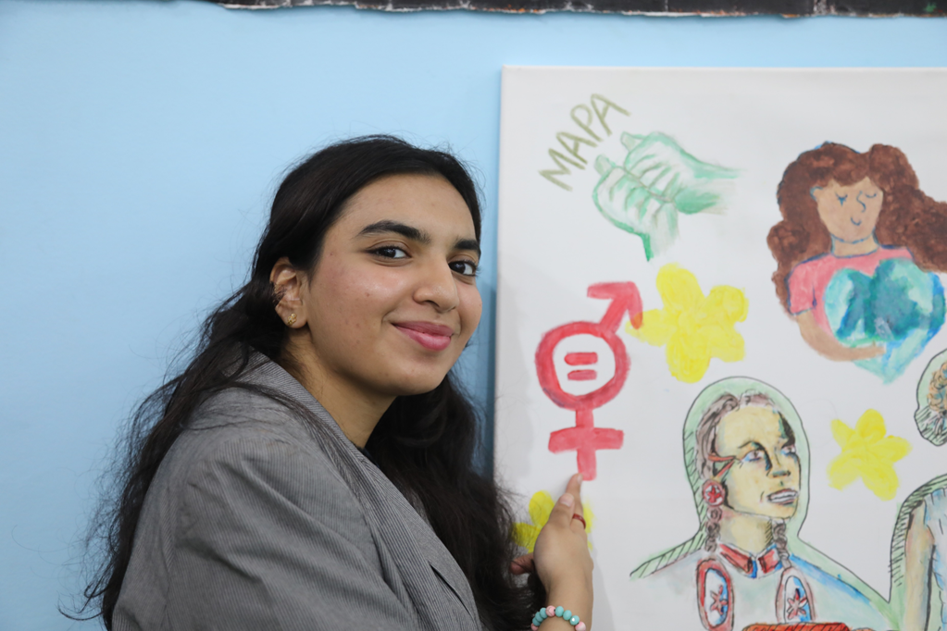
Reflection
Find somewhere quiet and give yourself time and space to think about the following:
Everybody has mental health – all the time! Most people have times when their mental health is not as good as it is at other times.
Education about health and wellbeing is part of Article 24.
  What have you learnt recently about your own mental health?
  What have you learnt about supporting the mental health of others?
  How do the other rights you enjoy support your mental health and wellbeing?
UN0734214
Notes:
Highlights from an arts workshop at the Children and Youth Pavilion at COP27. This arts workshop is led by the Technical Cohort to Advance Adolescent Girls' and Young Women's Leadership in Climate Change which is supported by UNICEF and Karama (a regional women's rights network) . After leading a session of Gender Equal Adaptation Strategies, the adolescent girls and young women invited their peers to express what gender justice and environmental justice means for them.

Slide 25
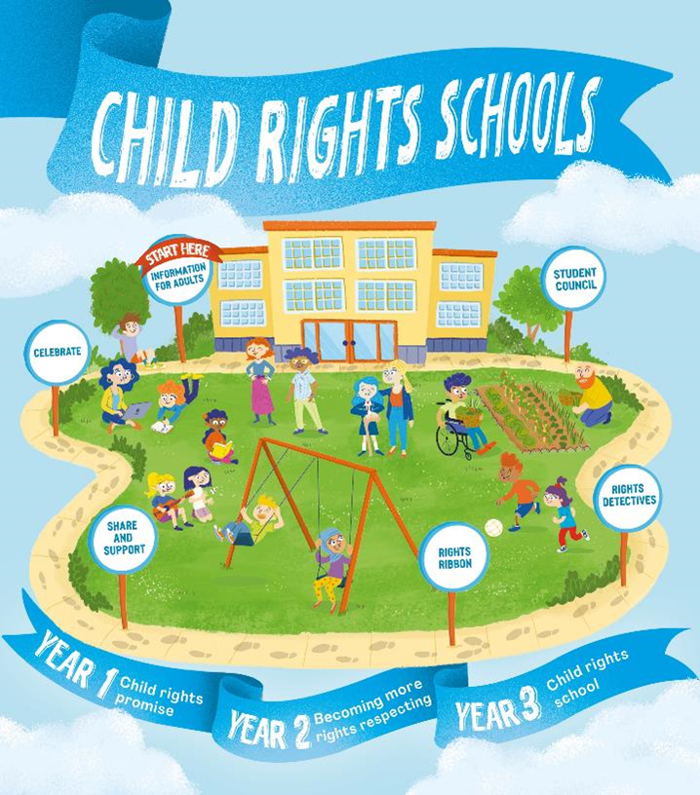

FURTHER CHILD RIGHTS EDUCATION SUPPORT
Child Rights Schools is a programme that supports you to embed child rights across the whole school community, including with parents and carers. Find our more here.
Find more classroom resources here.

Slide 26

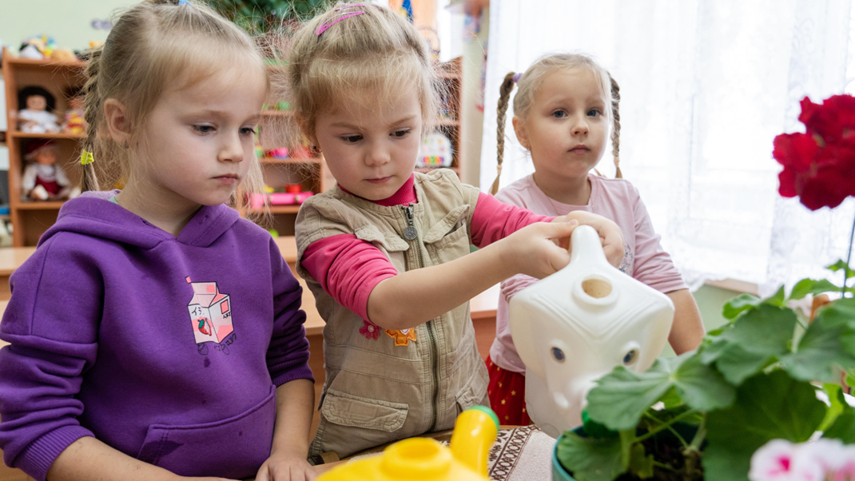
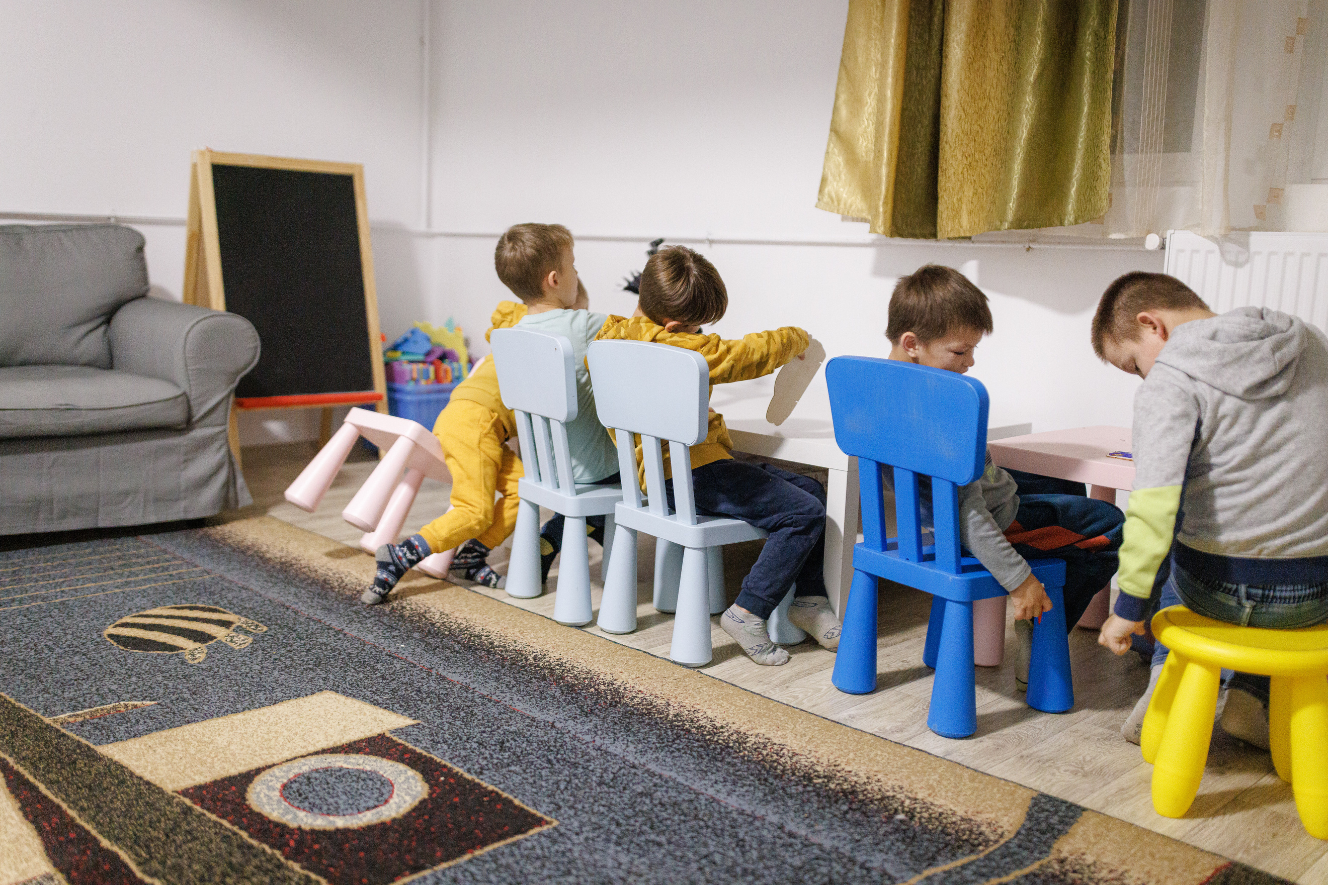
thank you
UNICEF/UNI497935
Notes:
November 22, 2023, Vasylkiv, Ukraine. Every day children at the preschool interact with water: in addition to hygienic procedures, they are shown how to water flowers.

