Slide 1
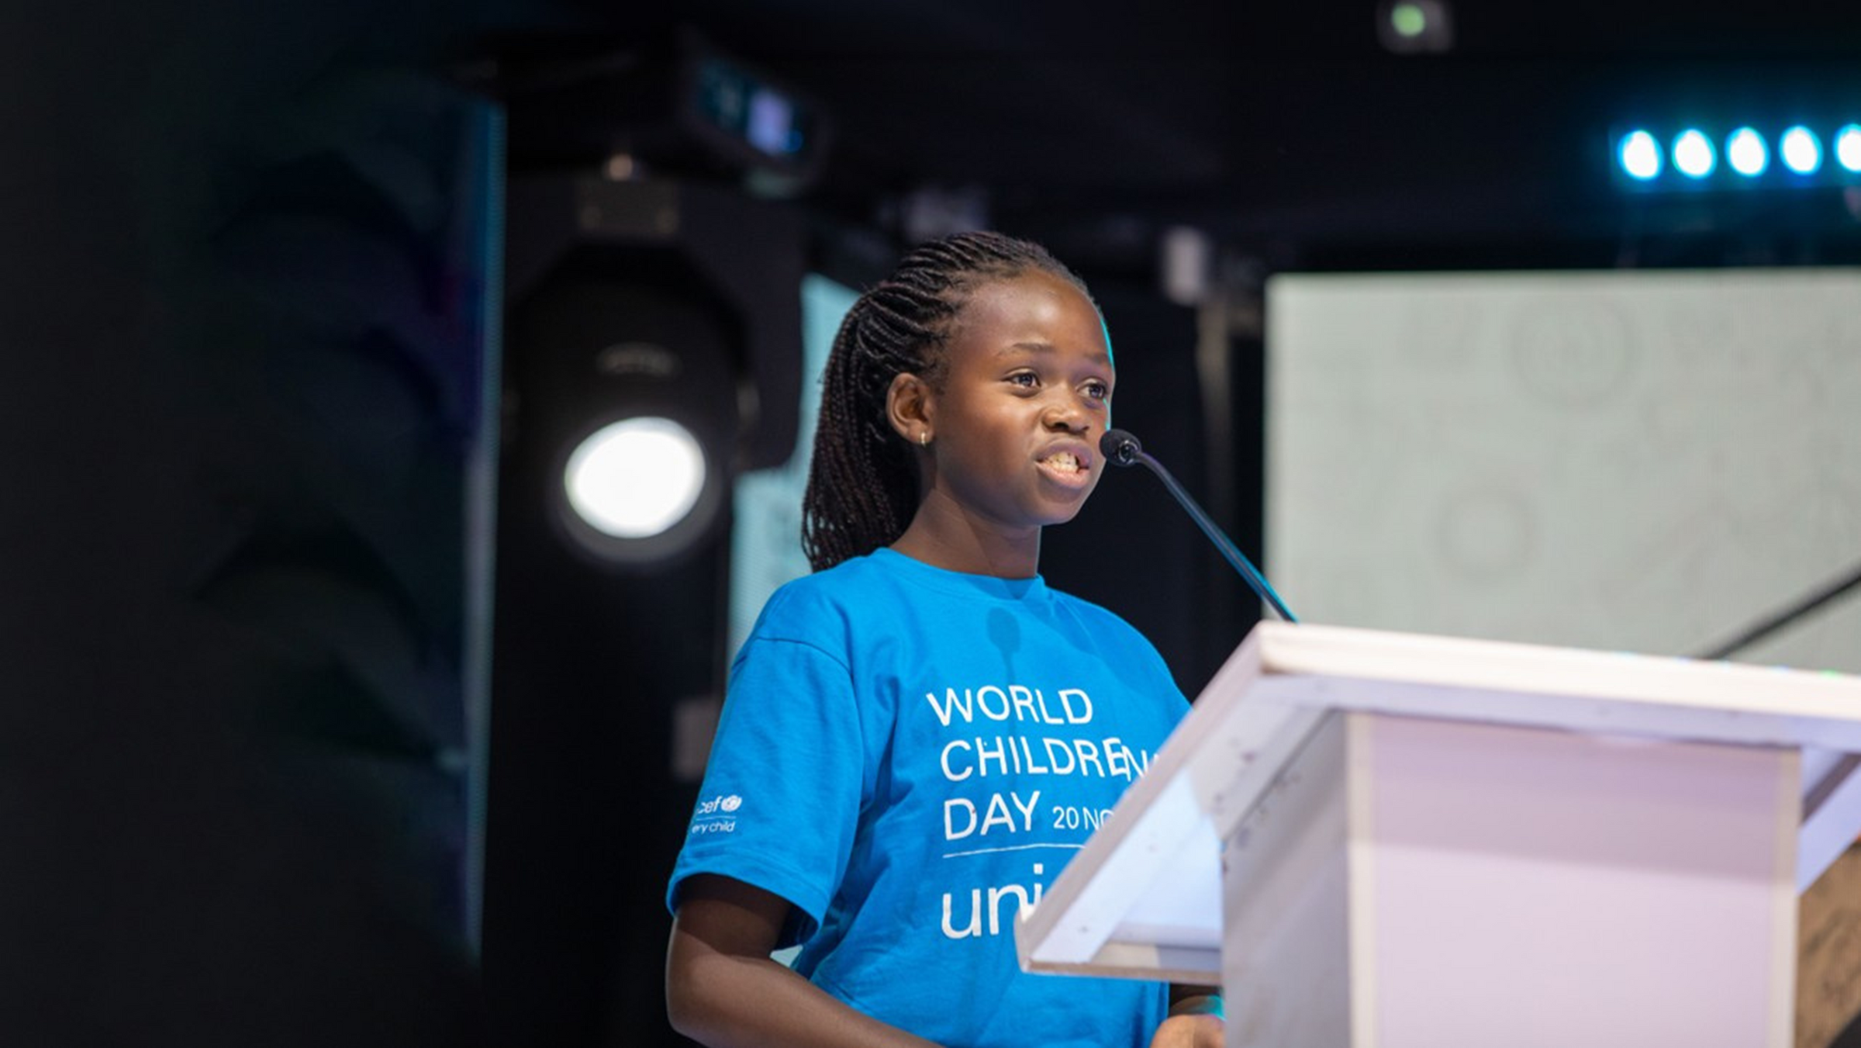

WORLD CHILDREN’S DAY

Slide 2
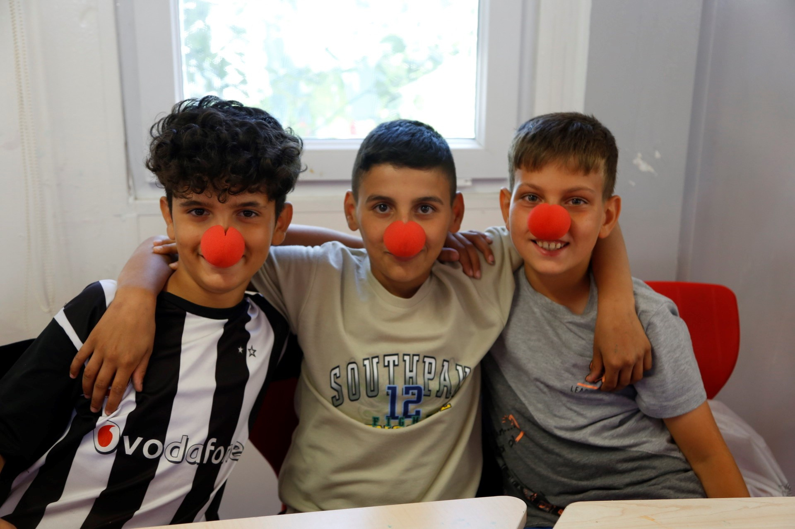
BEFORE YOU BEGIN
    We strongly recommend completing this week’s pack in class with teacher supervision and not setting this pack, or activities from this pack, as homework. This is a flexible resource and is intended to provide you with some easy to use, appropriate rights-related learning to share with your children, their families and your colleagues.
    Please edit out non relevant slides or activities before sharing with your students. Please check that the content works for your learners and feel free to adapt or add any content that would make the material more relevant for your setting.
    Some activities in this pack have been adapted from the World’s Largest Lesson resource.
UNICEF/UNI482372
UNICEF/ UN0841967
Notes:
Three friends in a child friendly space at a temporary accommodation shelter in Hatay, after two devastating earthquakes hit south-east Türkiye on 6 February 2023.

Slide 3


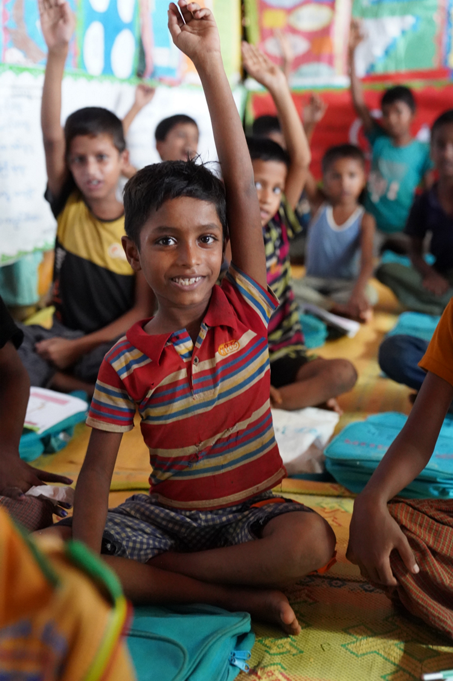




UNICEF/UN0751763
The energy sources we use today are highly disruptive and damaging to the environment, especially due to the use of hydrocarbon fuels that have increasingly caused global warming.
WHAT IS WORLD CHILDREN’S DAY?
Notes:
“What’s the date today? (20th November) Why is today special? Is it anyone’s birthday today? Why else is today
special? Today is World Children’s Day! But what does that mean?
Image: A Rohingya refugee boy raises his hand at a UNICEF learning centre. Over 866,000 Rohingya refugees are living in Cox’s Bazar, 54.2 % of whom are children. UNICEF is implementing the Myanmar formal education curriculum in the camps. Education offers Rohingya children stability and structure to help them cope with trauma and gives them a sense of hope. It also protects them from child marriage, child labour, sexual exploitation and other social ills.

Slide 4
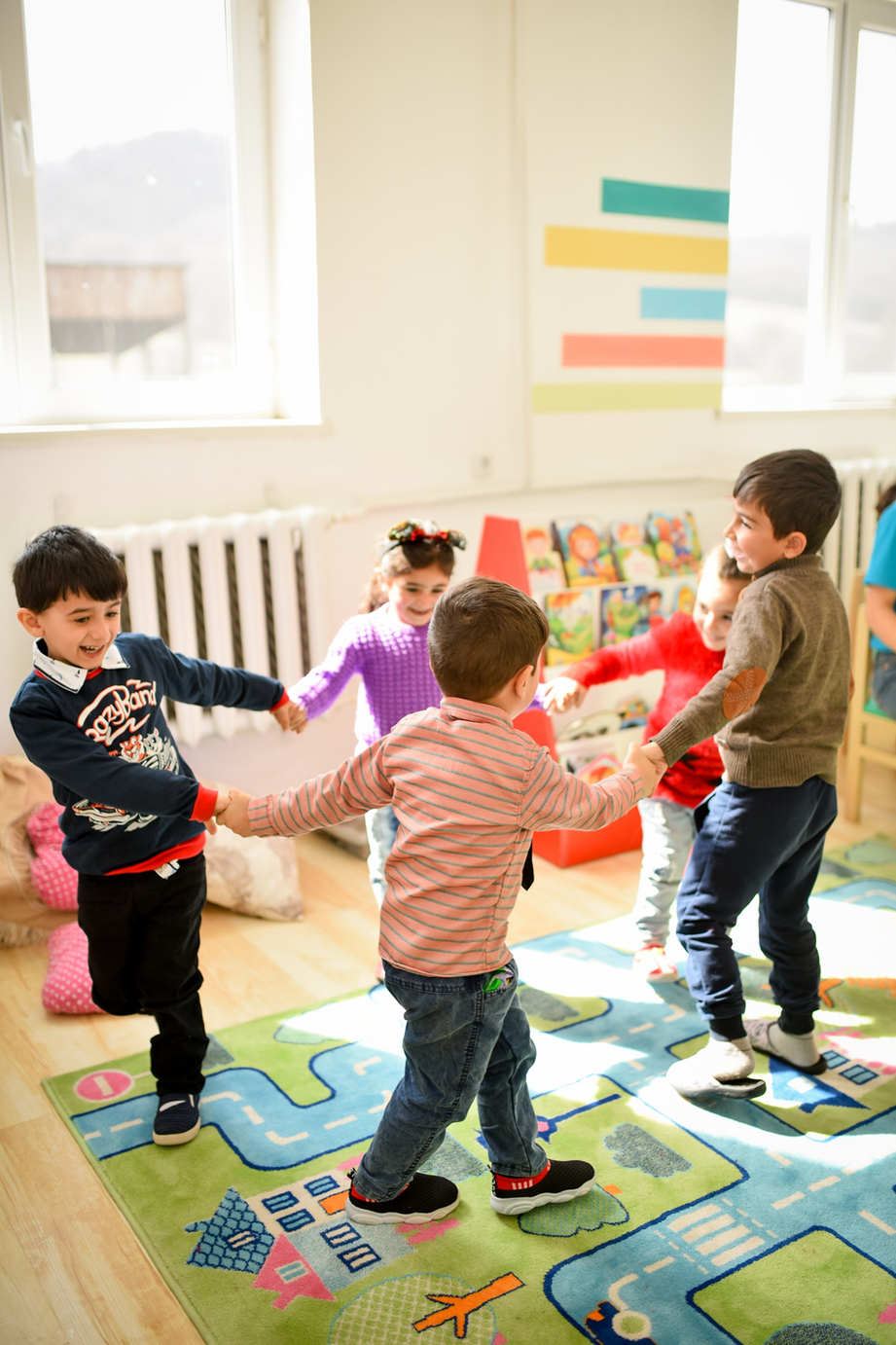
WHAT IS WORLD CHILDREN’S DAY?
World Children’s Day takes place each year on 20 November. The day marks the United Nations General Assembly’s adoption of the Declaration of the Rights of the Child in 1959 as well as the Convention on the Rights of the Child (UNCRC) in 1989.
In 2024, World Children's Day calls on adults to listen to the future. By listening to children, we can fulfill their right to self-expression, understand their ideas for a better world and include their priorities in our actions today.
UNICEF/UNI557589
UNICEF/UN0366601/Margaryan

Slide 5



Listen to the Future!
  This year, the global theme for WCD is “Listen to the Future”, encouraging children to envision the future of their local, national, and global communities. We are inviting Child Rights Schools to take part in World Children’s Day, asking children to reflect on how their communities can better respect and uphold the rights of all children as they share their hopes for the future.
  On World Children’s Day, children can imagine what they want the future to look like, and what changes need to be made to make it a reality. It is a day of action for children, by children. This links to Article 12 in the Convention, as children have the right to give their opinions freely on issues that affect them.
The term "alternative" refers to a technology other than the technology used in fossil fuels to produce energy.

Slide 6
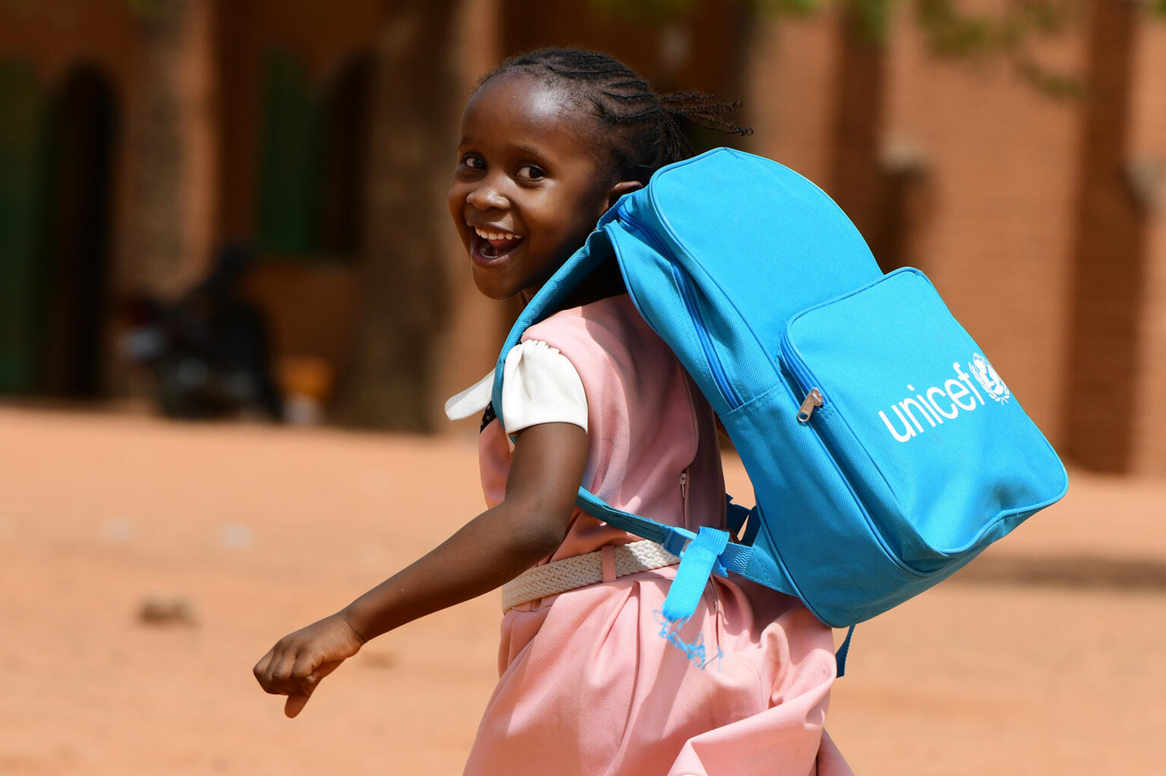
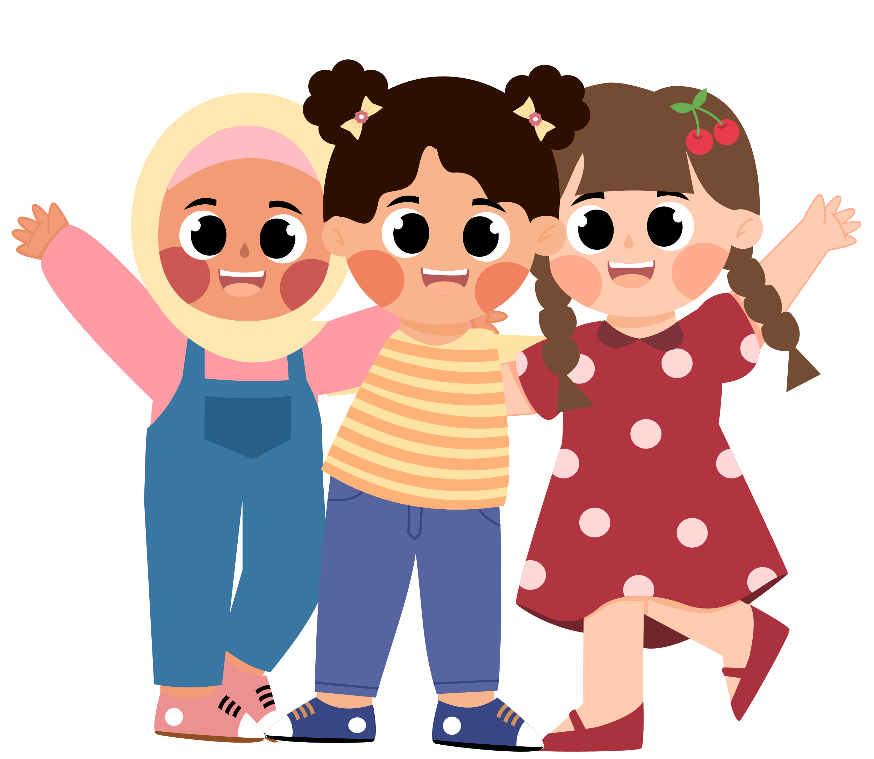
What does the word ‘childhood’ mean to you?
Write down your ideas on a piece of paper. If you feel comfortable. Share with your class during discussion time.
© UNICEF/UN0439618/Dejongh
Notes:
Note to educators:
This first step is a discussion with students about what childhood means to them. It could be a short starter to your lesson, or you may wish to have a longer discussion referring to all the questions suggested below.
Ask students: What does the word childhood mean to you?
Oxford Dictionary definition: The state or period of being a child.
Ask students to note down some ideas on a piece of paper. They do not need to share these with anyone else in the
class if they do not want to.
Have a class discussion and take feedback and ideas from different members of the class.
Next show the illustrations.
Image: Child in the playground of her school in Niamey. Niger

Slide 7
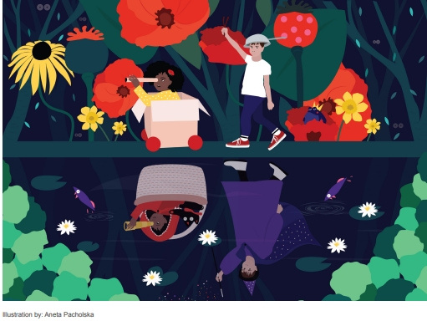
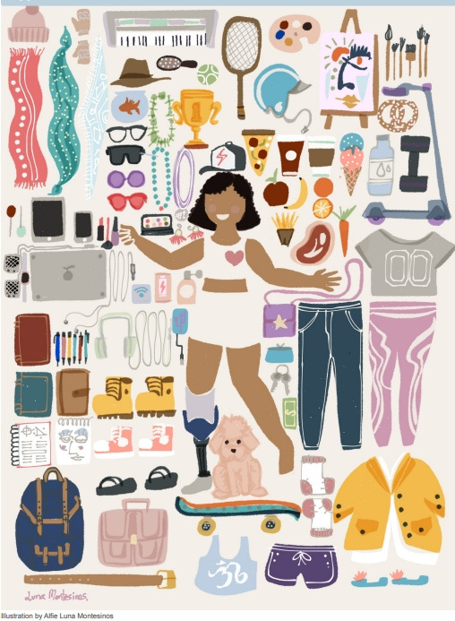
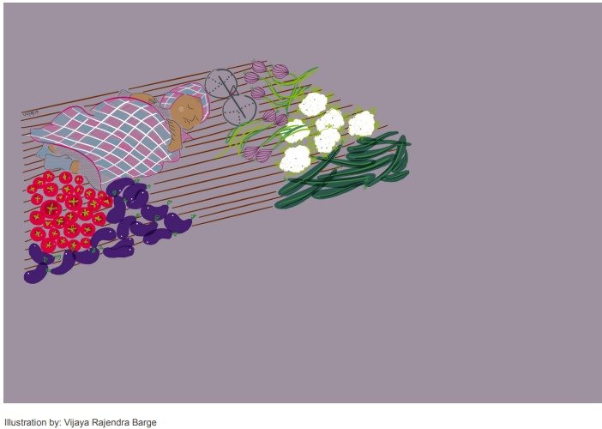
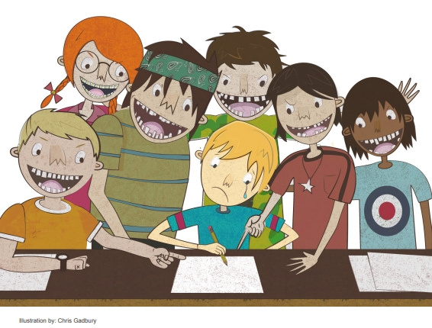
Notes:
4 of different perspectives of childhood from different artists around the world. Ask students:
- Are these all images of childhood?
-What similarities do you see between your childhood
and the artist’s depiction?
-What differences do you see?

Slide 8
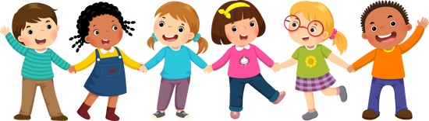


EXPLORING IDEAS ABOUT CHILDHOOD
  When does childhood start and finish?
  Do you think childhood is the same for children everywhere?
  How might childhood in Ireland be different and/or similar to childhood in (name a different country to the one you are living in).
  What’s important for a ‘good’ childhood?
Notes:
For teachers: After a class discussion, ask students to refer to their ideas on childhood that they wrote at the beginning of the lesson.
Have any of their ideas on childhood changed? Is there anything else they would like to add? Did any of the class
discussions prompt a new idea in their head?
Identify some key themes that everyone in the class believes are important to childhood.

Slide 9
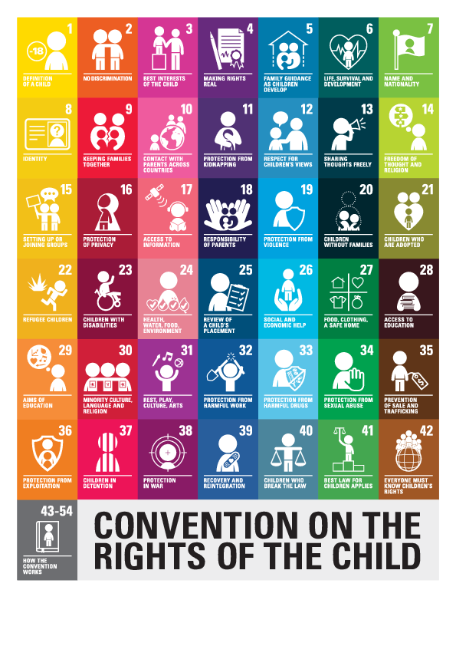
Notes:
Explain to students that they are not the only ones who have been thinking about childhood and what it means to be a child. Thirty years ago, the United Nations (nearly all the governments in the world) agreed on a legally binding document called the Convention on the Rights of the Child. This includes 54 articles that set out children’s rights and how governments should work together to make
them available to all children.
Ask students to refer to their initial ideas about childhood from the beginning of the lesson. Can they see where their initial discussions on childhood link into the Convention on the Rights of the Child?

Slide 10



WHOLE-SCHOOL ACTIVITIES
Take a look at this document for activities to complete throughout the week with your entire school. This includes activities like the #KidsTakeover, Turning the World Blue, and other activities that encourage children to lead and take action!
World Children's Day- Activity Ideas

Slide 11
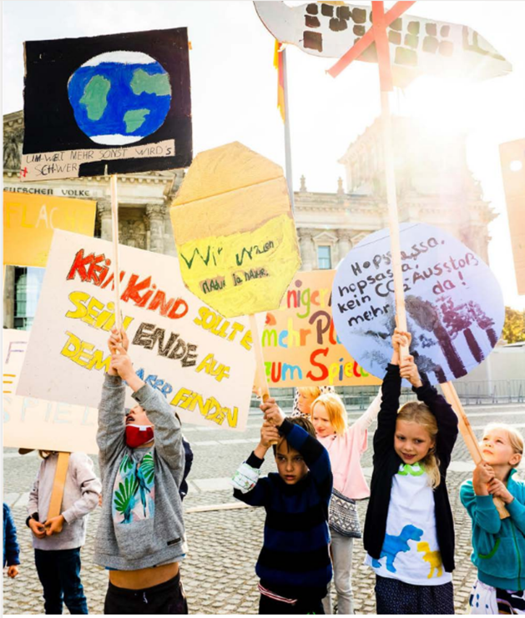
ACTIVITES FOR AGES 4-6
UNICEF/UNI372155/Zimmermann

Slide 12
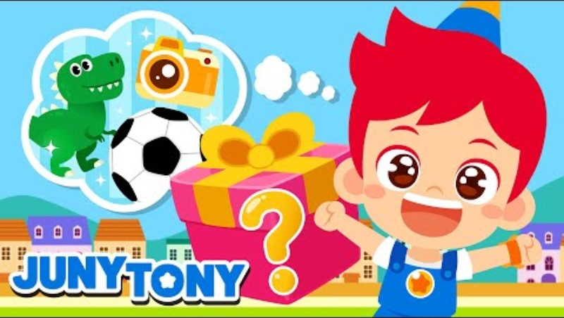
World Children’s Day Song

Slide 13

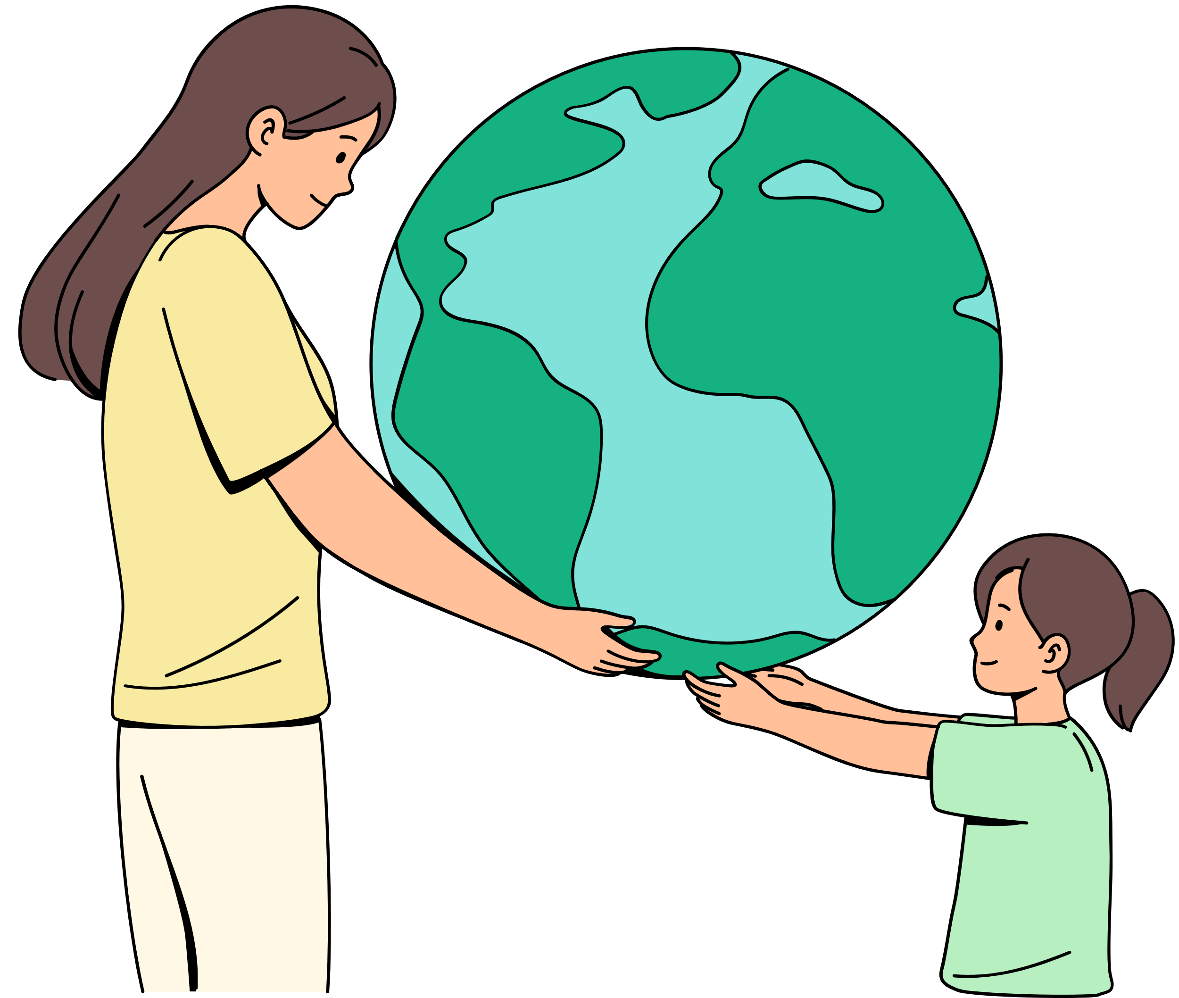
HOPE FOR THE FUTURE
Close your eyes and think about the future. What would the world look like if everything was perfect? How would life be for all children in the world? Draw or describe what this future full of hope looks like.
Now that you’ve imagined a hopeful future, what do we need to do to make that happen? What can you do to help? Complete the sentence: "I will create hope for the future
by…"
Discussion: Share your statements and pictures with your peers.
Notes:
"Today, you get to think about how you can help create a hopeful future. We’ll be
sharing how we will create hope for the future by finishing the sentence: ‘I will
create hope for the future by…’”
Step 1: Imagine the World in the Future
-Ask the students: Close your eyes and think about the future. What would the
world look like if everything was perfect? How would life be for all children in the world?
Prompt students with questions like:
-"What will schools look like? Will they be different?"
-''How would children be treated?''
- "How will we treat our planet?"
-"What cool things can we do with technology?"
Step 2: Draw or Describe the Future
-Give the students a few minutes to either draw or describe what they think a future full of hope looks like.
-Encourage them to be creative and think big!
Step 3: I hope to...
Tell the students that now that you’ve imagined a hopeful future, what do we need to do to make that happen? What can you do to help? Guide students with simple prompts:
■ "Maybe you want to plant trees to help the Earth."
■ "Or maybe you want to help people learn new things or stand up for
fairness."
Ask each student to complete the sentence: "I will create hope for the future
by…"
Examples for this age group:
■ "I will create hope for the future by planting flowers to help bees."
■ "I will create hope for the future by helping my friends when they need it."
Reflection and Discussion: Have students share their "I will create hope" statements with the class. Give them the option to share drawings they made earlier or explain them.
Summarize the activity and emphasize that their ideas matter. "Remember, you are part of building a better world. Your actions, no matter how small, create hope!"

Slide 14

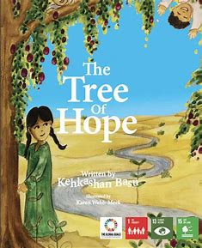
READ ALOUD: THE TREE OF HOPE
Read about the story of a girl named Khadra who makes a difference, rising beyond conflict and drought, by planting and caring for trees, to benefit her whole community.
Notes:
Link to The Tree of Hope: https://worldslargestlesson.globalgoals.org/wp-content/uploads/2020/08/The-Tree-of-Hope.pdf
Copy the link to your browser and you will be prompted to save as a PDF on your computer. You can then read using PDF.

Slide 15


CHILD RIGHTS THROUGH ART
Choose a right from the Convention that is important to you. Create a drawing, poem, painting or write a story about this right!
Discussion: Show your creative piece to the class and describe why you chose your right.
The energy sources we use today are highly disruptive and damaging to the environment, especially due to the use of hydrocarbon fuels that have increasingly caused global warming.

Slide 16
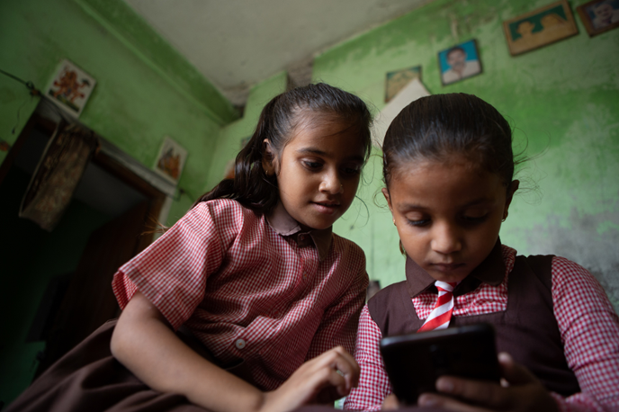
ACTIVITES FOR AGES 7-9
UNICEF/UN0657546
The energy sources we use today are highly disruptive and damaging to the environment, especially due to the use of hydrocarbon fuels that have increasingly caused global warming.
3
Notes:
Ayushi and Ankita, both 8 years old, study in the same class in Uttar Pradesh, India. They play a game of Ludo on Ankita’s mobile phone.

Slide 17
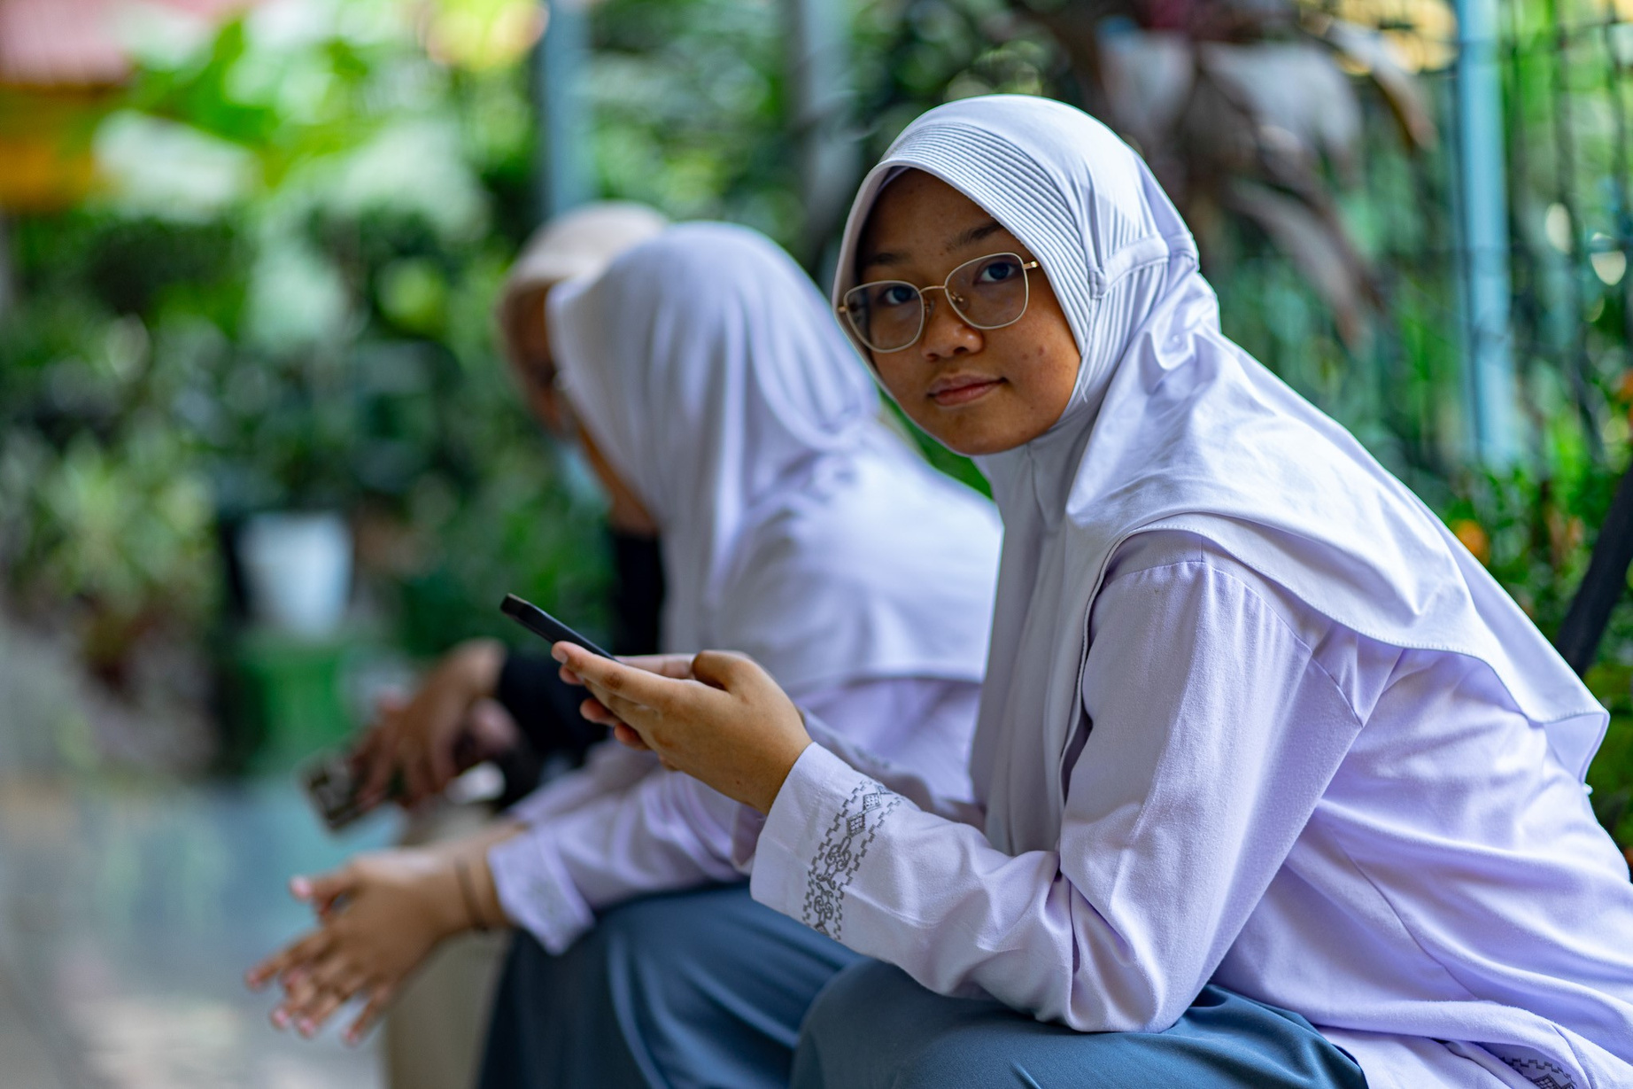
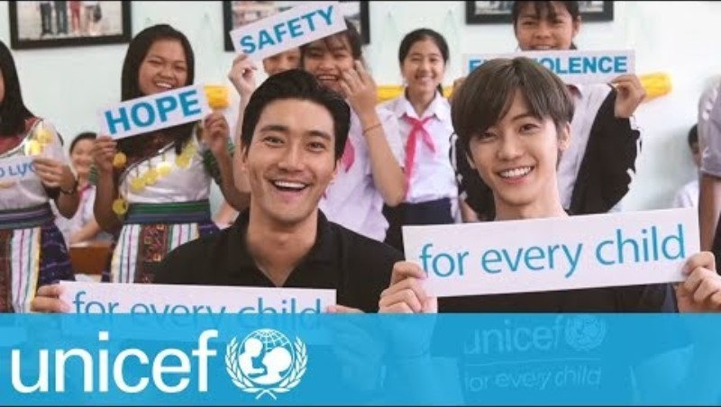
VIDEO
Notes:
Diba (16), student of SMAN 112 Jakarta, West Jakarta, browses on her mobile phone in front of her classroom.

Slide 18



THE FUTURE OF CHILDHOOD
In groups, work together to create your own vision of a future of childhood where all children have their rights respected. Choose from the following ideas:
  Write a newspaper article about the challenges children face in enjoying their rights, or an imaginative “Future News” headline and article dated 30 years from now when all children have equal access to all their rights all over the world and how this was achieved.
  Create a collective drawing/painting of the world where all children have the opportunity to experience a rights respecting childhood.
  Write a rap or song that describes a student’s vision of the future of childhood.
The energy sources we use today are highly disruptive and damaging to the environment, especially due to the use of hydrocarbon fuels that have increasingly caused global warming.
BE CREATIVE!
Notes:
Explain to students that now they have a greater understanding of some of the challenges children face,
they are going to create their own vision of a future of childhood where all children have their rights respected.
Allow students the choice in how they would like to express their future of childhood. Some ideas include:
• Writing a newspaper article about the challenges children face in enjoying their rights, or an imaginative “Future News”
headline and article dated 30 years from now when all children have equal access to all their rights all over the world,
and how this was achieved.
• Creating a poem on their own vision of a future of childhood.
• Drawing/painting a picture of the world where all children have the opportunity to experience a rights respecting
childhood - you may want to refer to the illustrations in Appendices 1, 2, 3 & 4.
• Writing a rap or song that describes a student’s vision of the future of childhood.
• Write a short chapter/paragraph on their vision of the future of childhood, which could then be compiled together to
make a class book

Slide 19
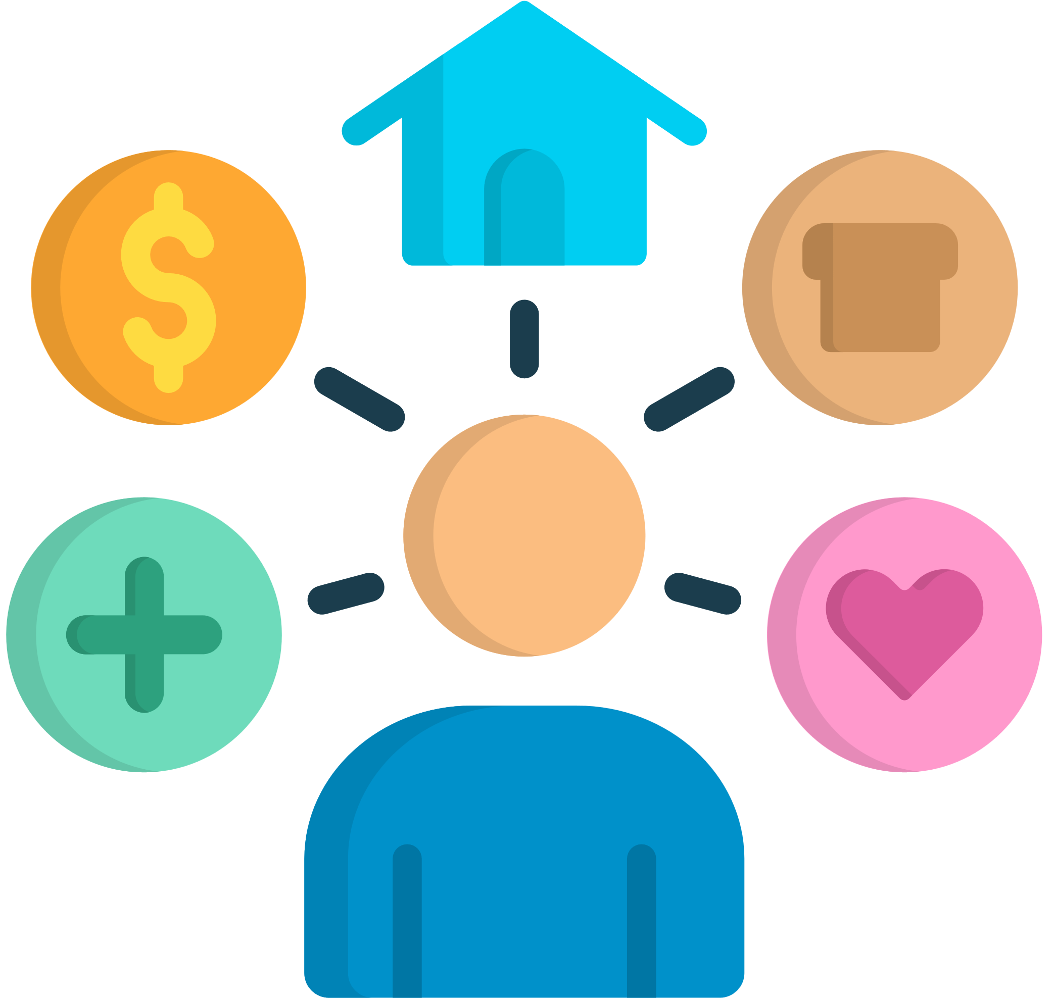
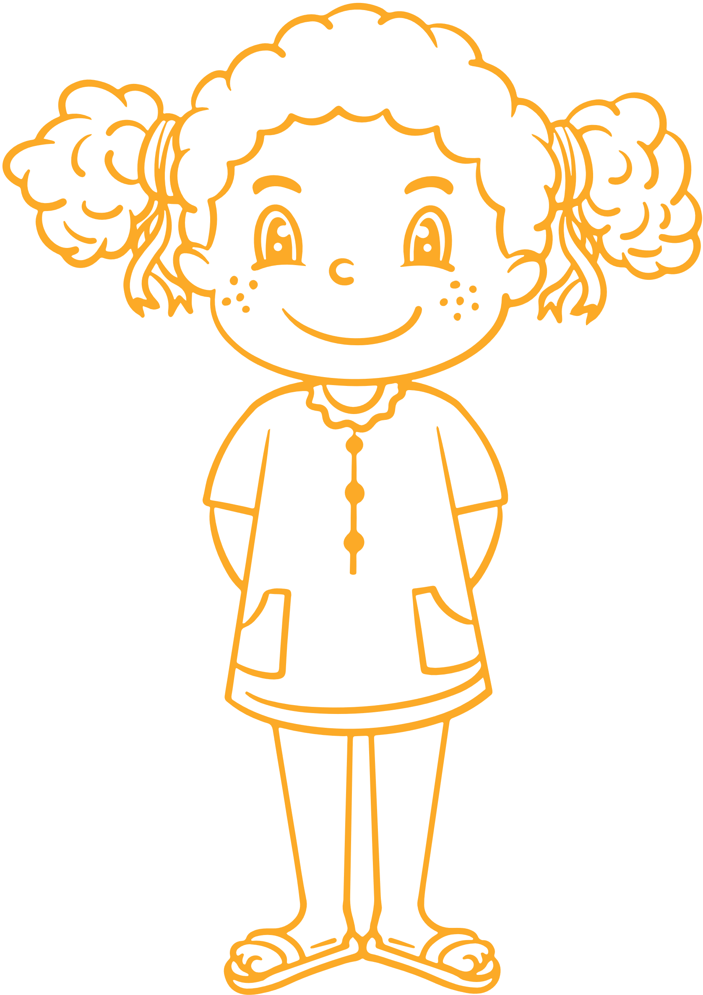
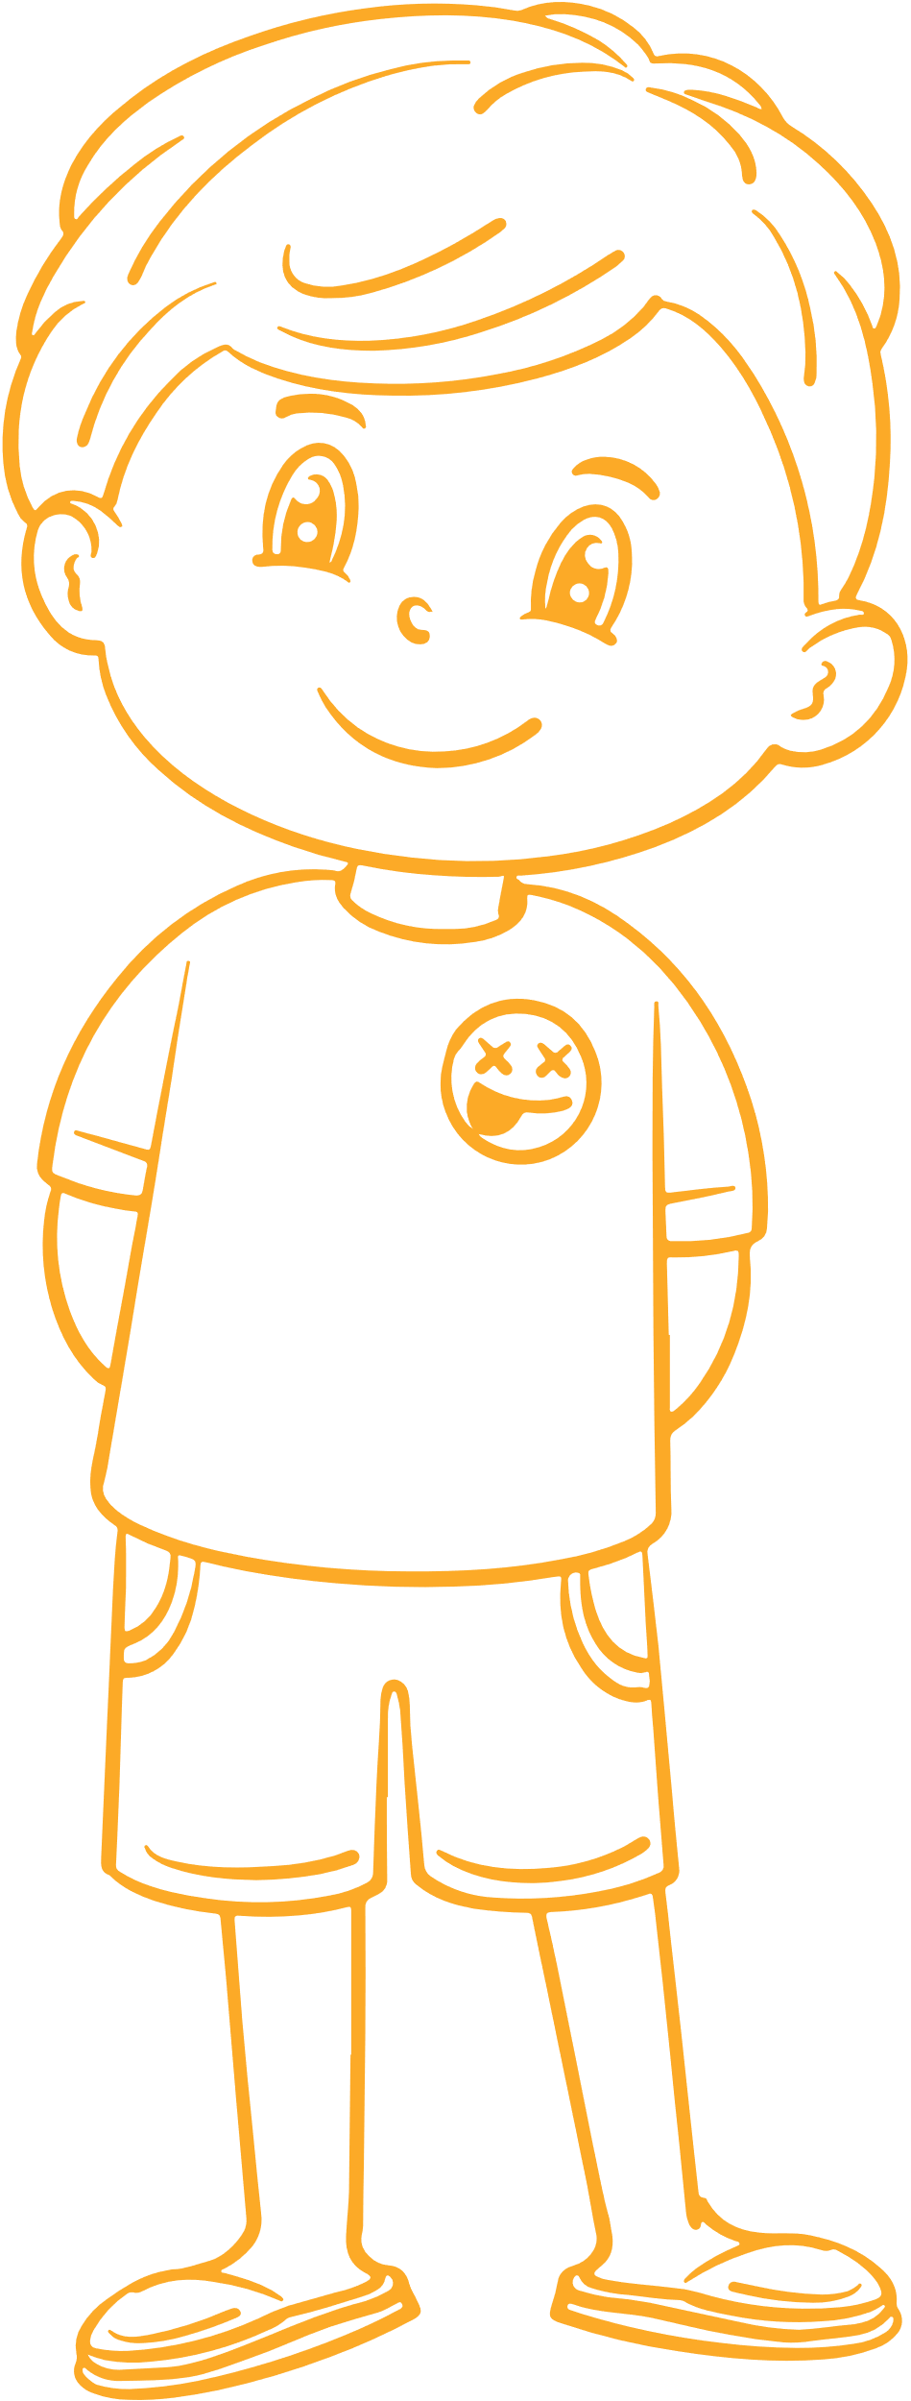
UNDERSTANDING NEEDS VS. RIGHTS
Draw an outline of yourself. Write or draw what you think all children need to grow up and develop into the best person they can possibly be.
Discussion: Choose one thing that every young person in the world should have and describe it as a right (e.g. ‘’The right to’......’’. Why is it important to speak up for children’s rights?
Notes:
Activity: Expect students to express ideas like ‘love’, ‘safety’, ‘education’, ‘friends’, ’food’ etc.
Clarifying the Difference between Human Rights VS Human Needs
Ask if anyone has anyone heard of human rights. “What are they?” Refer to the list of needs generated in
Step 2 and ask whether any of them are rights too?
Encourage feedback and examples. Test understanding by suggesting some rights and needs and asking which they are, or if they are both. You could set these up on a board or screen in advance or call them out. They should be relevant to your country and setting. Add in some that are neither rights or needs but simply “wants” such as games and toys.
Use these examples to prompt if necessary:
Mobile phone
Games and toys
A name
To give an opinion
Privacy
Healthcare
Food
Water
A safe environment
Education
Books
Friends
To play
Free music streaming
Comics
Clothes
A social life
Religious freedom
TV
Protection from harmful drugs
Protection from exploitation
Fair treatment
To know your rights
Explain that rights are more sustainable, fair and dignified. All human beings have human rights simply because they are human. It doesn’t matter how old you are, what colour, sex, nationality, religion or anything else. We’re all human and we all have human rights.
We should understand our own rights and respect the rights of others. Children (anyone under 18) are in a special period of development and so they have some special human rights called children’s rights.
Finish this step by encouraging students to think about and speak up for children’s rights.
Ask them to choose one thing that every young person in the world should have and describe it as a right e.g.
“The right to…..”

Slide 20
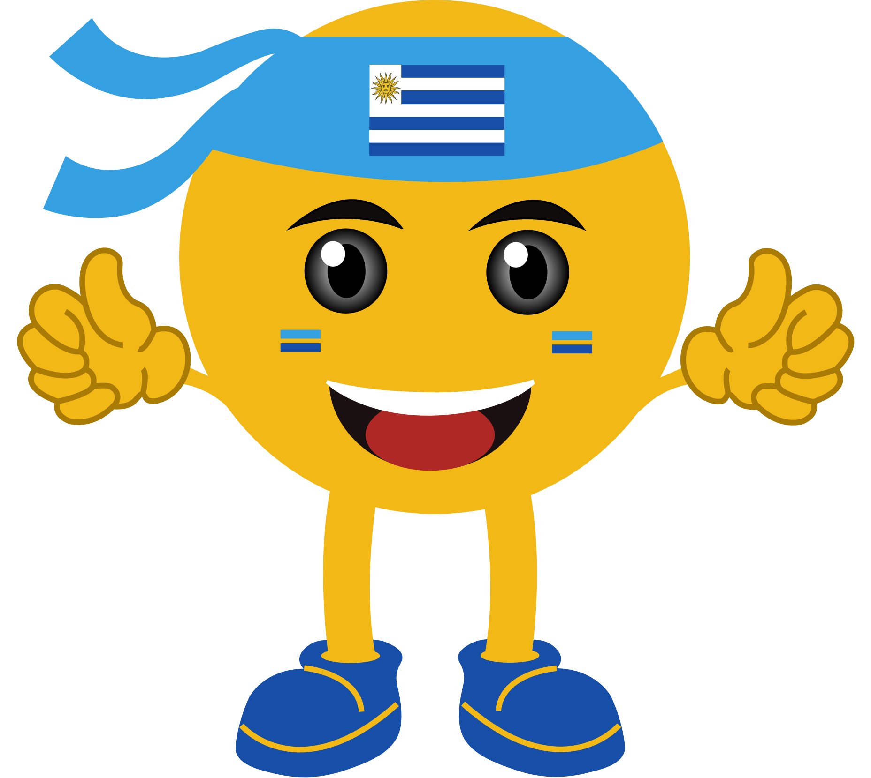

CHILD RIGHTS EMOJIS!
Choose one of the rights from the Convention and design an emoji to represent it. As a class, create a gallery of the emojis on the classroom wall.
Discussion: Go around in a circle and explain why you chose your right and how your emoji represents the right you chose.
The energy sources we use today are highly disruptive and damaging to the environment, especially due to the use of hydrocarbon fuels that have increasingly caused global warming.

Slide 21
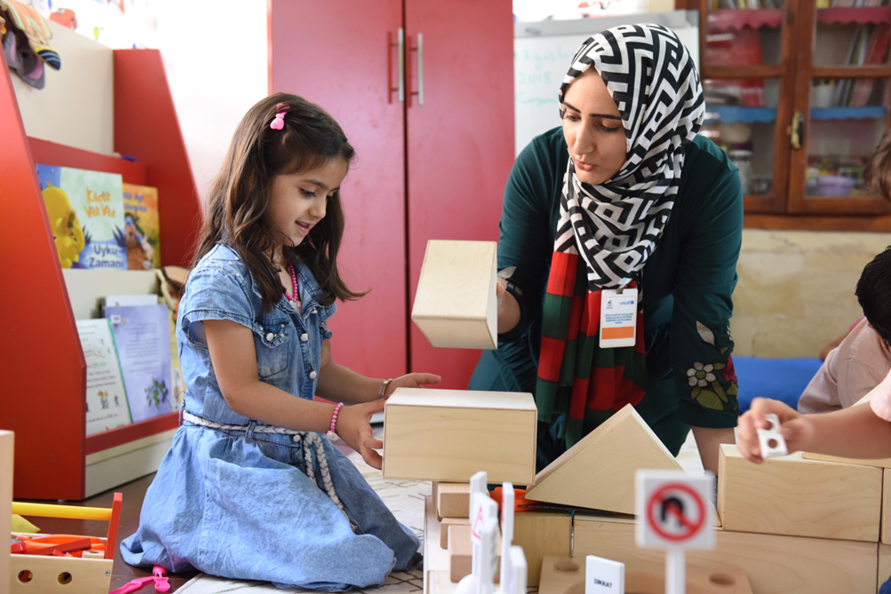
UNICEF/UNI406810
ACTIVITES FOR AGES 10-12
UNICEF/UN0444256
UNICEF/UNI509138
The term "alternative" refers to a technology other than the technology used in fossil fuels to produce energy.
Notes:
Teachers and student in classroom in Turkey, 2018

Slide 22
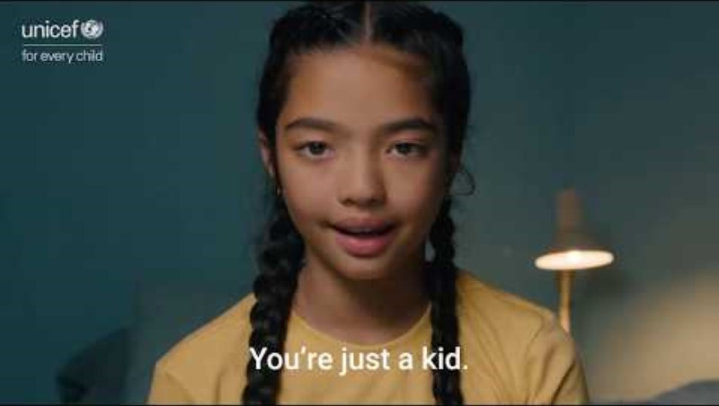
VIDEO

Slide 23

INVESTIGATION TIME!
Respond to the question: What do you think is the most important issue affecting children today? How would you resolve it to ensure children’s rights are respected? Put together a short lesson plan and be prepared to ‘’teach’’ your peers about this important topic!
You can choose an issue you care about or think about issues that UNICEF focuses on such as migration, child marriage, missing out on school, etc.

Slide 24




OUR VISION FOR THE FUTURE
In groups, create a vision board illustrating your hopes and dreams for the future where all children have their rights respected. You can include images, words, or drawings that represent a future free of conflict, a healthy planet, and a world where children’s rights are upheld.
Discussion: Present your vision board as a group to the rest of the class.
The energy sources we use today are highly disruptive and damaging to the environment, especially due to the use of hydrocarbon fuels that have increasingly caused global warming.

Slide 25





RIGHTS DEFENDERS!
Greta Thunberg
Defender of: Environmental Rights
About Her:
A rights defender is someone who speaks up for themselves or others when they see injustice. Rights defenders speak up on different issues that they are passionate about - child rights, human rights, animal rights, indigenous rights, environmental rights, land rights.
Research a rights defender and what cause they are a defender of. See examples below. Write about them (see example). Present to your class.
Greta Thunberg
Xiuhtezcatl Roske-Martinez
Thandiwe Abdullah
Bana Alabed
Malala Yousafzai
Rima Sultana Rimu
Notes:
A rights defender is someone who speaks up for themselves or others when they see injustice. In spite of hardship and obstacles, they persevere in pursuit of change. Rights defenders speak up on different issues that they are passionate about - children's rights, human rights, animal rights, indigenous rights, environmental rights, land rights... There are many important causes to defend.
Anyone can be a rights defender! No matter how old you are, your abilities, background, language, gender or any other attribute - anyone can speak up for rights. Many rights defenders use their talents to advocate for rights, this could be through music, stories, art, sport or any other skill.

Slide 26
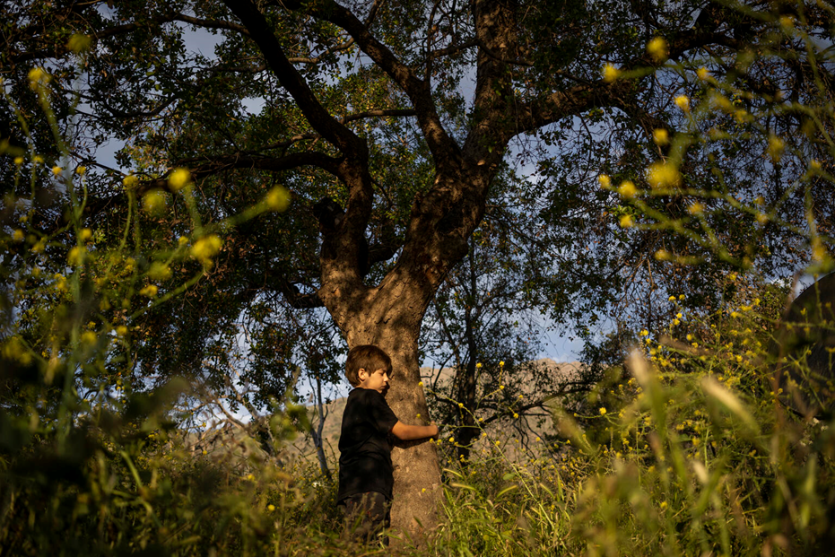
Reflection
Find somewhere quiet and give yourself time and space to think about the following:
  What have you learnt about how children experience childhood around the world?
  What have you learnt about the power of children in changing the future?
  How do your rights ensure that you play an important role in shaping the future for the better?
@UNICEF/UN0364082

Slide 27
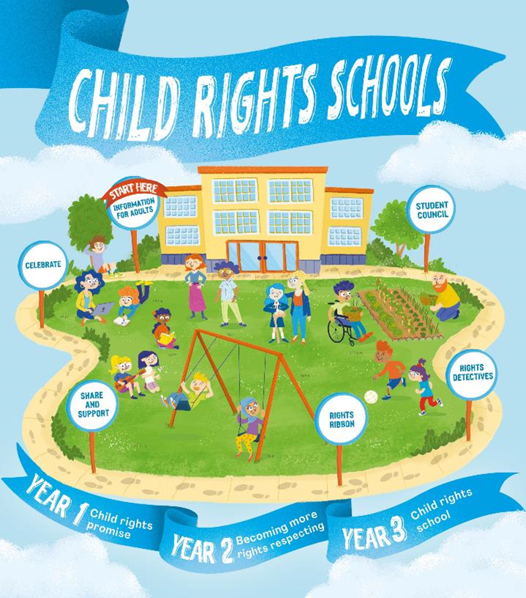

FURTHER CHILD RIGHTS EDUCATION SUPPORT
Child Rights Schools is a programme that supports you to embed child rights across the whole school community, including with parents and carers. Find our more here.
Find more classroom resources here.

Slide 28

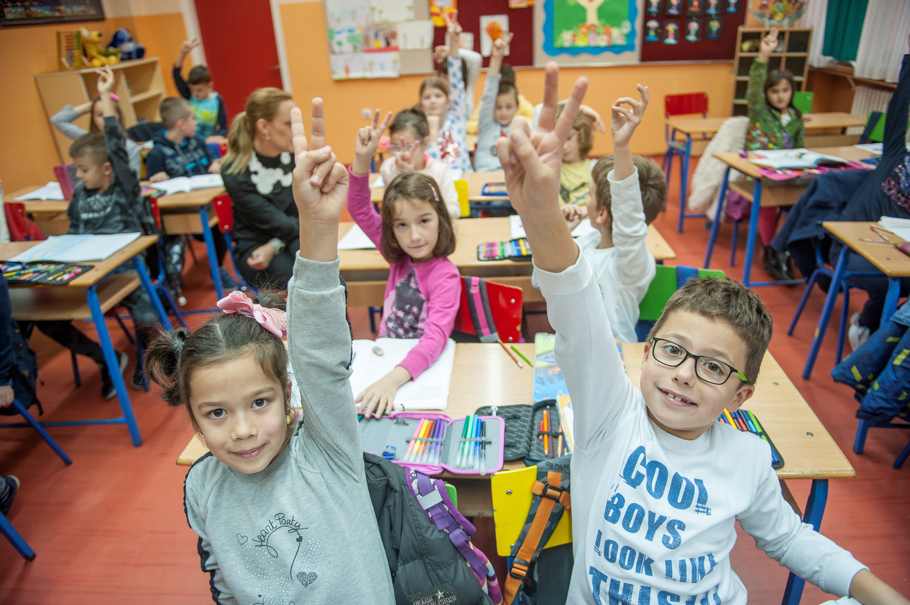
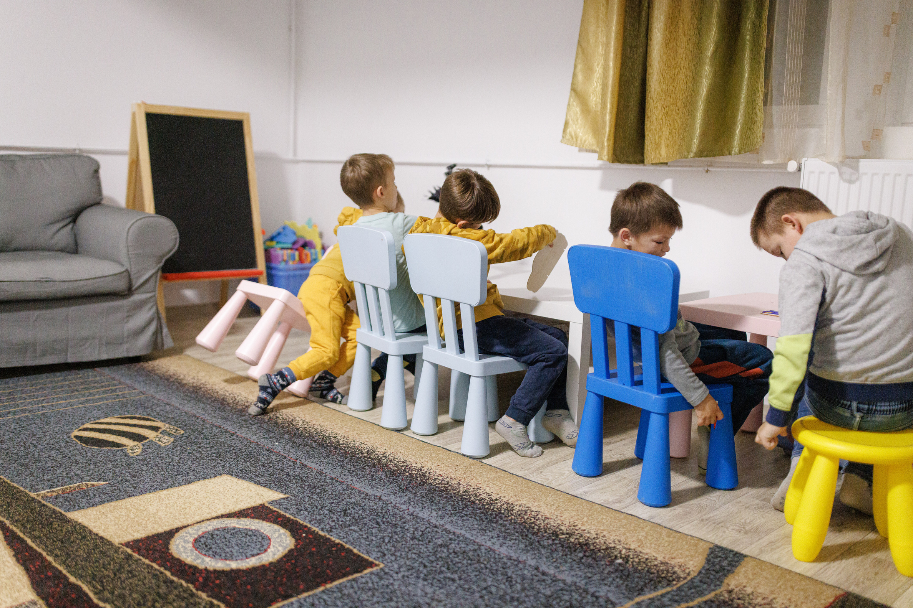
thank you
UNICEF/PANCIC
Notes:
Children attending classes at inclusive primary school Despot Stefan Lazarevic in Belgrade, Serbia.

