Slide 1
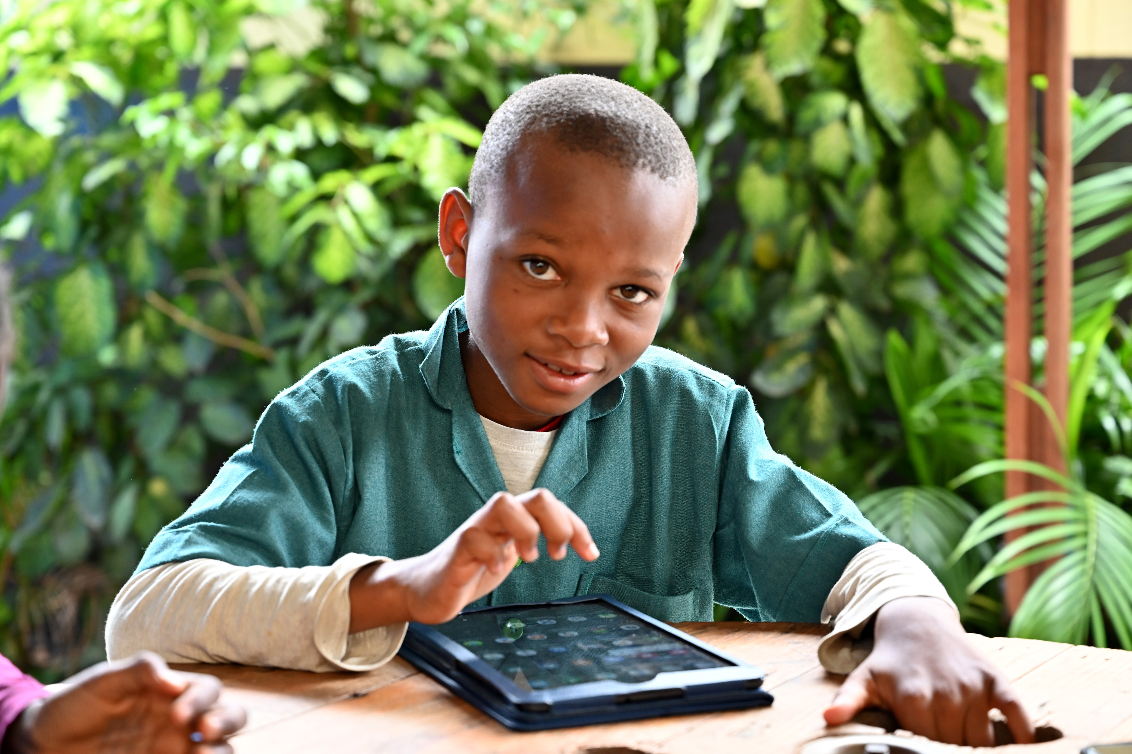

SAFER INTERNET DAY
UN0551724
Notes:
On 2 November 2021 in Yaoundé, Cameroon, a child works on a tablet at the Public Melen School.
The “CONNECT MY SCHOOL” initiative, aims at building and expanding sustainable models for improved access to primary & secondary education through ICT (Information and communication technology) use in the classroom in primary schools.
Through the construction and running of Digital Hubs in selected communities, improved learning models will be created to benefit primary, and secondary school aged children, as well as the communities. Based on funding availability, primary and secondary schools in targeted municipalities of 4 regions (East, Center, Littoral, West) will be connected by the creation of a e-Container (E-hub) and will be the special place where digital learning is promoted and implemented, for improved learning outcomes, inclusive education, and girl’s empowerment.

Slide 2

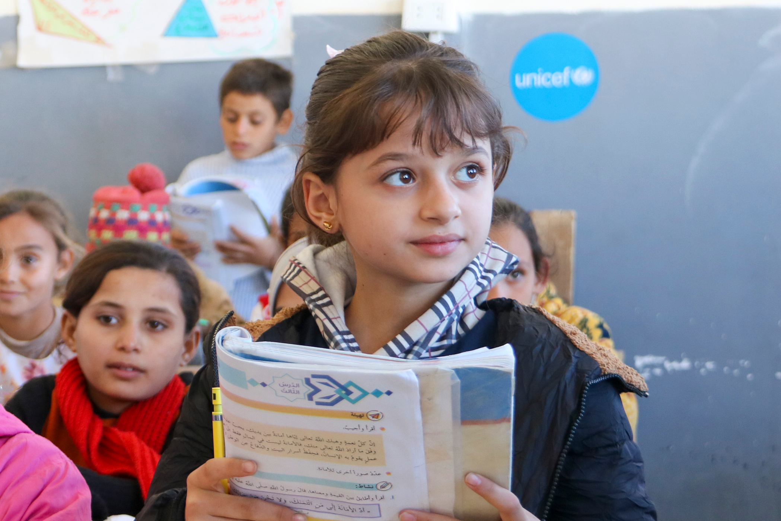
BEFORE YOU BEGIN
      We strongly recommend completing this week’s pack in class with teacher supervision and not setting this pack, or activities from this pack, as homework. This is a flexible resource and is intended to provide you with some easy to use, appropriate rights-related learning to share with your children, their families and your colleagues.
      Please edit out non relevant slides or activities before sharing with your students. Please check that the content works for your learners and feel free to adapt or add any content that would make the material more relevant for your setting.
      Some activities in this pack have been adapted from UNICEF UK Rights Respecting Schools resources.
UNI492523
Notes:
Alma, 11, Grade 5, reads from her book in front of her classmates during a lesson in UNICEF -rehabilitated Al Tabni school, in Deir ez-zor governorate, Syria, on 21 November 2023.
“I was registered in Al Tabni school when we returned from Al Hasakeh. I love it. The new desks are comfortable, and I can run and play as much as I want in the playground,” she said.
“I want to become an engineer when I grow up to rebuild the destroyed houses in Al Tabni,” Alma said.

Slide 3


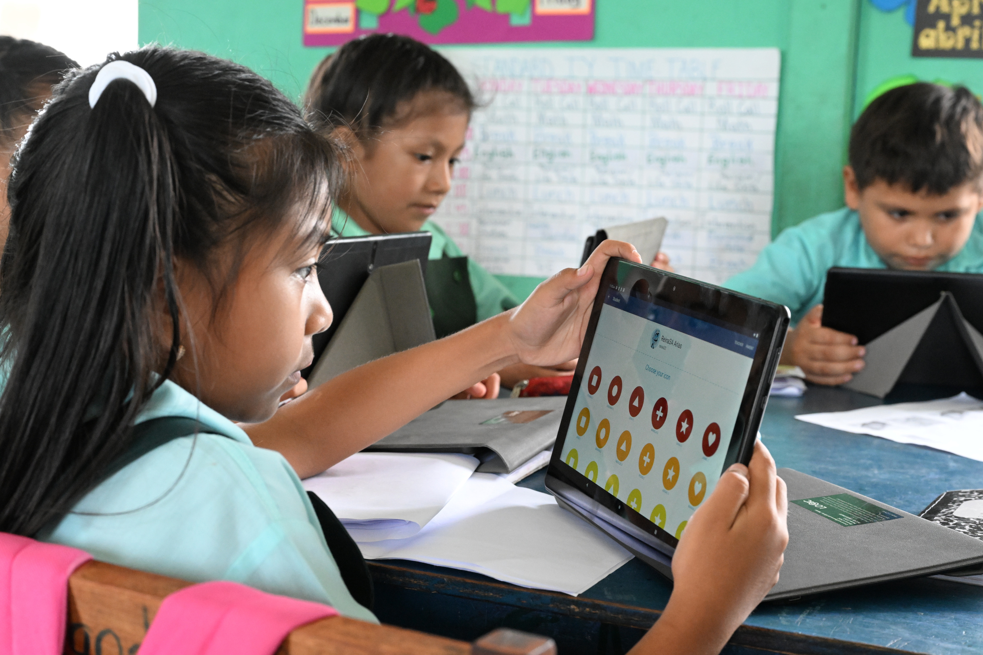
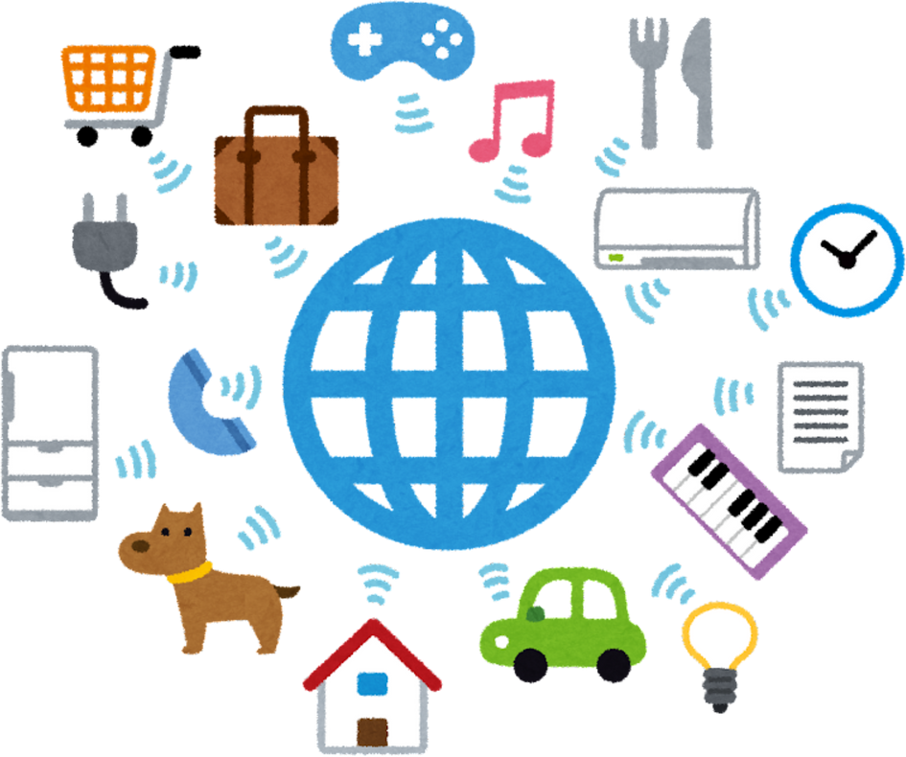


UNI594379
WHAT IS SAFER INTERNET DAY?
The energy sources we use today are highly disruptive and damaging to the environment, especially due to the use of hydrocarbon fuels that have increasingly caused global warming.
Notes:
Children attending class at the Armenia Governement School in Armenia, in the Cayo District of Belize.
The school benefits from the EIIS program.
UNICEF Belize has collaborated with RESTORE Belize to implement the EIIS program The EIIS programme uses the RAZ PLUS application to use technology to teach literacy and numeracy. UNICEF supports this as a part of the Reimagine Education Agenda and the Transforming Education Summit commitment. Using the RAPID framework we agreed to ensure children have catch up classes to bridge the learning gaps from COVID-19 pandemic and to reinforce foundational learning in classrooms.
For every child education.

Slide 4
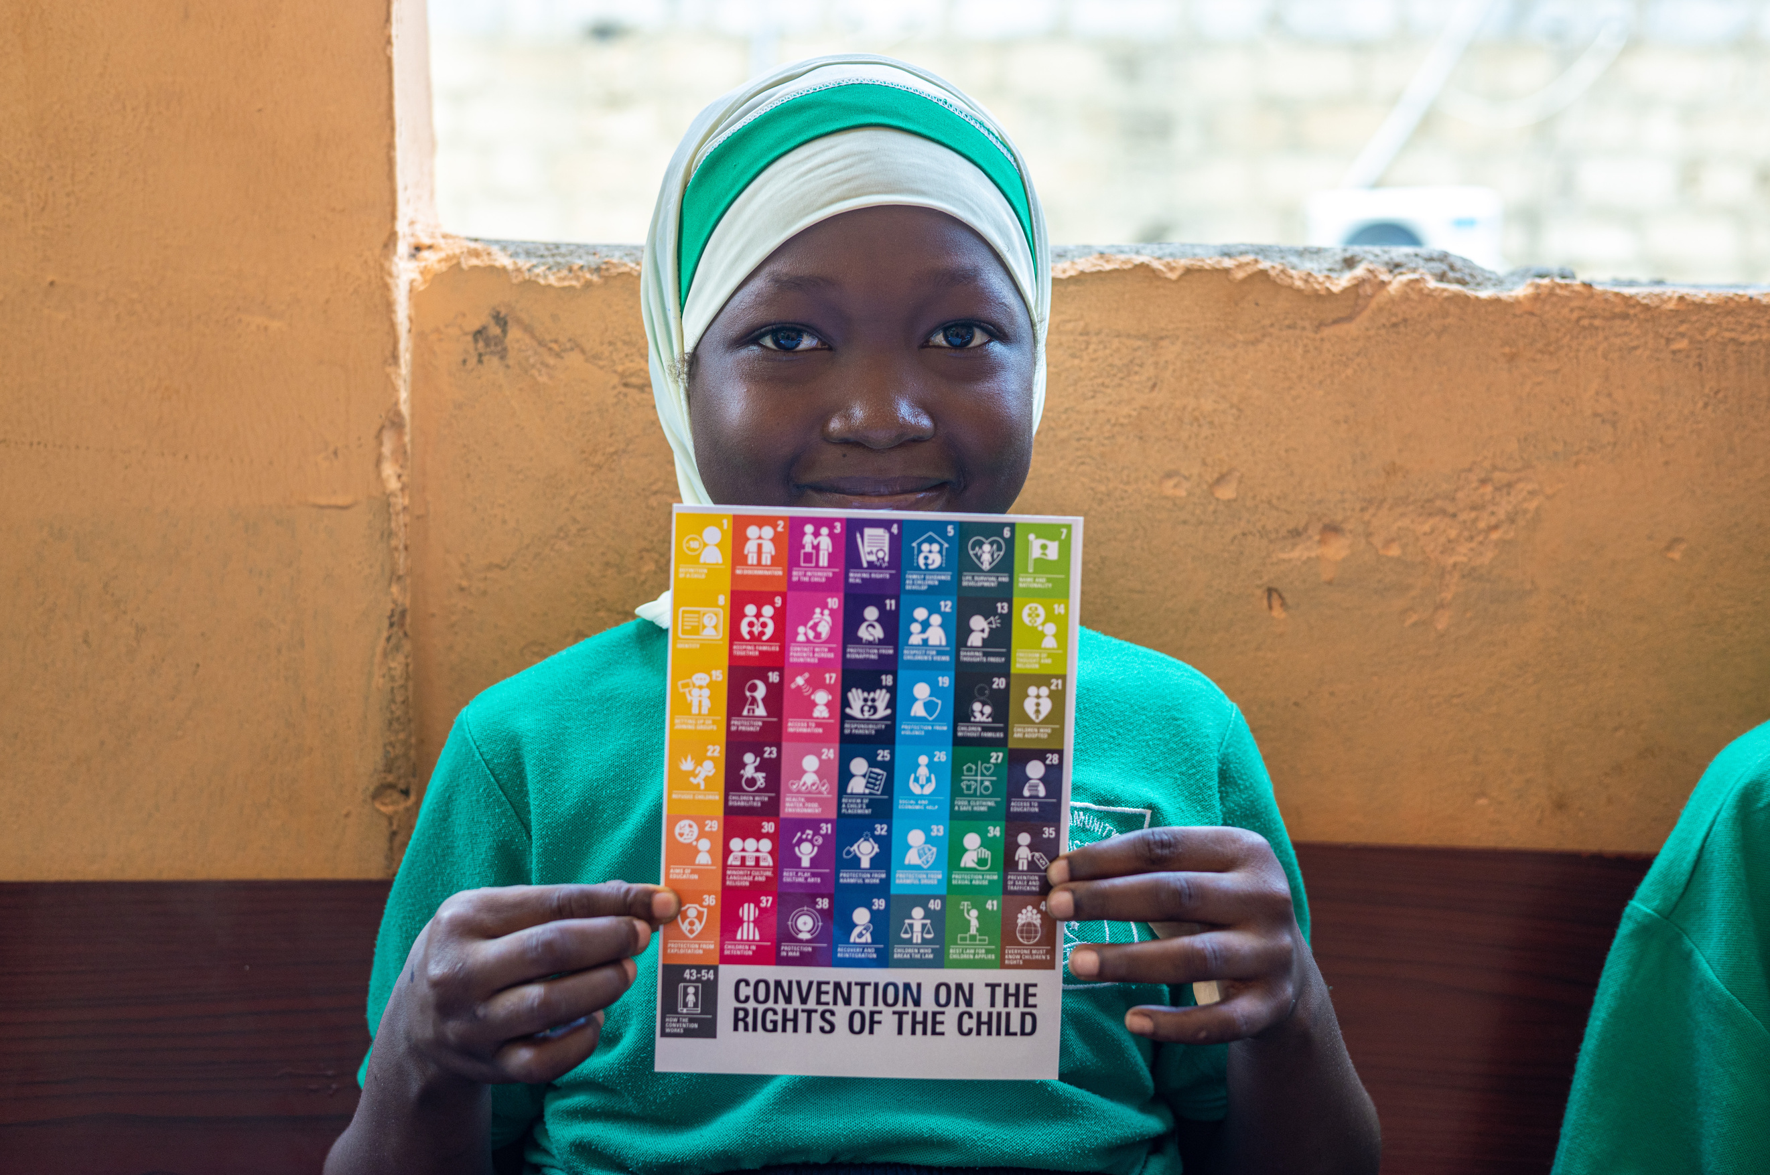

SAFER INTERNET DAY
Safer Internet Day takes place on Tuesday, 11th February 2025. The celebrations focus on the theme, “Prepare / Protect / Thrive: Navigating Algorithms and Influencers.” This theme invites parents, schools, educators, young people, and all stakeholders to consider how algorithms and influencers shape young people’s lives. In a world of endless online information, Safer Internet Day explores ways to empower children to thrive, equipping them with skills to navigate both the opportunities and challenges of these powerful digital influences.
Safer Internet Day has a particular focus on Article 19: The Right to Protection from Harm, Article 17: The Right to Reliable Information and Article 34: Protection from Exploitation.
UNICEF/UNI557589
UNI667813
Notes:
A girl child hold the chart of Convention on the Rights of the Child while attending a UNICEF organized art workshop at Awoshie Community Islamic School in Accra. Ghana.

Slide 5
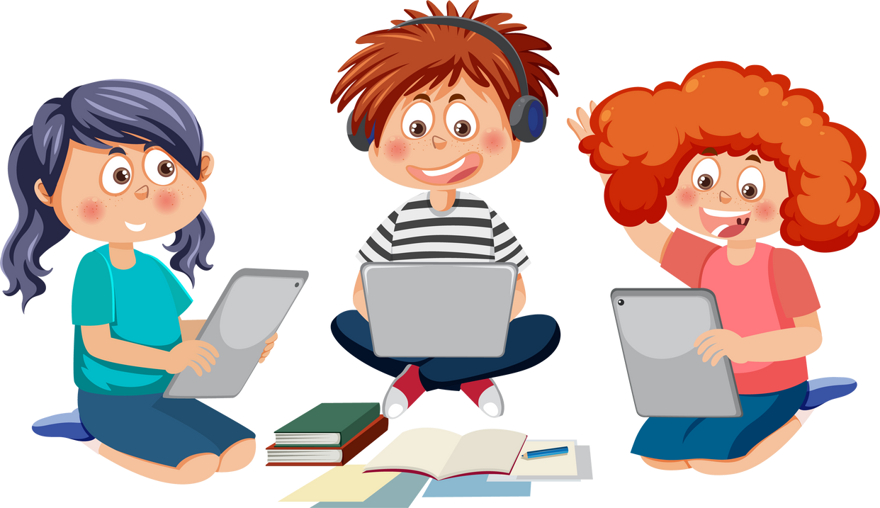

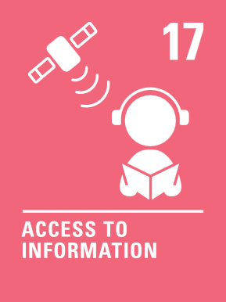


SAFER INTERNET DAY AND THE CRC
  Article 17: Access to information from the media - Every child has the right to reliable information from a variety of sources and governments should encourage the media to provide information that children can understand. Governments must help protect children from materials that could harm them.
  Article 19: Protection from violence, abuse and neglect - Governments must do all they can to ensure that children are protected from all forms of violence, abuse, neglect and bad treatment by their parents or anyone else who looks after them.
  Article 34: Sexual exploitation - Governments must protect children from forms of sexual abuse and exploitation.
Notes:
We all have a right to feel safe and secure and that means safe online as well as in the real world. Safer Internet Day is an annual event that promotes the safe, responsible and positive use of the internet.
There are a large number of articles that link with being online. This week’s activities have a particular focus on Article 19, the right to protection from harm, Article 17, the right to reliable information and Article 34, protection from exploitation.
The internet can be a great place but needs to be used carefully. Please use these activities to start the conversation about internet issues that matter to you, what changes you would like to see and how we can make it a more positive and rights respecting place!

Slide 6

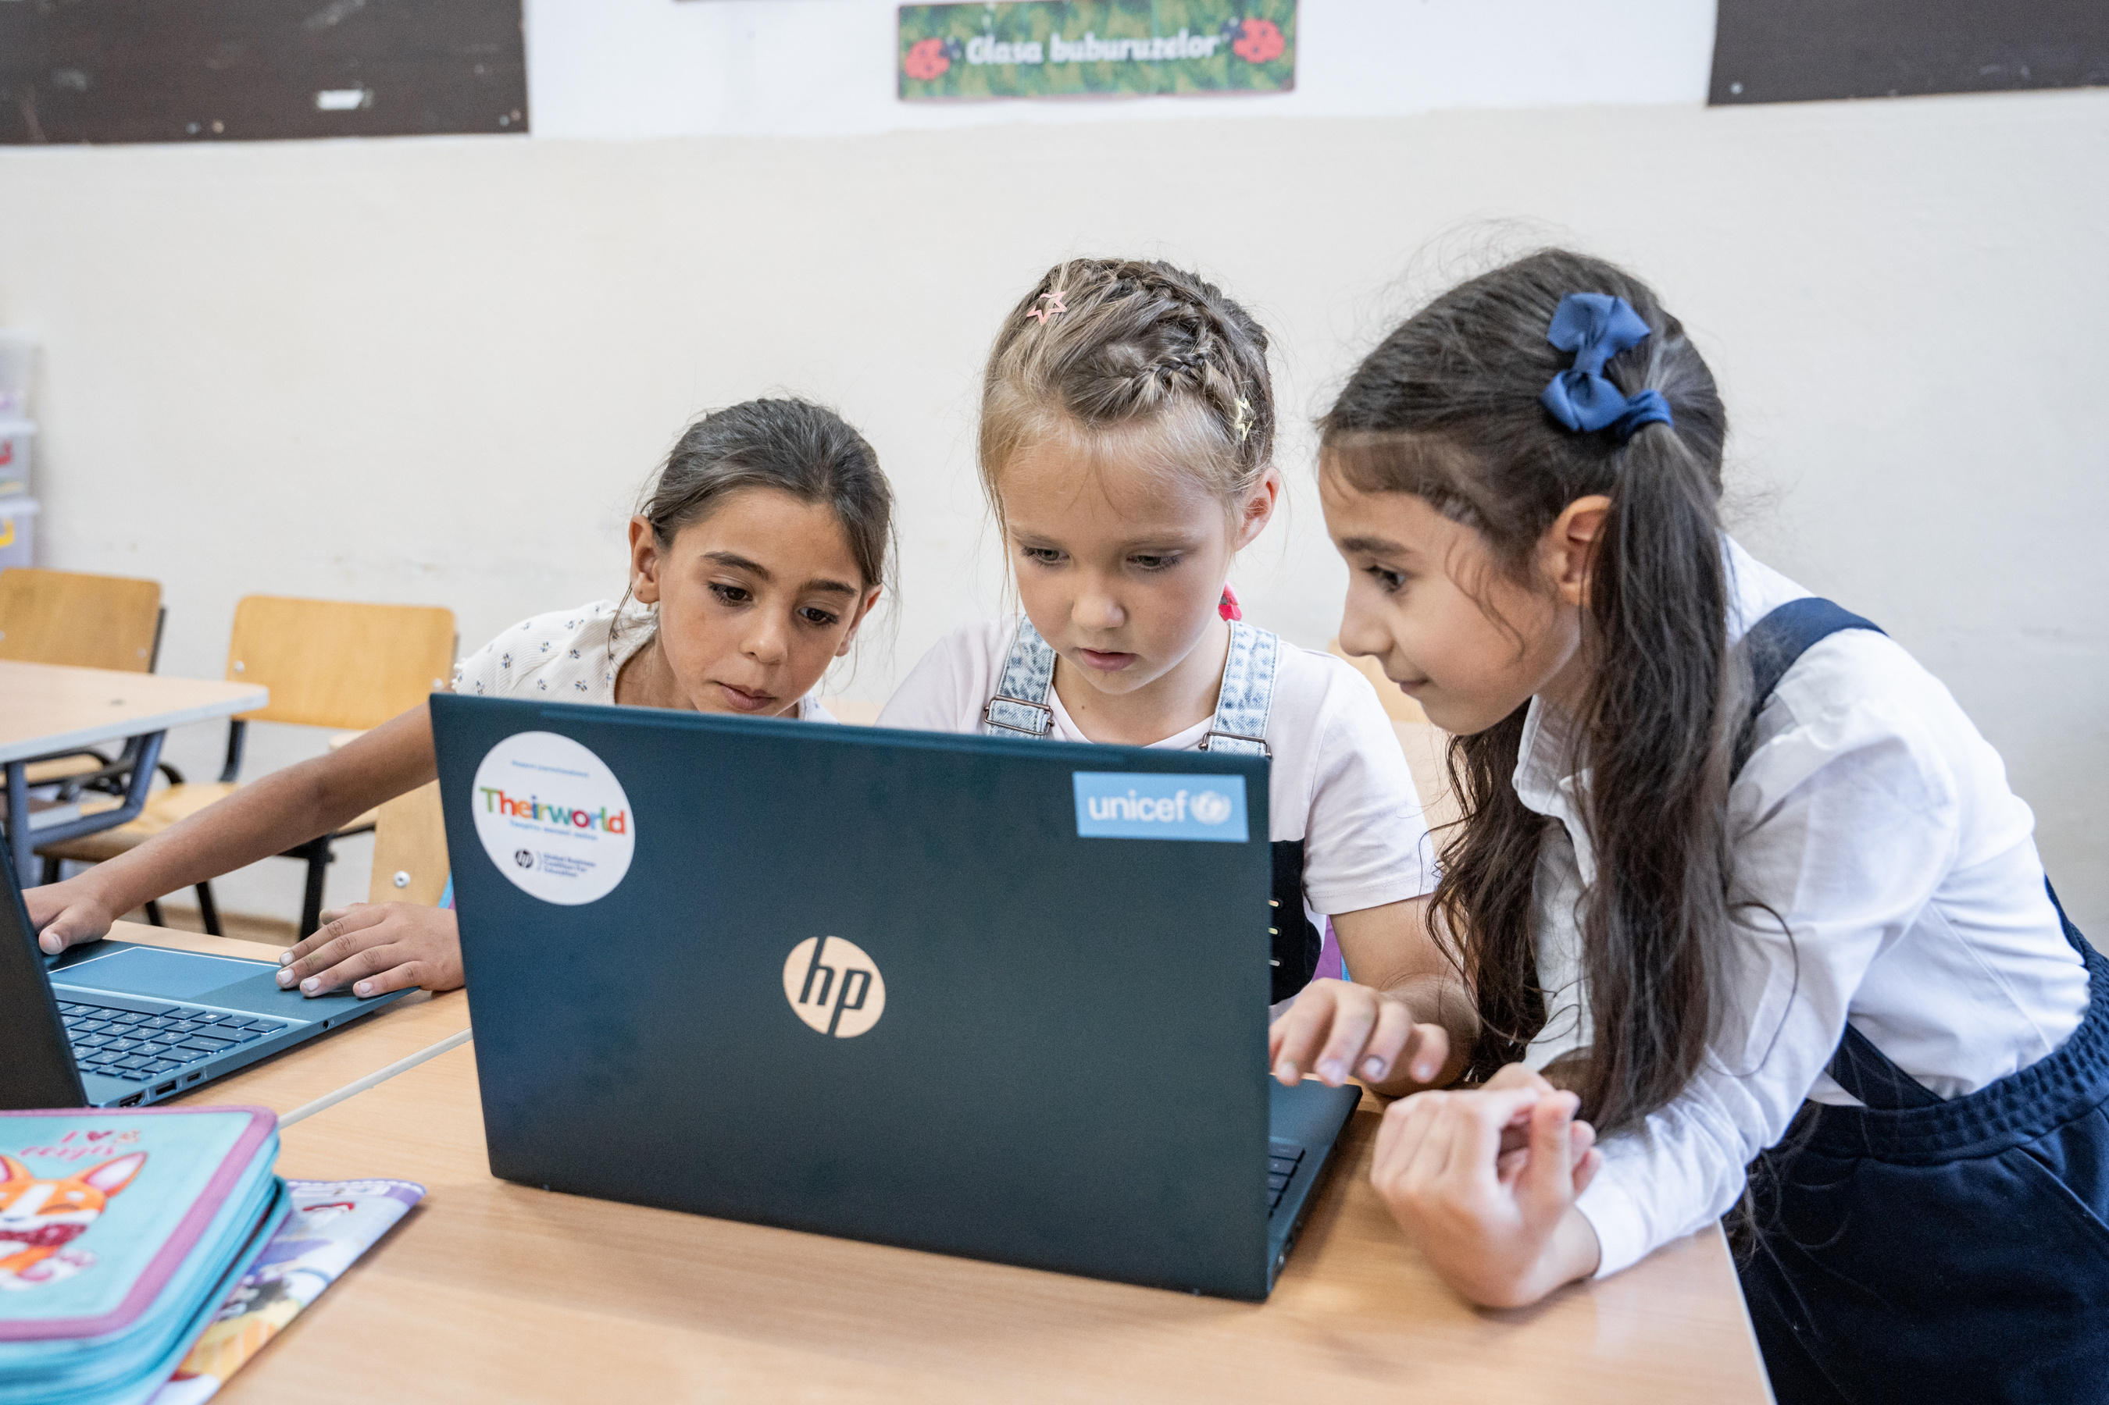

This week there are TWO questions to think about!
1. What do you feel are some of the great things about the internet and life online?
2. What don’t you like about the internet and life online?
UNI618910
Write down your ideas on a piece of paper. If you feel comfortable. Share with your class during discussion time.
UNI445258
Notes:
At the end of June, 27,662 refugee children from Ukraine were officially registered within the national education system in Romania, largely as a result of the reform adopted through Government decision no. 368, adopted on 26 April 2023.
The Ministry of Education and development partners collaborating under the Refugee Response Plan (RRP) Education Working Group, coordinated by UNICEF in Romania, have agreed to organize a Back-to-School Campaign with a view to ensure that all refugee children can effectively access learning opportunities, in the new academic year, through the Romanian education system.
About 43,000 school bags, stationeries including play and learning materials for about 700 classrooms (school-in-a-box / ECD kits), 3,000 laptops to install computer labs in schools, 500 recreation kits, 100 first aid kits, 100 maths and science teaching kits, and 40,000 multilingual learning support materials have been donated by UNICEF to support the access for education for the vulnerable children in Romania, including the refugee children. These supplies were delivered to 16 districts that host the largest refugee communities from Ukraine. These supplies are also intended to benefit other refugees and vulnerable learners as necessary.

Slide 7
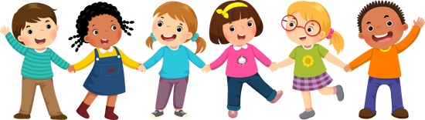
EXPLORING SAFER INTERNET DAY
Great things about the internet....
  You can find out lots of information quickly and easily.
  You can connect with your friends even if you can’t meet face-to-face.
  Learning is possible even if you haven’t got books at home or access to a library.
  There are lots of fun games and activities to do online.
  You can keep in touch with family and friends who live far away.
  It can increase equality and democracy because more people can have their voices heard.
  You can shop and bank online which is good for people who are busy, not near the shops or have mobility issues.
  You can visit places remotely that you can’t get to in person.
  It helps you find places in the car and people you want to contact with.
What else did you think of?

Slide 8
EXPLORING SAFER INTERNET DAY
I don’t like it when....
  People don’t respect each other and make unkind comments.
  Children use it to bully other children.
  People’s right to privacy is not always respected.
  Some information is not reliable and there is a lot of fake news.
  People are sometimes tricked out of money and savings.
  Companies and businesses are hacked and your information can be shared without your consent.
  I spend too much time online instead of doing other things.
  People make fun of others because they don’t have the latest technology.
What else did you think of?

Slide 9
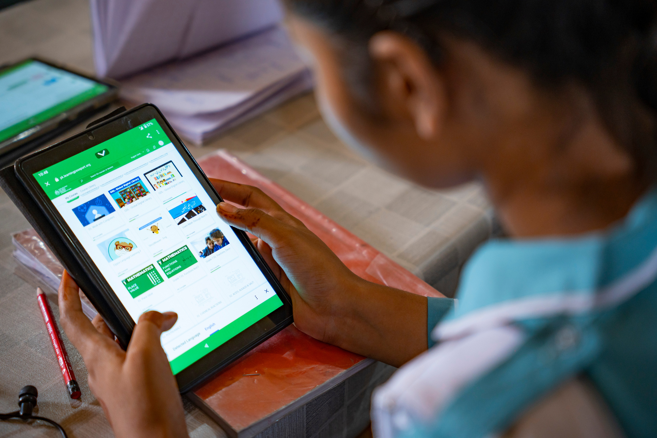

ACTIVITES FOR AGES 4-6
UNI522057
Notes:
"UNICEF's gift of electronic tablets is a beacon of hope, illuminating the path to bright futures. In the classrooms of Government Comprehensive HS School for Girls, these digital tools are not just gadgets; they are gateways to knowledge and limitless opportunities."

Slide 10

Read ‘’Digiduck’s Big Decision’’
Read ‘Digiduck’s Big Decision’ - there is an online version which would work on your class screen. Discuss the lessons from the story about friendship and respect online.

Slide 11



MY FAVOURITE ONLINE...
Draw a picture of your favourite online game or character.
Discuss the sort of helpful message they might give to you and other children. You could add these to the pictures as speech bubbles.

Slide 12


CREATING SAFE SPACES ONLINE & OFFLINE
Have a discussion and perhaps create a display about safe play and friendship in the playground and safe play and friendship online.
The energy sources we use today are highly disruptive and damaging to the environment, especially due to the use of hydrocarbon fuels that have increasingly caused global warming.

Slide 13
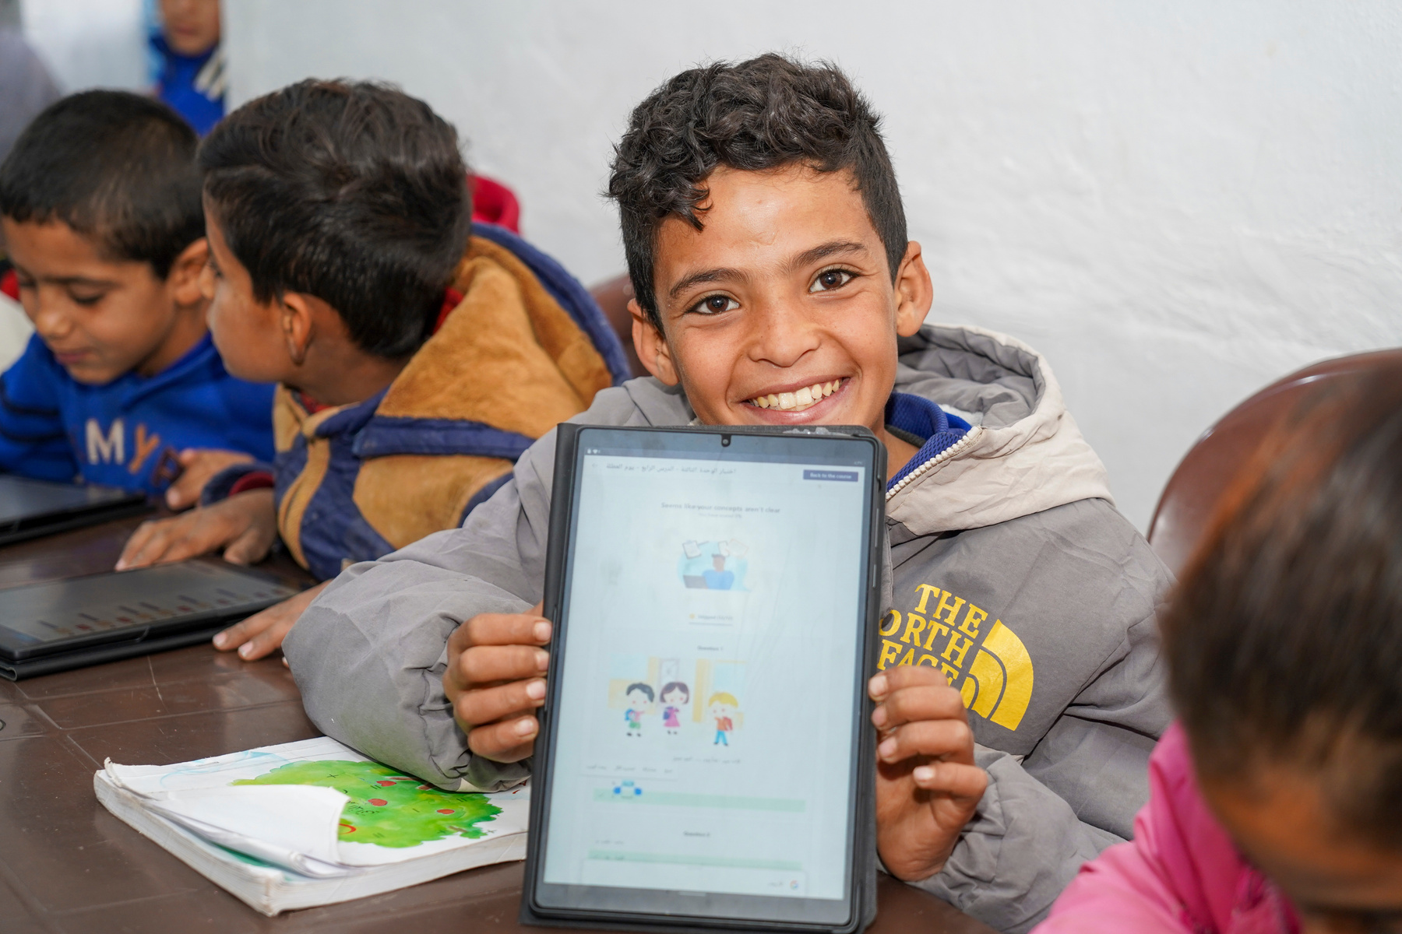
ACTIVITES FOR AGES 7-9
The energy sources we use today are highly disruptive and damaging to the environment, especially due to the use of hydrocarbon fuels that have increasingly caused global warming.
UNI498799
3
Notes:
“I’ve been attending the classes for 6 months. I like learning here and using the tab. At home, I use my dad’s mobile to revise my lessons,” said Ahmad, 10, during class at a home-based learning point in Qamishli city, Al-Hasakeh, northeast Syria, on 16 December 2023. “English and Arabic are my favourite subjects, because I’m good at both,” added Ahmad who wants to become a doctor in the future.

Slide 14

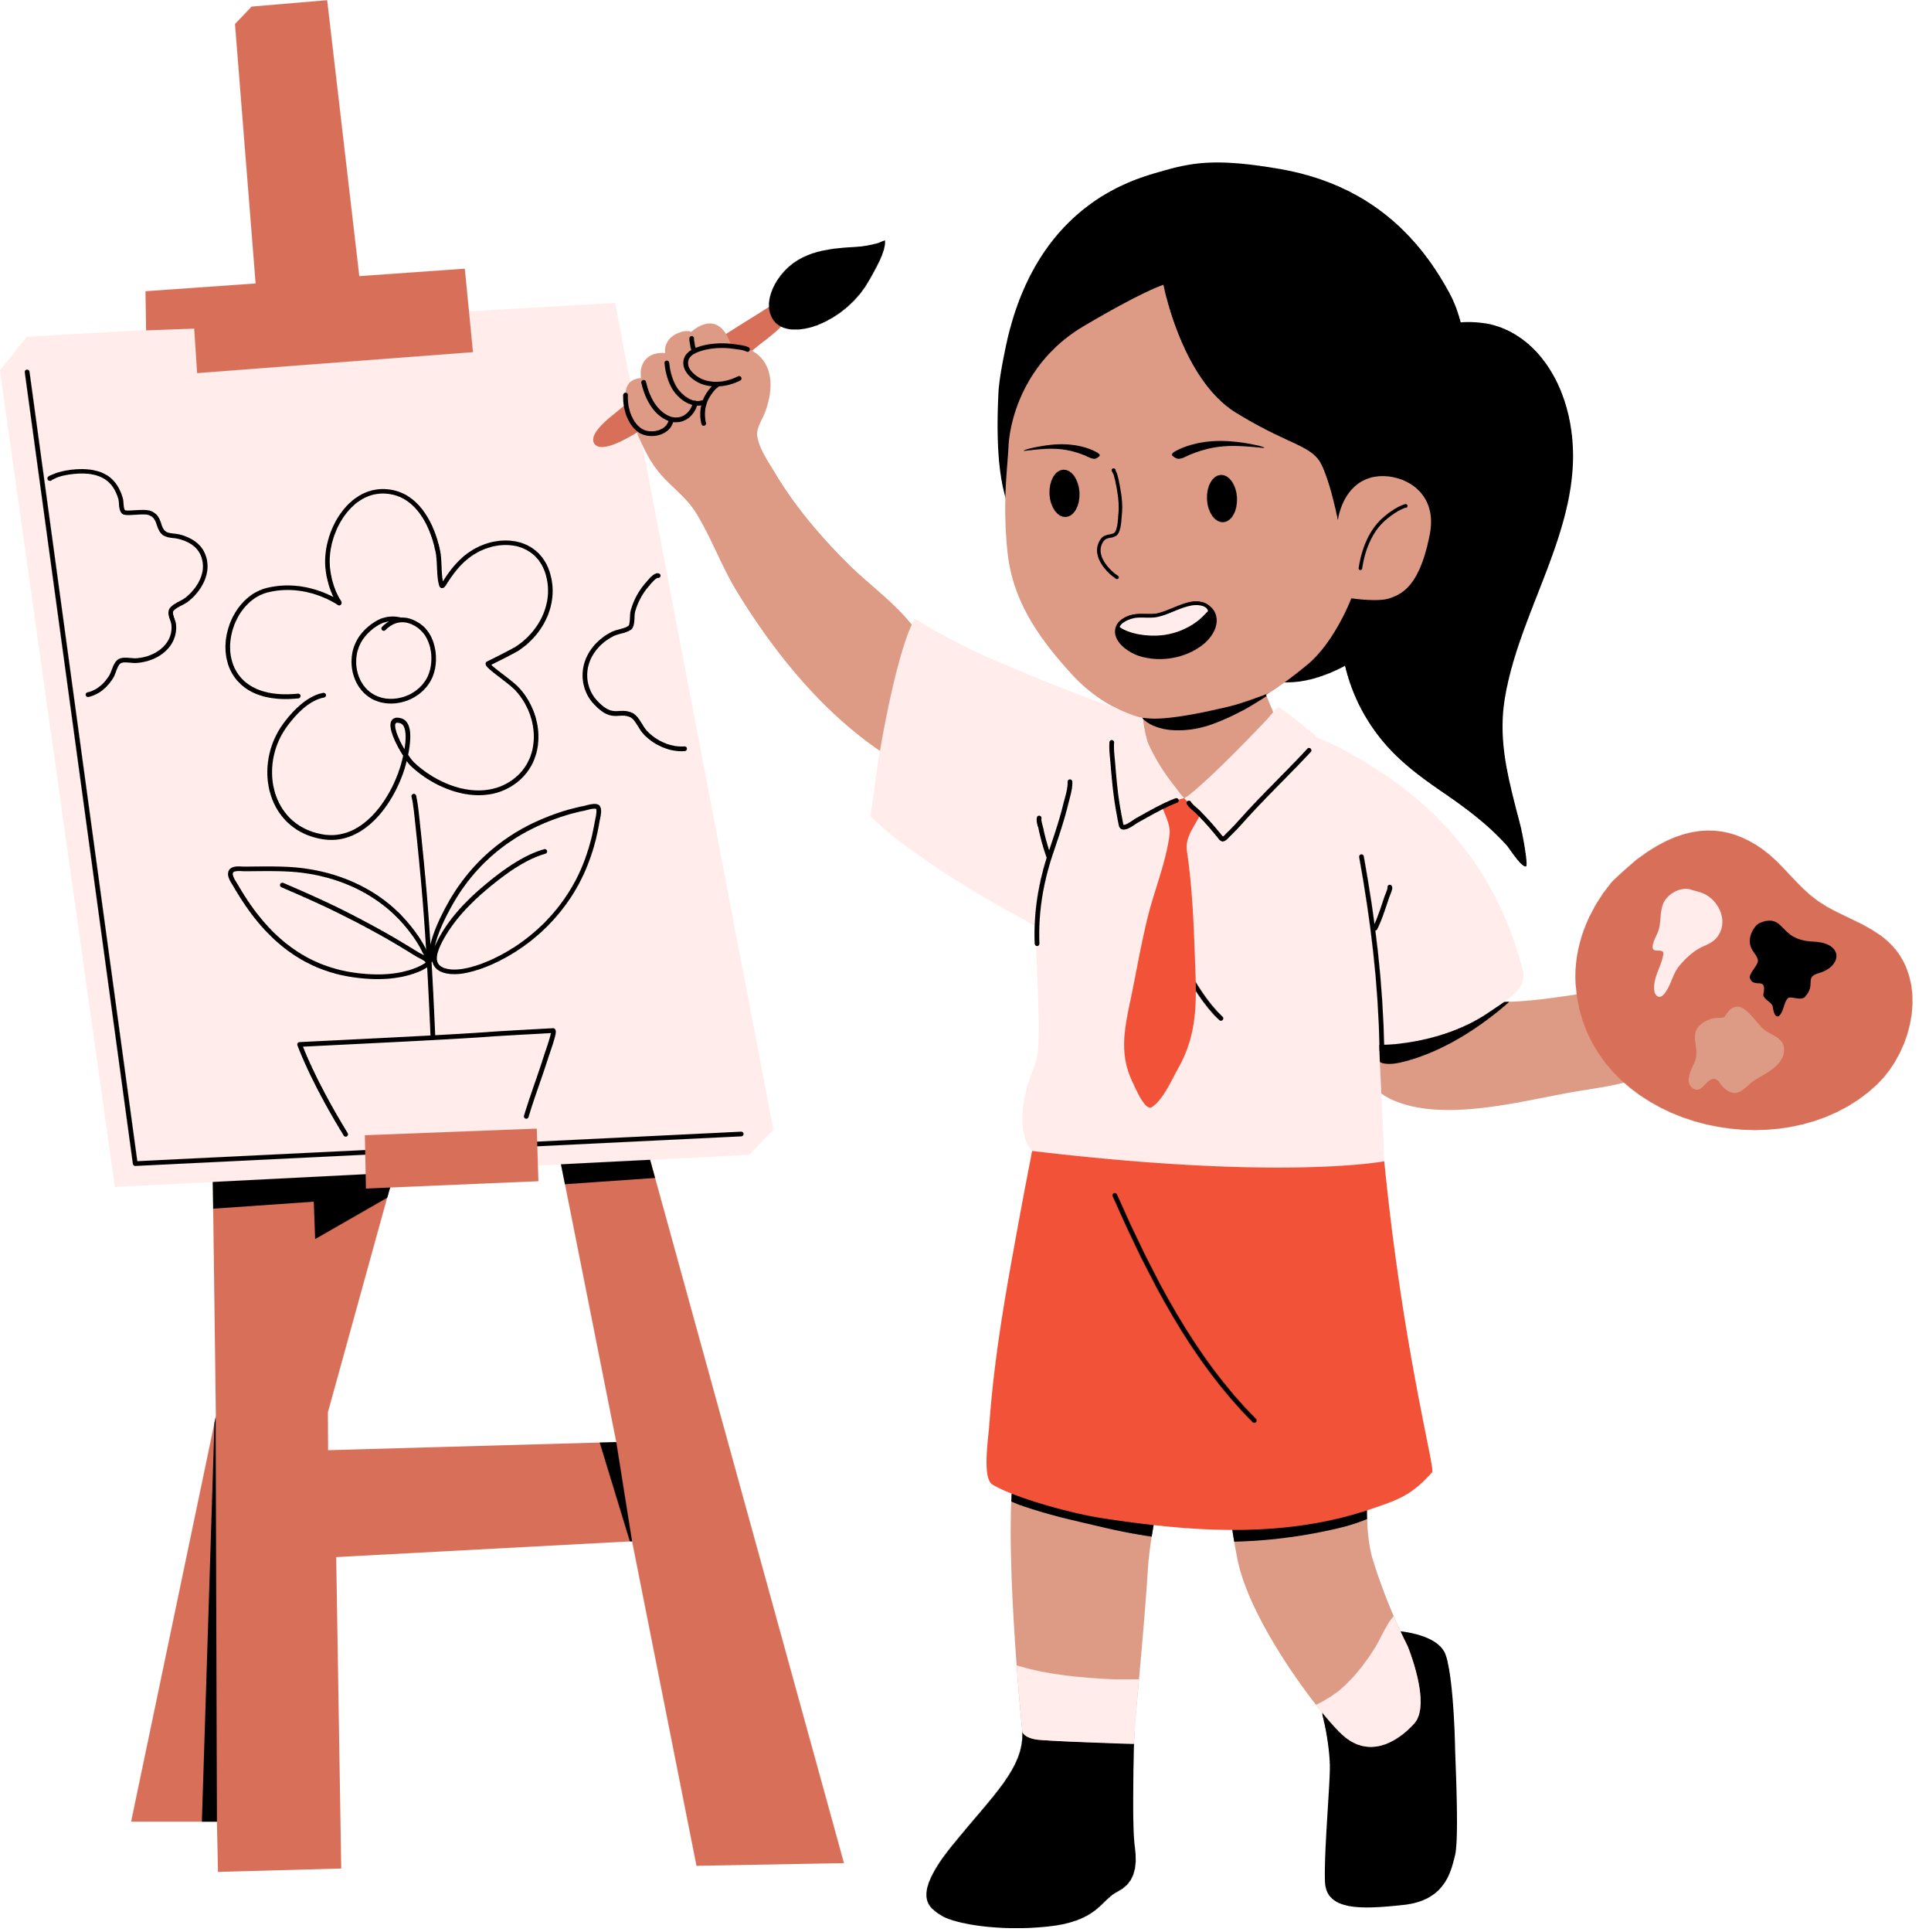
STAYING SAFE ONLINE
Make a persuasive poster that teaches other children how to stay safe online.

Slide 15

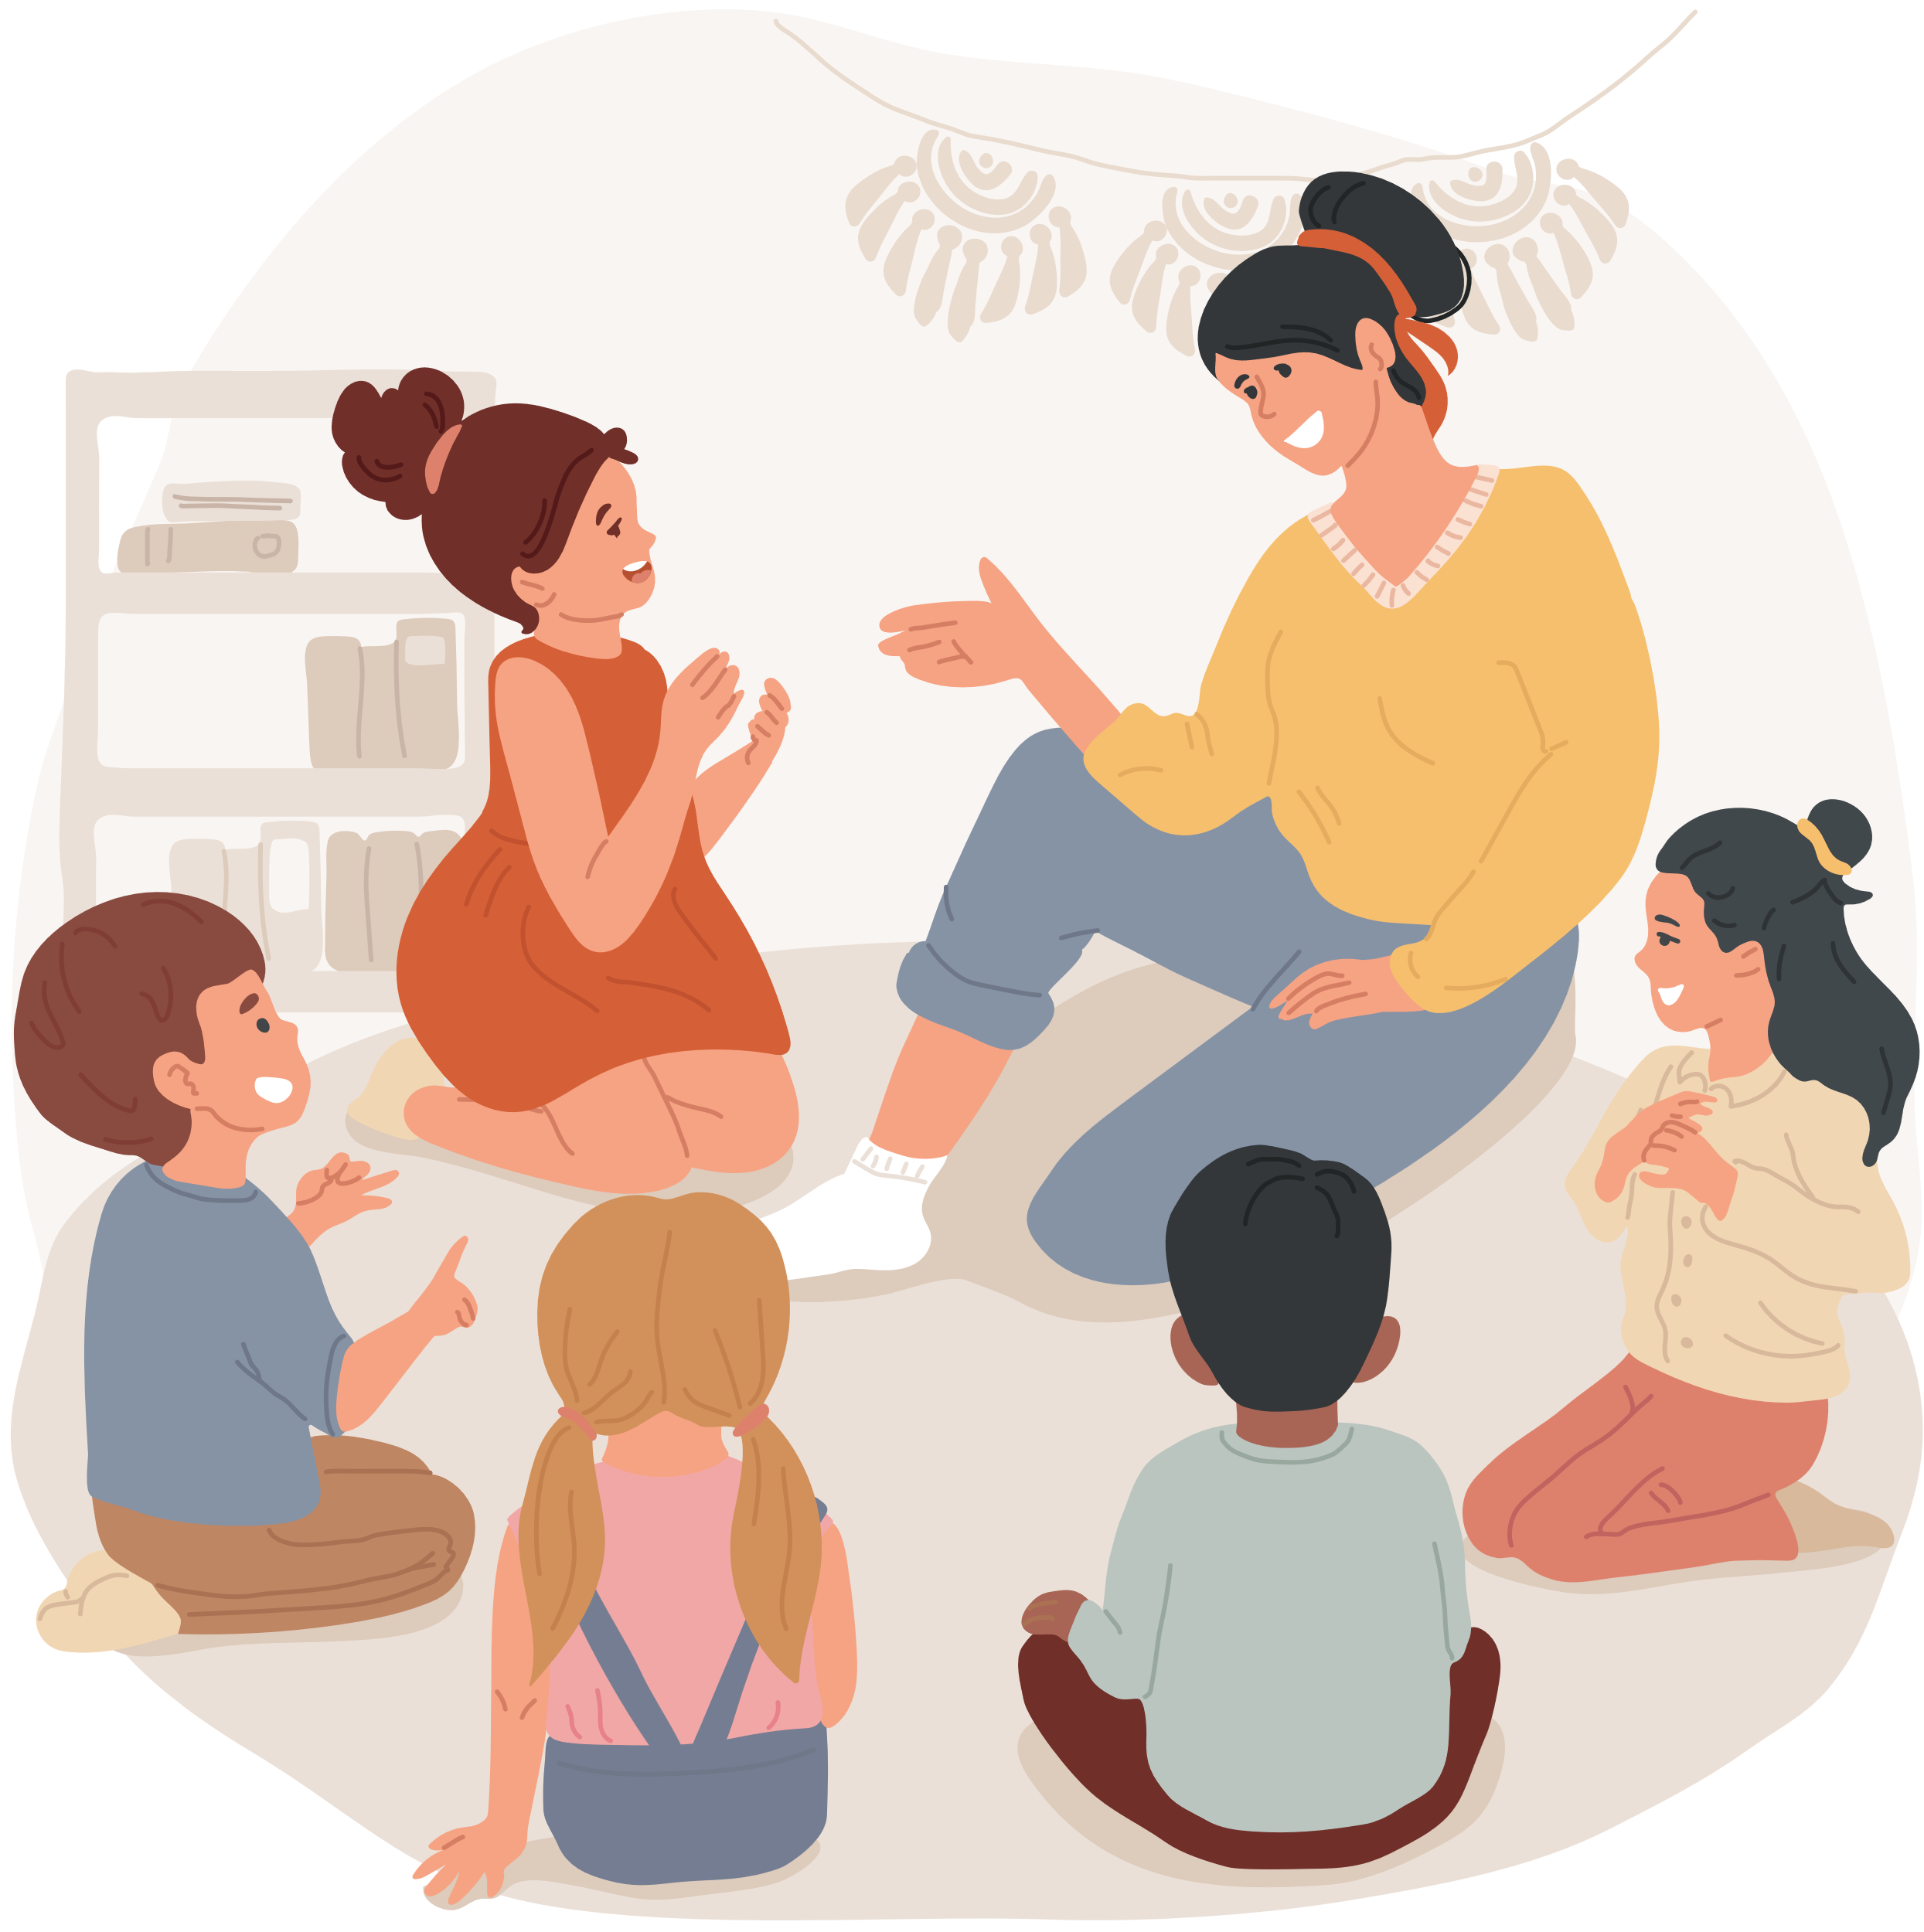

CIRCLE TIME
In Circle Time talk about any worries you might have about the internet. Decide on some conversation guidelines that include listening respectfully and being supportive.
As part of your discussions decide on three things you will do as a group to address your worries.

Slide 16



STORY TIME!
Write a story that teaches young children about the potential dangers of the Internet.
BE CREATIVE!

Slide 17
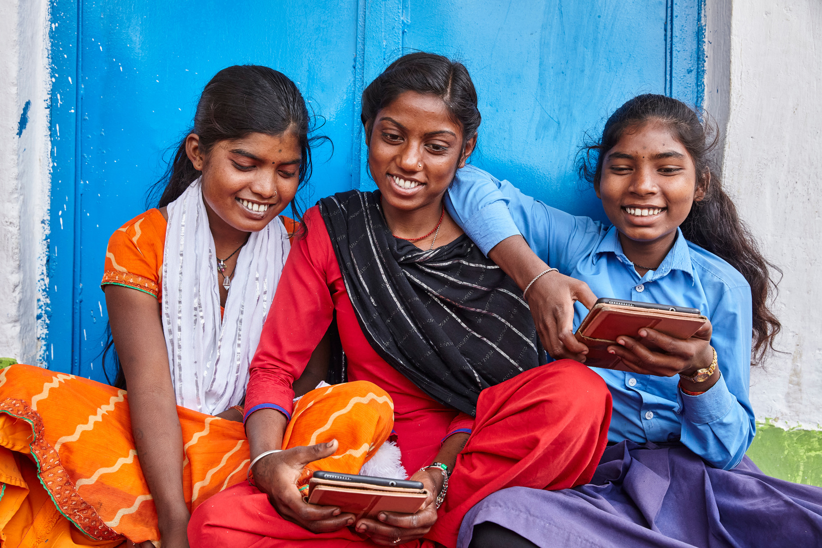
UN0825676
ACTIVITES FOR AGES 10-12
UNICEF/UNI509138
The term "alternative" refers to a technology other than the technology used in fossil fuels to produce energy.
Notes:
Rupa, Sonam and Kajal Kumari explore learning through digital literacy at school, Madhyamik Vidyalaya, Bajitpur, Kalyanpur Panchayat, Patna, Bihar, India.

Slide 18



INTERNET SAFETY TIPS
Your right to be safe and protected is always important, including when you use computers, phones and the internet. Can you think of three top tips for staying safe online? Use this list of tips to help.

Slide 19
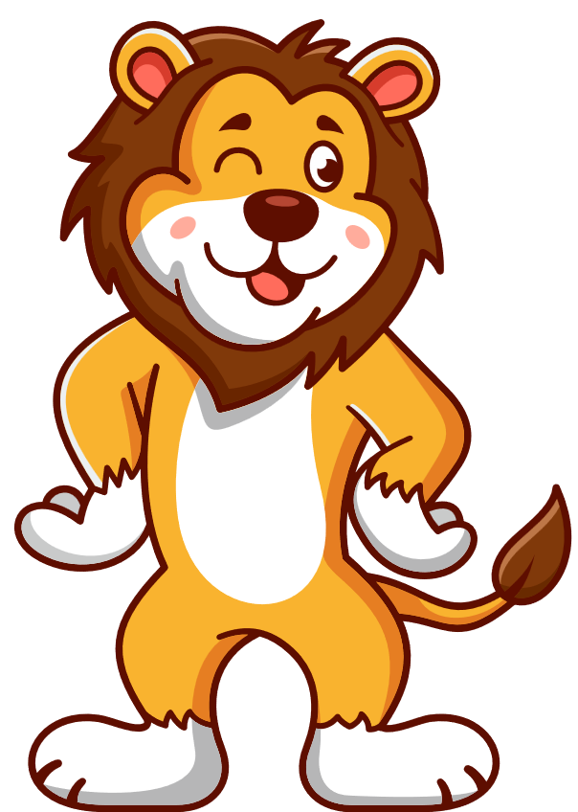
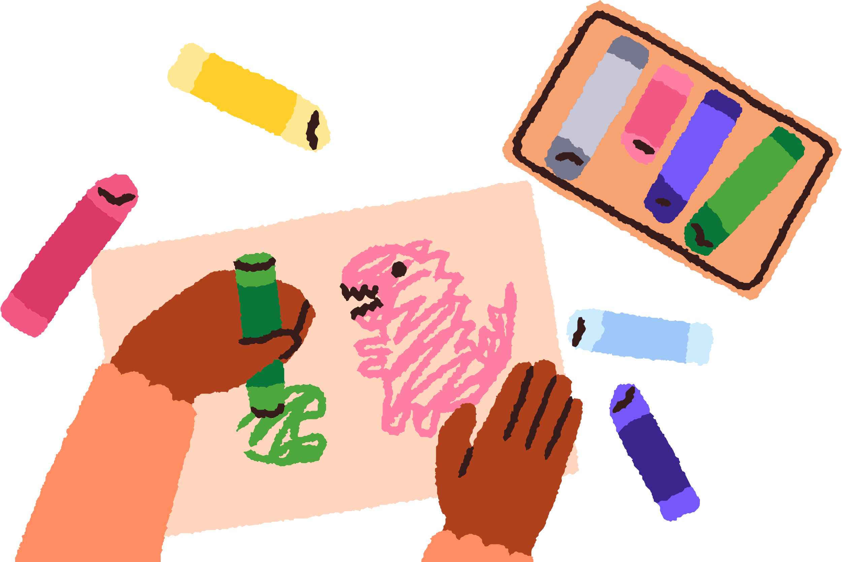
SAFE INTERNET MASCOT
As a group, design a ‘mascot’ on paper that could be used to promote Safer Internet Day around the world.
Discussion: Present your mascot as a group to the rest of the class.
The energy sources we use today are highly disruptive and damaging to the environment, especially due to the use of hydrocarbon fuels that have increasingly caused global warming.

Slide 20



LET’S TALK ABOUT FRIENDSHIPS....ONLINE!
In groups, talk about how things might go wrong with friendships online. Try to make up some examples and then work out ways of resolving or sorting out these difficulties. Remember some situations might require adult help.
Work as group to design an advice guide to share your ideas.

Slide 21
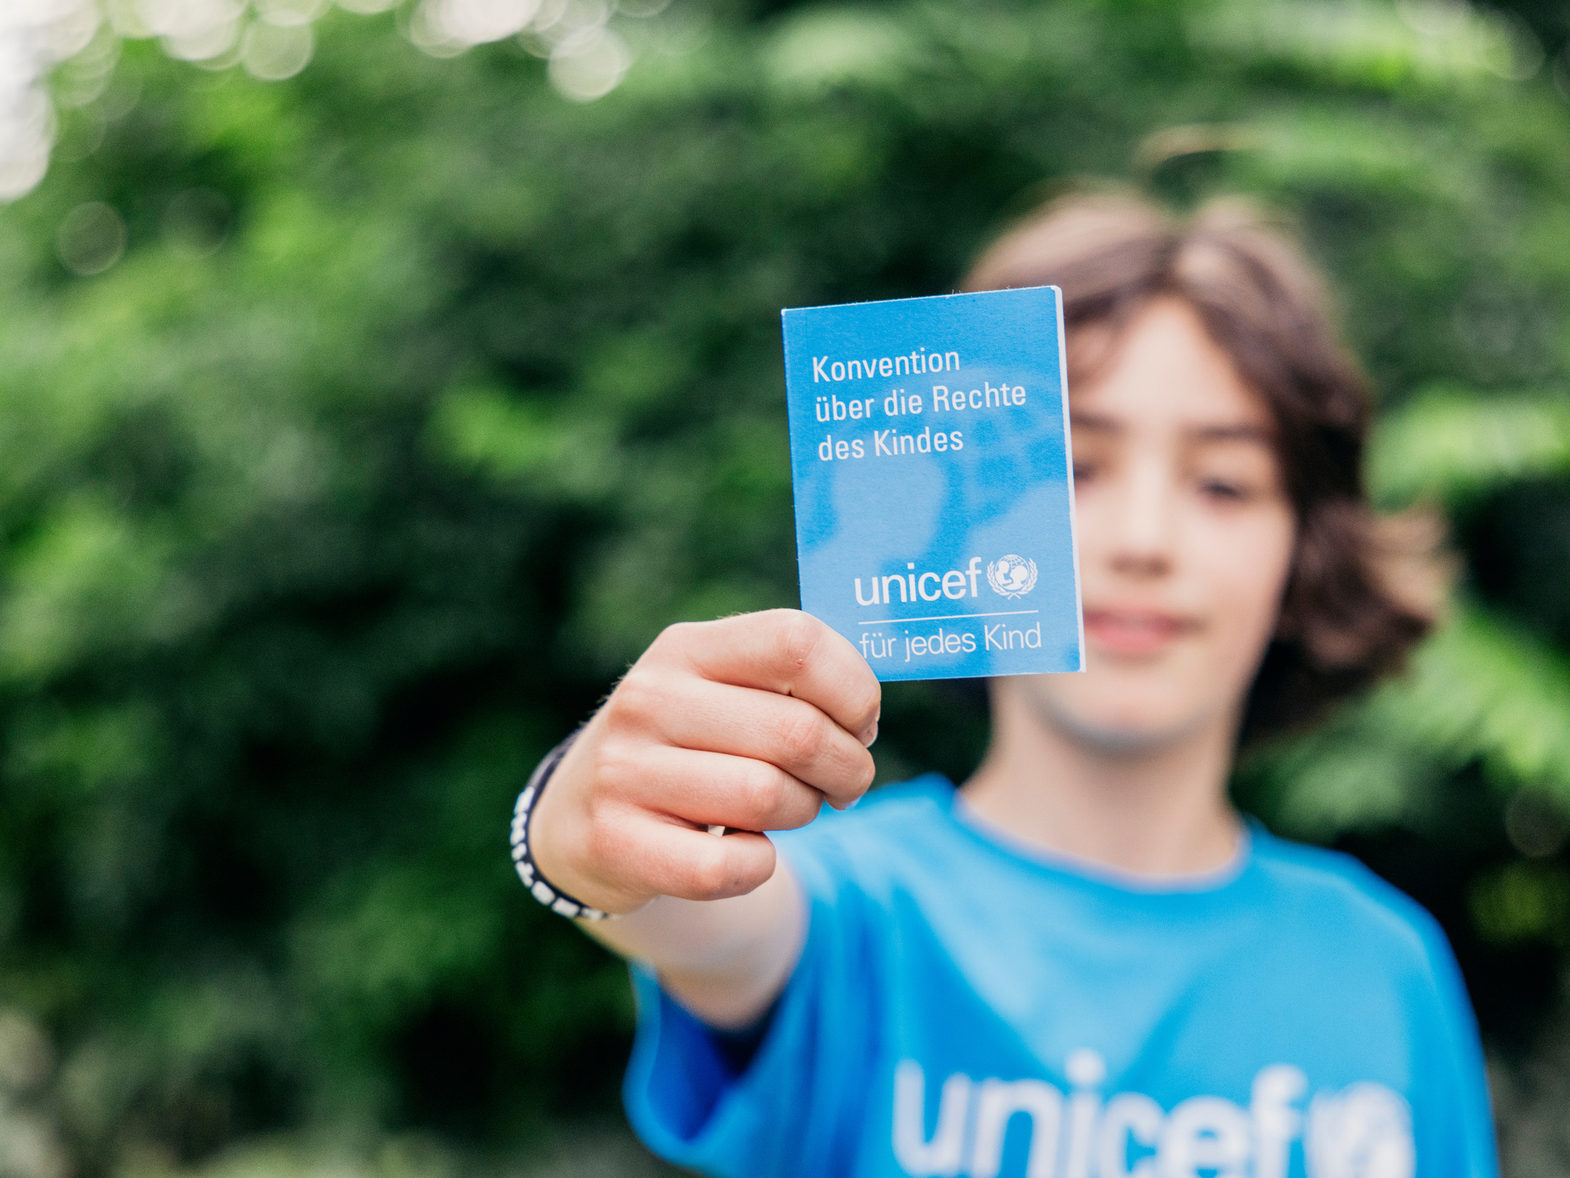
Reflection
Take some time to think about and reflect on our lives online and how to make the internet safer.
    How can we make sure that the internet is a good place to talk?
    What changes need to be made and who would you talk to if you had concerns about your own online life or someone else’s?
UNI595695
UNI524456
Notes:
From June 07.- 09. June 2024, around 150 committed young people from all over Germany met in Mannheim for the third UNICEF YouthFestival. The focus of this year’s campaign, chosen by the young participants themselves was: "Together for a more just future" (Gemeinsam für eine gerechtere Zukunft). The topics of mental health, education, discrimination and racism were discussed, with a particular focus on tolerance and diversity.

Slide 22
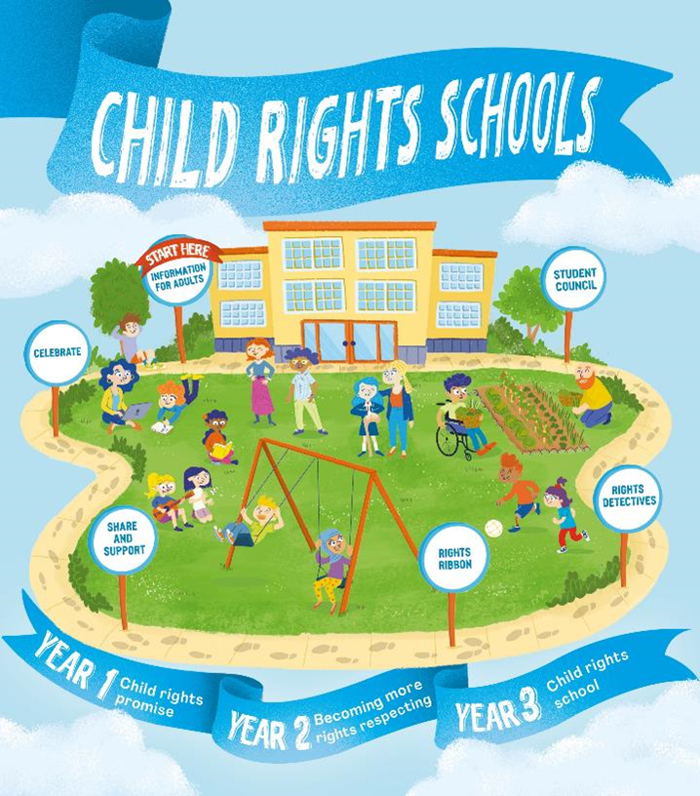

FURTHER CHILD RIGHTS EDUCATION SUPPORT
Child Rights Schools is a programme that supports you to embed child rights across the whole school community, including with parents and carers. Find our more here.
Find more classroom resources here.

Slide 23

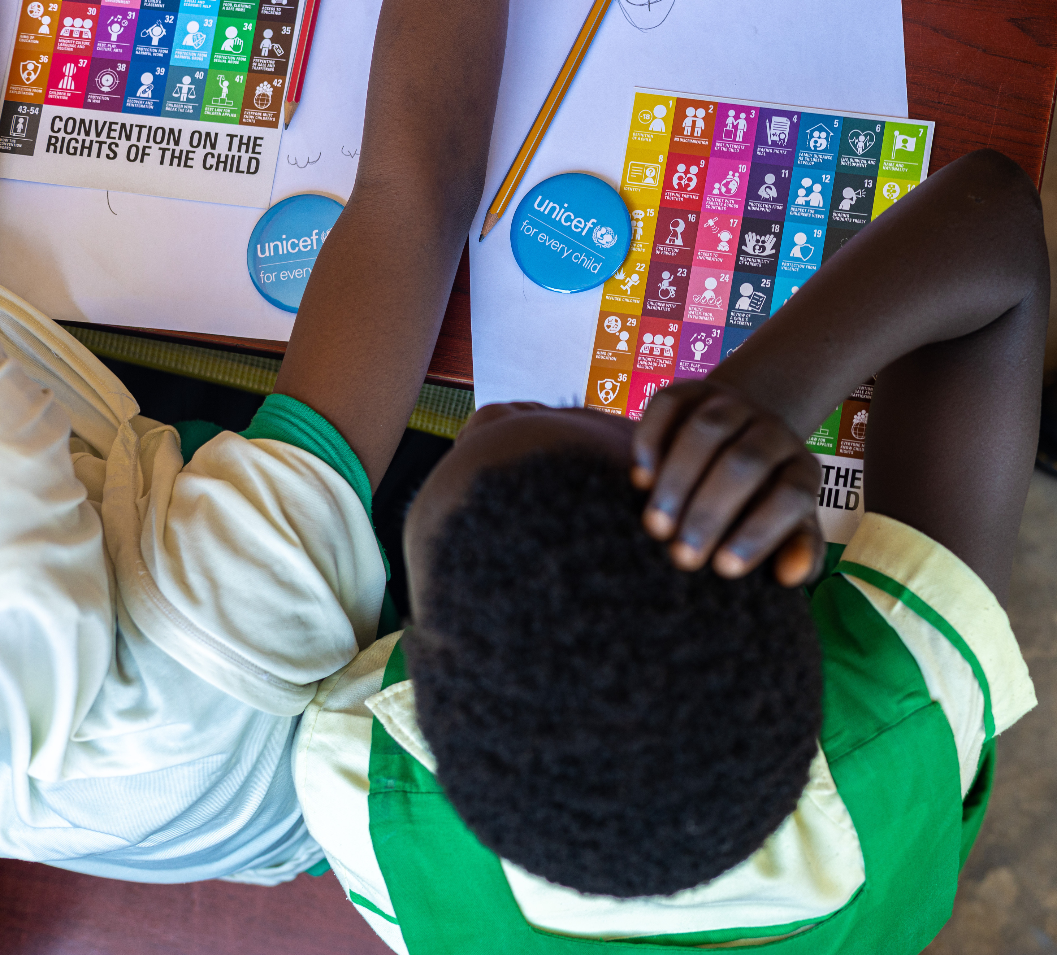
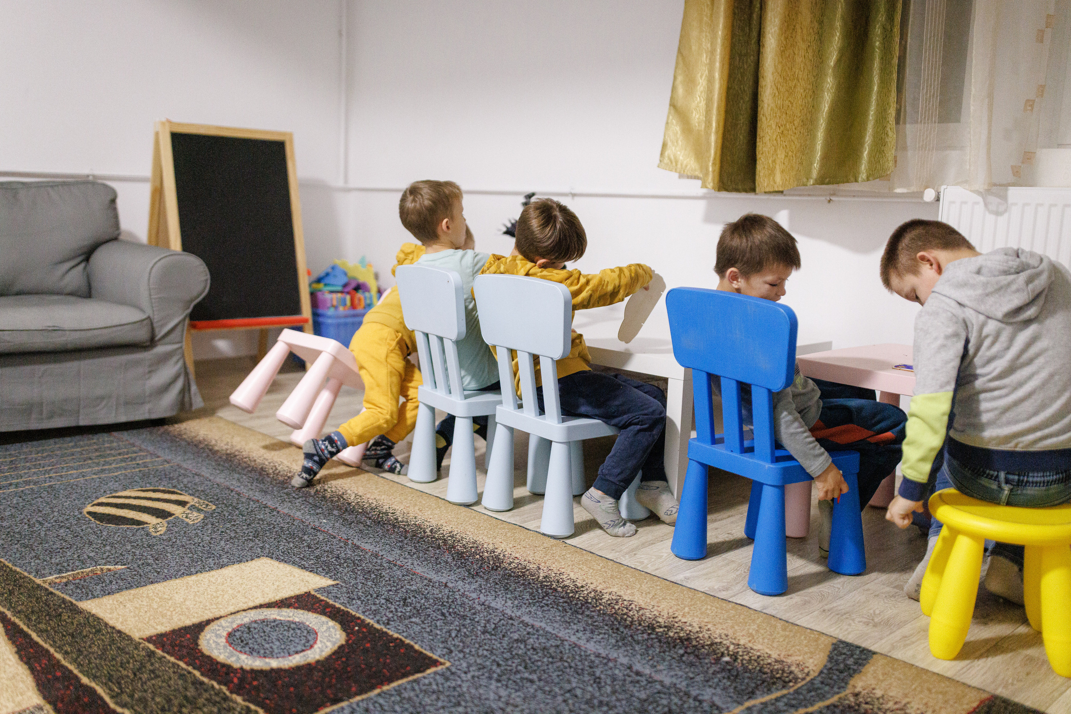
thank you
UNI667810
Notes:
Children attend a UNICEF organized art workshop on the Convention of the Rights of the Child (CRC) at Awoshie Community Islamic School in Accra. Ghana. in Accra. Ghana.

