Slide 1
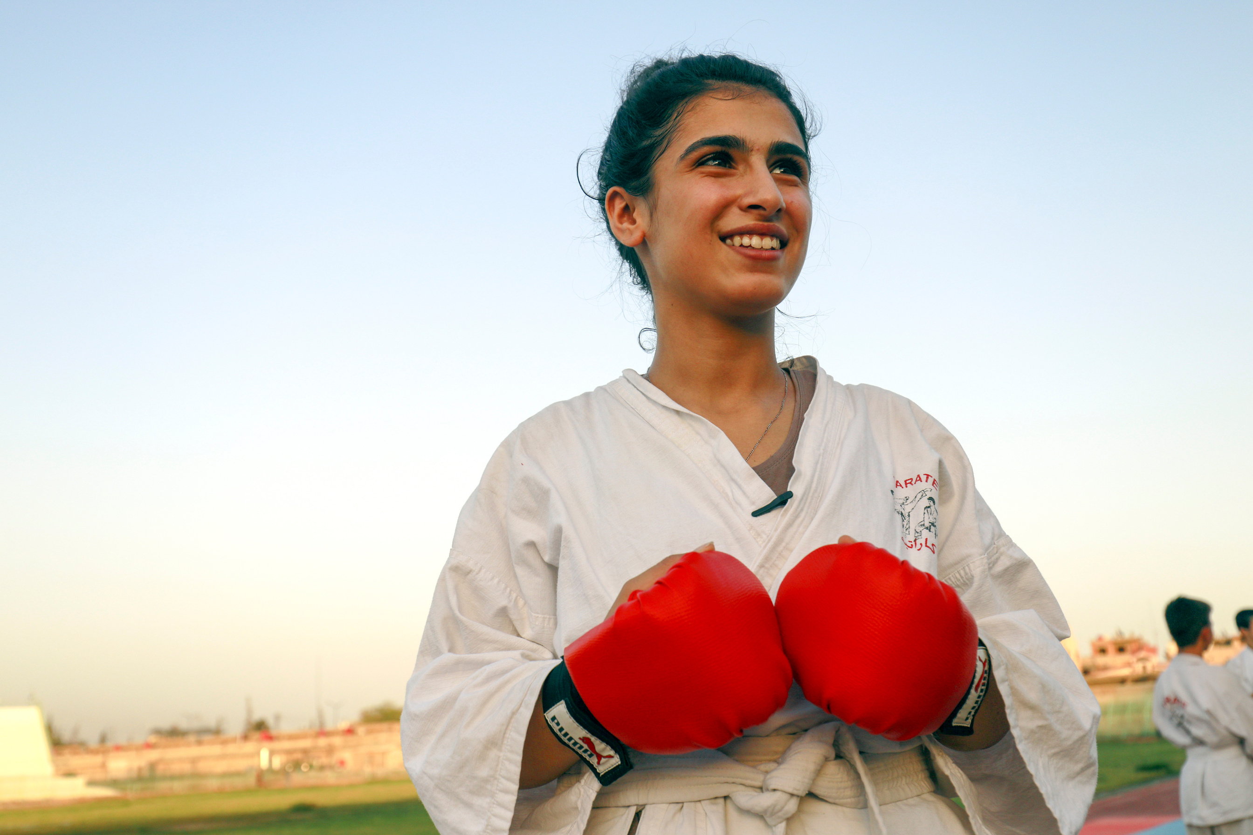

INTERNATIONAL WOMEN’S DAY
UN0399375
Notes:
On 4 July 2018, in Al-Hassakeh, Syria Najbeer, 14,encouraged by her family and peers, overcomes gender expectations and trains hard to earn her karate black belt. She dreams of becoming a karate coach for girls and women to empower them to break gender stereotypes.

Slide 2

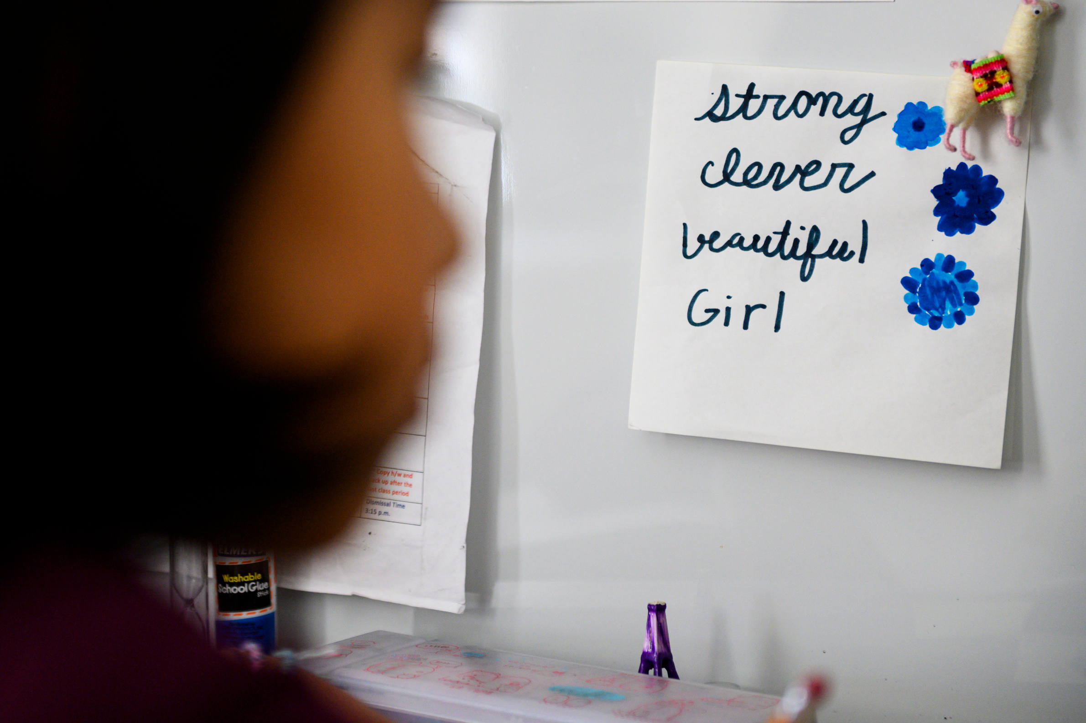
BEFORE YOU BEGIN
      We strongly recommend completing this week’s pack in class with teacher supervision and not setting this pack, or activities from this pack, as homework. This is a flexible resource and is intended to provide you with some easy to use, appropriate rights-related learning to share with your children, their families and your colleagues.
      Please edit out non relevant slides or activities before sharing with your students. Please check that the content works for your learners and feel free to adapt or add any content that would make the material more relevant for your setting.
      Some activities in this pack have been adapted from UNICEF UK Rights Respecting Schools resources.
UNI320491
Notes:
On 6 April 2020, Yolanda, 9, sits at her desk as she studies from home in New York City, United States of America. In front of her on the wall is a motivational note she wrote for herself – accented by her favourite color, blue – which reads: “strong clever beautiful girl.”

Slide 3


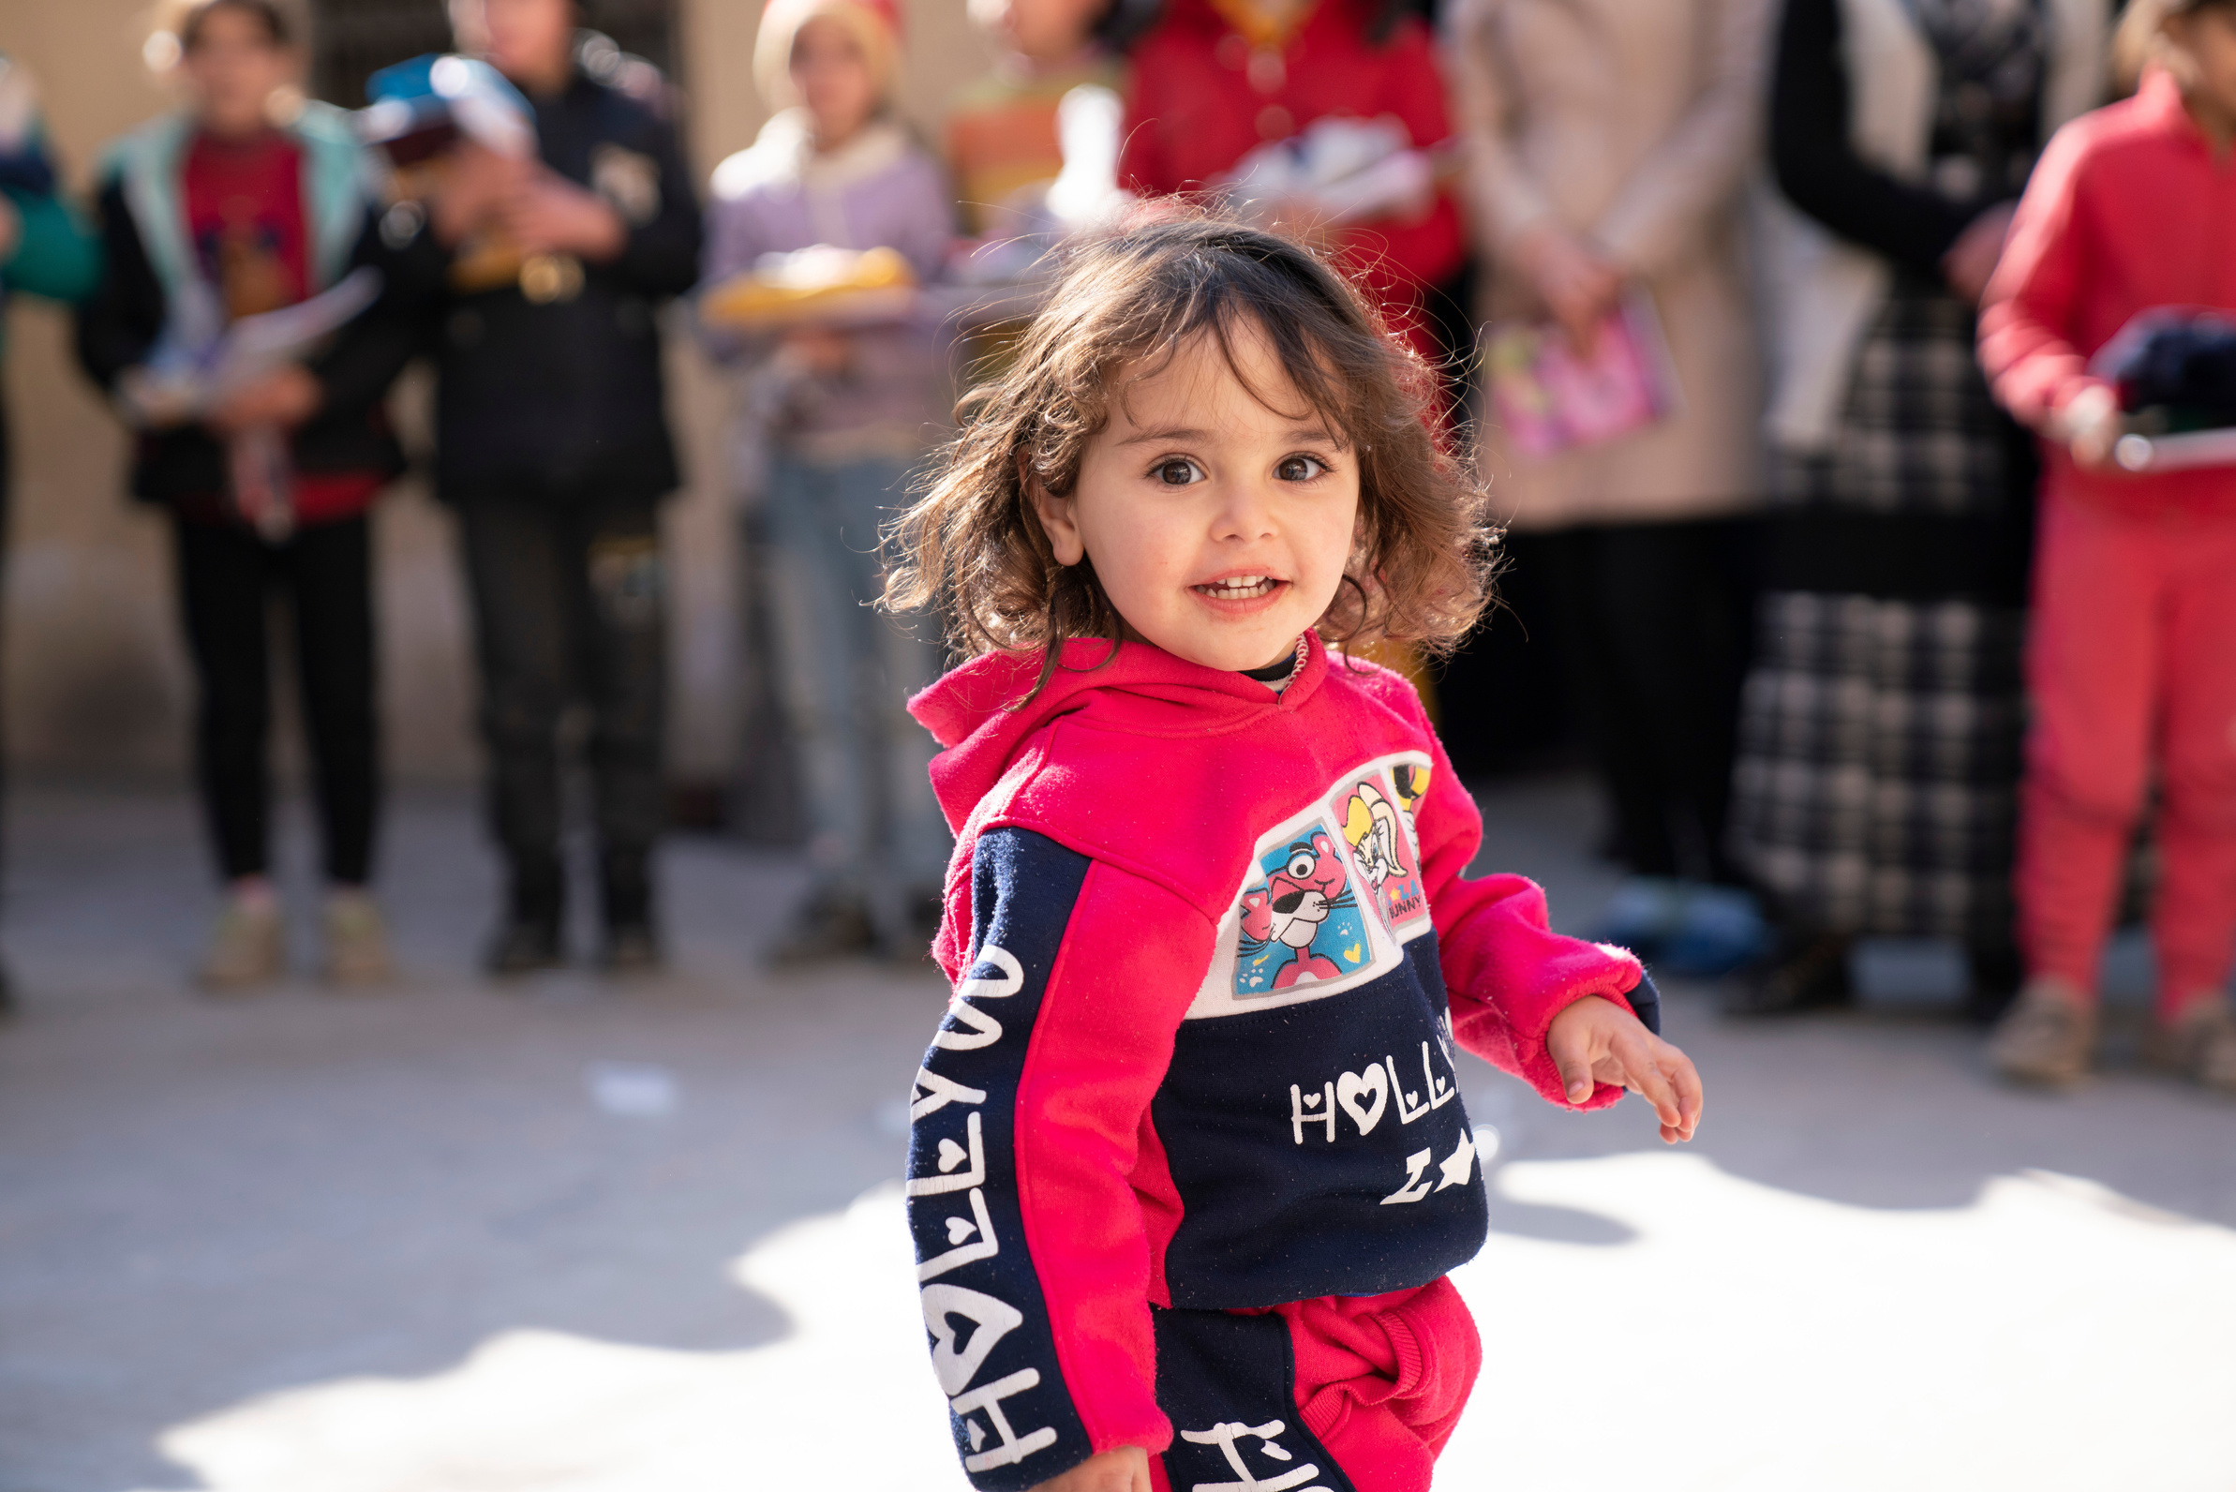



UN0796317
WHAT IS INTERNATIONAL WOMEN’S DAY?
The energy sources we use today are highly disruptive and damaging to the environment, especially due to the use of hydrocarbon fuels that have increasingly caused global warming.
Notes:
Hadeel, 2, participates in a recreational activity provided by UNICEF-supported volunteers in Abdul Muttaleb Al Qad School, on 15 February 2023. The school, in Al-Jabrieh neighbourhood, Aleppo city, is being used as a shelter for people displaced by the earthquakes.

Slide 4
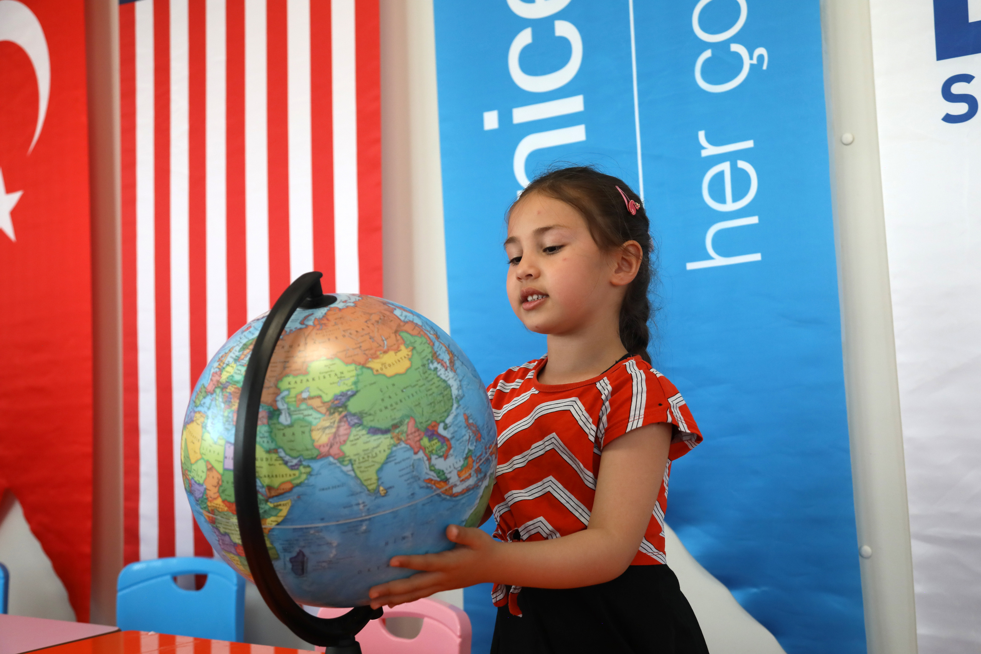

INTERNATIONAL WOMEN’S DAY
International Women's Day (IWD) is celebrated on 8 March. It is a global day celebrating the social, economic, cultural and political achievements of women. The day also marks a call to action for accelerating gender parity. Significant activity is witnessed worldwide as groups come together to celebrate women's achievements or rally for women's equality.
UNICEF/UNI557589
UNI568442
Notes:
Children playing during the early childhood education programme at Islahiye temporary accommodation center at Gaziantep, Türkiye.

Slide 5

INTERNATIONAL WOMEN’S DAY AND THE CRC
Notes:
https://www.youtube.com/watch?v=O5gia39y5uo
Article 2 means every child must live a life without discrimination, regardless of gender.

Slide 6
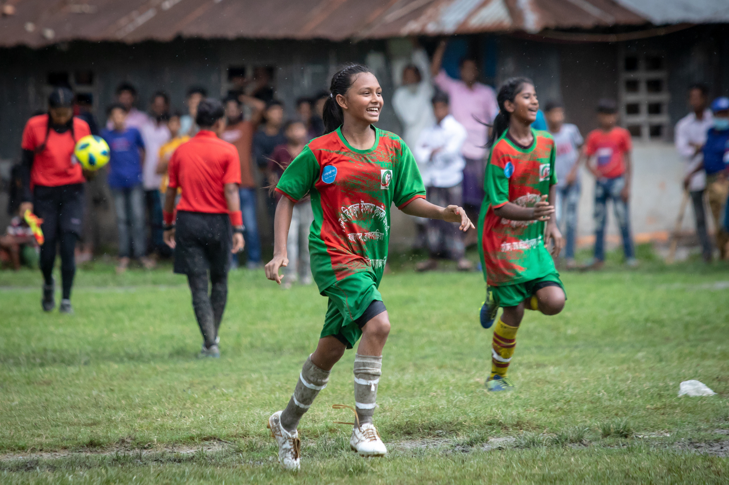
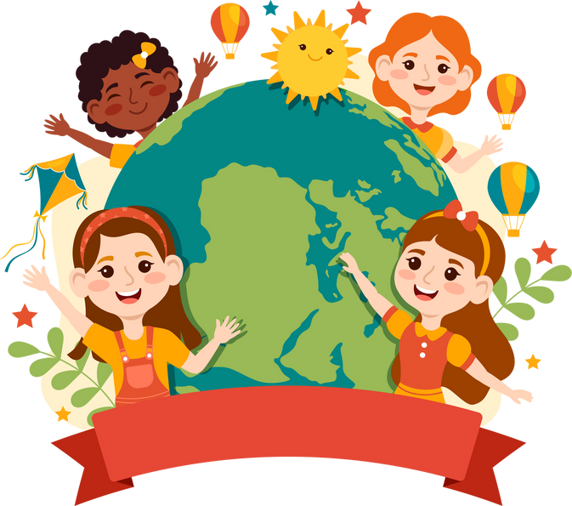

Why do you think it is important to have a special day to celebrate women?
Write down your ideas on a piece of paper. If you feel comfortable. Share with your class during discussion time.
UNI528220
UN0479336
Notes:
On 18 June 2021, players of the Brahmanbaria team celebrate after winning the final match of the BFF-UNICEF Under-16 National Women’s Championship at Sonaimuri, Noakhali, Bangladesh.

Slide 7
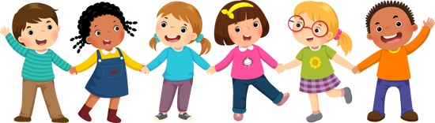
EXPLORING INTERNATIONAL WOMEN’S DAY
Did you think of these?
  To celebrate how amazing women are.
  To recognise how women have changed the world.
  To acknowledge the challenges women still face around the world.
  To encourage women to be themselves – to be the best they can be!
  To let women know they are appreciated.
  To speak out about inequality.
  Fewer girls than boys go to school – this isn’t right.
  Women often get paid less than men for doing the same job.
  It is about equality and ensuring all are treated fairly and not discriminated against.
  To explore what we need to do to create a world where gender equality exists.
What else did you think of?

Slide 8
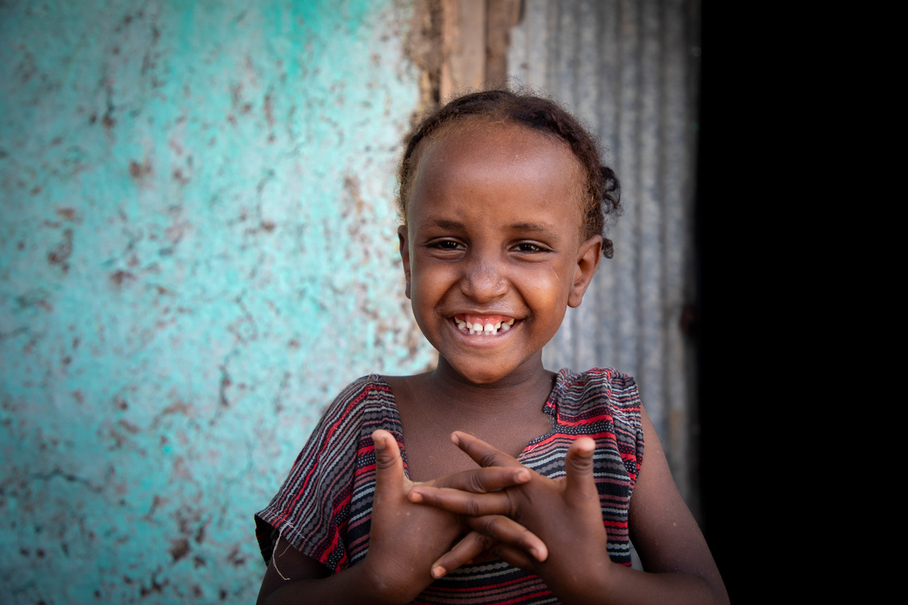

ACTIVITES FOR AGES 4-6
UNI627067
Notes:
I am a child, not a bride. In the drought-stricken Afar region of north-eastern Ethiopia, water scarcity and loss of livelihoods are threatening the future of girls who are increasingly forced into child marriage.
UNICEF is conducting awareness-raising activities on the ground to ensure that young girls are where they belong: in school!

Slide 9


WOMEN ARE LEADERS!
There are so many amazing women to learn about and some brilliant books that help you to do this! Watch this clip to see some drawings of the women who are part of the Puffin Little Leaders books. Choose someone to find out more about as a class.
Notes:
https://www.youtube.com/watch?v=O5gia39y5uo
Article 28 says that all children have the right to an education. Read the book All are Welcome about children going about their day at school where all children are welcome or listen to it on YouTube. How are all children welcomed in your class?

Slide 10
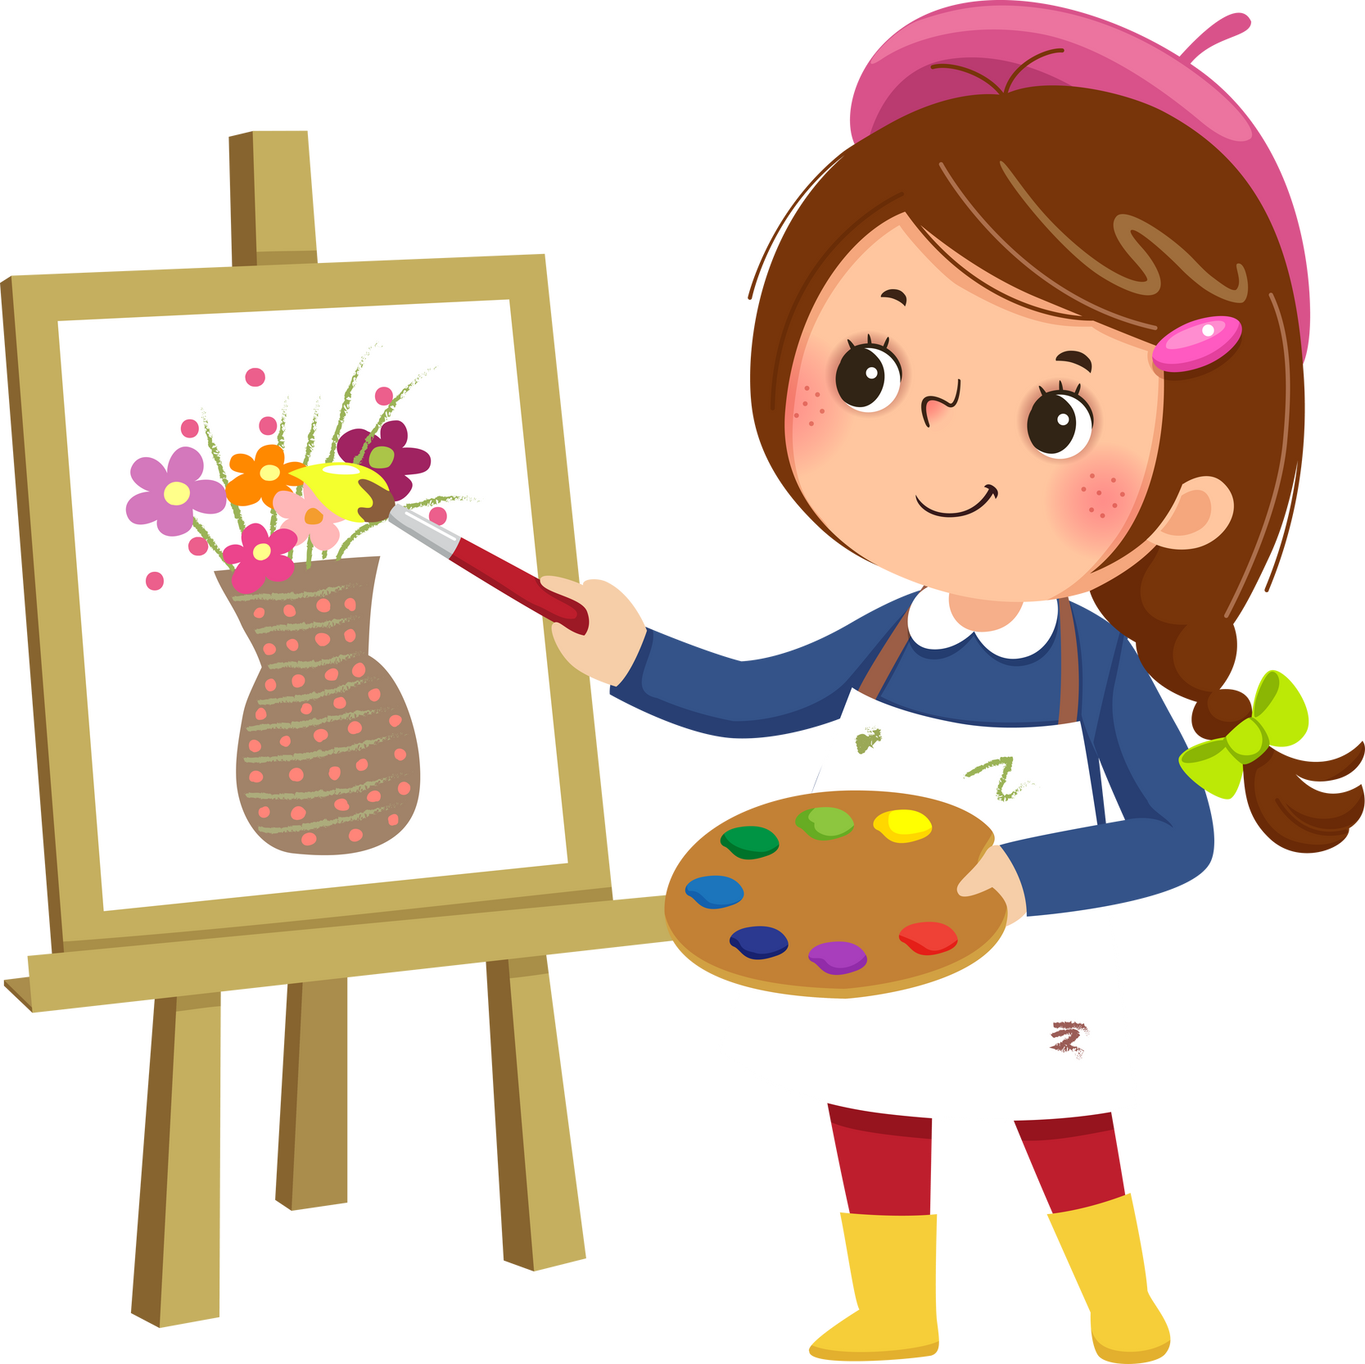

WOMEN AND GIRLS WHO INSPIRE ME!
Draw a picture of a woman or girl that you look up to. This might be a member of your family, someone at school or someone you have learned about. Share your picture with your classmates.

Slide 11



DANCING TO CELEBRATE WOMEN!
Have a boogie to celebrate International Women’s Day and dance along to songs which celebrate women. Make sure to use radio edits!
The energy sources we use today are highly disruptive and damaging to the environment, especially due to the use of hydrocarbon fuels that have increasingly caused global warming.

Slide 12
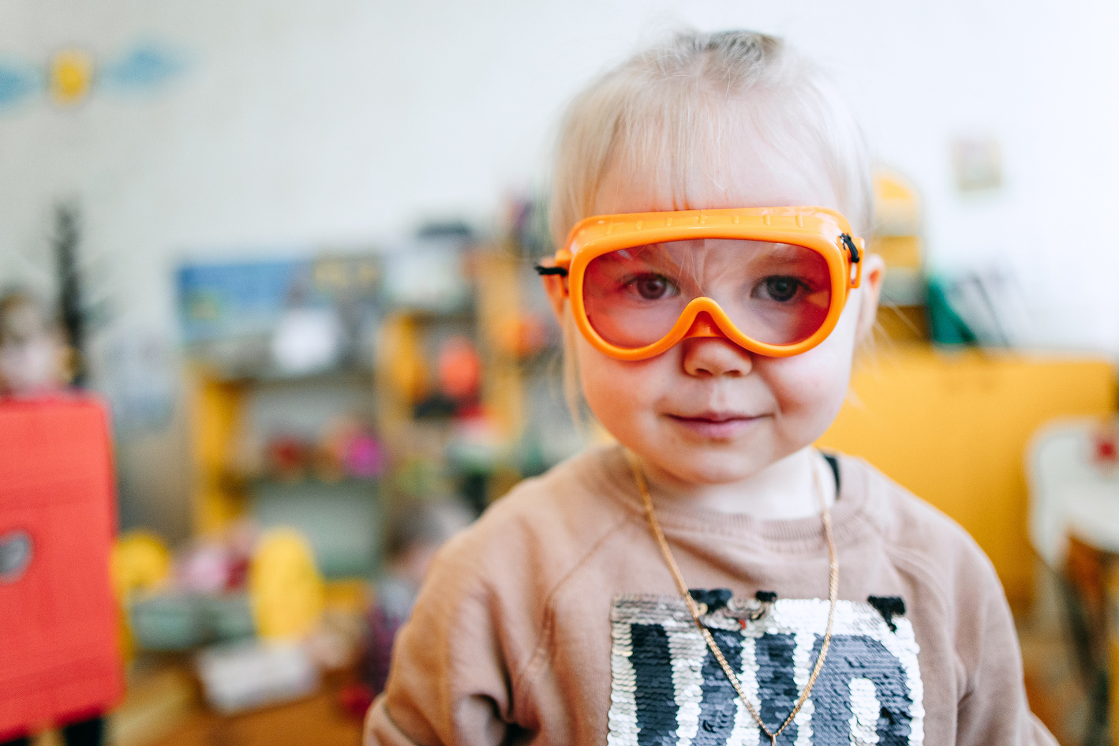
ACTIVITES FOR AGES 7-9
The energy sources we use today are highly disruptive and damaging to the environment, especially due to the use of hydrocarbon fuels that have increasingly caused global warming.
UNI558149UNICEF/UN0657546
3
Notes:
March 6, 2024, Myrhorod, Ukraine. Karen (3) is wearing toy goggles at her kindergarden.

Slide 13

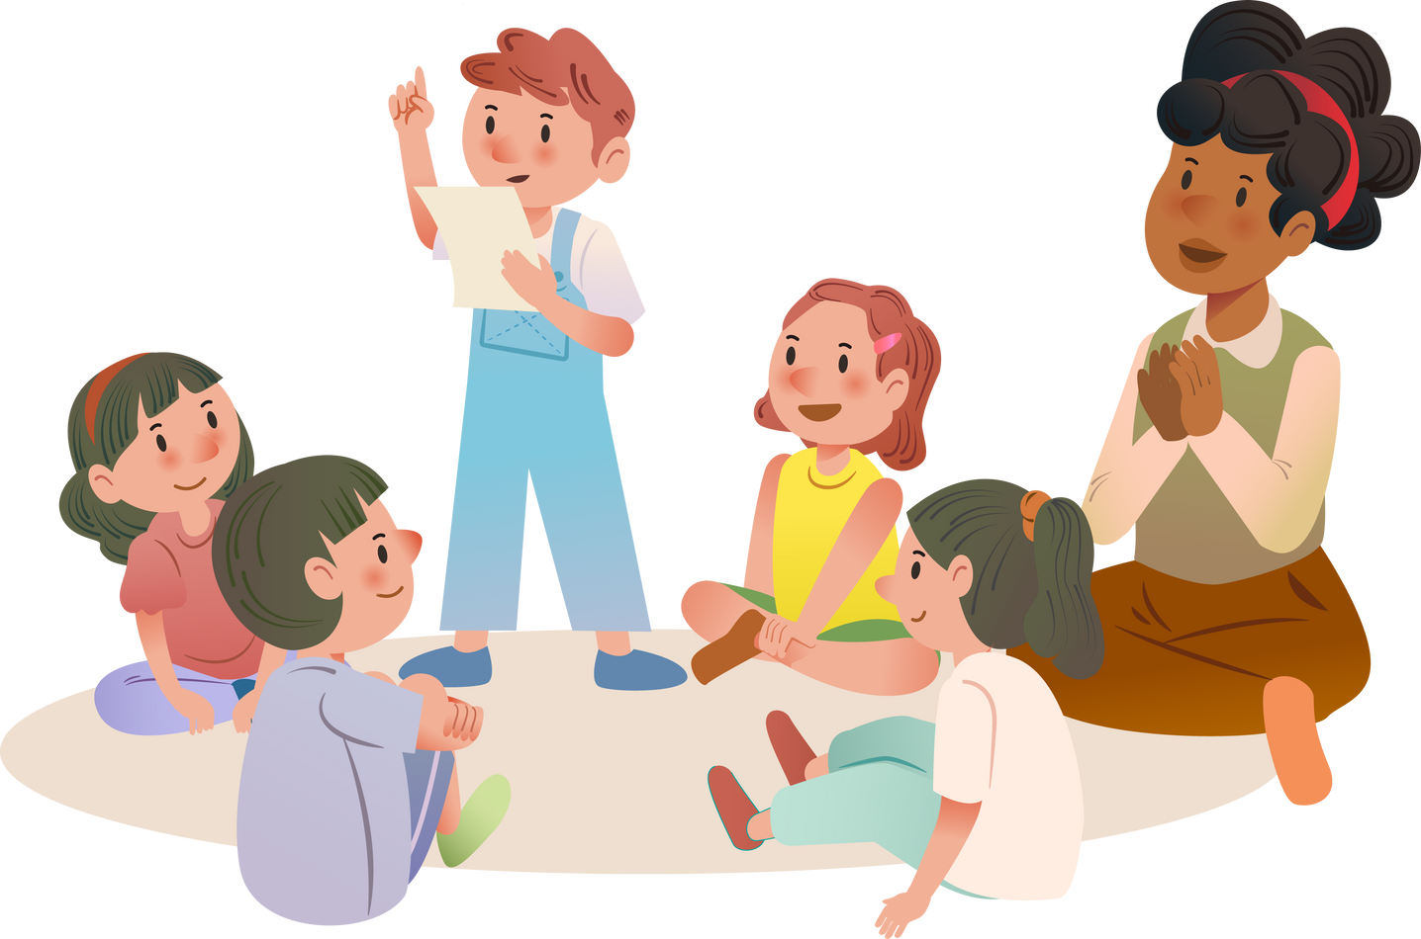
UNDERSTANDING GENDER EQUALITY
Have you heard of the Sustainable Development Goals? One of them is about gender equality. Find out more about Global Goal 5 by watching this video. What can you do to support the Global Goal of Gender Equality? Choose an action you will take individually or as a class.

Slide 14



READ ALOUD
Read about Audrey Faye Hendricks, the youngest known child to be arrested for a civil rights protest in Birmingham, Alabama. This story is a powerful reminder that young voices can make a big impact!

Slide 15
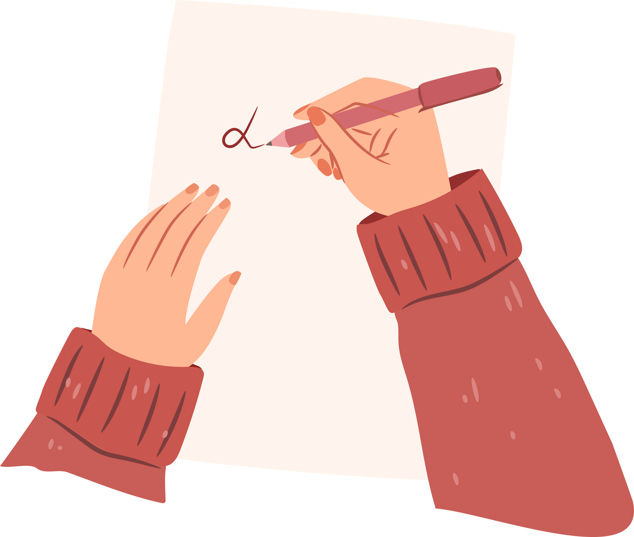
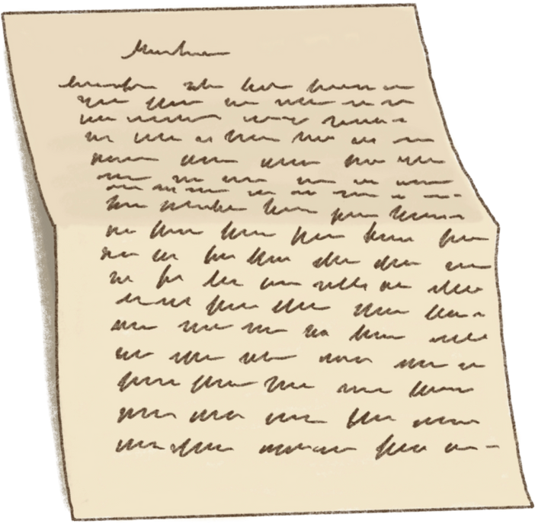
A LETTER TO AN INSPIRING WOMAN
Find out about some influential women who have changed the world in the Fantastically Great Women series. Write a letter to a woman who has inspired you. You could start with ‘’I have learned _____ from you’’ or You inspire me because...’’.
The energy sources we use today are highly disruptive and damaging to the environment, especially due to the use of hydrocarbon fuels that have increasingly caused global warming.
BE CREATIVE!
Notes:
Share sentence starters with students such as:
I am grateful for you because…
You inspire me because…
I have learned ____ from you

Slide 16
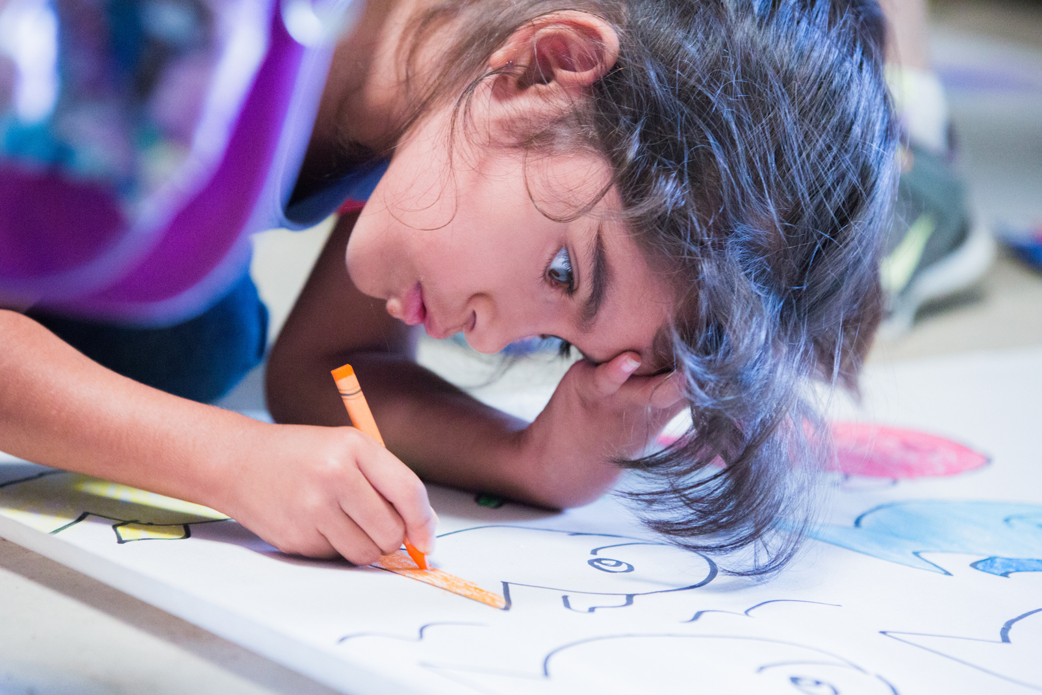
UN0490971
ACTIVITES FOR AGES 10-12
UNICEF/UNI509138
The term "alternative" refers to a technology other than the technology used in fossil fuels to produce energy.
Notes:
Abiguail Rosales (5 years old) is drawing one of the last drawing of the year as "Escuela Los Laureles" in Jalapa, Guatemala.

Slide 17

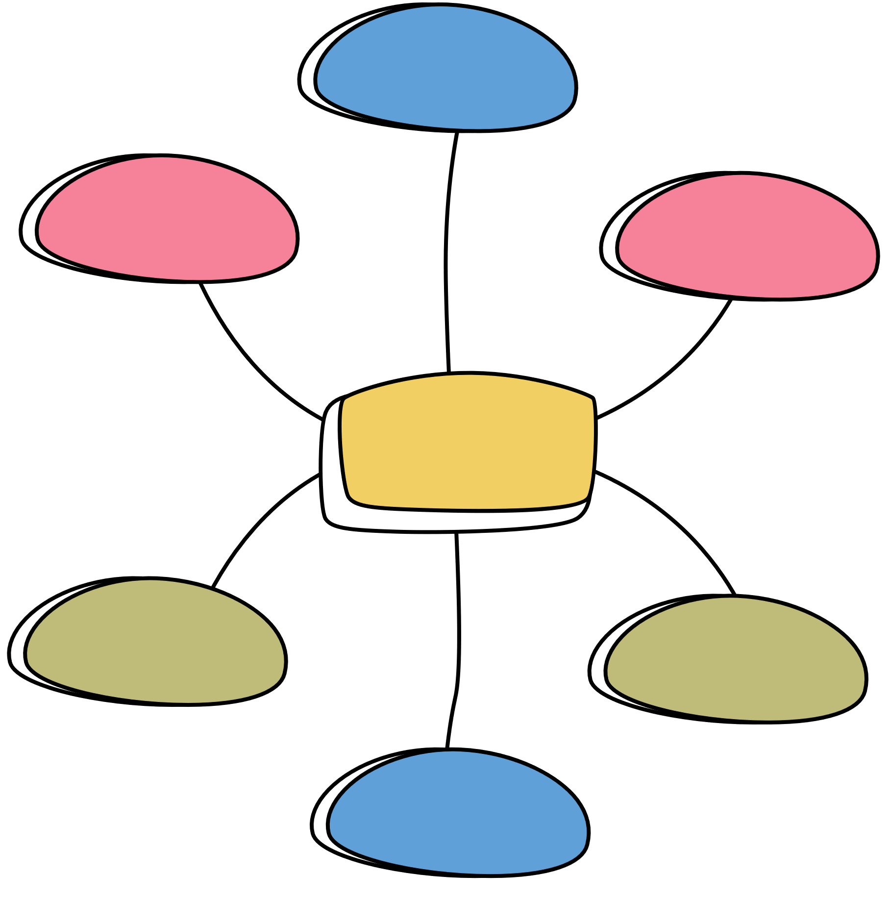
ARTICLE 2: NO DISCRIMINATION
Article 2 is about non-discrimination. What does discrimination mean? Think about ways in which your school can be made fairer for girls (and boys). For example, think about your playground and whether there are spaces that both boys and girls enjoy. Present your ideas in a mind map and compare with friends. You might want to share the most popular ideas with your principal.

Slide 18



RESEARCHING GIRL ACTIVISTS!
Look at UNICEF’s Teen-Girl-Activist page and read about five inspiring young women from across the world. Choose an activist and decide what questions you would you ask if she came to visit your school.
The energy sources we use today are highly disruptive and damaging to the environment, especially due to the use of hydrocarbon fuels that have increasingly caused global warming.

Slide 19



COMIC TIME!
Sustainable Development Goal 5 is all about Gender Equality. Look at page 5 of this comic which shows what we can do to tackle gender equality. Work in groups to create your own comic showing four things you can do to work towards gender equality in your school or community.

Slide 20
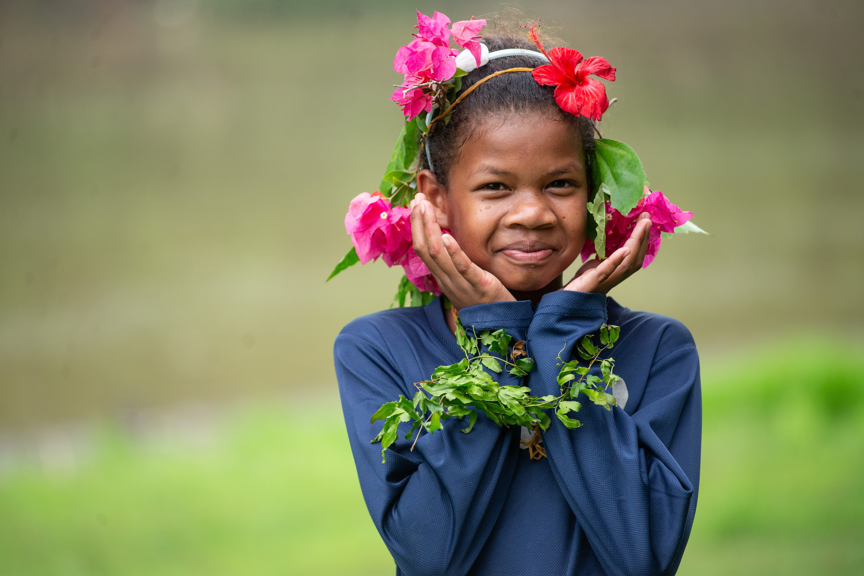
Reflection
We need to be brave to challenge unfairness and make the world a better place for everyone
  Think of a change that would help to make a fairer world where gender equality is a reality. It might be something small.
  Is there something you can do to make this happen?
  Can you tell somebody about the change you would like to see?
UNI608801
Notes:
Natisah binti Sidik, 11, is a member of the Jahai native tribe. She lives in Kampung Sungai Tiang near Banding Lake in Royal Belum State Park, Malaysia.

Slide 21


FURTHER CHILD RIGHTS EDUCATION SUPPORT
Child Rights Schools is a programme that supports you to embed child rights across the whole school community, including with parents and carers. Find our more here.
Find more classroom resources here.

Slide 22

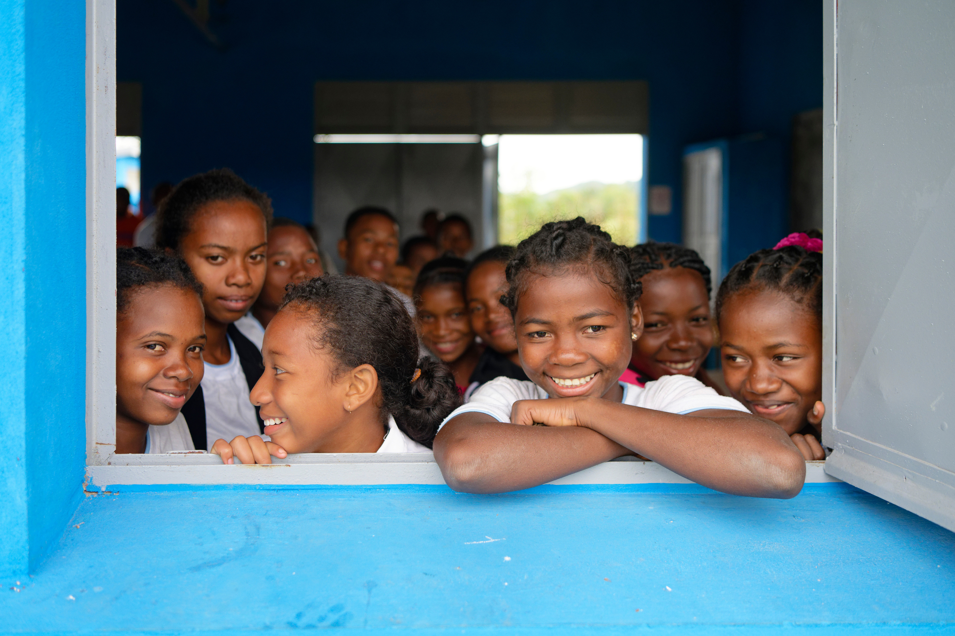
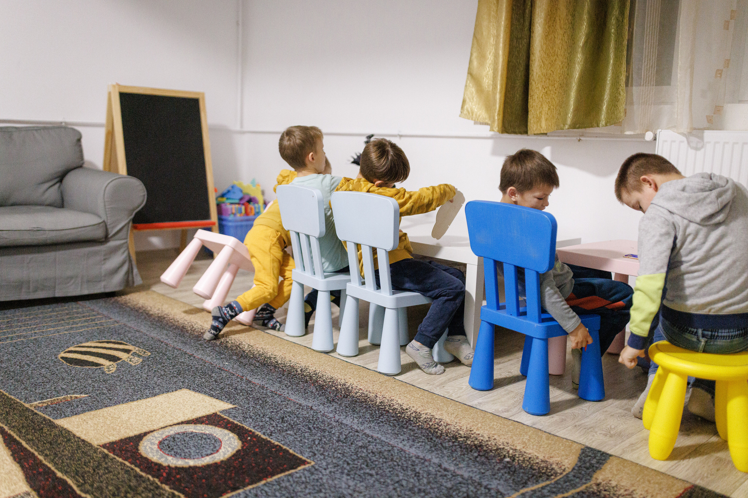
thank you
UNI619463
Notes:
Mavorano Secondary School, Manakara District, Fitovinany Region, Madagascar (03/07/2024) : group photo of smiling schoolkids looking through the open window of their classroom taken during the visit of the school. The Executive Board had the opportunity to see: 1) The importance of building schools that can withstand cyclones and climate hazards and provide a safe learning environment, preventing dropouts. New school buildings

