Slide 1
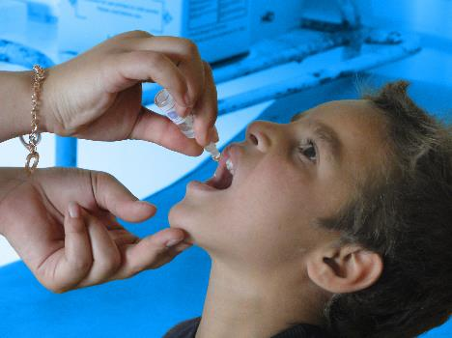
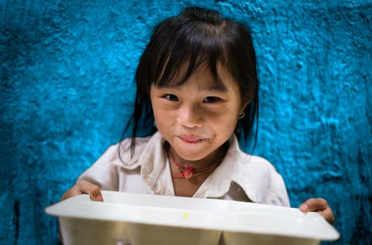
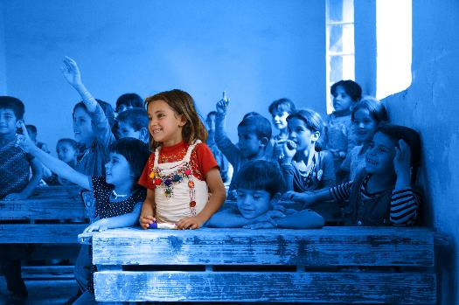
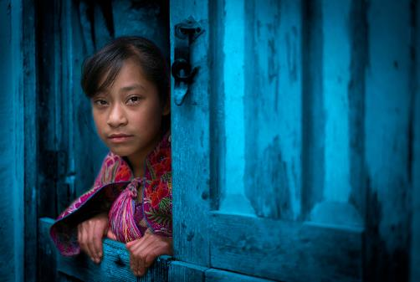
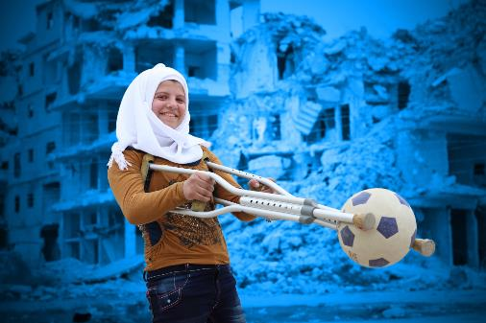
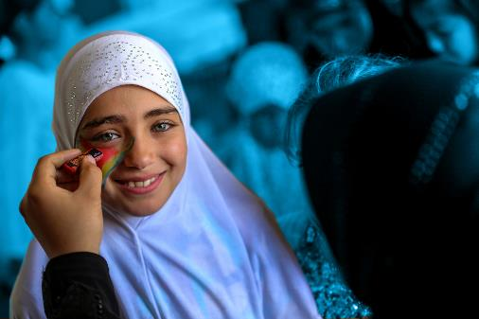
End Racism and Discrimination
Notes:
Delivering this Activity:
You will need:
The United Nations Convention on the Rights of the Child - a few double-sided printed copies
A projector, a screen and a reliable internet connection to show the presentation.
*Please Note: UNICEF encourages peer-led learning. If you are a young person delivering this workshop to your peers, follow the steps below for a successful workshop!
Get support from a teacher or adult to run through the workshop with you first.
If it is a challenging issue, that might cause upset to people, only deliver it with the support of an adult in the room. And also give prior warning to the participants of topic you are covering as they may or may not wish to participate.
Make sure all the technical things (internet, computer connections, etc) are working before the workshop
Follow the notes and use them to talk through each of the slides and show the different videos. Most slides have notes with more info, but don’t worry if you don't share everything in the notes.
Always encourage discussion during the presentation – being sensitive to everyone’s personal experiences and perspectives.

Slide 2
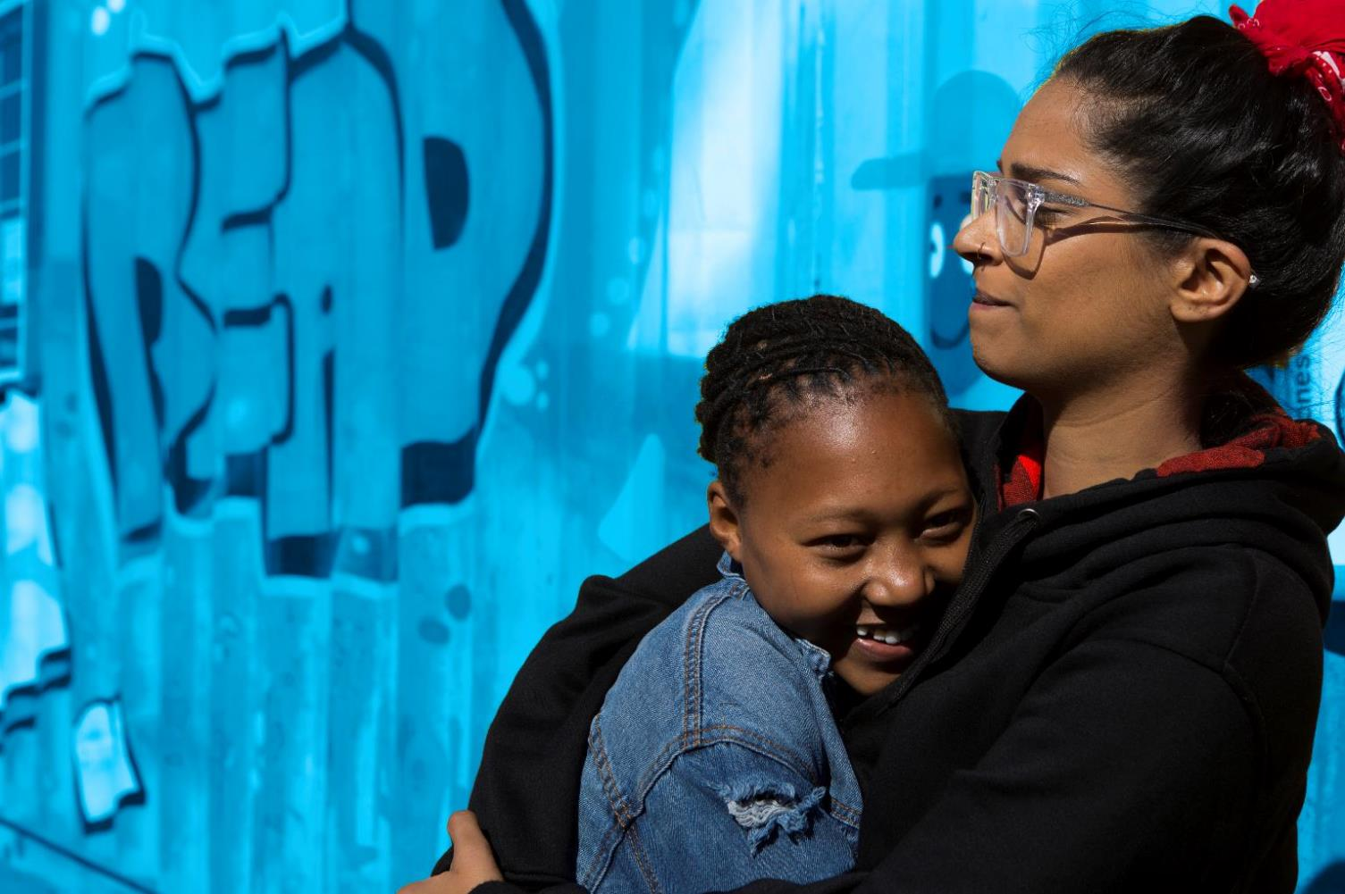

RESPECT
CONFIDENTIALITY
PRIVACY
INCLUSION
AWARENESS
Notes:
Working Well Together - This workshop might touch on some personal experiences you, a family member, or friend has dealt with. ​Because this is an open forum and the discussion might be challenging, please keep in mind the following.
​
RESPECT- Listen when people are speaking, be non-judgmental and respect difference, and don't laugh, deride or make fun of others
CONFIDENTIALITY – Try to ensure that what is said in the room stays in the room
PRIVACY - Only share what we want to share with the group, though we ask for confidentiality, we cannot guarantee it.
INCLUSION – Include everyone, let’s all make sure everybody has an opportunity to contribute if they want to and no one is left out of a group or discussion.
AWARENESS- Be aware this topic might be upsetting If you find the discussion is upsetting you and or you need support please feel free to excuse yourself and find an adult who can support you, be that a teacher, guidance counsellor or a support organisation. X is in the room to support you as well.

Slide 3
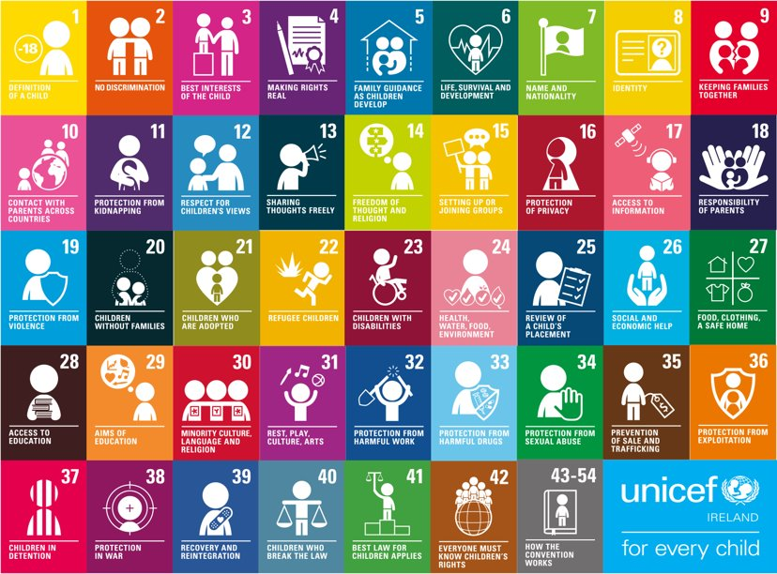
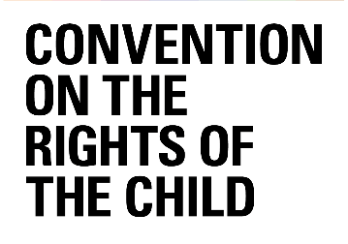
Notes:
2 minutes
Explain the workshop is around equality and non-discrimination
Explain children's rights (Note: a child is defined as anyone up to 18. But, you might like to use the term "children and young people" for anyone up to 18)
Children and young people have the same general human rights as adults and also specific rights that recognize their special needs. Children are neither the property of their parents nor are they helpless objects of charity. They are human beings and are the subject of their own rights.
The Convention is one of the nine core treaties that are part of the international human rights framework.
Highlight how all children (and young people) have the same rights – no matter what (see next slide for more).

Slide 4
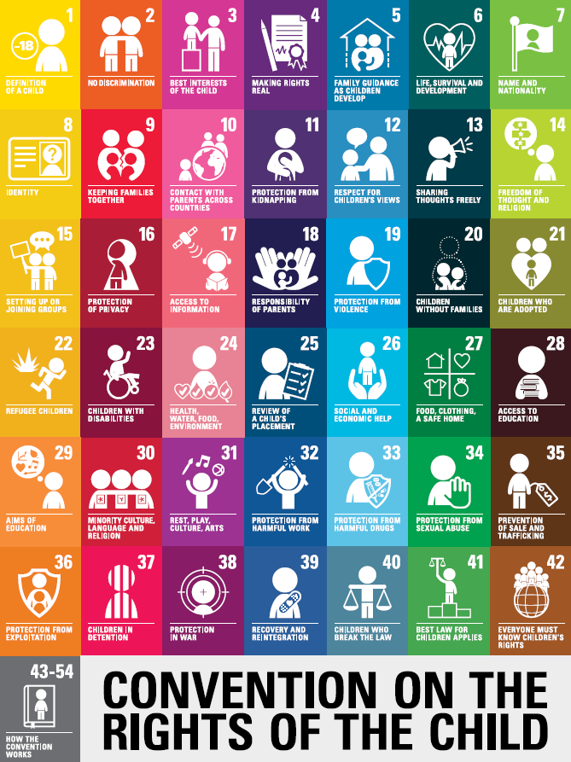
ACTIVITY
What rights are in the Convention to protect against discrimination?
Which communities in Ireland are most vulnerable to discrimination?
What can individuals to prevent discrimination?
Notes:
10-15 minutes
Activity – Think – Pair - Share
Divide up into pairs.
Handout copies of the Convention to all participants.
Ask pairs to think about the 9 forms of discrimination
Discuss, what rights are in the Convention to protect against discrimination
Discuss Which communities in Ireland are most vulnerable to discrimination and
Discuss what can individuals to prevent discrimination.
Give pairs time to discuss and identify rights together (5-7 minutes)
Share back your thoughts with the class.
Information on rights:
Find Articles from the convention and child-friendly explainer text on the next few slides, if needed.
Alternatively, students can go to https://www.unicef.ie/childrens-rights/ to learn more and access copies of the convention.
NOTE: TRY AND END ON A POSITIVE NOTE. BELOW ARE TWO OPTIONS:
Feedback & Closure: Go around the room and ask participants to share their feedback and close by asking them to describe in one word a feeling they wish to leave behind in the room or by watching this video.

Slide 5
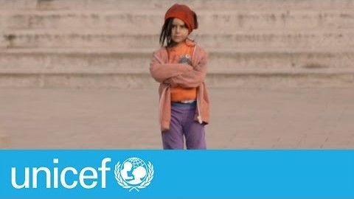
Notes:
2 minutes **Explaining the universality of rights**
We are all equal in dignity and rights
Everyone, everywhere has the same rights as a result of our common humanity. We are all equally entitled to our human rights without discrimination.
No matter who they are, where they live, what language they speak, what their religion is, what they think, what they look like, if they are a boy or girl, if they have a disability, if they are rich or poor, and no matter who their parents or families are or what their parents or families believe or do.
Play the video – explaining that today we're going to be talking specifically about non-discrimination 3-minute
Ask participants for their comments after the video.

Slide 6
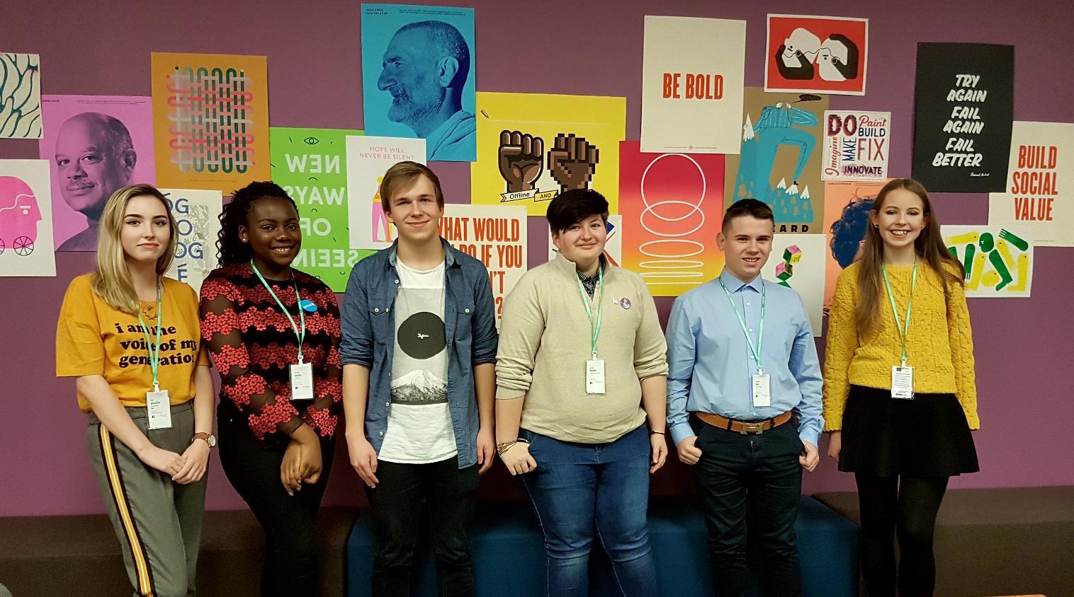
9 FORMS OF DISCRIMINATION IN IRELAND
AGE
RELIGION
GENDER
DISABILITY
TRAVELLERS
CIVIL STATUS
FAMILY STATUS
SEXUAL ORIENTATION
Notes:
2 minutes: How the law protects people's rights in Ireland
The law in Ireland: Discrimination occurs where one person is treated less favorably than another.
The Irish Constitution guarantees equality before the law and legislation protects us from discrimination in the workplace and in the receipt of services.
Protection is also offered, under EU law and international human rights instruments such as the UNCRC.
Can you name the nine grounds in Irish law that it is unlawful to discriminate against a person
Gender: this means man, woman or transsexual
Civil status: includes single, married, separated, divorced, widowed people, civil partners and former civil partners
Family status: this refers to the parent of a person under 18 years or the resident primary carer or parent of a person with a disability
Sexual orientation: includes gay, lesbian, bisexual and heterosexual
Religion: means religious belief, background, outlook or none
Age: this does not apply to a person aged under 16
Disability: includes people with physical, intellectual, learning, cognitive or emotional disabilities and a range of medical conditions
Race: includes race, skin colour, nationality or ethnic origin
Membership of the Traveller community.

Slide 7
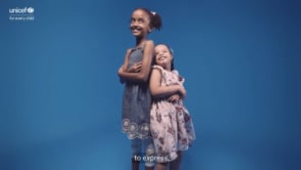
Notes:
Group work: (Think-pair-share) Handout copies of the Convention. Ask pairs to think about the 9 forms of discrimination and discuss how this might impact on children’s rights, which communities in Ireland are most vulnerable to discrimination and what can individuals to prevent discrimination.
Feedback: Go around the room and ask the participants to share their feedback. Ask if there are any forms of discrimination Irish legislation does not cover? Think back to the video, could it be argued age and socioeconomic status are not protected against discrimination? Discuss
Video: For Every Child, Every Right

Slide 8
DEFINITIONS TO UNDERSTAND
Discrimination
Unjust or prejudicial treatment of different categories of people, especially on the grounds of race, age, or sex.
Racism
Prejudice, discrimination, or antagonism directed against someone of a different race based on the belief that one's own race is superior.
Bigotry
Intolerant devotion to one's own opinions and prejudices.
Prejudice
Preconceived opinion that is not based on reason or actual experience.
Xenophobia
Dislike of or prejudice against people from other countries.
Notes:
1 minute
Some definitions of words to run through.
Explain to participants that you will go through 7 of the 9 forms of discrimination over the next few slides.

Slide 9
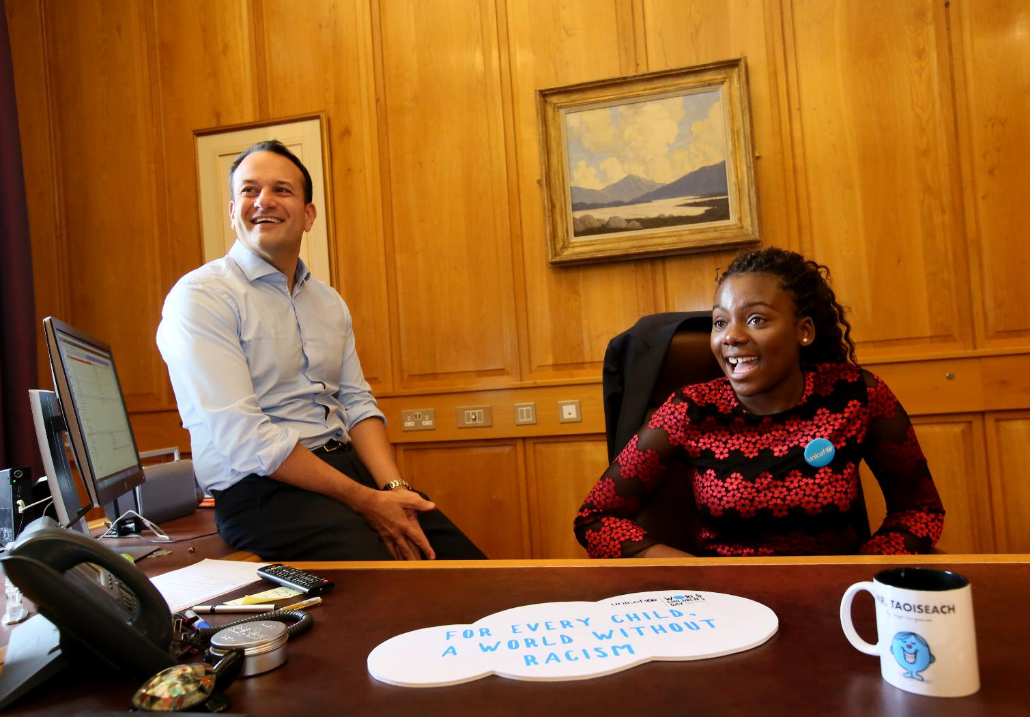
RACISM
Notes:
2 minutes
Racism - a belief that race is the primary determinant of human traits and capacities and that racial differences produce an inherent superiority of a particular race (MerriamWebster)
The United Nations, in a 1950 statement, opted to “drop the term ‘race’ altogether and speak of “ethnic groups”.
There is no evidence that the groups we commonly call “races” have distinct, unifying genetic identities. Ultimately, there is so much ambiguity between the races, and so much variation within them, that two people of European descent may be more genetically similar to an Asian person than they are to each other. Source: http://sitn.hms.harvard.edu/flash/2017/science-genetics-reshaping-race-debate-21st-century/
It's important we talk about racism. Does racism exist in Ireland?
In recent years, incidents of police brutality, such as the murder of George Floyd, have brought the issues of racism and systemic mistreatment and disadvantage of Black Americans further into the spotlight.
Every child, every young person, deserves to grow up with every chance for safety and every opportunity to succeed. Discrimination, violence and racism cause deep harm, unsettling communities and leaving lasting scars for children and families.
Image source: https://commons.wikimedia.org/wiki/File:George_Floyd_mural_Mauerpark_Berlin_2020-05-30_01.jpg

Slide 10
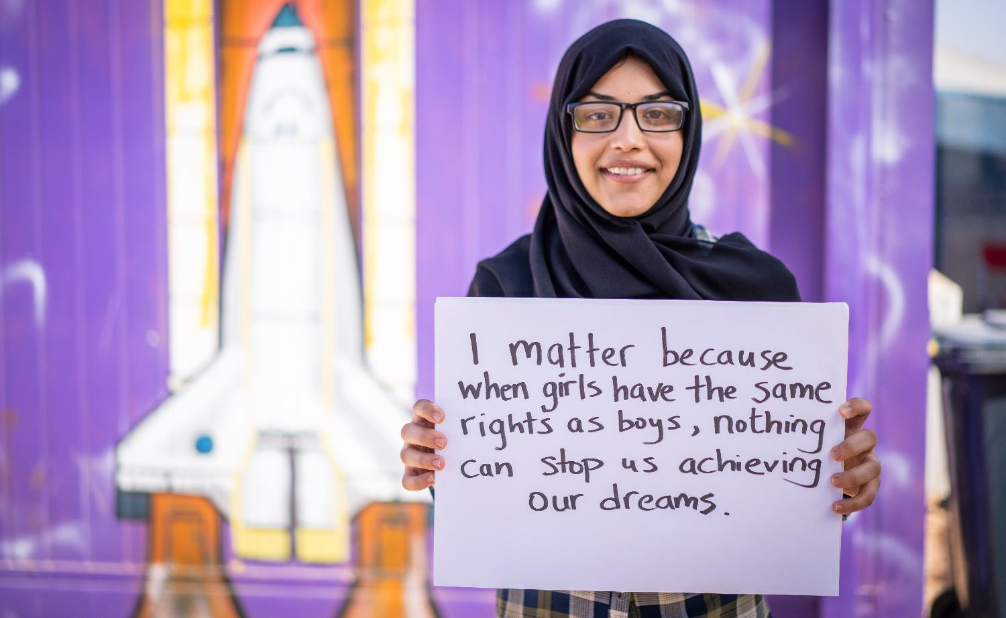
GENDER

Slide 11
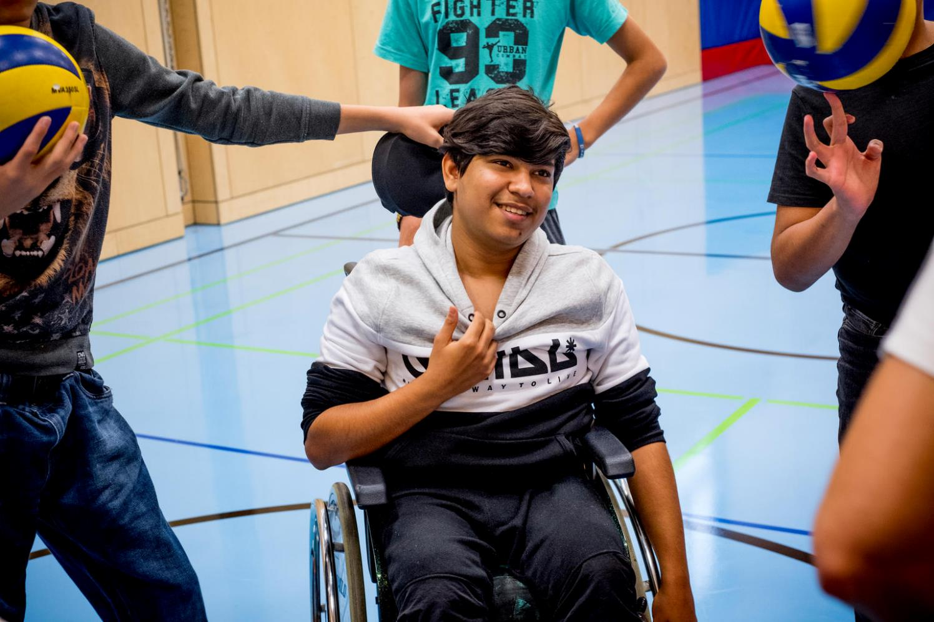
DISABILITY

Slide 12
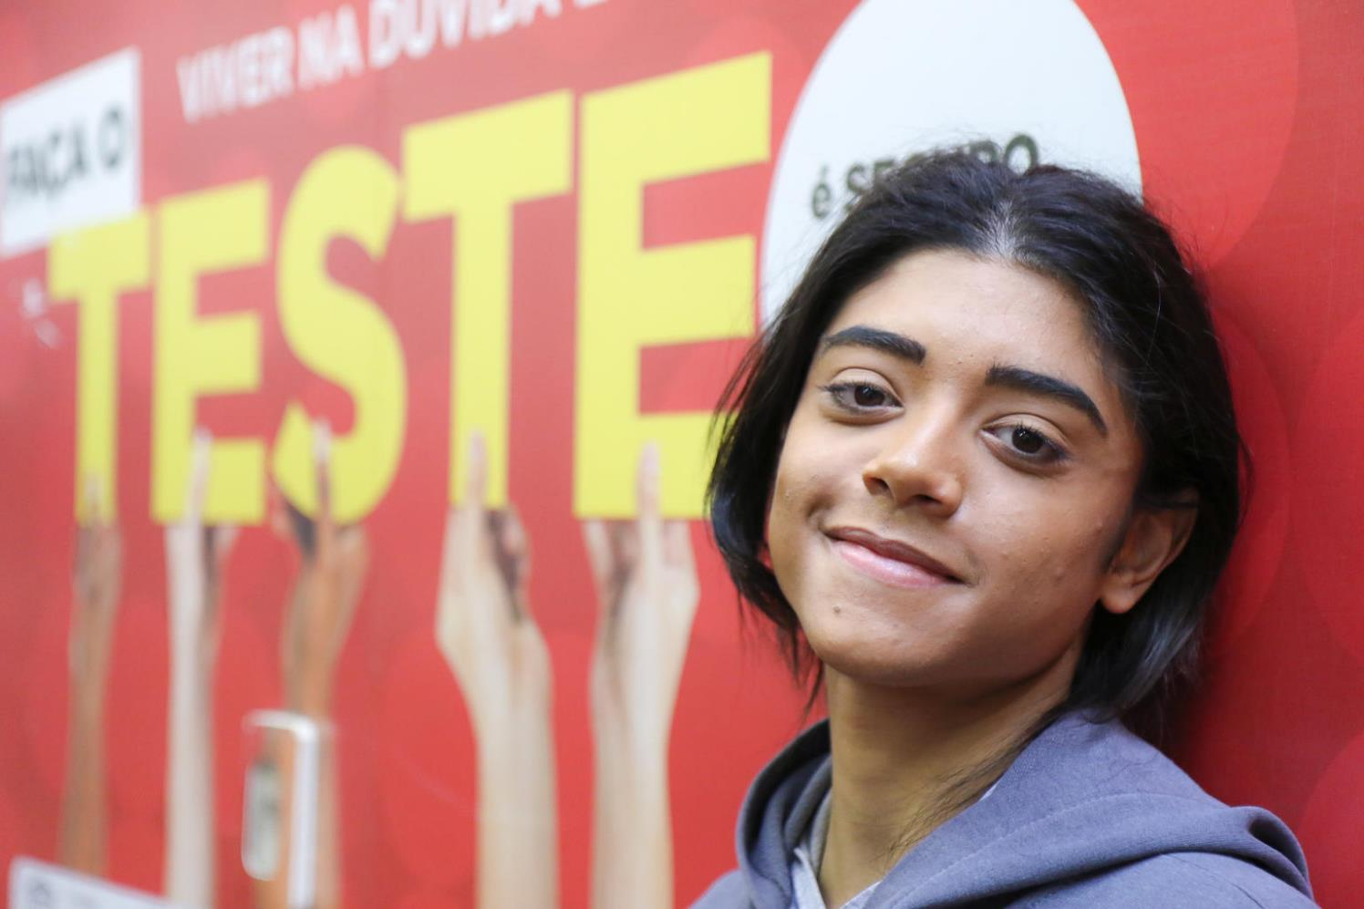
SEXUAL ORIENTATION

Slide 13
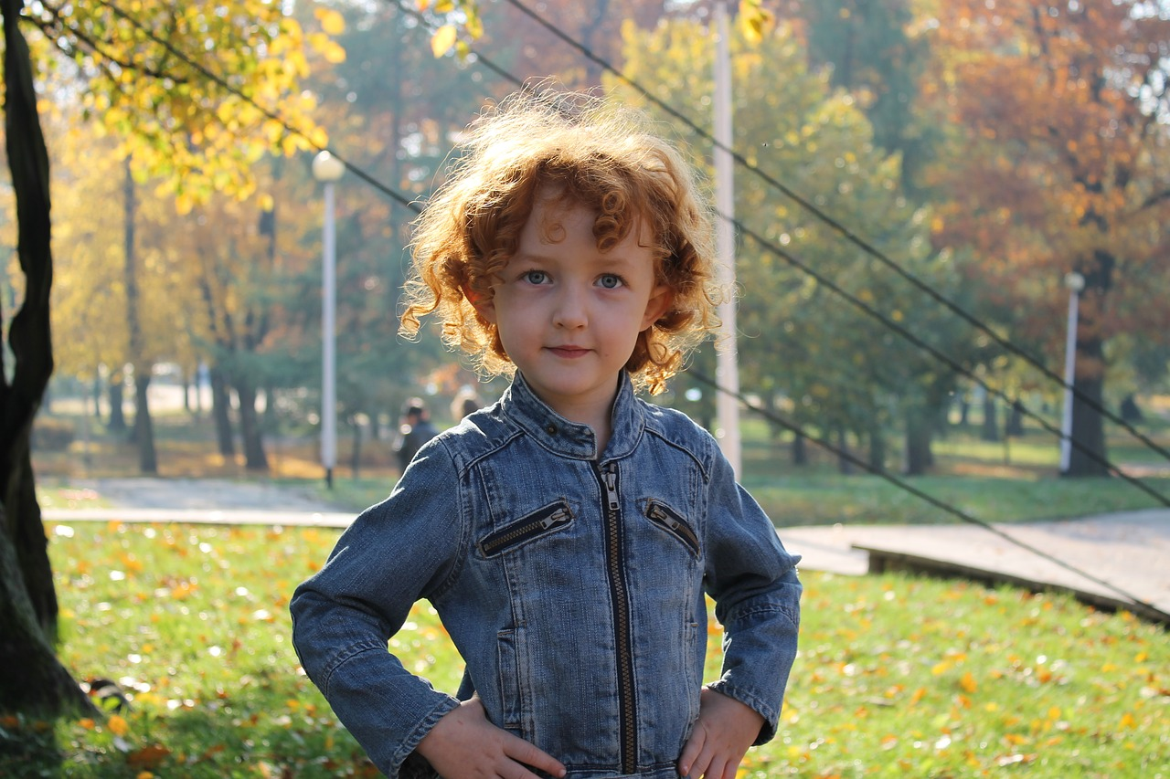
ETHNICITY/MINORITES
Notes:
2 minutes
Ethnic Cleansing - the systematic forced removal of ethnic, racial and/or religious groups from a given territory by a more powerful ethnic group, often with the intent of making it ethnically homogeneous.
Example: Rohingya 2017
There are now nearly 700,000 Rohingya living in the world's largest refugee camp in Bangladesh. They are in dire need of humanitarian assistance and protection.
In August 2017, a massive influx of refugees fled into Bangladesh following a brutal crackdown on ethnic Rohingya Muslim minority villages and areas in northern Myanmar. This crackdown reportedly came in retaliation for a number of attacks by Rohingya militants on several military and police stations.
However, according to United Nations human rights experts, the retaliation amounts to “a textbook example of ethnic cleansing” and “bears the hallmarks of genocide.”
Examples of the documented atrocities that have taken place in northern Myanmar since August 2017 include systematic torture and intentional killing; the burning of homes, religious buildings, businesses and crops; widespread rape of women and girls; and the targeting of children.

Slide 14
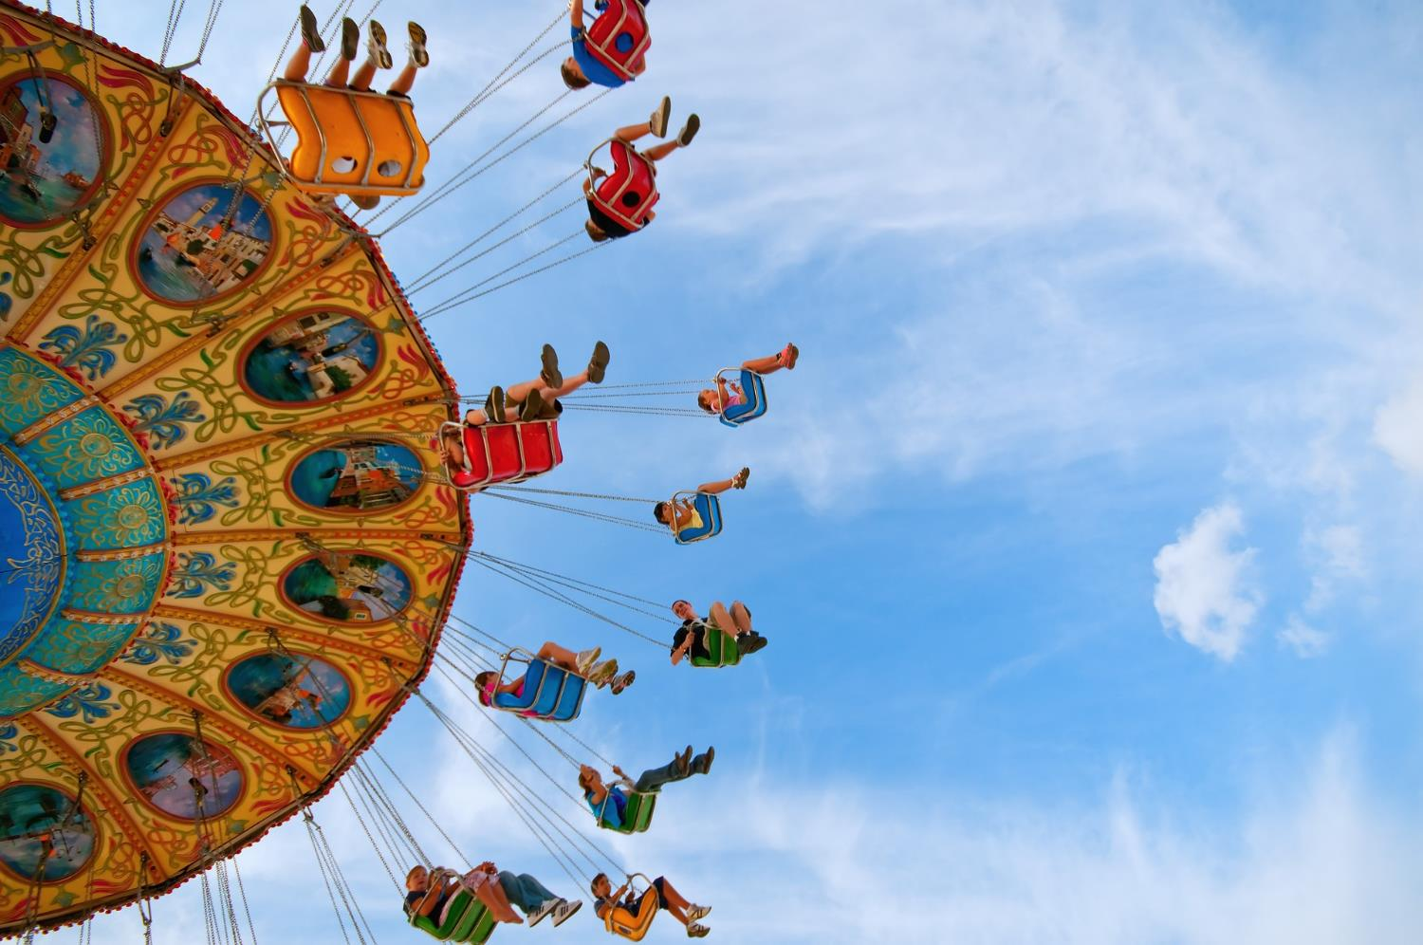
UPPER CLASS
SOCIAL CLASS
UPPER MIDDLE CLASS
LOWER MIDDLE CLASS
WORKING CLASS
WORKING POOR
UNDER CLASS
Notes:
2 minutes
Social class - a group sharing the same economic or social status e.g. the working class or the upper class. Does class discrimination exist in school? Are certain people discriminated against because of their perceived group or class?
Example: Caste system in India
For centuries, caste dictated almost every aspect of Hindu religious and social life, with each group occupying a specific place in this complex hierarchy.
Rural communities were long arranged on the basis of castes - the upper and lower castes almost always lived in segregated colonies, the water wells were not shared, Brahmins would not accept food or drink from the Shudras, and one could marry only within one's caste.
Traditionally, the system bestowed many privileges on the upper castes while sanctioning repression of the lower castes by privileged groups.
Deeply entrenched caste-based inequalities have economically excluded millions, particularly those from rural areas. Children from castes suffer from multiple deprivations related to poverty, malnutrition, access to quality health services, child marriage, poor school attendance, low learning outcomes, lack of sanitation facilities, hygiene, and access to improved water.
Often criticised for being unjust and regressive, it remained virtually unchanged for centuries, trapping people into fixed social orders from which it was impossible to escape. Despite the obstacles, however, some Dalits and other low-caste Indians, such as BR Ambedkar who authored the Indian constitution, and KR Narayanan who became the nation's first Dalit president, have risen to hold prestigious positions in the country.
Image source: https://www.bbc.com/news/world-asia-india-35650616

Slide 15
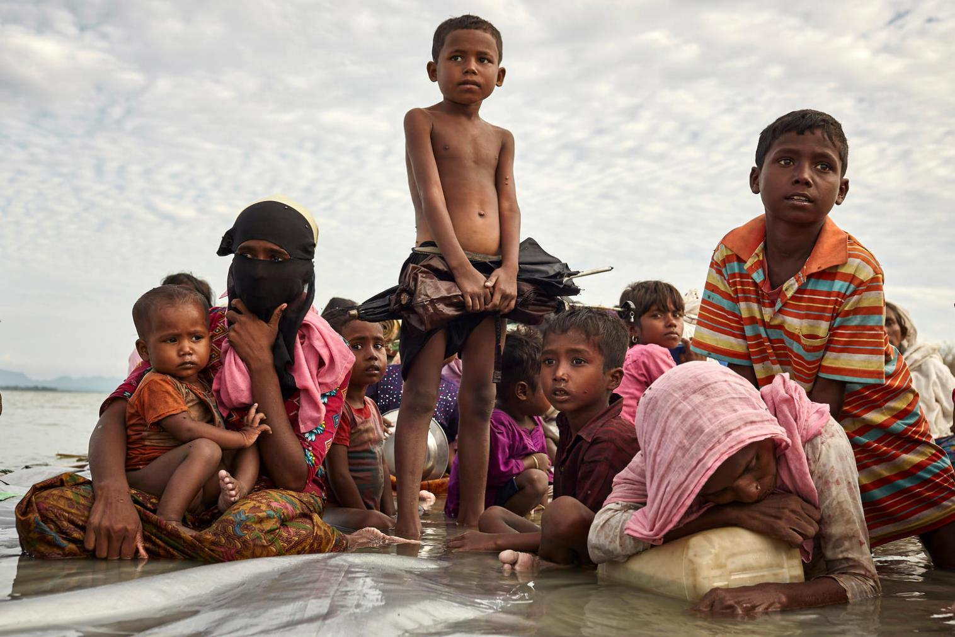
RELIGION
Notes:
2 minutes
Religion - Bigotry against believers in certain religions is another form of discrimination globally. Does discrimination because of religion happen in Ireland?
Here are a few global examples of anti-Muslim bigotry and anti-Semitism from around the world
Anti-muslim bigotry in China
The UN noted reports of mass detention of ethnic Uyghurs and other Turkic Muslim minorities, and estimates that upwards of a million people were being held in so-called counter-extremism centres and another two million had been forced into so-called “re-education camps” for political and cultural indoctrination.
A UN report found that, in the name of combatting “religious extremism” and maintaining “social stability”, credible sources had reported that China had turned the Xinjiang Uyghur Autonomous Region into something that resembled a massive internment camp shrouded in secrecy, a “no rights zone”, while members of the Xinjiang Uyghur minority, along with others who were identified as Muslim, were being treated as enemies of the State based on nothing more than their ethno-religious identity.
It's also been highlighted that the State party was making even the most common-placed expressions of ethno-religious significance to Muslims into a penal offence, including daily greetings, possession of certain Halal products, and growing a full beard or wearing a full-face headscarf.
Source: https://www.ohchr.org/EN/NewsEvents/Pages/DisplayNews.aspx?NewsID=23452&LangID=E

Slide 16
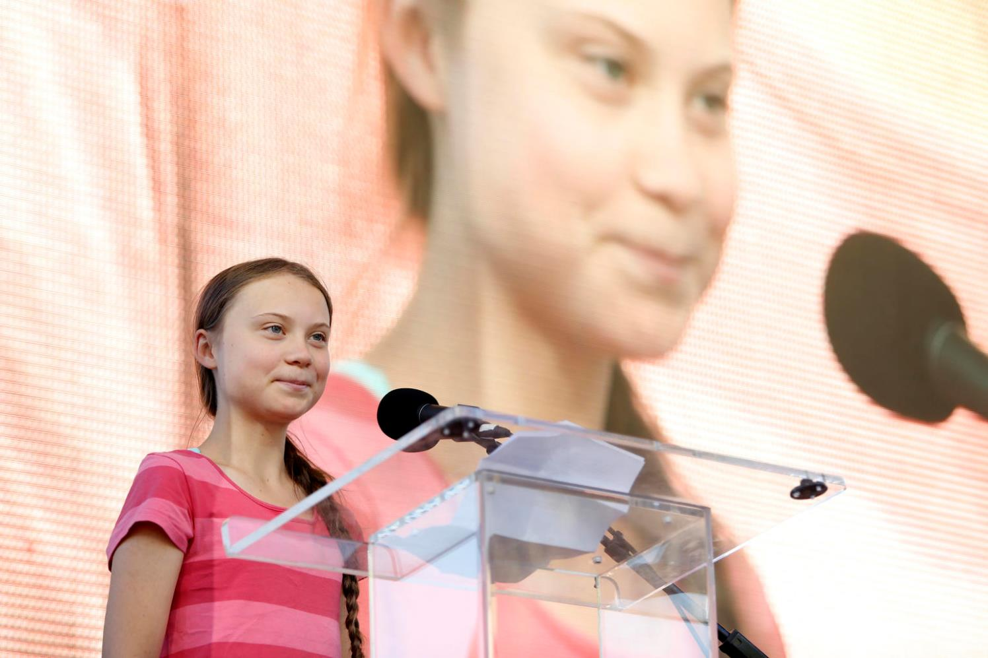
AGE

Slide 17
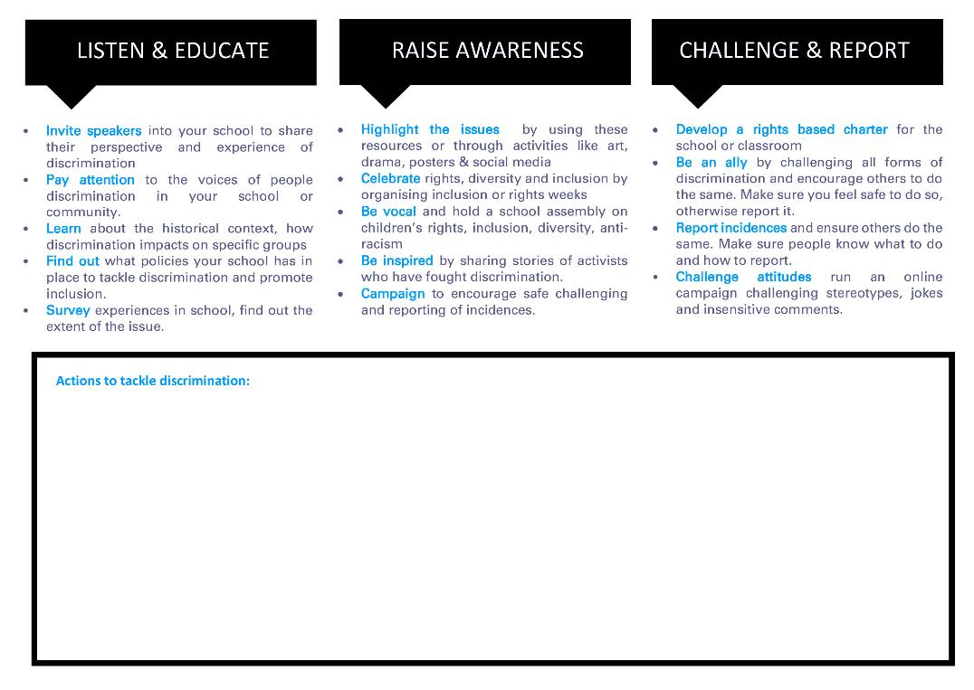
TACKLE
DISCRIMINATION
IN SCHOOL
Notes:
This activity is a continuation of the previous discussion. Participants will audit the actions that are taken in school to combat discrimination and decide what actions they can take to improve responses and promote inclusion and diversity.
Group work: Groups can focus on the issues they discussed in the previous activity. Explain that the task is to discuss the actions being taken in their school to combat the form of discrimination that they’re investigating. Ask participants to then determine what they can do to improve the actions.
Feedback: Get each group to present their ideas back to the class. Follow this with a big group discussion, asking:
What are the common themes and ideas between the groups?
And what can we do as a group to make this happen?
Discussion Card Worksheet: download and print for groups

Slide 18
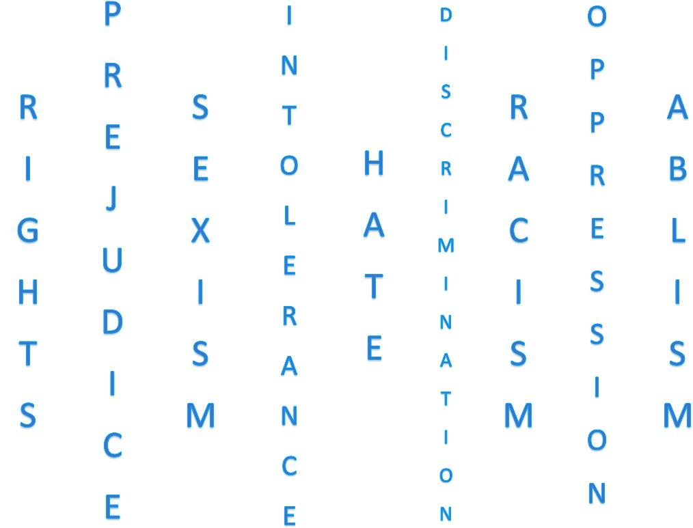
CAMPAIGN AGAINST
DISCRIMINATION
Notes:
This activity follows on from the last two activities, it aims to create an online or school-based visual anti-discrimination campaign
Discussion: Handout a copy of Imelda May’s poem, #YouDontGetToBeRacistAndIrish read it out loud or watch her video. Discuss the poem with the group.
Group work: Ask the group to form smaller groups. Each group is to choose an issue discussed earlier and devise an online or visual anti-discrimination campaign for the school. Below are two concept ideas to get started with, but participants can come up with their own ideas if they prefer.

Slide 19
