Slide 1
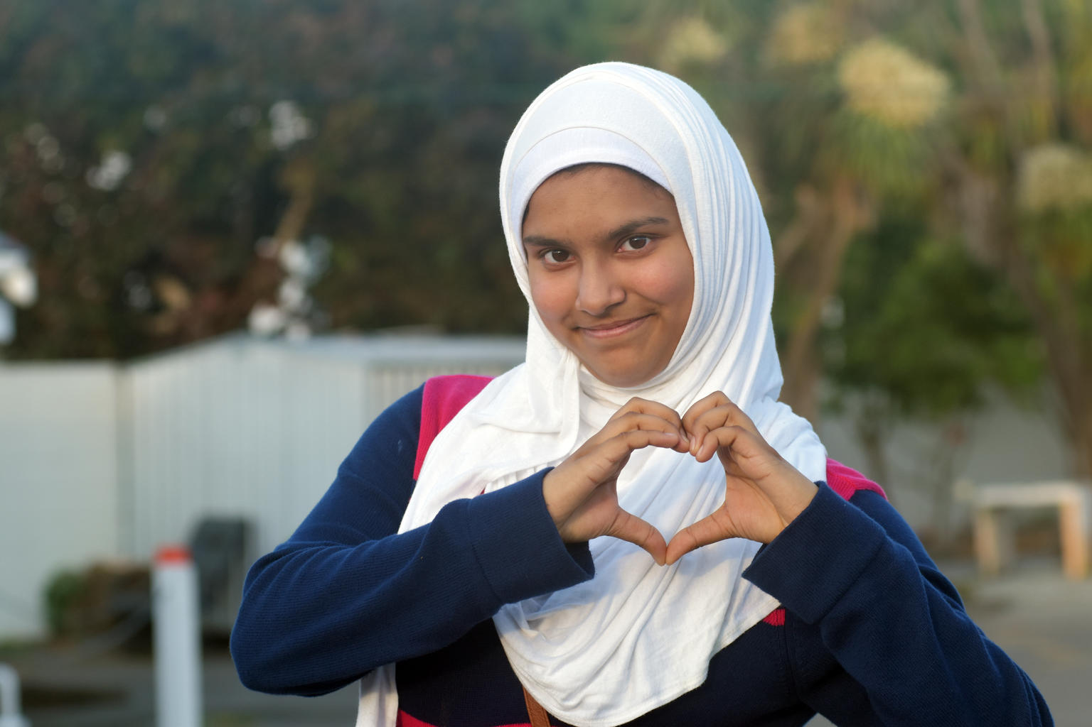

ARTICLE IN FOCUS
© UNICEF/UN0345982/Donnell
Notes:
Child outside Mosque in Christchurch, New Zealand

Slide 2
BEFORE YOU BEGIN
This is a flexible resource and is intended to provide you with some easy to use, appropriate rights-related learning to share with your children, their families and your colleagues.
Please edit out non relevant slides or activities before sharing with your students. Please check that the content works for your learners and feel free to adapt or add any content that would make the material more relevant for your setting.
This resource was developed by UNICEF UK and adapted by UNICEF Ireland.
Slide 3 – Guess the article
Slide 4 – Introducing Article 14
Slide 5 – Exploring Article 14
Slide 6 – Some possible answers
Slide 7 & 8 – Activities for the classroom
Slide 9 – Reflection
Slide 10 - Extension
Slide 11 – Further support

Slide 3
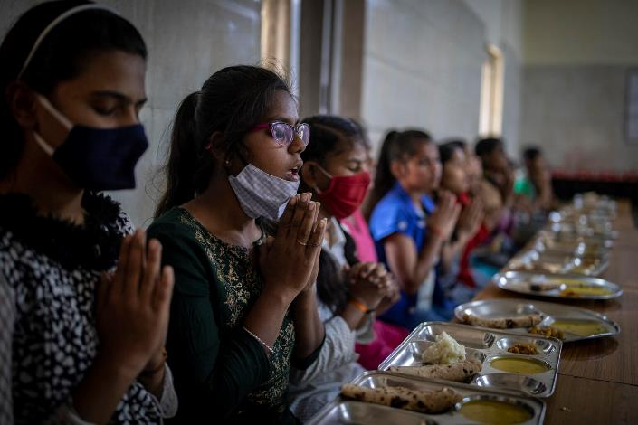
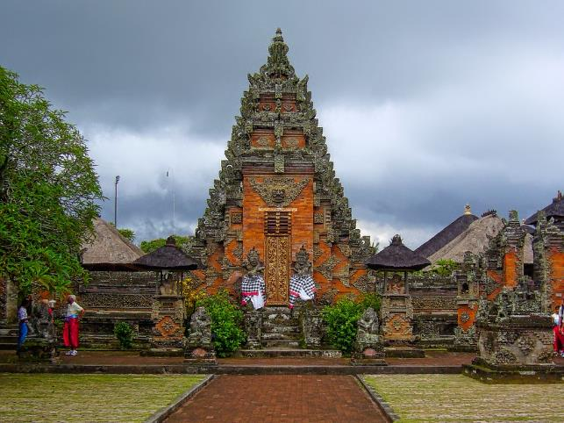
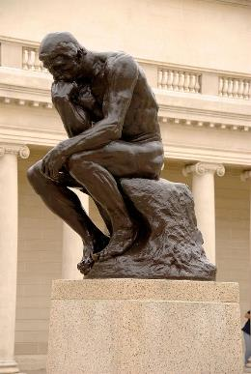
Guess the article
These pictures provide a clue to this week’s article.
How do these pictures help you? Can you guess how they are linked together?
Write down your thoughts or discuss with someone in your house.
© UNICEF/UN0570278/Altaf Ahmad
Wikimedia commons
Wikimedia commons
Notes:
1. Children praying before lunch in India
2. ‘The Thinker’ is a bronze sculptor by Auguste Rodin. The work depicts a male posed in deep thought and contemplation. The statue is often used to represent philosophy.
3. Hindu temple in Bali, Indonesia

Slide 4
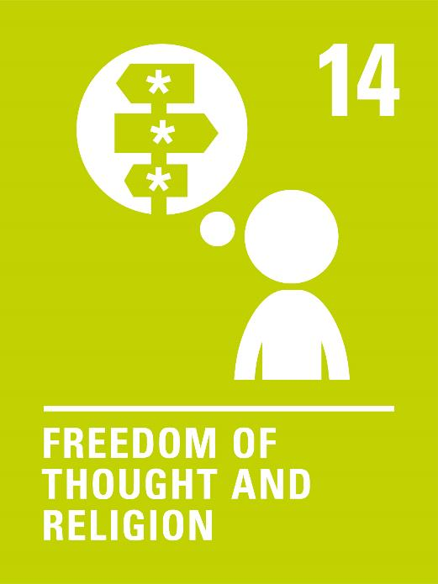
INTRODUCING ARTICLE 14
Children can choose their own thoughts, opinions and religion, but this should not stop other people from enjoying their rights. Parents can guide children so that as they grow up, they learn to properly use this right.

Slide 5
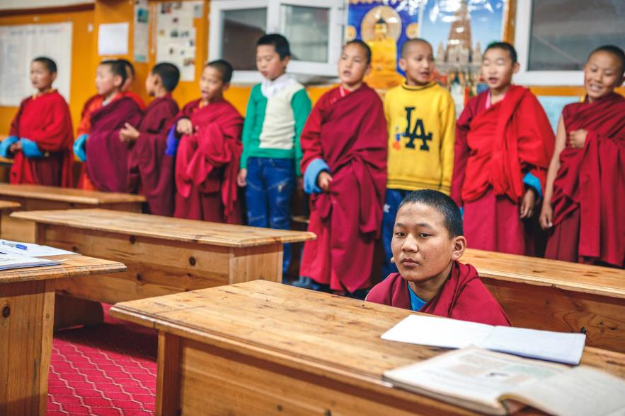
EXPLORING ARTICLE 14
How does your school show respect for everyone’s beliefs?
Write down suggestions and compare your answers with the next slide.
© UNICEF/UN0155842/Zammit
Notes:
Children in school in a Buddhist Monastery in Mongolia

Slide 6
DID YOU INCLUDE ANY OF THESE?
You have opportunities to have your views listened to and valued
Your food choices are respected
People have the time and space to pray or reflect
There is an opportunity to celebrate special times or festivals
You have a variety of uniform options to reflect beliefs
Everyone is encouraged to respect each other’s viewpoints
It is an inclusive environment where everyone feels welcome
Did you think of any others?

Slide 7
ACTIVITIES FOR THE CLASSROOM
Read the ‘Here we are’ by Oliver Jeffers. Share your questions about the world and think about how we can look after the world around us so that we can all survive and thrive.
Food choices are really important to some people. Find out about the food rules of a specific religion. If you have the ingredients at home, make a dish with your family.
Make a list of five things you like and five things you don’t like. Compare it with a friend.
Are your lists the same? It’s okay, we’re allowed to have different opinions! Talk about the importance of different views and beliefs.
List as many different religions that you can think of.
Research what symbols are linked with each religion. Draw and display the symbols in your classroom.
Research religious buildings. Make a sculpture of the buildings out of clay, or construct them out of cardboard.

Slide 8
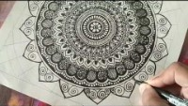
ACTIVITIES FOR THE CLASSROOM
People’s beliefs often influence the way they act and behave. Imagine you have discovered a new planet to live on. What ideas do you have about how you would want all the people who live there to treat each other and their planet?
Could your school do more to celebrate different religions, beliefs and thoughts of all children? Make a list of suggestions and share them with the student council.
A mandala is a symbolic representation of the universe. It is used in sacred rituals and as an aid for meditation in Buddhism and Hinduism.
Watch this video to learn how to learn how to draw a mandala. Draw or colour your own.

Slide 9
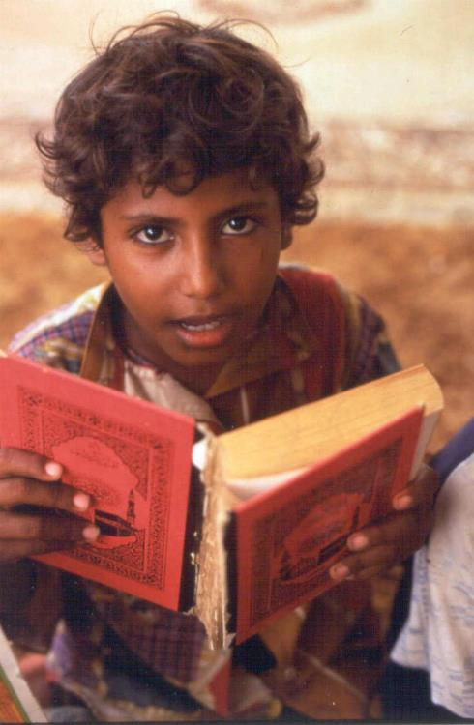
REFLECTION
Take some time to consider these philosophical questions.
What does it mean to live a good life?
Should you forgive others?
Is it better to do what you think is right or to follow the rules?
Is a human life more valuable than a cow’s life?
© UNICEF/UNI20094/Pirozzi
Notes:
A boy reading the Koran in Koranic school

Slide 10
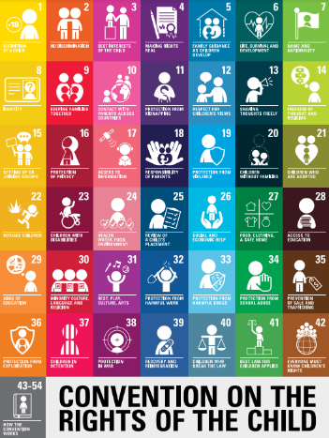
EXTENSION
Have a look at a variety of rights and ask yourself how does Article 14 apply to or add to our understanding of each right.
You can find a summary of the whole Convention here.

Slide 11
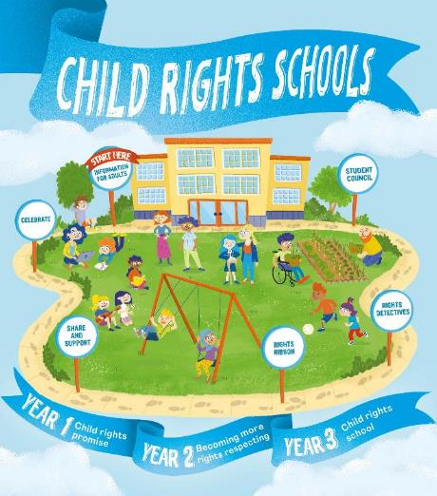

FURTHER CHILD RIGHTS EDUCATION SUPPORT
Child Rights Schools is a programme that supports you to embed child rights across the primary school.
Children are supported to express their views through the Student Council.
Find out more here.
Find more classroom resources here.

Slide 12


THANK YOU

