Slide 1
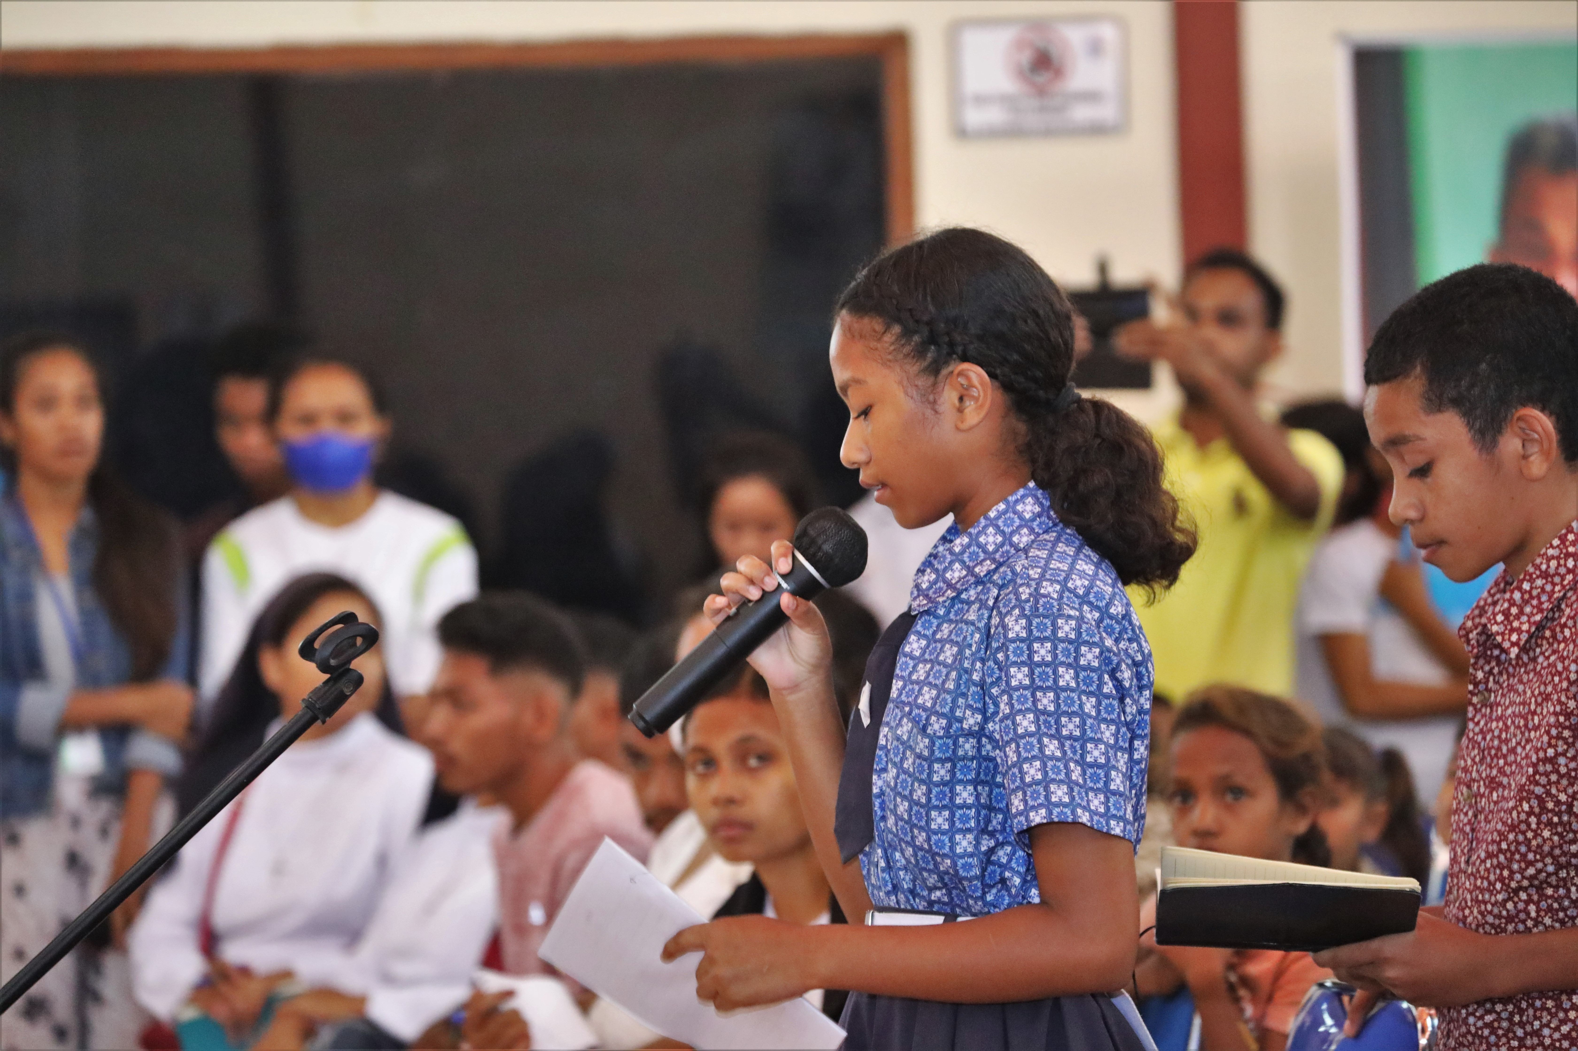

ARTICLE IN FOCUS
UNICEF/UNI427263
Notes:
The Institute of Defense for Child Rights in Timor-Leste (INDDICA), with the support from UNICEF and other partners, conducted a national dialogue with children themed “Listening to our voices as children, to protect and ensure our rights”.

Slide 2
BEFORE YOU BEGIN
This is a flexible resource and is intended to provide you with some easy to use, appropriate rights-related learning to share with your children, their families and your colleagues.
Please edit out non relevant slides or activities before sharing with your students. Please check that the content works for your learners and feel free to adapt or add any content that would make the material more relevant for your setting.
This resource was developed by UNICEF UK and adapted by UNICEF Ireland.
Slide 3 – International Women’s Day
Slide 4 – Linked Articles
Slide 5 – Exploring International Women’s Day
Slides 6 – Some Possible Answers
Slide 7,8,9 – Activities for the classroom
Slide 10 – Reflection
Slide 11– Further Support

Slide 3
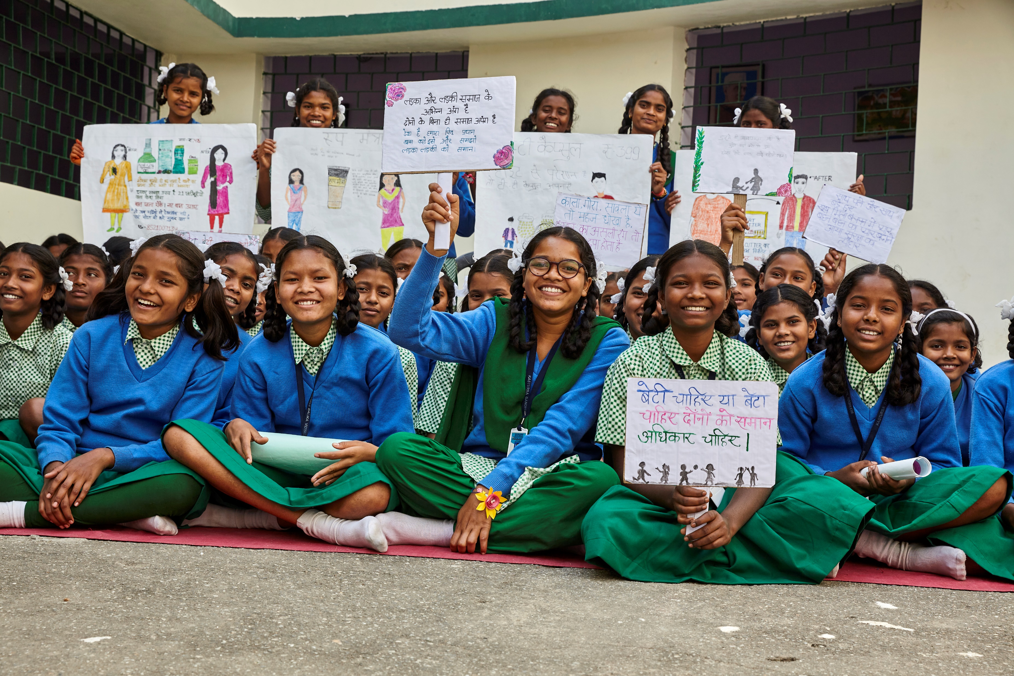
International Women’s Day – March 8th
International Women's Day (IWD) is celebrated on 8 March. It is a global day celebrating the social, economic, cultural and political achievements of women. The day also marks a call to action for accelerating gender parity. Significant activity is witnessed worldwide as groups come together to celebrate women's achievements or rally for women's equality.
UNICEF/UNI496909
Notes:
2023: Adolescent students display drawings and placards to depict gender equality as a learning from the life skills programs at the Kasturba Gandhi Balika Vidyalaya, Namkumbh, Ranchi, Jharkhand, India

Slide 4

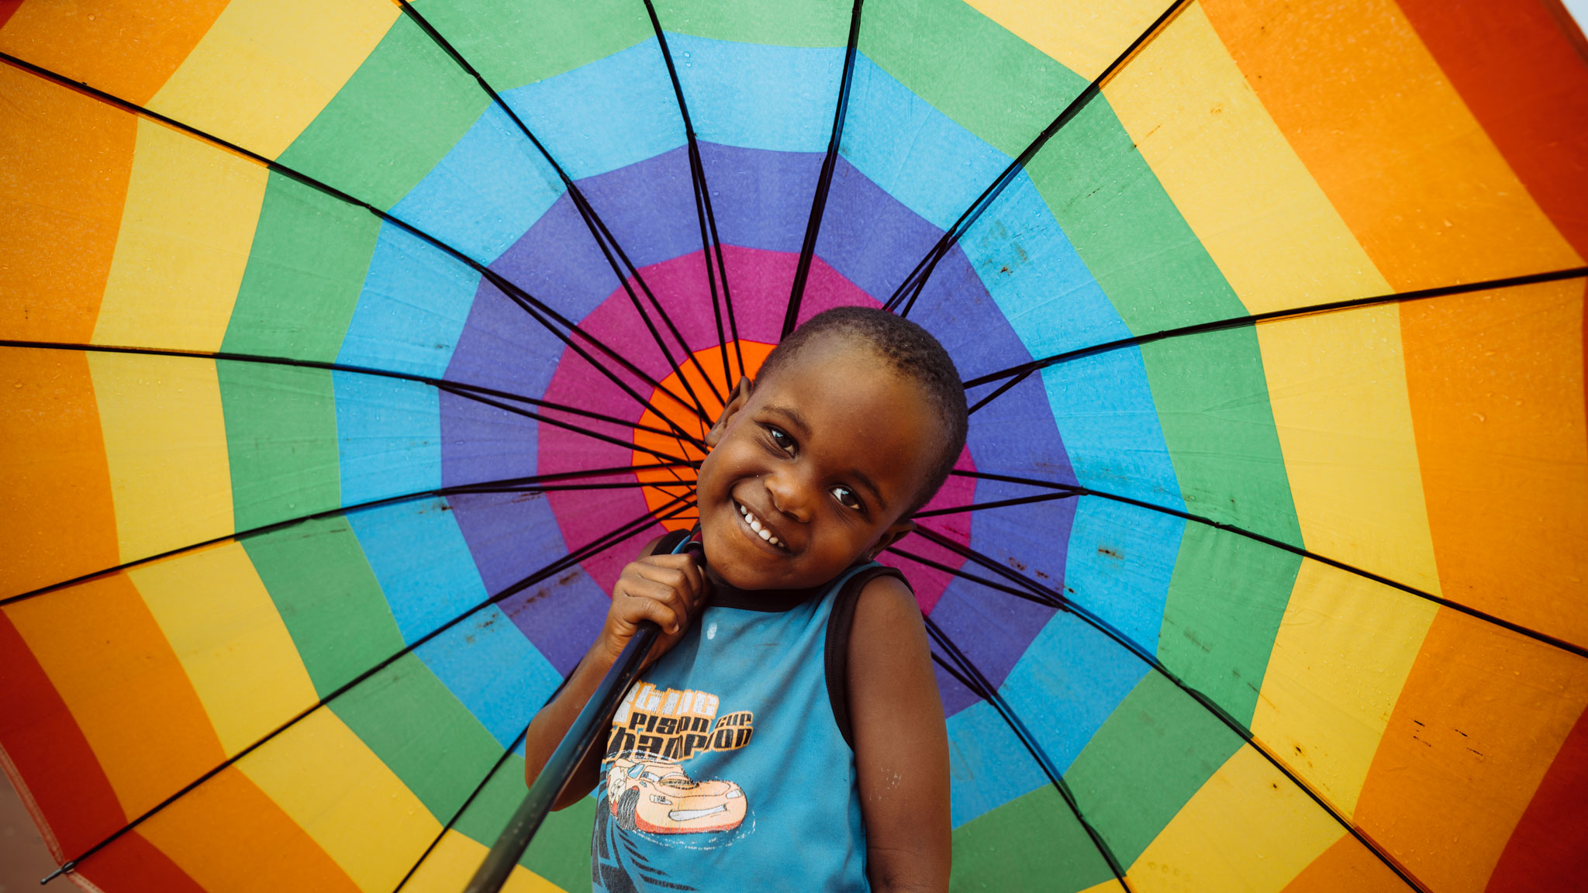

LINKED ARTICLES
International Women’s Day connects with many articles of the Convention but in particular:
Article 2: The Convention applies to every child without discrimination.
UN0765149
Notes:
UNICEF, with the support of the Global Programme to end Child Marriage (GPECM), produced and painted a graffiti on the walls of a secondary school in Monapo district (Nampula province) to sensitize the community on the negative impact of child marriage and on the appropriate reporting channel to follow (Child Helpline 116).

Slide 5
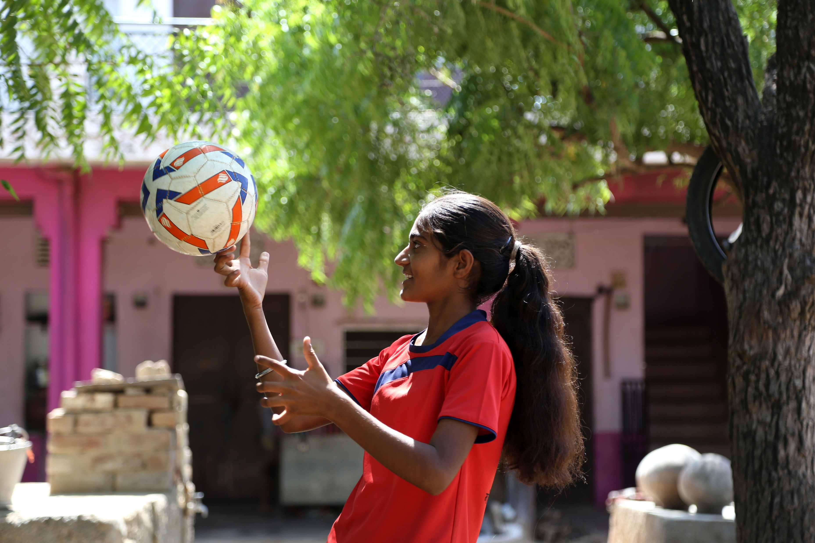
Exploring International Women’s Day
Why do you think it is important to have a special day to celebrate women?
Have a think and write down some ideas!
UN0723964
Notes:
AJMER , RAJASTHAN, INDIA - OCTOBER, 02, 2022: Nisha Rawat, 15, pictured while balancing football on her finger at her residence in Chachiawas village in Ajmer district of Rajasthan, India. Nisha has been playing football since 2016 at national and district-level tournaments. Her father is a Shepard and her mother works at MGNREGA, Nisha braved all odds to study and play in her village and has become an inspiration for many boys and girls. Besides playing as a defender, she also enjoys training the younger girls in her village.

Slide 6
Exploring International Women’s Day
Did you think of these?
To celebrate how amazing women are.
To recognise how women have changed the world.
To acknowledge the challenges women still face around the world.
To encourage women to be themselves – to be the best they can be!
To let women know they are appreciated.
To speak out about inequality.
Fewer girls than boys go to school – this isn’t right.
Women often get paid less than men for doing the same job.
It is about equality and ensuring all are treated fairly and not discriminated against.
To explore what we need to do to create a world where gender equality exists.
Did you think of anything else?

Slide 7

ACTIVITIES FOR THE CLASSROOM
You do not need to complete every activity but if you have time, you can try to complete more than one.
Draw a picture of a woman or girl that you look up to. This might be a member of your family, someone at school or someone you have learned about. Share your picture with your classmates.
Read a chapter of Fantastically Great Women who Changed the World, which introduces readers to some incredible women who have shaped our world like Marie Curie and Rosa Parks! Children’s Books Ireland has a resource pack with lots of suggestions for reading activities too!
Have a boogie to celebrate International Women’s Day and dance along to songs which celebrate women. Make sure to use radio edits!
Notes:
https://www.youtube.com/watch?v=xRhEjvLWcZY

Slide 8
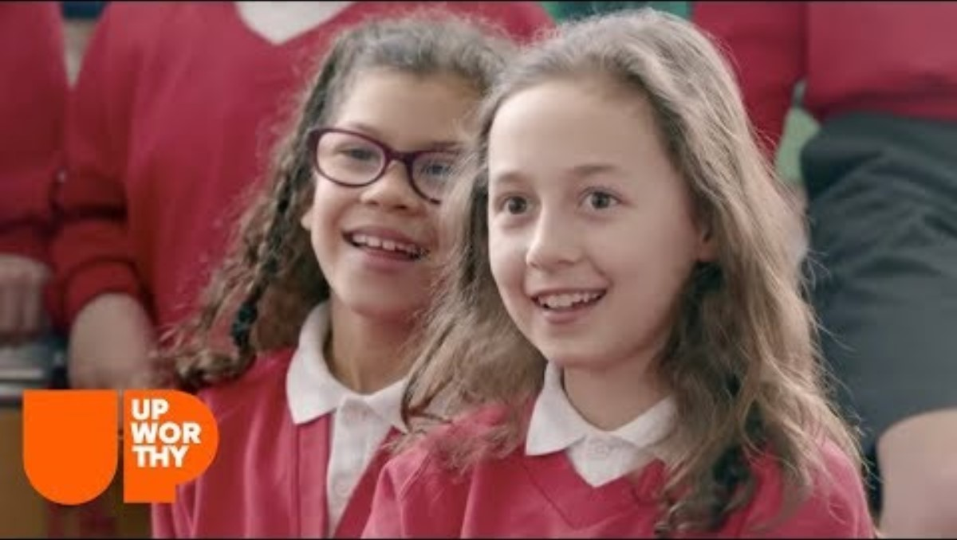
ACTIVITIES FOR THE CLASSROOM
You do not need to complete every activity but if you have time, you can try to complete more than one.
As a class choose an influential or inspiring woman who has changed the world to research (or choose a few for group projects!). Create ways to share these women’s stories with the rest of your school. Check out the Fantastically Great Women series for inspiration and don’t forget about all of the amazing Irish women who have changed history!
Have you heard of the Sustainable Development Goals? One of them is about gender equality. Find out more about Global Goal 5 by watching this video. What can you do to support the Global Goal of Gender Equality? Choose an action you will take individually or as a class.
Discuss different jobs that people do. Can anyone do any job they like? Share your opinions in class. Watch this video and see if anything surprises you. What are your thoughts after watching the video? Draw a picture of you doing your dream job.

Slide 9
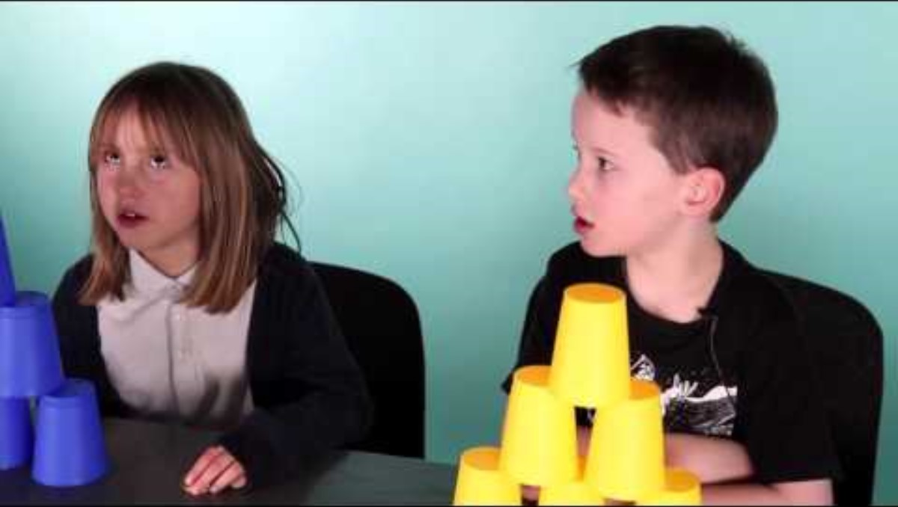

ACTIVITIES FOR THE CLASSROOM
You do not need to complete every activity but if you have time, you can try to complete more than one.
Watch this video which explores the different rates of pay women and men sometimes receive. Do you think the gender pay gap exists in Ireland? Research this question as a class and display your results (could link in well with math class!)
Discrimination against women and girls is a problem in every country in the world. In some parts of the world girls are unable to access the same education as boys. Imagine you were a girl kept at home to grow food, cook and help look after your siblings while your brothers went to school. Write a poem about your feelings or a letter to your parents to explain why this situation should change
Article 2 is about non-discrimination. What does discrimination mean? Think about ways in which your school can be made fairer for girls (and boys). For example, think about your playground and whether there are spaces that both boys and girls enjoy. Present your ideas in a mind map and compare with friends. You might want to share the most popular ideas with your principal.
.
Have you heard the word sexism? As a class discuss its meaning and watch this video. Unfortunately, there is still a great deal of hate directed towards women and girls, particularly on social media. Men and boys can also be targeted for being seen as different. What can be done in school (and online) to make sure everyone is treated with respect?

Slide 10
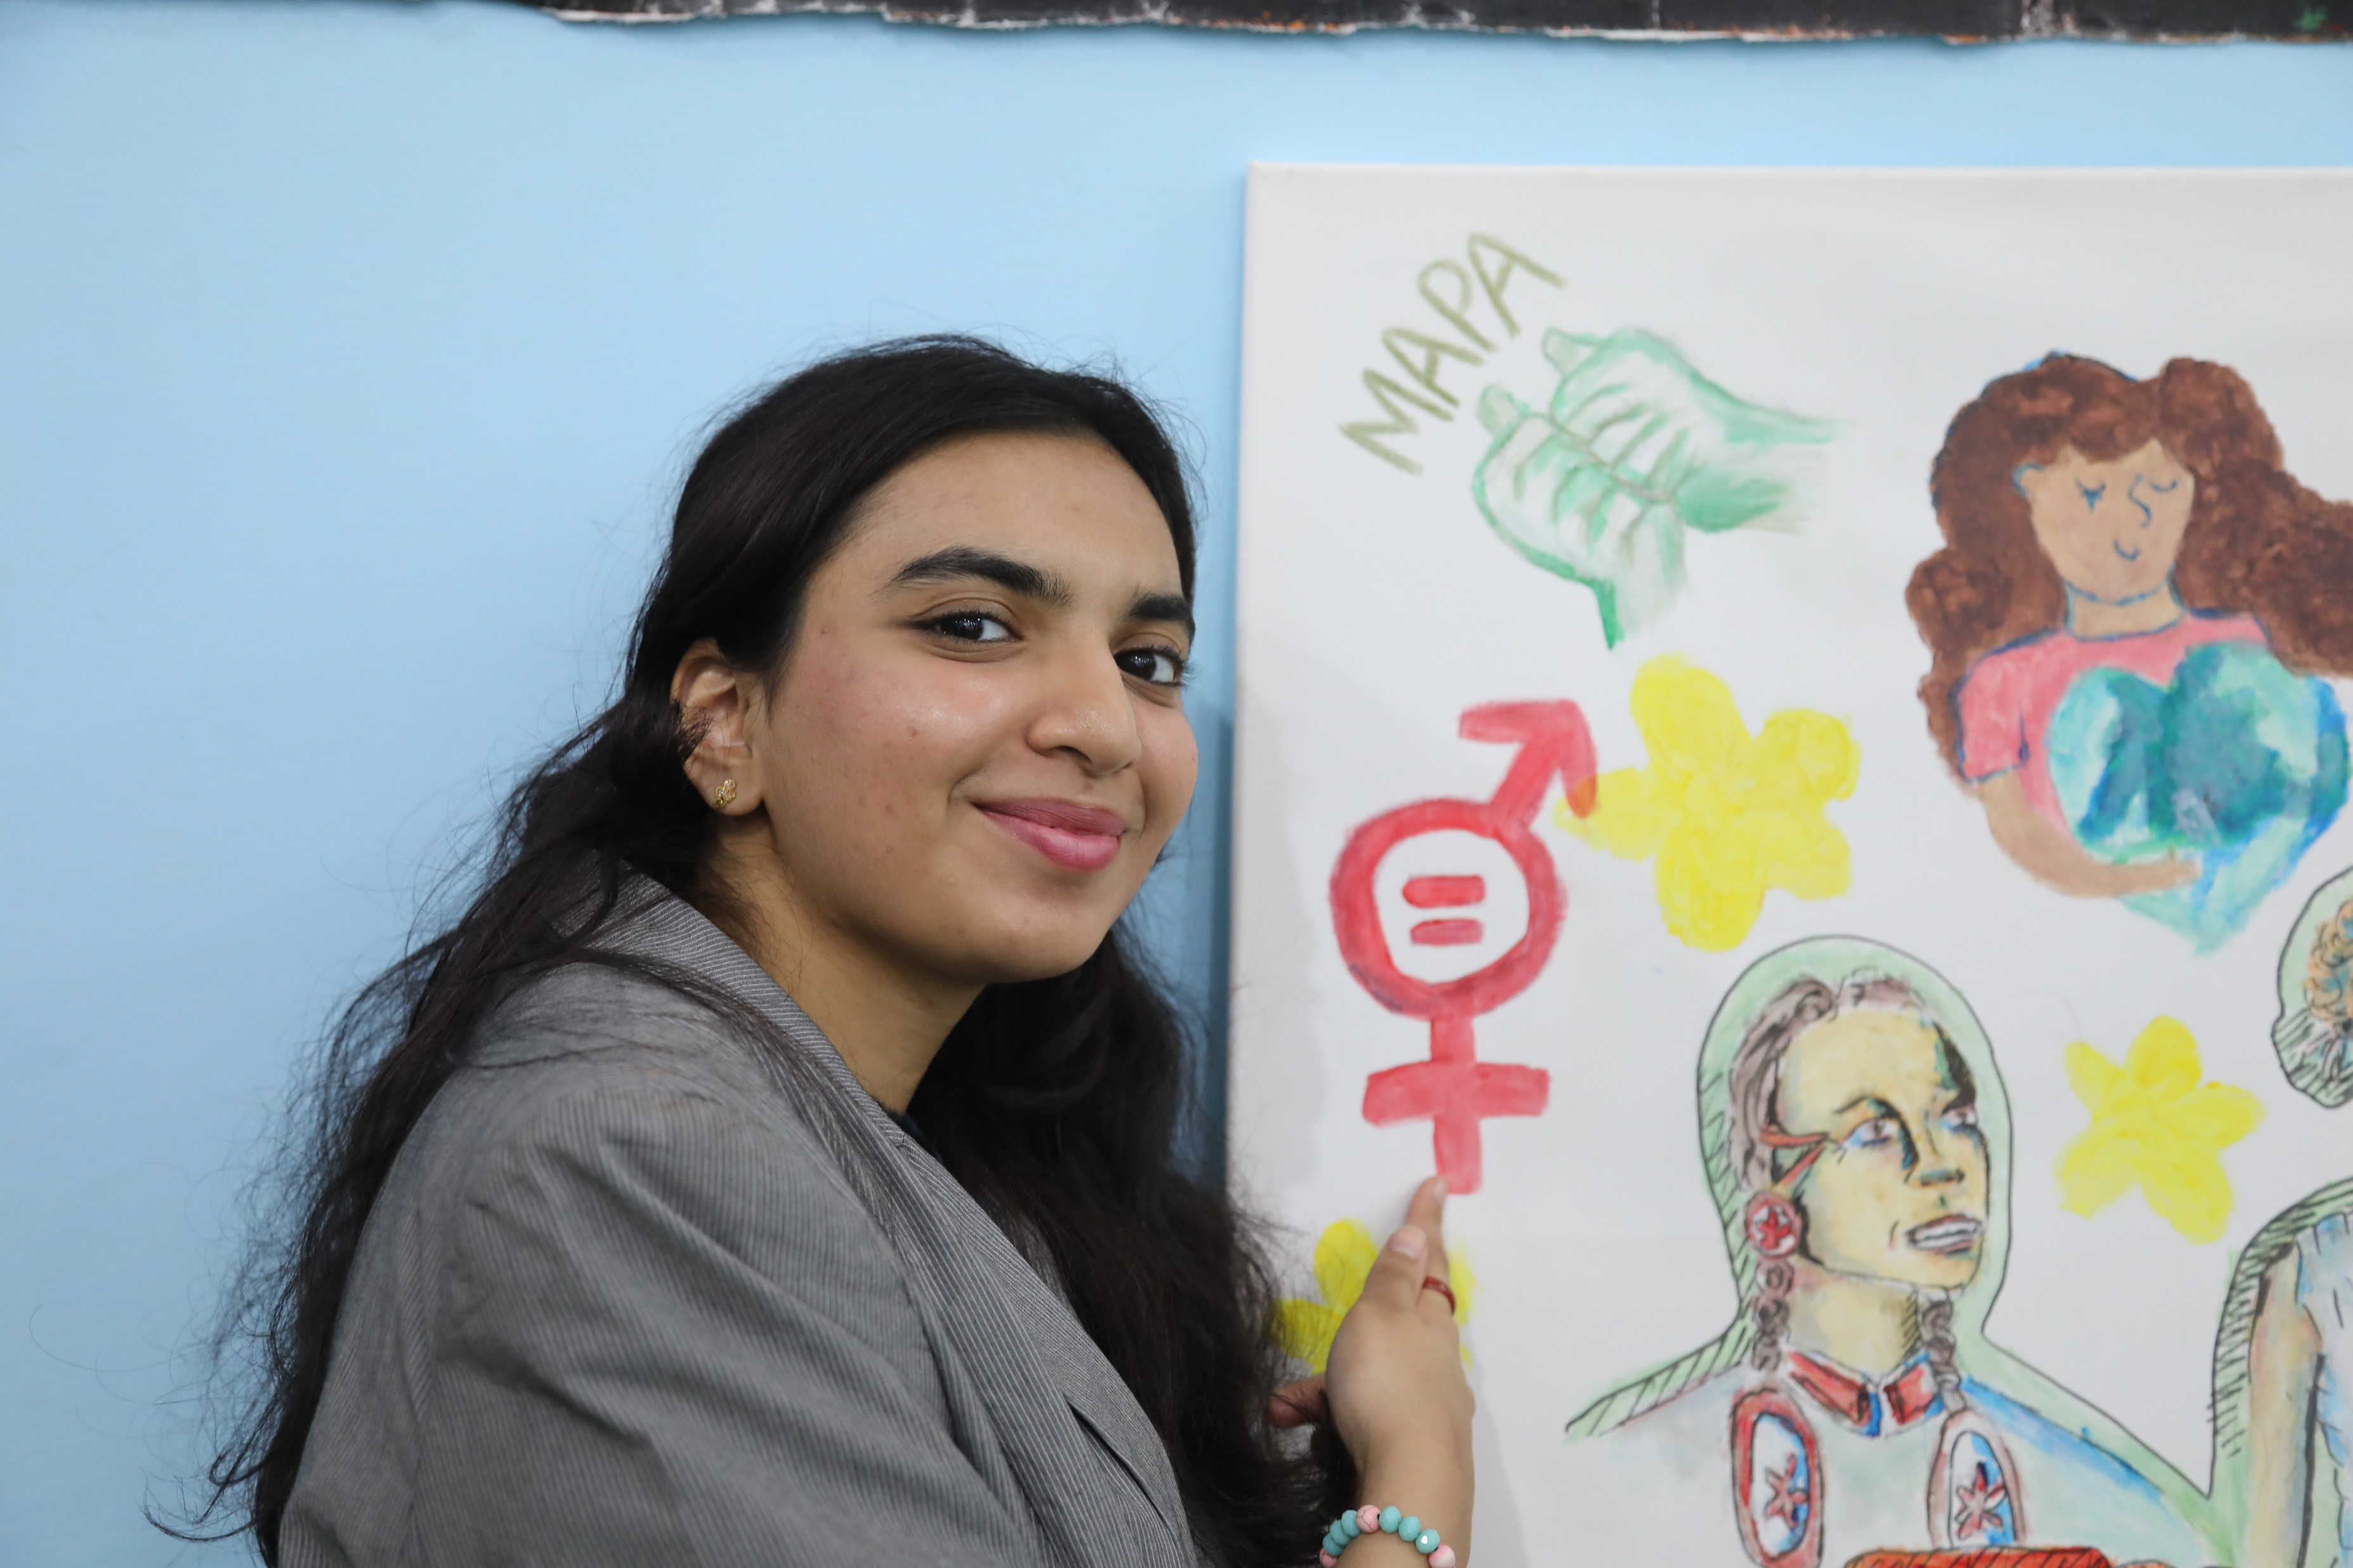
REFLECTION
We need to be brave to challenge unfairness and make the world a better place for everyone
UN0734214
Think of a change that would help to make a fairer world where gender equality is a reality. It might be something small.
Is there something you can do to make this happen?
Can you tell somebody about the change you would like to see?
Notes:
Highlights from an arts workshop at the Children and Youth Pavilion at COP27. This arts workshop is led by the Technical Cohort to Advance Adolescent Girls' and Young Women's Leadership in Climate Change which is supported by UNICEF and Karama (a regional women's rights network) . After leading a session of Gender Equal Adaptation Strategies, the adolescent girls and young women invited their peers to express what gender justice and environmental justice means for them.

Slide 11


FURTHER CHILD RIGHTS EDUCATION SUPPORT
Child Rights Schools is a programme that supports you to embed child rights across the whole school community, including with parents and carers. Find our more here.
Find more classroom resources here.

Slide 12

THANK YOU!
UN0794814
Notes:
February 2023: Mariam Koromi, a 16 year old deaf girl, and her friend Kaltuma, at their school at the site of Kaya, the Lac region, in the West of Chad.

