Slide 1

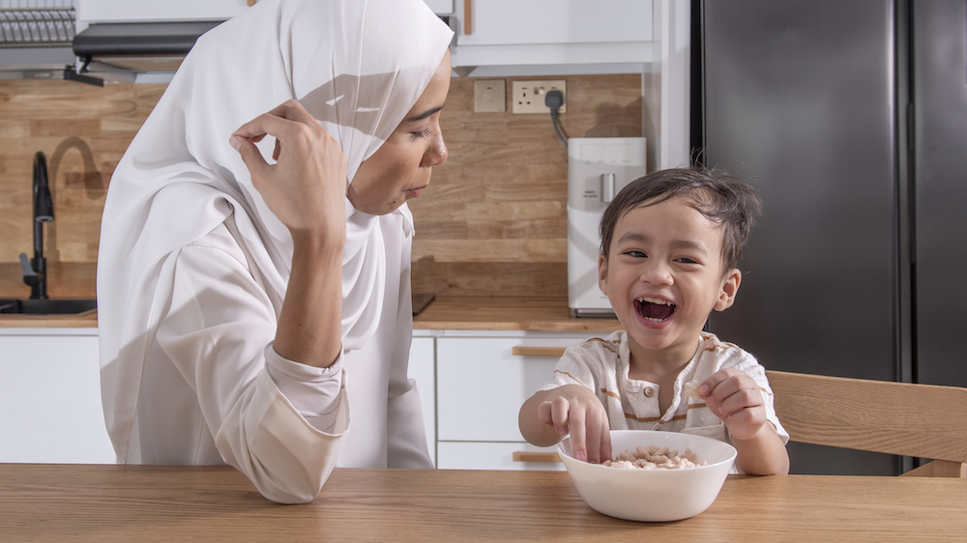
ARTICLE OF THE WEEK
UNICEF/UNI485316
Notes:
A mother entertains her 3-year-old son eating rice cereal in the kitchen at their home in Puchong, Selangor.

Slide 2
BEFORE YOU BEGIN
This is a flexible resource and is intended to provide you with some easy to use, appropriate rights-related learning to share with your children, their families and your colleagues.
Please edit out non relevant slides or activities before sharing with your students. Please check that the content works for your learners and feel free to adapt or add any content that would make the material more relevant for your setting.
This resource was developed by UNICEF UK and adapted by UNICEF Ireland.
Slide 3 – Guess the Article
Slide 4 – Introducing Articles 26 & 27
Slide 5 – Exploring the Articles
Slides 6 – Some Possible Answers
Slide 7,8,9 – Activities for the classroom
Slide 10 – Reflection
Slide 11– Further Support

Slide 3
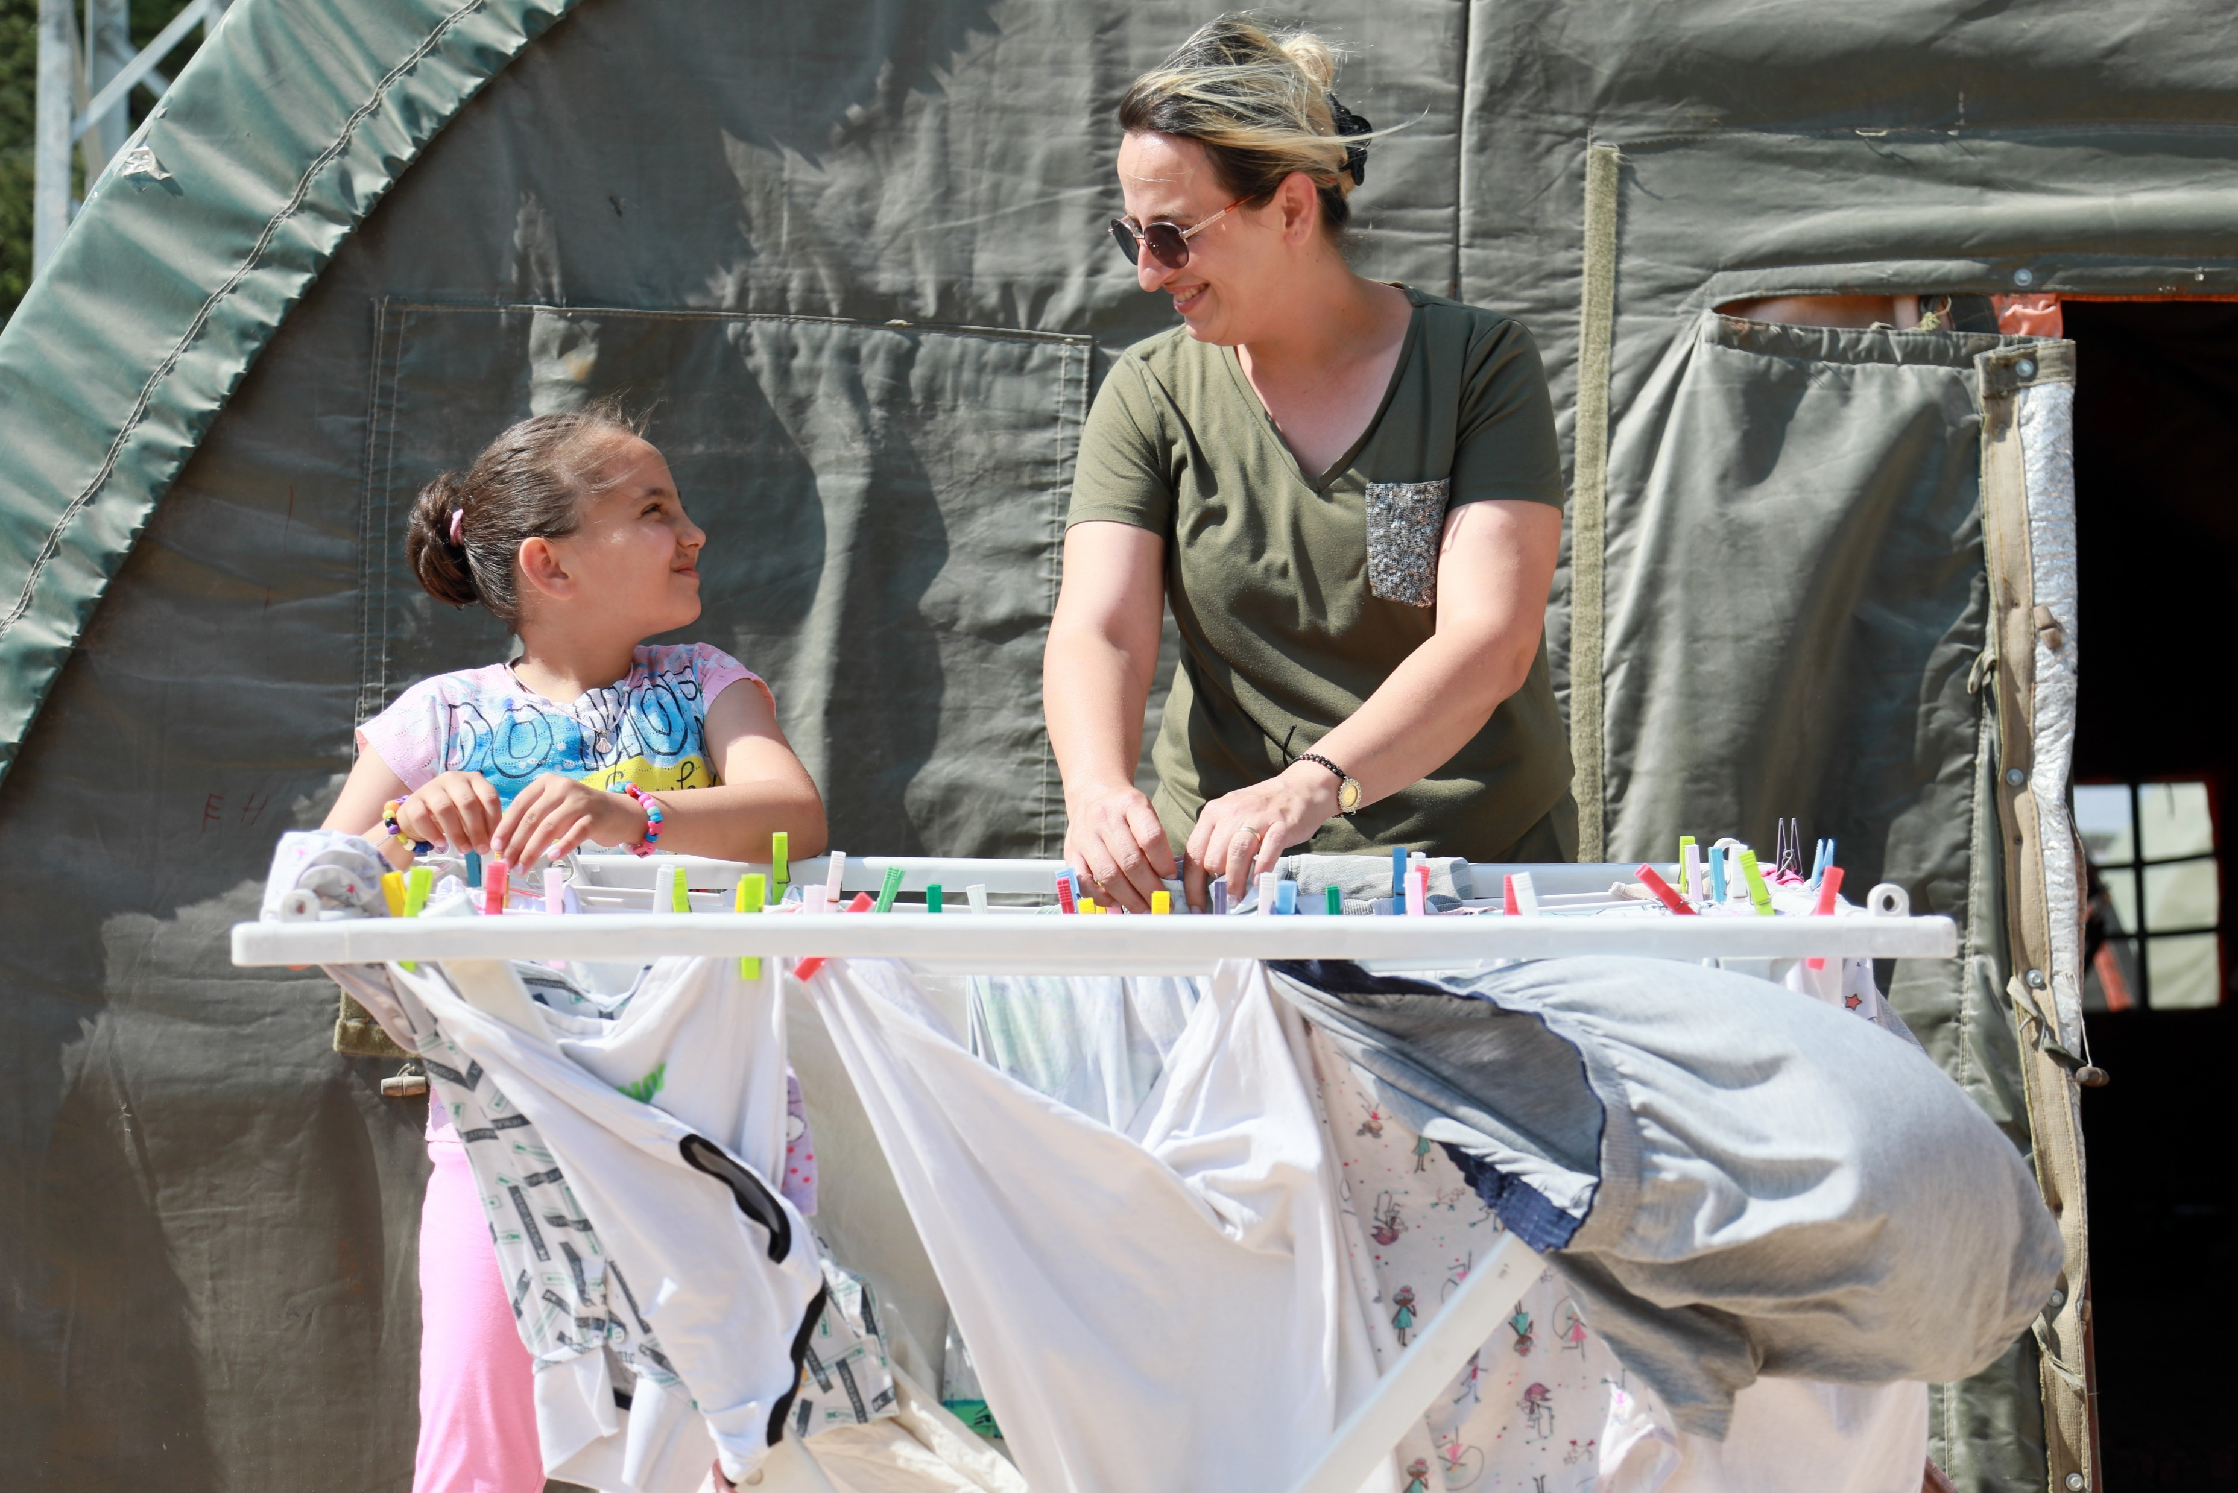
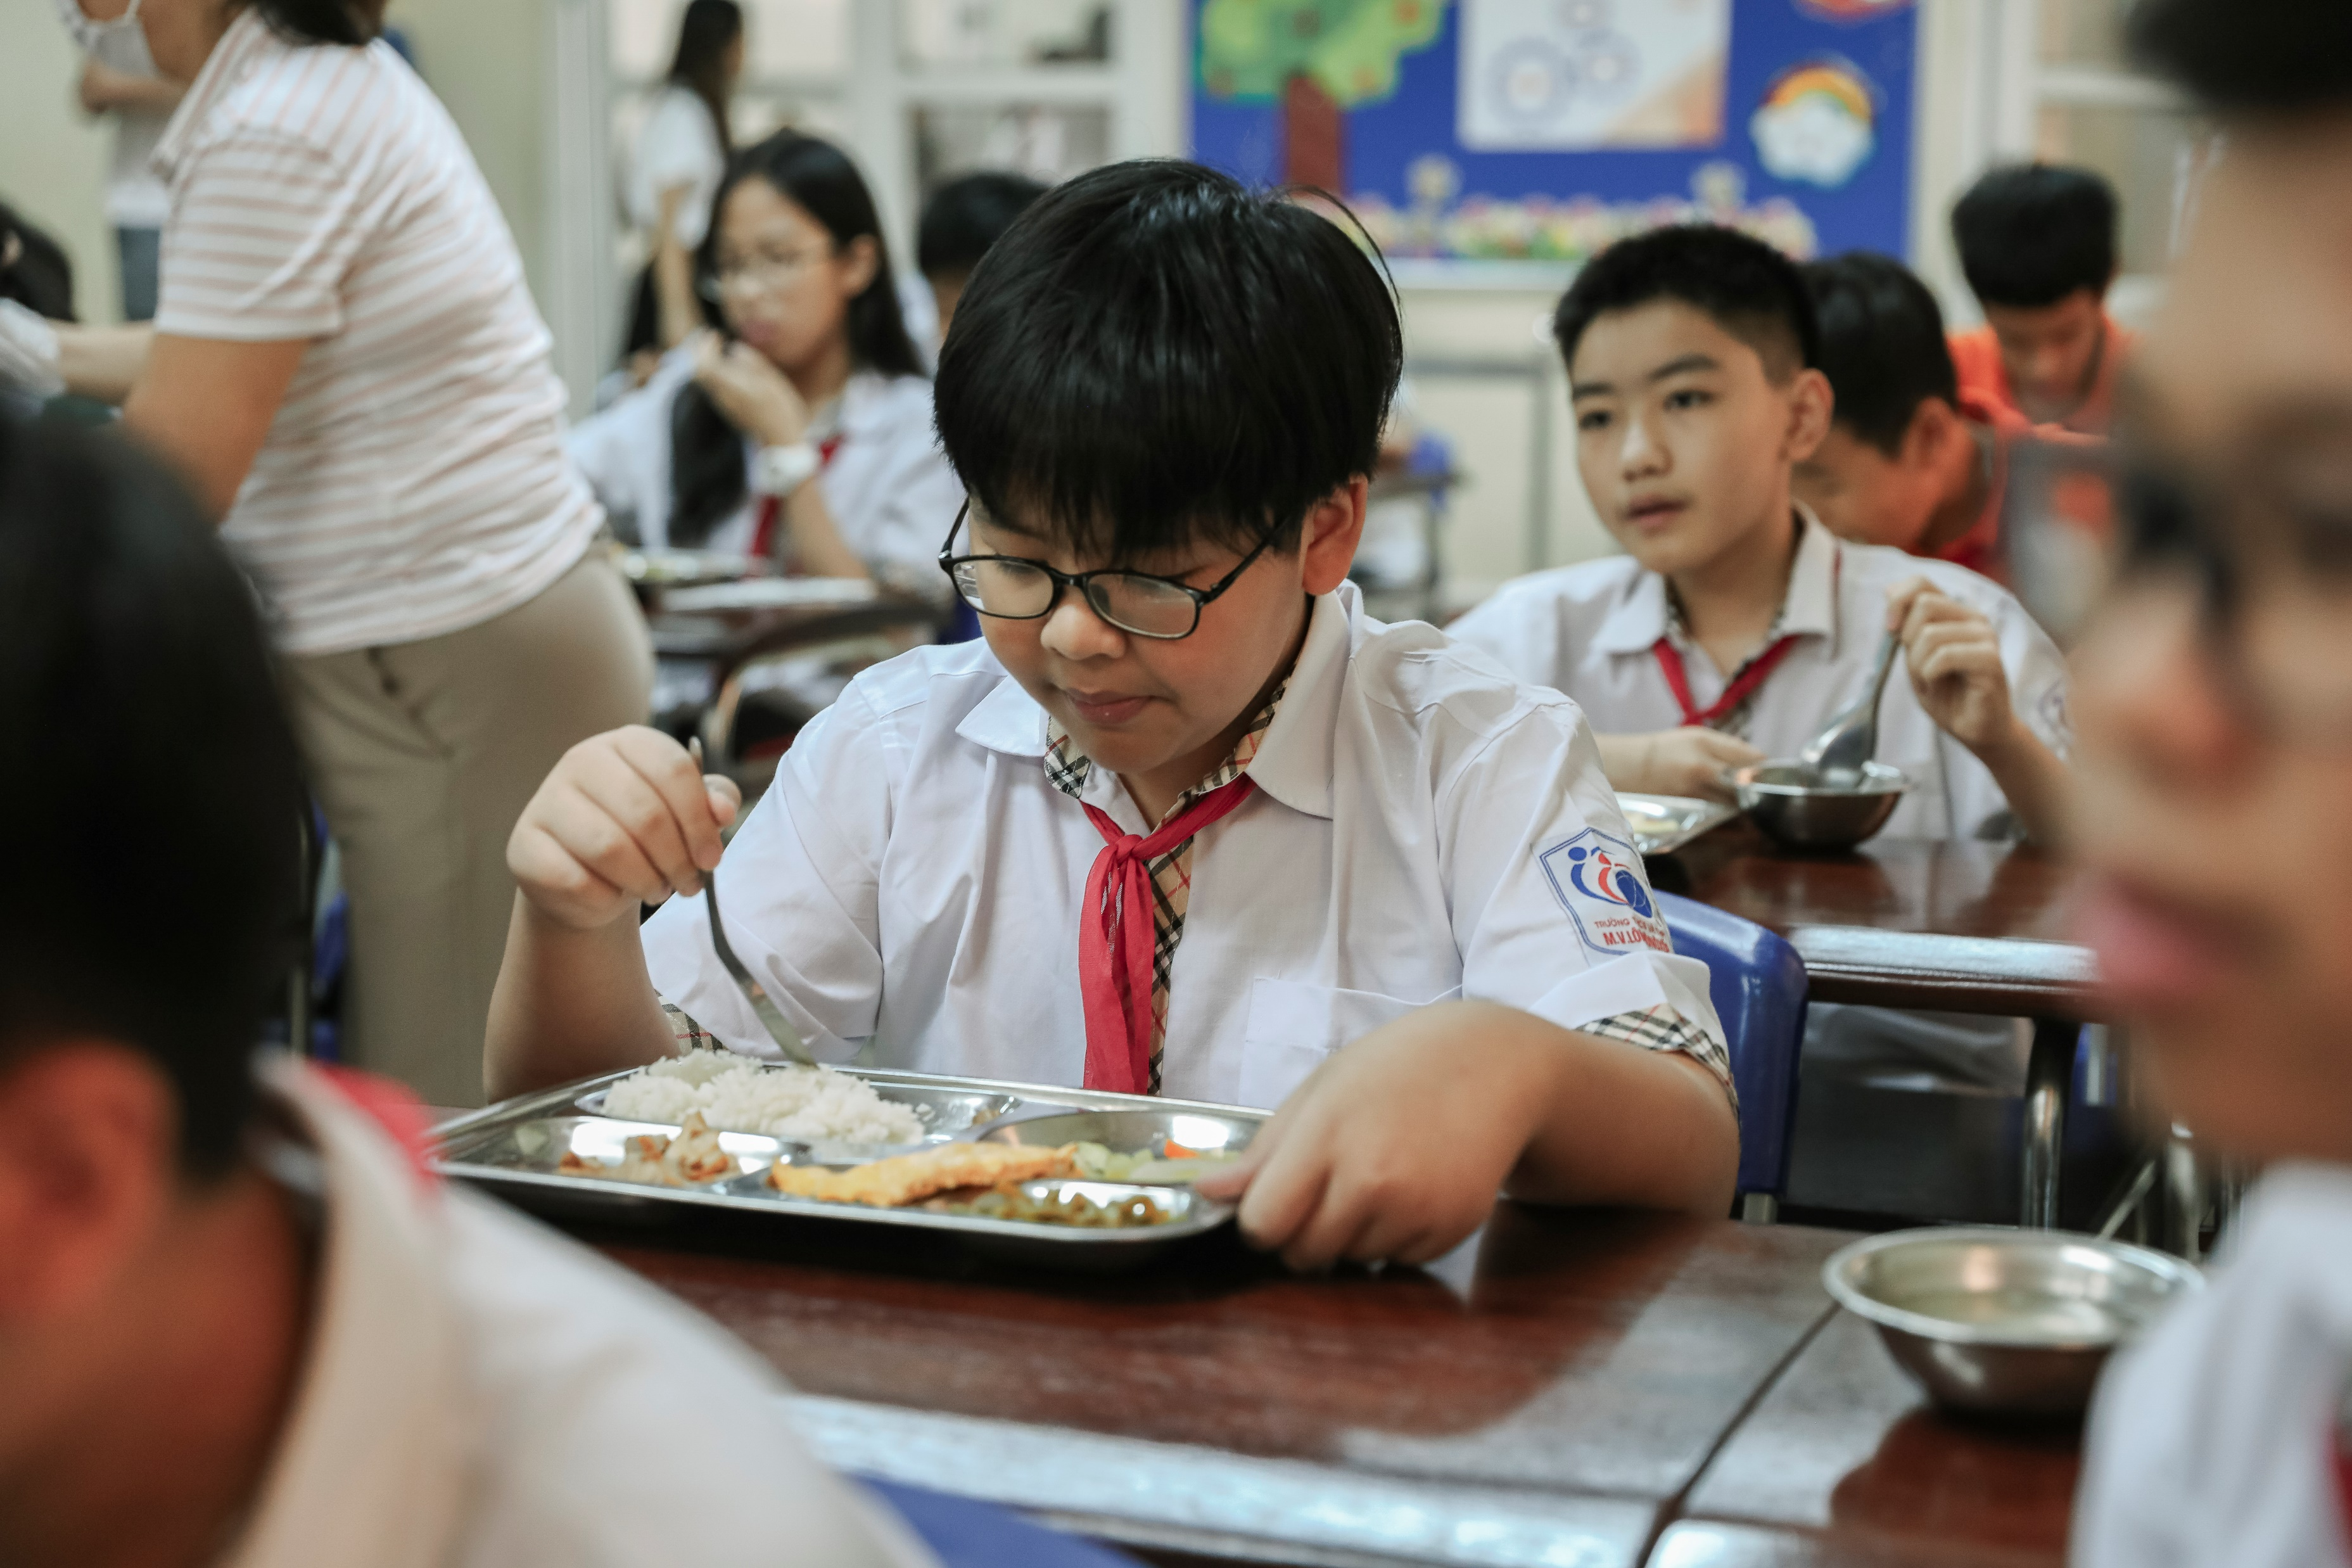
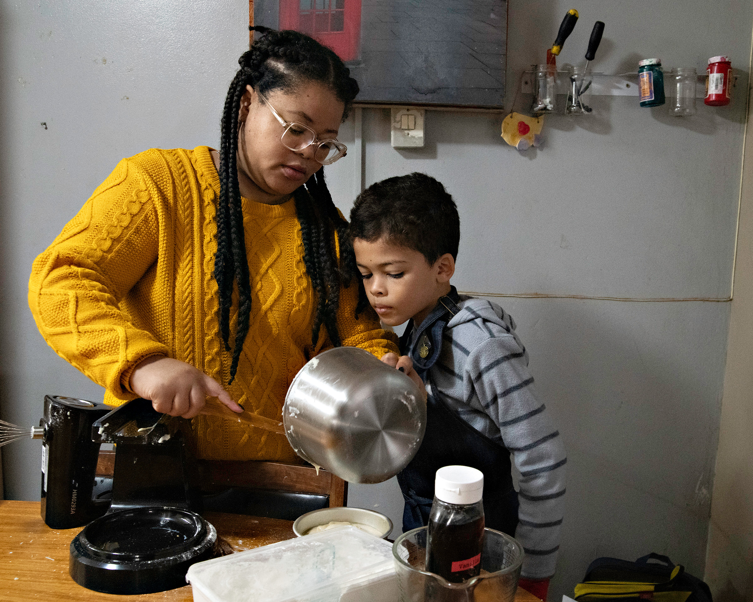
GUESS THE ARTICLE
UNICEF/UNI401131
UNICEF/UNI456018
UNICEF/UNI448761
These pictures provide a clue to this week’s articles.
How do these pictures help you? Can you guess how they are linked together?
Write down your thoughts or discuss with someone in your class.
Notes:
A mother and her daughter hanging out their laundry in Küçükdalyan accommodation shelter in Hatay, after two devastating earthquakes hit south-east Türkiye on 6 February 2023
On 14 August 2023 in Viet Nam, Ha, 13, eats lunch at M.V. Lomonosov Middle and High School in Hanoi. Ha advocates for healthier food environments around his home and his school.
Eleanor (38) and Aidan (10) spend time together at home in their kitchen in Kariega, Eastern Cape, South Africa on 25 May 2023.

Slide 4


ARTICLES 26 & 27
Article 26 (Social Security): Every child has the right to benefit from social security. Governments must provide social security, including financial support and other benefits, to families in need of assistance.
Article 27 (Adequate Standard of Living): Every child has the right to a standard of living that is good enough to meet their physical and social needs and support their development. Governments must help families who cannot afford to provide this.

Slide 5
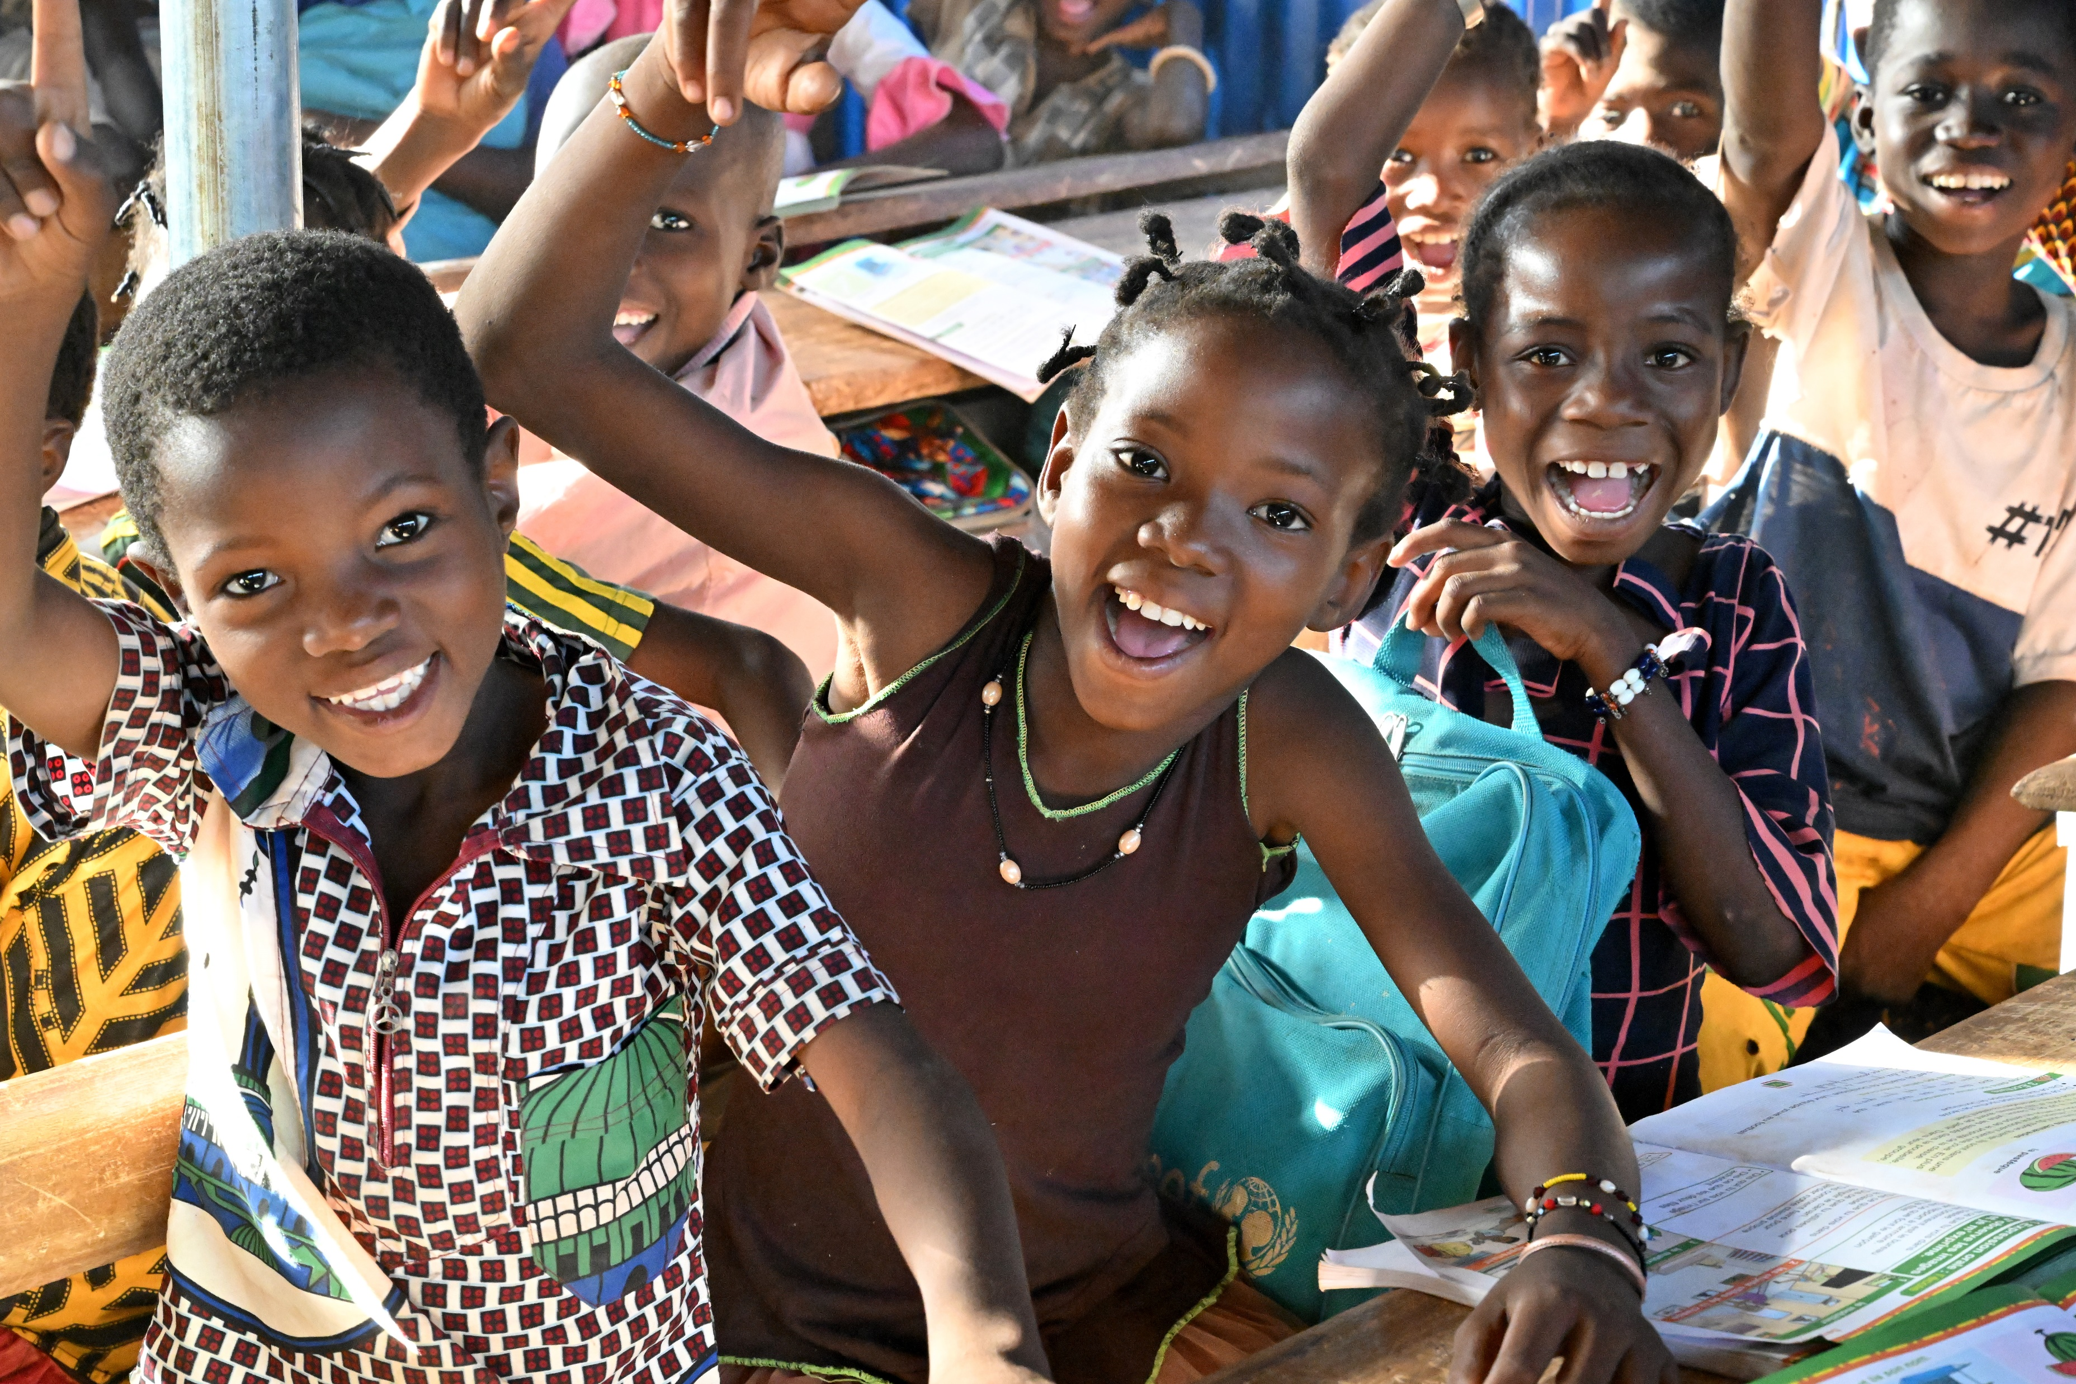
EXPLORING ARTICLES 26 & 27
What are the basic things that every child needs in order to have a good enough living?
Brainstorm alone or in a group for 1 minute and think of as many answers as you can!
UNICEF/UN0339584
UNICEF/UNI486216
Notes:
Children attending class at the school, Baapouguini B, in Fada N’gourma, in the east of Burkina Faso.
Note: If you are doing this before Christmas you could do it as a class letter to santa, explaining that this is not a typical letter to Santa asking for specific toys etc. Instead the class are asking for all the things that children everywhere need to have a good enough life

Slide 6
DID YOU INCLUDE ANY OF THESE?
A safe, warm and dry place to live
Nutritious food
Clean water to drink
Somewhere to wash
Clean clothes to wear
Space, time and resources to relax and play
Healthcare and medical treatment
Education and the chance to develop your talents
A chance to have friends
People to look after you
Enough money for the essential things in life
Did you think of anything else?

Slide 7
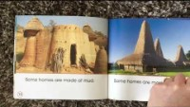

ACTIVITIES FOR THE CLASSROOM
You do not need to complete every activity but if you have time, you can try to complete more than one.
Around the world, people live in all sorts of different homes. Research different types of homes and discuss or watch this video. What would your ideal home look like? Draw a picture and label the important elements.
Use the items from your brainstorm to write a class letter to Santa, listing all the things children in Ireland (and around the world) need to live a good enough life. Draw pictures of the different items, making it as colourful as you can! Think about who else you could send this list to, including local politicians.
In recent years foodbanks have seen a huge demand for their services and are supporting children and families across Ireland who are struggling to afford enough food. Read or listen to the book ‘It’s a no money day’ by Kate Milner. What can communities do to help families in need?

Slide 8
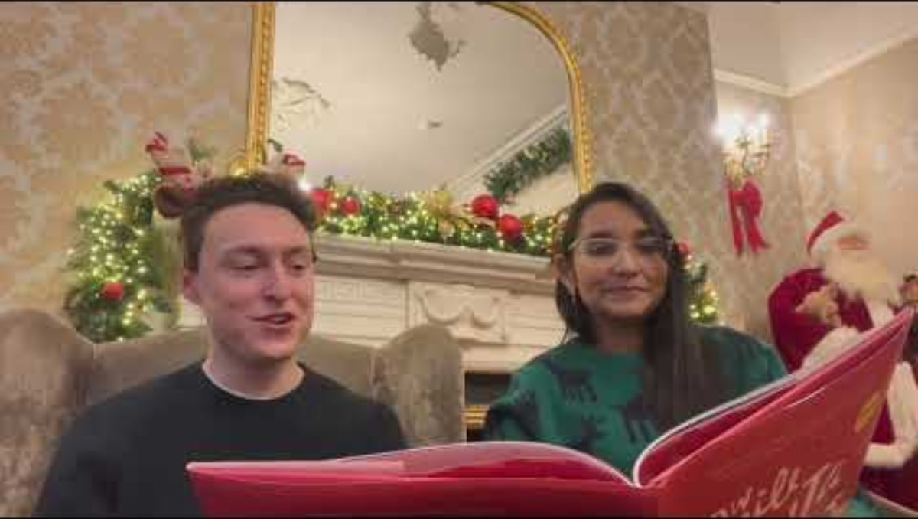
ACTIVITIES FOR THE CLASSROOM
You do not need to complete every activity but if you have time, you can try to complete more than one.
Explore Article 26 & 27 in your class. Draw images or find items that represent Article 26 and Article 27 or write a poem or story about why everyone should have a good enough standard of living.
Find out more about organisations working in your local area who support families and individuals in need. You could contact them and ask them to come into school to discuss their work and how they help realise children’s rights. How could your school community support this work?
Read “How Will Santa Find Us” by Shane O’Brien and Stephen Rogers. What rights were impacted in this story? What helped the family to keep going?

Slide 9
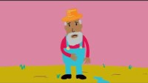
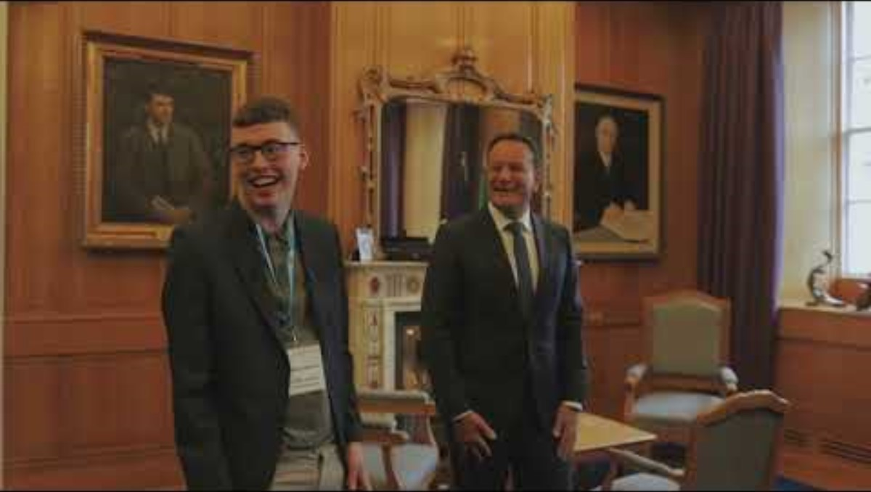
ACTIVITIES FOR THE CLASSROOM
You do not need to complete every activity but if you have time, you can try to complete more than one.
The Irish Government has pledged to provide free hot school meals for all children in Ireland by 2028. Discuss why you think the government has made this pledge – link your discussion to articles 26 and 27. Does it link with other rights too?
Watch this animation about the Sustainable Development Goal – No Poverty. Note down what the causes of poverty worldwide are, then discuss in class and create a display to show what you have learnt.
Listen to an interview with UNICEF Youth Advocate Nathan Dunne speaking about child poverty, or watch Nathan meet with Leo Varadkar during this year’s Taoiseach Takeover for World Children’s Day
Articles 26 and 27 have some challenging vocabulary. Look up the following terms and do some research to find out what they mean: SOCIAL SECURITY/ BENEFITS/
STANDARD OF LIVING
Present what you find out to your class.

Slide 10
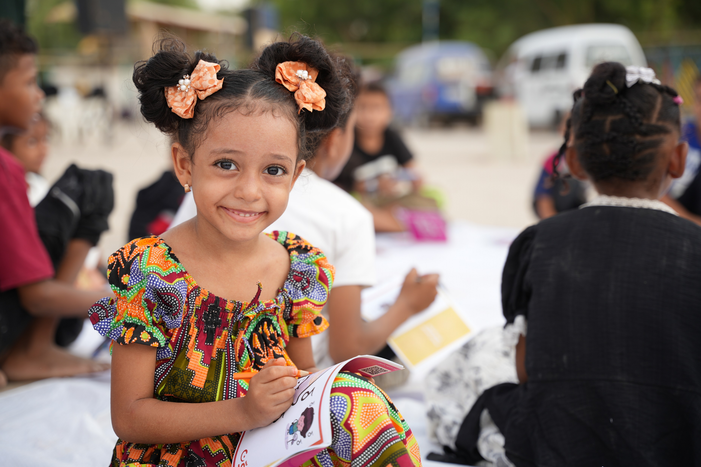
REFLECTION
Take some time to think about and reflect on articles 26, social security, and 27, adequate standard of living…
Children living in poverty are often denied their right to the basic items they need to survive and develop under Article 27. Reflect on the following:
How could the government help children living in poverty?
How could your school help children living in poverty?
If you know somebody living in poverty, how can your words and actions help to respect their dignity and rights?
UNICEF/UNI422143
Notes:
Yemen, World Breastfeeding Week August 2023: UNICEF carried out a number of social activities promoting for breastfeeding with focus on displaced people using several fun, interactive, educational techniques and conducting information sessions.

Slide 11
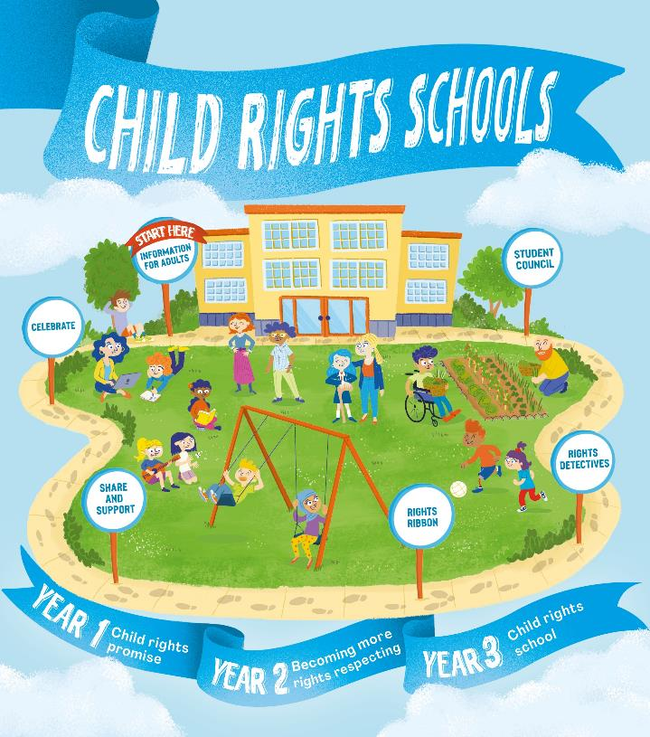

FURTHER CHILD RIGHTS EDUCATION SUPPORT
Child Rights Schools is a programme that supports you to embed child rights across the whole school community, including with parents and carers. Find our more here.
Find more classroom resources here.

Slide 12

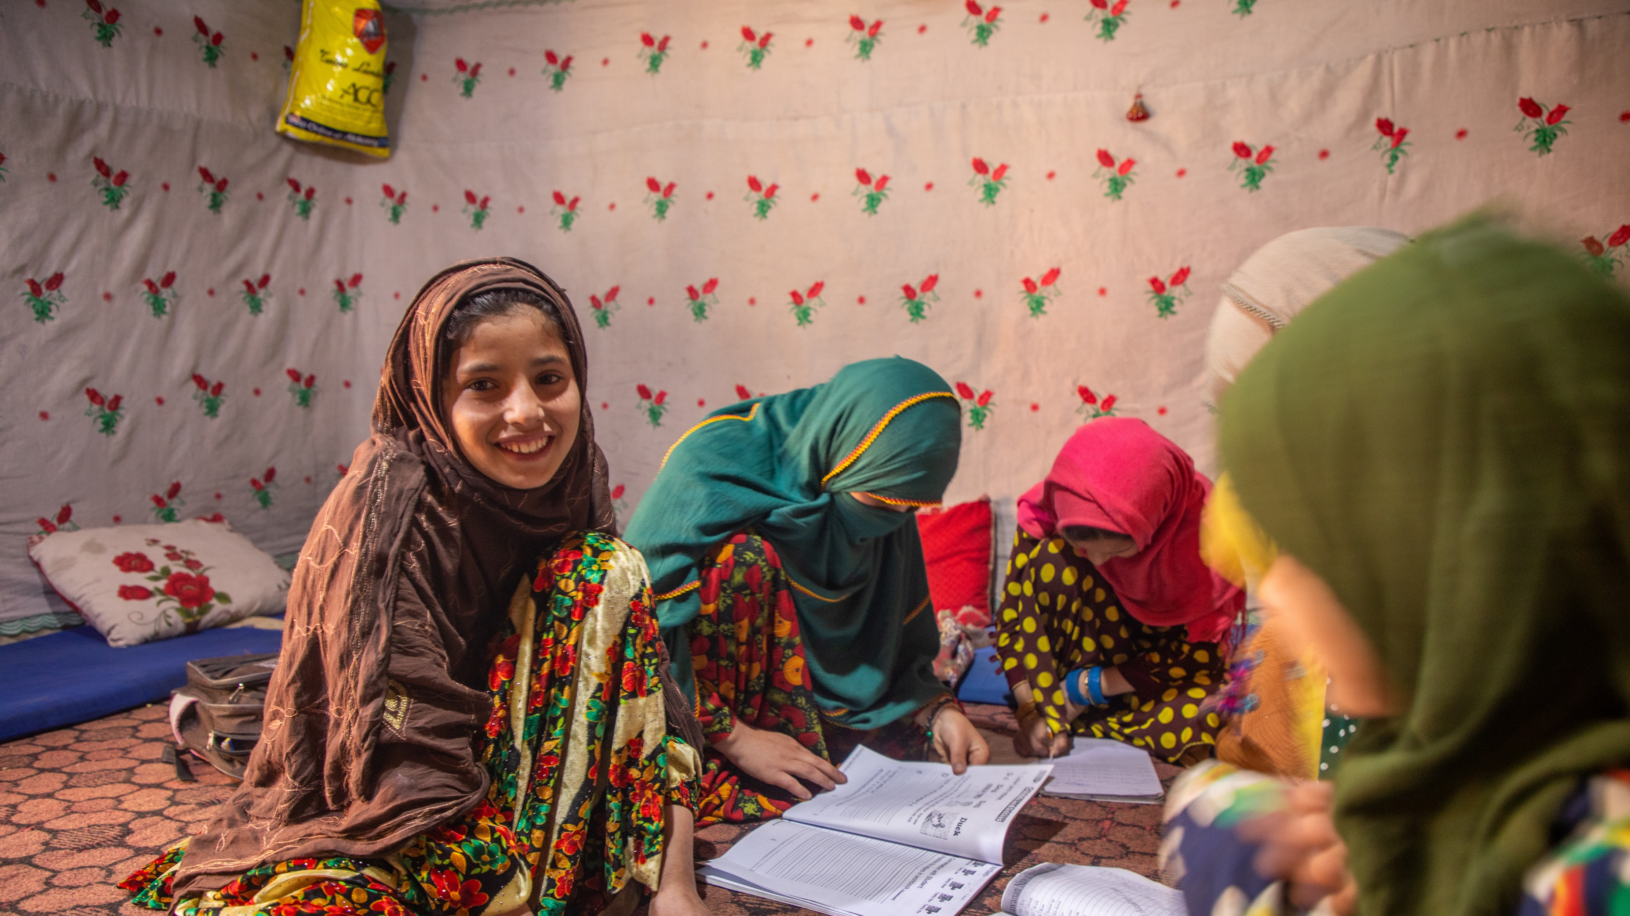

THANK YOU!
UNICEF/UNI482372
Notes:
On 28 November 2023, 10-year-old Farzana works on her school lessons inside her one-room home in Parun district, Nuristan province, Afghanistan.

