Slide 1

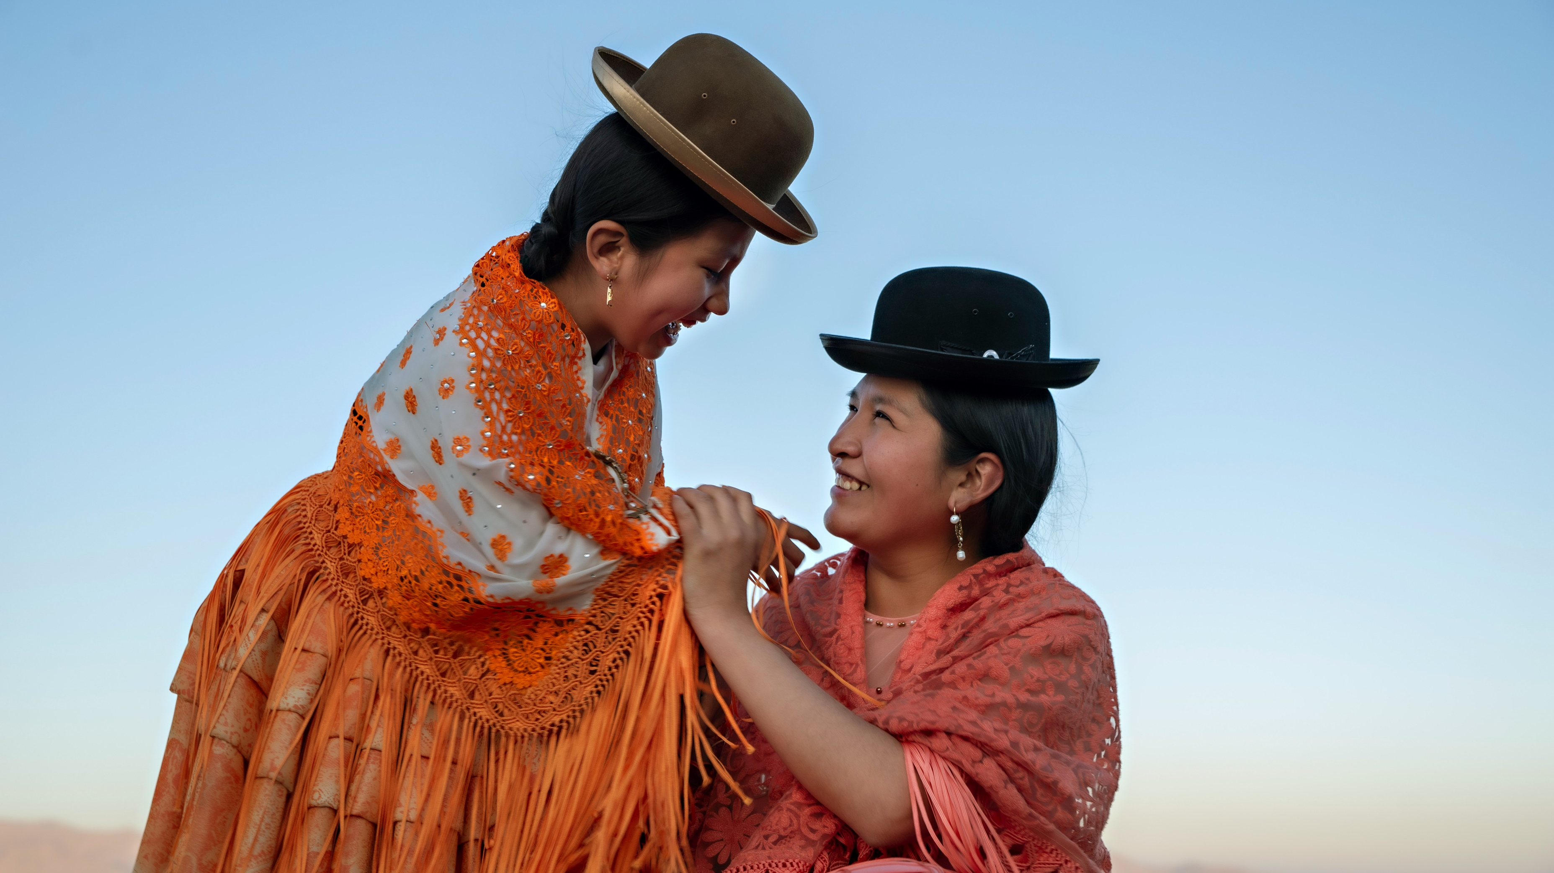
ARTICLE IN FOCUS
UNICEF/UNI448978
Notes:
Nathaly (7) laughs with her mother Sandra in La Paz, Bolivia on 27 August 2023.

Slide 2

BEFORE YOU BEGIN
This is a flexible resource and is intended to provide you with some easy to use, appropriate rights-related learning to share with your children, their families and your colleagues.
Please edit out non relevant slides or activities before sharing with your students. Please check that the content works for your learners and feel free to adapt or add any content that would make the material more relevant for your setting.
This resource was developed by UNICEF UK and adapted by UNICEF Ireland.
Slide 3 – Guess the Article
Slide 4 – Introducing Article 30
Slide 5 – Exploring the Article
Slides 6 – Some Possible Answers
Slide 7,8,9 – Activities for the classroom
Slide 10 – Reflection
Slide 11– Further Support

Slide 3
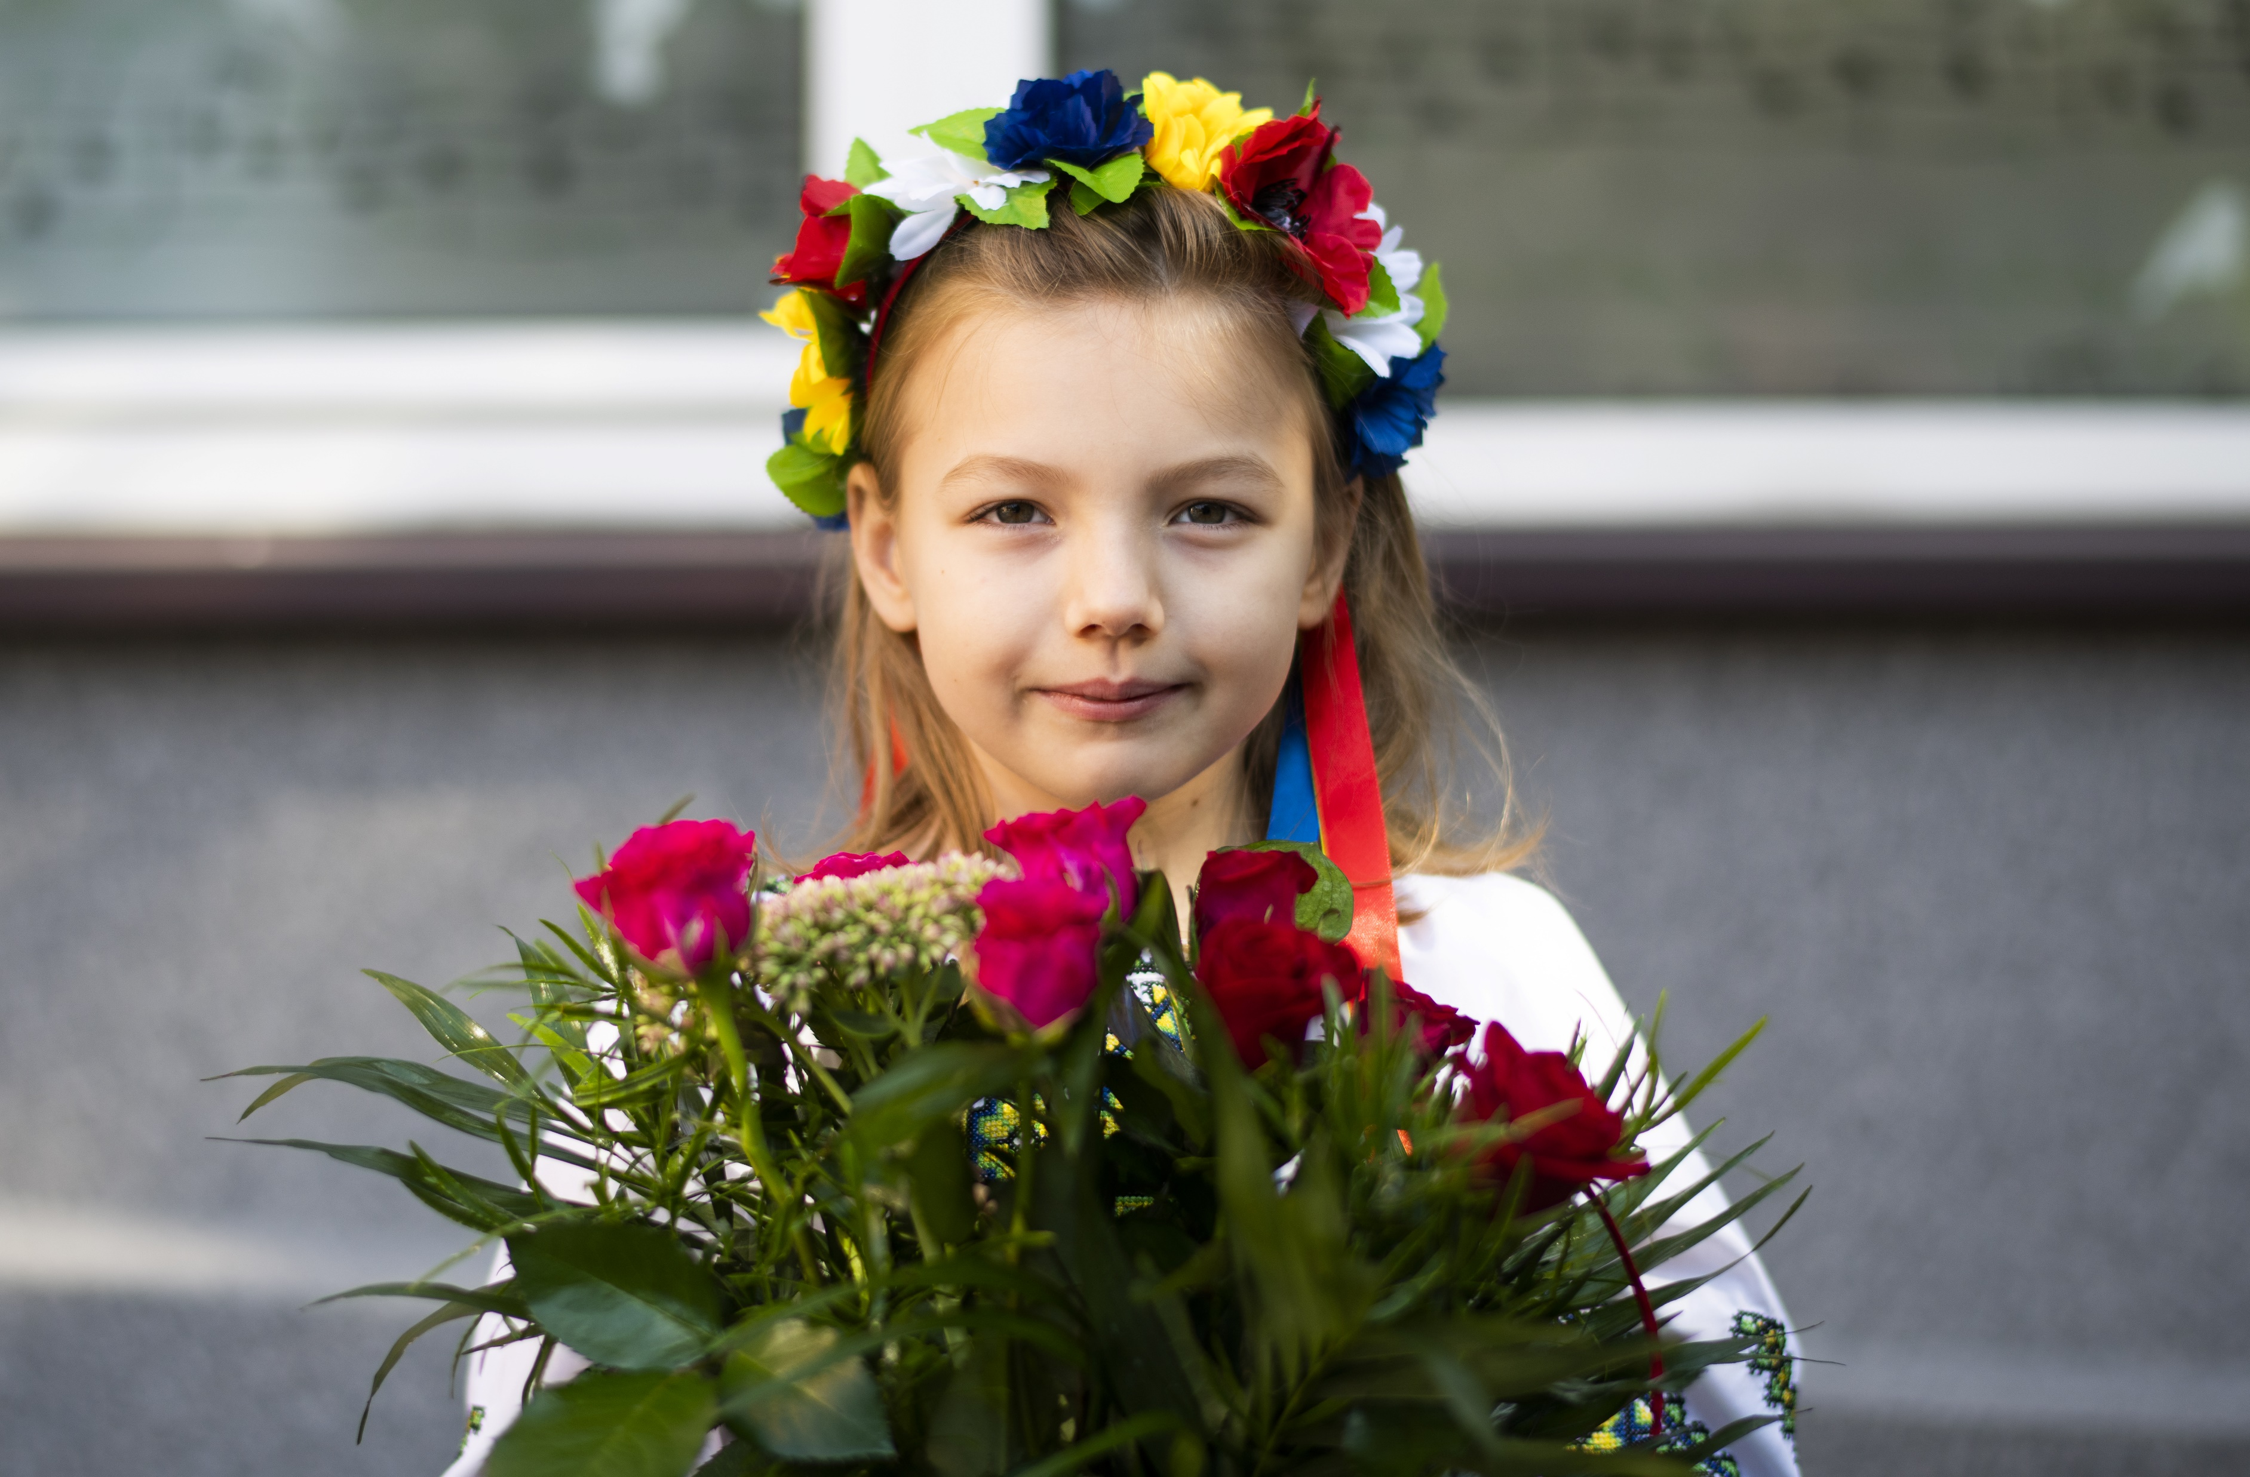
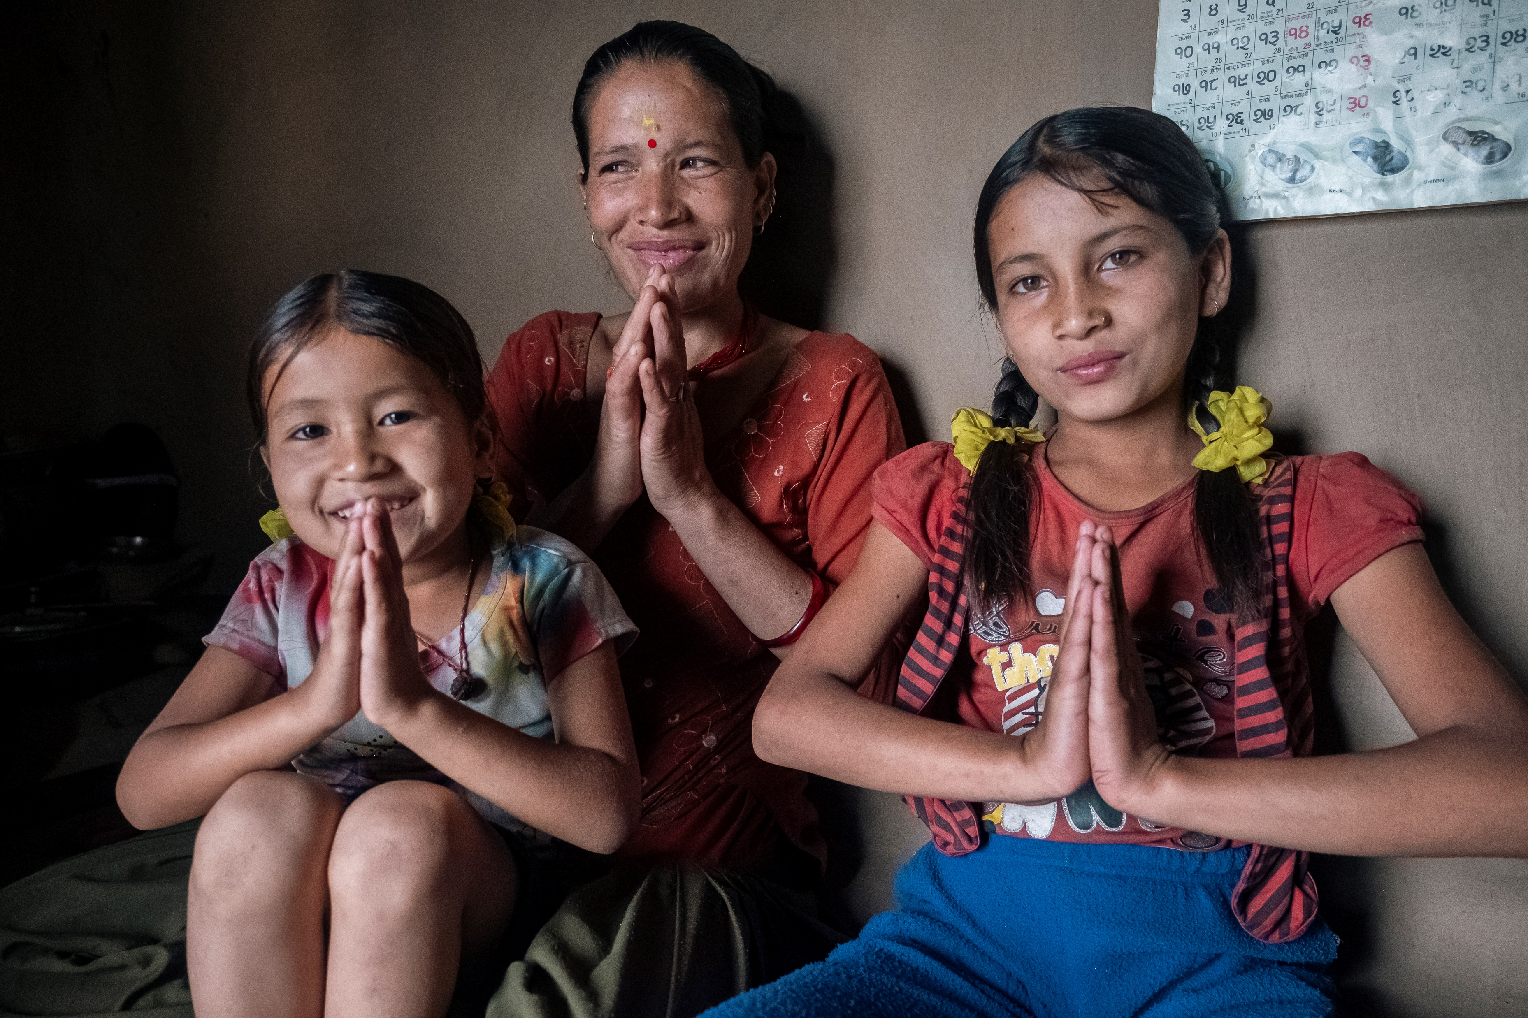
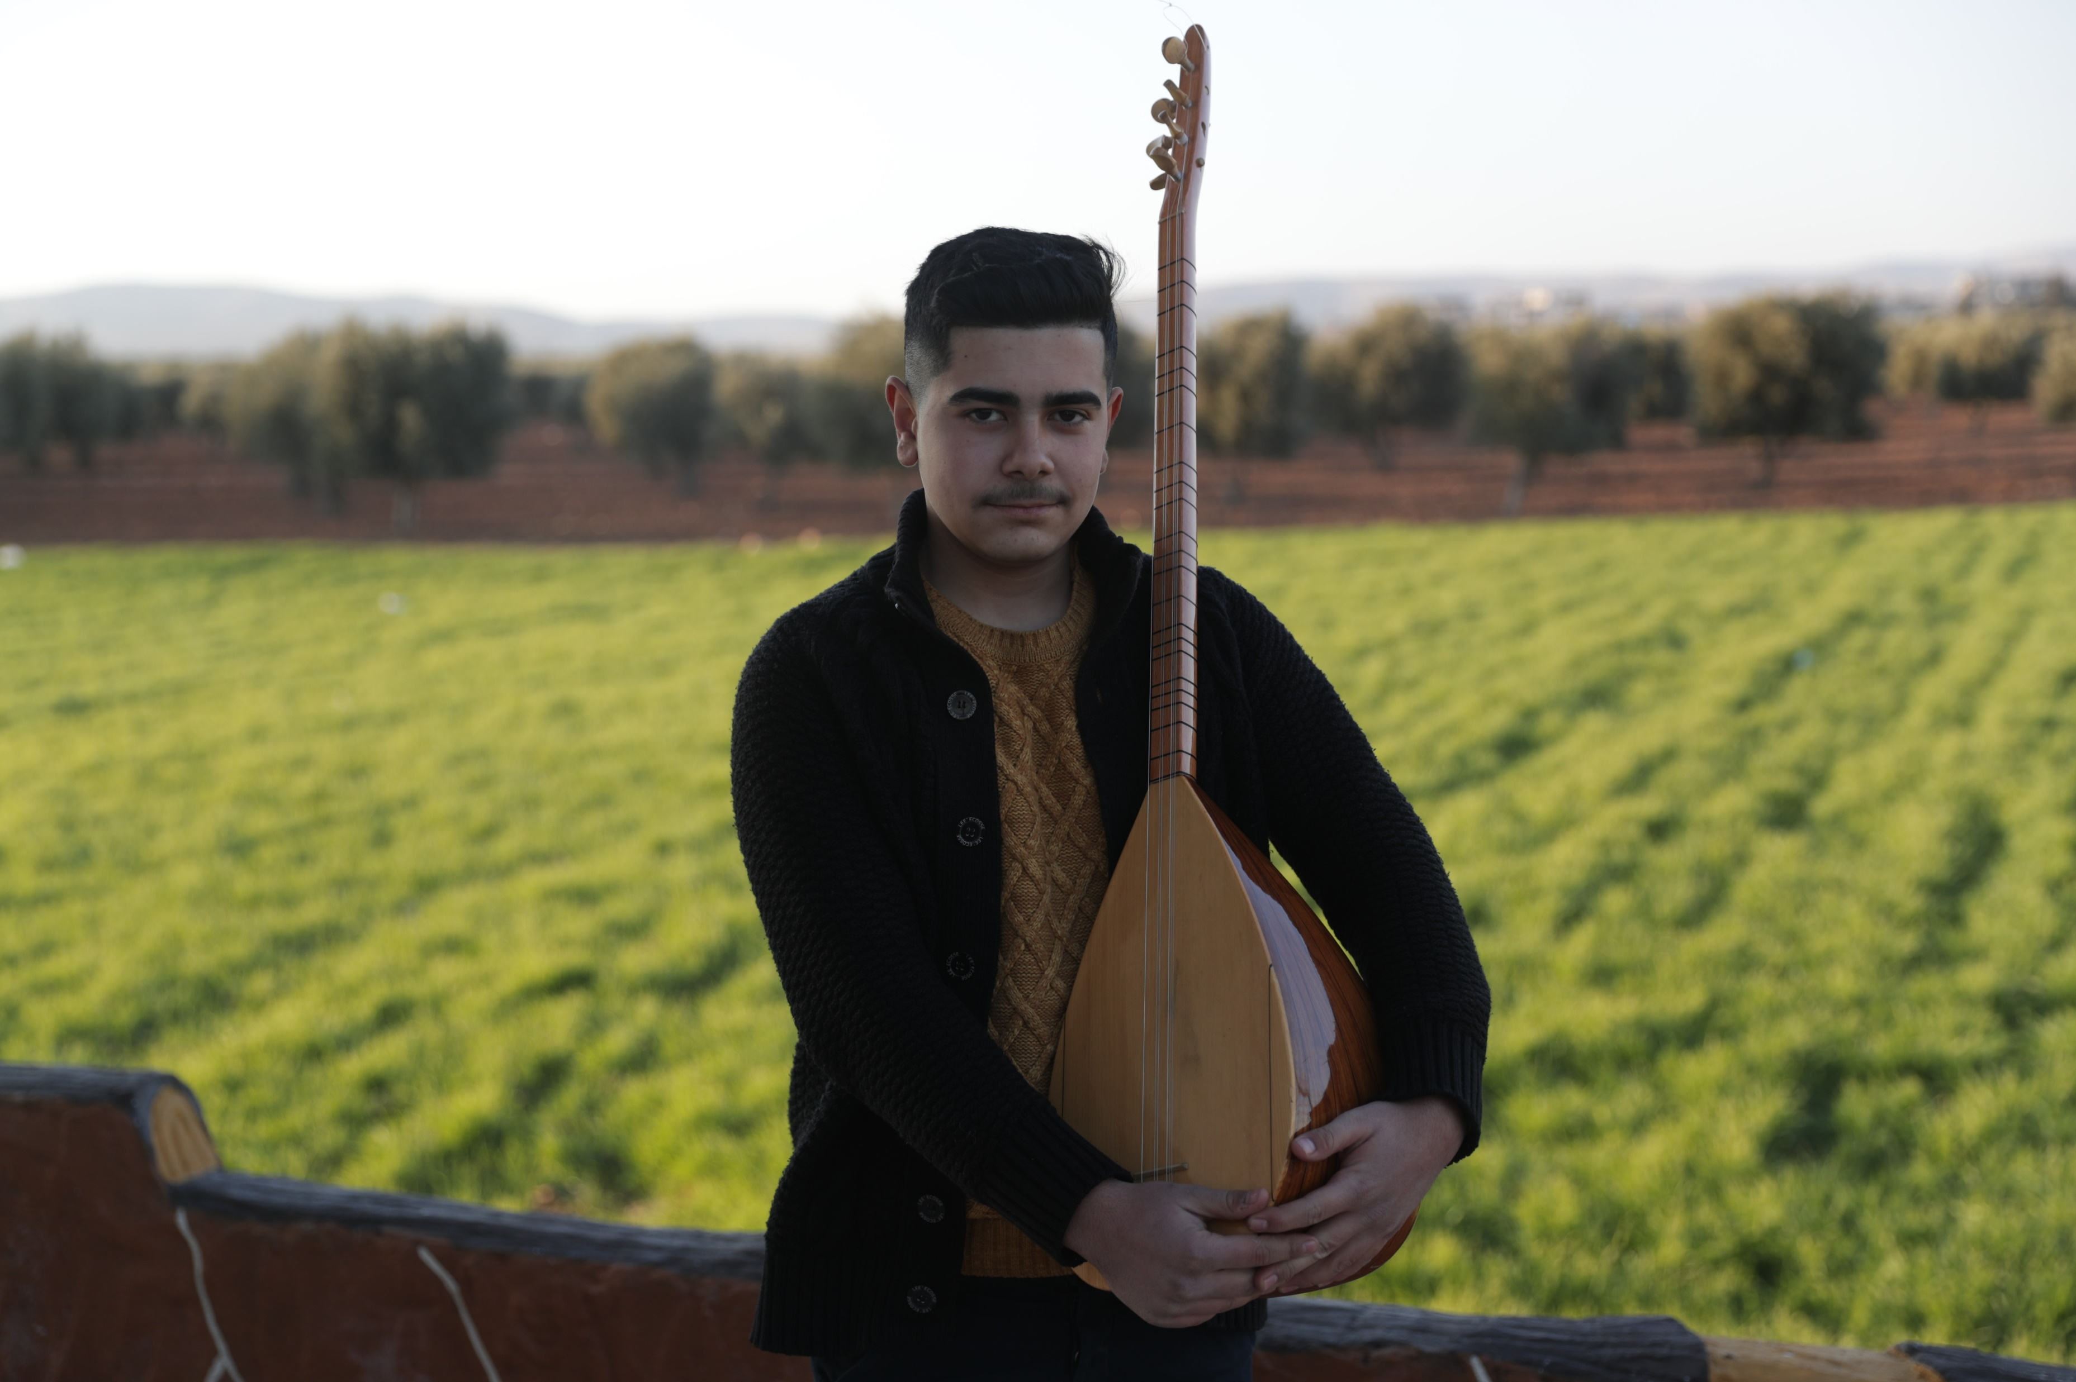
GUESS THE ARTICLE
These pictures provide a clue to this week’s article.
How do these pictures help you? Can you guess how they are linked together?
Write down your thoughts or discuss with someone in your class.
UNICEF/UN0696252
UNICEF/UNI431505
UNICEF/UN0788651
Notes:
Left to right: On September 1, Emilia, 7 from Irpen, Ukraine is posing for a photo in front of her new school in Krakow, Poland; In the village of Netakot, Nepal, Dhana Saud, 32 years old, along with her daughters, Angela, aged 6, and Dipika, aged 11, warmly greets guests with a traditional "Namaste" welcome; On 17 February 2023, 16-year-old Mohamed holds his Buzuq, a traditional Kurdish music instrument, and poses for a photo in the backyard of his home in his hometown Jandaris, in the Afrin District of the Aleppo Governorate, which was heavily affected by the earthquake that struck northwestern Syria on 6 February 2023

Slide 4

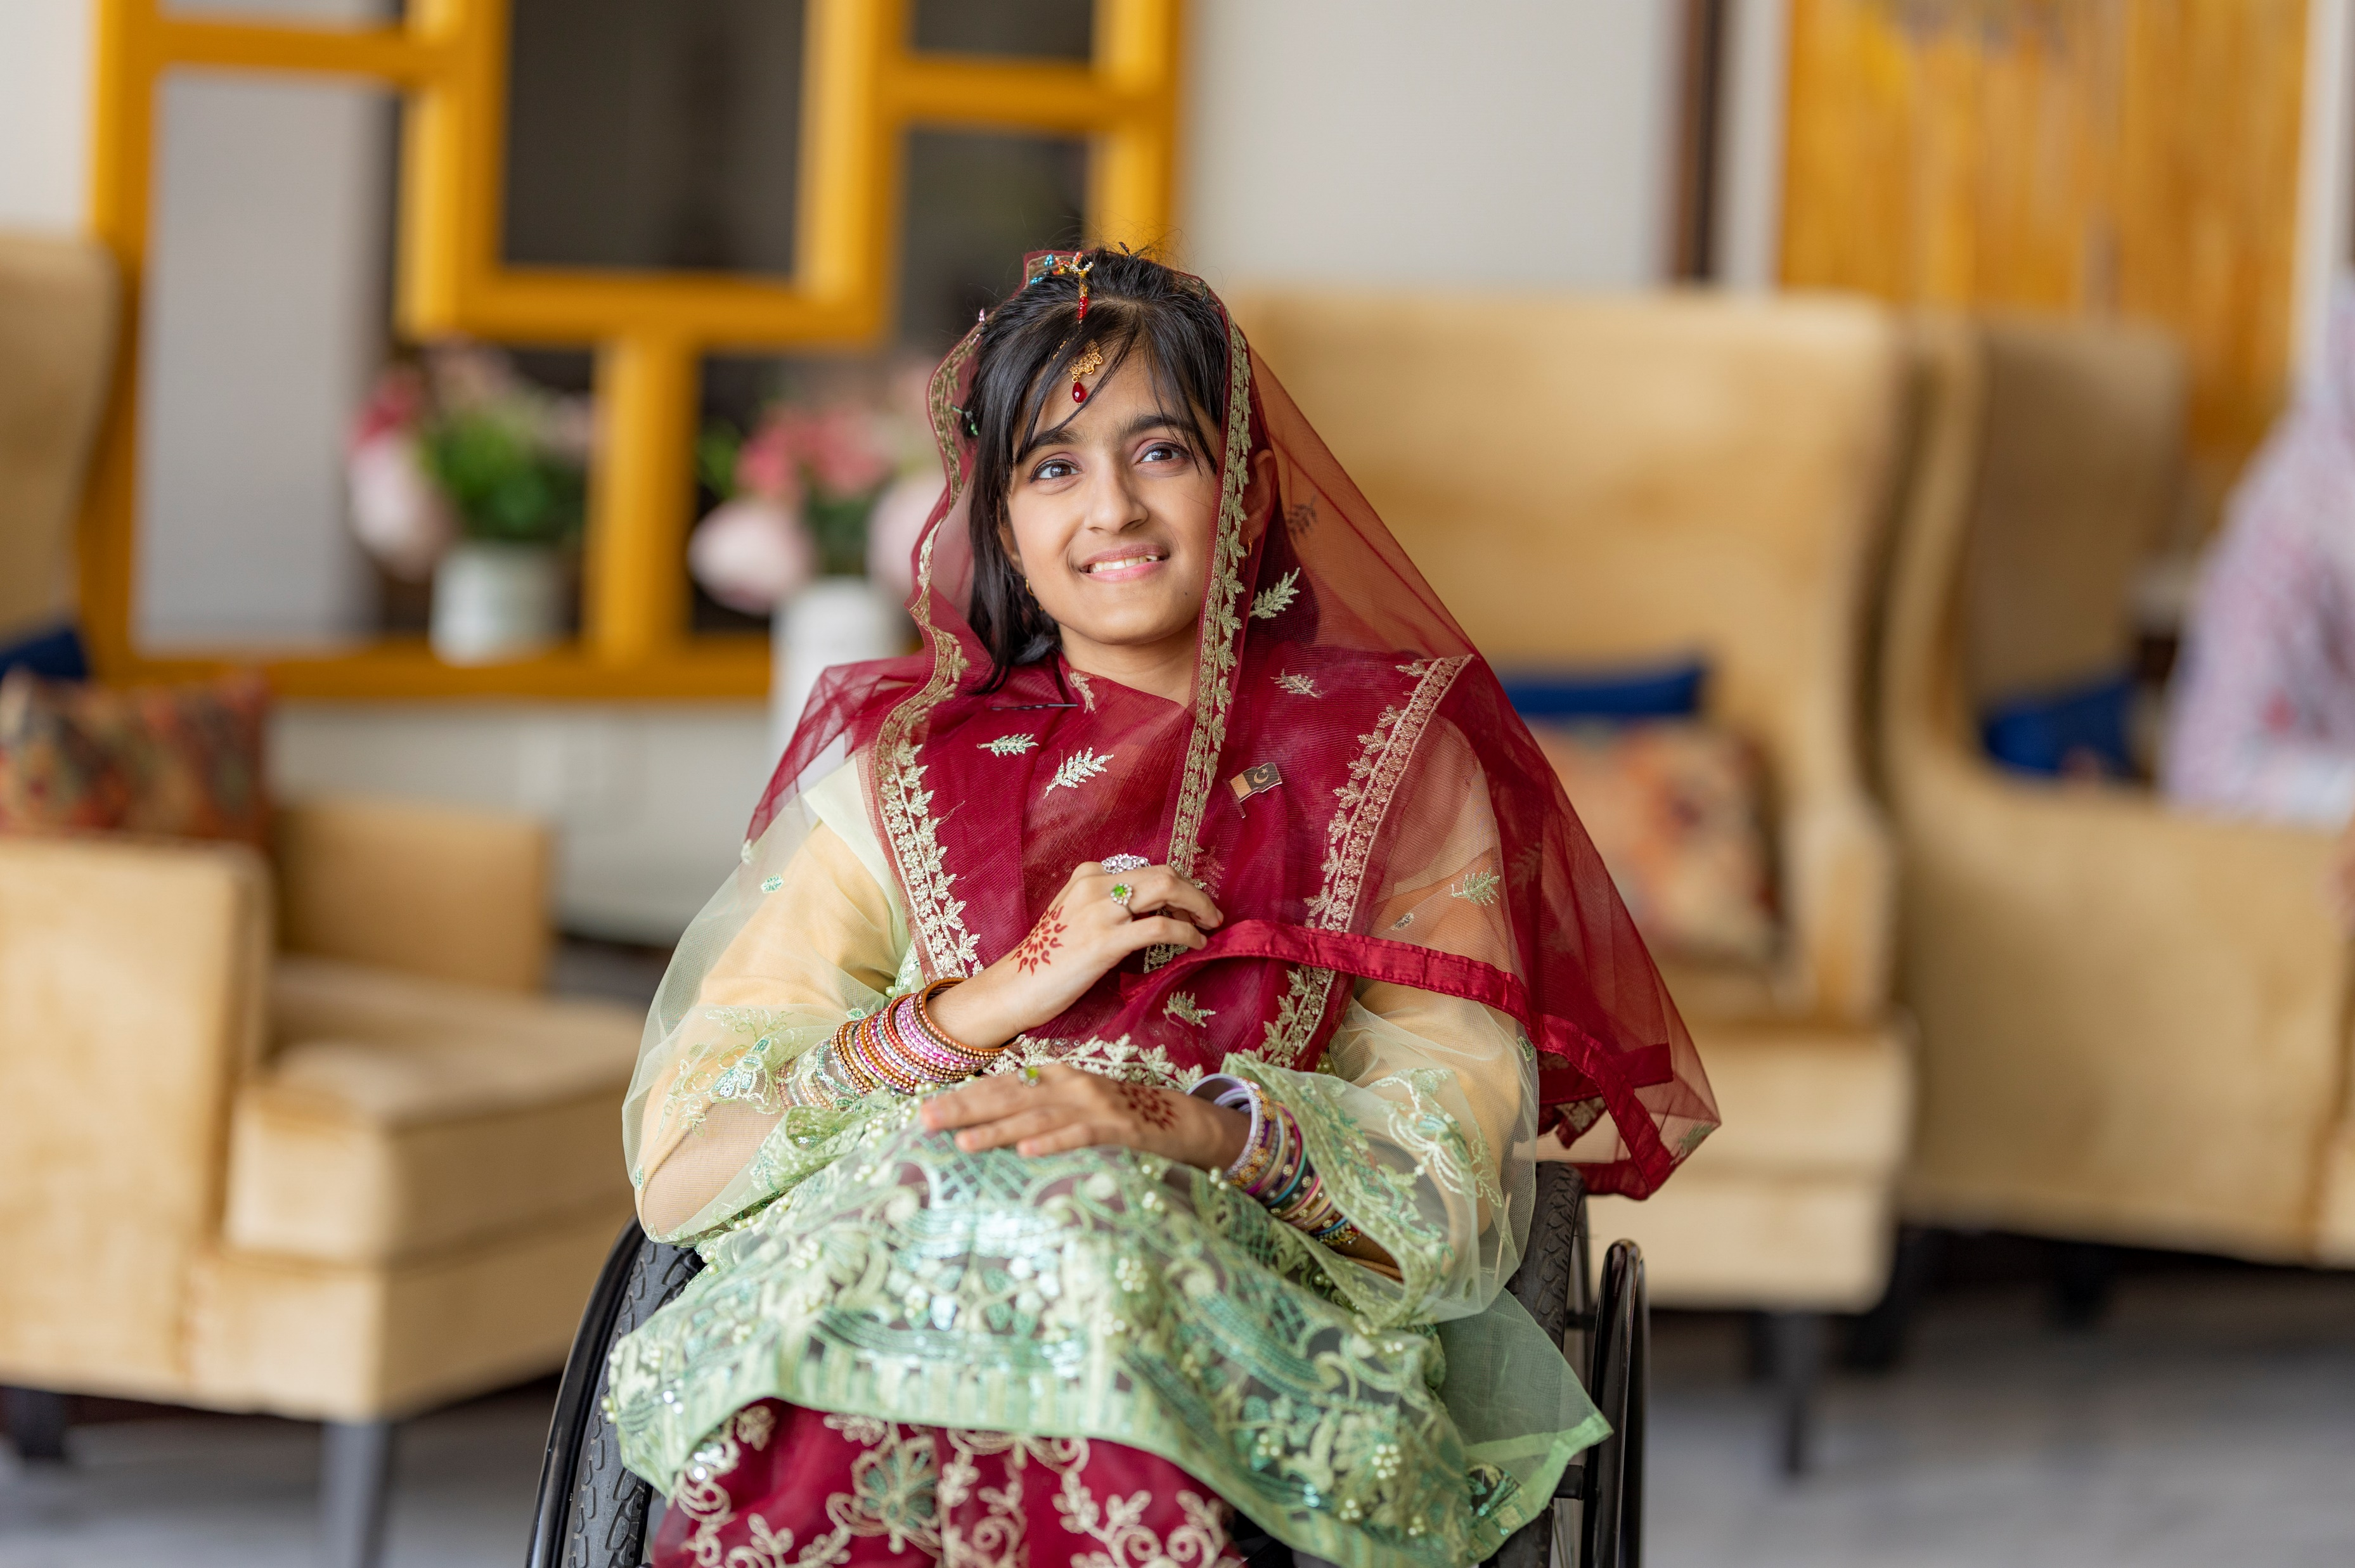
ARTICLE 30 – Children from Minority or Indigenous Groups
UNICEF/UNI476520
Article 30: Every child has the right to learn and use the language, customs and religion of their family, whether or not these are shared by the majority of the people in the country where they live.
Notes:
UNICEF Pakistan's Youth Advocate, Taqwa (16) poses in her traditional attire representing the province of Punjab on World Children's Day in Islamabad, Pakistan, 2023.

Slide 5
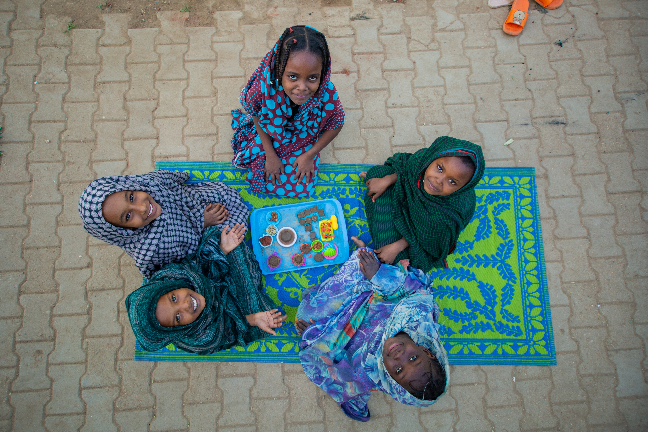
EXPLORING ARTICLE 30
Why is it important that minority cultures are celebrated and protected?
Have a think and write down some answers!
UNICEF/UNI523498
Notes:
During play activities at a safe learning space in Al Salam IDP gathering point, a group of girls use mold clay to prepare meals similar to what they prepared during the Ramadan season in the past, Sudan, 2024.

Slide 6
EXPLORING ARTICLE 30
Did you think of these?
To make everyone feel welcome and that they belong
To make sure nobody is treated unfairly because they have a different culture/religion/language
To ensure that we can hear a diverse range of stories and viewpoints
Because all communities, including schools, should encourage respect for everyone and celebrate diversity and inclusion.
To celebrate people’s heritage and to keep it with them
Celebrating our diversity of cultures makes for more interesting, vibrant and colourful communities
To challenge negative stereotypes and to support people to challenge discrimination
What else did you think of?

Slide 7
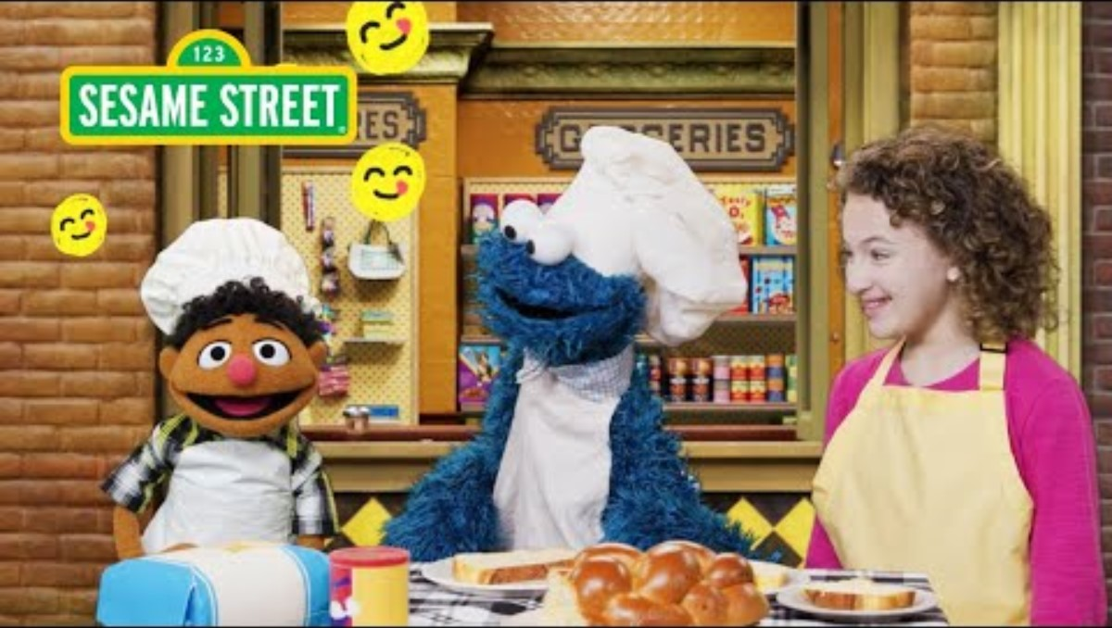
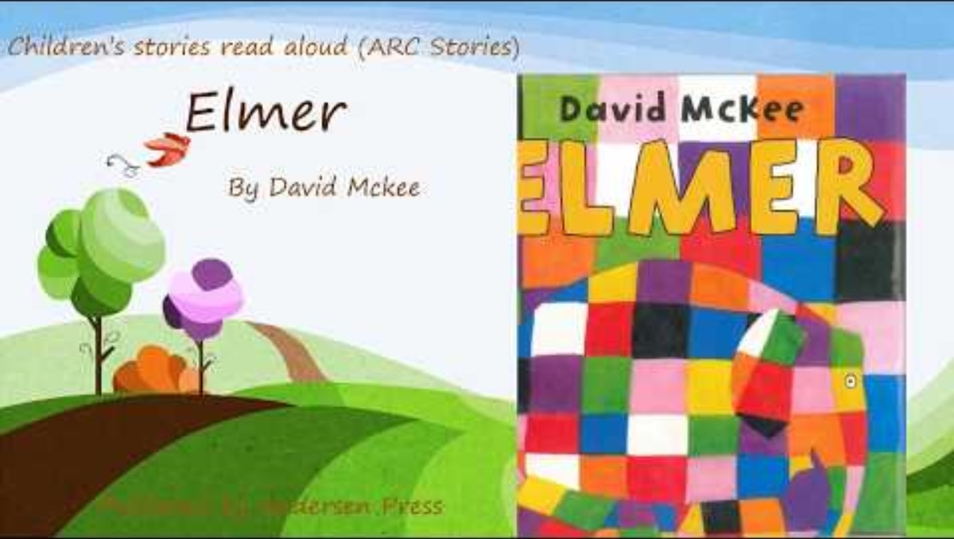
ACTIVITIES FOR THE CLASSROOM
You do not need to complete every activity but if you have time, you can try to complete more than one.
Every family has different traditions. Watch Tamir learn about some different family traditions on Sesame Street, then think about what are your favourite family traditions and share with your class!
Everyone is special and important! What is the best thing about being you? Create a classroom display that reflects what you are ‘Proud to Be’. Link this to relevant articles from the CRC.
Imagine a world where everyone was treated fairly and could be themselves without worrying about discrimination. Describe how that world would feel and then write a poem, song or piece of art!
Listen to the story Elmer the Elephant. Think about how Elmer felt in the herd of grey elephants. How can we celebrate our differences and the things that make us unique? Come up with some ideas as a class or group that you could do in your school!
Notes:
https://www.youtube.com/watch?v=Rp7S1drKzEk&ab_channel=ARCStories

Slide 8
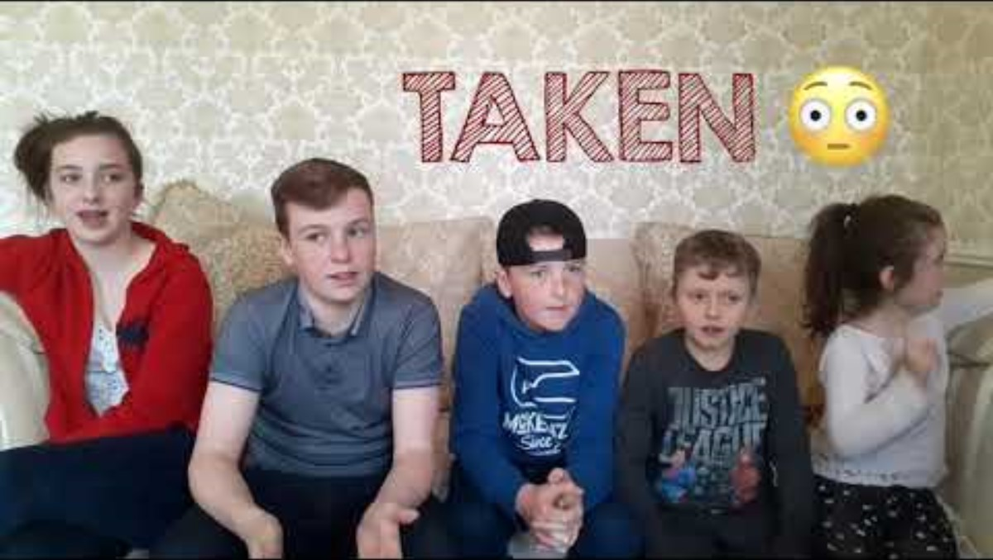

ACTIVITIES FOR THE CLASSROOM
You do not need to complete every activity but if you have time, you can try to complete more than one.
Did you know Gammon (or Cant), spoken by members of the Irish Traveller Community has been included in the UNESCO Inventory of Intangible Culture? Listen to these children translate various words into Gammon and find some words to include in your Diversity Wall below!
Ireland today is a diverse country, where many communities have different cultural heritages. Learn about religious and cultural festivals celebrated by different communities in Ireland and make an intercultural classroom calendar! Start by listening to these children discuss how they celebrate Eid al-Fitr after the month of Ramadan.
Carry out a language audit to see how many different languages are spoken by children in your school community. Create a Diversity Wall or a Multilingual Mural in the heart of your school highlighting all the different languages and encouraging everyone to learn a few phrases from each!

Slide 9
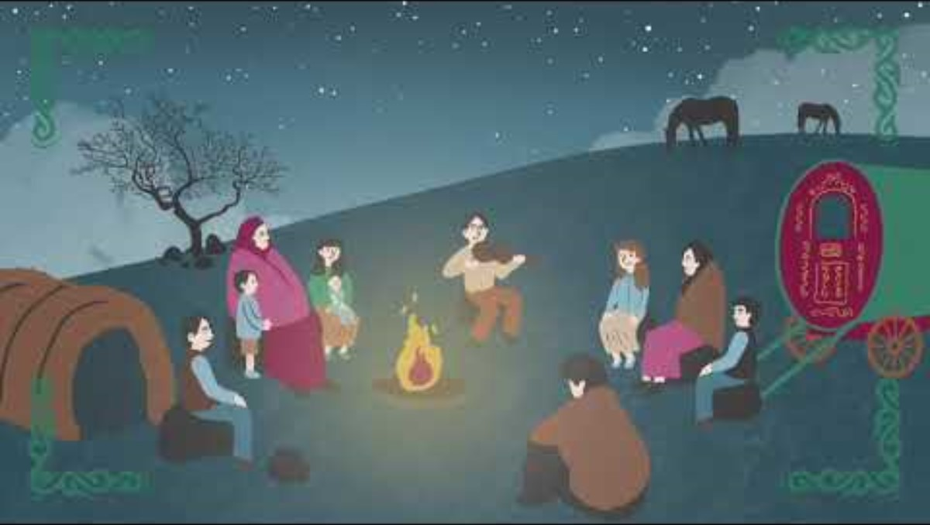
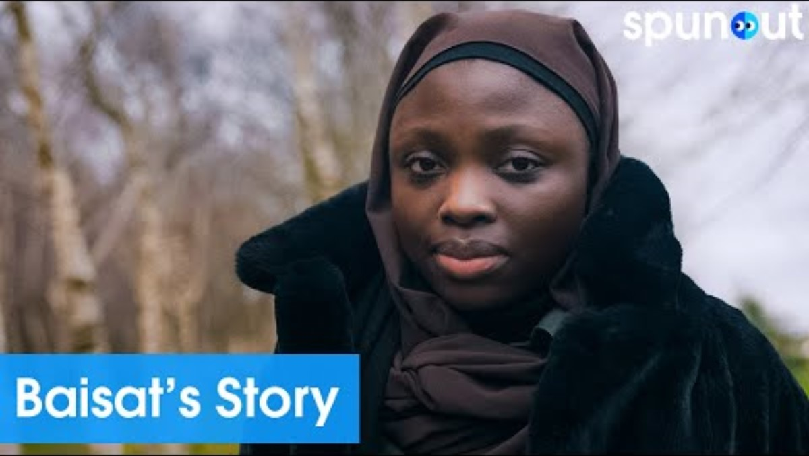
ACTIVITIES FOR THE CLASSROOM
You do not need to complete every activity but if you have time, you can try to complete more than one.
Did you know that Irish Travellers have been part of Irish society for centuries? Watch this video on the history of Irish Travellers to learn about their culture and traditions, as well as some of the challenges they have faced in becoming recognised as a distinct ethnic minority group.
Irish Sign Language (ISL) is the first and/or preferred language of approximately 5000 Deaf people in Ireland, and around 40,000 people communicate in ISL (family, friends, etc.) Deaf people consider themselves to be part of a linguistic and cultural minority group, and ISL is a unique sign language. As a class try to learn the ISL for each letter of the alphabet!
As a school, think about how you can support minority communities to celebrate their culture and traditions. You could host an intercultural day, review your school library to ensure a diversity of authors are represented, and invite minority groups to speak with students.
Listen to Baisat speaking about her experience of racism and Islamophobia growing up in Ireland. Create a Diversity and Anti-Racism charter or code, highlighting relevant Articles of the UNCRC. Get the whole school involved and be as creative as you can!

Slide 10
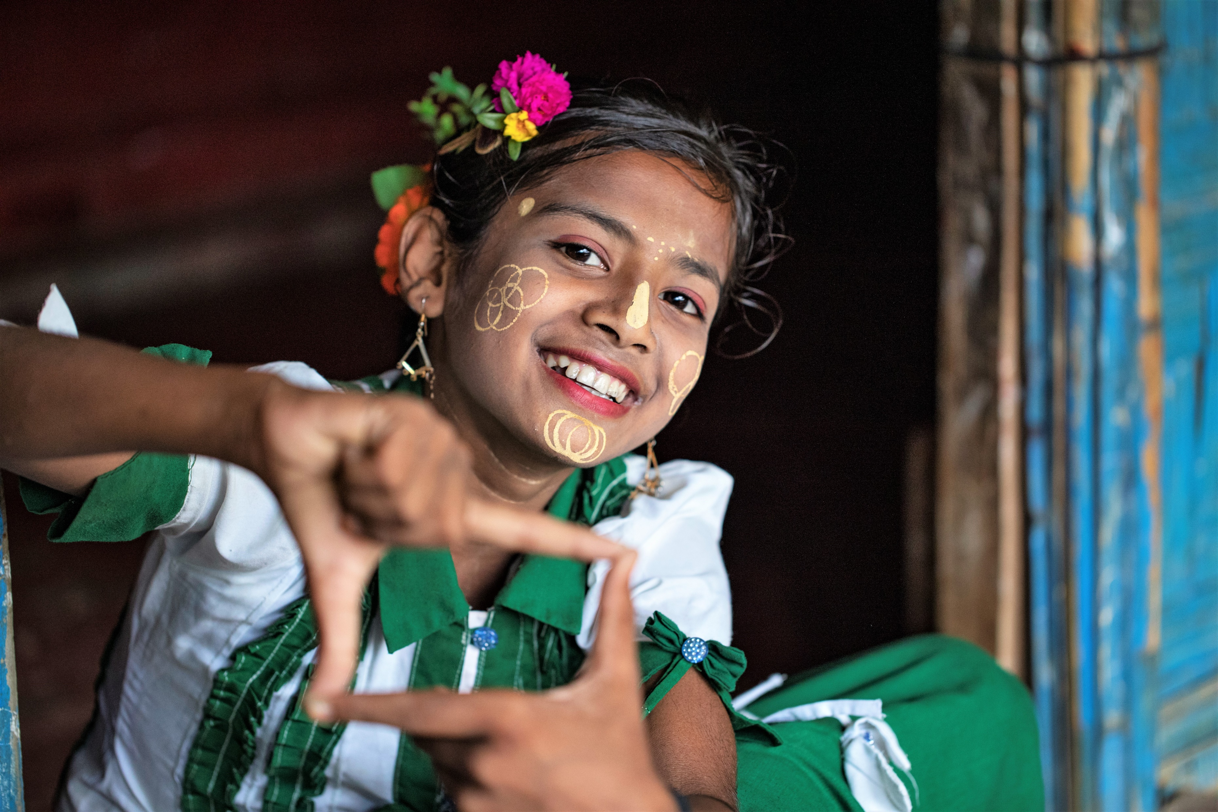
REFLECTION
Find someplace quiet and take a little time to think about the following prompts ….
Spend some time thinking again about what makes you proud to be the person you are.
How can you regularly remind yourself of these things?
What can you say to others to help them feel proud of themselves and who they are?
Think about what you could do if you ever hear or see racism at school or in your community.
How can you challenge this and be an ally to others?
UNICEF/UNI406810
Notes:
Umme Solima, 12, a Rohingya refugee girl stands in front of her home, posing for a portrait on 11 June, 2023 at a Rohingya refugee camp in Cox's Bazar, Bangladesh. Solima attended the One Minute's Jr. Workshop and learned how to film and edit videos from experts. In her one-minute film titled 'Preserving Our Tradition,' Solima showcases the rich tapestry of her community's vibrant heritage and culture.

Slide 11
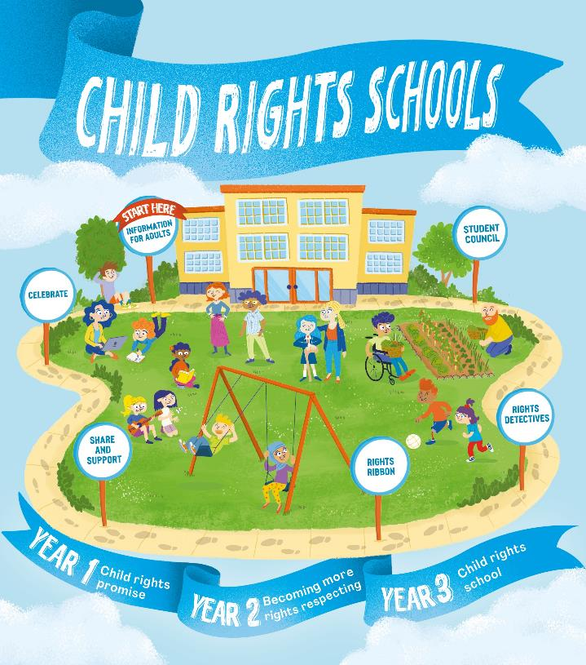

FURTHER CHILD RIGHTS EDUCATION SUPPORT
Child Rights Schools is a programme that supports you to embed child rights across the whole school community, including with parents and carers. Find our more here.
Find more classroom resources here.

Slide 12
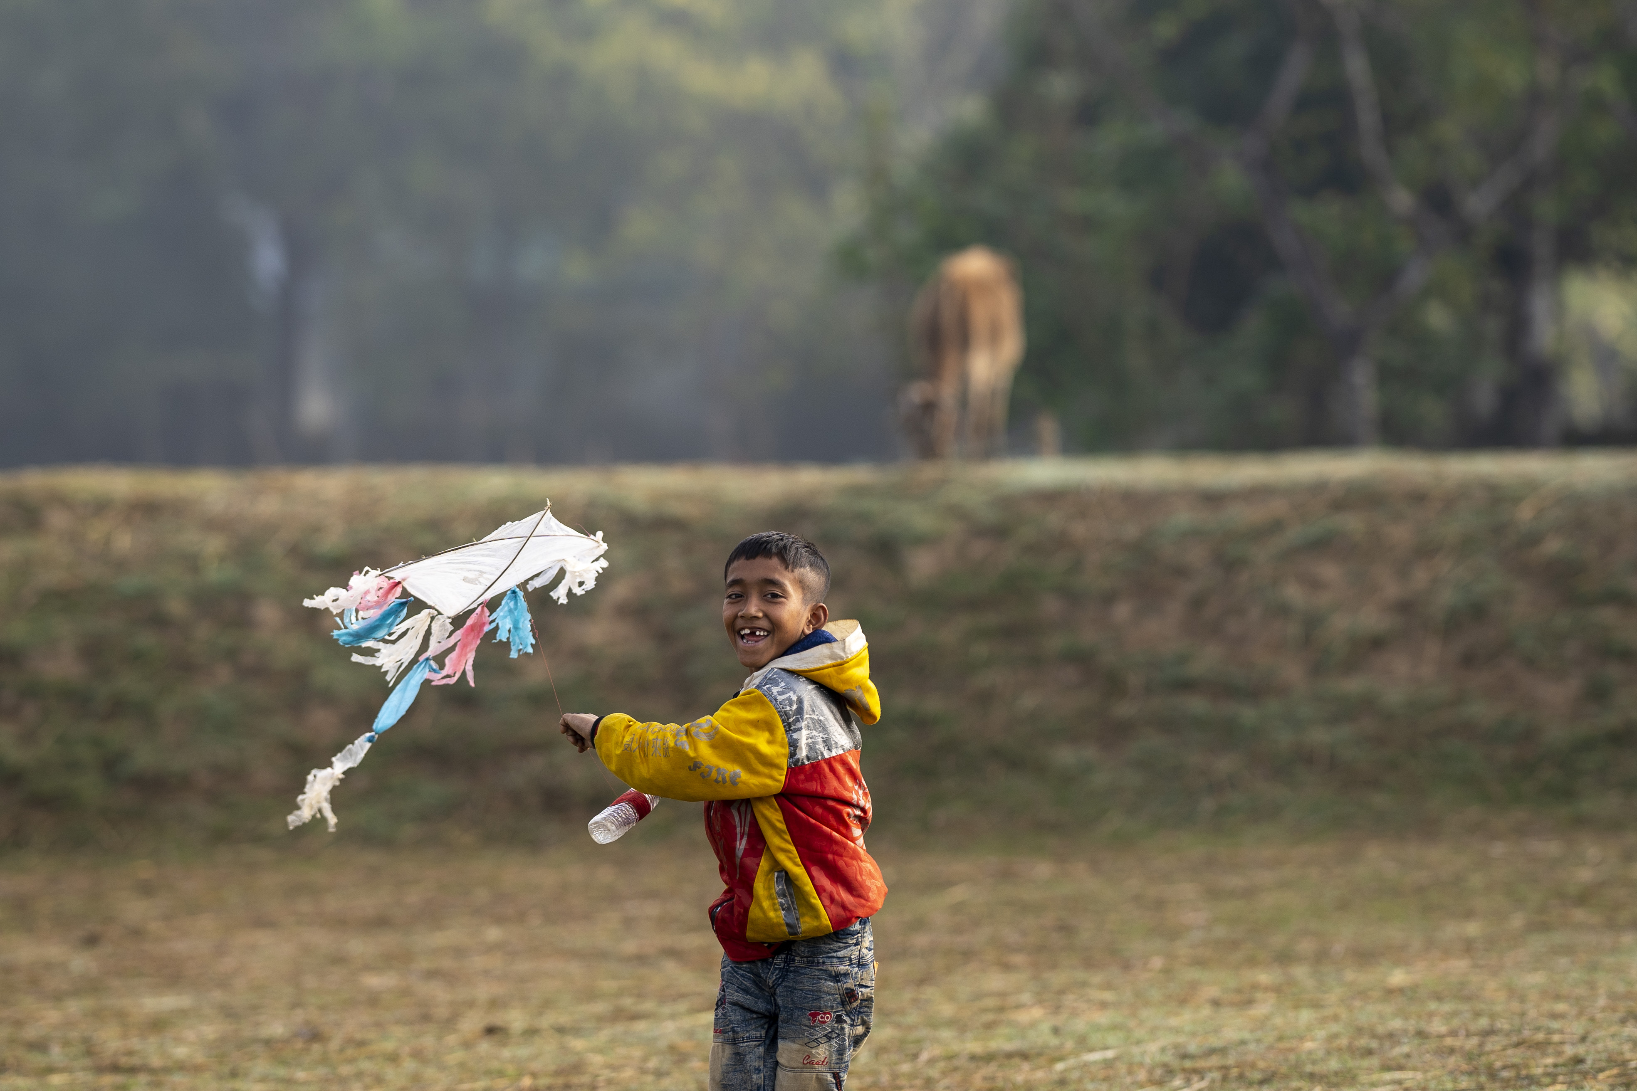

THANK YOU!
UNICEF/UNI463933
Notes:
Mohit (9) is flying a kite during a day at Mahtabpur, Balishjhuri, Tahirpur, Sunamganj, Sylhet. January 05, 2023.

