Slide 1
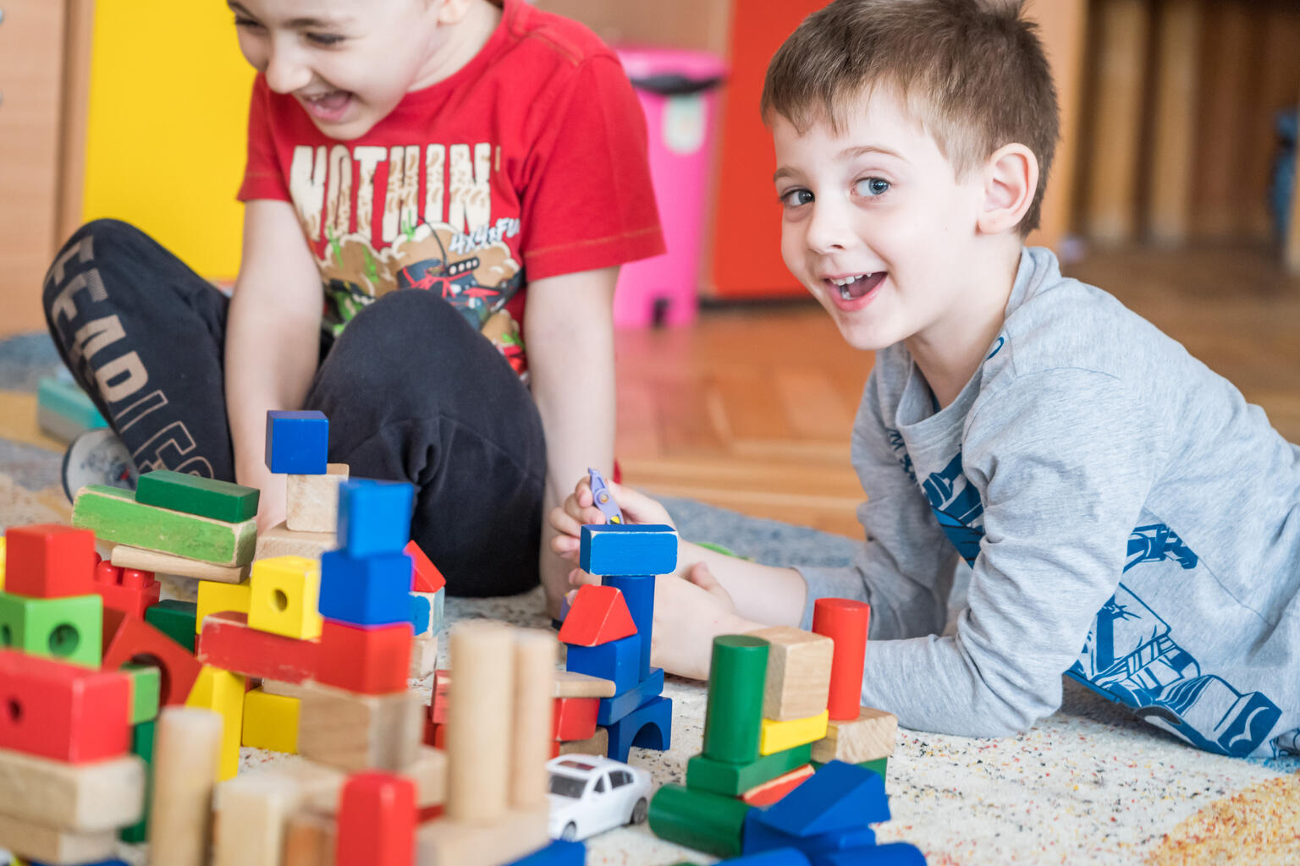

ARTICLE IN FOCUS
@UNICEF/Adrian Holerga

Slide 2
BEFORE YOU BEGIN
This is a flexible resource and is intended to provide you with some easy to use, appropriate rights-related learning to share with your children, their families and your colleagues.
Please edit out non relevant slides or activities before sharing with your students. Please check that the content works for your learners and feel free to adapt or add any content that would make the material more relevant for your setting.
This resource was developed by UNICEF UK and adapted by UNICEF Ireland.
Slide 3 – Guess the article
Slide 4 – Introducing Article 31
Slide 5 – Exploring Article 31
Slide 6 – Some possible answers
Slide 7 & 8 – Activities for the classroom
Slide 9 – Reflection
Slide 10 – Further Support

Slide 3
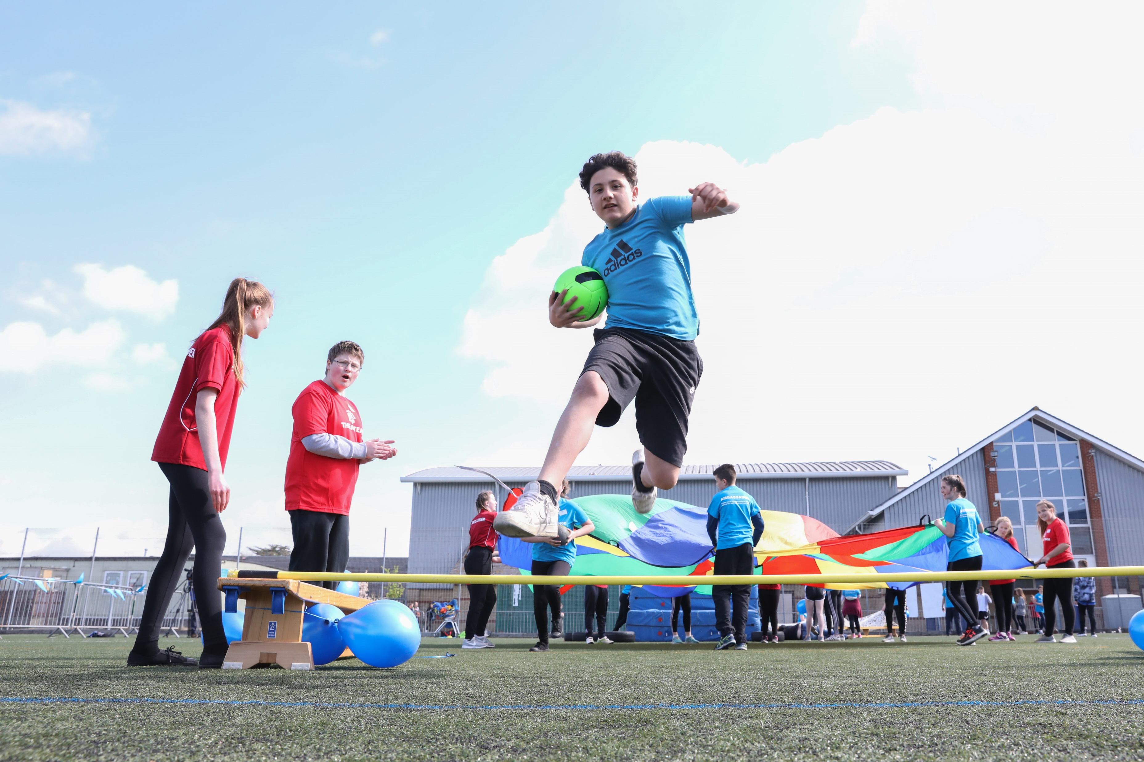
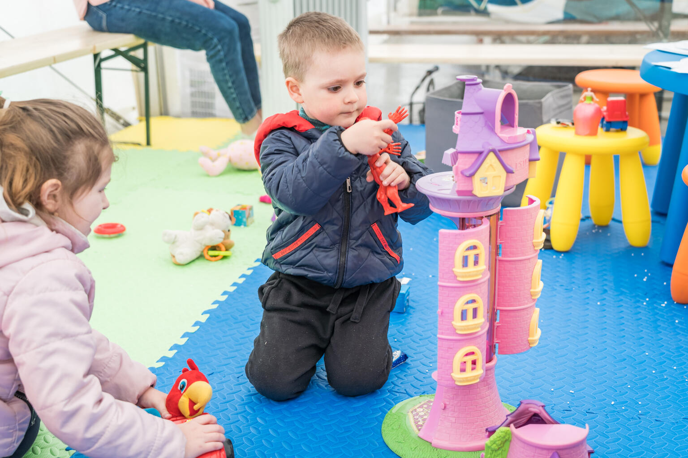
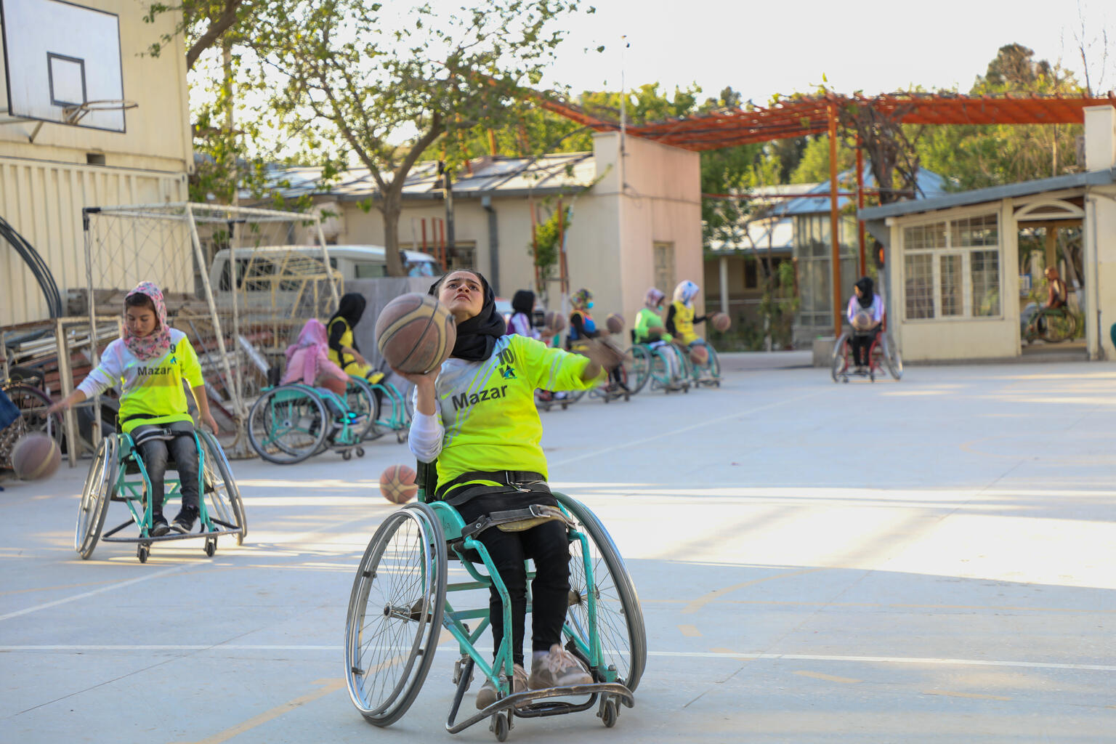
Guess the article
These pictures provide a clue to this week’s article.
Can you guess how they are linked together? Which article of the Convention do these pictures relate to?
Write down your thoughts or discuss with someone in your home.
©UNICEF/Dawe
@UNICEF/ Adrian Holerga
@UNICEF/ Azizullah Karimi

Slide 4

INTRODUCING ARTICLE 31
Article 31 Rest, play, culture, arts
Every child has the right to rest, relax, play and to take part in cultural and creative activities.

Slide 5
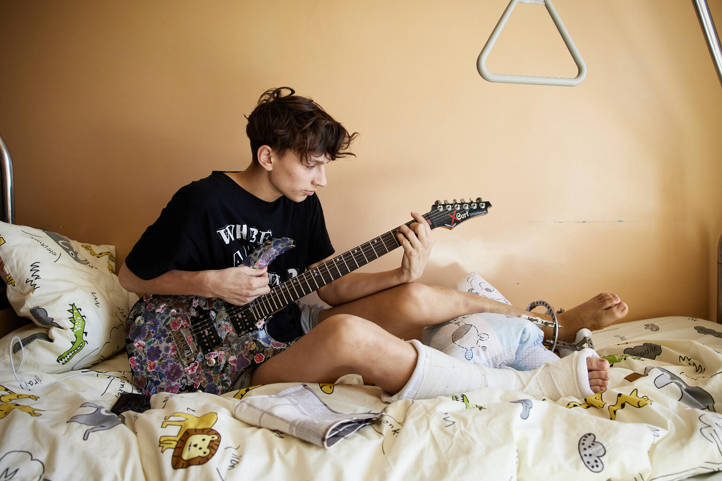
EXPLORING ARTICLE 31
Why do you think
play is important
for children?
@UNICEF/Viktor Moskaliuk

Slide 6
Did you think of these?
It’s good to have fun and relax.
Some play is good for exercise.
It can help you get on with people and make friends.
You might learn to take turns and to share.
It can help your education and learning.
It can help your mental health.
Play can help you to imagine and be creative.
It’s one of the rights children have.
What else did you think of?

Slide 7

ACTIVITIES FOR THE CLASSROOM
Watch and listen to The Things I love about Playtime. Discuss how you play in school. How do you help each other enjoy your right to play? Create a display of everyone enjoying their favourite way of playing.
Some people like to relax by dancing. Different cultures have different traditional dances. Do you know any? Why not try to learn a traditional dance with your class.
Make an Article 31 chill-out den in your classroom or playground where you can relax. Use cushions, blankets and even fairy lights. Take a picture of yourself relaxing in your chill out den and share it with your school community.

Slide 8
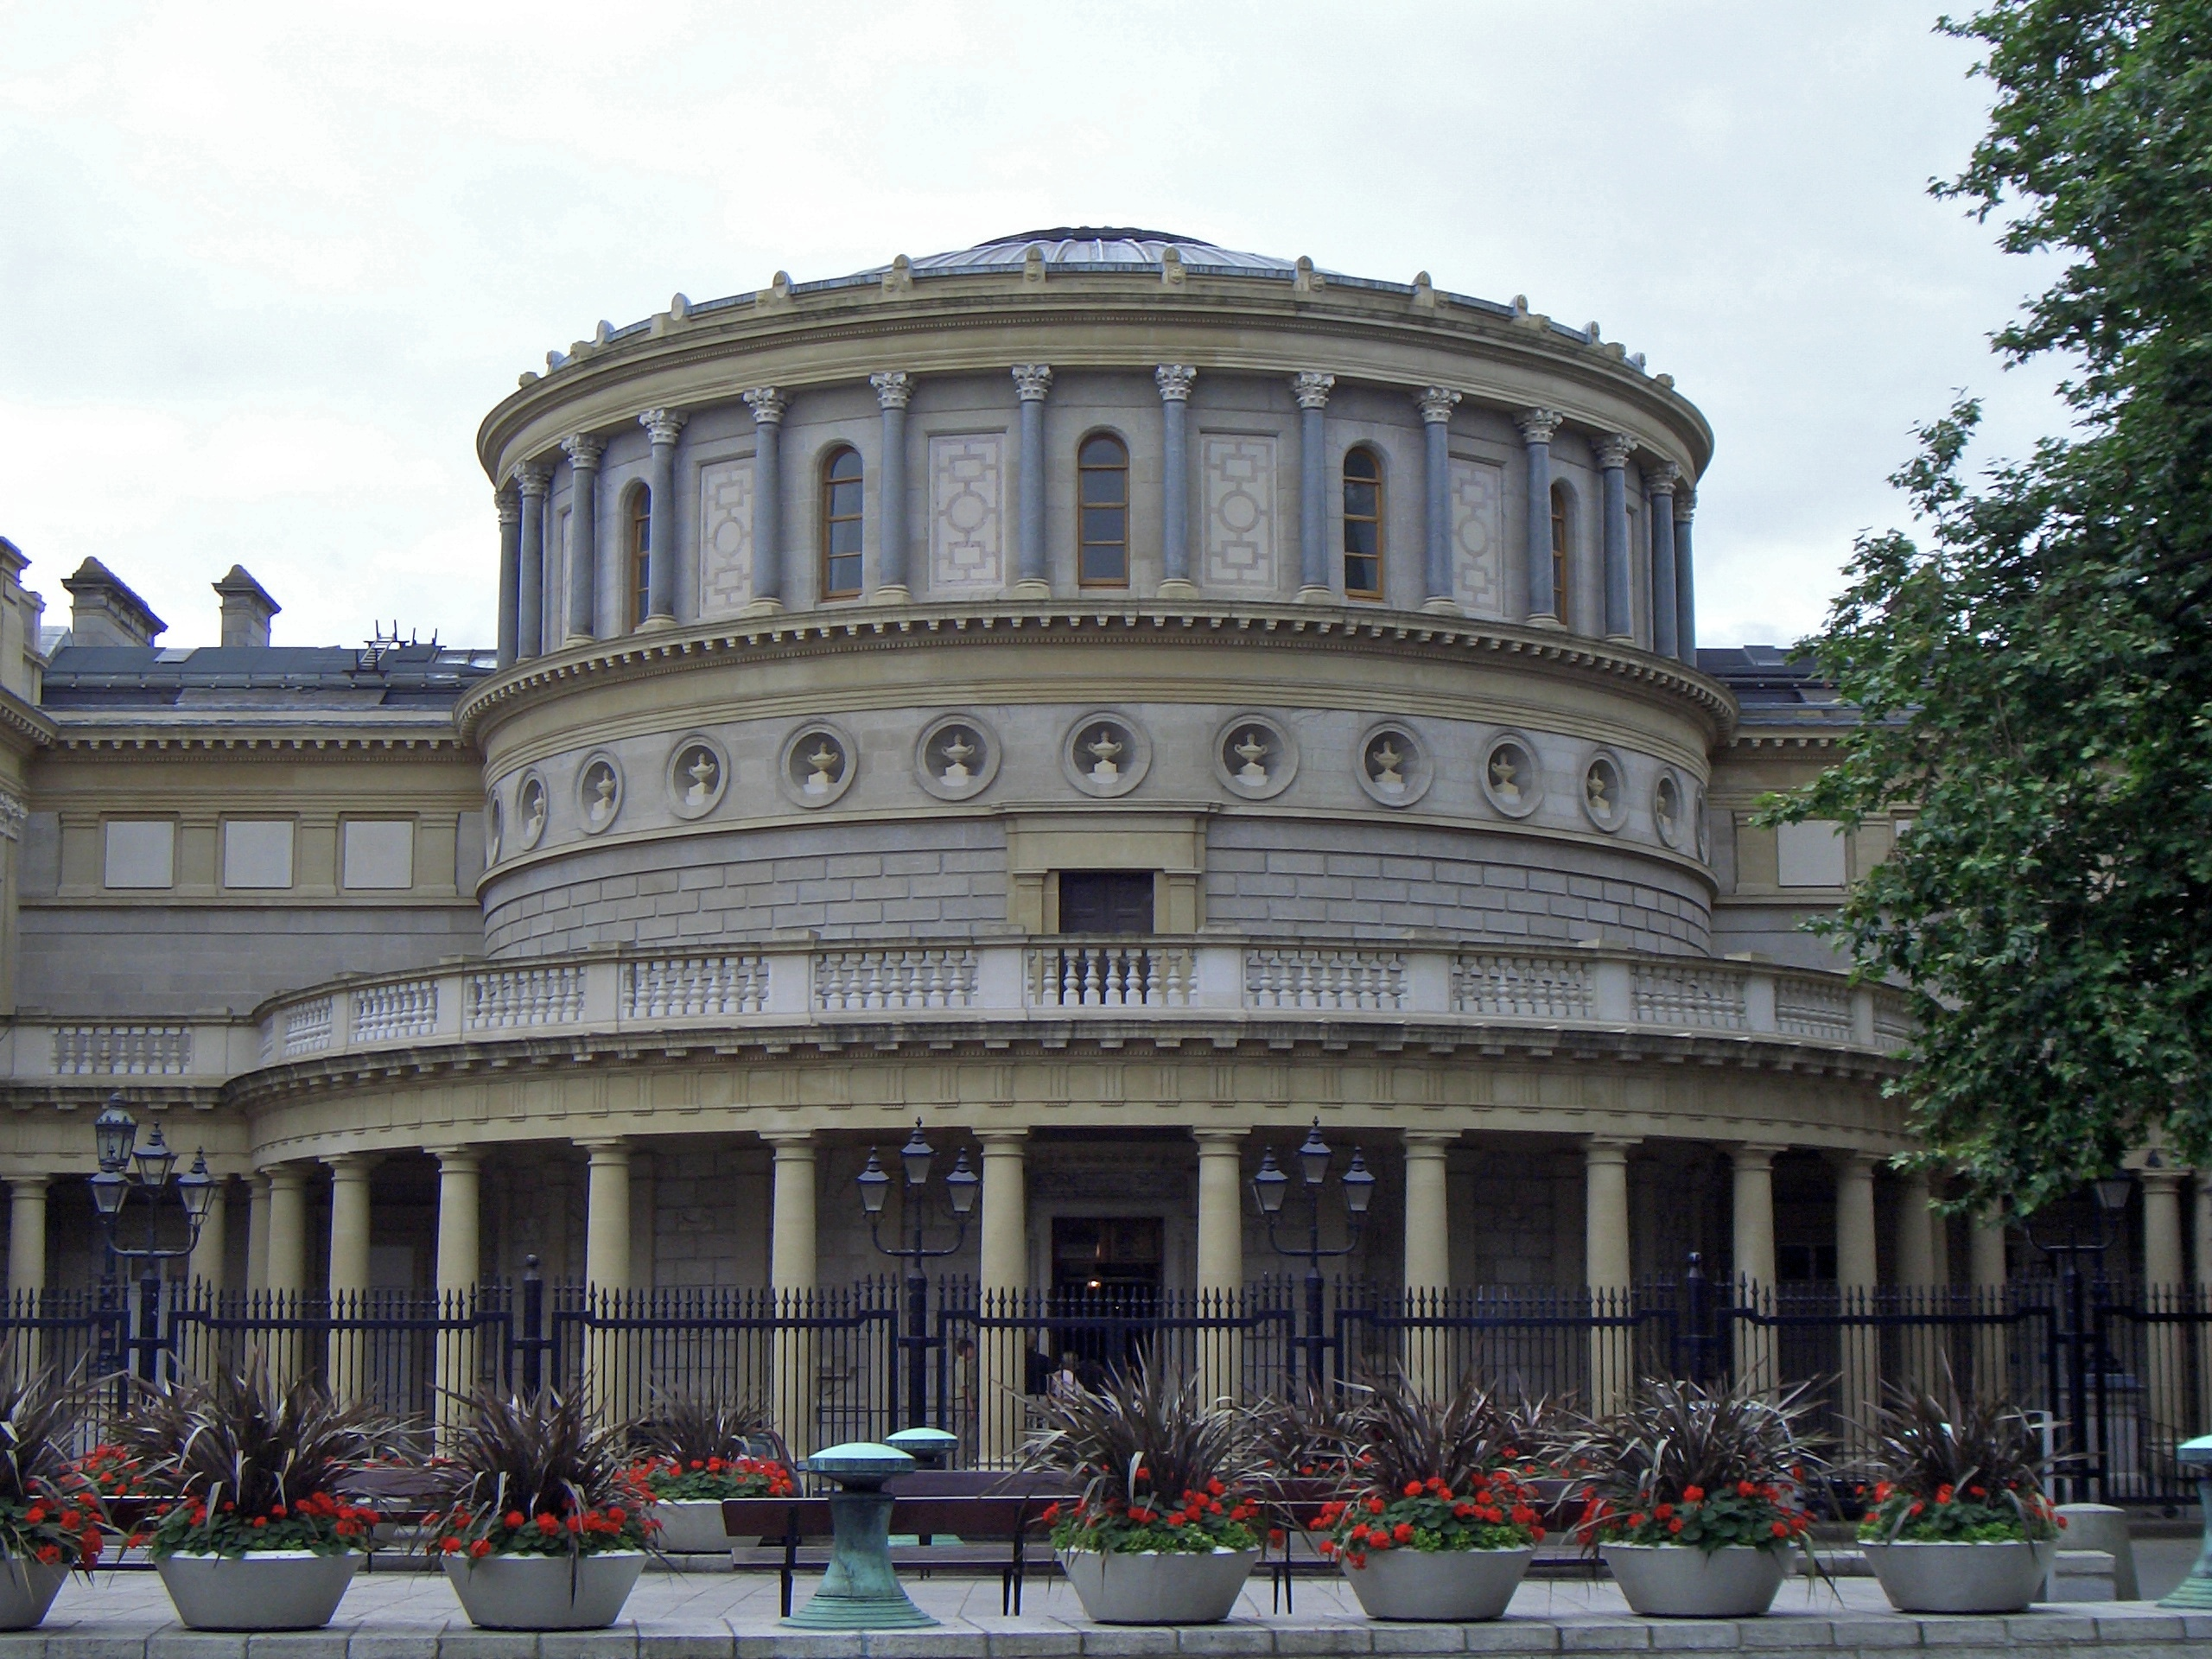
ACTIVITIES FOR THE CLASSROOM
Make a list of the clubs or activities your school runs at lunchtimes and after school. Is there something for everyone? Do you have a great idea for a new club? Think about how you could share your views about clubs at your school.
Sleep is really important for all children. What do you do to get to sleep at night? Do you like a special story, or have a special toy to cuddle? Talk about and compare your bedtime routines with your friends.
Lots of museums and galleries now have virtual tours so you can visit museums all over the world from your classroom or living room! Choose a museum and go on a virtual tour. Find out if your local museums or galleries have virtual tours.
.
Notes:
Photo: National museum of Ireland, Dublin

Slide 9
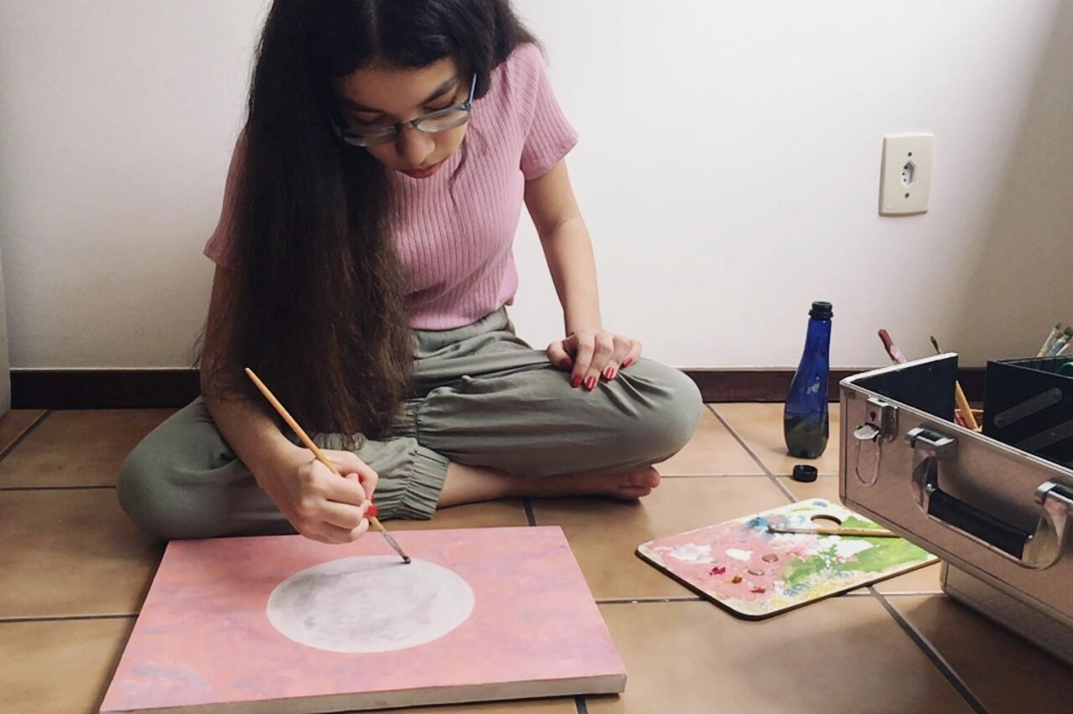
REFLECTION
Find somewhere peaceful and spend a few minutes being quiet and still. Think about …
All schools take holidays throughout the year. Why is having a break from school important?
Spend some time thinking about how you will make sure that you enjoy your right to rest, play and take part in cultural activities this weekend.
@UNICEF/ Mary Gelman / VII Photo

Slide 10
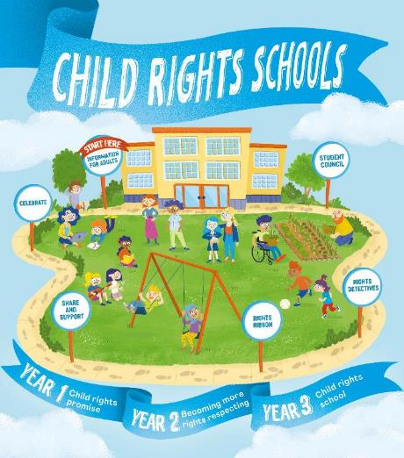

FURTHER CHILD RIGHTS EDUCATION SUPPORT
Child Rights Schools is a programme that supports you to embed child rights across the primary school.
Children are supported to express their views through the Student Council.
Find out more here.
Find more classroom resources here.

Slide 11

THANK YOU

