Slide 1
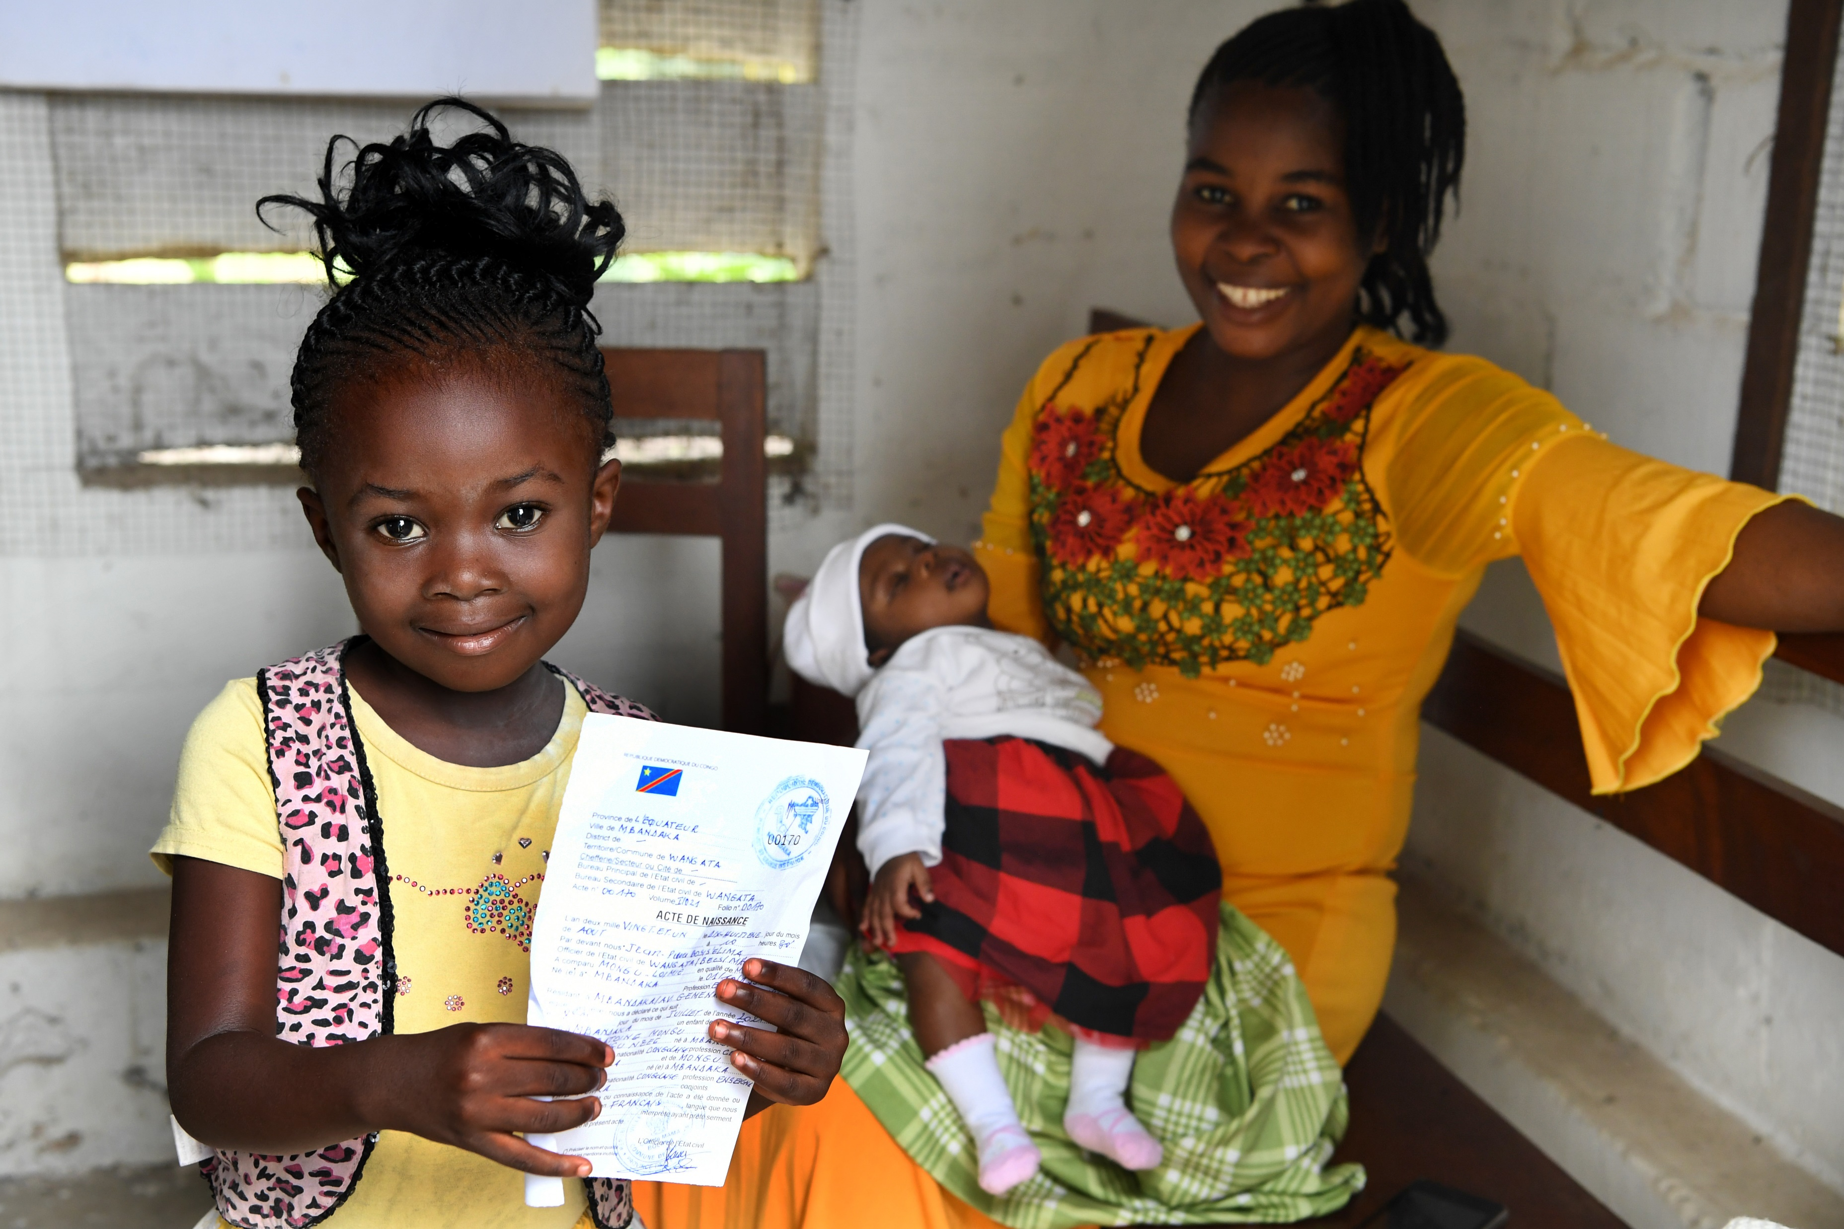

ARTICLE IN FOCUS
UN0507465/Dejongh
Notes:
Shekina, a 5 years old girl came with her mother to register her one month old little sister, in Mbandaka, the Equatorial Provence of the Democratic Republic of Congo.

Slide 2
BEFORE YOU BEGIN
This is a flexible resource and is intended to provide you with some easy to use, appropriate rights-related learning to share with your children, their families and your colleagues.
Please edit out non relevant slides or activities before sharing with your students. Please check that the content works for your learners and feel free to adapt or add any content that would make the material more relevant for your setting.
This resource was developed by UNICEF UK and adapted by UNICEF Ireland.
Slide 3 – Guess the article
Slide 4 – Introducing Article 7
Slide 5 – Exploring Article 7
Slide 6 – Some possible answers
Slide 7 & 8 – Activities for the classroom
Slide 9 – Reflection
Slide 10 - Extension
Slide 11 – Further Support

Slide 3
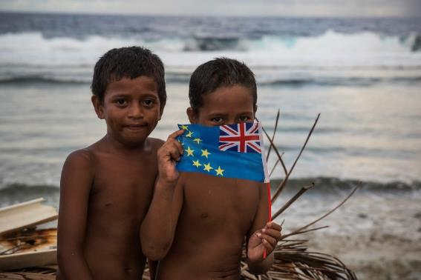
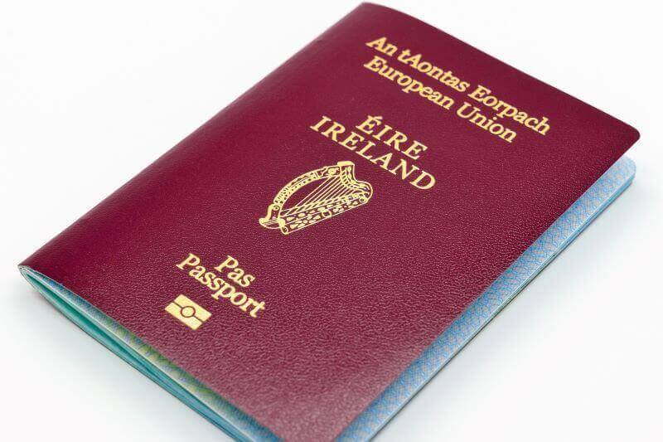
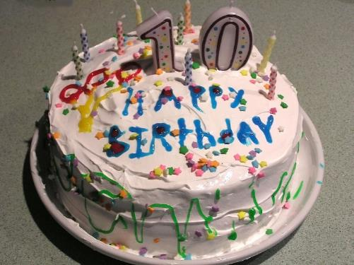
Guess the article
These pictures provide a clue to this week’s article.
How do these pictures help you? Can you guess how they are linked together?
UNICEF/Sokhin
Wikimedia commons
Wikimedia commons

Slide 4

INTRODUCING ARTICLE 7
Children must be registered when they are born and given a name which is officially recognized by the government.
Children must have a nationality (belong to a country).
Whenever possible, children should know their parents and be looked after by them.

Slide 5
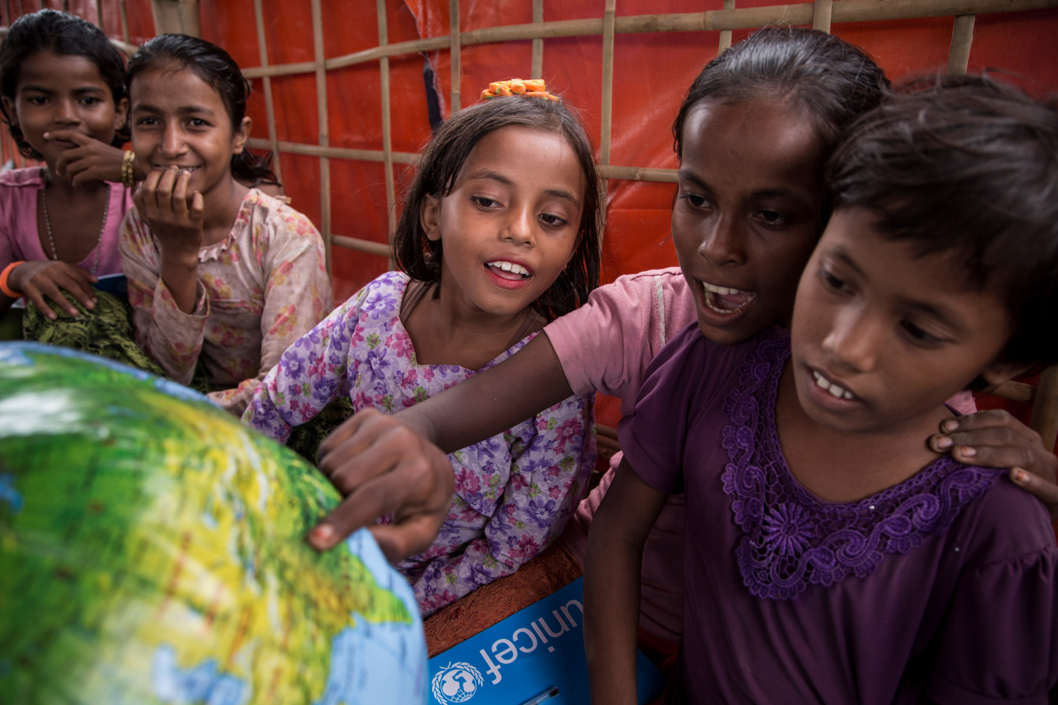
EXPLORING ARTICLE 7
What things need to happen for your name and nationality to be respected?
What would help you?
What should adults do?
Write them down and compare your answers with the next slide.
UN0141031/LeMoyne
Notes:
Students look at an inflatable globe, part of the educational supplies contained in a School-in-a-Box, at a new Transitional Learning Centre in the Uchiprang refugee camp, near Cox's Bazar, Bangladesh, Saturday 21 October 2017. The Transitional Learning Centre is equipped with a School-in-a-Box kit and Early Childhood Development (ECD) kit.

Slide 6
DID YOU INCLUDE ANY OF THESE?
By being called your preferred name (shortened or in full)
Your name being pronounced properly and spelt correctly
A birth certificate
A passport (if you need to travel out of Ireland)
You are encouraged to be proud of your name and nationality
You get a chance to celebrate your national identity perhaps with a special day, food or music
To know and be cared for by your parents - it might be two parents, or it might be one parent. It could also be another adult in your family such as a grandparent, aunt or uncle. It could also be a carer that is not a family member but is an adult who looks after you.

Slide 7

ACTIVITIES FOR THE CLASSROOM
Read the ‘Here we are’ by Oliver Jeffers. Share your questions about the world and think about how we can look after the world around us so that we can all survive and thrive.
Read The Name Jar or watch the video and think about whether you respect other children’s names.
Have you ever been to a naming and welcoming ceremony, like a christening or aqiqa? Ask your family if you had one. Write a short description of what happened. Find out about naming ceremonies from other faiths or cultures.
Ask your family about your name. Talk to your friends or family about their names. Do you know if they have a middle name? Do they like their names? Do the names tell you anything about their culture? Imagine if someone decided you had to have a new name, without your agreement. How would you feel? Write down your thoughts.
Create a sign with your name on – this could be with paper and pen, paint or a collage with indoor or outdoor materials. Can you write an acrostic poem with your name and words that describe you?

Slide 8
ACTIVITIES FOR THE CLASSROOM
Do you celebrate the day you were born? Draw a picture of a memorable birthday. Create a bar chart to show the most popular birthday month amongst your friends.
Why do you think it is important to be registered at birth?
A coat of arms of a family, town or organisation is a special design in the form of a shield that they use as a symbol of their identity. Design your own coat of arms with things that represent your identity - perhaps the things you like to do such as hobbies or sports.
What is your nationality? Do you know what the national flag looks like? Look at other flags, pick a favourite and find out which country it belongs to. Talk to your family about how you celebrate your nationality. Perhaps through days like St Patrick’s Day, St George’s Day or Chinese New Year?
Conduct a survey of the different nationalities in your school and create a display of all the national flags.

Slide 9
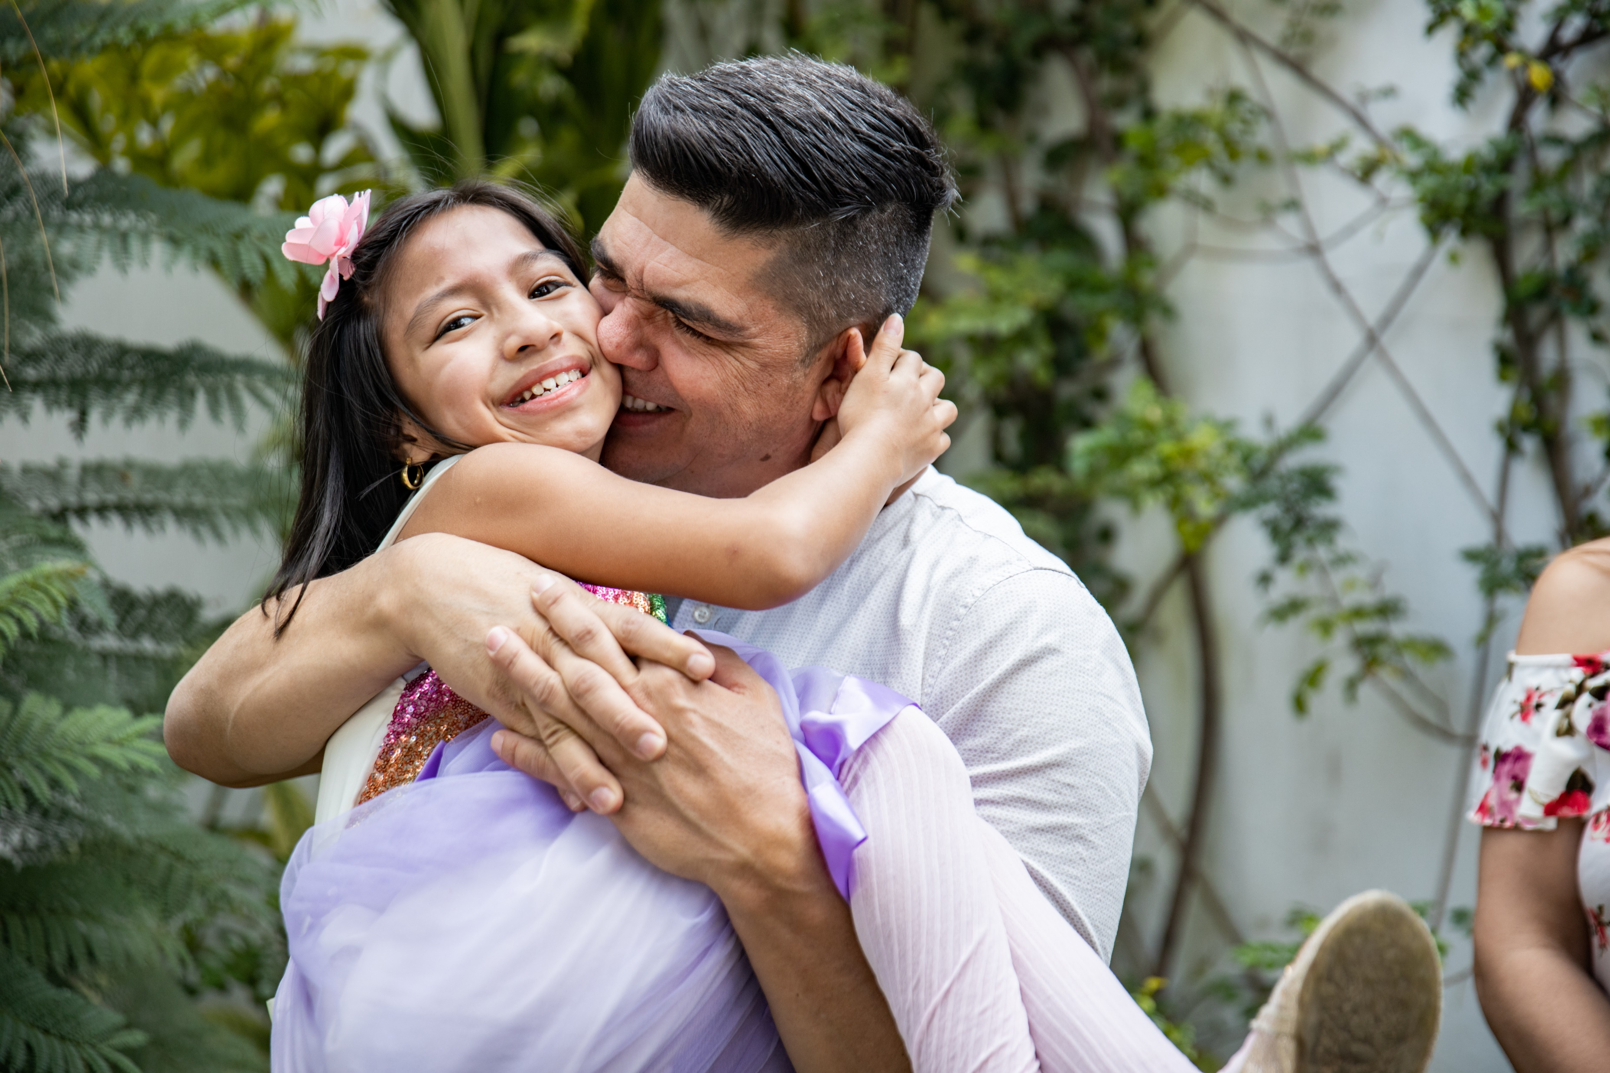
REFLECTION
Find somewhere peaceful and spend a few minutes being quiet and still. Then think about these questions…
Who are you - your name, your nationality, the people who care for you?
Do you always show respect for the right to a name and nationality in your life at home or school?
How does your school protect this right?
What could you do today to show respect for this right?
Why is this right important to you? How does it help you?
UN0582645/Wilocq
Notes:
Samuel Menendez Rivera (45 pars old) hugs his daughter Jenifer (11 years old) in a front of their house in Quetzaltenango, Guatemala.

Slide 10
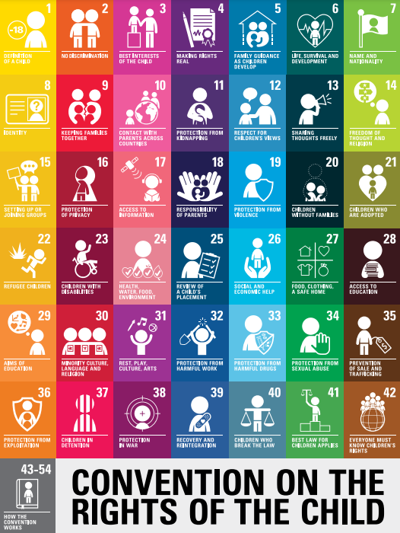
EXTENSION
Are there other articles from the CRC that relate to name and nationality– can you explain?
Rights are universal – all children have rights regardless of nationality. Do all children of all nationalities get to enjoy their rights in every country? If not, why not?
You can find a summary of the Convention here.

Slide 11
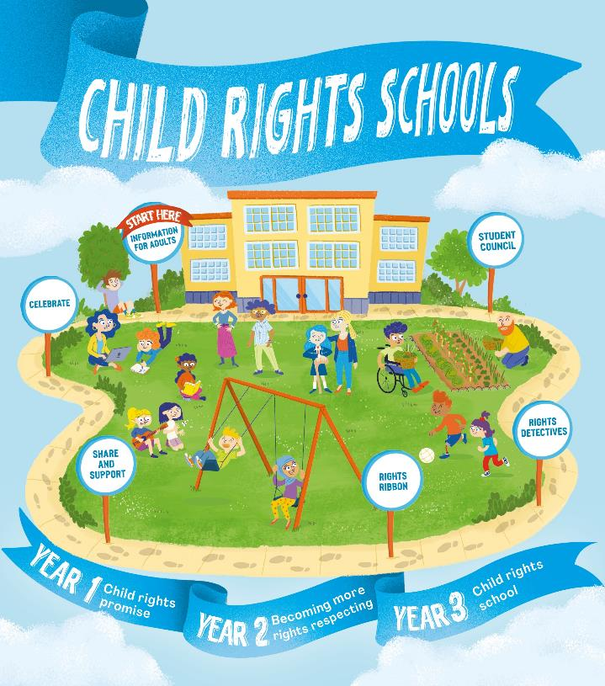

FURTHER CHILD RIGHTS EDUCATION SUPPORT
Child Rights Schools is a programme that supports you to embed child rights across the primary school. Find our more here.
Find more classroom resources here.

Slide 12


THANK YOU

