Slide 1
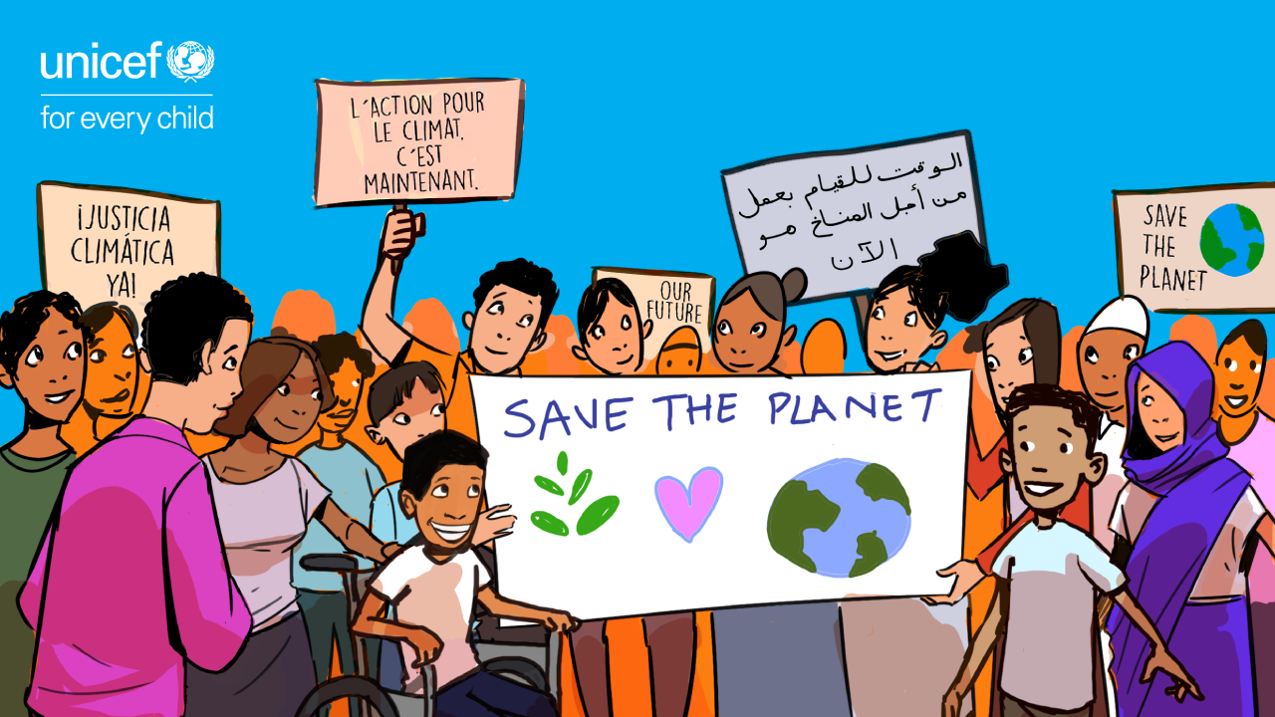
UNICEF/ UN0444599

Slide 2

BEFORE YOU BEGIN
This is a flexible resource and is intended to provide you with some easy to use, appropriate rights-related learning to share with your children, their families and your colleagues.
Please edit out non relevant slides or activities before sharing with your students. Please check that the content works for your learners and feel free to adapt or add any content that would make the material more relevant for your setting.
This resource was developed by UNICEF UK and adapted by UNICEF Ireland.
Slide 3 – Introducing Earth Day
Slide 4 – Exploring Earth Day
Slide 5 – Some possible answer
Slide 6 & 7 – Activities for the classroom
Slide 8 – Reflection
Slide 9 & 10 – Additional Resources
Slide 11– Further Support

Slide 3

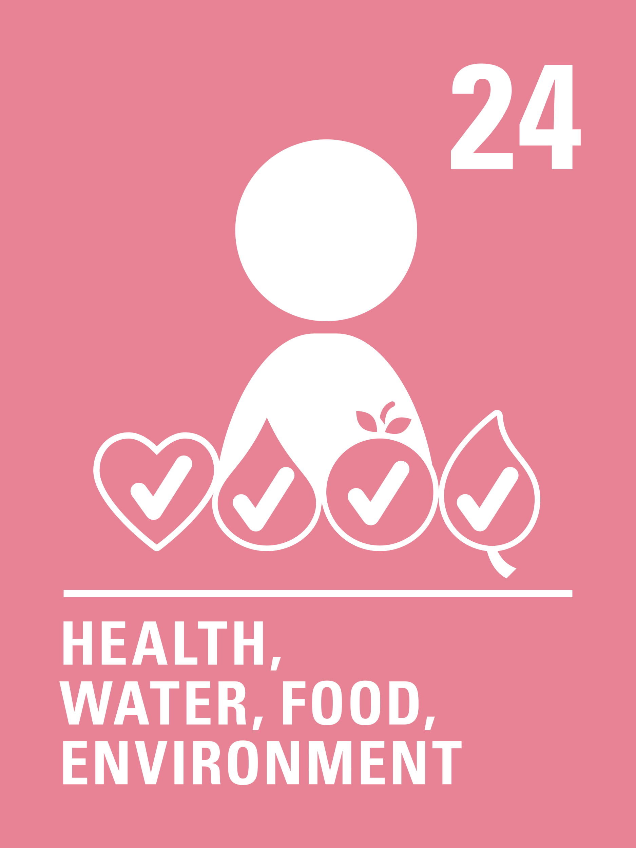
Introducing Earth Day
Earth Day, 22 April
Earth Day takes place every year on April 22 to show support for the protection of the environment and our planet. It was first held on April 22, 1970, in the United Stated of America. More than 1 billion people around the world now participate in Earth Day activities each year.
This year’s theme is Invest In Our Planet, encouraging everyone to take action and come together in partnership for our planet.
UNCRC Articles that closely connect with Earth Day include Article 6 (life, survival and development) and Article 24 (health, water, food, environment).
Notes:
Article 6 (life, survival and development): Every child has the right to life. Governments must do all they can to ensure that children survive and develop to their full potential.
Article 24 (health and health services): Every child has the right to the best possible health. Governments must provide good quality health care, clean water, nutritious food, and a clean environment and education on health and well-being so that children can stay healthy. Richer countries must help poorer countries achieve this.

Slide 4
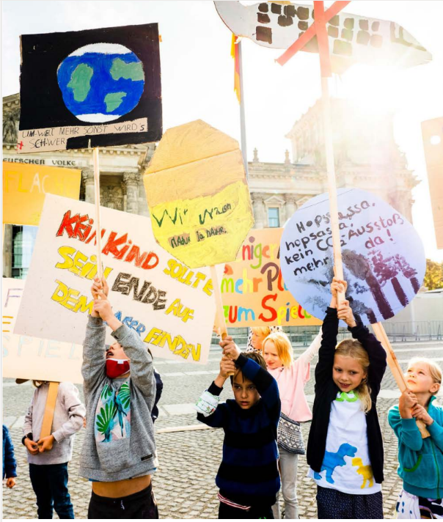
EXPLORING EARTH DAY
What do you, your school and your family do that helps the environment and the planet?
List as many answers as you can
and then compare your thoughts with the next slide
UNICEF/UNI372155/Zimmermann
Notes:
Emma, 5 years old, from Odessa, Ukraine, plays with UNICEF staff at the
Blue Dot safe space in Isaccea bord crossing in Romania, where she arrived
with her mother, Yulia, and her little brother.
UNICEF is setting up Blue Dot across Romania and the region, which are
dedicated refugee children and family support hubs and represent an
integrated model that provides support for the most immediate needs of
children and women

Slide 5
DID YOU INCLUDE ANY OF THESE?
Recycle
Litter picking
Buy local to reduce food miles
Turn off lights, TV etc when not in use
Walk to school
Donate clothes and toys that are still in good condition
Use a ‘bag for life’
Don’t waste water
Use a reusable water bottle
Plant trees/rewild areas
Write letters to your local TD/companies in the area to ask them to protect the local environment
Did you think of anything else?

Slide 6
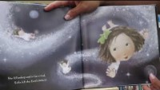
ACTIVITIES FOR THE CLASSROOM
This activity is part of Global citizenship resources developed by Dreamachine and UNICEF UK. Find out more here.
Think about your local area. Are there any issues or challenges to the environment – air pollution, litter, lack of green spaces? Vote on which is most important and agree a plan to raise awareness of the issue in school and the community.
Watch this clip of the book The Girl Who Spoke to the Moon by Land Wilson. Discuss the importance of looking after the natural world. What do you value about our environment? How are we going to look after it?
Celebrate all the great things you are already doing in school or at home to protect the environment. Create a display to showcase these things.

Slide 7
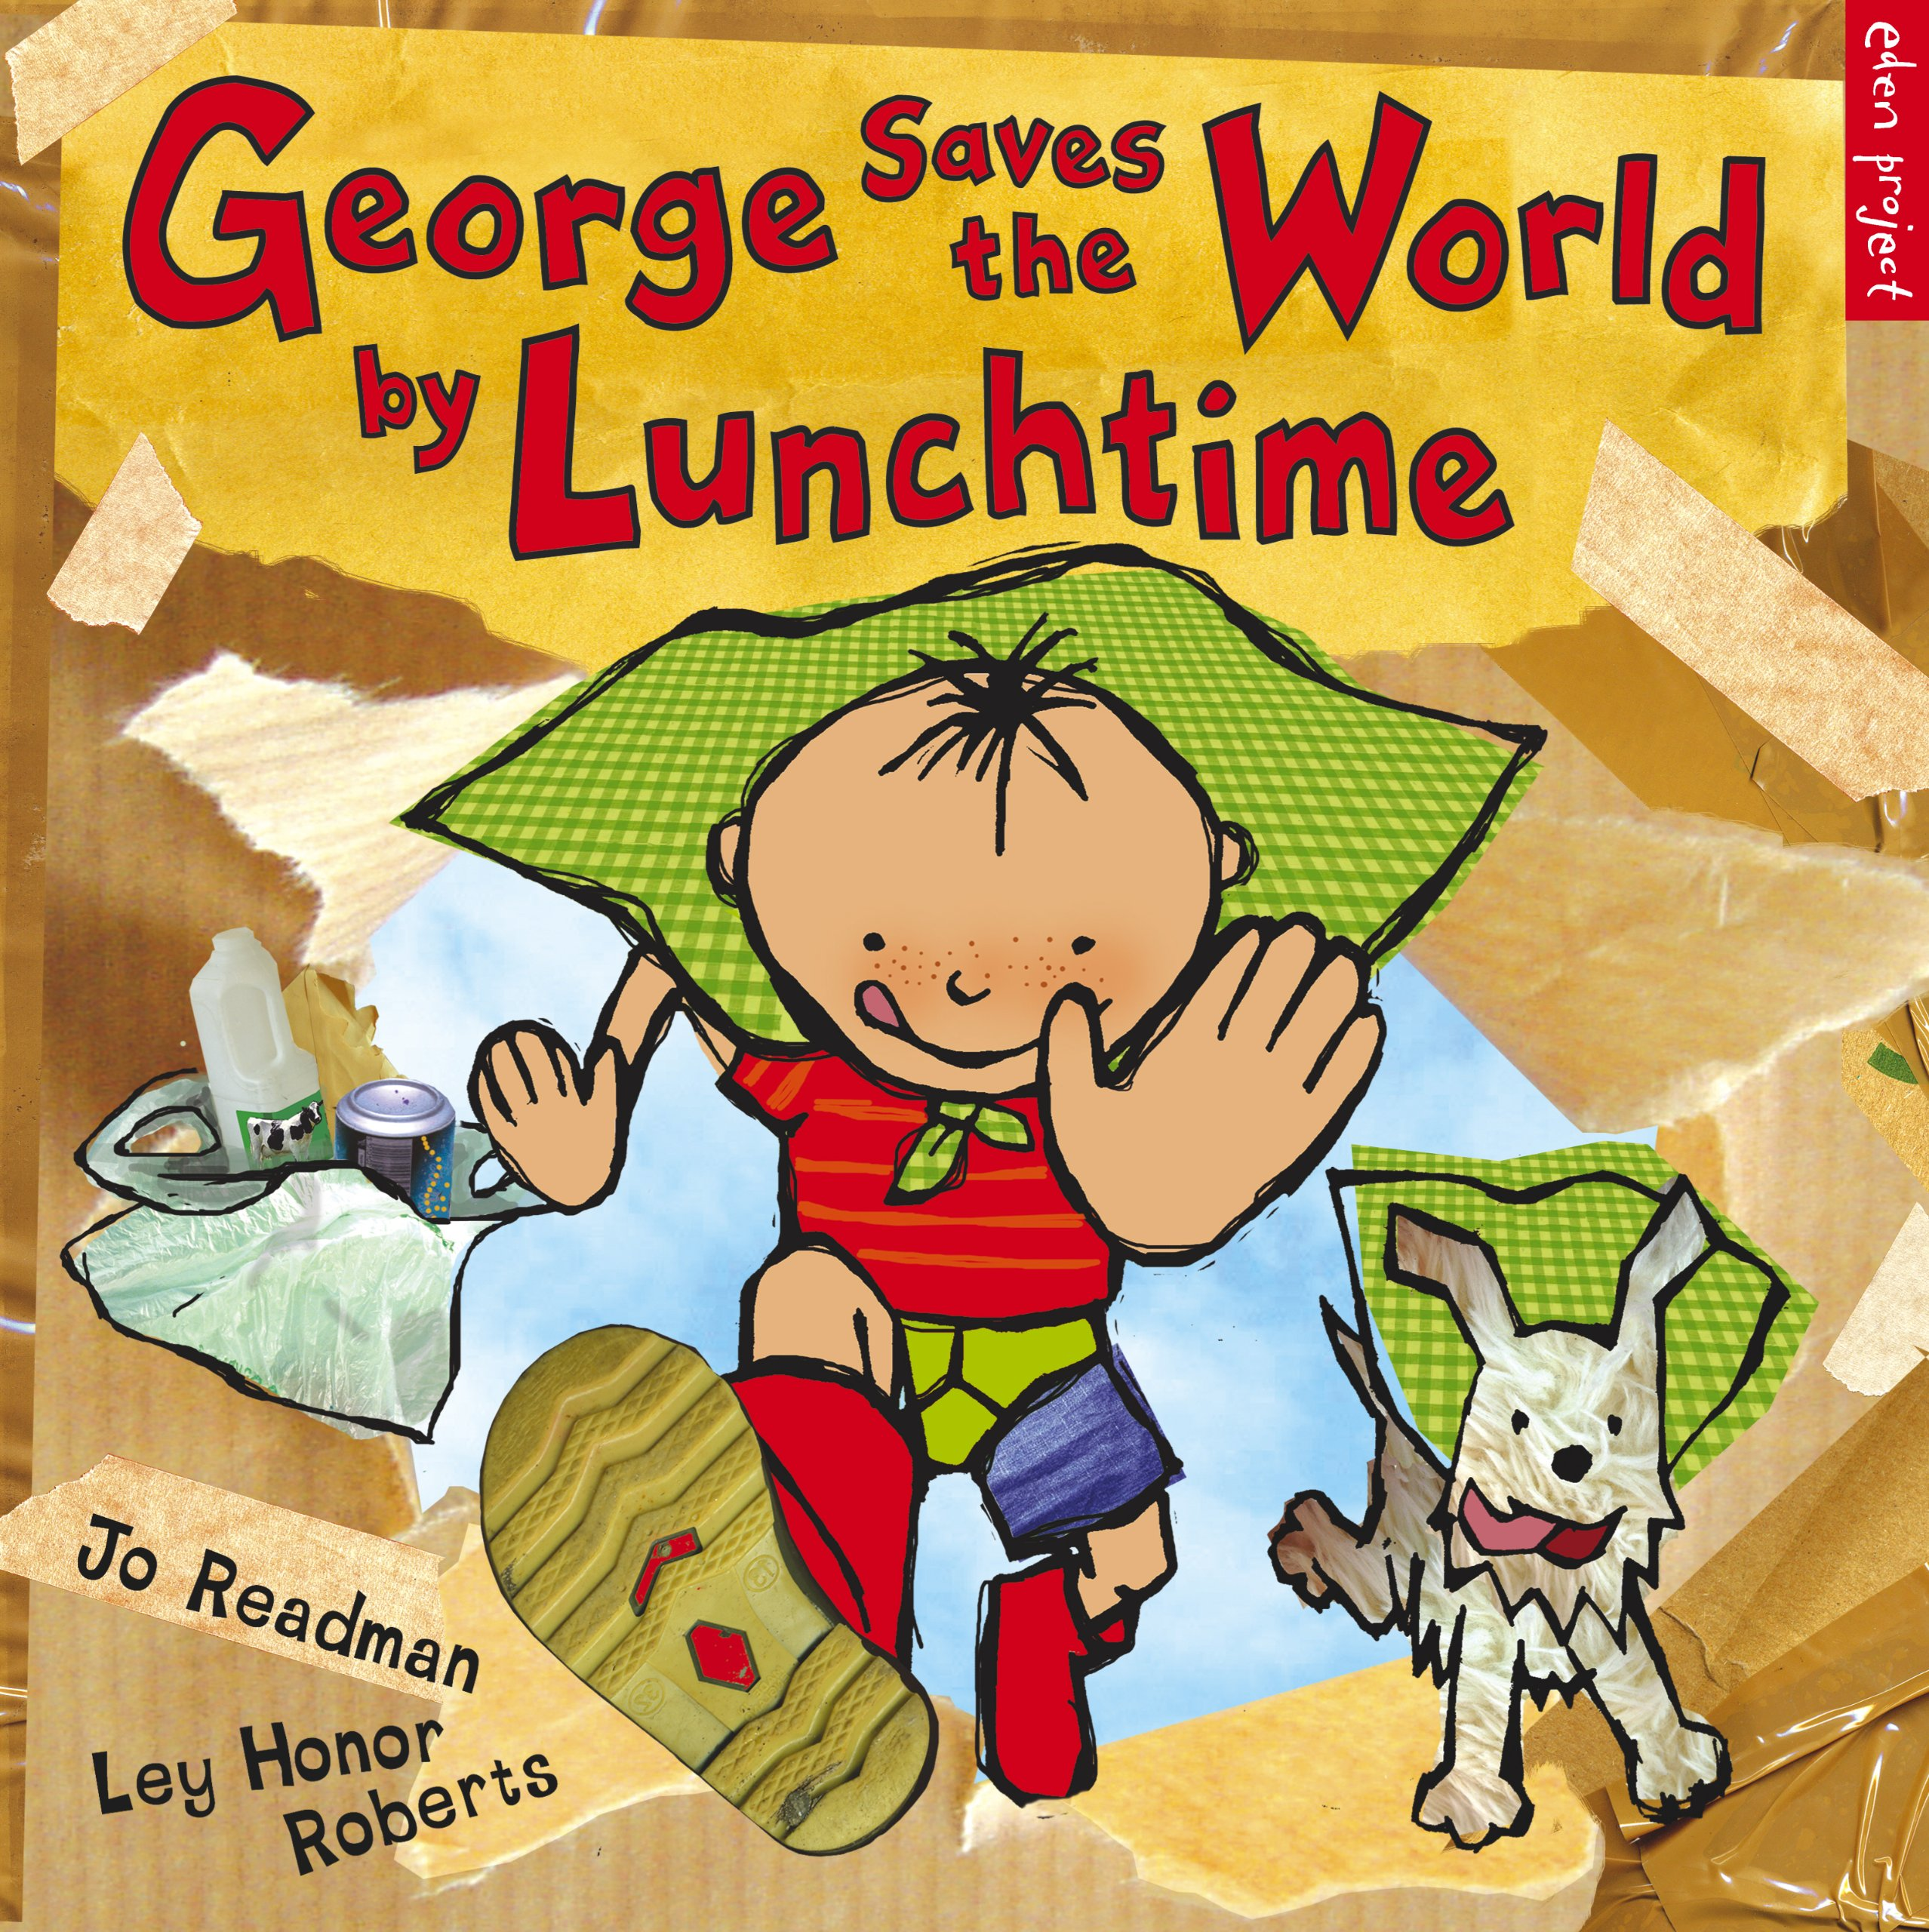
ACTIVITIES FOR THE CLASSROOM
Take a look at the Earth Day Website. Write an article for your school newsletter or create a video to ask as many families as possible to participate in Earth Day 2023. Explain why this is important and how this links to children’s rights and your work as a Child Rights School.
“For us, every day is Earth Day.”
Why would people say this? Discuss with your friends. If you feel the same, check out these 52 actions and tips to make a difference. Discuss and choose one to implement in your school and one for home.
Read or listen to George Saves the World by Lunchtime. Discuss what you have learnt and as a class make a pledge to do one good thing for the planet.

Slide 8
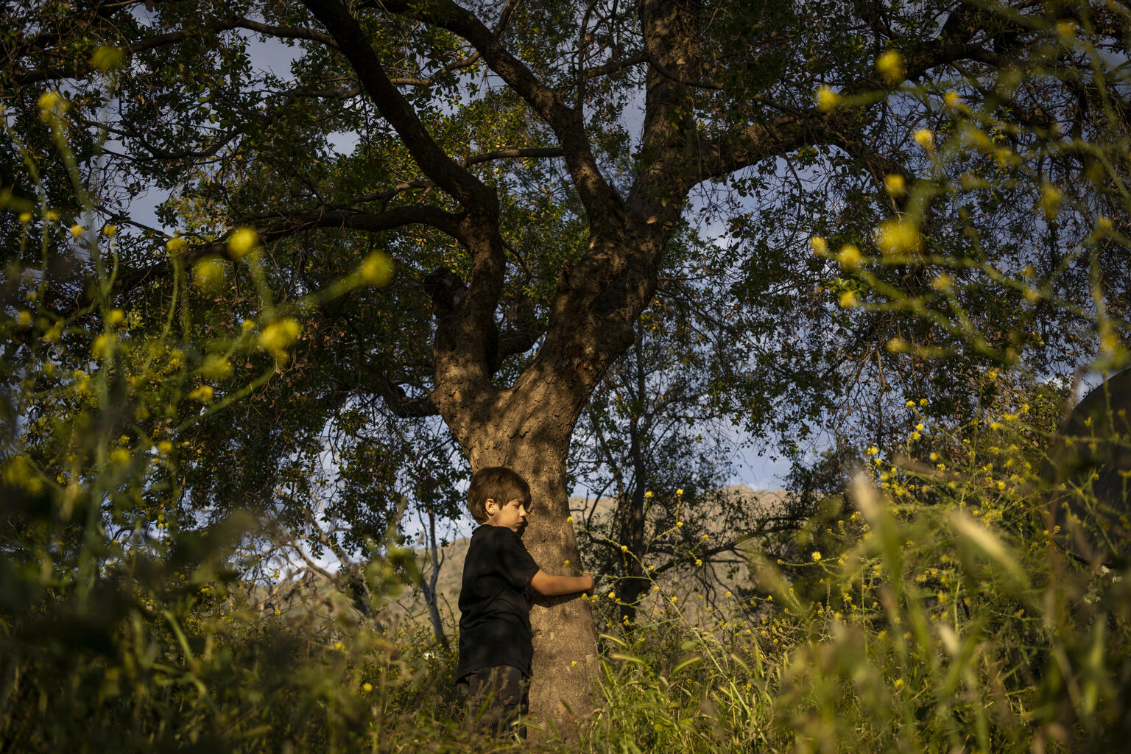
REFLECTION
Take a few minutes and find some space to be quiet and to think... If you can, go outside, look out of a window or put some images of earth and the environment on a screen...
Why is our planet special to you? What do you value most about the environment?
How can upholding everyone’s rights help protect the planet?
How will you ‘celebrate’ Earth Day this year?
How can you encourage positive environmental action with friends, neighbours and family members?
@UNICEF/UN0364082

Slide 9
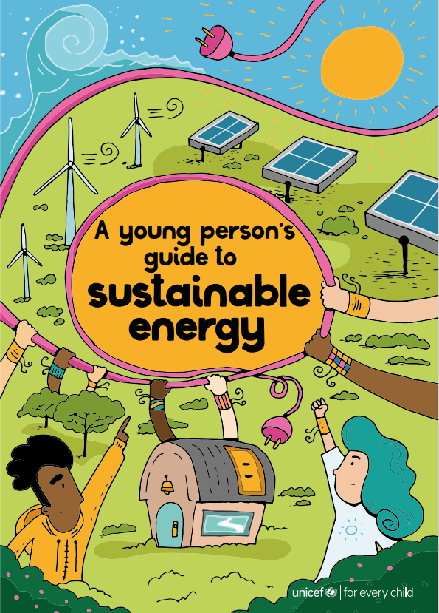
More REsources
Want to discuss renewable energy in the classroom?
Check out UNICEF’s “A young person’s guide to sustainable energy”

Slide 10

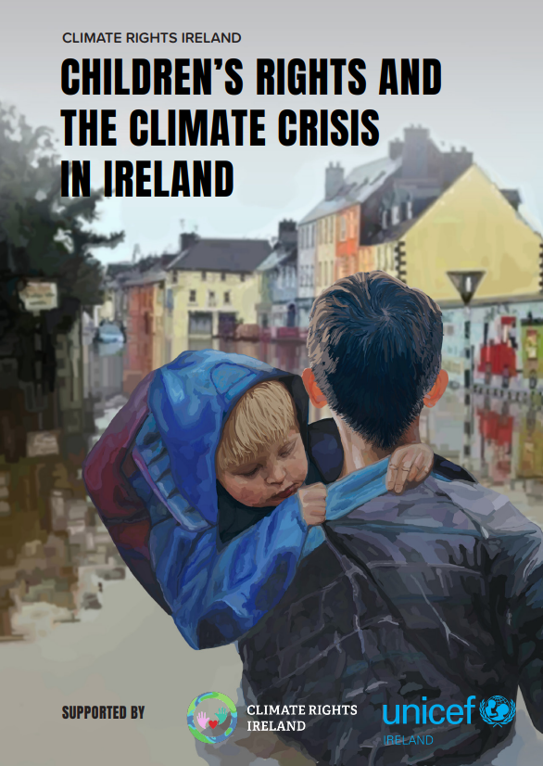



Learn more about Climate Change and Children’s Rights
Read Climate Rights Ireland’s report to learn about how the climate crisis is impacting on:

Slide 11
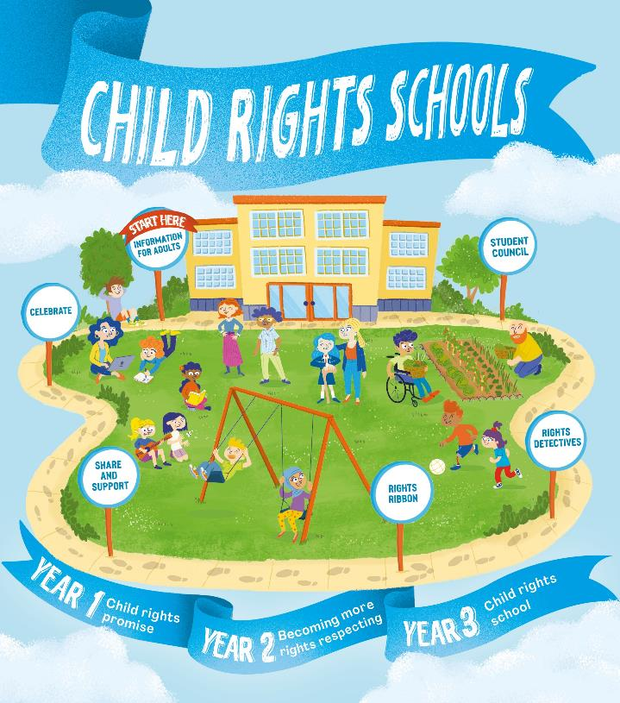

FURTHER CHILD RIGHTS EDUCATION SUPPORT
Child Rights Schools is a programme that supports you to embed child rights across the primary school. Find our more here.
Find more classroom resources here.

Slide 12


THANK YOU

