Slide 1

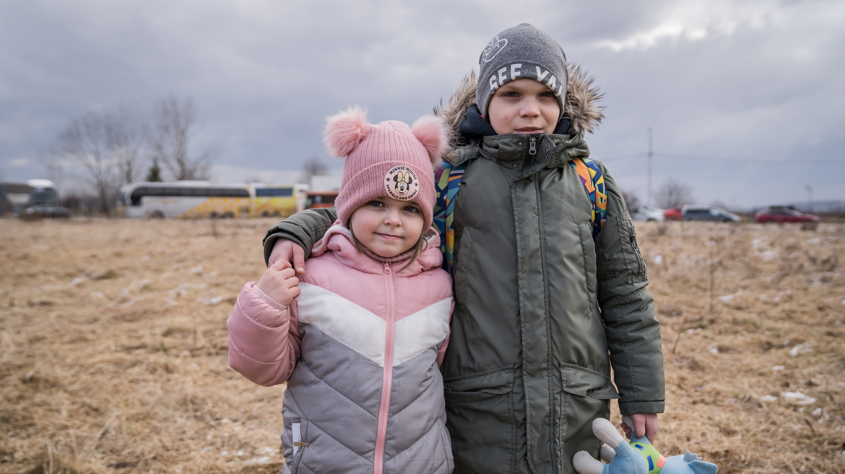
DISCUSSING CONFLICT AND WAR WITH CHILDREN

Slide 2
BEFORE YOU BEGIN
This is a flexible resource and is intended to provide you with some easy to use, appropriate rights-related learning to share with your children, their families and your colleagues.
Please edit out non relevant slides or activities before sharing with your students. Please check that the content works for your learners and feel free to adapt or add any content that would make the material more relevant for your setting.
This resource was developed by UNICEF UK and adapted by UNICEF Ireland.

Slide 3
GUIDANCE FOR TEACHERS
Does your class already have an agreement for working together respectfully, or do you need to agree some ground rules especially for this work?
Have an open dialogue with your pupils. Actively encourage them to share their own perspectives and ideas. Be receptive to verbal and non-verbal cues that show children have been moved emotionally. Click here for useful tips. ­
Make time to stress that you understand pupils may be upset and confused when thinking about what is happening in Ukraine, and remind them of the people and places offering support to children within and outside of their school.
Underline the fact that the CRC states the best interests of the child must always be a primary consideration, and the world has a longstanding commitment to put children first. All children must receive the care, respect and protection to which they are entitled, no matter who they are and where they are from. ­It is a sad fact that over the years and in so many places there have been and continue to be situations when duty bearers fail to do all they can for children. The world is not perfect but by having the CRC we can see when rights are not being accessed and children and those who care for them can speak up for their rights.
Consistently emphasise that human rights are a collective promise made by all countries of the world, including those currently in conflict. This promise can be summarised as everyone being able to enjoy a safe, happy and fulfilling life, where their dignity and worth is equally valued. You can also emphasise that the international system of refugee protection is founded on the principle of every country helping fellow human beings in times of need. It is a mutual system.

Slide 4
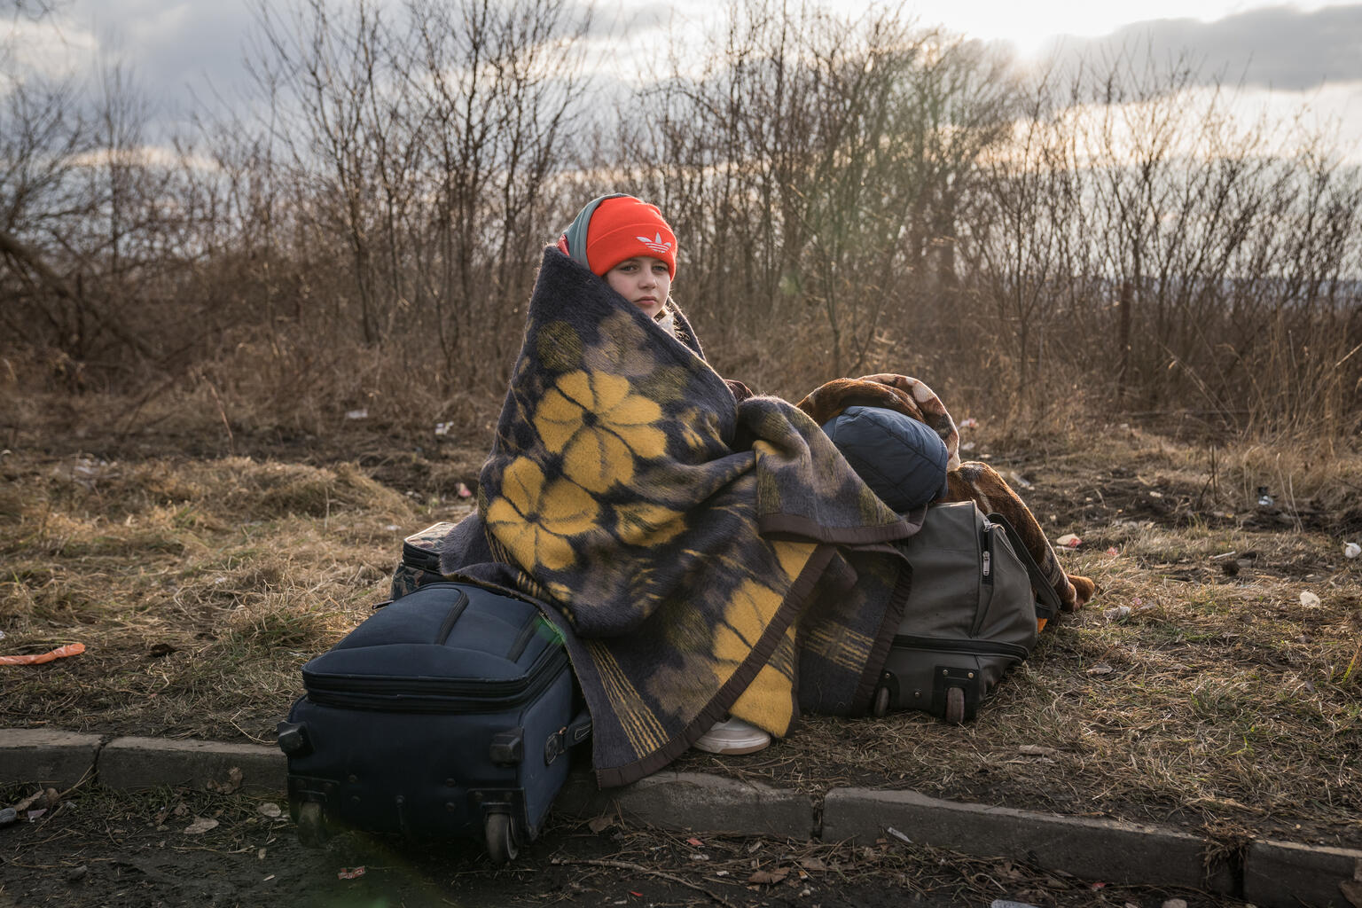
EXPLORING ARTICLES 38 & 39 OF THE CONVENTION
Can you think about why children should be protected from wars?
UN0599229

Slide 5
INTRODUCING ARTICLES 38 & 39
Article 38 (war and armed conflicts): Governments must not allow children under the age of 15 to take part in war or join the armed forces. Governments must do everything they can to protect and care for children affected by war and armed conflicts.
Article 39 (recovery from trauma and reintegration): Children who have experienced neglect, abuse, exploitation, torture or who are victims of war must receive special support to help them recover their health, dignity, self-respect and social life.

Slide 6
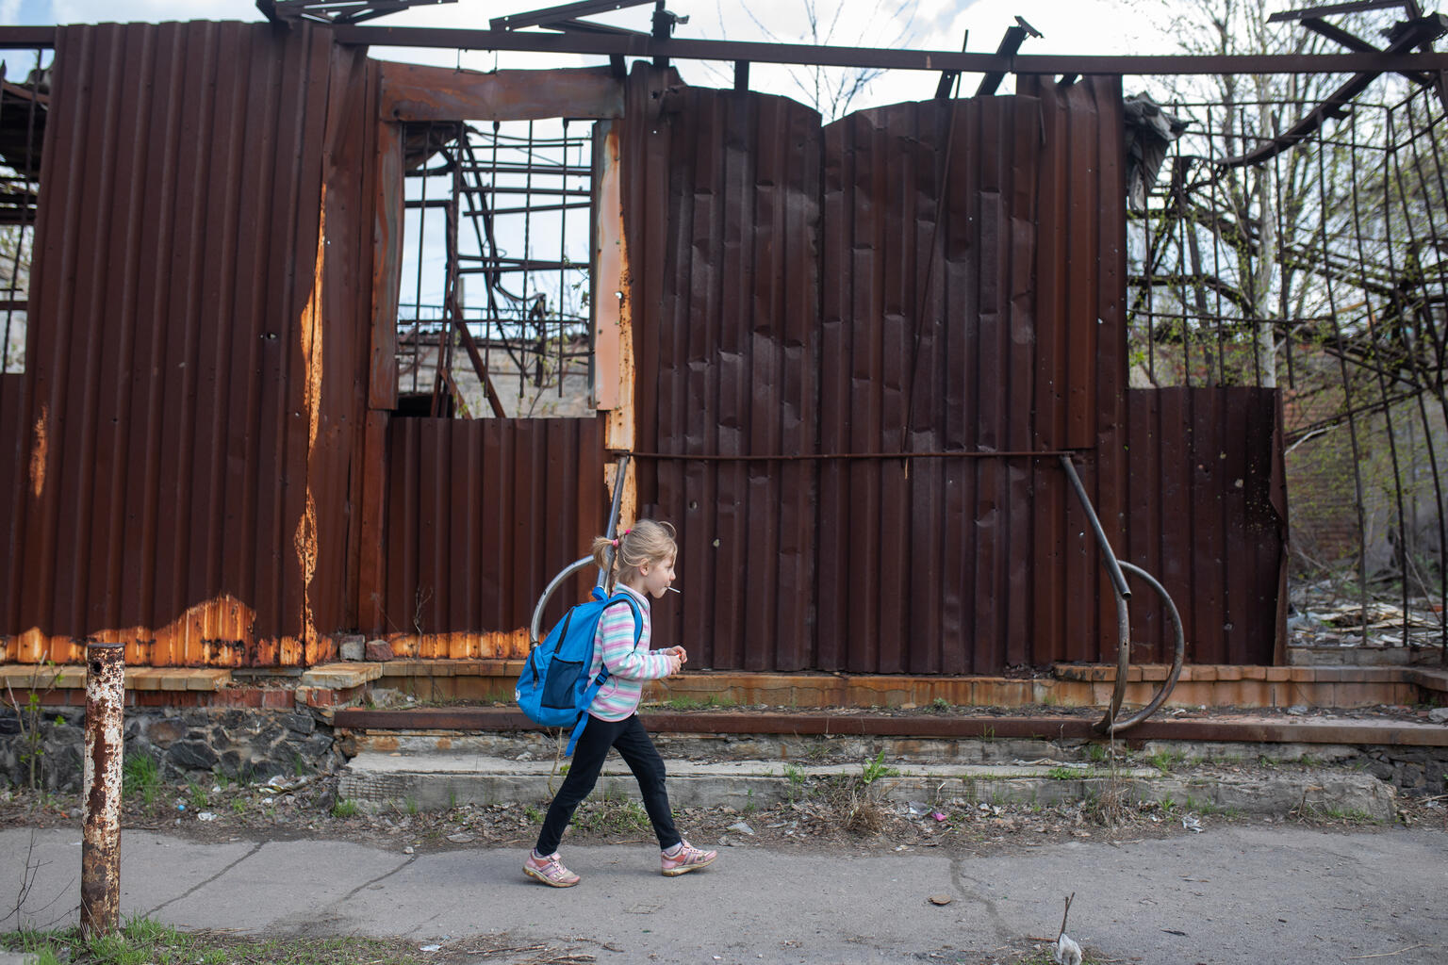
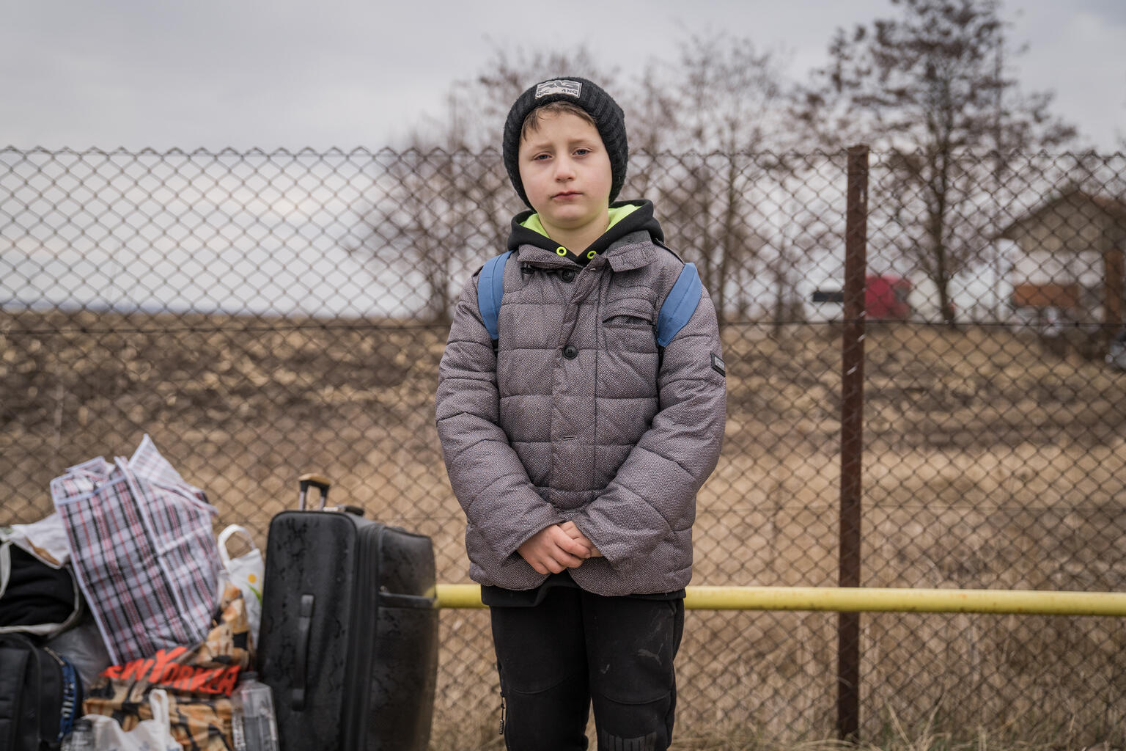
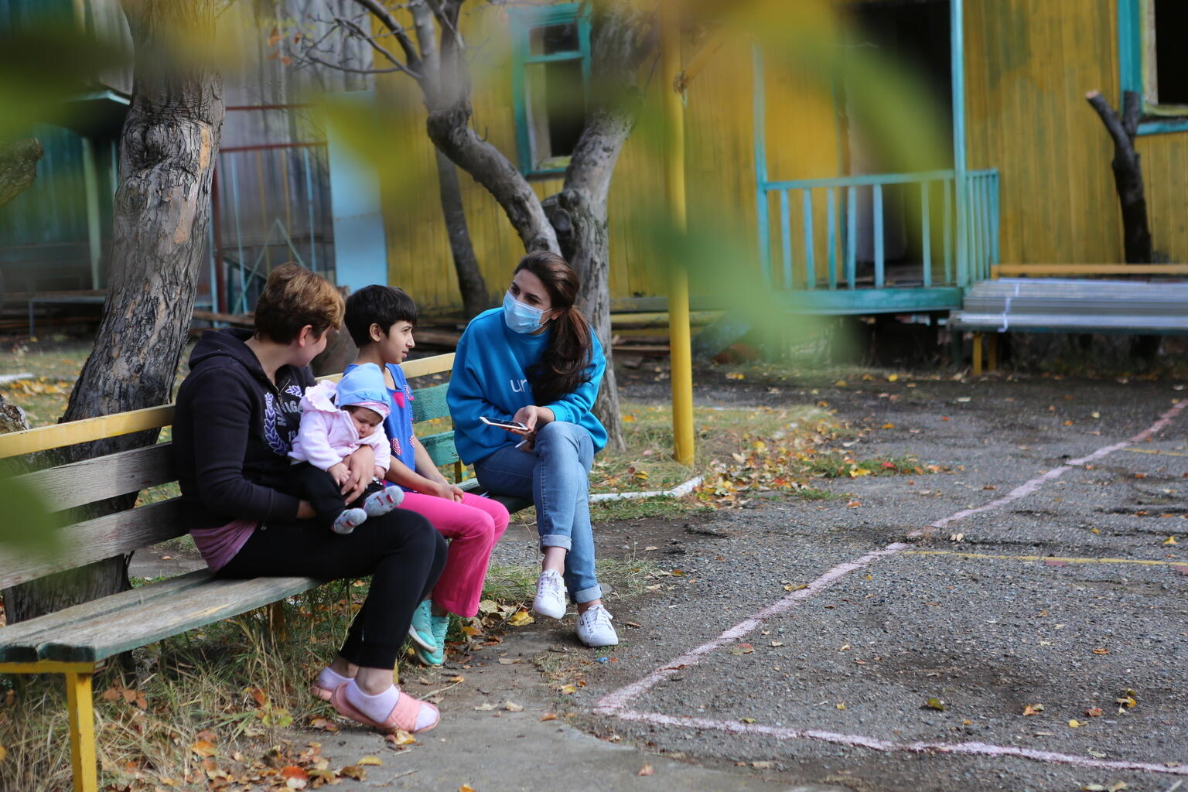
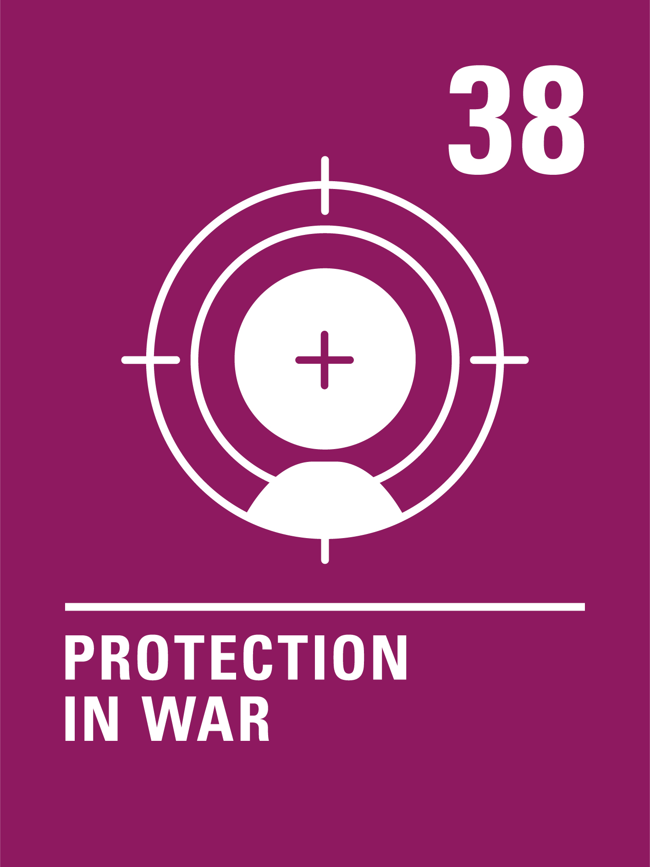
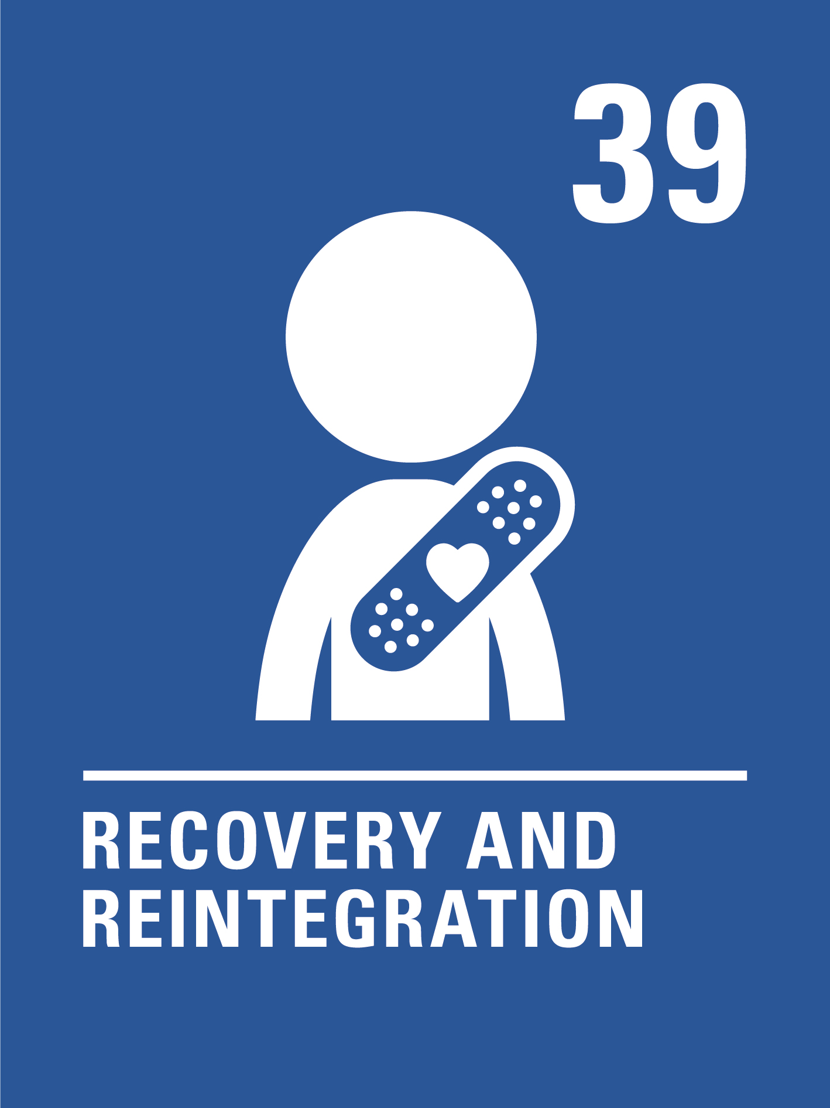
Can you guess how these photos are linked to the articles 38 and 39 of the CRC?
Write down your thoughts or discuss with someone in your class.
@UNICEF/Aleksey Filippov
@UNICEF/Ioana Moldovan
@UNICEFLilian Galstyan

Slide 7
Did you think of these?
They should have all their rights in the Convention and war will impact on their ability to enjoy many of these rights.
War is dangerous. You can be seriously injured or killed and participation in war can have a life-long impact on a person. It’s wrong to make children and young people take part in wars, particularly if they are forced to do so.
Adults make wars happen, why should innocent children be affected?
If children see fighting and war as the answer to problems this may affect their whole lives.
They may be too young to understand what the war is about.
Adults choose to join the armed forces as a profession, and they receive training and support to do their work. Child soldiers are often coerced or forced to take part and receive no training or support.
They are still growing and may not have the physical or emotional maturity to cope.
What else did you think of?

Slide 8

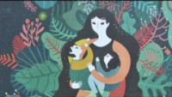
ACTIVITIES FOR THE CLASSROOM
When something bad has happened to someone, it is important that they feel safe. Think about where you feel safe. Draw a picture of your safe place and share it with a friend. Create a cosy corner in your classroom where people can go to feel safe and secure.
Watch this video of the book The Journey by Francesca Sanna about a family fleeing war. What difficult things does the family experience? When they finally arrive in a safe place, what will they need to ‘begin their story again’?
If there was peace all over the world, all children would be safe from war. That’s one of the goals of the United Nations. See if you can design a poster to promote peace. You could include why war is so dangerous for children and emphasise that children have the right to be protected from war.
If someone is worried about what is happening, who can they tell? Talk about the different people that you can talk to if you have a worry or don’t feel safe.

Slide 9
ACTIVITIES FOR THE CLASSROOM
“Children bear no responsibility for war. Yet they suffer its consequences for life.”
Can you explain why UNICEF uses this statement? How do you feel about it?
A growing number of children and young people joining schools in Ireland are refugees fleeing from countries at war. How can schools support such pupils and help them to feel welcome? What role could fellow students play in this?
The rights within the Convention are indivisible – a child should have all of their rights, all the time. Look at the Convention and try to identify how many other rights might be affected when a child or young person’s life is disrupted by armed conflict or war.

Slide 10
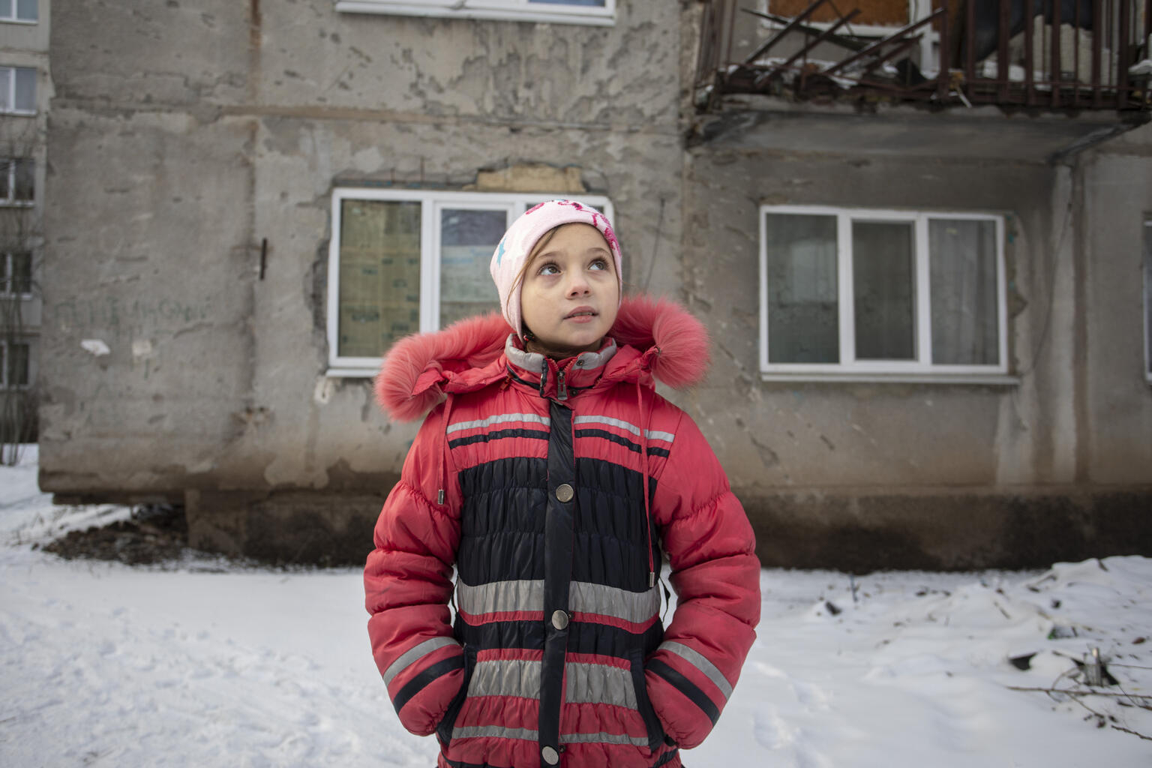
HELPING PROTECT CHILDREN IN UKRAINE
7.5 million children, are now at risk as the conflict continues to escalate. With explosions in major cities across the country and thousands of families being forced to flee their homes, UNICEF is calling for an immediate ceasefire. We also support children and families by:
helping to provide them with access to clean water and nutritious food
helping to make sure that child health and protection services are sustained
working with our partners and the UN High Commissioner for Refugees to assess the refugee situation across neighbouring countries.
If you would like to support us in this, you can find more information on the UNICEF website.

Slide 11

REFLECTION
You may like to reflect as a class or in an assembly…..
When there is war and conflict we often try to think of peace.
What makes you feel peaceful and calm?
How can your thoughts, words and actions bring a sense of peace to your friends and family?
What does it take to be a peace maker?
In these difficult days could your class or school create a focal point with symbols of peace – perhaps images of doves, candles or hands reaching out in friendship? Take some time to get creative and use this activity to share some positivity and hope, together.

Slide 12
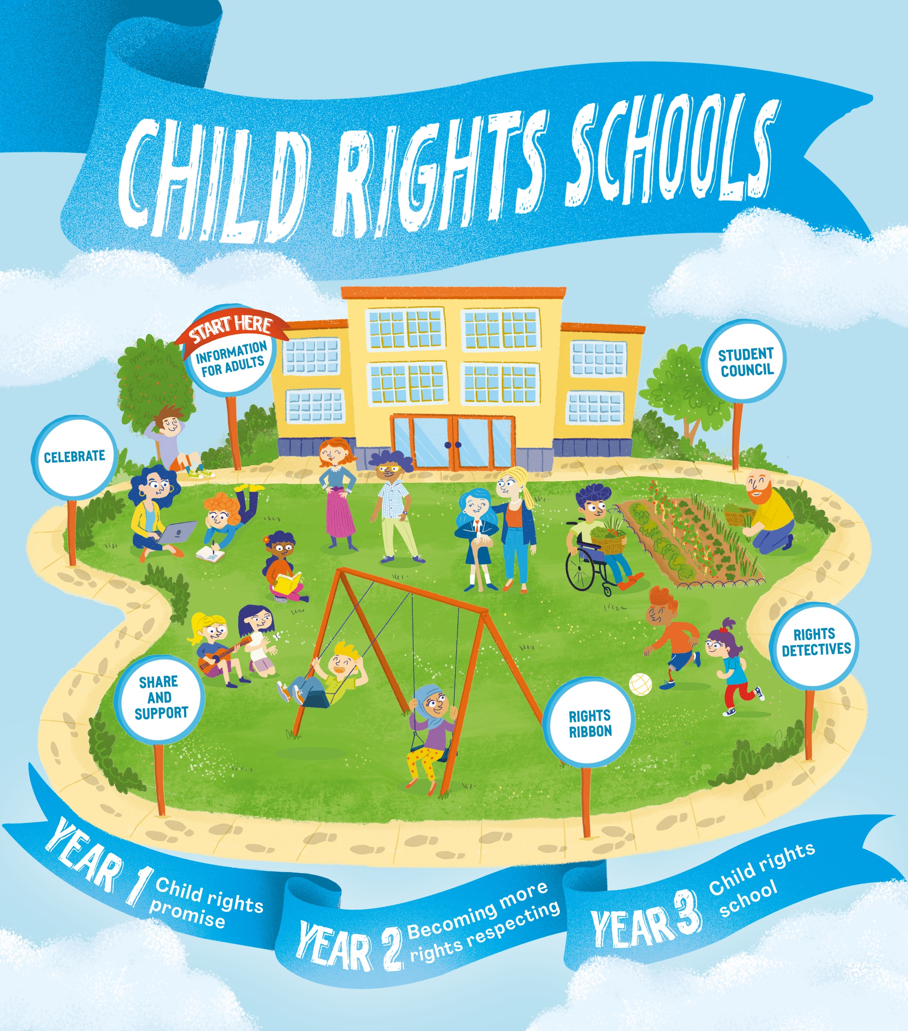
FURTHER CHILD RIGHTS EDUCATION SUPPORT
Child Rights Schools is a programme that supports you to embed child rights across the primary school. Find our more here.
If you would like to participate in UNICEF’s free child rights education summer course for teachers and principals find out more and register here.

